Slide 1

CS 24000: Programming in C
Lecture 1: Course Introduction

Slide 2
Lecture 01
Objectives
Course policies
(*NIX commands)

Slide 3
Announcements
Read Chapter 1 in K&R

Slide 4
Lab This Week
We have lab this week!
A hopefully somewhat gentle re-introduction to the UNIX command line
and gcc
Only time the assignment will be submitted and due during lab!

Slide 5
Instructor
Prof. Jeff Turkstra
HAAS 128
jeff@purdue.edu
49-63088
Office Hours: MW 1:30pm – 2:30pm T 3:00pm – 5:00pm
(or by appointment)

Slide 6
About me
BSCmpE, MSECE, and PhD from Purdue University
Focused on operating systems and distributed systems
Instructor, ECE 2005-2008
Software Engineer with HUBzero/RCAC
Microfluidic Innovations, LLC and other startups
Current academic activity
CS 240, CS 252, CS 307, CS 180, CS 250, CS 50011
Metachory
Enjoys
Linux, skiing, piano/saxophone, flying, HAM, etc
More information at https://turkeyland.net/

Slide 7
Instructor
Prof. Xiangyu Zhang
LWSN 3154K
xyzhang@cs.purdue.edu
765-4969415
Office Hours: WF 1:30pm – 2:30pm (or by appointment)

Slide 8
About me
My website: http://www.cs.purdue.edu/homes/xyzhang
Joined Purdue CS at 2006
Professor, working on security, software engineering, compilers, and deep learning
Has graduated more than 15 PhDs and 6 post-docs
Taught CS240, CS352, and CS408
Enjoys
Research, soccer, scuba diving, and 1st person shooter games

Slide 9
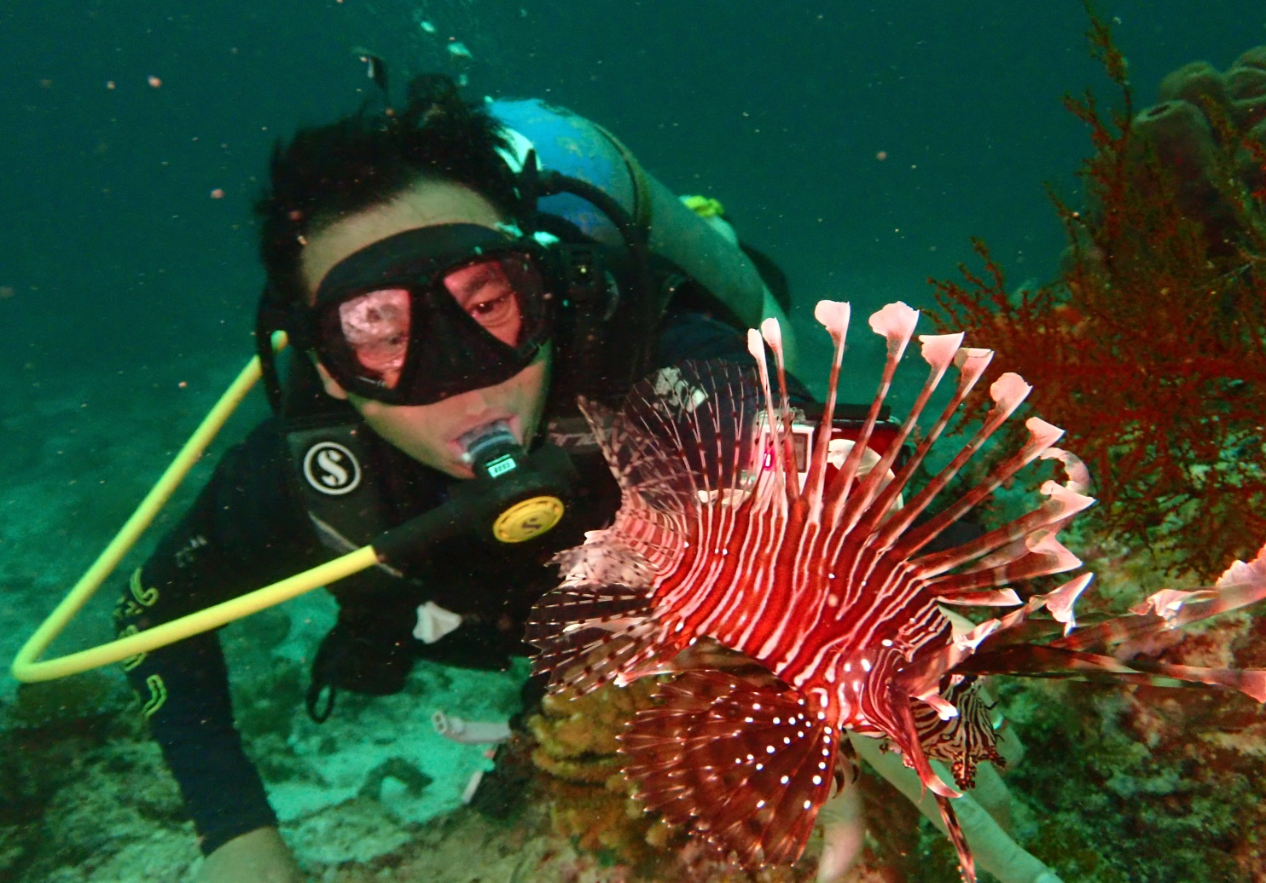

Slide 10
Teaching assistants
Found on the website
Office hours too (soon)
Do not expect the TAs to do your homework
Ask TAs about your code – don’t ask the TAs to come up with code for you.

Slide 11
Course Website
https://endor.cs.purdue.edu/~cs240/
Some resources are password protected when accessed off-campus
Username: cs240
Password: programming
Contains things like:
Syllabus
Lecture slides
Schedule
Lectures may be different, roughly same schedule
Notes:
Talk about textbook

Slide 12
Syllabus
You are responsible for reading and understanding the entire syllabus
“I didn’t know that was the policy” is not an excuse
Do not hesitate to ask questions!

Slide 13
Things you should already know how to do...
How to write and compile a Java program in the UNIX environment
How to declare variables
How to manipulate arrays
Declaration/definition is a little different
How to write a for loop!!!!
How to write a while loop
How to write a do-while loop
How to use if statements
How to use switch statements

Slide 14
Logical operators ( || && ! )
How to write data with printf()
How to write functions
How to copy, move, execute, and delete files
How to navigate a file system (pwd, cd, etc)
How to edit files in a UNIX environment
Vi(m), Emacs, pico, nano, etc

Slide 15
IDE
We will not use an IDE for this class
You are strongly encouraged to develop on data.cs.purdue.edu, or another CS Linux system
E.g., borgNN.cs.purdue.edu
Notes:
Those that do not will automatically be subjected to extra scrutiny

Slide 16
Questions and contact
Piazza
https://piazza.com/purdue/spring2020/cs240
Lab
Office Hours
Email
https://endor.cs.purdue.edu/~cs240/contact.php

Slide 17
Homework Assignments
Usually due on Wednesdays at 9PM
Usually assigned 1.5 weeks before due date
Approximately 12 assignments
100 points each
Style grade worth additional 20 points

Slide 18
Code Standard
Intended to serve as basic recommendations and requirements for how to write your functions
Like a dialect or accent of a language
All good software development environments use a code standard
You may not agree with the format
https://endor.cs.purdue.edu/~cs240/code.php

Slide 19
Test Modules
You will be provided with a test module for most assignments
Can run it as many times as you want
If your program crashes at any point, you will receive a score of 0
Test module will not progress to the next function until all tests up to that point pass
Run your test modules often
Many are randomized!
We will run it many times for grading, and take the lowest score

Slide 20
Submission
Programs that do not compile generally will not receive credit
We will always grade the latest submission
Only run “make submit” if you want us to grade the current version using the current date and time

Slide 21
Regrades
Aside from exceptional circumstances, regrades are typically honored only when a bug in the test module is discovered
The entire course is then regraded
Always compile and test your programs before submitting
Even for one line changes! We all make mistakes!

Slide 22
Lab
Environment to work on your homework with help available
Again:
Do not expect the TAs to do your homework
Ask TAs about your code – don’t ask the TAs to come up with code for you.
The first hour of each lab is reserved for students in that section only
Students of that section always have priority
TAs reserve the right to ask people to leave

Slide 23
Help
Be prepared to talk about steps you have already taken in debugging
Avoid questions like “this doesn’t work. Why?”
Instead, “I am having trouble with part X. I have printed out the values of variables Y and Z on lines K and N. I set a breakpoint for function F and stepped through to line W. I think that the issue involves variable Z ….”

Slide 24
Piazza
Great resource for posting questions about homework and other course content
Any post involving code must be private
We expect people to treat each other with respect
Work to keep a positive atmosphere

Slide 25
!Piazza
Piazza is NOT a place for:
Regrade requests – submit through gradescope for quizzes, exams, and code standard; or, email me for homeworks
Complaining
Posts that are not productive or overly negative will be removed

Slide 26
Quizzes
Several 10 to 20 minute quizzes
100 points – same as a homework
Never know when
Need to miss lecture? Let us know in advance!
Score of 0 if absent
If you are sick, go to PUSH (student health center)
See syllabus for more information

Slide 27
Exams
Two midterms worth 14% each
Written!
One cumulative final worth 22%
Also written
Notes:
Quizzes and exams are written.
forces them to step back and put some thought into things instead of just bashing their head against the compiler; and, because many places (e.g., google) require you to stand in front of a whiteboard and write code.

Slide 28
Grades
Homework and Quizzes 50% Midterms 14% ea Final 22%
Grading issues will be addressed as they occur. Not at the end of the semester.

Slide 29
Academic Integrity
“If you claim someone else’s work as your own, we call that ‘cheating’”.
Do not do quizzes or exams for other students
Asking questions is probably OK, but do not look at other students’ homework files and do not work with other students. At all.
Protect your work
If your work is turned in by another student, you are both guilty

Slide 30
Academic Integrity
When in doubt, talk to a TA or instructor instead of a fellow student
All work is subject to computer-based comparison and analysis...
Notes:
academic dishonesty is unacceptable. I'll explain briefly how MOSS works - that it shows us similarities between students when those similarities are not common among most of the population. I will tell them that if they can write a compiler, they can probably beat MOSS, but then they wouldn't need to.

Slide 31
Academic Integrity
The minimum penalty for any incident of academic dishonesty is a score of zero for the item in question
More serious or repeated infractions will result in a grade of ‘F’ for the course
All incidents will be referred to the Dean of Students and the Department of Computer Science

Slide 32
Academic Integrity
Ask questions about the policy without risk

Slide 33
Supplemental Instruction

Slide 34
Tips for Success
Write your programs out on paper first
Start on homework projects as early as possible
Practice
Experiment
Create a cool personal project
Look at source code available on the Internet
If you can learn to enjoy programming you are guaranteed to do well

Slide 35
How to Fail This Course*
Assume that since your prerequisites were easy, this class will be too!
Try to do the homework at the last minute
Don’t do the homework at all
Don’t come to lecture
Get “help” from somebody else in the class
Don’t practice for the exams
* most students do quite well

Slide 36
Why C?
It is still widely used and growing
IOBE January 2020 index lists it as #2, with a 2.44% increase
Java is #1 and dropped 0.01%
Programming Language of the Year 2019
Used in a huge number of embedded and IoT devices
Ubiquitous for systems programming
Small
Fast
Security (offense, defense, reverse-engineering), gaming, system software building, infrastructure building, and compilers
Notes:
https://www.tiobe.com/tiobe-index/
What do you think the JVM is written in?
Most modern languages have C bindings
Lot’s of OSS uses it
Why not C++? It’s a best, we don’t have time

Slide 37
C vs. Java
You already know how to write some C code
Java was designed using C/C++-style syntax
But, there are many differences

Slide 38
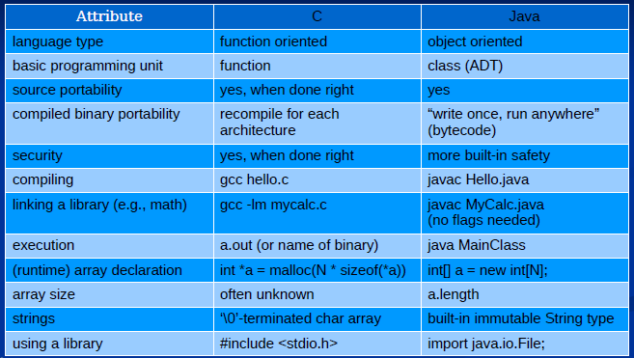
Java vs. C
Notes:
public static void main
gdb ./a.out dissassemble main
javap -c
using a library - #include, more subtlety there

Slide 39
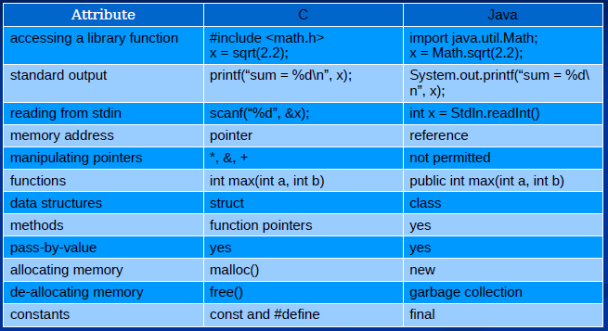
Java vs. C
Notes:
functions – can have static, limit scope to that file
Library functions: functions have different namespaces in Java. Not in C

Slide 40
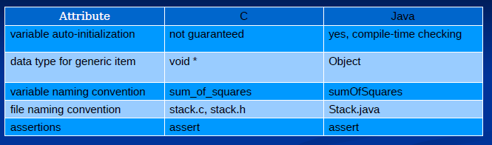
Java vs. C
* Not a complete list :-)
Notes:
Library functions: functions have different namespaces in Java. Not in C

Slide 41
Slides
Some slides based on Prof. Rodgriguez-Rivera’s, Prof. Fred Mowle’s, and Dr. Richard Kennell’s material

Slide 42
Lab This Week
We have lab this week!
A hopefully somewhat gentle re-introduction to the UNIX command line
and gcc
Only time the assignment will be submitted and due during lab!

Slide 43
For Next Lecture
Familiarize yourself with C programming
Ensure your computer account is setup
Choose an editor. Practice using it
Practice writing a few programs
“Hello, world”
Prompt for a string, print it back
Write something to do your calculus homework
Read and review Chapter 1 of your text

Slide 44
Questions?

Slide 45
man
Interface to reference manuals
man [options] [section] file
Examples… man cp # manual page for copy cmd man -k printf # search pages for keyword man 3 exec # man page from section 3

Slide 46
Sections
1: Executable programs or shells
2: System calls
3: Library calls
4: Special files (usually in /dev)
5: File formats and coventions
6: Games
7: Miscellaneous
8: System administration commands
9: Kernel routines (non standard)
Notes:
Show the difference between man 1 printf and man 3 printf

Slide 47
ls
List directory contents ls [options] [file(s)] Examples... ls # list files in pwd ls -al # hidden (all) files, long listing ls -R # recursive

Slide 48
mkdir
Make directories mkdir [options] directory Examples... mkdir bob mkdir -p bob/is/deep # leading path mkdir -m 700 bob # set the mode

Slide 49
cp
Copy files and directories cp [options] src dest Examples... cp bob joe cp -r dir1 dir2 # recursive cp -rp dir1 dir2 # preserve perms/times/etc cp -x dir1 dir2 # do not cross filesystems

Slide 50
mv
Move (rename) files mv [options] src dest Examples... mv bob mike mv dir1 dir2 mv -n bob exists # do not overwrite mv -i bob exists # interactive
Notes:
Some people alias mv to mv -n or -i

Slide 51
rm
Remove files or directories rm [options] file(s) Examples... rm a.txt b.txt rm -f a.txt # force, no error message rm -r dir1 # recursive rm -rf dir1 # be careful rm -rf ~ /some/path # be very careful

Slide 52
Quiz
What track are you in?
List one or more tracks or “undecided”
If not CS, tell me your major
Are you taking another class or classes this summer?
If yes, which one(s) and when do they meet?
Are you retaking this class?
Do you understand that you will not be excused from any exam except in the most extreme circumstances (e.g., medical emergencies)?
Work, travel (including interviews), and other classes are not excusable reasons.

