Slide 1
GUI Testing
By Norbert Haché

Slide 2
Contents
What is GUI testing
Elements of GUI testing
Old Approach (TRUMP Project)
Scripting
Capture / Replay
Full Test Integration
Evaluation of CAPBAK
Demo

Slide 3
What is GUI Testing
Graphical User Interface (GUI) Testing
Methods used to identify and conduct GUI tests, including the use of automated tools.
Source: (www.systemhouse.mci.com)

Slide 4
Elements of GUI Testing
A process
A GUI Test Plan
A set of supporting tools
source : www.csst-technologies.com/guioutln.html
Notes:
A GUI Test plan should contain a section for each of the following topics:
(source is www.csst-technologies.com/guioutln.html)
1. Set test objectives
2. Describe modules and associated GUIs to be tested.
3. Generate Testing schedules.
4. Compose Test Team
5. Design test process/Create test case design specification.
6. Define test cases
Create scenarios for expected business uses (via scripting)
Create test script for each business scenario (via automated testing tools using
object-level and/or event-level structured capture)
7. Create test procedures specification; execute test cases
Evaluate scripts (using walkthrough or inspection)
Execute scripts (playback using test tool)
Record test results (using test tool)
Generate incident reports (using test tool)
Analyze results (using playback of tests)
Generate management level summary reports
8. Evaluate test tool performance
9. Evaluate GUI development tools platform

Slide 5
Old Approach Example (TRUMP)
Was Done by manually stepping through thousands of pages of test procedures.
Labour intensive, highly error prone.
Needed to be redone each time regression testing was required.
Very expensive.
Notes:
When I worked at PMO TRUMP from 1986 to 1989 and then again in 1991 and 1992, I was extensively involved in the software acceptance program for the new TRUMP Command and Control System.
The system consist of 9 tactical displays each of which has its own function but which can also assume the function of any of the other 8 displays. The main user interface consist of a software controlled variable function key matrix at the bottom left hand side of the display. Several other user interface artifacts exist and are dependant on the state of the VFKs. There are several standard read only outputs, such as time of day etc, that are available for display at all times.
The testing of this GUI consisted of nearly 3 thousand pages of test procedures which had to be manually executed one step at a time at an actual Teactical Display without the full benefit of the operational software that was to be driven by the actual user selections.
Needless to say, the execution of this test was highly error prone as it required individuals to do all the steps which after several hours got extremely boring and caused some mistakes to be made.
This in itself was not so bad, the worst of it all was that most of this test needed to be repeated again and again when regression testing was required.

Slide 6
Scripting
Another Programming Language.
Needs to be subjected to some form of formal verification.
Eliminates human error during execution of the test.
Can be used (sometimes with modifications) for regression testing.
Notes:
Test scripts are program written in a language that is used as the input to a front end for an automated testing tool. The testing tool must be able to take the test script and translate it into the appropriate data and command streams that are used to exercise the system in a way that achieves a satisfactory coverage.
The problem with test scripts is that they are programs just like the software being tested. They are subject to the same kind of errors that are found in any software system under test. A test script must therefore be itself the subject of some form of formal verification before it is used to formally verify the actual software under test.
Once a test script is ready to be used however, it eliminates the human erro factor found in the manual execution of test procedures. It can be used in subsequent regression testing (after appropriate modifications in the case where the functionality being tested has changed).

Slide 7
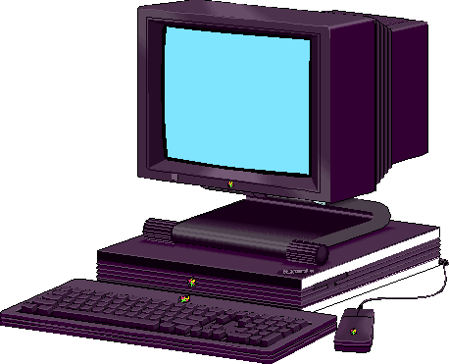


Scripting cont’d
Replay tool
Script

Slide 8
Capture/Replay Tools
A capture replay tool is a set of software programs that capture user inputs and stores it into a format (a script) suitable to be used at a later time to replay the user inputs.
Note: Throughout this presentation I use capture/replay and capture/playback to mean the same.

Slide 9
Available Capture replay tools
QA Partner [Segue Software, Inc)
Xrunner & WinRunner (Mercury Interactive)
QC/Replay (CenterLine Sftware)
Evaluator (Eastern Systems)
CAPBAK (Software Research, Inc)
Vermont High Test Plus (Vermont Creative Software)
WITT (IBM)
ATS/X-Tester (Automated Testing Solutions Inc.)
source : www.stlabs.com/marick/faqs/t-gui.htm
Notes:
The source of the following information is : www.stlabs.com
QA Partner
QA Partner automates testing of GUI applications on single and multi-platform software (more than 22 platforms currently supported). Its fully object-oriented, script-driven approach allows testing to begin early in the software development lifecycle and permits concurrent testing on multiple machines in the client/server environment. In addition to flexible, robust test scripts that QA engineers code by hand, QA Partner 2.0 has TestMaker, a new recording facility that automatically generates test scripts by means of mouse clicks, and point-and-click scripting, which captures selected code and adds it to existing scripts.QA Partner is fully extensible and can be used to test custom objects, and it is fully internationalizable as well.
QC Replay
QC/Replay offers "widget-based" testing of GUI based applications. Testers can record sessions and play them back on a variety of platforms. "Widget-based" rather than bitmap based verification makes test scripts robust: they are unaffected by changes in window size, position, window manager, screen size and color, as well as changes in the application during normal development. QC/Replay uses Tcl for scripting, and supports portable testing across platforms.
CAPBAK
CAPBAK/X is a capture/playback system for X that includes OCR support (from XIS); CAPBAK/MSW is for MS-WIN, also with OCR. Both are compatible with other tools in Software Research's tool suite "Software TestWorks (STW (tm))".

Slide 10

Capture Replay tools
Capture/Replay
Script
Notes:
In a capture/replay (capture/playback) tool, the tool is activated and normally an option on the tool allowas the user to specify the start of recording for all user actions. From that point on, every interaction the user has with the application under test are diverted to the tool which records those actions as primitives that can later be replayed. Once the recording has taken place, the tool forwards the input to its normal destination in the application. This requires the tool to hook into the operating system mechanism for dispatching events to the application and to only select those events that are original user events. The reason for this is that some events that are sent to an application are often events that are a consequence of a user action. Since this consequence would manifest itself using only the raw user actions, it should not be recorded, because during playback it would result in duplication of events and would mess up the whole playback sequence. So only the raw user input events should be recorded as oppose to all events that are forwarded to an application. Some clever programmers simulate in their application the occurrence of raw user input by sending messages to itself that mimic those events. For a tool to work under such conditions, it must capture the user input directly at the input device as oppose to hooking the OS where it generates the event. By doing so, application generated event won’t get recorded.

Slide 11
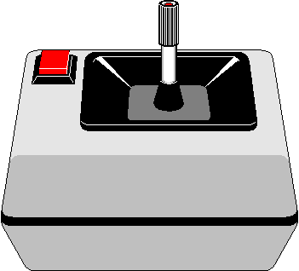
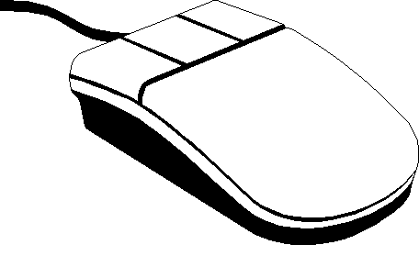
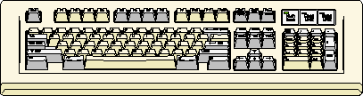
Capture Replay Models
Capture/Playback tool
Application
Application Events
Self Events
OS
Device Driver
Device Driver
Device Driver
Notes:
The above model is simple because most OS allow an application such as the capture/playback tool to intercept events that are directed to an application from the OS. Under x windows the application need only register for such events and under microsoft windows, the API provides for hooks that allow an application to intercept anything that is directed to a specific application.
The drawback from this approach is that it does not allow the tool to filter out application generated events (self events) that mimic a real hardware event. To do so would require to intercept the event at a different location.

Slide 12
Capture Replay Models (cont’d)
Application
Application Events
Self Events
OS
Device Driver
Device Driver
Device Driver
Capture/Playback tool
Notes:
In the above model, the capture playback tool replaces the device driversand intercepts every raw user input. This is the ideal model becauseit makes the whole process totally transparent to the OS which sees the tool just as another device driver from which it gets its input. The draw back from this approach is that the tool must be able to emulate the device drivers for every possible type of devices. Replacing the device may be as simple as revectoring the interrupts to the tool from the existing drivers in the OS.

Slide 13
Capture Replay Models [cont’d]
Application
Application Events
Self Events
OS
Capture/Playback tool
Device Driver
Device Driver
Device Driver
Notes:
The above model allows the tool to ignore the details of the actual devices and to intercept only raw user events. The drawback from this approach is that it may require a modification to the OS if the device drivers are compiled into the kernel itself. In the case of windows NT or Windows95, all virtual device drivers (VXDs) are compiled separately, so this is not a problem.

Slide 14
Full Test Integration
Major drawback in Capture/Playback tool is that when the GUI changes, input sequences previously recorded may no longer be valid.
A test system which makes the maintenance of Capture/Playback generated test scripts easy and fast is a must for such a tool to be of any use.

Slide 15
Full Test Integration (cont’d)
A capture/playback tool that support the following capabilities could be used in a more capable and fully integrated test development environment:
  record scripts of user/system interactions
  user access to scripts for editing/maintenance
  user ability to insert validation commands in the script
  allows replay of the recorded script.

Slide 16
Full Test Integration (cont’d)
A fully integrated GUI test development environment would also require the following additional characteristics:
  Script editing using higher level abstractions such as icons etc.
  High level view of what functionality is being tested.
  The ability to generate many variations of a recorded script without having to manually edit the script itself.

Slide 17
Full Test Integration (cont’d)
A product called TDE under development by Siemens is to provide exactly this kind of functionality (currently only at the prototype level)
Source: ISSTA 98 Proceedings of the ACM SigSoft International Symposium on Software Testing and Analysis.

Slide 18
Full Test Integration (cont’d)
TDE capabilities:
  uses higher level scenario language instead of scripting. This allows graphical editing of the test sequence and easy creation of variations.
  Has a test designer, which through user interactions with the system, builds an internal model of the system’s GUI to produce a high level test design representing many executable scripts.
  Test design library.
  Test generator engine to convert high level scenario into tests scripts.
Notes:
The high level system model created has two components. A top level graph in which each node represents a window of the GUI under test, and an arc from one window to another represents a user action in one window that invokes the other. A t a lowere level, the model represents the individual window components ( a true representation of the actual windows of the GUI).
The tester can interact directly with the model to edit the tests scripts and scenarios.
Source:ISSTA 98 proceedings of the ACM SigSoft International Symposium on Software Testing and Analysis.

Slide 19

GUI
Replay
record
Tester
GUI
Info
Test
Script
Test
Scripts
Specify Variations
TDE
Test
Generation
Engine
Test Designer
Test
Design
Test Design
Library
Notes:
The test design library contains recorded scripts, test scripts, and general test patterns that can be used to build specific scripts.
The test generator engine converts the high level test design into scripts that can be executed on the SUT through normal playback mechanism of the capture/replay tool
This is quoted as is from the ISSTA 98 Proceedings of the ACM SigSoft International Symposium on Software Testing and Analysis.

Slide 20
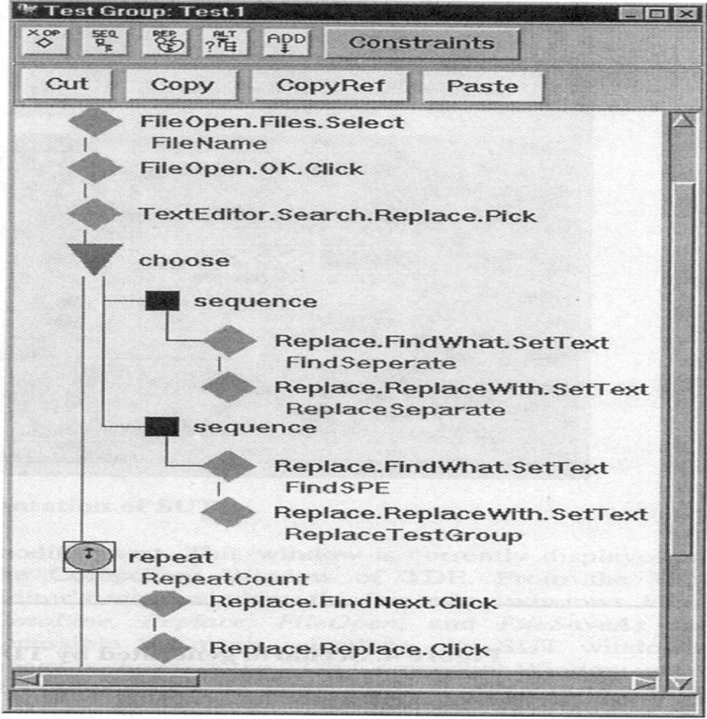
Test Scenario Screen

Slide 21
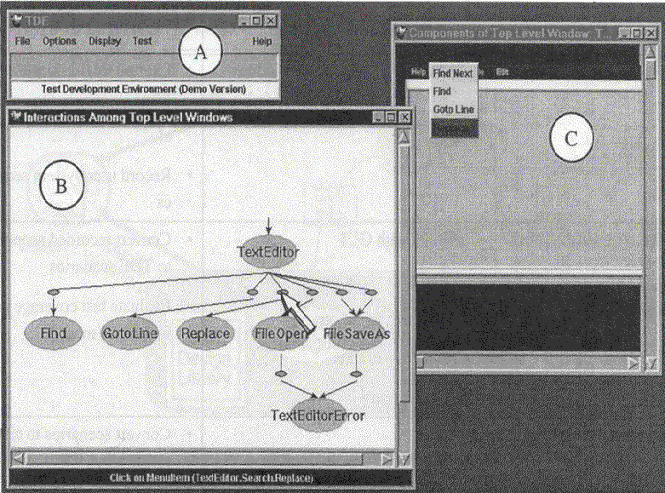
TDE SUT Representation

Slide 22
Full Test Integration (cont’d)
When the GUI changes, instead of editing the hundreds of generated test scripts, the editing is done at the scenario level where it is much easier and faster. This is followed by the automatic regenaration of the test scripts from the scenario.
TDE can detect and analyse the differences between a new GUI and its previous version. It then makes assumptions about the changes that can be subsequently overriden by the tester prior to script regeneration.
Notes:
An example of the kind of assumption TDE makes on changes, if a change was made by moving a menu item from one menu to another, but keeping the same name for the menu, TDE will assume that the item of the same name in the new location has the same functionality as the old item in the previous location.

Slide 23
Full Test Integration (cont’d)
Using the prototype it was shown that in 30 minutes, a tester was able to create a single scenario that produced 2500 test cases which exercised every significant combination of input values and action choices available for the particular application.
Source: ISSTA 98 Proceedings of the ACM SigSoft International Symposium on Software Testing and Analysis

Slide 24
Evaluation of CAPBAK
CAPBAK is a capture/replay tool developed by Software Research Inc of San Fransisco.
Versions are available for Windows 95, NT as well as for X-Windows.
My evaluation for the Windows 95 version.

Slide 25
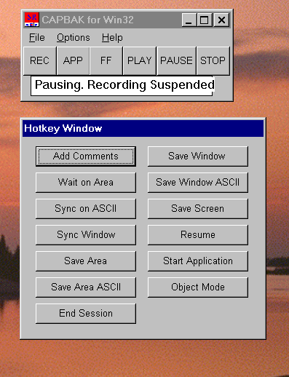
CAPBAK User Interface

Slide 26
CAPBAK
Very simple and intuitive to use.
Documentation provided was dated.
Had several bugs that need to be fixed to make the product more robust.
Provides many synchronization mechanisms, not all of which I could get to work properly.

Slide 27
CAPBAK
Provides OCR to save window text for baselining window image.
Provides automatic detection of changes to the window at the bitmap and text level.
Provides an object mode to record at the widget level. (I could not get this to work properly).

Slide 28
CAPBAK
For more information, you may read the hand out on my evaluation of CAPBAK.

Slide 29
Demo
I have developed a basic MS Windows application that experiments with the basic principles of user entry capture.
It is very basic and does not attempt to filter out any particular events. I did it to show how easy it is to do such thing using the first model showed earlier in the presentation which I am showing here again.

Slide 30
Capture/Playback tool
Application
Application Events
OS
Device Driver
Device Driver
Device Driver

Slide 31
Console output
Capture
Main Window
Application
Capture
DLL
Application
being
captured
USER32.EXE
Notes:
The main window capture application is responsible for loading the DLL into memory and to call up functions within the DLL that register the proper hooks to allow the DLL to get all window events destined for the application being captured.
The DLL is necessary for hooking system wide events.
The DLL is also used to map shared memory between USER32.EXE (the windows messaging system is part of this) and the capture Main Window application so that messages received from USER32 can then later be shown on a console with minimum overhead. The DLL forwards any intercepted messages to the destination application.

Slide 32
Summary
GUI Testing using capture/replay tools is a useful technology if it can be used within a test system that allows efficient and high level maintenance capabilities of the test design.

