Slide 1

Test Web applications using Selenium

Slide 2
Outline
Uniqueness of web app testing
  Heterogonous system
  Dynamic pages
  Load
  Security
Selenium WebDriver
Course project 4

Slide 3
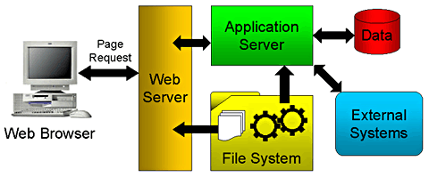
Web application architecture
Heterogeneous system
  Front end
    Browser: IE, Firefox, Chrome, Safari…
  Server side
    Application Server
    Database Server
    File System
    ……

Slide 4
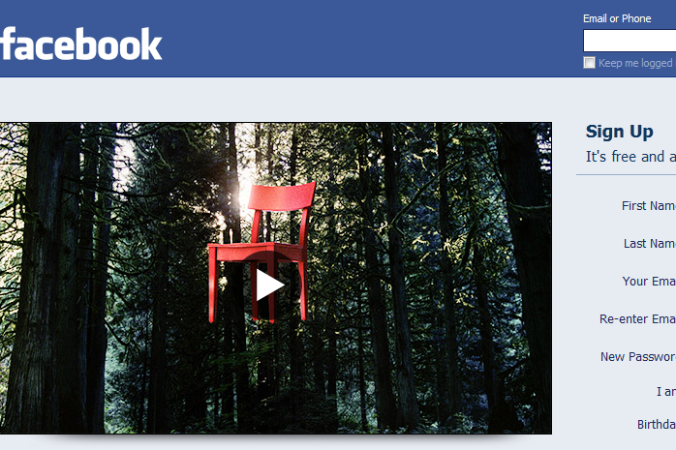
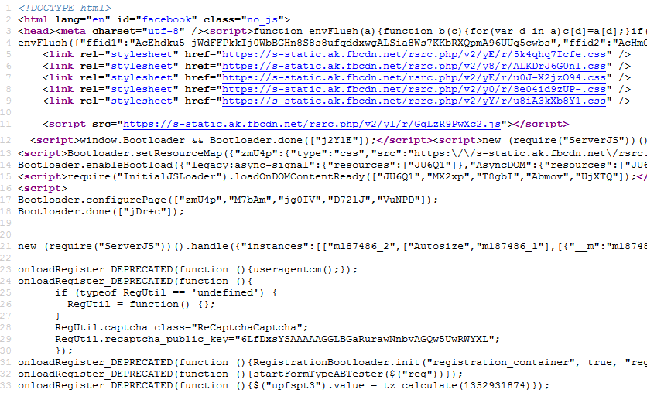
Heterogeneous system
Front end
  HTML, JavaScript, Adobe Flash……
Page in Browser
HTML
JavaScript
Source behind

Slide 5
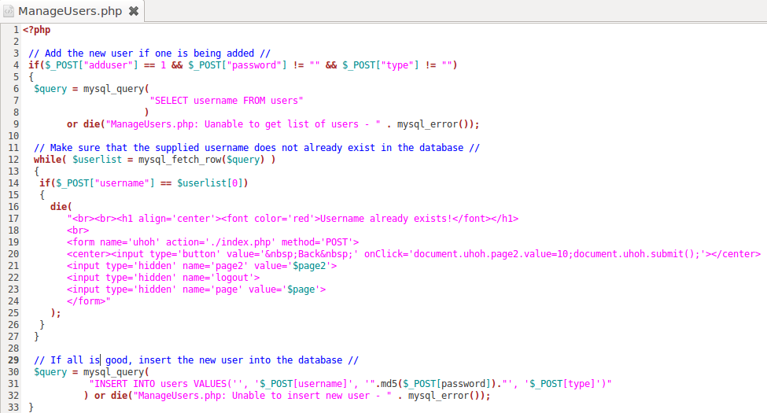
Uniqueness 1: Heterogeneous system
Server side
  Can be written in PHP, Java, C#...
  Communicate with Database server in SQL
PHP Script
PHP
SQL
HTML
SQL

Slide 6
Heterogeneous system
Should test all involved parts
  Everything can go wrong…
However, only front end is accessible for tests
  Can not directly test the Server code and SQL
  Have to drive the execution and test
    Frontend
      HTML: Malformed HTML page? (demo)
      JavaScript: Runtime Errors? (demo)
    Server script
      PHP, Java…: Runtime Errors? (demo)
      SQL: Malformed SQL query string? (demo)

Slide 7
Test from the front end
Good things
  Hide the complexity of the backend
  Uniformed interface
  Can put a robot in the front end and automate the tests
  Bad things
  The front end is not trustable
    Crafted malicious requests

Slide 8
Good things of testing from the front end
Automated web app testing
  Compare to commend-line program testing…
    Sensitive to input values (the same)
    GUI testing: event driven (the difference)
      “Button A” then “Button B” → OK
      “Button B” then “Button A” → FAIL
  The robot should be able to
    Provide input values
    Simulate user actions
Selenium
  A tool set automates web app testing across platforms
  Can simulate user interactions in browser
  Two components
    Selenium IDE
    Selenium WebDriver (aka. Selenium 2)

Slide 9
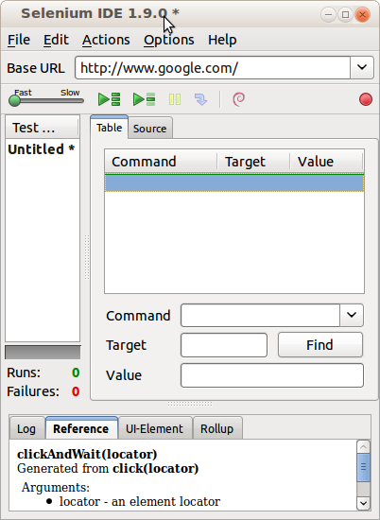
Selenium IDE
Firefox extension
Easy record and replay
Debug and set breakpoints
Save tests in HTML,
WebDriver and other
formats.

Slide 10
Selenium IDE test cases
Selenium saves all information in an HTML table format
Each record consists of:
  Command – tells Selenium what to do (e.g. “open”, “type”, “click”, “verifyText”)
  Target – tells Selenium which HTML element a command refers to (e.g. textbox, header, table)
  Value – used for any command that might need a value of some kind (e.g. type something into a textbox)

Slide 11
How to record/replay with Selenium IDE
Start recording in Selenium IDE
Execute scenario on running web application
Stop recording in Selenium IDE
Verify / Add assertions
Replay the test.
Selenium IDE Demo……

Slide 12
Bad things of testing from the front end
The front end is not trustable
  Front end code can be accessed to anybody
  They can infer the input parameters
  Crafted requests!
Demo
  Front end limits the length of the input values
  Front end limits the content of the input values
  Front end limits the combination of the input values

Slide 13
Uniqueness 2: Dynamic pages
Client page is dynamic
  It can change itself in the runtime
  HTML can be modified by JavaScript
  JavaScript can modify itself
  Demo
Server script is dynamic
  Client pages are constructed in the runtime
  A same server script can produce completely different client pages
  Demo
    SchoolMate

Slide 14
Uniqueness 3: Performance
Performance is crucial to the success of a web app
  Recall the experience to register for a class in the first days of the semester…
  Are the servers powerful enough?
Performance testing evaluates system performance under normal and heavy usage
  Load testing
    For expected concurrent number of users
  Stress testing
    To understand the upper limits of capacity
Performance testing can be automated

Slide 15
Uniqueness 4: Security
Web app usually deals with sensitive info, e.g.
  Credit card number
  SSN
  Billing / Shipping address
Security is the biggest concern
Security testing should simulate possible attacks

Slide 16
Uniqueness 4: Security
SQL Injection
  The untrusted input is used to construct dynamic SQL queries.
  E.g, update my own password
$str = "UPDATE users SET password = \” “ . $_POST['newPass’] .
“\” WHERE username =\”“ . $_POST['username'] . “\””;
mysql_query( $str );
PHP Script
$_POST['newPass’] = pass, $_POST['username'] = me
Query String: UPDATE users SET password = “pass” WHERE username =“me”
Normal Case
$_POST['newPass’] = pass, $_POST['username'] = “ OR 1=1 --
Query String: UPDATE users SET password = “pass” WHERE username =“” OR 1=1 --”
Attack

Slide 17
Uniqueness 4: Security
Cross Site Scripting (XSS)
  The untrusted input is used to construct dynamic HTML pages.
  The malicious JS injected executes in victim’s browser
  The malicious JS can steal sensitive info
  Demo
Solution: Never trust user inputs
Design test cases to simulate attacks

Slide 18
Outline
Uniqueness of web app testing
  Heterogonous system
  Dynamic pages
  Load
  Security
Selenium WebDriver
Course project 4

Slide 19
Limitation of Selenium IDE
No multiple browsers support
  It runs only in Mozilla Firefox.
No manual scripts
  E.g. conditions and Loops for Data Driven Testing
Fancy test cases → Selenium WebDriver

Slide 20
Selenium WebDriver (Selenium 2)
Selenium-WebDriver
  A piece of program
  Control the browser by programming
  More flexible and powerful
Selenium-WebDriver supports multiple browsers in multiple platforms
  Google Chrome 12.0.712.0+
  Internet Explorer 6+
  Firefox 3.0+
  Opera 11.5+
  Android – 2.3+ for phones and tablets
  iOS 3+ for phones
  iOS 3.2+ for tablets

Slide 21
Selenium WebDriver
WebDriver is designed to providing a simpler and uniformed programming interface
  Same WebDriver script runs for different platforms
Support multiple programming language:
  Java, C#, Python, Ruby, PHP, Perl…
It’s efficient
  WebDriver leverages each browser’s native support for automation.

Slide 22
What Selenium can do
A solution for the automated testing
  Simulate user actions
  Functional testing
    Create regression tests to verify functionality and user acceptance.
  Browser compatibility testing
    The same script can run on any Selenium platform
  Load testing
  Stress testing

Slide 23
How to use Selenium WebDriver
(1) Go to a page
(2) Locate an element
(3) Do something with that element
......
(i) Locate an element
(i+1) Do something with that element
(i+2) Verify / Assert the result

Slide 24
Demo: Verify page title
public static void main( String[] args )
{
// Create a new instance of the Firefox driver
WebDriver driver = new FirefoxDriver();
// (1) Go to a page
driver.get("http://www.google.com");
// (2) Locate an element
WebElement element = driver.findElement(By.name("q"));
// (3-1) Enter something to search for
element.sendKeys("Purdue Univeristy");
// (3-2) Now submit the form. WebDriver will find the form for us from the element
element.submit();
// (3-3) Wait up to 10 seconds for a condition
WebDriverWait waiting = new WebDriverWait(driver, 10);
waiting.until( ExpectedConditions.presenceOfElementLocated( By.id("pnnext") ) );
// (4) Check the title of the page
if( driver.getTitle().equals("purdue univeristy - Google Search") )
System.out.println("PASS");
else
System.err.println("FAIL");
//Close the browser
driver.quit();
}

Slide 25
How to locate an element
By id
  HTML: <div id="coolestWidgetEvah">...</div>
  WebDriver:
  driver.findElement( By.id("coolestWidgetEvah") );
By name
  HTML: <input name="cheese" type="text"/>
  WebDriver: driver.findElement( By.name("cheese") );
By Xpath
  HTML
  <html>
  <input type="text" name="example" />
  <input type="text" name="other" />
  </html>
  WebDriver: driver.findElements( By.xpath("//input") );
  There are plug-ins for firefox/chrome to automatically display the Xpath

Slide 26
Time issue
There are delays between submitting a request and receiving the response
We can wait until the response page is loaded
Robot doesn’t know!
In WebDriver, sometimes it doesn’t work if
  Submit a request
  Verify the response immediately
Solution:
  Simulate the wait. Wait until some HTML object appears
  Demo

Slide 27
Outline
What to test for a web application
Test web app with selenium
  What’s Selenium?
  Why Selenium?
  How to use Selenium
Course project 4

Slide 28
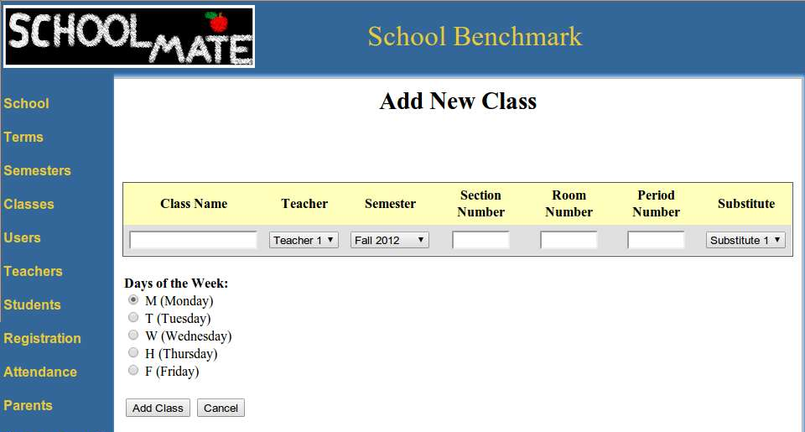
Course Project 4
Test a functionality without the source
The subject web application
  “Add New Class” in “SchoolMate”

Slide 29
Course Project 4
Part 1: overview
  Design test cases against the requirement
    The tests should consider
      all possible cases
      equivalence class partitioning
  Implement Selenium WebDriver Script for “Add new class”
Your test cases
Your WebDriver test template
Test
results
input
output

Slide 30
Part 1: requirement analysis
Requirement for values entered/selected
  [R-1] Class Name : alphabets and numbers are allowed.
  [R-2] Section Number : only numbers are allowed.
  [R-3] Room Number : only numbers are allowed.
  [R-4] Period Number : only numbers are allowed.
  [R-5] All textbox fields : no Cross-Site Scripting (XSS) injection vulnerabilities.

Slide 31
Part 1: requirement analysis
Requirement for the “add” function
After clicking the “Add class” button…
  [R-6] The class record added is successfully shown in the table.
  [R-7] The values are exactly the same as those were entered or selected.

Slide 32
Part 1:Design testcases
For each requirement, design test cases
Only need test one field in each case
  Do not need consider combinations of fileds
E.g.
  [R-1] Class Name : alphabets and numbers are allowed.
  You need consider all possible cases
  Divide the test space and find the equivalence class
    Alphabets
    Numbers
    ….
The test case format is defined
  Test cases will be used as input to your WebDriver Script

Slide 33
Part 1: Implement WebDriver Script
In WebDriver script, Simulate the user action
  Navigate to the subject page
  Enter values into textboxs based on input values
  Select options based on input values
  Click the “add class” button
  Check the result against the requirements
Run all your test cases and report the results.

Slide 34
Course Project 4
Part 2: Pair wise testing
  Use an existing pair wise testing tool fire-eye
  Largely you may reuse the WebDriver template in Part 1
Test cases generated
Convert
Your test cases
Your WebDriver test template
Test
result
input
output

Slide 35
Part 2: Generate test cases
Consider the combination of all textboxs/options
Use the existing tool, fire-eye, to generate test cases
Export the test case in “Nist form”
Parse and convert the exported test cases to the form that your WebDriver can accept
Run all pair-wise test cases
Report the result

Slide 36
Part 2: Solution design
Selenium can do more …
Black Friday is coming, hot items can be sold in a few seconds
Can you leverage the automated tool and design a practical solution to score a super hot deal?
Explain
  What’s the challenge
  What’s the possible cases to handle and how?
    In stock
    Out of stock
    Your shopping cart may be reset under what conditions…
  How to add it into your shopping cart asap
  How you are going to cooperate with the automated tool

Slide 37
Thanks
Q & A

