Slide 1
Mahmoud, Nidhi, Fernando, Chris, Joe, John, and Thomas present:
TEST CASE GENERATOR

Slide 2
GUI Testing Background
Motivation
  GUIs are common within consumer software
  GUI Testing Problem
How to test a GUI?
  Manual
    Resource intensive
    Unreliable
  Automated
    Systematic method of test case generation

Slide 3
Automated GUI Testing
GUITAR
  a GUI testing framework
Contains four parts:
  The GUIRipper
    used to extract GUI information from a program.
  The GUIStructure2Graph
    uses this output to build a traversable graph representation of the GUI elements.
  The TestCaseGenerator
    creates an extensive set of test cases based on the graph.
  The GUIReplayer
    runs the program as instructed by these tests.

Slide 4
Test Case Generator
Generates test cases given two inputs:
  Formal model of the GUI in the form of a Graph
  Graph traversal algorithm to simulate a user’s possible interactions with the GUI
Event Flow Graph
Bundled plugins
  Sequence Length
  Random

Slide 5
TCG Demo
  Test case generator arguments:
    Output.dir
    EFG
    Plugin
    Length
    Max-number
  These arguments can be changed in the TestCaseGenerator.properties file

Slide 6
Sequence Length Plugin Demo
Looking at a sequence generated:
<?xml version="1.0" encoding="UTF-8" standalone="yes"?>
<TestCase>
<Step>
<EventId>e16</EventId>
<ReachingStep>false</ReachingStep>
</Step>
<Step>
<EventId>e18</EventId>
<ReachingStep>false</ReachingStep>
</Step>
<Step>
<EventId>e39</EventId>
<ReachingStep>false</ReachingStep>
</Step>
</TestCase>

Slide 7
WeightedRandom Plugin Demo
Takes as input an EFG representing the graph structure and an EFG representing the weights of edges.
Generates shortest path test cases for each potential starting event to every reachable event.
Rest of tests generated by picking starting event and rest of path randomly, weighted by out edges.
Notes:
WeightedRandom is another plugin we’ve included with the TestCaseGenerator tool.
WeightedRandom takes as input an EFG file representing the event flow’s graph structure,
and an EFG file containing the weights of edges from that graph.
This plugin generates two sets of test: one set containing tests following the shortest path of every
potential starting event to all events it can reach and another set of tests that are generated at random
with higher precedence going to edges leading to events with a low sum of out edges.

Slide 8
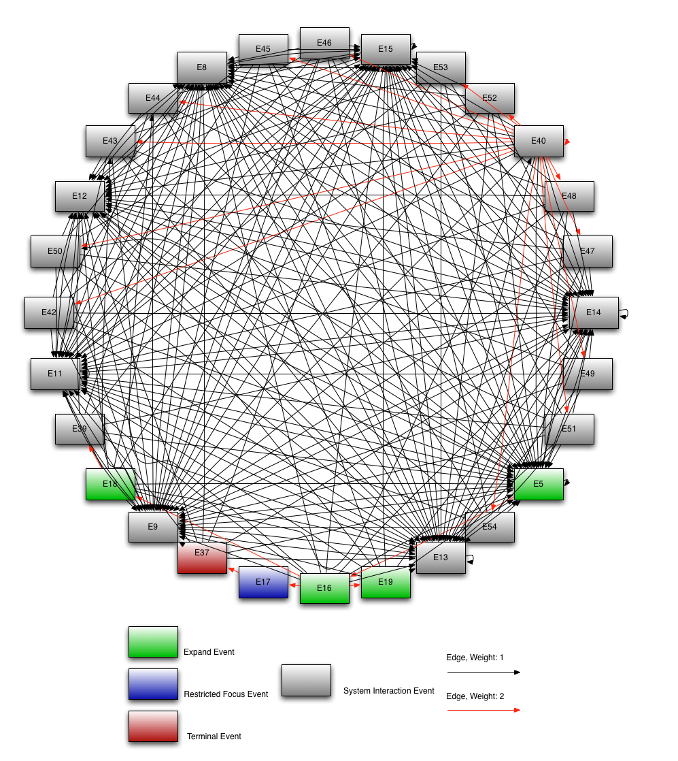
Notes:
The WeightedRandom plugin comes in handy when developers desire some degree of
control over a large set of potential tests. Dense event flow graphs like the following cannot
provide total path coverage in testing, therefore randomization is desirable to generate tests so
paths are not cherry-picked by developers.
WeightedRandom enhances this process by accepting weighted edges in event flow graph, which
can be hand generated for tricky/buggy events, produced from empirical data on how an interface is
commonly used, or according to other criteria.

Slide 9
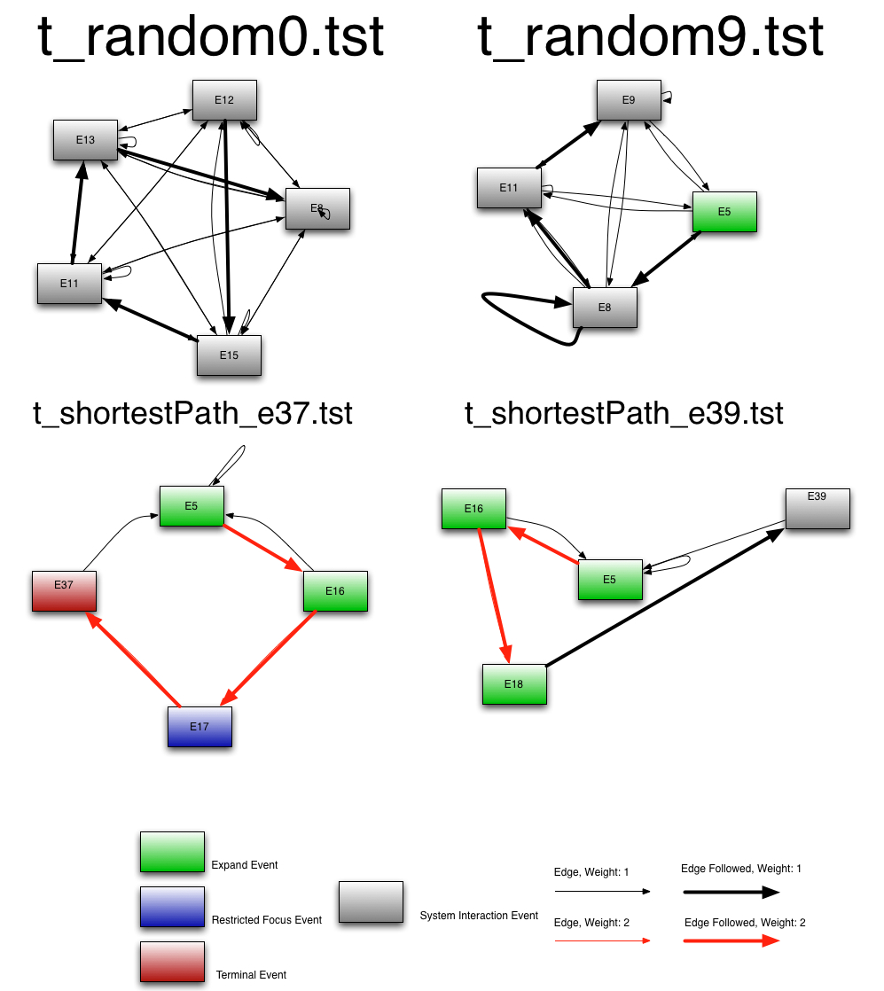
Example Test Cases
Notes:
Here are example test cases generated from a previous run of this plugin with max length set to be 5.
The top two test cases are from the randomly generated test cases and the bottom two are from the
shortest path test cases.
As you can see, these test cases span at most 5 nodes each. The random test cases appear to follow
edges leading to events that have the highest sum of out edges, but does so randomly as t_random9.tst
Illustrates on event E8 where two edges are taken on two different visits to E8.
The shortest path test cases are also generated to spec, as none of the test cases form loops and the shortest
path to the destination event is always taken.

Slide 10
GUITAR Recap
JFC Ripper
GUI Structure
2 EFG
Testcase
Generator
JFC Replayer

Slide 11
TCG Plugin Structure
TestCaseGenerator Core
Sequence
Length
Coverage
Random
Test Case
Custom
Plugin

Slide 12
An EFG
e0
e1
e2
e3
e4

Slide 13
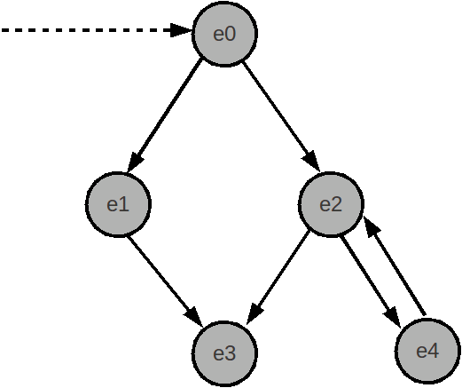
A Graph Traversal (SequenceLengthCoverage)
Testcases:
e0 → e2 → e4
e0 → e2 → e3

Slide 14
Another Graph Traversal (Random)
Testcases:
e0 → e1 → e3
e0 → e2 → e4

Slide 15
Plugin Goals
TestCaseGenerator uses this plugin mechanism due to different goals in graph traversal:
Speed: Complete coverage plugins may be infeasible for larger graphs
Completeness: For smaller GUIs, all possible test cases may be preferred
Focus: Specific types of test cases, e.g. “All test cases with no cycles”

Slide 16
Plugin Implementation
GUITAR TestCaseGenerator plugins are based off the TCPlugin abstract class
public abstract class TCPlugin
* generate(EFG efg, String outputDir, int nMaxNumber)
* getConfiguration()
* isValidArgs()
* writeToFile(String tCName, LinkedList<EventType> path)
* initialize()
* getPathToRoot(EventType event)

Slide 17
Plugin Implementation (ctd)
TCG events are broken down into three types:
Successors
Predecessors
Initial Events
1
2
3

Slide 18
Relevant GUITAR Constants
NO_EDGE: There is no relationship between the two events
FOLLOW_EDGE: Typical edges in a graph
REACHING_EDGE: Edges used to reach an event

Slide 19
initialize()
e0
FOLLOW_EDGE
e1
e2
REACHING_EDGE
e3
e4

Slide 20
initialize()
e0
initialEvents: {e0}
preds: {e0 → Ø}
{e1 → Ø}
{e2 → e0, e4}
{e3 → e2}
{e4 → Ø}
succs: {e0 → e1, e2}
{e1 → e3}
{e2 → e3, e4}
{e3 → Ø}
{e4 → e2}
e1
e2
e3
e4

Slide 21
getPathToRoot(EventType event)
e0
Paths to Root -
e0 : e0
e1 : Ø
e2 : e0 → e2
e3 : e0 → e2 → e3
e4 : Ø
e1
e2
e3
e4

Slide 22
Configuration
In many cases, additional arguments are needed for a TestCaseGenerator plugin.
Plugins can override a “getConfiguration” method in the TCPlugin interface.
The configuration specifies which additional arguments are to be parsed from the command line.

Slide 23
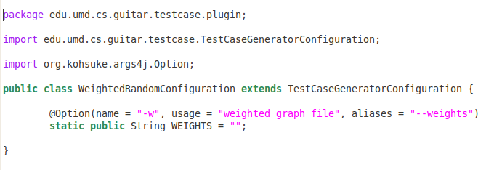
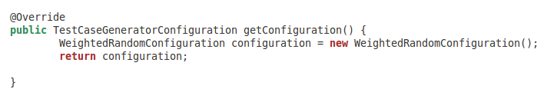
Example: Weighted Random Configuration
Configuration Class File:
Implementation of getConfiguration() in WeightedRandom.java:

Slide 24
Relevant Java Imports
org.kohsuke.args4j:
useful command line parser that contains
an “Option” object, which acts as a
field/setter that receives a command line
switch value

