Slide 1
Software architectures projects
Instructor: Dr. Mehrdad Ashtiani
TA: Morteza Zakeri
Fall 2022

Slide 2
Outline
Objectives
Scopes
Topics
Techniques and tools
Scheduling, grading policy, and groups

Slide 3
Objectives
Understanding the state-of-the-art research in software architectures
Learning the structure of scientific articles
Practicing tool development for automated software engineering

Slide 4
Scopes
Design patterns and smells detection (P1 – P5)
Automated refactoring (P6 – P10)
Microservice extraction / remodularization (P11 – P15)
Video games (P16 – P20)

Slide 5
Paper titles
Design patterns and smells detection
DeleSmell: Code smell detection based on deep learning and latent semantic analysis
Identifying emerging smells in software designs based on predicting package dependencies
Automatic detection of Long Method and God Class code smells through neural source code embeddings
Feature-based software design pattern detection
Exploring design smells for smell-based defect prediction

Slide 6
Paper titles
Automated refactoring
DEPICTER: A design-principle guided and heuristic-rule constrained software refactoring approach
Generation of refactoring algorithms by grammatical evolution
Multi-view refactoring of class and activity diagrams using a multi-objective evolutionary algorithm
Systematically refactoring inheritance to delegation in Java
Identification of generalization refactoring opportunities

Slide 7
Paper titles
Microservice extraction / remodularization
Improving microservices extraction using evolutionary search
Analysis of a many-objective optimization approach for identifying microservices from legacy systems
Microservice extraction based on knowledge graph from monolithic applications
Untangling the knot: enabling architecture evolution with search-based refactoring
Many-objective software remodularization using NSGA-III

Slide 8
Paper titles
Video games architectures
Detecting video game-specific bad smells in unity projects
Product line architecture recovery with outlier filtering in software families: the Apo-Games case study
A fine-grained requirement traceability evolutionary algorithm: Kromaia, a commercial video game case study
An architecture for multi-layer object coding in 2D game streaming using shared data in a multi-user environment
A multifaceted surrogate model for search-based procedural content generation

Slide 9
Enabling techniques and tools
Program analysis and transformation
Understand, Eclipse JDT, ANTLR, OpenStaticAnalyzer
Machine learning / deep learning / NLP
Scikit-learn/imbalanced-learn, Tensorflow, PyTorch, Gensim, Spacy
Evolutionary computing
Pymoo, Platypus
Networks science
NetworkX
Visualization
Graphviz, Seaborn, Matplotlib

Slide 10
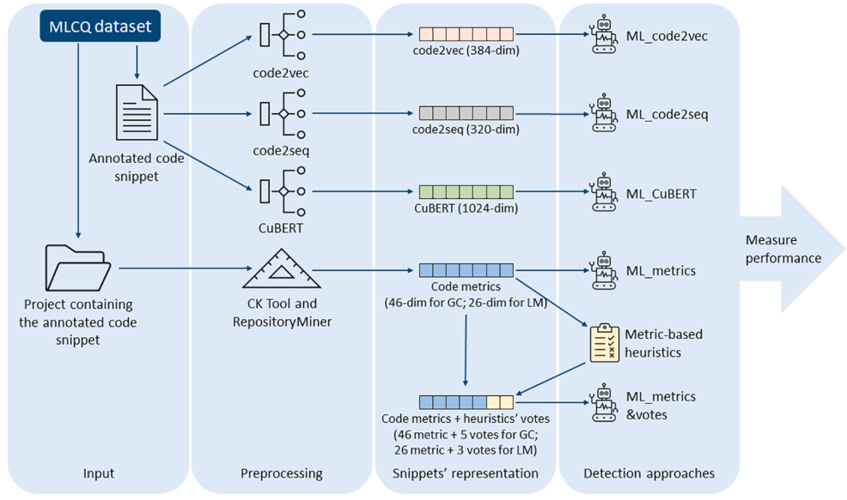
Example: Smell detection
Automatic detection of Long Method and God Class (Insufficient Modularization) code smells

Slide 11
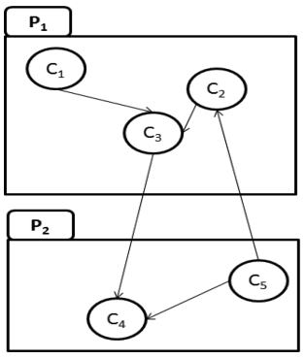
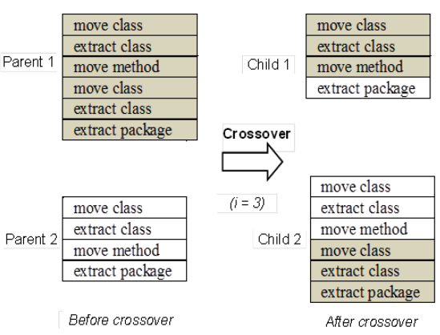
Example: Refactoring/ remodularization
Many-objective software remodularization using NSGA-III
Remodularization Objectives:
Number of classes per package (to minimize)
Number of packages in the system (to minimize)
cohesion (to maximize)
coupling (to minimize)
…

Slide 12
Scheduling and grading policy
Minor changes may be applied
Activity | Evaluation criteria | Deliverables | Grade (100)
In-class presentation (a 40 minutes presentation) | Paper understanding Teamwork quality Scheduling | Slides | 30
2. Implementation (from scratch) | Completeness Clean code principles Teamwork quality | Source code Replication package Technical report | 30
3. Validation | Results quality Additional experiments | Replication packages | 30
4. Final report (in-person) | Academic writing | Technical report | 20
Improvement (extra bonus) | -- |  | (15+)
Sum |  |  | 115

Slide 13
Groups
Up to 3 members, no individual
No repeated paper
Register: google-sheet, Due date: Mehr, 26
In-class presentation dates | Group
Aban, 17 | G1, 2
Aban, 24 | G3, 4
Azar, 01 | G5, 6
Azar, 08 | G7, 8
Azar, 15 | G9, 10
Azar, 22 | G11, 12

Slide 14
Remarks
Consider data availability for evaluations.
Most papers use open-source projects and public datasets
You may need to email authors, asking for data
You can use alternative datasets
Do not get stuck on details.
Follow an iterative and incremental approach
Work together, all groups!
TEAM: together every one achieve more
Ask your questions at early stages.

Slide 15
Questions?
Email: m-zakeri@live.com
Telegram ID: @mztel

