Slide 1

AN AGENT-BASED PLATFORM FOR SIMULATING FINANCIAL MARKETS
CSS739 class project under supervision of Robert Axtell
presented for CSS739, May 14, 2008
Notes:
CCR changed title (added “social” for specificity), venue, and date.

Slide 2
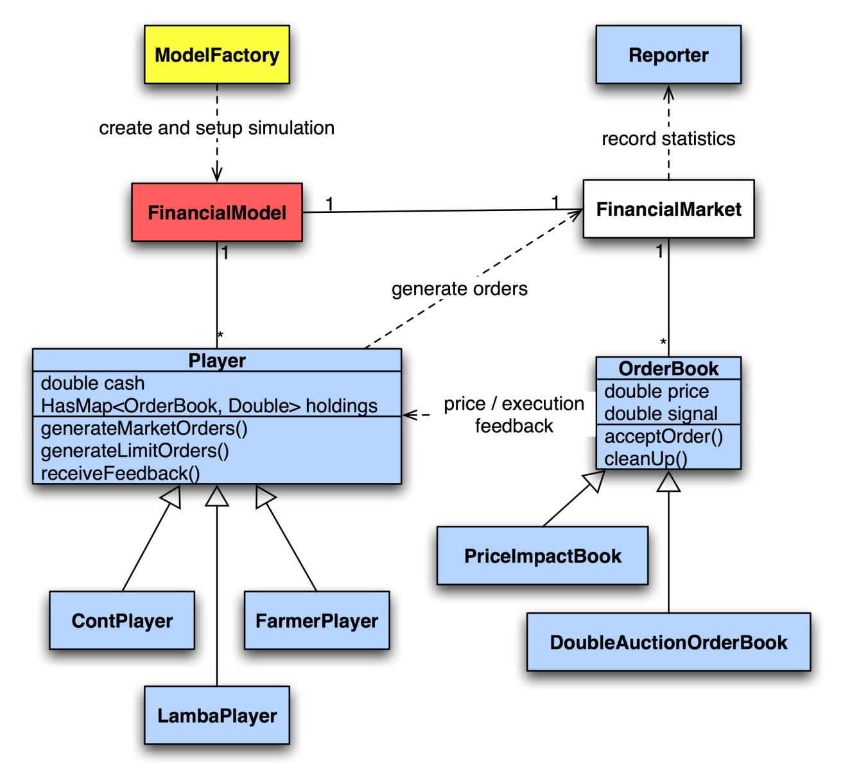
Architecture
Notes:
CCR edite #3 linking to the canonical theory.

Slide 3
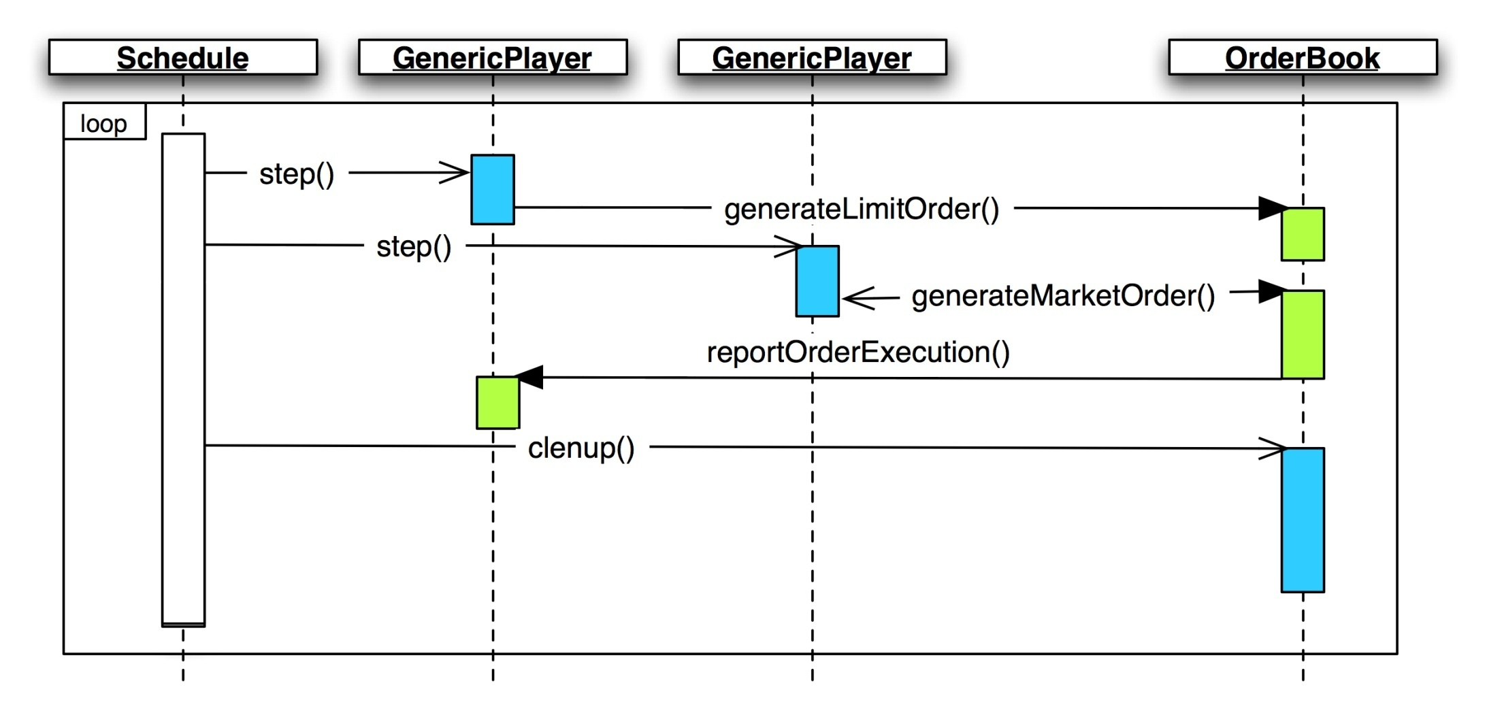
Timing of Events
Notes:
CCR edite #3 linking to the canonical theory.

