Slide 1
MARKET MICRO-STRUCTURE MULTI-AGENT SIMULATOR AND LONDON SETS
Sheri Markose #*, Azeem Malik* and Wing-Lon Ng**
#* Economics Department and CCFEA
*Muenster and CCFEA
*CCFEA and IDEA Group
For presentation at
CCFEA Summer School Sept 2007
The executable form of the simulator can be found on http://www.marketmicrostructure.co.uk

Slide 2
ROAD MAP OF TALK
…
1. Introduction
1.1 HISTORY: CHALLENGES TO THEORY AND PRACTICE OF MARKET MICRO STRUCTURE (MMS) FROM ELECTRONIC TRADING
New interdisciplinary area referred to as computational market microstructure at forefront with electronic financial markets and automated trading.
1.2The CCFEA SETS Multi agent simulator Project :Objectives
(London SETS1 : Electronic Limit Order Book E-LOB Price formation and trading service for the securities comprising the FTSE-100 index)

Slide 3
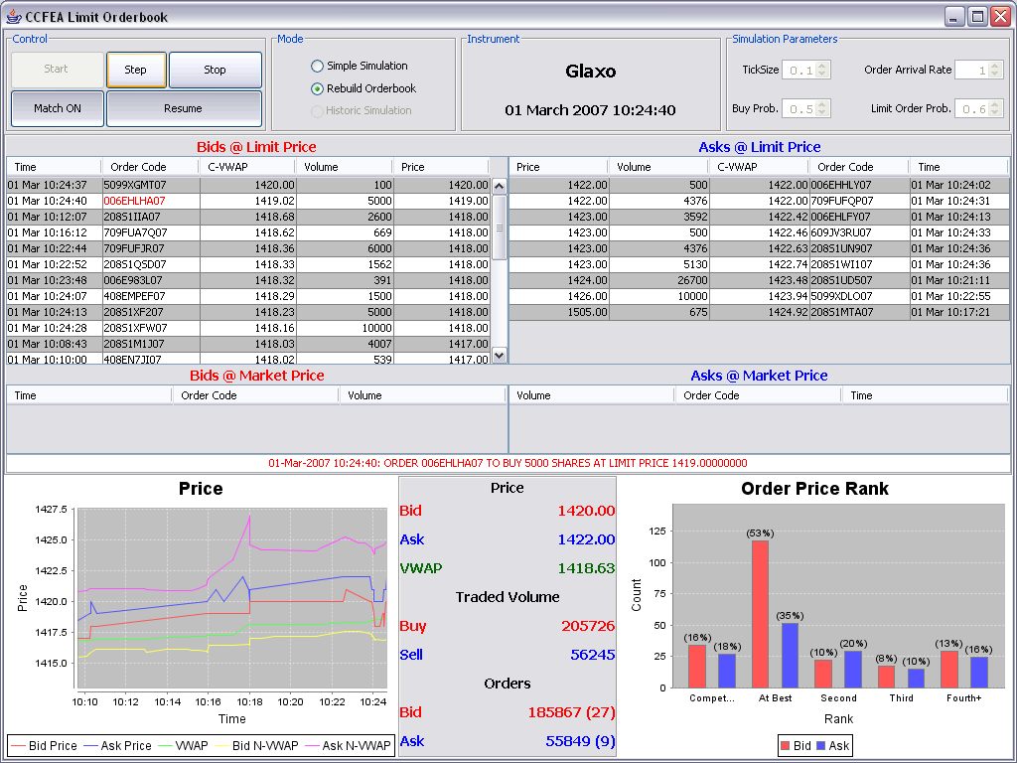

Slide 4
Objectives of CCFEA
E-LOB Project
PART I
●ASSUMPTIONS AND BUILDING OF BENCHMARK ELOB SIMULATOR
●EXPERIMENTS : ‘SLOW’ AND ‘FAST’ MARKETS WITH EXOGENOUS MARKET EVENTS
RESULTS FROM ELOB SIMULATOR AND COMPARISONS WITH REAL WORLD SETS LOB DATA FOR A TYPICAL DAY
ACD Signatures and Market Price Impact Functions

Slide 5
PART II Rebuild a SETS historical simulator for sample of stocks
Third part of project to critically assess the scope of a first fully fledged agent based simulator that combines virtual or human interfaced client orders with limit order data from a real-world electronic exchange. This was previously attempted only in the Penn-Lehman Automated Trading Project ( Kearns and Ortiz, 2003) which is currently not in operation.
Final part of the project will aim to integrate dynamic portfolio rebalancing and also dynamic arbitrage and hedging activities in view of the non-trivial order scheduling problem in electronic limit order markets.
Here in Part I of talk, we will confine our attention to the first and second parts of the project.

Slide 6
PART II
DEPTH ENHANCING NON-PRICE AGGRESSIVE OPTIMAL SCHEDULING STRATEGIES (Account for over 50% of market events)
ABSENCE OF DESIGNATED MARKET MAKING AND ENDOGENOUS LIQUIDITY PROVISION
ARE THERE BUY-SELL CYCLES ?
VWAP ON LOB AS BEST UNBIASED ESTIMATE OF PRICE TO TRANSACT QUANTITY
TIME OF DAY VOLUME DURATION: A CRITICAL CONCEPT

Slide 7
INTRODUCTION: 1.1History of E-Fin Markets
Pre www era markets were a given from venerable forms lost in the mystery of time
Continuous double auction trading facilitated primarily by a market maker or specialist system has had a long tradition
Post www era with its electronic financial markets and automated trading : E- markets can be designed
Rapid decentralized and global access to e-trading platforms
Challenges to floor-based centralized exchanges and restrictive practices of established intermediaries
E- online order submission began in the mid 1990s
Early 1990’s, NYSE and LSE hybridize floor-based market maker based continuous double auctions by replacing open outcry by an automated screen based quotation system and execution of best price. LSE SEAQ

Slide 8
Recent Developments
1/3 of all US stock trades in 2006 were driven by automatic programs and by 2010 claimed to reach 50%. In 2006, at the London Stock Exchange over 40% of all orders were entered by so called algo traders and 60% is predicted for 2007. Futures and options markets amenable to e-trading and both foreign exchange and bond markets are moving toward this.[1]
Practitioners expending very large budgets on IT based trading systems in order to cope with the optimize limit and market order scheduling in a very fast and complex environment of the electronic limit order system.
●Competitive co-evolution : Trading algorithms called Guerrillas , Snipers and Sniffers
[1] The electronic derivatives markets include Eurex, Globex, Matif while those for fixed income securities are eSpeed, Euro MTS, BonkLink and BontNet.

Slide 9
1.2 The new trend of computational market microstructure
DEBACLE OF NO TRADE RESULTS OF TRADITIONAL FINANCE
WITH GROWING TRADING VOLUMES
●Assumption :Fully optimizing traders necessary for efficient markets and the postulation of the possibility of a homogenous rational expectations HRE not tenable.
●The impossibility of a HRE in financial markets where profits arise from being contrarian : Arthur (1991,1994) highly influential vignette of the El Farol/Minority game
•Self-referential and contrarian decision problems typical of financial markets: DEFY a unique, homogenous and effective procedure for finding solutions and hence deduction in forecast rules to determine the winning strategy, Markose (200
●Endogenous heterogeneity in expectations and strategies among initially identical agents
Red Queen type arms race in technology that is already evident in the IT innovations of trading in E- markets

Slide 10
HIA and Multi-Agent Models
●New paradigm of heterogeneous interacting agent models (Reviewed in Markose, Arifovic and Sunder (2007))
●Zero intelligence traders Gode and Sunder (1993). Fully optimizing traders not necessary for efficient exploitation of gains from trade; the onus on robust trading rules and institutional design.
●Markose et al (2007) and Markose and Sunder (2007 c) “model verite ” in artificial models : represent real time data with no simplifying assumptions. The historical simulator of the actual SETS1 data and the agent abased replica of the same fall into this category of models.

Slide 11
1.3 NEW HIGH FREQUENCY FINANCIAL ECONOMETRICS FOR IRREGULARLY ARRIVING MARKET EVENTS WITH AUTOCORRELATION/CLUSTERING
New trend with Biasis et. al. (1995) investigate the ELOB system as is. New high frequency financial econometrics have highlighted statistical properties of market events in at least three different ways
Engle and Russell (1994) ACD models : the clustering in trade duration (time between trades), with short trade durations implying fast markets.
Dufour and Engle (2000) they find that as time duration between trades decrease, the price impact of trades decrease and spreads decrease.
Extensions to multivariate models with ACI models (see, Hall and Hautsch, 2004). The ACD/ACI models point to a fundamental persistence or the clustering first observed in trade durations can lead to predictability and the design of trading strategies.
ACI models can tackle multivariate analysis; Hall and Hautsch (07)
develops 6 dimensional model; Vasco Leemans (2007) analyses 12 dimensional model

Slide 12
• Second class of models Econometric testing of
Market Micro-Structure ( MMS)
Based on explicit theoretical models of order placement (Sandås (2001))or an informally stated hypothesis (see, Ellul et. al. 2007 ) then conduct econometric tests with ELOB data.
Sandås (2001):The model based estimates are found to yield a flat market impact function relative to the data driven estimates for the same.
Hasbrouck (2007) gives the most up to date discussion of the econometric approach for the testing of hypothesis relating to market microstructure.
●The third class of empirical studies of LOBs
Dacorogna et. al. (2001) as well as Bouchaud et. al. (2006), Farmer et. al. (2003), Gabaix et. al. (2003) and Eisler et al. (2007) highlight certain fat tailed properties of (limit) order price changes.
As yet no consensus of the size of the power exponent on price changes: Farmer et. al. find power law price impact function of 0.25, Gabaix et. al report 0.5.

Slide 13
1.4 The demise of traditional ‘informed’/’uninformed’ trader models
View of trading : critiqued by Rosu (2006)
Over representing the arrival of new information and on the asymmetry of information among traders as the main drivers for trades and their role in explaining features such as price impact and changes in the bid-ask spreads.
Glosten and Milgrom (1985) and Kyle (1985), so called informed and uninformed traders interact and increased spreads arise because market makers or liquidity providers need to protect themselves from informed traders who aim to trade large volumes as directed by their knowledge of the true value.
In a dynamic price setting Easley and O’ Hara (1992) find :
Spread is an inverse function of trade durations
The absence of trades and the low volume, in this theory, imply high probability of no information (or less asymmetry of information)
Hence risk of adverse selection faced by liquidity providers decreases and with it the spread.

Slide 14
Easley and O’Hara (1992) result contradicted
By empirical ACD based Dufour and Engle (2001) analysis that spreads fall under brisk trading conditions with short trade durations. Information based theory of trades that a slow market when traders arrive more slowly to the market has smaller spread, has seriously damaged its empirical validity in view of serial correlation in trade durations and the fact that more trades occur when spreads are small.
Laboratory experimental testing by Bloomfield et. al. (2003) of the informed and uninformed trader hypothesis: found negative evidence that informed agents keen to make a speedy transformation of their informational advantage into profits will dominate market orders. Informational advantage did not prevent these agents from making large numbers of limit orders as well.
With institutional investors, large orders naturally arise from liquidity demands and knowledge of this by other price setting parties in the market will enable them to skew prices against the purveyors of large orders. Following, Rosu (2006) it appears to us that fictions such as ‘informed’ and ‘uninformed’ traders are best abandoned as a useful frame of reference to trading in ELOBs.

Slide 15
2.5Models of Trader Behaviour
Focus on optimal order placement strategies within a game theory framework (see, Parlour (1998), Goettler et. al. ( 2003)) have important insights into conditions that could drive individual traders.
But they abstract from ingredients of the ELOB for purposes of analytical tractability.
Optimal order submission strategy models: Simple one of Bertsimas and Lo(2000), to elaborate AI based adaptive learning strategies (see, footnote 7) with Kissel and Glantz (2003) giving a good survey of some the state of the art order placement strategies.
As yet no consensus as to what information is contained in the LOB !
Idea first mooted in Berkowitz et. al. (1988) that the best unbiased estimate of the price a certain quantity can be transacted at in any relevant trading period by a randomly selected trader is given by the Volume Weighted Average Price (VWAP) on the relevant side of the LOB book.
Order book VWAP information available ex ante to a trader
Basis of trader strategy as well as the market price impact function that is estimated.

Slide 16
Part I : Artificial SETS Simulator
Market Microstructure of ELOB
2.1 The LSE SETS1 and transparent ELOB
Buy limit orders: bids
Sell limit orders: offers or asks
Best Price and Spread : (lowest ask - highest bid)
Market depth on each side of the market is the listed the volumes
Price Priority and time priority (P, V) vector
Rank determined by uniquely different price
-1 : Competitive
0 : Best
1: 2nd best
2: ……..4⁺

Slide 17
In SETS1 market orders of a volume greater than the volume at the best price on the LOB is allowed to walk the order book.
That is, the remaining volume of the market order that remains after execution at best price is converted into a limit order with time priority only if it cannot be fully executed at the 2nd best price and so on further down the order book.
Each of the limit prices at which the market order is executed then assume best price status in quick succession.
Limit orders once entered can leave the system only if they are matched in a trade, cancellation, modification or expiry. The maximum time a market, limit or iceberg order can sit on the order book is 90 calendar days.
Iceberg Orders

Slide 18
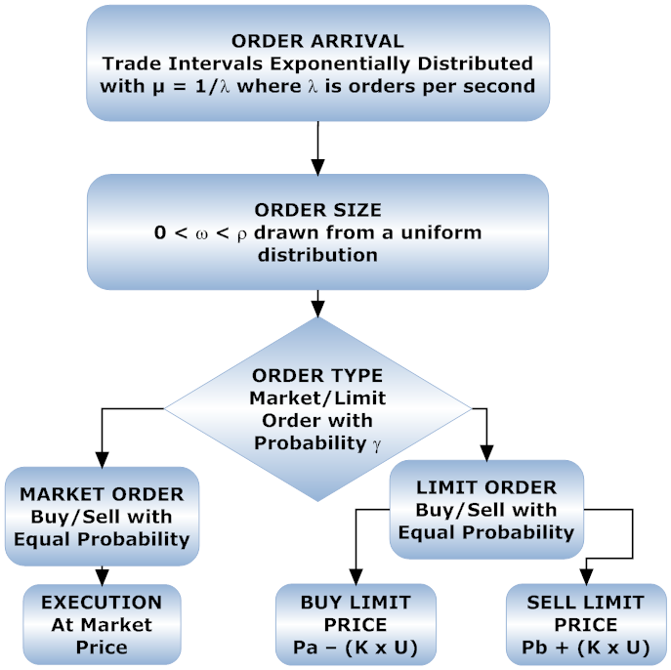

Slide 19
3.1 Information in Order Book, Order Scheduling and Market Impact
we follow the idea first mooted in Berkowitz et. al. (1988) that the best unbiased estimate of the price a certain quantity can be transacted at in any relevant trading period by a randomly selected trader is given by the Volume Weighted Average Price (VWAP) on the relevant side of the LOB.
The ex ante estimate of the expected profitability of a trade and the optimal size of an increase of depth at a given non price improving position on the buy side also requires knowledge of the time of day volume duration.
The latter is a notion integral to a market in terms of the time needed to trade a given cumulative volume of stock at a given time of day.

Slide 20
Round Trip Made by ‘scalper’
As a profitable supplier of liquidity, a trader has to complete a buy and then a sell, ie. a round trip. Given any i position in the queue a trader chooses to join in the LOB, the best estimate of the price that he will succeed in buying at and the best estimate of the price he can sell a quantity of stock, V, to realize profits in the round trip is given by the VWAP on the respective sides of the order book.

Slide 21
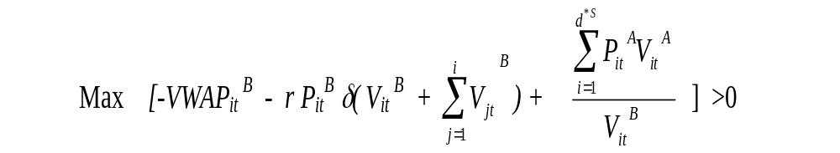
The profit maximizing volume VitB can be determined from the following unit profit function for all i for which it is positive

Slide 22
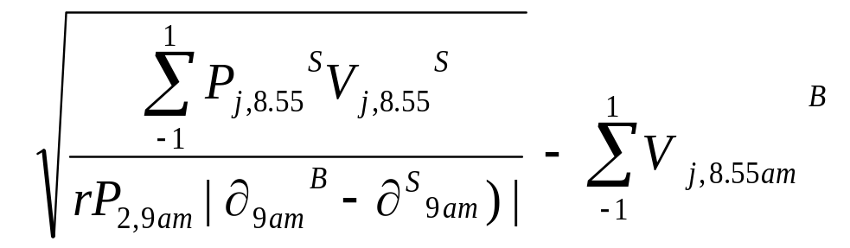
We plan to estimate the back marker at 1st rank price priority optimal bid volumes submitted at 9am, 10 am and For each of these the ex ante order book data that it will be based on will be that of 5 minutes previously, viz. 8.55 am, 9.55 am

Slide 23

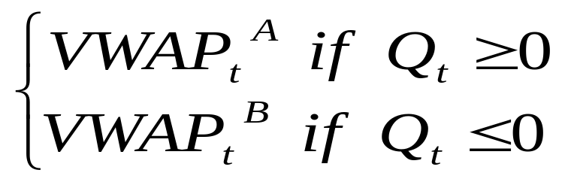
Price Impact :The transaction price changes or the market impact of trading such volumes, depends on the aggregate order imbalance.
Q (t) measures the imbalance between buy and sell orders,
The normalised imbalance is expressed as a percentage of average daily trading volume, where is the average daily volume traded in the stock over the previous 30 intervals.
VWAP(Qt) =

Slide 24
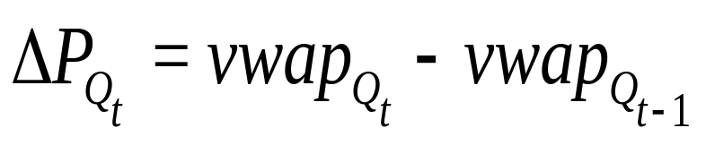
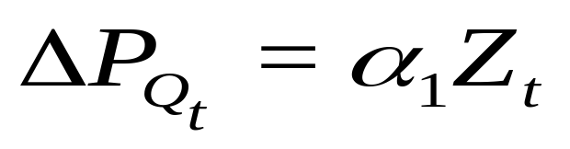
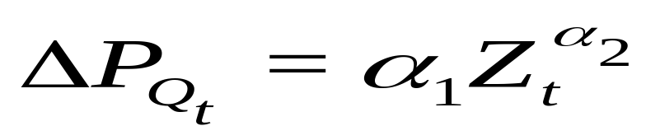
Price Impact function: Linear and Power Law Case
Therefore, price impact is the change in execution price:

Slide 25
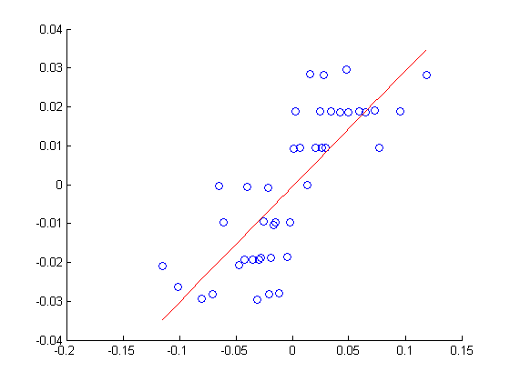
Estimated:Market Impact Functions
Linear for Artificial Fast Market

Slide 26
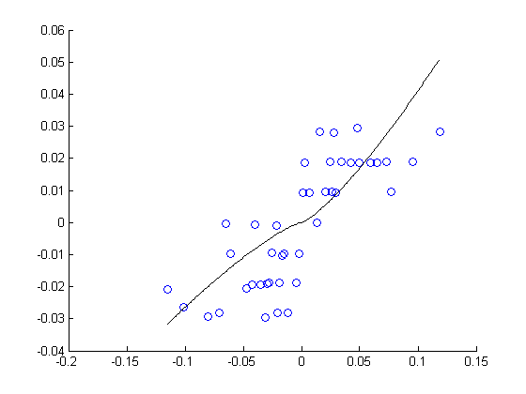
Estimated: Market Impact Functions
Power Law Artificial Fast Market

Slide 27
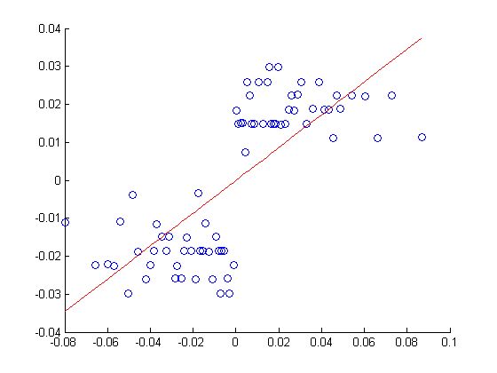
Estimated:Market Impact Functions
Linear Artificial ‘Slow’ Market

Slide 28
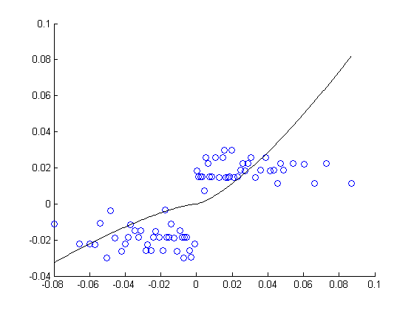
Estimated: Market Impact Functions
Power Artificial ‘Slow’ Market

Slide 29
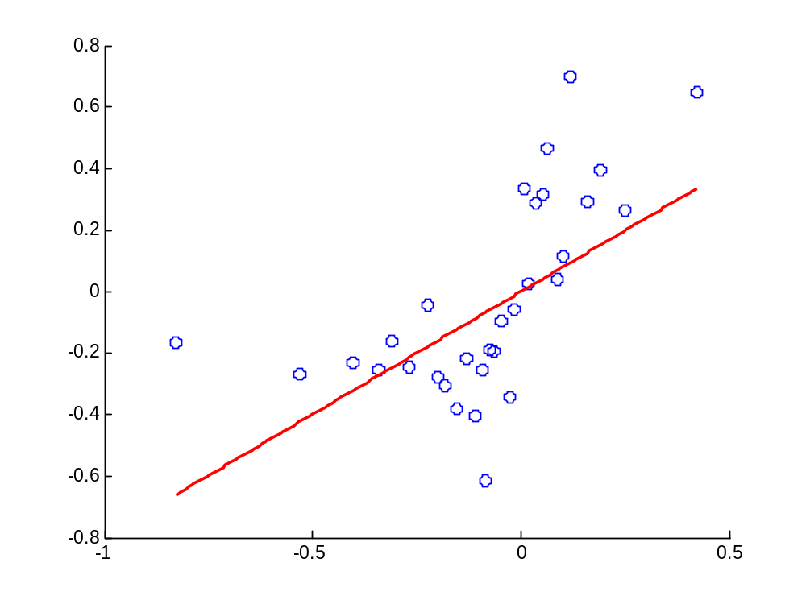
Glaxo: Linear Function: α 0.7967 R2 0.3689

Slide 30
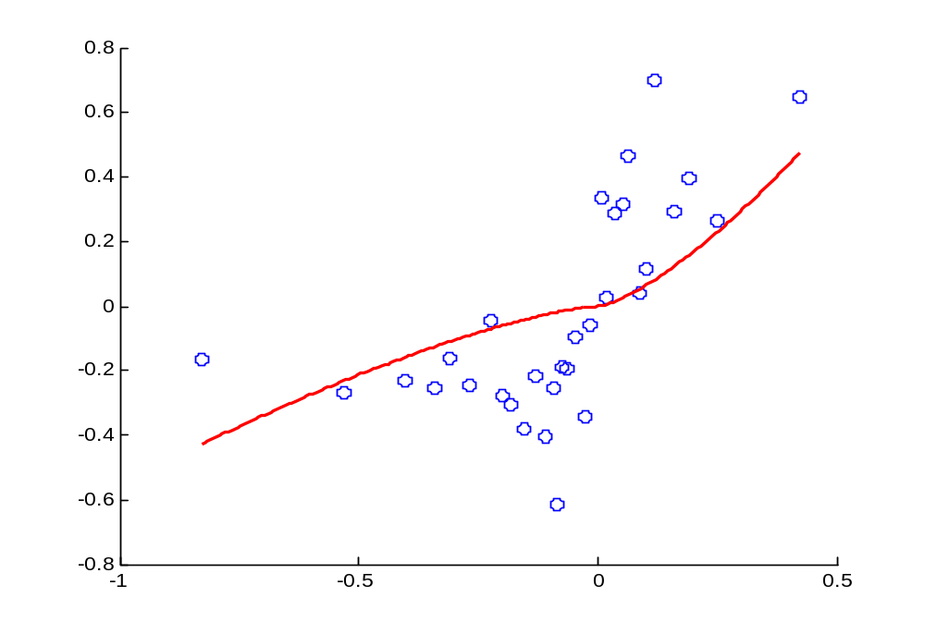
Glaxo:Power Function: α1 1.5709 α2 1.3851 R2 0.4004

Slide 31
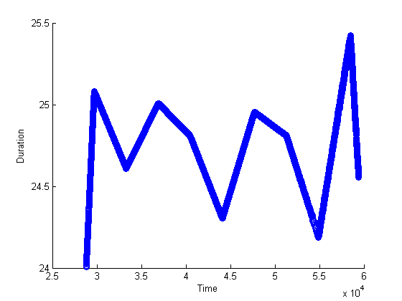
Trade Duration For Artificial Data

Slide 32
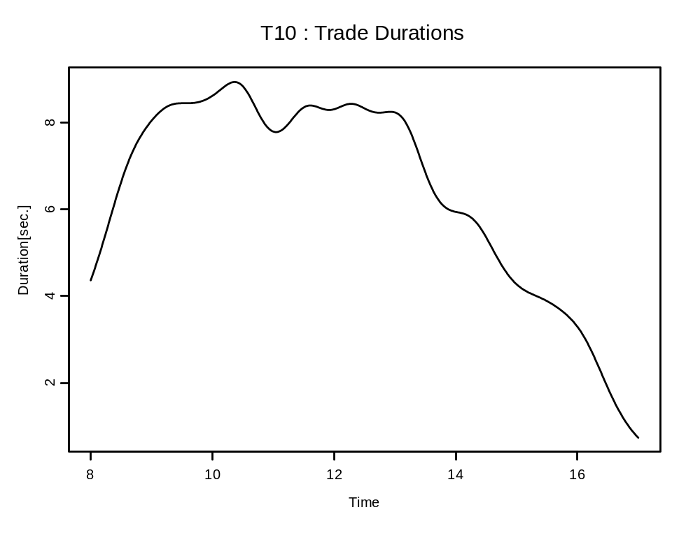
Trade Duration for Glaxo

Slide 33
4.1 Part II Time of Day Volume Duration
Is there a buy-sell wave ?
(Buy 9-10 am Sell at 11 am; then buy at 3pm and sell by 4pm )
VD: It is defined as the time elapsed until a certain quantity of shares is traded on the market (Bauwens and Giot, 2001) and, thus, provides a good indicator for the time costs of liquidity (Hautsch, 2004).
First, we look for a certain amount of shares above which it is too expensive - in terms of time costs – to submit further orders. For this purpose a sequence of ACD models for volume durations with increasing cumulative volumes is performed.
We secondly run sequential nonlinear regressions in order to find out how the time until execution varies depending on the time of day and the trade size.

Slide 34
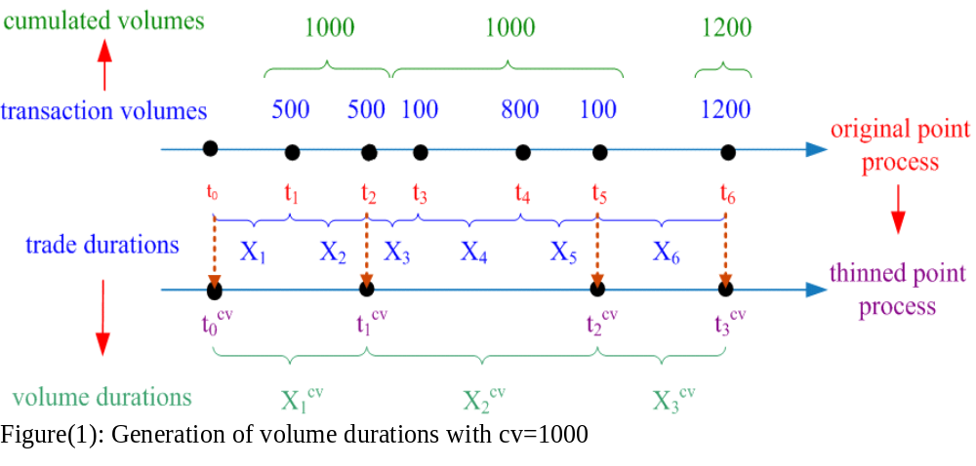
Absorption Capacity of Market

Slide 35
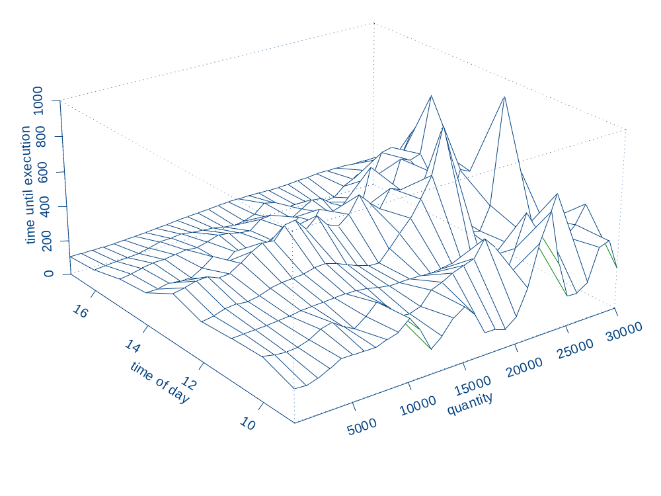

Slide 36
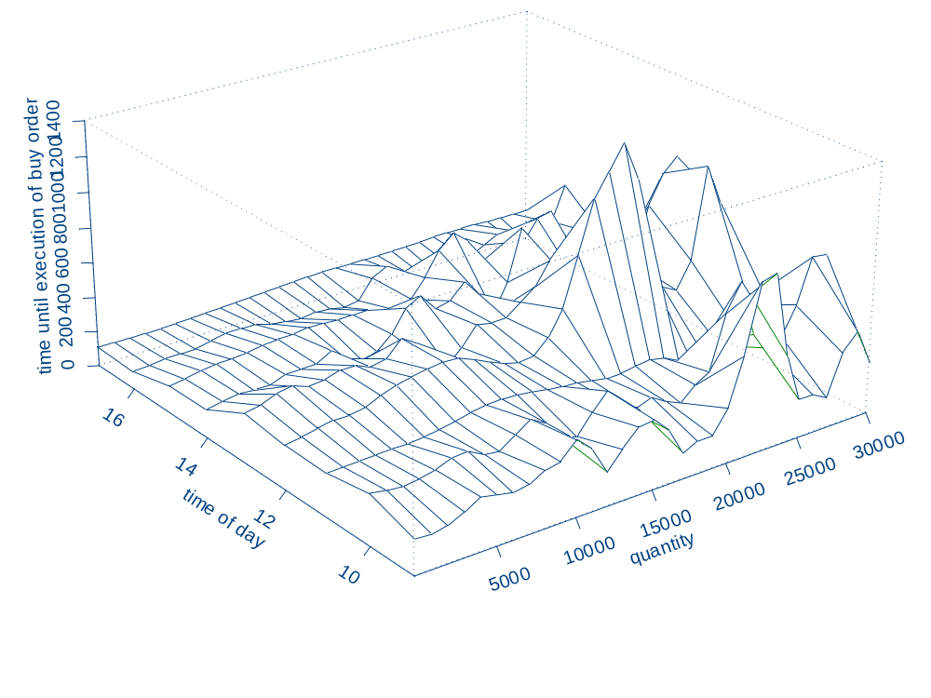

Slide 37
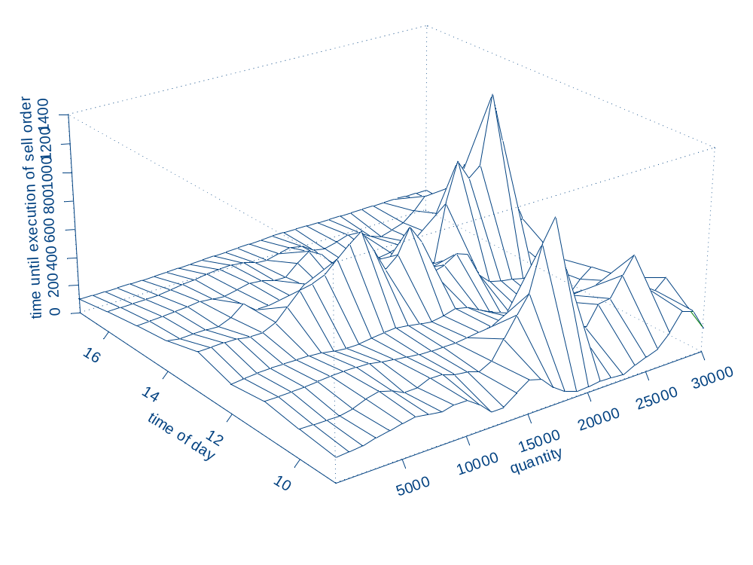

Slide 38
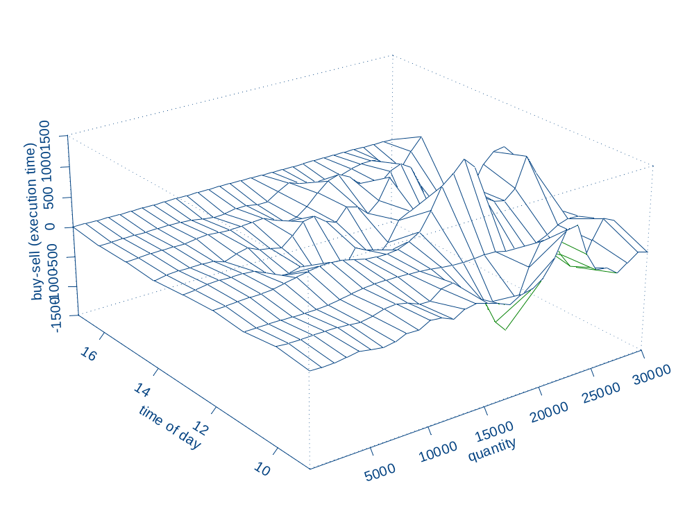

Slide 39
Look UP Table For Volume Duration based on Time of Day
quantity from 08:10 08:20 08:30 08:40 08:50 09:00 09:10 09:20 09:30 09:40
1 163.5808849 232.2895987 191.4712334 274.2477779 152.2408874 179.661353 410.3862834 408.2887181 224.9055485 175.9351474
101 164.9780941 228.0516764 190.2736492 275.2570099 152.8034255 179.4431587 408.0031256 407.1859566 224.7500223 175.7700445
201 166.497455 223.8037266 189.0689319 276.3748196 153.4006349 179.2386139 405.6392835 406.0787018 224.5604541 175.6106027
301 168.1485915 219.5715859 187.8670169 277.5958675 154.0344523 179.0564769 403.3023962 404.9682536 224.3381218 175.4577309
401 169.9405694 215.3847752 186.6792559 278.9115646 154.706878 178.9067547 401.0006941 403.8569736 224.0854456 175.312375
501 171.8815502 211.2765341 185.5184188 280.3097157 155.4199704 178.8007274 398.743013 402.7486403 223.8062231 175.1755062
601 173.9784079 207.2837395 184.3986508 281.7742743 156.1758385 178.7509341 396.5388045 401.6488223 223.5058752 175.048106
701 176.2363215 203.4466825 183.3353741 283.2852597 156.9766326 178.7711122 394.3981394 400.5652335 223.19169 174.9311461
801 178.6583686 199.8086716 182.345125 284.8188832 157.8245334 178.8760778 392.3317034 399.5080239 222.8730512 174.8255642
901 181.2451467 196.4154358 181.445318 286.3479286 158.7217382 179.0815393 390.3507839 398.4899426 222.5616307 174.7322345
1001 183.9944672 193.3143015 180.6539309 287.8424171 159.6704456 179.4038328 388.467245 397.5263036 222.2715248 174.6519337
1101 186.9011647 190.5531318 179.9891082 289.2705771 160.6728367 179.859575 386.6934896 396.6346791 222.019304 174.5853014
1201 189.9570793 188.1790259 179.4686859 290.600115 161.7310534 180.4652266 385.0424048 395.8342551 221.8239527 174.5327965
1301 193.1512604 186.2368005 179.1096475 291.7997659 162.8471745 181.2365687 383.5272897 395.1448031 221.7066654 174.4946504
1401 196.4704395 184.7673016 178.9275282 292.8410788 164.023188 182.1880967 382.1617625 394.585257 221.6904787 174.4708179
1501 199.899799 183.8056263 178.9357944 293.7003768 165.2609596 183.3323436 380.9596427 394.1719372 221.7997174 174.4609277
1601 203.4240356 183.3793694 179.1452327 294.3608107 166.5621988 184.6791517 379.9348089 393.9165168 222.0592487 174.4642362
1701 207.0286804 183.5070406 179.5633892 294.8144171 167.9284203 186.2349182 379.1010266 393.8238916 222.4935515 174.4795852
1801 210.7015924 184.1968223 180.1941012 295.0640753 169.3609034 188.0018469 378.4717461 393.8901673 223.1256264 174.5053697
1901 214.434496 185.4458435 181.0371641 295.1252482 170.8606464 189.9772426 378.0598692 394.1010153 223.975792 174.5395172
2001 218.2243947 187.2401291 182.0881608 295.0273764 172.4283197 192.1528891 377.8774829 394.4306648 225.060432 174.5794825
2101 222.0746702 189.55534 183.3384732 294.8147837 174.0642143 194.5145511 377.9355623 394.8417802 226.3907732 174.6222624
2201 225.9956694 192.3583453 184.775467 294.5469376 175.76819 197.0416396 378.2436449 395.2864299 227.9717825 174.6644316
2301 230.0046046 195.6095739 186.3828252 294.2979067 177.5396203 199.707074 378.8094806 395.708275 229.801271 174.702202
2401 234.1246312 199.2659911 188.14098 294.1548673 179.3773374 202.4773709 379.6386634 396.0460078 231.8692827 174.7315045
2501 238.3830216 203.2844434 190.0275845 294.215543 181.2795775 205.3129771 380.7342564 396.2379559 234.1578253 174.7480935
2601 242.8084225 207.6250511 192.0179571 294.584519 183.2439267 208.1688617 382.0964184 396.2276351 236.6409728 174.7476676
2701 247.4272438 212.2542893 194.0854468 295.3684552 185.2672702 210.9953706 383.7220514 395.9699088 239.2853438 174.7260038

Slide 40
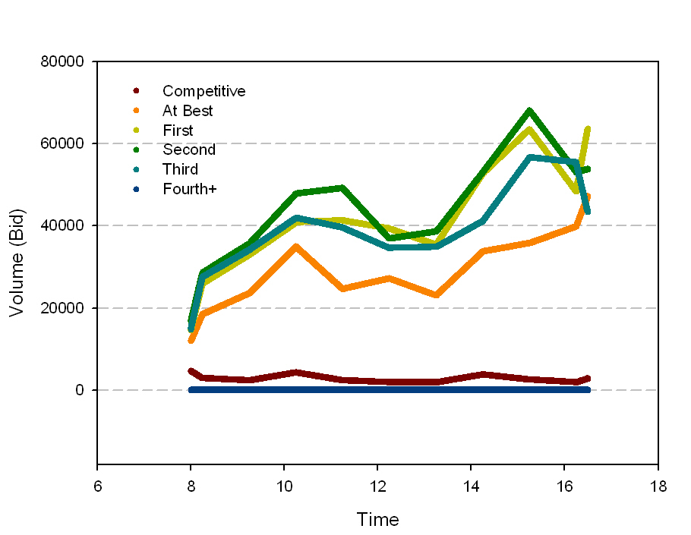
March 07 (22 day) time of day average Depth (Buy side)

Slide 41
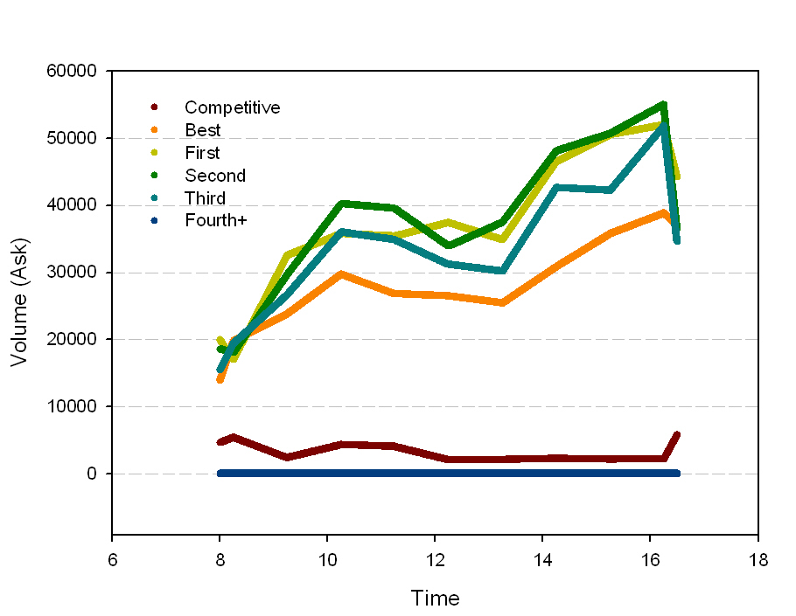
March 07 (22 day) time of day average of Depth (Buy side)

Slide 42
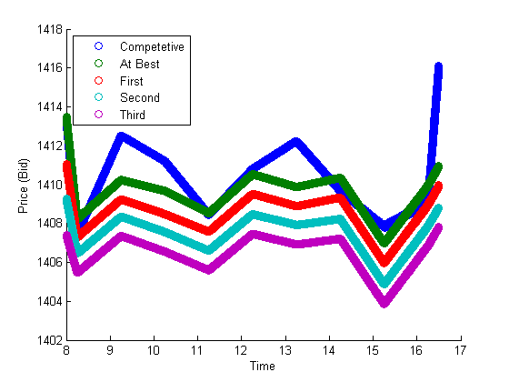
Time of Day Bids Glaxo (March Average) Competitive at all ranks at 9am

Slide 43
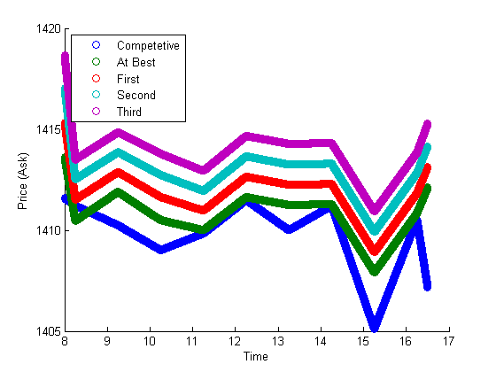
Time of Day Asks Glaxo (March Average) Sell highly competitive at 3.15 at all ranks

Slide 44
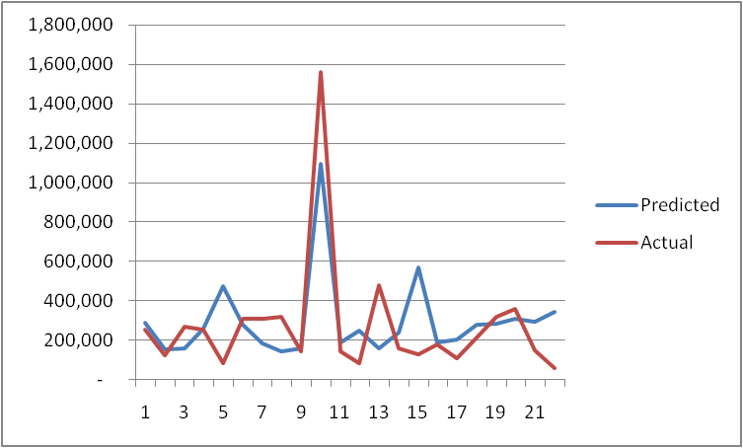
9am BackMarker Depth Increase at Rank 1 over 22 days

Slide 45
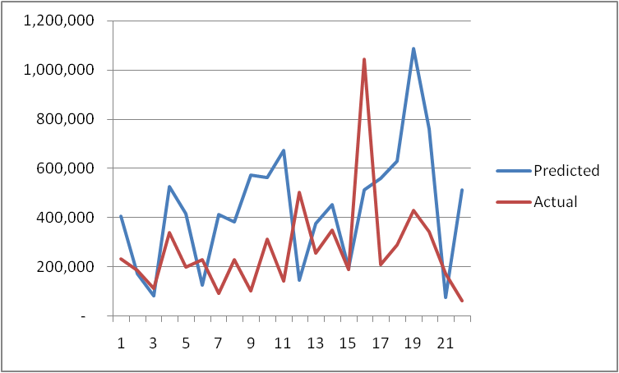
10am BackMarker Depth Increase at Rank 1(Buy Side) over 22 days

Slide 46
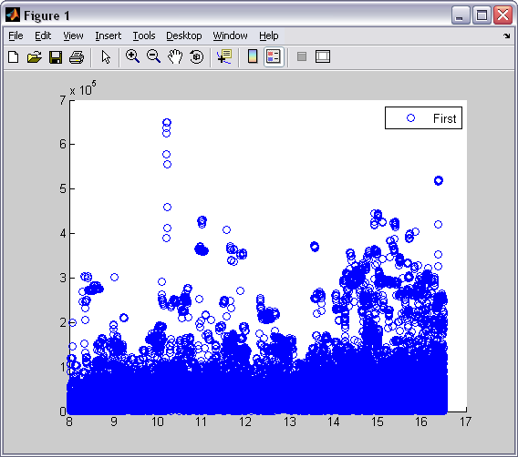
22-day Average point process time of day Volume at rank 1

Slide 47
Concluding Remarks
Project is still Work in Progress
Testing of this passive depth increasing strategy feasible on basis of ex ante
order book information and ex post order placement
•Need to consider price aggressive strategies
•Behaviour of order book in market crises eg. August 2007

Slide 48
Some References: Market Microstructure
Hasbrouck, J., 2007, Empirical Market Microstructure: The Institutions, Economics and Econometrics of Securities Trading
The Microstructure Approach to Exchange Rates by Richard K. Lyons
Easley, D. and M. O’Hara (1987). Price, trade size, and information in securities markets. Journal of Financial Economics 19(1), 69–90.
Easley, D. and M. O’Hara (1992). Time and the process of security price adjustment.
Journal of Finance 47(2), 576–606.
Eisler, Zoltan; Kertesz, Janos; Lillo, Fabrizio; Mantegna, Rosario N. 2007 Diffusive behavior and the modeling of characteristic times in limit order executions, Quantitative Finance.
Gabaix, X., P. Gopikrishnan, V. Plerou, and H. E. Stanley (2003). A theory of power-law distributions in financial market fluctuations. Nature 423, 267–270.
Hasbrouck, J. (1991). Measuring the information content of stock trades. The Journal of Finance 46(1), 179–207.
Kissell, R. and M. Glantz (2003). Optimal Trading Strategies: Quantitative Approaches for Managing Market Impact and Trading Risk. American Management Association.
Gode, D.K and Sunder, S.(1993). “Allocative efficiency of markets with zero intelligence traders : markets as a partial substitute for individual rationality”, Journal of Political Economy, 101, 119-137.

Slide 49
High Frequency Financial Econometrics
Wing Lon Ng, 2007, “Analyzing Liquidity and Absorption Limits of Electronic Markets with Volume Durations”, Mimeo
Bauwens and Hautsch (2006), Modelling Financial High Frequency Data using Point Processes, Core Discussion Paper 2006/80., Université catholique de Louvain
Carrasco, M., and X. Chen (2002), Mixing and Moment Properties of Various GARCH and Stochastic volatility Models, Econometric Theory, 18(1), 17—39.
Dufour, A. and Engle, R. F. (2000), The ACD-Model: Predictability of the time between consecutive trades, Discussion paper, ISMA Centre, University of Reading.
Fernandes, M., and J. Grammig (2006), A Family of Autoregressive Conditional Durations Models, Journal of Econometrics, 130(1), 1—23.
Härdle, W. (1990), Applied nonparametric regression, Cambridge University Press,Cambridge.
Hautsch, N. (2002), Modelling intraday trading activity using Box-Cox ACD models, Working paper, CoFE.
Hautsch, N. (2004), Modelling Irregularly Spaced Financial Data, Springer, Heidelberg.

Slide 50
Agent Based (ACE)Approach
Reading on using ACE for real world market design:
Markose, M, et. al. A smart market for passenger road transport (SMPRT) congestion: An application of computational mechanism design
Journal of Economic Dynamics and Control , Volume 31, Issue 6, June 2007, Pages 2001-2032
Markose, S., J. Arifovic and S. Sunder ( 2007), Advances in Experimental and Agent-based Modelling: Asset Markets, Economic Networks, Computational Mechanism Design and Evolutionary Game Dynamics
Volume 31, Issue 6, pages 1801-1807
Readings for rationale for ACE in complex dynamics with contrarian structures
Arthur, W.B., (1994). “Inductive Behaviour and Bounded Rationality”, American Economic Review, 84, pp.406-411.
Markose, S.M, 2005 , “Computability and Evolutionary Complexity : Markets as Complex Adaptive Systems (CAS)”, Economic Journal , Vol. 115, pp.F159-F192.
Markose, S.M, 2004, “Novelty in Complex Adaptive Systems (CAS): A Computational Theory of Actor Innovation”, Physica A: Statistical Mechanics and Its Applications, vol. 344, pp. 41- 49. Fuller details in University of Essex, Economics Dept. Discussion Paper No. 575, January 2004.
Markose S.M., 2006 “Gödelian Foundations of Non-Computability and Heterogeneity In Economic Forecasting and Strategic Innovation”, Presented at Gödel Centenary Colloquium at Computability in Europe 2006 Logical Approaches to Computational Barriers
http://privatewww.essex.ac.uk/~scher/
.

