Slide 1
Econophysics
Irene Giardina
ISC - Institute for Complex Systems INFM-CNR
and
Department of Physics, University of Rome La Sapienza
Summary
I) Data analysis
Stylized facts of financial markets
Double auction market and statistics of the order books
II) Models
Minority Games
Market models

Slide 2

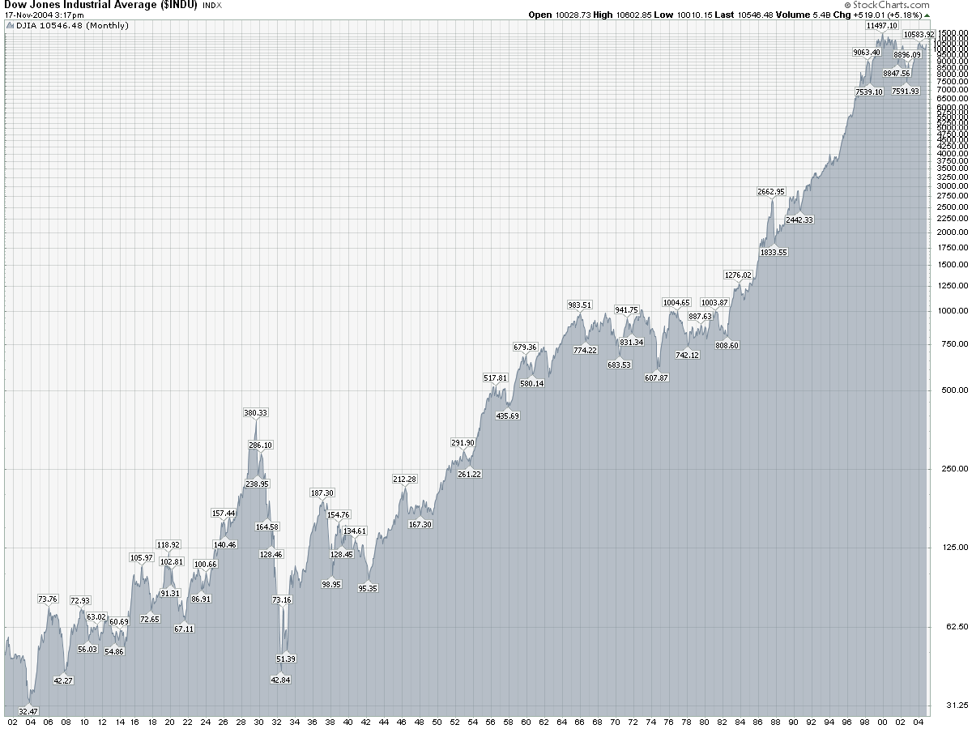

Stylized facts of financial markets
Traders (individual investors, mutual funds, brokerage firms, banks)
Assets ( stocks, bonds, derivatives - options, futures ….)
Transactions
transaction price
return
S&P 500 1950-2005
Dow Jones 1902-2004
Market-value weighted
Price-weighted index

Slide 3
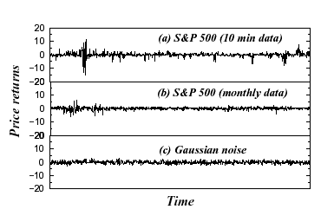
What are the statistical properties of the returns ?
Bachelier (1900) returns = i.i.d. Gaussian random variables
Bachelier, Ann. Sci. Ecole Norm. Super. 3, 21 (1897)
Large tails in the returns distribution !
Mandelbrot, J. Business 36, 294 (1963) Levy distribution
Mantegna & Stanley, Nature, 376 (1995); 383, 587 (1996) truncated Levy
Bouchaud& Sornette, J. Phys. I, 4, 663 (1994) Student
Ghasghaie et al., Nature, 381, 767 (1996)
Large fluctuations
Clustering

Slide 4
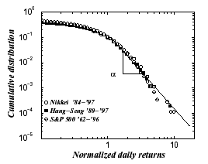
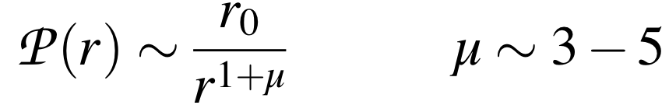
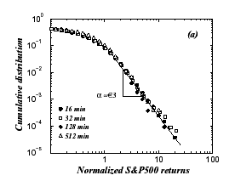
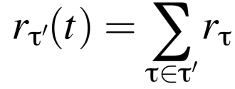
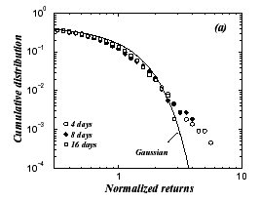



Distribution of returns
α=3.03−3.35
Daily returns
Power law ! but finite variance
Holds for indexes and individual stocks
Gopikrishnan, Plerou, Amaral, Mayer &Stanley, PRE 60, 5306 (1999)
τ’> τ
CLT
Convergence to Gaussian
Scaling behaviour for τ < 4 days
Slow convergence to a Gaussian
The reshuffled series is faster correlations in the returns !!

Slide 5
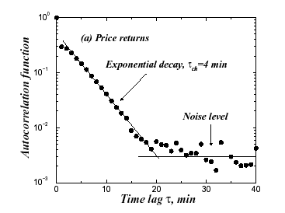
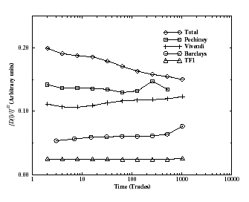


Linear returns correlations
Efficiency
S&P 500 Gopikrishnan et al. (1999)
Paris Bourse Bouchaud, Gefen, Potters & Wyart, Quantitative Finance 4, 176 (2004)
Linear efficiency: no linear patterns to be exploited for trading
Efficient Market Hypothesis Fama, Journal of finance, 25, 383 (1970)
All available information is included in the price
Fully rational agents arbitrage away any deviation from the fair price - prices are random walks in time
NO ! There are other long-memory observables

Slide 6
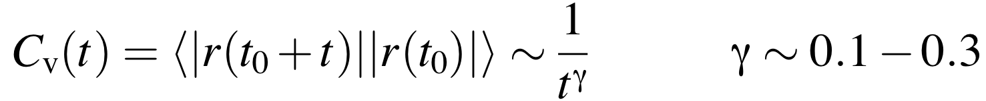
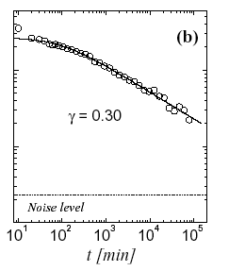
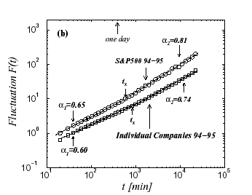
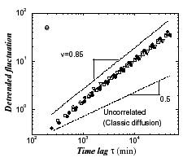

Volatility Clustering
Long-range correlations
Lo, Econometrica 59, 225 (1991)
Ding, Granger & Engle, Journal of Empirical Finance 1, 83 (1993)
Liu et al., Phys. Rev. E 60, 1390 (1999)
S&P 500 Liu et al., (1999)
Plerou et al., Phys. Rev. E. 62, R3023 (2000)
Long-memory in the volatility is determined by long-range correlations in trading activity

Slide 7
The double auction market
Sell orders
Order Book
Δ
shares
bid
ask
market orders
limit orders
cancellations
Log price
spread
Buy orders
Best prices or quotes:
The bid price b(t) best buying price
The ask price a(t) best selling price
bid-ask spread
The midprice: p(t)=[a(t)+b(t)] / 2
The transaction price

Slide 8
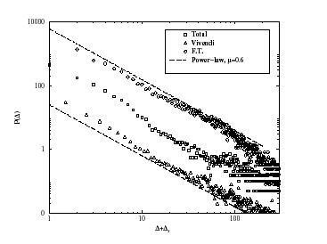
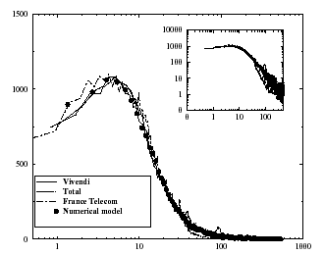
Statistical properties of the order book
Power-law distribution of the incoming limit orders
Zovko & Farmer 2002; Bouchaud, Mezard & Potters 2002
Δ = limit price - bid/ask
Agents expect large return fluctations (true)
Incoming volumes far from the best price are smaller (power law)
The shape of the order book (global volume vs Δ )
Large fluctuations
Order flow +price dynamics and erosion at the best price

Slide 9
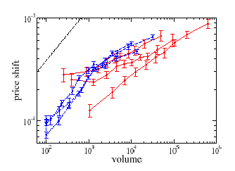
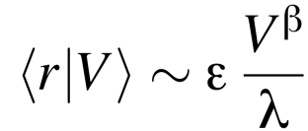

Important questions:
What is the average market impact ?
What is the impact of a single trade on the price ?
Do larger volumes have a greater impact ? Not as much as one would expect !
r = log shift in the midprice due to trade
V = volume of the transaction
ε = sign of the transaction
λ = liquidity
LES & NYSE Farmer-Lillo 2004
β ~ 0.5 - 0.2 NYSE Lillo, Farmer & Mantegna, Nature 421, 129 (2003)
β ~ 0.26 LSE Lillo & Farmer, Quantitative Finance 4, C7 (2004)
Paris
Potters & Bouchaud, Physica A 324, 133 (2003)

Slide 10
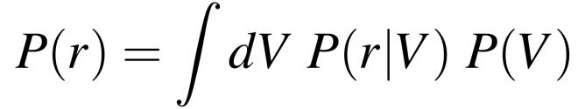


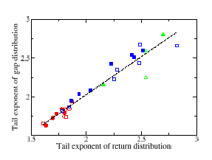
Is it possible to explain the power law tails in price fluctuations ?
Deterministic price impact + power law distribution of volumes
Gabaix, Gopikrishnan, Plerou & Stanley, Nature 423, 267 (2003)
α ~ 3
Large volume orders cause
large price mouvements
λ = const β = 1/2 γ = 3/2
Stochastic price impact + fluctuations in the liquidity
Farmer, Gillemot, Lillo, Mike & Sen, Quantitative Finance 4, 383 (2004)
The whole book is relevant to
determine
large price mouvements
Power law, V independent
Determined by the
(best-next order) gap

Slide 11
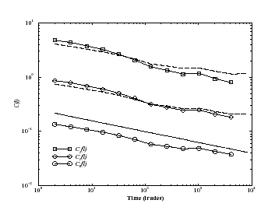
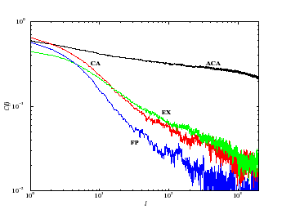
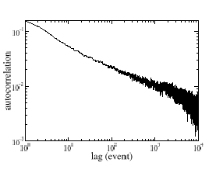
Correlations in the signs
Trade market order that initiated the trade above the mid-price ε = 1
Below the mid-price ε = − 1
FT 2001-2002 Bouchaud, Gefen, Potters & Wyart (2004)
Vodafone 1999-2002 Farmer & Lillo, cond-mat/0311053
BUT returns do NOT exhibit correlations (i.e. efficiency)
How is efficiency restored ?

Slide 12
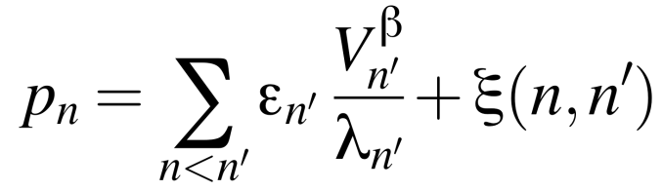
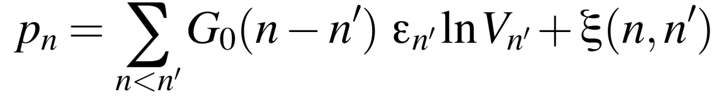
Efficieny comes from fluctuations in the impact (i.e. in the liquidity)
liquidity and volume fluctuations are anti-correlated with fluctuations in order signs
Farmer & Lillo,2003
Run of buy market orders next buy market order has i) smaller volume ii) smaller impact
The price impact is NOT constant but decays in time in such a way to
compensate for the sign correlations and determine uncorrelated returns
Bouchaud, Gefen, Potters & Wyart, 2004
‘Liquidity takers’ Market orders order splitting correlations in the signs (PL with γ)
Information driven
‘Liquidity providers’ limit orders mean-reversion decaying impact function (PL with β)
Gain on bid/ask spread
The market is at a critical point
Bouchaud, Kockelkoren, Potters, cond-mat/0406224

Slide 13

Market models
Standard perspective in economics: GAME THEORY
agents are rational, deductive and strategic (optimize utility function)
agents are homogeneous (i.e. equivalent, all with the same capabilities)
i strategies/actions (s^{i}₁,….s^{i}_{m}) utility function U(s_{i}, s_{-i})
Each agent wishes to optimize his utility function, BUT taking into account the action of the other players
Best strategy
(Dominant strategy)
Nash equilibrium
Strategy profile {s¹ , s²…..s^{N}} where each s^{i} is an optimal strategy
There is no advantage for any agent in changing her strategy 1 spin-flip stability !

Slide 14
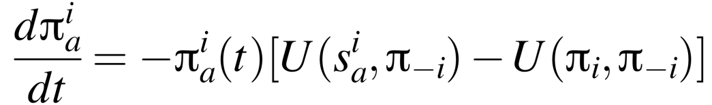
Ex: Prisonner’s dilemma
2
1
NC
C
C is a strictly dominant strategy
NC
-2 , -2
-9 , -1
Nash
C
-1 , -9
-5 , -5
mixed strategies: s^{i}_{a} π^{i}_{a}
i π_{i} = (π^{i}₁,…π^{i}_{m})
Are Nash equilibria relevant for the dynamics ?
replicator dynamics:
converges to a Nash state (which is dynamically stable)

Slide 15

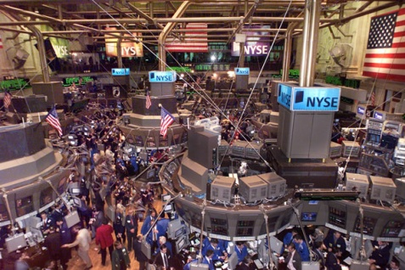
A new perspective
To model systems of many interacting agents
Panic phenomena
Agents competing for a scarce resource
Financial markets
Agents are NOT rational, but
heterogeneous and adaptive
Perfect rationality
Deductive reasoning
Homogeneity
Bounded rationality
Inductive reasoning
Heterogeneity
Game Theory, Nash equilibria
Replicator dynamics
Santa Fe market model, El Farol, Minority Game
N ∞
Adaptive dynamics
Disorder
Physicists !

Slide 16
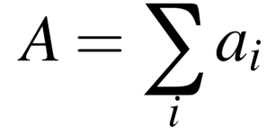

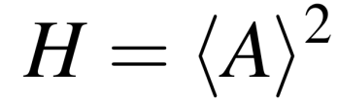
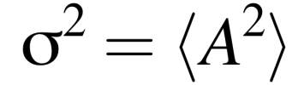
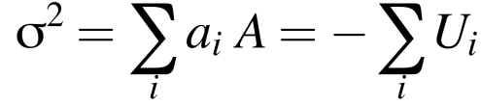
The simpler Minority Game
a_{i1}= 1
i=1, … N agents
a_{i}
a_{i2}= - 1
Minority rule
Nash equilibria
Pure Nash:
(N-1)/2 with a_{i}=1, the others with a_{i}=-1
Many !
Mixed Nash:
K agents frozen (pure), and N-K with π_{i}=1/2
Predictability (if H > 0 a = - sign <A> is winning ! )
Volatility is the global loss

Slide 17
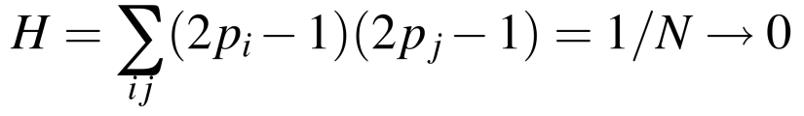
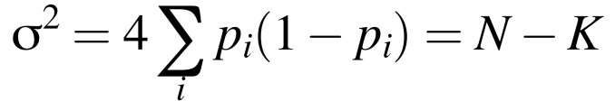
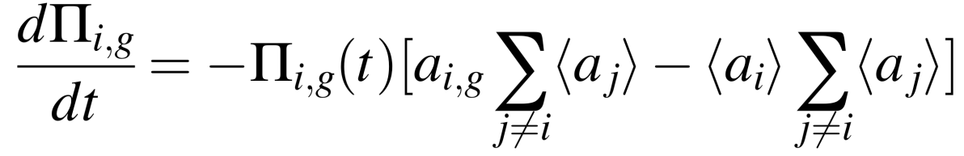
No predictability
Pure Nash have better ‘global’ performance
In real life would a loosing agent remain in a Nash equilibrium ?
U(a_{i,g}, Π_{-i,g})
U(Π_{i,g}, Π_{-i,g})
Replicator Dynamics:
Converges to pure Nash, this is not realistic
Inductive reasoning
Adaptivity
Learning
Heterogeneity

Slide 18



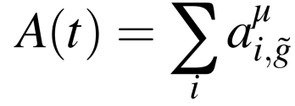

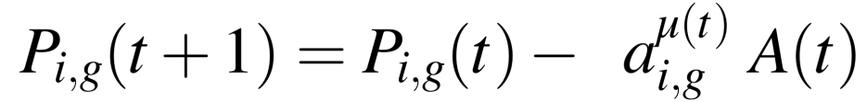
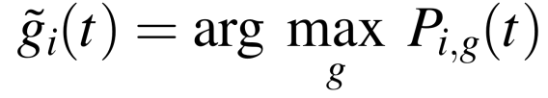
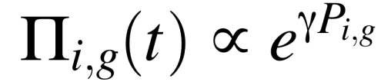
Minority Game
Challet , Zhang 1997
System of heterogeneous agents with adaptive strategies who compete for some resources
Repeated game with two choices and a minority rule e.g. non-adaptive case very simple !
i=1, … N agents
μ(t)= 1,… P information patterns
g=1, … S strategies
Heterogeneity
Disorder
Agent choice:
1 buy
-1 sell
μ(t)
Minority Rule
Excess demand
best strategy
global action
gain
win
loose
Performance dynamics
Adaptivity

Slide 19
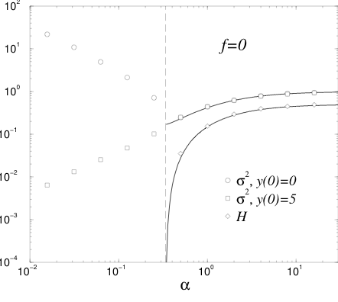


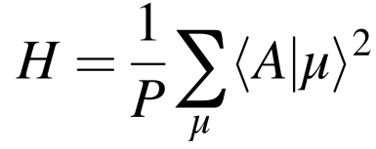

What can we do ?
σ²/N
Relevant parameter:
volatility
predictability
α_{c}
transition
Efficient H=0
Inefficient H > 0
Frozen agents
Numerical simulations
Challet, Zhang Physica A 246, 51 (1998)
Savit et al. PRL 82, 2203 (1999)
Cavagna, PRE 59, R3783 (1998)
Cavagna, Garrahan, Giardina, Sherrington, PRL 83, 4429 (1999)
Analytical computations
dynamical properties
equilibrium properties (NOT Nash !)
Heimel, Coolen, PRE 63, 056121 (2001)
Coolen, cond-mat/ 0410335
Challet, Marsili, Zecchina, PRL 85, 5008 (2000)
Marsili, Challet, Zecchina, Physica A 280,552 (2000)
Garrahan, Moro, Sherrington, PRE 62, R9 (2000)
Generalizations:
grand canonical MG
producers + speculators
mixed majo+mino
Jefferies et al. EPJB 20, 493 (2001)
Bouchaud, Giardina, Mezard, Quant. Finance 1, 212 (2001)
Challet, Marsili, Zhang, Physica A 276, 284 (2001)
Challet, Chessa, Marsili, Zhang, Quant. Finance 1, 168 (2001)
De Martino, Giardina, Mosetti, J..Phys. A 36, 8935 (2003)
De Martino, Giardina, Marsili, Tedeschi, PRE 70 (2004)
Challet & Marsili, cond-mat/0210549

Slide 20
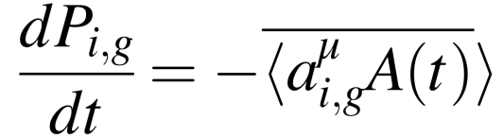
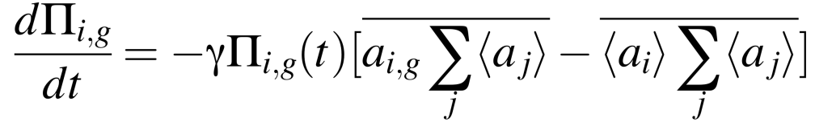
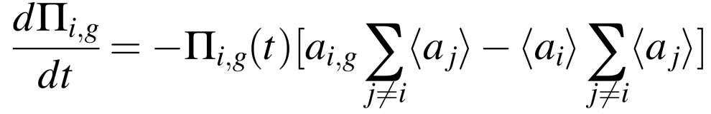

statics
i) Continuous time limit:
Marsili, Challet, Zecchina, Physica A 280,552 (2000)
NOTE: role of the impact
ii) H(Π) is a Lyapunov function for this dynamics Minima of H(Π) Replica method
Transition diverging susceptibility
dynamics
i) Discrete time dynamics + Batch approximation (average over μ)
ii) Generating functional method
Transition anomalous response

Slide 21
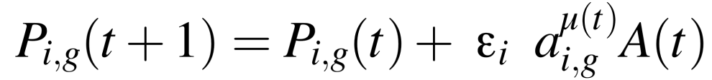
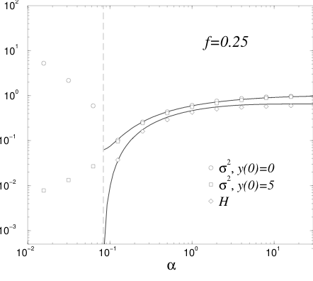
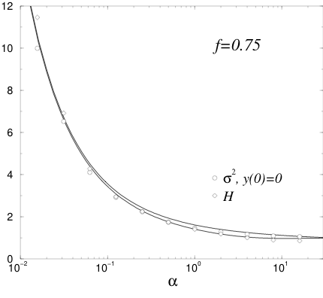
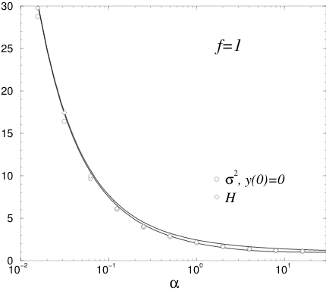
Mixed Minority-Majority Game
De Martino, Giardina and Mosetti, J. Phys. A 36, 8935 (2003)
N f agents play a majority game, N(1-f) a Minority Game
Trend-followers
Fundamentalists/contrarians
ε_{i}
1 for i=1, … N f
-1 for i=N f … N
MINO
MAJO
Trend-followers (majo players) provide exploitable patterns

Slide 22
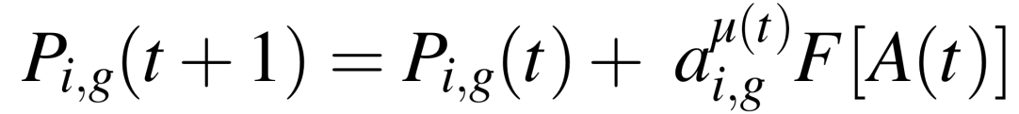
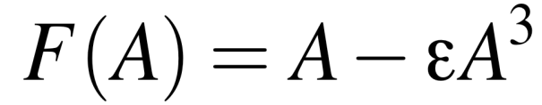



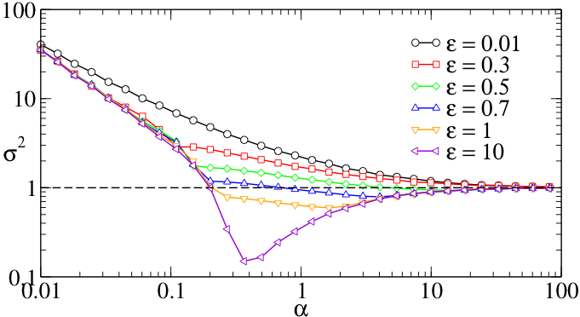
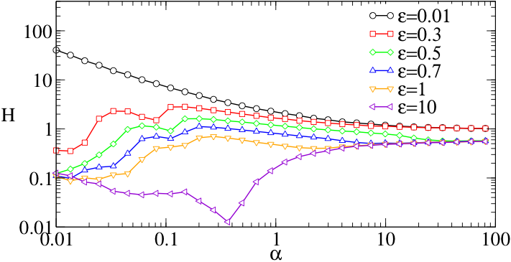
Adaptive trend-followers and contrarians
De Martino, Giardina, Marsili, Tedeschi PRE 70 (2004)
Each agent can switch between contrarian/trend-follower behaviour
Risk threshold
Small excess demand
F(A) ~ A Trend-follower
Excess demand larger than threshold
F(A) ~ - A³ fundamentalist behaviour
small ε small risk perceived
trend-following behaviour
up to large scales
large ε large risk perceived
contrarian behaviour
down to small scales
Smooth crossover from Mino to Majo

Slide 23


From MG to real markets
NO PRICE
no activity fluctuations
Gran Canonical MG
GCMG with speculators + producers reproduces stylized facts BUT
close to the critical point !
Producers provide information, speculators exploit it and at the critical point
the system is marginally efficient
Challet, Marsili & Zhang, 2001
no wealths (stocks/bonds …)
no market clearing

Slide 24







Agent based market models
Bouchaud, Giardina, Mezard, Quant. Finance 1, 212 (2001)
Giardina and Bouchaud, Physica A 299, 28 (2001)
Giardina and Bouchaud, EPJB 31, 421 (2003)
Opinion formation mechanism
Heterogeneous agents with adaptive strategies
Dynamics of the strategies performance
Price dynamics
Wealths (stocks/bonds) evolution
Market clearing and Financial balance
+
Single asset market:
agent i
stocks
Bonds/cash
also inactive strategy !!
return
Action A(t)
Price formation
interest rate
Strategy dynamics
Orders
Matching offer/demand
Wealths update

Slide 25


The relevant parameter is the market impact constant g/λ
i) g/λ < (g/λ)_{c} : bubbles/crashes
ii) g/λ > (g/λ)_{c} : stylized facts
Self-organization ?
Reduce λ - increase g
Small g/λ
Large g/λ
Small execution rates
Small volatility/risk
No trends
Large volatility/risk
Decrease g

Slide 26

Volatility clustering
Empirical evidence: long range volatility correlations activity correlations
Volatility clustering understand what microscopic mechanism generates
the non trivial activity correlations
Agent i: strategy 1 (active) P₁(t)
strategy 2 (inactive) P₂(t)
P(t)
active
P₁
P₂
inactive
t
Survival time of one strategy return time of a random walk
Bouchaud, Giardina, Mezard, Quant. Finance 1, 212 (2001)

Slide 27


Activity variogram
n_{a} = number of active agents
distribution of activity
Universal behaviour
Bouchaud, Giardina, Mezard, Quant. Finance 1, 212 (2001)
Subordination of strategies to performance
Multi-time behaviour of volume/volatility

Slide 28
Conclusions
Systems of many interacting agents can be efficiently described with models
of evolving players with adaptive strategies.
Simple models like the MG can be treated analytically and display a non trivial
collective behaviour different from rational equilibrium
More complex models are needed to appropriately describe financial markets
and reproduce their phenomenology (stylized facts).
Different models suggest that real markets are somehow ‘ close to a critical point `
Simple microscopic mechanims may be responsible of some universal features
observed in real markets.
New agent-based models with a more realistic description of the price formation process

