Slide 1
Evolving Long Run Investors In A Short Run World
Blake LeBaron
International Business School
Brandeis University
www.brandeis.edu/~blebaron
Computational Economics and Finance, 2004
University of Amsterdam

Slide 2
The Importance of Short Horizon Traders
Replicating empirical features
Behavioral evolution
Crash dynamics

Slide 3
“My favorite holding
period is forever.”
Warren Buffett

Slide 4
Overview
Introduction
  Short memory traders
  Finance facts
  Agent-based financial markets
Computer experiments
  Calibration
  Crash dynamics
  Meta traders and survival
  Heterogeneity
Future

Slide 5
Short Memory Traders
Who are they?
Behavioral connections
Early clues

Slide 6
Who Are Short Memory Traders?
Use small past histories in decision making
Short memory versus short horizon

Slide 7
“Our proprietary portfolio of New Economy stocks was up over 80.2% in 1998!”
“At this rate, $10,000 turns into $3.4 million in 10 years or less!”

Slide 8
Behavioral Connections
Gambler’s fallacy/Law of small numbers
Examples
  Hot hands
  Mutual funds
  Technical trading
Is this really irrational?
  Econometrics and regime changes
  Constant gain learning
  Cooling and annealing

Slide 9
Early Clues on the Importance of Memory and Time
Agent-based stock markets
  Levy, Levy, and Solomon (1994)
  Santa Fe Artificial Stock Market (1997)
Practitioners
  Olsen, Dacoragna, Müller, Pictet(1992)
  Peters(1994)

Slide 10
Financial Puzzles
Volatility
Equity premium
Predictability (Dividend/Price Ratios)
Trading volume
  Level and persistence
Volatility persistence
  GARCH
Large moves/crashes
  Excess kurtosis
Arifovic
Brock and Hommes
Levy et al.
Lux
SFI Market
and many others

Slide 11
Agent-based Financial Markets
Many autonomous agents
Endogenous heterogeneity
Emergent macro features
  Correlations and coordination
Bounded rationality

Slide 12
Bounded Rationality
Why?
  Computational limitations
  Environmental complexity
Behavioral connections
  Psychological biases
  Simple, robust heuristics

Slide 13
Desired Features
Parsimony
Calibration
  Multiple features
  Multiple time horizons
Reasonable irrationality
Benchmarks

Slide 14
Overview
Introduction
  Short memory traders
  Finance facts
  Agent-based financial markets
Computer experiments
  Calibration
  Crash dynamics
  Meta traders and survival
Future

Slide 15
Computer Experiments
Quick description
  “Calibrating an agent-based financial market”
Results
  Calibration
  Crashes
  Meta-traders and noise traders

Slide 16
Agents
Portfolio
Rules
Market

Slide 17
Assets
Equity
  Risky dividend (Weekly U.S. Data)
    Annual growth = 1.7%, std. = 5.4%
  Fixed supply (1 share)
Risk free
  Infinite supply
  Constant interest: 0% per year

Slide 18
Agents
500 Agents
Intertemporal log utility (CRRA)
  Consume constant fraction of wealth
  Myopic portfolio decisions
Decide on different portfolio strategies using different memory lengths

Slide 19
Rules/Investment advisors
250 Rules
  Investment advisor/mutual fund
Information converted to portfolio weights
Information
  Lagged returns
  Dividend/price ratios
  Price momentum
Neural network structure
  Portfolio weight = f(info(t))

Slide 20
Rules as Dynamic Strategies
Portfolio weight
1
f(info(t))
0
Time

Slide 21
Portfolio Decision
Maximize expected log portfolio returns
Estimate over memory length history
Restrictions
  No borrowing
  No short sales

Slide 22
Heterogeneous Memories
(Long versus Short Memory)
Present
Return History
Past
Future
2 years
5 years
6 months

Slide 23
Wealth Dynamics
Short
Long
Memory

Slide 24
Agent Rule Selection
Each period: Agents evaluate rules with probability 0.10
Choose “challenger” rule from rule set
Evaluate using agent’s memory
Switch probability determined from discrete choice logistic function

Slide 25
Rule Structure
In Use
Unused

Slide 26
New Rules/Learning
Genetic algorithm
Replace rules not in use
Parent set = rules in use
Modify neural network weights
  Mutation
  Crossover
  Reinitialize

Slide 27
Trading
Rules chosen
Demand = f(p)
Numerically clear market
Temporary equilibrium

Slide 28
Homogeneous Equilibrium
Agents hold 100 percent equity
Price is proportional to dividend
  Price/dividend constant
Useful benchmark

Slide 29
Computer Experiments
Calibrate dividend to U.S. Aggregates
  Random Walk + Drift
Time period = 1 week
Simulation = 25,000 weeks (480 years)

Slide 30
Two Experiments
All Memory
  Memory uniform 1/2-60 years
Long Memory
  Memory uniform 55-60 years

Slide 31
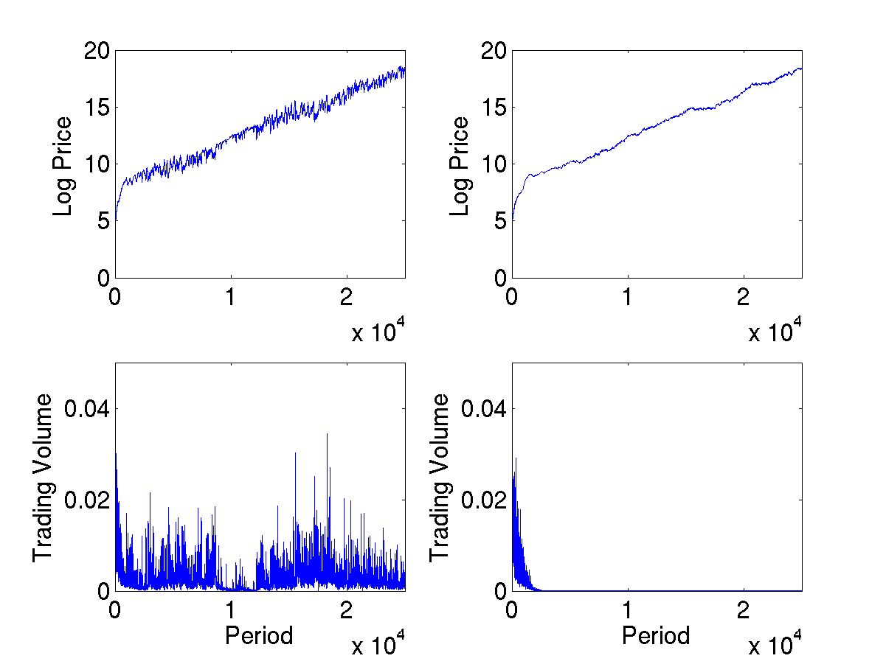
Memory Comparison
All Memory
Long Memory

Slide 32
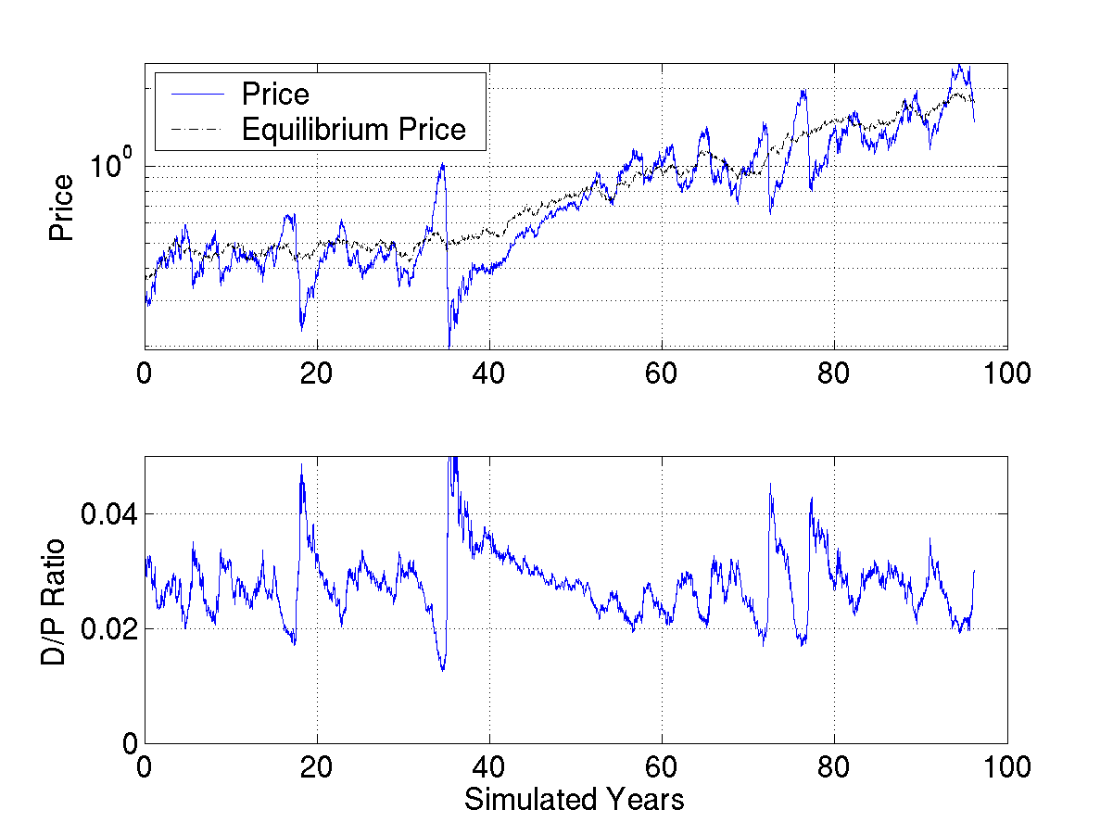
Price Comparison
All Memory

Slide 33
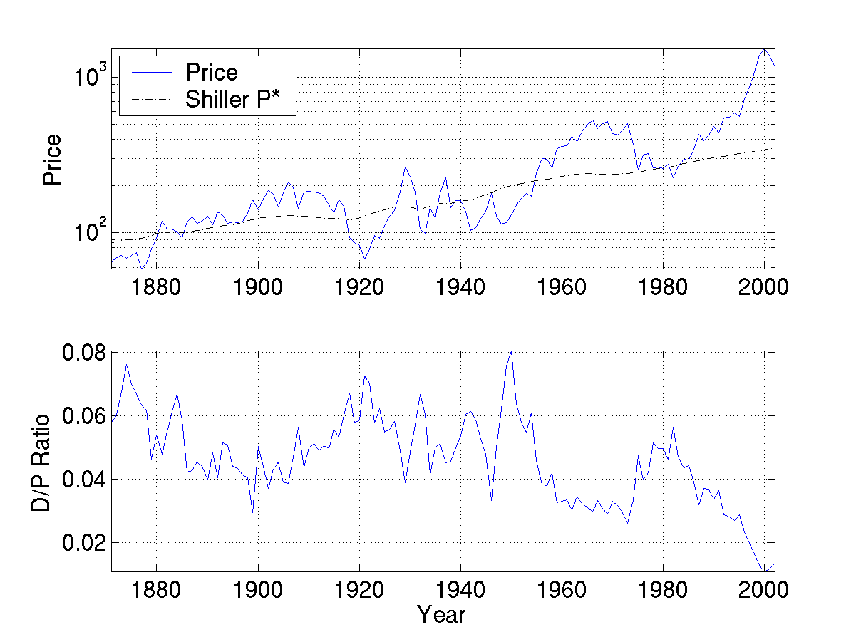
Price Comparison
Real S&P 500 (Shiller)

Slide 34
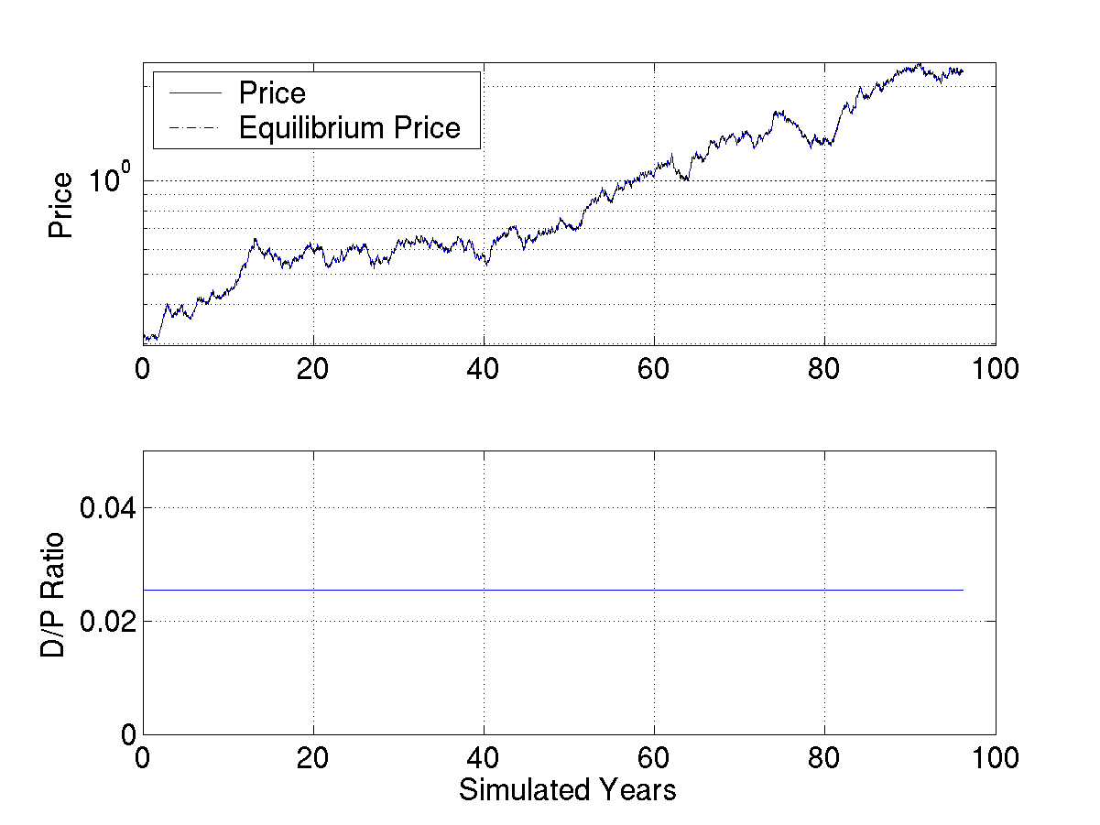
Price Comparison
Long Memory

Slide 35
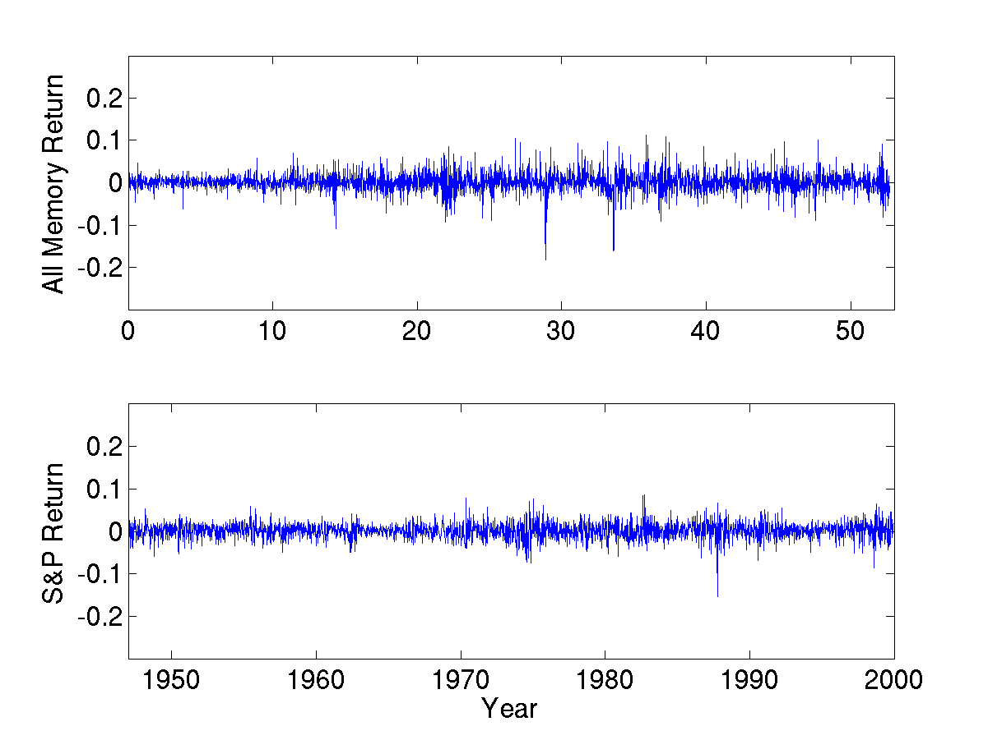
Weekly Returns

Slide 36
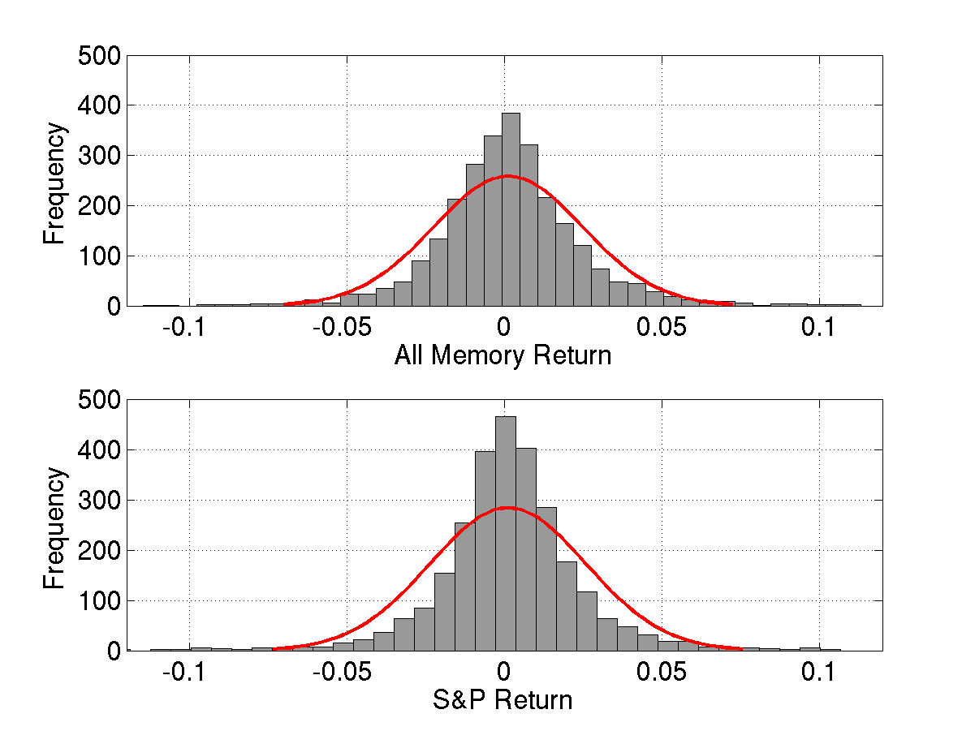
Weekly Return Histograms

Slide 37
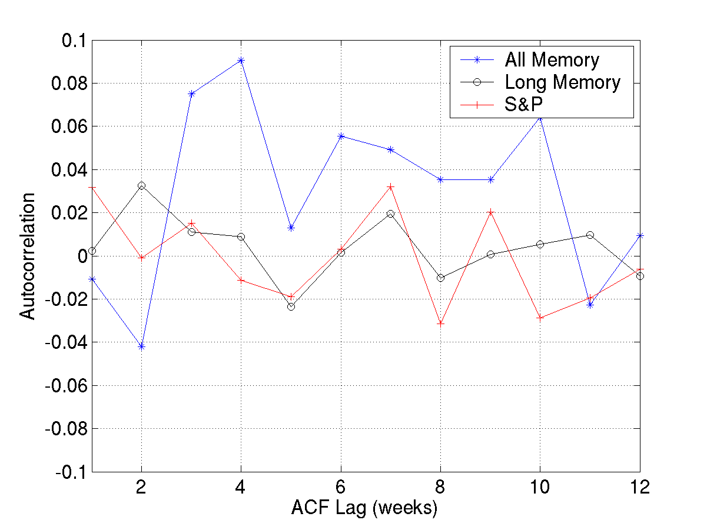
Weekly Return Autocorrelations

Slide 38
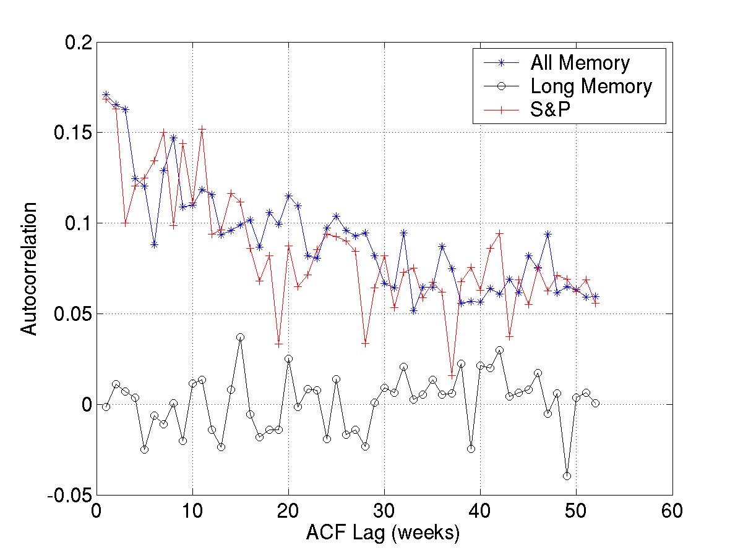
Absolute Return Autocorrelations

Slide 39
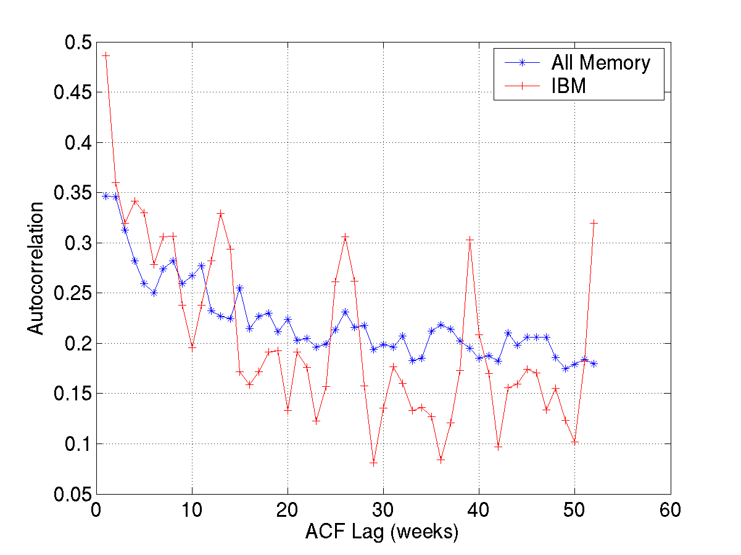
Trading Volume Autocorrelations

Slide 40
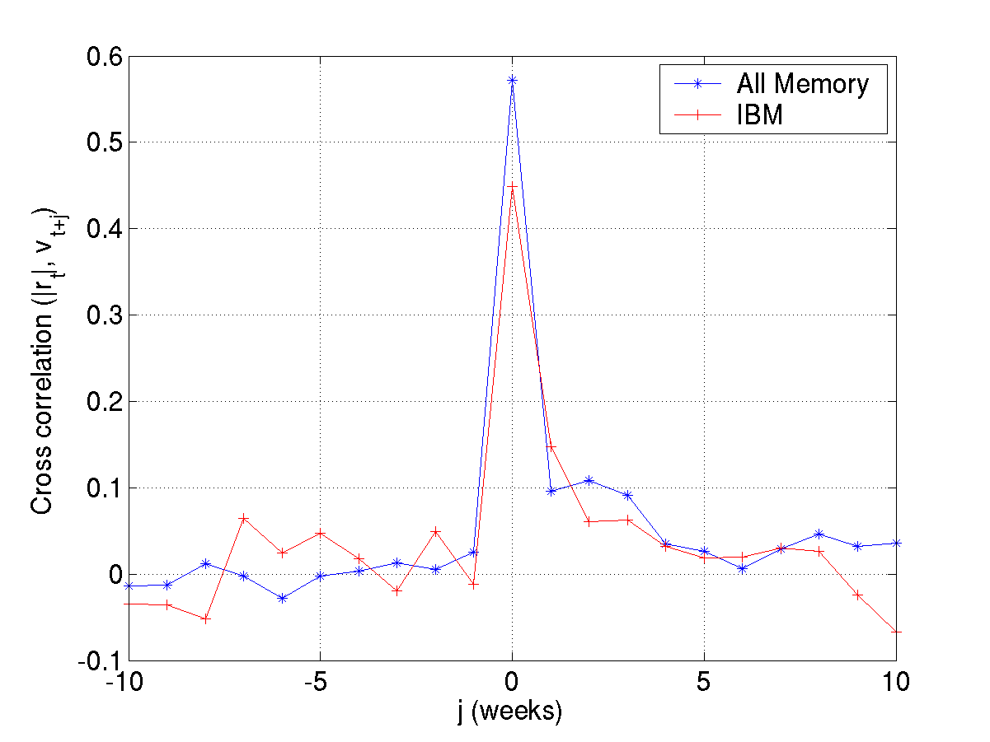
Volume/Volatility Correlation

Slide 41
Weekly Return Summary Statistics
 | All Memory | Long Memory | S&P 500 28-2000
Mean | 0.11% | 0.08% | 0.14%
Std. | 2.51% | 0.75% | 2.56%
Kurtosis | 10.2 | 3.0 | 11.7
VaR(99%) | -7.5% | -1.7% | -7.4%

Slide 42
Annual Excess Return Summary Statistics
 | All Memory | S&P 1871-2000
Mean | 6.8% | 5.8%
Std. | 21% | 18%
Sharpe Ratio | 0.33 | 0.32
Kurtosis | 3.49 | 3.21

Slide 43
Crash Dynamics
Rule dispersion
  Fraction of rules in use
Trading volume

Slide 44
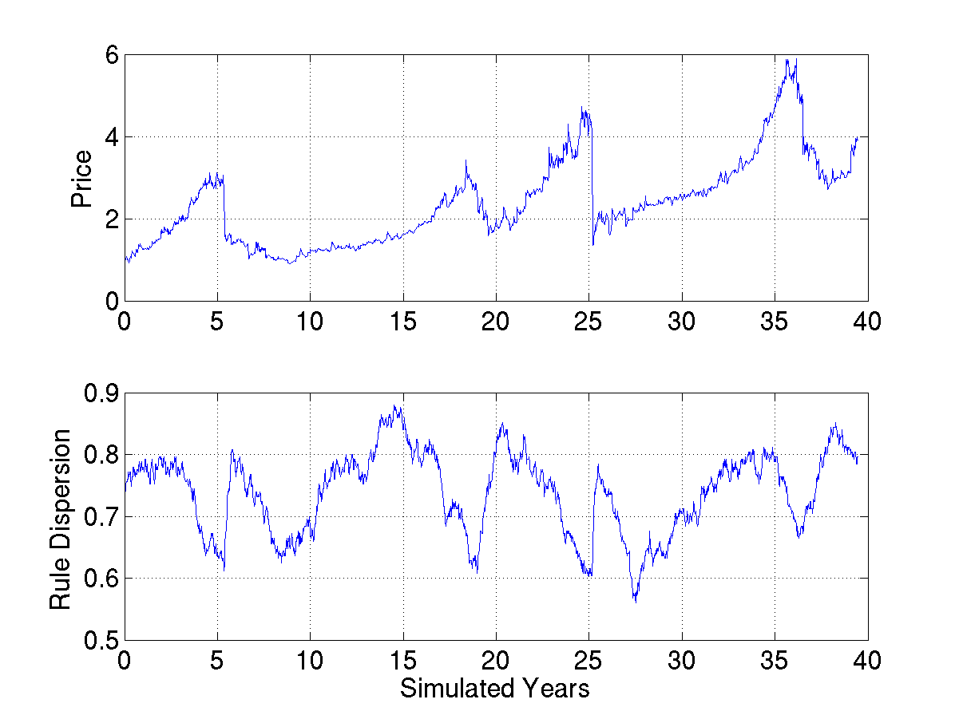
Price and Rule Dispersion

Slide 45
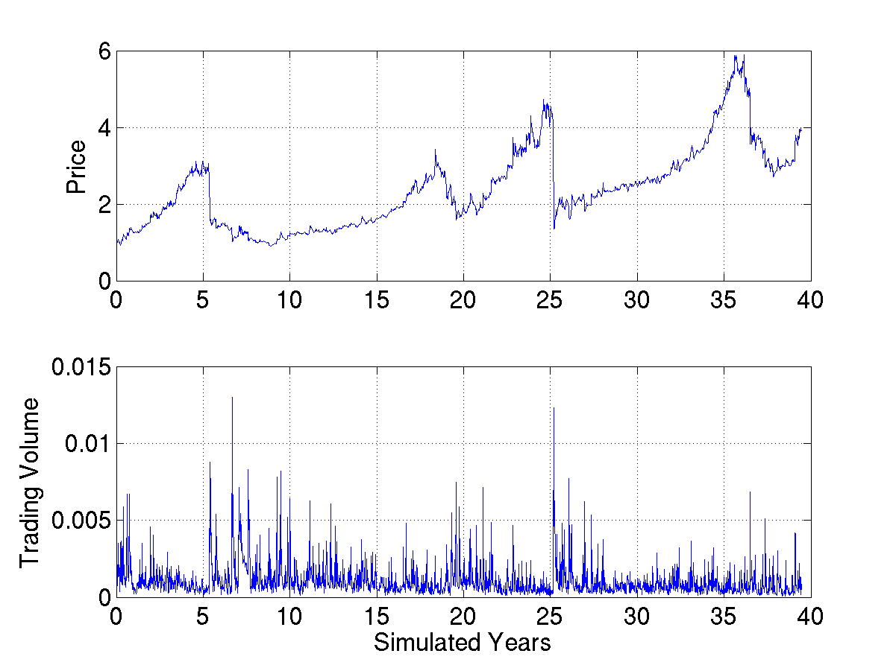
Price and Trading Volume

Slide 46
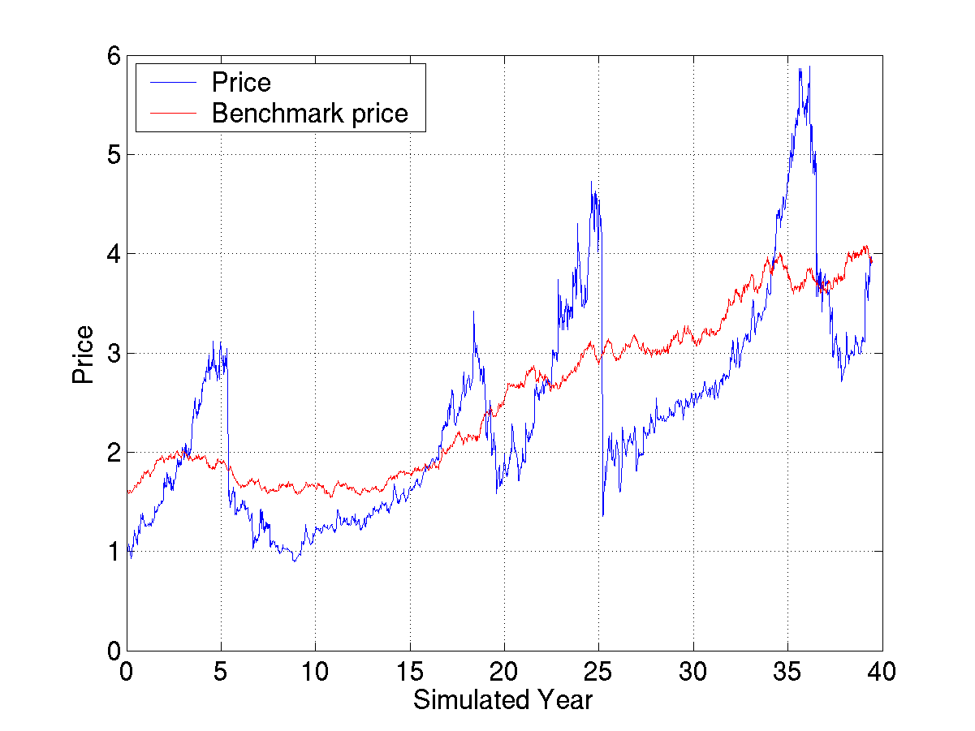
Crash Dynamics
Diversity falls
Consumption
unsustainable
Build up
cash
Short memory
enter

Slide 47
Meta Traders and Noise Trading
Compare buy and hold strategy to current rule population
Log utility versus risk neutral

Slide 48
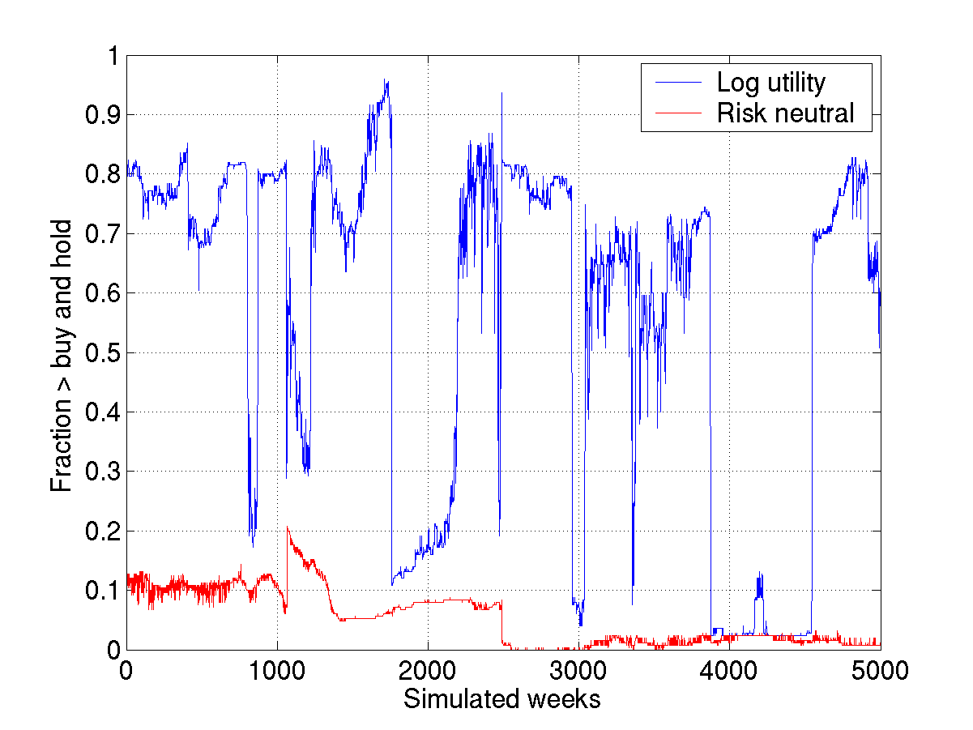
Buy and Hold Comparison

Slide 49
Result Summary
Empirical features
Crash dynamics
Evolutionary stability
  Short memory agents difficult to drive out
  Noise trader risk

Slide 50
Convergence Mechanisms
Eliminate short memory traders
Risk neutral objective
Eliminate crash data points

Slide 51
Future
This model
Validation
Policy
Finance and beyond

Slide 52
This Model
Multi-asset markets
Interest rates
Consumption
Asynchronous events

Slide 53
Validation
Parameters
  Sensitivity
  Endogenize
Extreme events
Experimental comparisons
Prediction

Slide 54
Policy
Trading policies
  Trading mechanisms
  Trading halts/limits
Monetary policy and asset markets
  FX interventions
Social security experiments
Benchmark irrational models

Slide 55
Finance and Beyond
Heterogeneity, noise, and stability
Out of equilibrium strategies and convergence
Behavioral tests
  Aggregation
  Evolution

Slide 56
Final Thought
Time
  Many horizons
Noise
  Noise <-> dynamics
  Endogenous correlations

