Slide 1

AN AGENT-BASED PLATFORM FOR SIMULATING FINANCIAL MARKETS
CSS739 class project under supervision of Robert Axtell
presented for CSS739, May 14, 2008
Notes:
CCR changed title (added “social” for specificity), venue, and date.

Slide 2
Motivation and Objectives

Slide 3
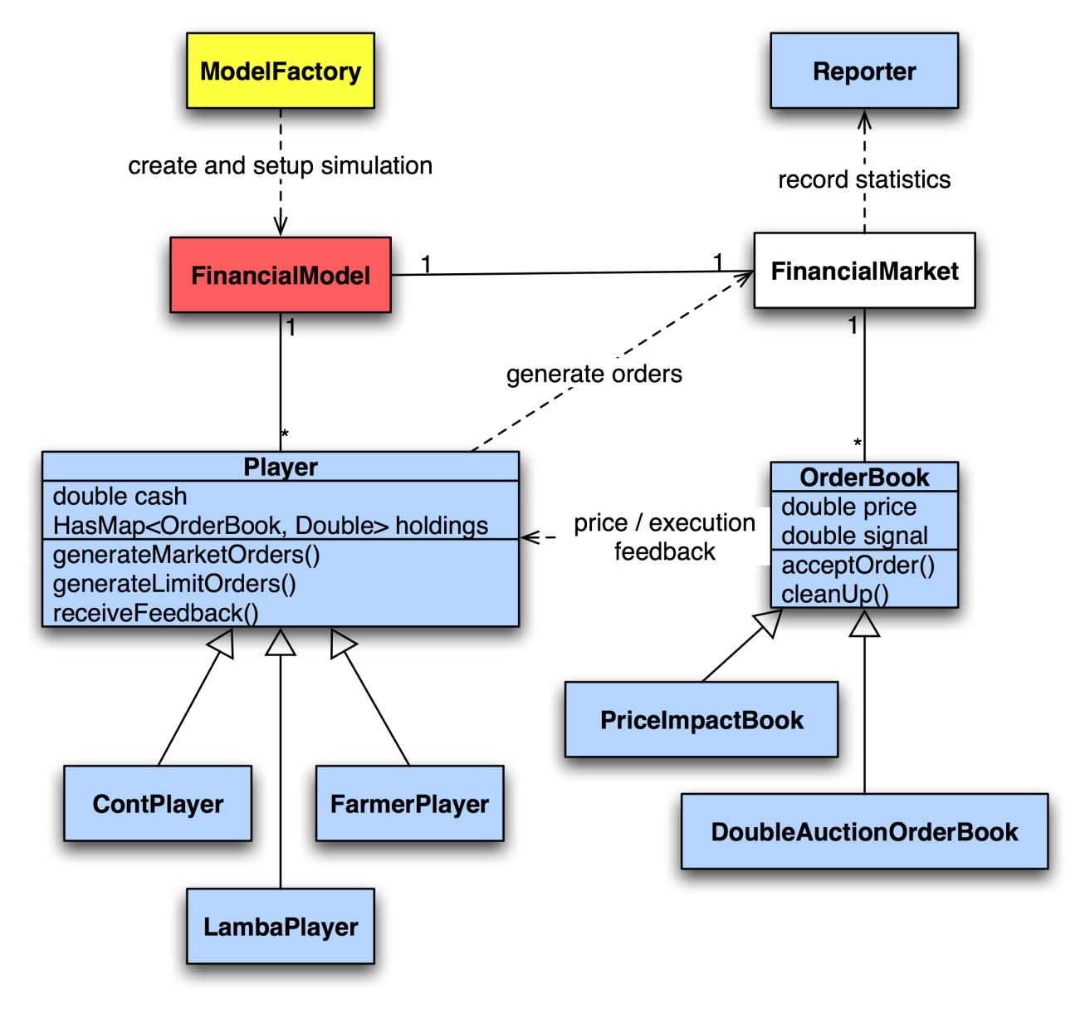
Architecture
Notes:
CCR edite #3 linking to the canonical theory.

Slide 4
Engineering issues
Notes:
CCR: The second decision (Rand<tension) not clear. Rank?
I edited some.

Slide 5
Functionalities

Slide 6
Implementation Verification
Notes:
CCR: The variance Var(t) processes are interesting; damped oscillation? Try adding in red a plot of the standard deviation on the top graph of average tension. For later; after the conference; not for this presentation.

Slide 7
THANK YOU!

