Slide 1

InduSkill
..a site to help Industries & skills
Hack4Society
Team leader:
Mohammad Zeeshan
Team members:
Siddhi Mishra
Afzal Hussin
Ruchika Muddinagiri

Slide 2

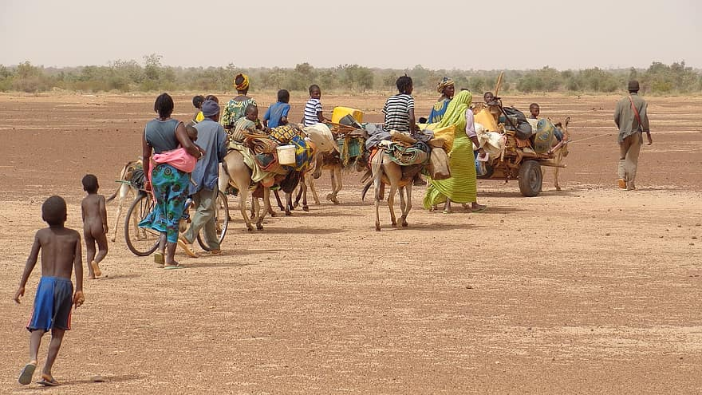
Problem Statement:
category:Social Impact
Description:
Due to Covid ,millions of workers in India have had to migrate from their work. However, now, when the country goes into an unlock phase, it’s a challenge for industries to find skilled workers for their industry as well as for workers having basic labour skills like sewing/welding/mechanics etc.
Taking the current situation in mind, we have hundreds of websites available where educated people can apply but for the workers having skills like this, they have only one way to go: to middle man(agent) who takes hefty commisions from them. Also, industries have to charge those people to get some workers.

Slide 3

Proposed Solution:
(provide platform to connect the industries to skilled workers)
We propose to build a website Induskill( industry & skill)
As follows: Induskill is a platform to provide help and support to skilled workers to find suitable industries with their preferred location and salary. Additionally, we provide assistance to industries to find workers with appropriate skillsets. Our aim is to provide a conection between industries and skilled workers. We also invite NGOs and government organisations to collaborate with us in our mission.

Slide 4
Website flow proposed:
Firstly, a candidate looking for a job or NGO/govt org fills details and similarly industries also can post their requirements on our website.
We provide recommendations according to skill/location and provide industries with details of people's having those skills
We are also planning to send the details of industries in which people are eligible on their phone via sms.

Slide 5
Milestones
Build Tech Stack
Backend Development
Design frontend
Testing & Submission
Work on technical stack required to attain website goal.
Translate text within an app
1st phase |  |  |  | 2nd phase
Based on the idea,create outlet of project
Test the website for some demo data and submit the project

Slide 6


