Slide 1
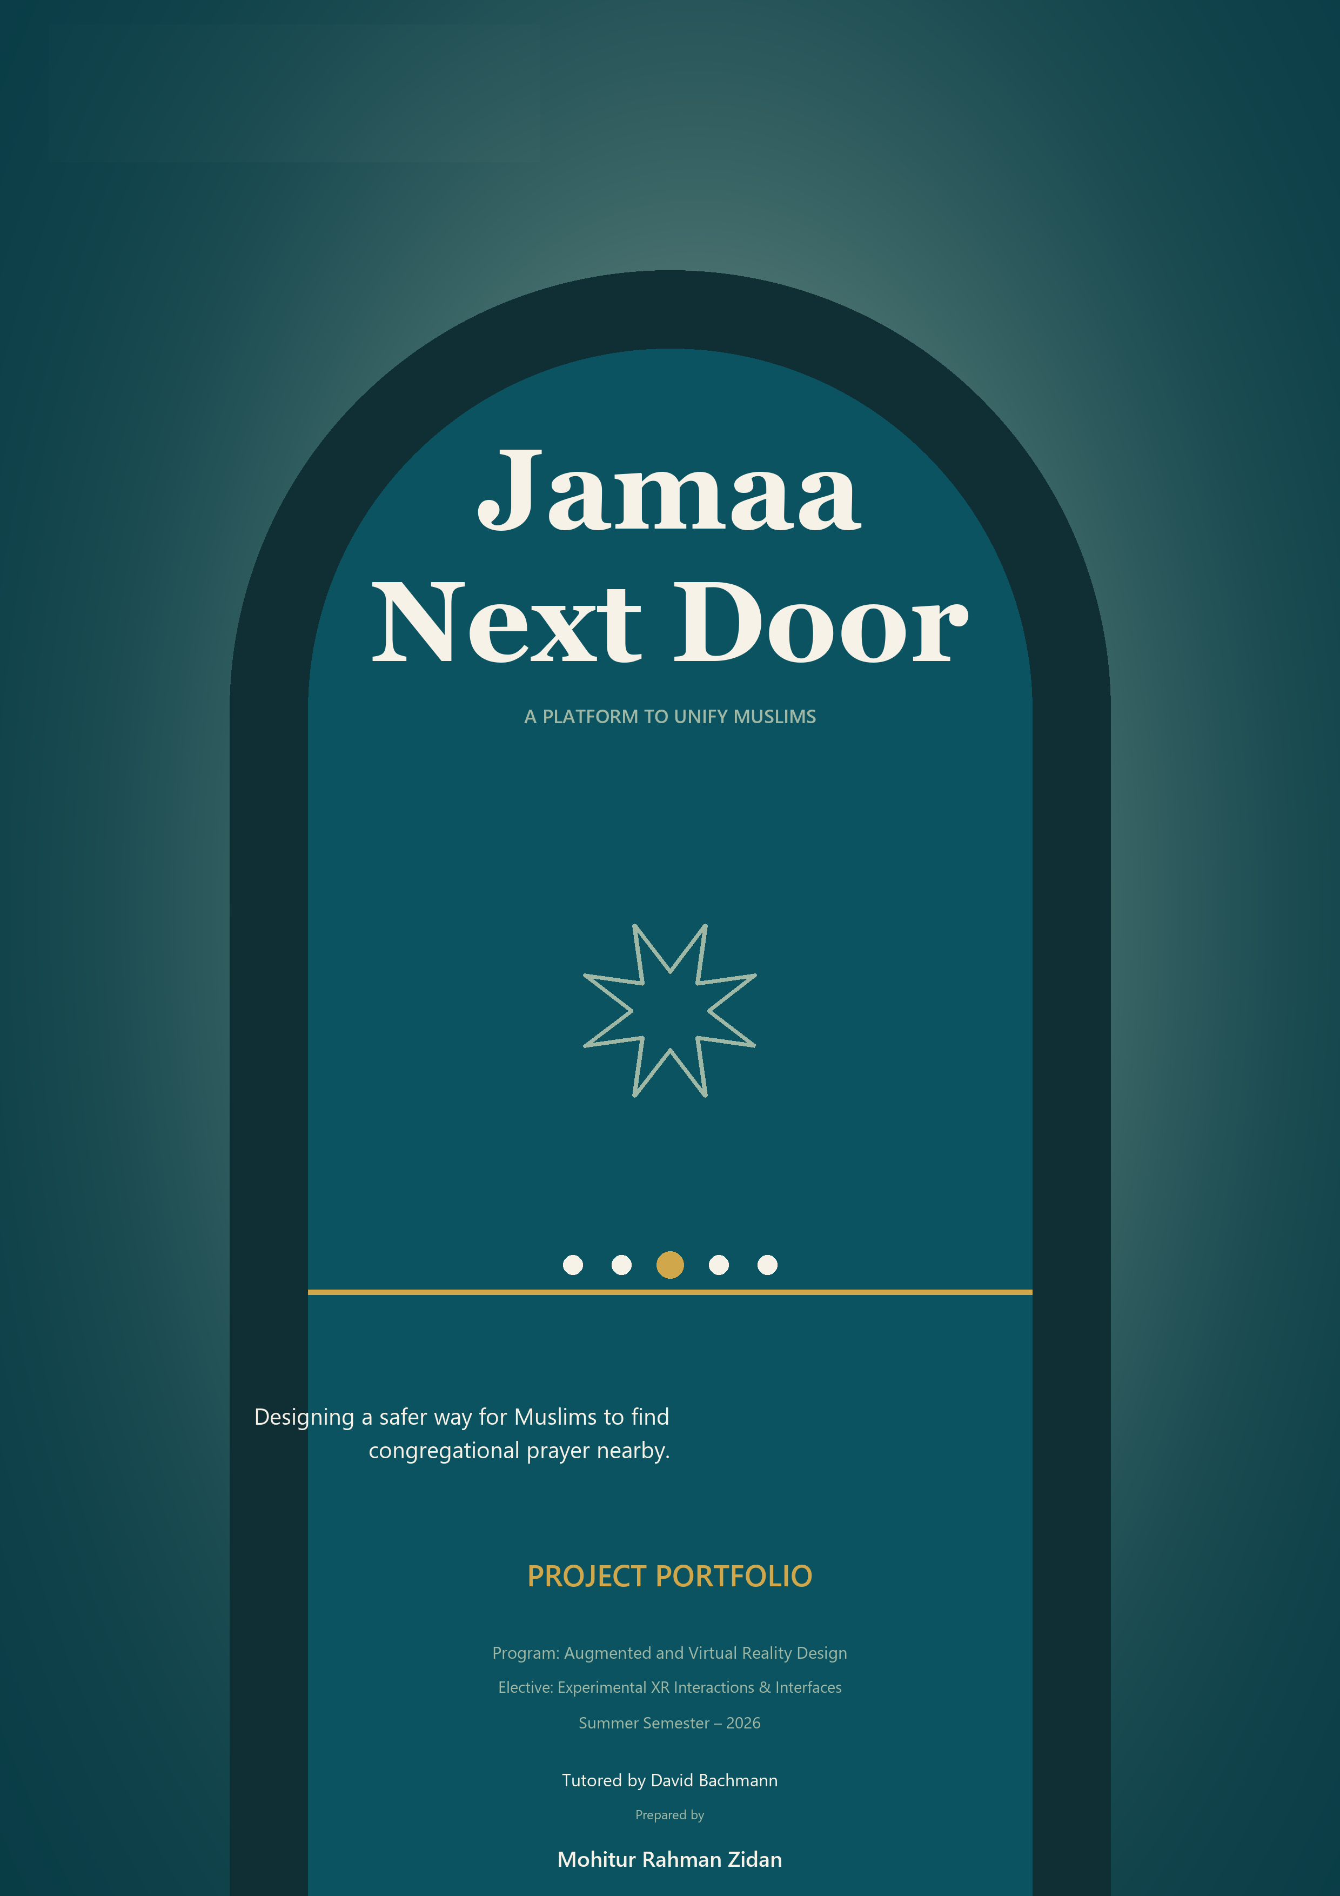
Jamaa Next Door
A platform to unify Muslims
PROJECT PRESENTATION
Mohitur Rahman Zidan
Augmented and Virtual Reality Design
Experimental XR Interactions & Interfaces
Summer Semester - 2026
Tutored by David Bachmann
Notes:
Open with the project name and mission. Establish that the presentation will connect a personal need to a working, responsibly designed Android prototype.
[Sources]
- Project portfolio cover artwork: output/documentation/cover-variations/jnd-cover-05-atmospheric-arch-portfolio.png
- Project metadata supplied by Mohitur Rahman Zidan.

Slide 2
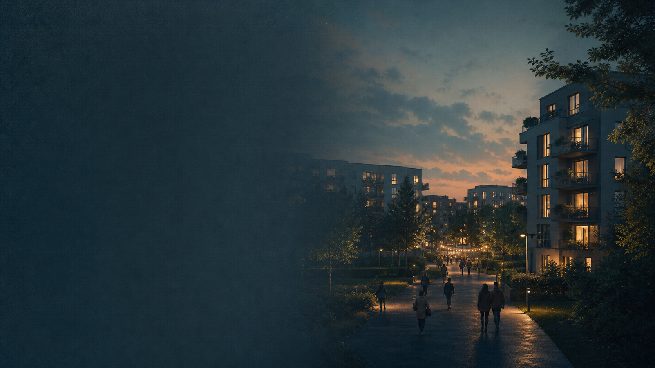
02
The idea began with religious isolation
For two months, I lived in Germany without a mosque nearby.
Muslims lived around me, but there was no simple way to find each other for congregational prayer.
Could nearby Muslims coordinate safely when the mosque is inaccessible or its Jama'ah has already passed?
JAMAA NEXT DOOR
02
Notes:
Explain the two-month experience and why the absence of coordination felt painful despite Muslims living nearby. Use the final question to transition from personal experience to a design problem.
[Sources]
- Personal account supplied by Mohitur Rahman Zidan.
- AI-generated editorial illustration created for this presentation; no identifiable persons depicted.

Slide 3
03
The gap is coordination, not always the absence of people
ACCESS
TIMING
No nearby mosque or religious center
Work, classes, meetings or travel
Missing
Jama'ah
AWARENESS
TRUST
Muslims may be nearby but disconnected
Location and identity cannot be exposed carelessly
Worker / Student / Traveler / New arrival / Local host
JAMAA NEXT DOOR
03
Notes:
Frame the problem as a coordination gap shaped by four constraints. The five situations show that the need is broader than one demographic or routine.
[Sources]
- Problem framing derived from the project portfolio and user-provided motivation.

Slide 4
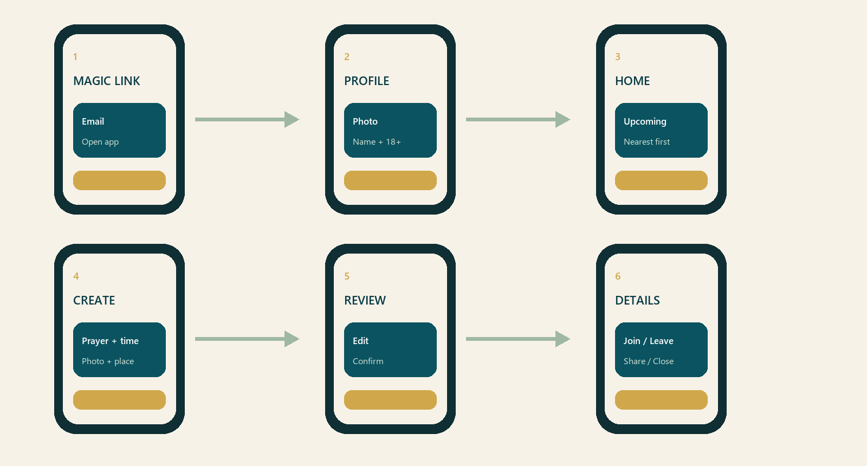
04
The prototype turns the need into a time-bounded journey
One central flow carries the user from trust-building access to a gathering that ends at its scheduled time.
REVIEW + CONFIRM
AUTOMATIC END
JAMAA NEXT DOOR
04
Notes:
Walk through the journey at a high level before discussing individual UX and technical decisions. Emphasize review before publication and automatic ending as deliberate safeguards.
[Sources]
- Project portfolio, page 19: product-flow graphic.

Slide 5
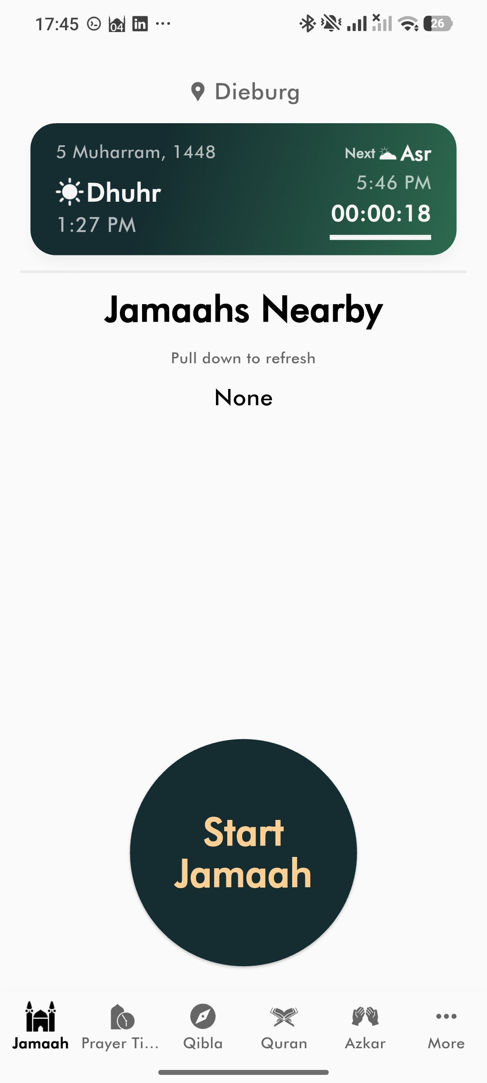
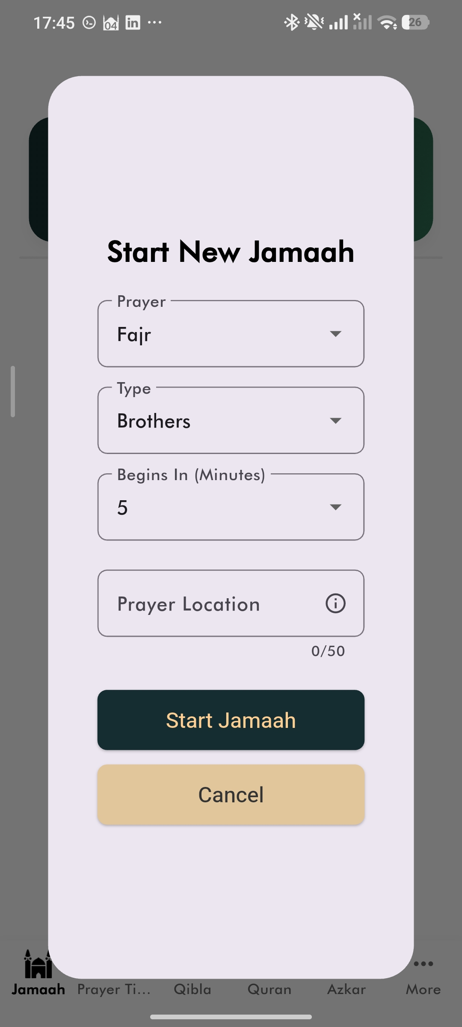
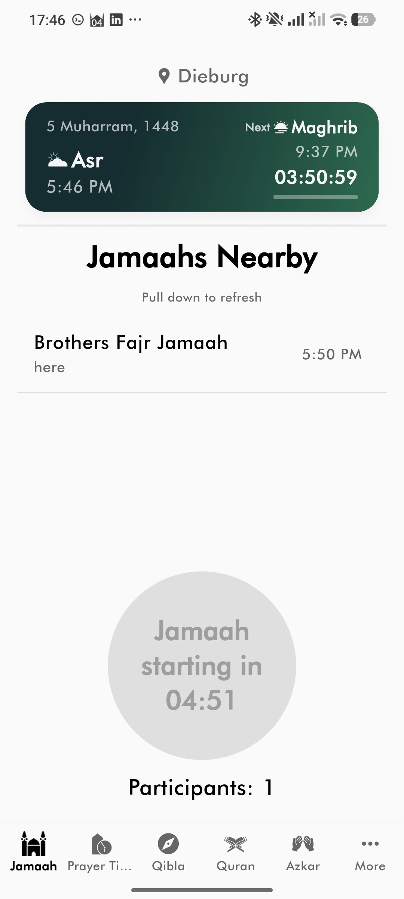
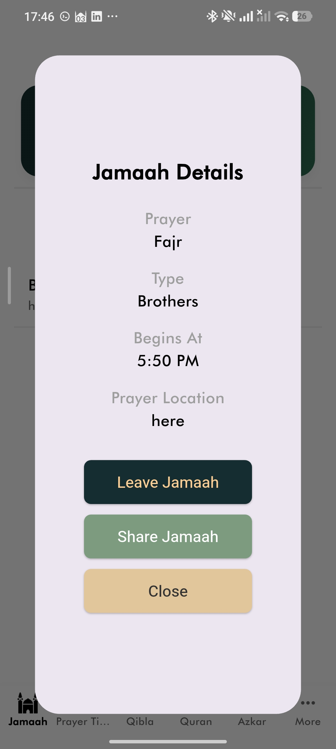
05
Reference interactions clarified the missing transitions
REFERENCE APPLICATION INTERACTION STUDY
ADAPTED FOR JAMAA NEXT DOOR
Review before publication
Time-sorted discovery
Bottom-sheet details
Role-based actions
Privacy-controlled location
Home action
Creation form
Published nearby item
Contextual details
JAMAA NEXT DOOR
05
Notes:
Make clear that these screens belong to a reference application. Explain that observing the transitions helped identify what the Jamaa Next Door flow still needed, while the final behavior was adapted for privacy and role-based participation.
[Sources]
- Research/App Interface and Interaction.pdf. Reference application screenshots are visibly labeled and are not Jamaa Next Door screens.

Slide 6
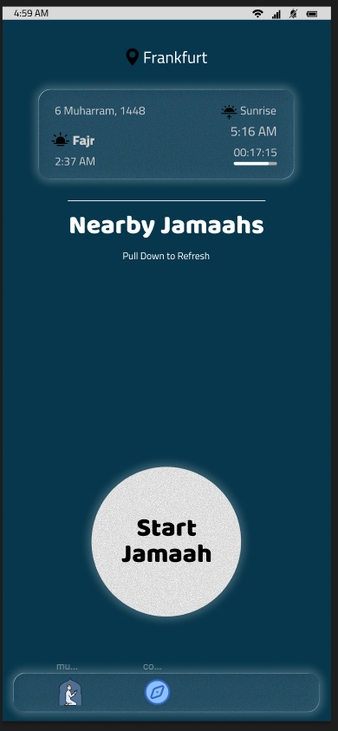
06
The visual language moved toward calm, human trust
EARLY
CURRENT
Prayer and countdown remained priorities. The hierarchy became quieter, the language more explicit, and privacy more visible.
Frankfurt am Main
Nearby prayer
Jama'ah
Approximate locations remain private.
Upcoming Jama'ahs
Human, not generic
Dhuhr
3 joined
Calm, not technical
12:45
Asr
1 joined
Specific, not decorative
Start
Jama'ah
16:30
Trust visible in language
Current prototype reconstruction based on implemented UI
JAMAA NEXT DOOR
06
Notes:
Contrast the early Figma screen with the current implemented hierarchy. Acknowledge the teacher's request for a more human, authentic visual identity and show how language, spacing and trust cues were refined.
[Sources]
- Research/Figma Home interface.png.
- Current prototype reconstruction based on apps/mobile/app/(tabs)/jamaahs.tsx and apps/mobile/src/theme/tokens.ts.

Slide 7

07
Location makes privacy part of the product architecture
PUBLIC DISCOVERY
Prayer and start time
APPROXIMATE
PUBLIC ZONE
Approximate area
Participant count
EXACT
PARTICIPANT ZONE
PROTECTED ACCESS
Exact address
Location image
Participant-only information
BACKEND ENFORCEMENT
Private Storage / RLS / authenticated functions / reports, blocks and deletion
JAMAA NEXT DOOR
07
Notes:
Present privacy as functionality: discovery is useful without revealing exact meeting data, and protected fields are controlled server-side rather than merely hidden in the interface.
[Sources]
- Project portfolio privacy model and implemented Supabase policies.
- AI-generated abstract privacy/proximity background created for this presentation.

Slide 8
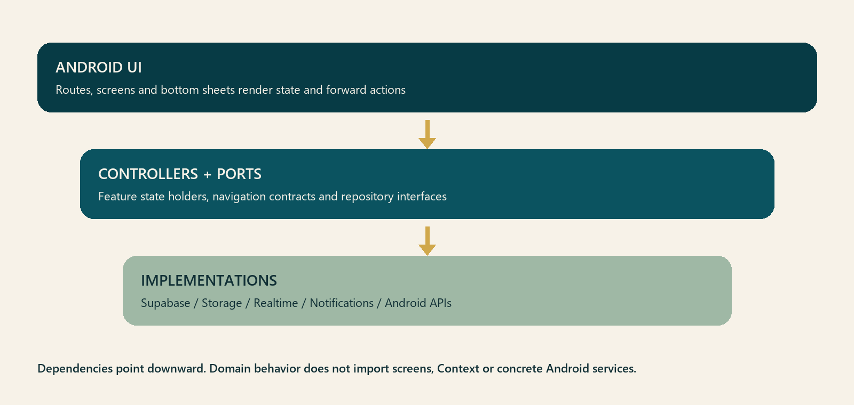
08
A standalone APK connects focused mobile layers to Supabase
ANDROID UI
FOCUSED MOBILE LAYERS
SERVICE IMPLEMENTATIONS
APK
Expo React Native + TypeScript
Expo Router + deep links
Controllers, state holders
and repository interfaces
Supabase Auth, PostGIS, RLS,
Realtime, Storage + notifications
JAMAA NEXT DOOR
08
Notes:
Explain the one-directional dependency boundary: screens render and forward actions, feature logic owns state transitions, and repositories isolate Supabase and Android services. Finish by pointing to the signed standalone APK.
[Sources]
- Project portfolio, page 14: technical architecture.
- Project source: apps/mobile/src/services/app-dependencies.ts and apps/mobile/src/ports/.

Slide 9
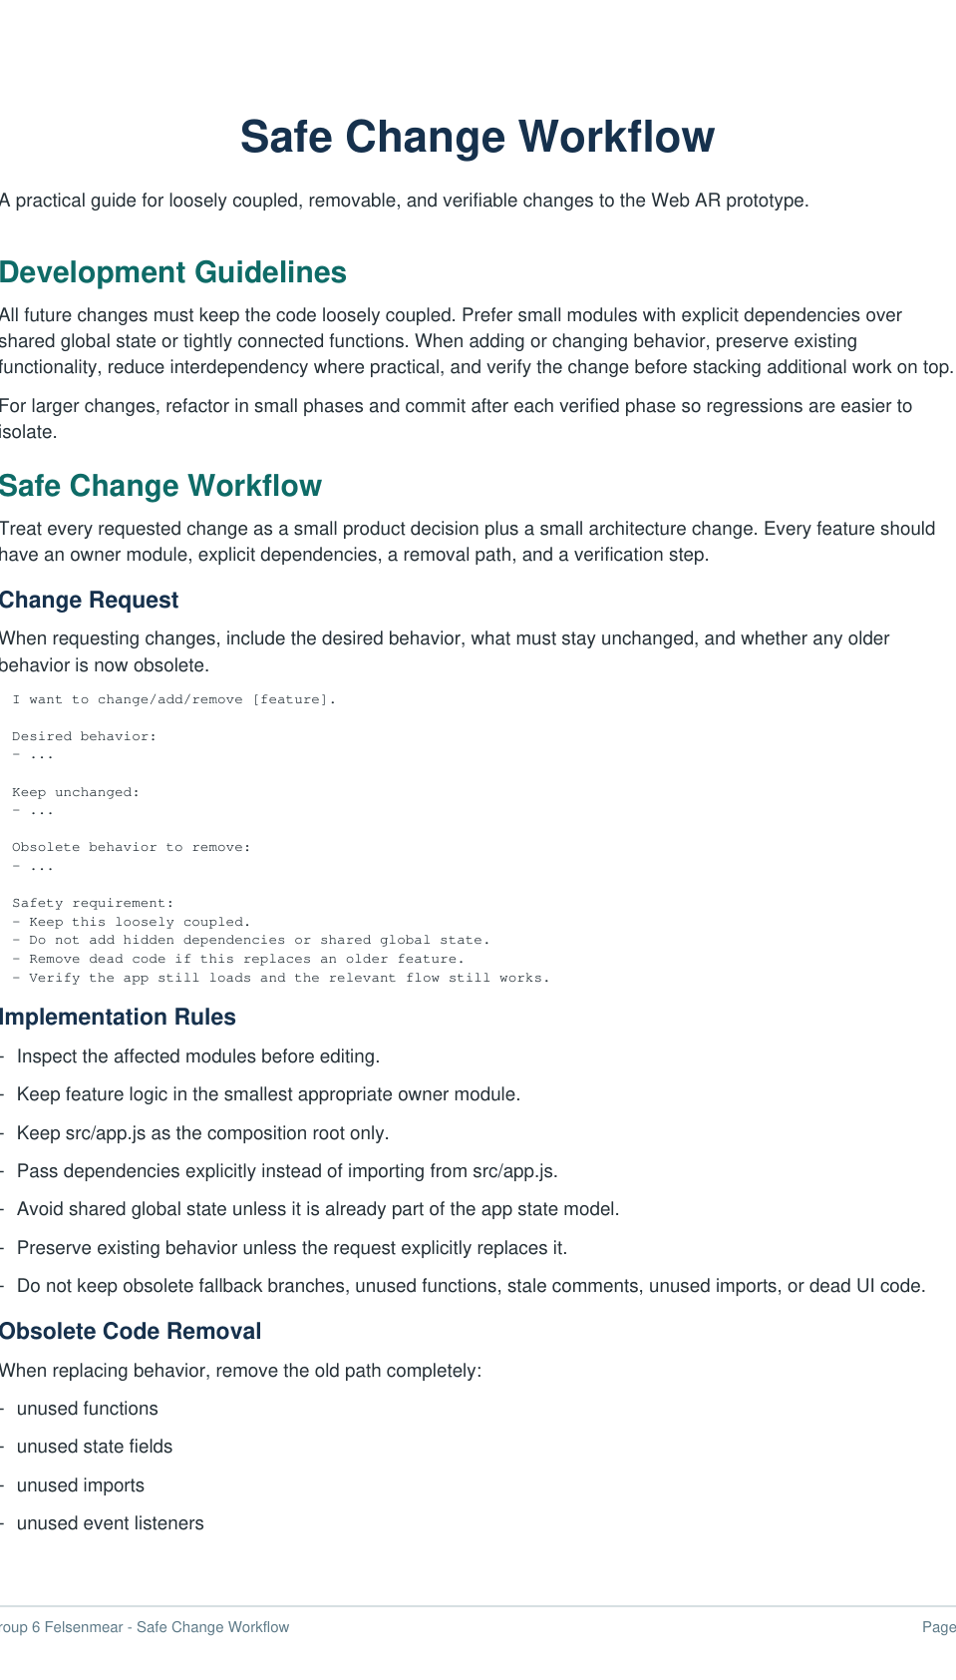
09
AI became useful when requests became controlled specifications
BROAD REQUEST
BOUNDED CHANGE
VERIFIED IMPLEMENTATION
Feature idea
Screenshots
Written description
Desired behavior
Keep unchanged
Obsolete behavior
Owner module
Syntax + imports
Smoke test
Device reproduction
Regression check
Prompting became an engineering control rather than a request for automatic output.
Safe-change template crop
JAMAA NEXT DOOR
09
Notes:
Describe the shift from broad prompting to bounded specifications. The key learning is that AI became reliable when the request defined scope, ownership and verification rather than asking for unsupervised output.
[Sources]
- Research/safe-change-workflow.updated.pdf, page 1.

Slide 10
10
Reusable prompts made different kinds of changes safer
ADD
Owner module + explicit dependencies
CHANGE
Preserve specified behavior + remove obsolete branches
REMOVE
Delete logic, state, UI, imports + stale documentation
FIX
Reproduce -> root cause -> focused regression check
REFACTOR
Preserve public behavior + separate incrementally
Observed behavior: ...
Expected behavior: ...
How to reproduce: ...
Identify the root cause before editing.
KEEP UNCHANGED
VERIFICATION
JAMAA NEXT DOOR
10
Notes:
Use the five verbs to show that different change types require different safety constraints. For fixes, quote the root-cause-first excerpt and explain why 'keep unchanged' and verification became mandatory fields.
[Sources]
- Research/safe-change-workflow.updated.pdf, pages 1-3. Exact prompt wording is adapted into visible excerpts.

Slide 11
11
Direct access shortened the feedback loop
DEVICE EVIDENCE
> adb devices
> adb install -r jamaa-next-door.apk
> adb logcat | findstr AuthSession
Magic-link callback
Crypto compatibility
Blank details route
06
Rebuild -> install -> verify
05
Browser-assisted setup
04
Device logs + reproduction
03
Direct APK installation
02
USB debugging + ADB
BROWSER-ASSISTED CONFIGURATION
01
NAMECHEAP -> RESEND -> SUPABASE
DNS records SMTP domain Auth redirects
Screenshots + written reports
JAMAA NEXT DOOR
11
Notes:
Explain how direct observation replaced guesswork: connect the phone, install the APK, reproduce the issue, inspect logs, then verify the same path. Mention magic-link routing, the missing profile action, the crypto error, blank details, and browser configuration without exposing credentials.
[Sources]
- Project development chronology supplied by Mohitur Rahman Zidan.
- Local project evidence: Android package com.zidan73.jamaanextdoor and EAS/APK build outputs.

Slide 12
12
The working prototype proves the central journey
Review Jama'ah
Create and confirm
PRAYER
Dhuhr
STARTS
12:45 today
LOCATION
Frankfurt-Bockenheim
PHOTO
Location image attached
APPLICATION WALKTHROUGH
60-90 seconds
Portrait H.264 MP4
Embedded for offline playback
Return to the
time-sorted home
Open details and
participation actions
A poster frame remains visible if playback is unavailable.
Confirm Jama'ah
Edit
JAMAA NEXT DOOR
12
Notes:
Replace the central poster with the final embedded 1080 x 1920 H.264 walkthrough before presentation. Demonstrate home, creation, prayer/time selection, location image, review, confirmation, refreshed home, details sheet, participation actions and Close. Keep the poster frame as the media fallback.
[Sources]
- Walkthrough sequence defined from the implemented application flow. No walkthrough MP4 was available during deck generation.

Slide 13
13
The prototype works; trust still requires real-world validation
WORKING
Standalone APK
STILL REQUIRES VALIDATION
Magic-link authentication
Upcoming Jama'ahs
Structured user testing
Profile setup
Transparent moderation policy
Create + confirm
Dhuhr Jama'ah
00:11:42
Professional selfie-verification decision
Time-sorted discovery
Starts
12:45 today
Approximate area
Frankfurt-Bockenheim
Participants
3
Details bottom sheet
Arabic and right-to-left design testing
Leave Jama'ah
Participation actions
Share Jama'ah
Production monitoring and safeguarding
Automatic ending
Close
Current prototype reconstruction
JAMAA NEXT DOOR
13
Notes:
Be explicit about what works and what remains unresolved. The prototype proves the central journey, but responsible release still depends on user testing, moderation transparency, verification policy, RTL design and ongoing safeguarding.
[Sources]
- Project source and current implementation status.
- Teacher feedback supplied by Mohitur Rahman Zidan.

Slide 14
Personal need became a responsible, verifiable product
Personal motivation
Jamaa Next Door demonstrates that local coordination can reduce religious isolation when privacy, timing and trust are treated as part of the functionality.
Trust-aware product design
Working Android implementation
AI-assisted, human-directed process
Questions
Notes:
Resolve the opening story: a personal need became a product whose central journey is implemented and whose risks are treated as design constraints. Invite questions without adding a generic thank-you slide.
[Sources]
- Conclusion synthesized from the project portfolio, implemented prototype and user-provided motivation.
- Project portfolio cover artwork reused as a visual bookend.

