Slide 1
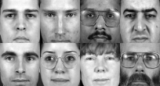
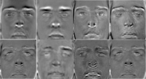
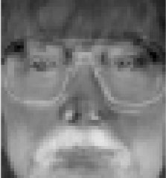
A Face Authentication System
Introduction
Facial recognition is the identification and recognition of noticeable characteristics of a human face. In the field of image analysis it is leading the race in research as its speed and versatile application out weights previous methods. It is less invasive than other biometrical analysis methods like retinal and finger print recognition with less hardware requirements. Human to computer authentication is an integral functionality of many software systems as it manages data or location security.
This report explores the application of face recognition and its effectiveness as an authentication system using the open vision library developed by IBM. The recognition algorithm uses Viola-Jones methodology of classification to detect the users face using a trained Haar classifier. PCA (Principal Component Analysis) is then used to train image sets to reduce data representation and extract a given range of Eigen values. Derived Eigen faces are compared and accepted when falling within a given threshold of deviation from a set of trained data’s average Eigen face.
Application
Face Detection
The OpenCV library offers the use of trained Classifiers that extract Haar like features from the subject image using Viola-Jones methodology of object detection [1]. These classifiers have been taught to detect a specific feature of the human face with the use of linear mathematical observation which recognize objects.
PCA (Principal Component Analysis) methodology is used to reduce the representation of image data which will allow comparing data during recognition to be executed much faster and more efficiently. PCA and recognition is used in other technical analysis fields such as voice recognition and medical image analysis. Essentially PCA derives the most dominant principal components of an images data within in given range which construct Eigen faces. Figure 1 illustrates a sample set of images drawn from the xm2vts face database [2].
Face Recognition
Once the input image has been added to the training data and re-trained the input images Eigen Face can be scored by calculating the Euclidean distance [3]. The smaller the distance the higher the similarity in facial features. This score is compared to the scores of the mean Eigen face and multiplied by the number of Eigen faces. If the comparison results fall between set thresholds the associated image is return as a successful match.
PCA (Principal Component Analysis)
Eigen Faces
Figure 1. Sample image set from XM2VTS
Figure 2. Calculated Eigen faces
Figure 3. Reconstructed Mean Eigen Face
References
OpenCV Documentation, “Haar like Features” (31/03/2016). [online] http://docs.opencv.org/2.4/modules/objdetect/doc/cascade_classification.html
XM2VTS Face Database (September 4, 2006). [online] http://www.idiap.ch/resource/faceverif/
ArcGIS, Calculating the Euclidian distance (May 2, 2007). [online] http://webhelp.esri.com/arcgisdesktop/9.2/index.cfm?TopicName=Understanding_Euclidean_distance_analysis
Acknowledgements
Hong Wei. Project support and supervision.
Degree programme
BSc Computer Science with industrial year

