Slide 1
Final Year Project
SE3IP11
Tom Bedford
A Face Authentication System

Slide 2
Introduction
A Face Authentication System developed by Tom Bedford.
Developed using JavaFX and Open CV.
Core technologies: Face detection and recognition with threshold acceptance.
Main algorithm of the system uses PCA (Principal Component Analysis).
Eigen Decomposition used to reduce data representation and extract unique facial features.
Threshold matching to verify recognition.

Slide 3
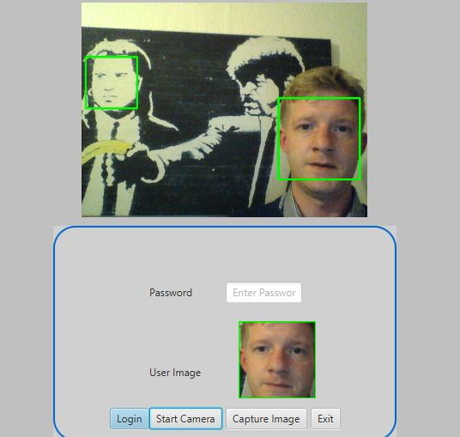
Application FEATURES
Login Screen
The login screen provides an area where trained and learnt users can test login face authentication on login.
Customise Database Screen
This interface provides functionality so that a user can capture user images and develop a customised database for training or append an existing database.
Training Screen
The main interface which allows a user to load, train and save trained data sets.
preview of login Screen

Slide 4
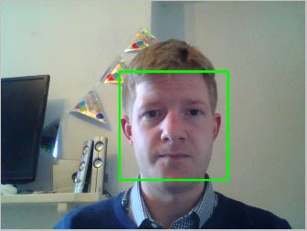
Face Detection
Haar-like feature extraction using trained Haar Cascade Classifier provided by the Open CV library.
Detection success rate of 92% with frontal facing faces within an offset of 45 degrees.
Robust classifier can successfully detect faces from inanimate images.

Slide 5
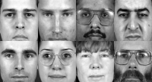
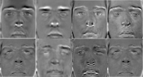
Face recognition
Data set is first normalised to standardise calculations.
Covariance matrix calculated.
Eigen vectors and the according values are calculated using PCA (Principal Component Analysis).
Custom built PCA class using third party libraries Jama and Apache Math library.
set of images extracted from xm2vts database
Computed Eigen faces

Slide 6
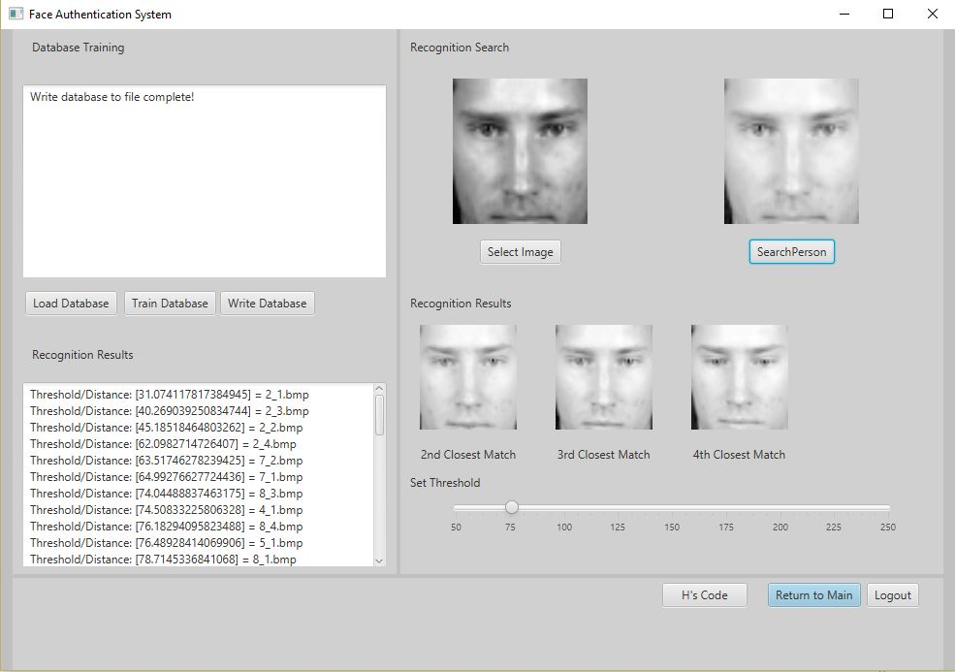
Threshold Matching
Search image Eigen values are calculated.
Results compared to average Eigen Face too determine the best match within a set threshold.
Adjustable thresholding to combat illumination changes of environment.

Slide 7
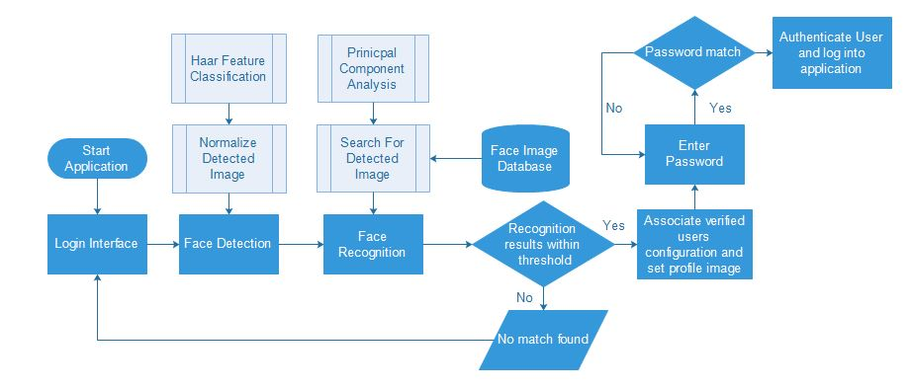
Application Design
System Overview

Slide 8
Conclusion
Through testing it was found that one of the biggest challenges for the system is changes in illumination.
This system can be used to accommodate an existing authentication system.
Can be effectively used as a stand alone recognition system to deliver custom messages, sessions or experiences.
However, as the system can be spoofed it should not be used on its own to access sensitive data.

Slide 9

Questions

