Slide 1
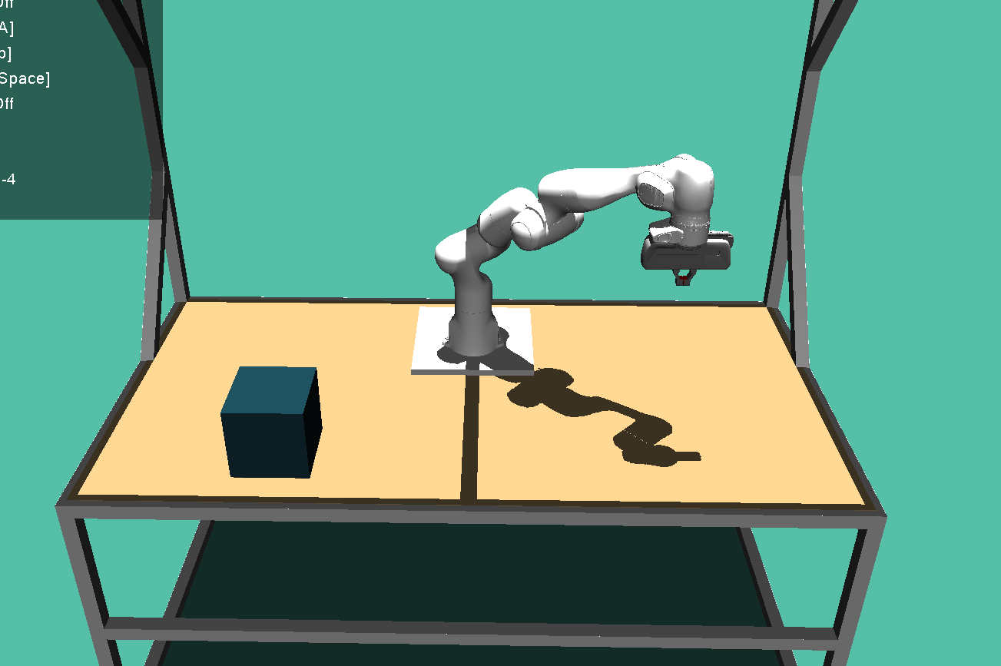
z
pos = (0.5,0.5,0.5), quat: (0,1,0,0)
-> KOS um 180° um x-Achse gedreht
y
-0.02 z-offset of table
x
y
z
0.2
(0.4, -0.4, -0.02)
x
0.2
pos = (0.5, -0.5, 0.1-0.02) (inside Box)
size = (0.1, 0.1, 0.1)

