Slide 1
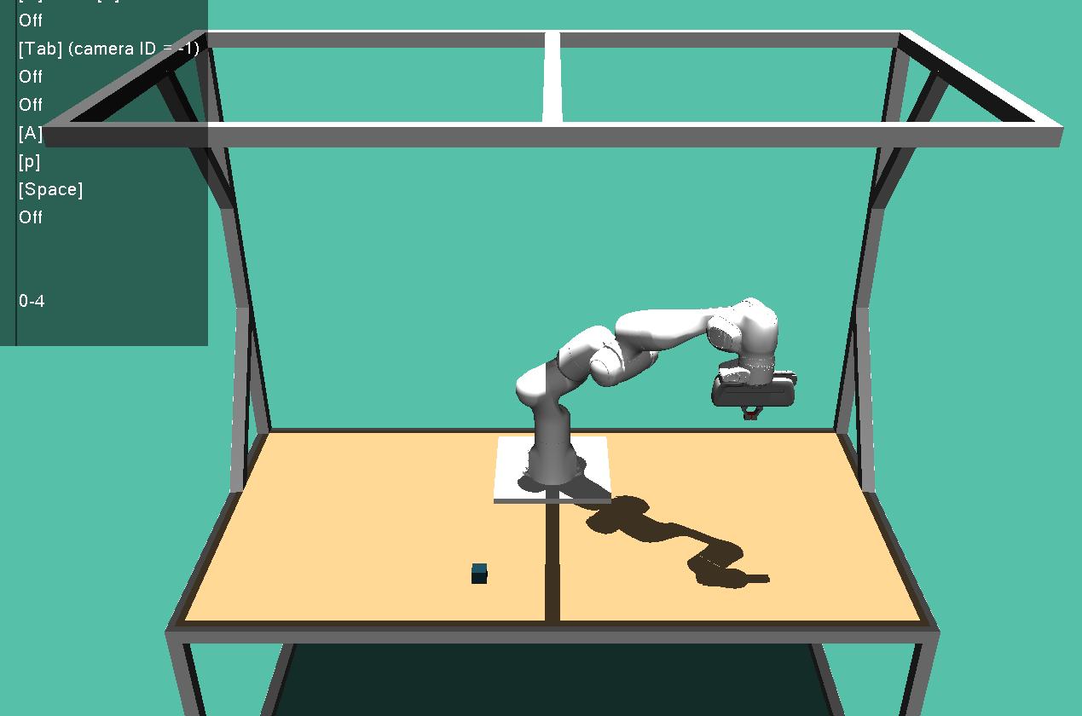
z
(0.5,0.5,0.5)
y
Wxyz-quat: (0,1,0,0) --> KOS um180 grad um x-Achse grdreht
x
y
z
x
(-0.2,0.5,0)

