Slide 1
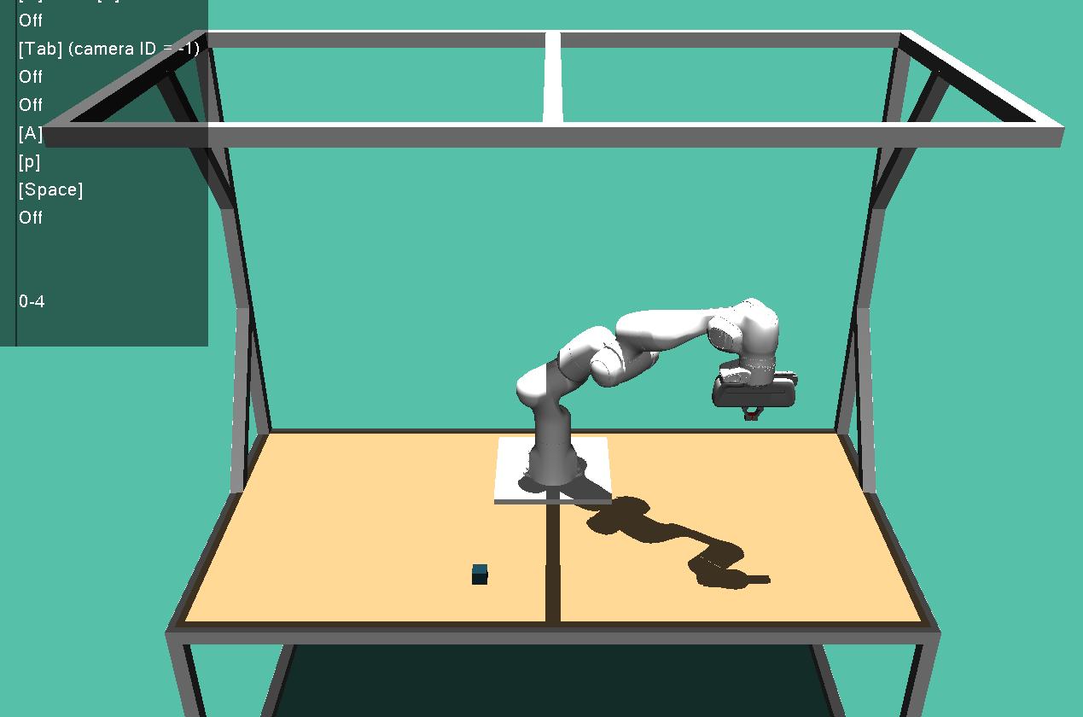
z
(0.5,0.5,0.5)
y
wxyz-quat: (0,1,0,0) -> KOS um 180° um x-Achse grdreht
x
y
z
x
(-0.2,0.5,0)

