Slide 1

GB3KM
All Digital* Repeater

Slide 2
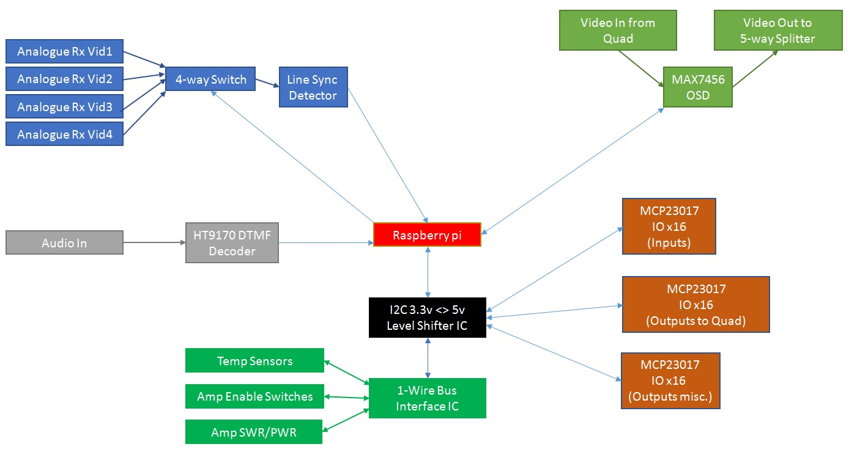
Back in 2014(!) we started talking about an upgrade...

Slide 3
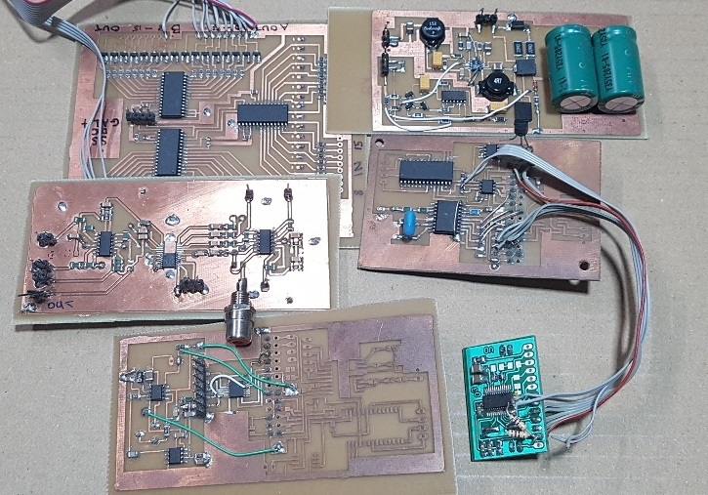
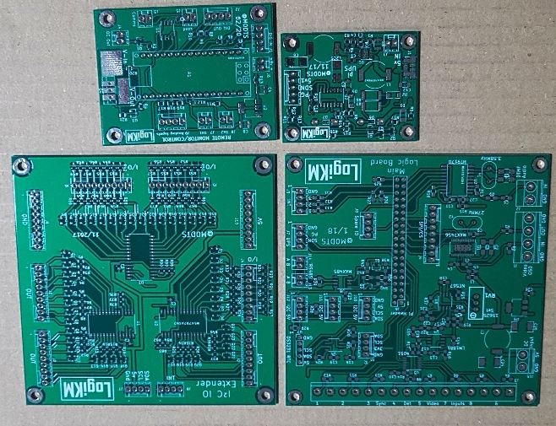
Some years later...

Slide 4
GB3KM MK3 – What’s new?
Logic Control unit - replaces a 16F84!
23cm Tx – ADALM Pluto with h264 265 Encoder Box
HDMI Video switch – HD!
Audio Mixer
Amplifier control/monitoring
Network router

Slide 5
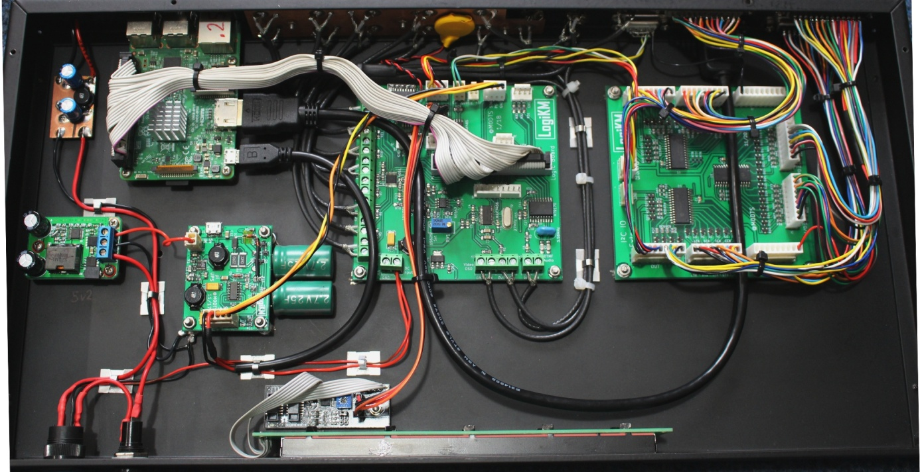
Logic Control
Raspberry Pi3
DC-DC PSU
UPS
8x Sync Detector*
DTMF Rx
Composite OSD
Real Time Clock
Display
48 Digital IO
Lots of python code
Basic Web GUI

Slide 6
Audio
Requirements:
Many more audio inputs and outputs
Controllable by the logic
Designed a new mixer unit...
Low cost ADC and DAC boards used with an FPGA for the glue logic plus a little dsp.
Squelch of noisy analogue sound inputs
Any of 12 inputs can be mixed to any of 6 outputs
Duplex operation: Users audio mixed to opposite L/R channels on Tx – user selects opposite channel to their own on receiver – You don’t hear your delayed audio.
Stream input audio could be omitted from Stream output audio for repeater linking – no feedback!
More than two users – TODO: Subcarriers? Modify TS for another audio PID?
There ARE easier/better ways to do this but I was learning new things!

Slide 7
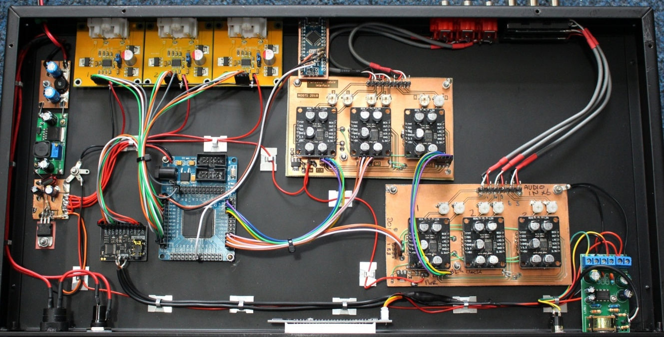
Audio Mixer
5v PSU
4x Stereo DAC
6x Stereo ADC
FPGA dev board
VU Meter
Headphone amp
Arduino (USB Control)

Slide 8
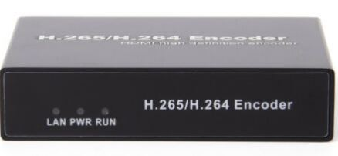
Video
New HDMI Video switch unit – A-NEU Video ANI-9MV
9 inputs – already nearly full: Sysop + Slideshow + 2x Ryde + 2x Analogue>HDMI
1/2/4/9/picture-in-picture display modes – Real-time live video
RS232 or LAN control
Can set each input to any segment of multi view
Allows us to hide analogue inputs in multi screen mode when the input is just noise – encoding noise is something to avoid.
Ryde Rx’s second HDMI port used to display easycap input for Analogue Rx’s
HDMI Encoder Box
Cheap way to get from HDMI to h264/265 stream at 1080i
Easy to remote control all parameters – Pi/Python
Can also stream to BATC at the same time
Image or Text OSD feature used for overlaying active input on screen

Slide 9
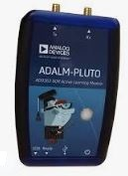
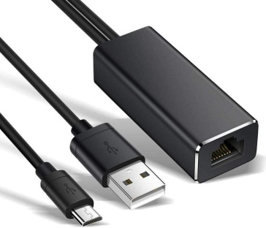
Transmitter
Big step forward from the MK808/PVR/DigiLite currently in use on 9cm
Pluto uses an Ethernet adapter to accept the AV stream over LAN
Tx parameters are configured using web interface.
Pluto output is filtered then amplified – for now just 23cm output using Mitsubishi PA
A future upgrade will be using the same Tx for the other Transmitters
Mixer and filtering to up-convert.
Hopefully this will be reliable over the years! - tbc

Slide 10
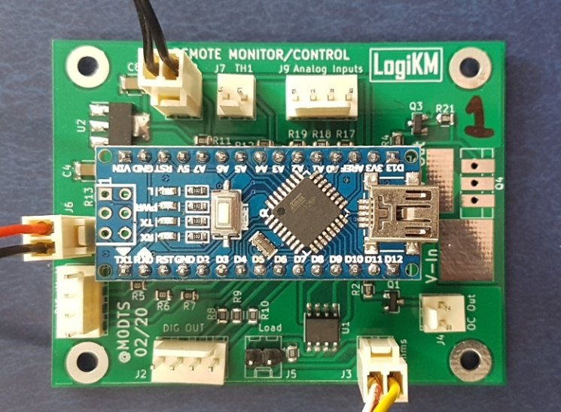
Tx Control/Monitoring
Needed a new way to control sequencing of Transmitters
1304MHz, 2440MHz, 3406MHz, 10065MHz
Ideally have monitoring as well as on/off control.
Temperature, Forward Power, Reverse Power
Arduino based control board designed
Allows multiple boards to be daisy chained
9k6 serial comms over twisted pair
High current DC Switch option
2x Thermocouple inputs
3x digital inputs/outputs
3x analogue inputs – 2x 0-5v, 1x 0-15v but adjustable

Slide 11
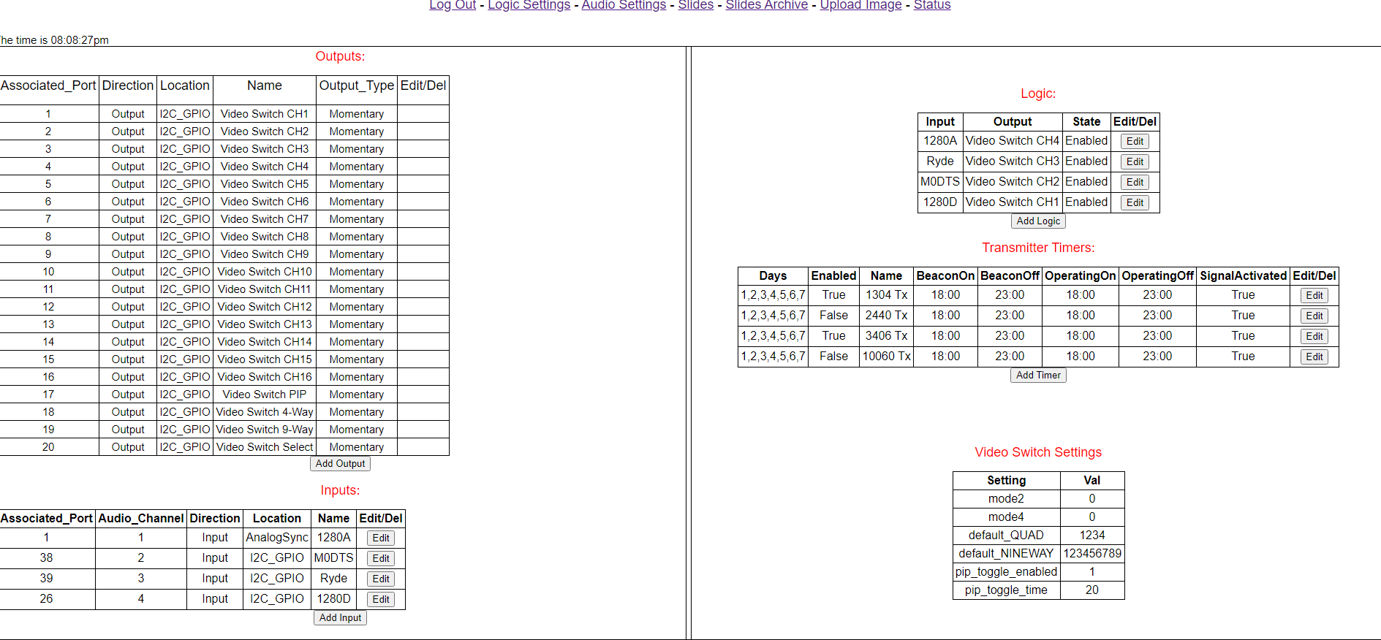
Web Config

Slide 12
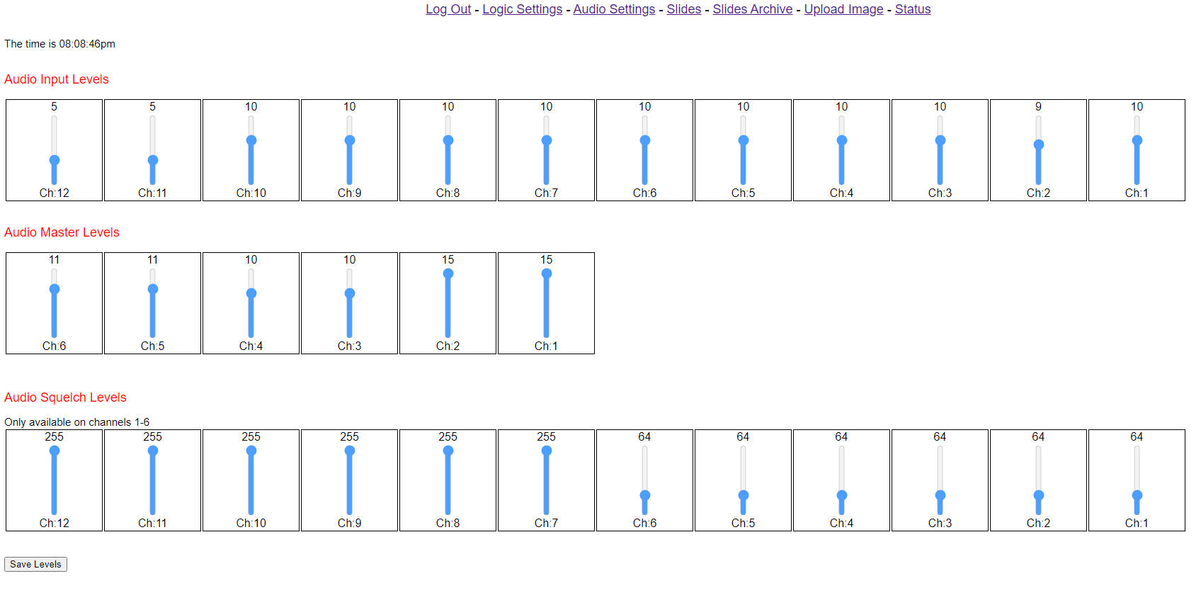
Audio Mixer Control

Slide 13
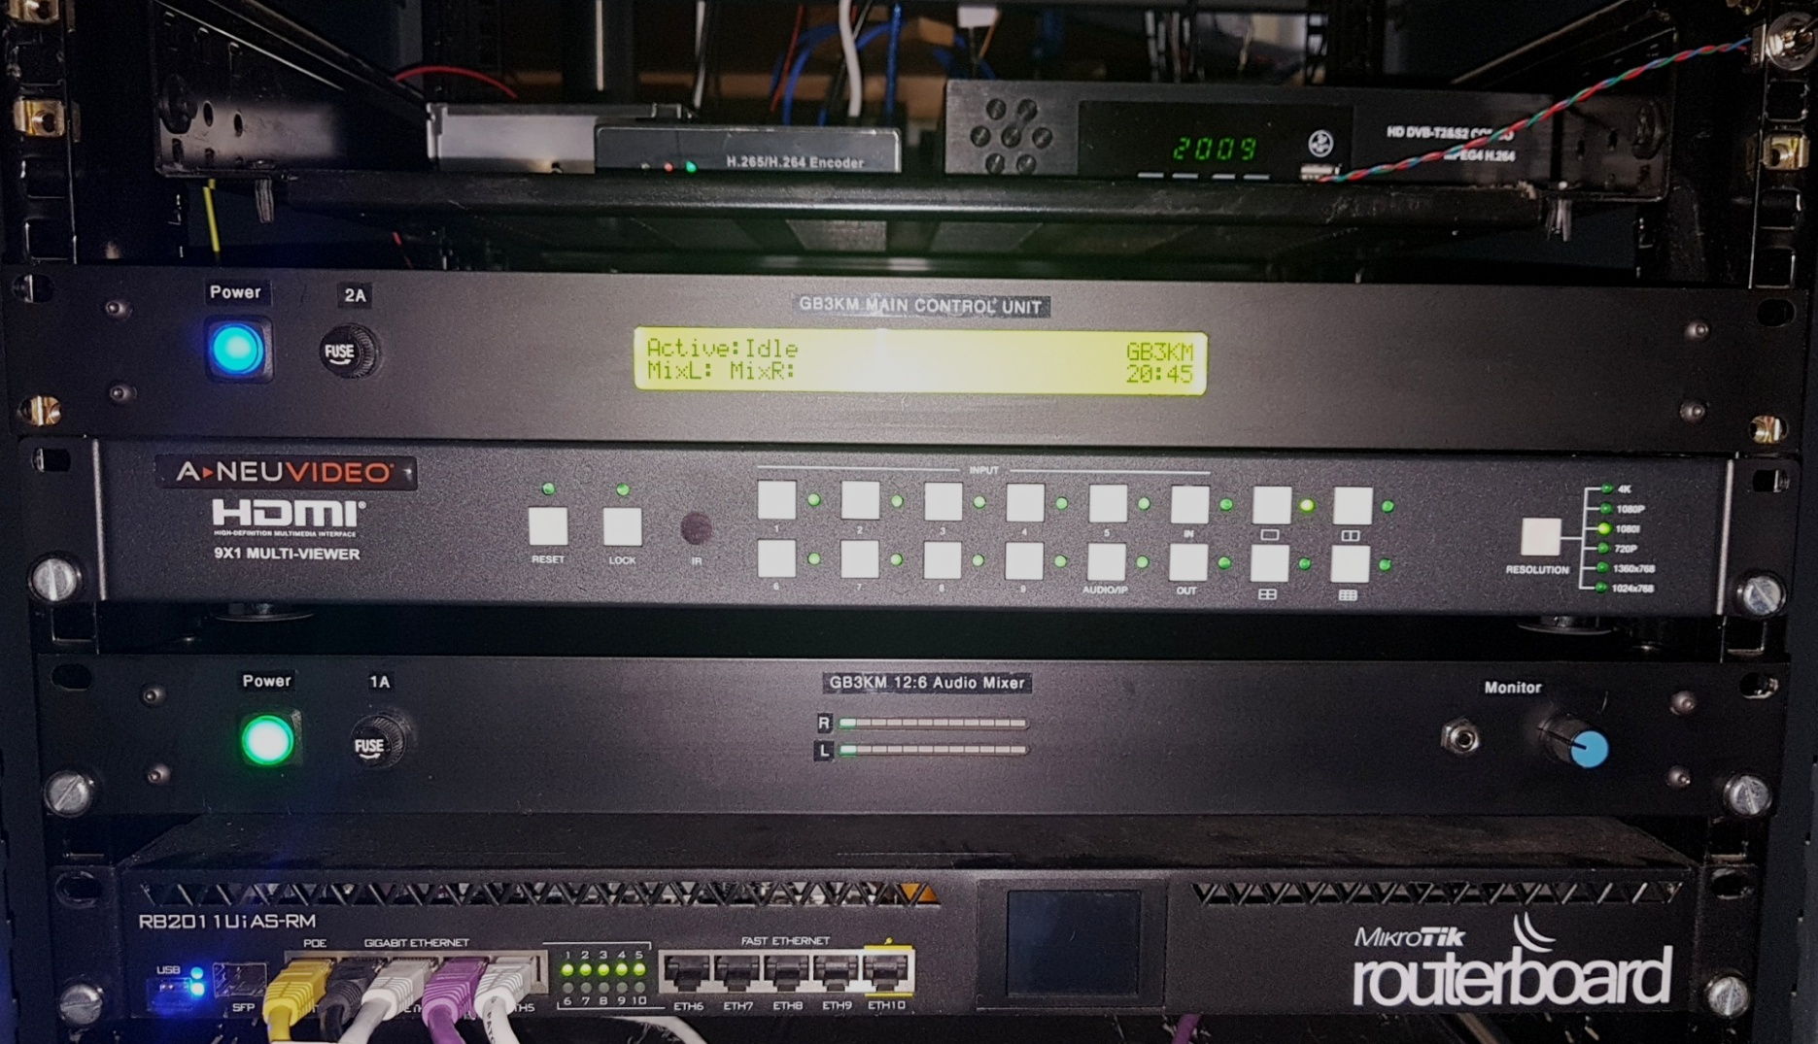
Development Rack

Slide 14
GB3KM – Will be back soon!
Check out M0DTS stream on the BATC website – Live development!
Thanks to BATC for the Bursary funding for some of the new equipment.
Any questions ?
Email: rob@m0dts.co.uk
Twitter: @M0DTS
Web: www.m0dts.co.uk

