Slide 1

GLOBALMART SALES PERFORMANCE ANALYSIS
BY MOSES MUIGA

Slide 2
BUSINESS UNDERSTANDING
PROBLEM STATEMENT
GlobalMart, a multinational retail company operating across diverse regions and product categories such as Furniture, Office Supplies, and Technology, faces challenges in optimizing its overall sales performance and profitability.
Despite generating substantial revenue, the company experiences uneven profit margins, regional disparities, and product-level inconsistencies that hinder sustainable growth.
The goal is to identify growth opportunities, highlight emerging trends, and address performance gaps across regions, product categories, and customer segments. This analysis will enable GlobalMart to make data-driven decisions that improve profitability, streamline operations, and strengthen its competitive position in the retail market.

Slide 3
BUSINESS
UNDERSTANDING
OBJECTIVES
1. Identify Sales Performance Trends
Examine overall sales, profit, and order volumes across years, quarters, and months.
2. Evaluate Regional Contributions
Compare performance across regions (Central, East, South, West).
Highlight high‑margin regions and diagnose underperforming areas
3. Assess Product Category & Sub‑Category Profitability
Determine which categories (Furniture, Office Supplies, Technology) drive revenue.
4. Analyze Customer & State-Level Insights
Understand customer demand distribution across states.
Evaluate profit margins, discounts, and order volumes at the state level.
5. Measure Impact of Discounts on Profitability
Quantify how average discounts affect profit margins.
6. Support Strategic Decision-Making
Provide actionable insights to executives for:
Improving profitability
Enhancing regional strategies

Slide 4
DATA UNDERSTANDING
The dataset, GlobalMart sales data contains detailed information on orders, including:
Order ID: Unique identifier for each order
Order Date: Date the order was placed
Ship Date: Date the order was shipped
Region: Geographical region (e.g., East, West, Central, South)
State: State within the region
Category: Product category (e.g., Furniture, Office Supplies, Technology)
Sub-Category: Sub-category of the product (e.g., Chairs, Binders, Phones)
Product Name: Name of the product
Sales: Revenue generated from the sale
Quantity: Number of units sold
Discount: Discount applied (in percentage)
Profit: Profit earned from the sale

Slide 5
DATA
ANALYSIS

Slide 6
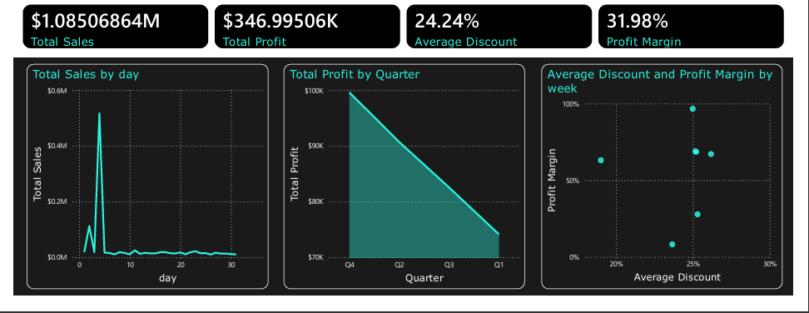
SALES ANALYSIS
Profit peaks in Q4, while Q1 shows the weakest performance.
There is a huge, sharp spike early in the month—close to $0.6M in a single day. After that spike, daily sales drop dramatically and stabilize at almost near-zero levels for the rest of the month.
High profit at mid-range discounts (23–25%)

Slide 7
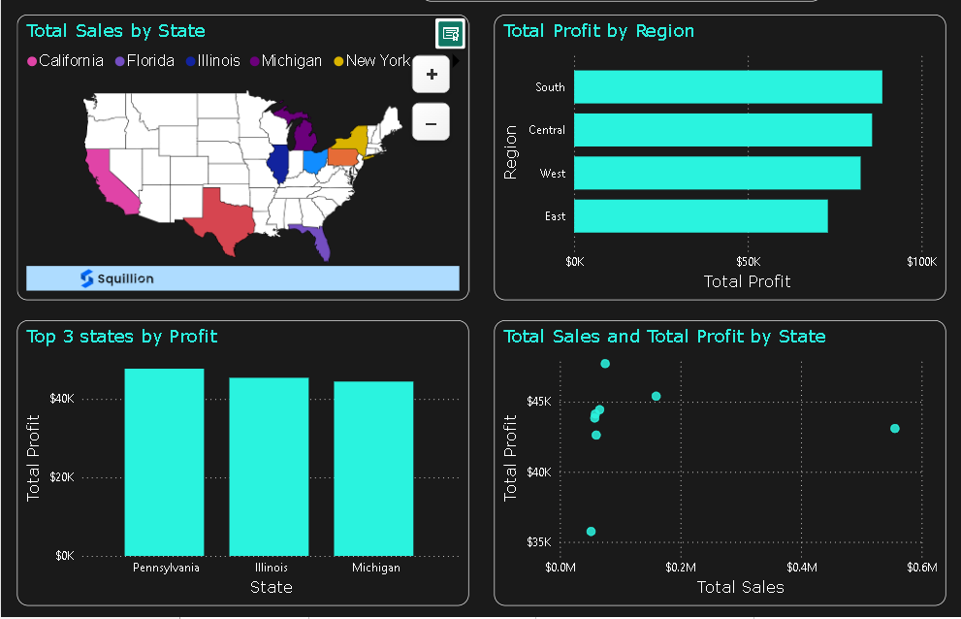
REGIONAL ANALYSIS
The top 3 states contributing to profit are: Pennsylvania, Illinois and Michigan.
The South Region has the highest profit while the east contributes the lowest.
Ohio state has the highest number of sales, but the profit is average.

Slide 8
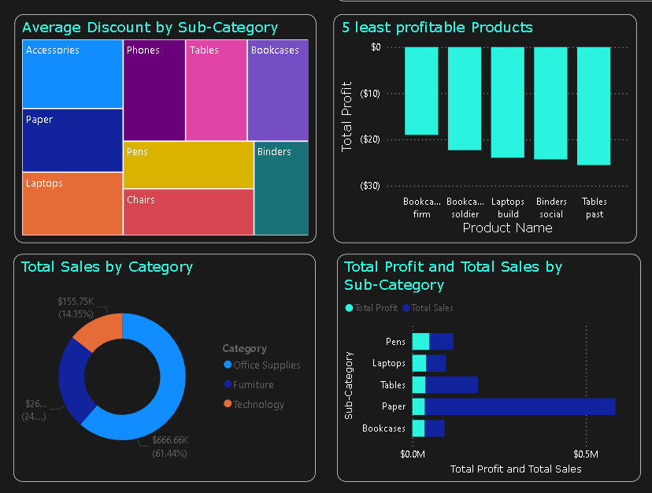
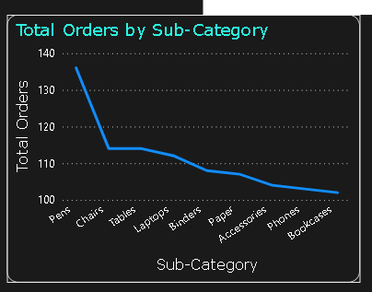
PRODUCT ANALYSIS
Office supplies category has the highest sales while technology has the least.
In terms of average discount accessories have the highest average discount while binders have the least.
Table past is the least profitable product.
Paper has the highest number of sales, but the profit is low.

Slide 9
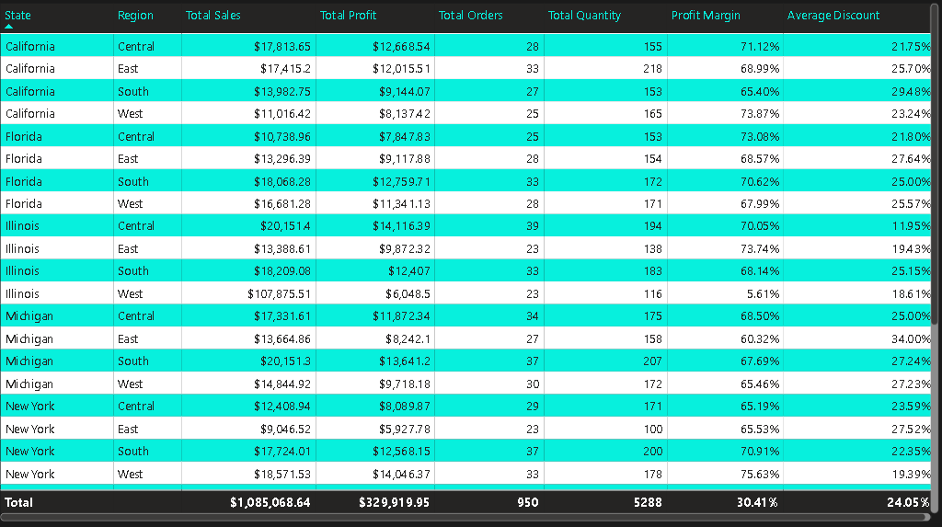
CUSTOMER ANALYSIS
The Western region has the highest number of total sales but has the lowest profit margin.
Ohio state has the lowest profit margin.

Slide 10
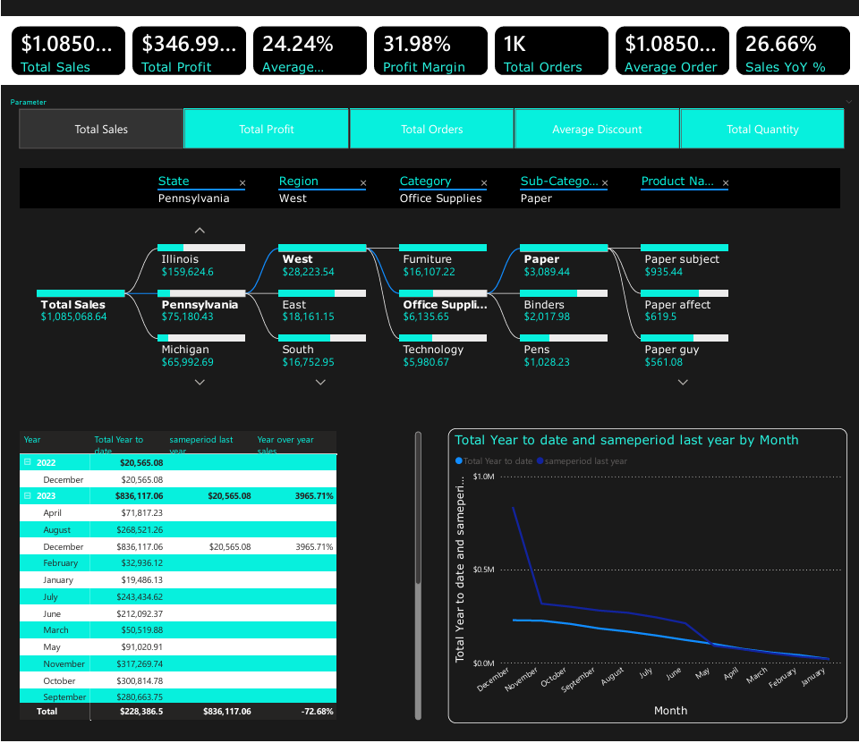
EXECUTIVE SUMMARY
Both lines reach their highest values, for total year to date and same period last year in December, with Year to Date significantly outperformed by the previous year

Slide 11
CONCLUSION
Sales Trends: The West region generates the highest revenue, but profit margins are lower compared to other regions.
Product Performance: Office supplies have the highest sales but the lowest profitability.
Regional Analysis: South region excels in profit and orders despite lower sales compared to the West.
Trends over time: Sales are high during the early days of the month followed by a significant drop and the profit are at peak during Q4.

Slide 12
RECOMMENDATIONS
Reduce discounting in low-profit regions and states
Increase products manufactured during December since the sales are high during this period.
Expand customer targeting in high margin states.
Focus investment to strengthen supply chain and marketing of technology products.
Review the pricing strategies for low-profit products and reassess the cost structure for Bookcases firm, Bookcases soldier, Laptop build, Binder social and Table past.

Slide 13
THANK YOU

