Slide 1


Hybrid insurance Recommender System
Using Machine Learning and Rule-Based Scoring for Personalized Client Pitches
Equipe : Nexora
Moemen Sfaxi Dhia Eddine Louati

Slide 2

Agenda
From Data to Dynamic Pitches
01
02
Foundations: Data & Features
Predictive Power: ML Model Training
Preparing the bedrock for intelligent insights.
Building the core of our recommendation engine.
03
04
Hybrid Harmony: Combining Strengths
Impact & Innovation: Deployment & LLM
Fusing ML with expert knowledge for precision.
Delivering personalized value at scale.

Slide 3
“Client & Product Data”
Chapter 1
Client & Product Data
Data & Feature Engineering: The Foundation
Robust recommendations begin with robust data. We aggregate diverse data sources to build a comprehensive view of user preferences and product attributes. This meticulous preparation ensures our models learn from the most relevant information.
Feature Engineering
User Data: Demographics, past purchases, browsing history, engagement metrics.
Product Data: Features, categories, popularity.
Interaction Data: claims, insurance products already owned.
ML Model
(XGBoost)
Rule-Based scoring
Hybrid Score
Personalized Pitch (LLM)

Slide 4
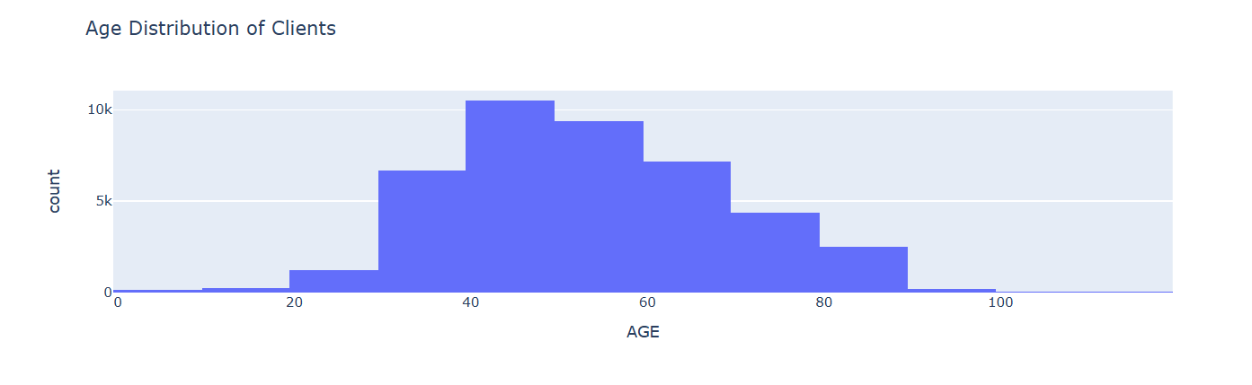
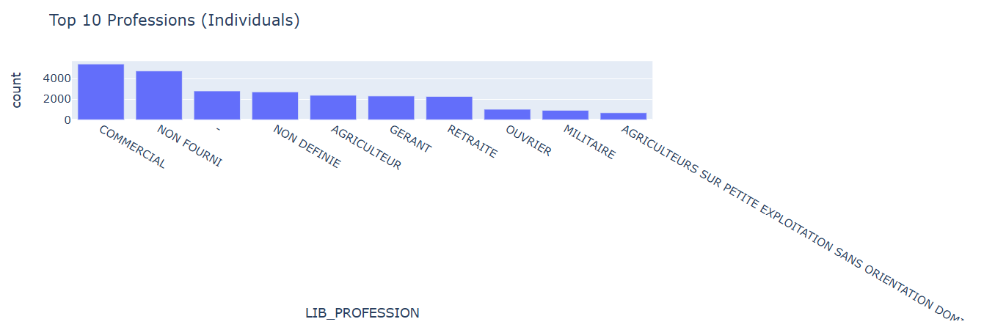
Data Collection
Source: Company client database & product catalog.
Data Includes:
Client demographics (age, sex, sector of activity)
Historical contracts, claims, and engagement
Product-specific features
Why: Clean, structured data ensures accurate ML predictions and personalized recommendations.

Slide 5
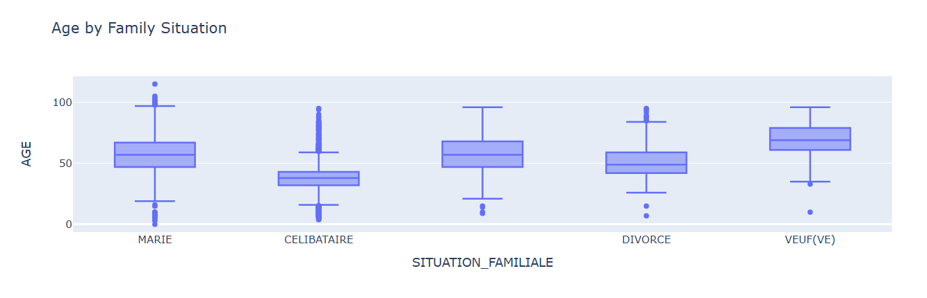
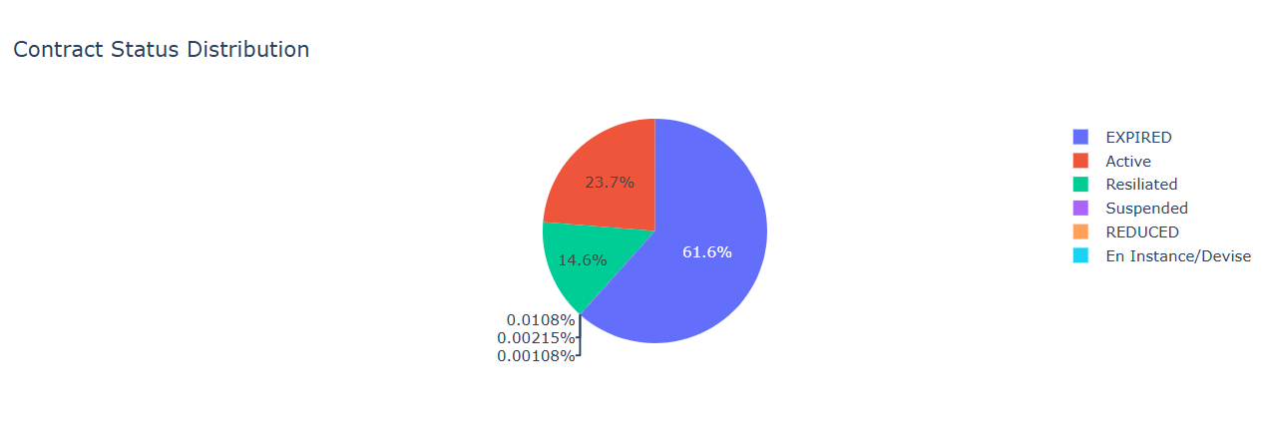

Slide 6
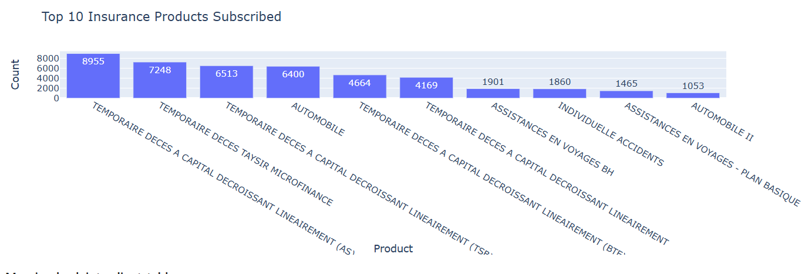
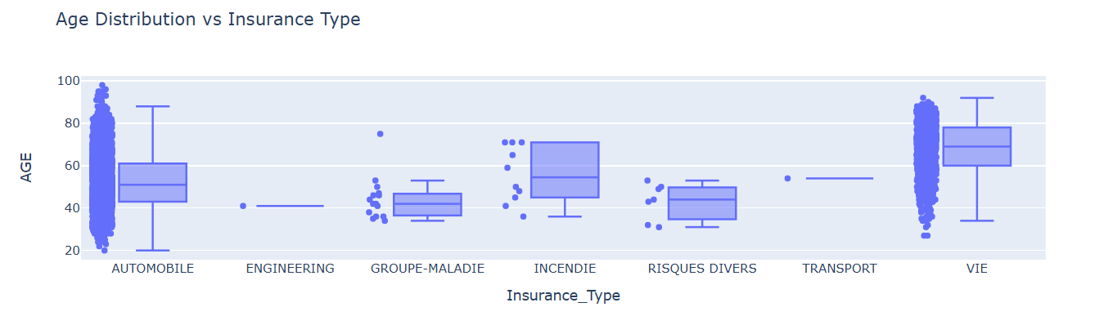

Slide 7

Chapter 2
Machine Learning Model: XGBoost
We selected XGBoost (Extreme Gradient Boosting) as our primary machine learning algorithm due to its proven performance in structured data, speed, and interpretability. XGBoost is an ensemble learning method that combines the predictions of multiple weak learners (decision trees) to create a strong learner.
Accuracy: Superior predictive accuracy on complex datasets.
Speed & Scalability: Efficient handling of large datasets and parallel processing capabilities.
Robustness: Less prone to overfitting and can handle missing values effectively.
Feature Importance: Provides insights into which features are most influential in predictions.

Slide 8


Chapter 3
The Hybrid Recommendation Logic
Our innovative approach combines the predictive power of machine learning with the nuanced insights of rule-based scoring, providing a recommendation system that is both intelligent and adaptable.
ML Prediction Score
Rule-Based Scoring (Expert Option)
Hybrid Final Score
XGBoost predicts the probability of a user interacting positively with a product.
A weighted average of ML prediction and rule-based score, ensuring optimal balance.
Incorporates business logic and expert knowledge : product/targeted profile
"This hybrid model significantly improves recommendation accuracy and aligns recommendations with core business objectives, moving beyond mere correlation to strategic impact."

Slide 9
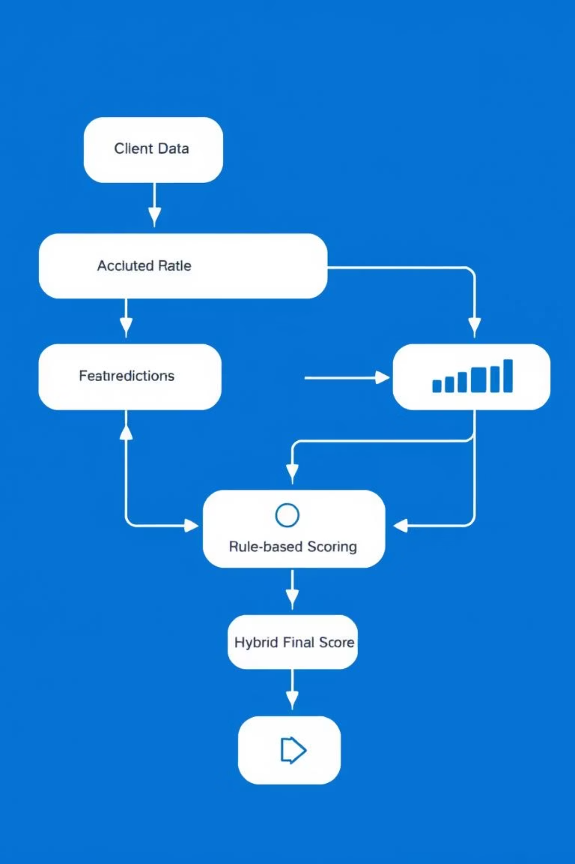
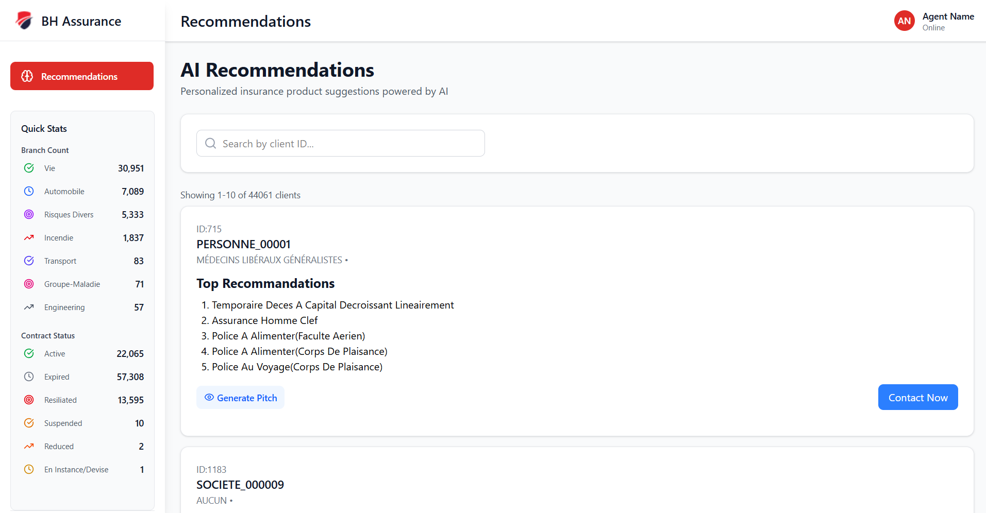
Data Flow: From Client to Pitch
This visual represents the complete lifecycle of a recommendation, from raw client data ingestion to the generation of a personalized marketing pitch. Each stage builds upon the last, culminating in a highly tailored client engagement.

Slide 10
Chapter 4
Deployment & LLM Integration
Deployment with Flask API
LLM for Personalized Pitches
Our recommender system is deployed as a scalable Flask API, enabling real-time requests for product recommendations. This ensures low latency and high availability for seamless integration into existing client-facing applications.
The final hybrid recommendation score is fed into a Large Language Model (LLM) to generate highly personalized marketing pitches for clients. This transforms a mere product list into compelling, contextually rich sales narratives.
Real-time inference: Quick recommendation generation.
Dynamic content: Pitches adapt to user preferences and product benefits.
Scalability: Handles high traffic loads efficiently.
Enhanced engagement: Increases conversion rates through tailored messaging.
Modular design: Easy to maintain and update.
Efficiency: Automates content generation, freeing up marketing teams.

Slide 11




Impact: Scalability, Personalization & Business Value
Our hybrid recommender system is engineered for maximum impact, delivering tangible benefits across the organization.
Scalability
Hyper-Personalization
Designed to handle millions of users and products, growing with your business needs without compromise.
Delivers truly unique recommendations and pitches, significantly improving user experience and satisfaction.
Increased Revenue
Strategic Alignment
Drives higher conversion rates, average order value, and customer lifetime value through optimized recommendations.
Incorporates business rules to align recommendations with strategic objectives, maximizing profitability.

Slide 12

Thank you for your attention
Hybrid Power: ML + Rule-based logic = Superior recommendations.
XGBoost Advantage: Accurate, scalable, and robust core.
End-to-End Solution: From data processing to personalized pitches.
Business Impact: Drives growth through enhanced personalization and efficiency.

