Slide 1
UDA-PEOPLE
CI/CD PROPOSAL
Presented By: Mohamed Ra’fat

Slide 2
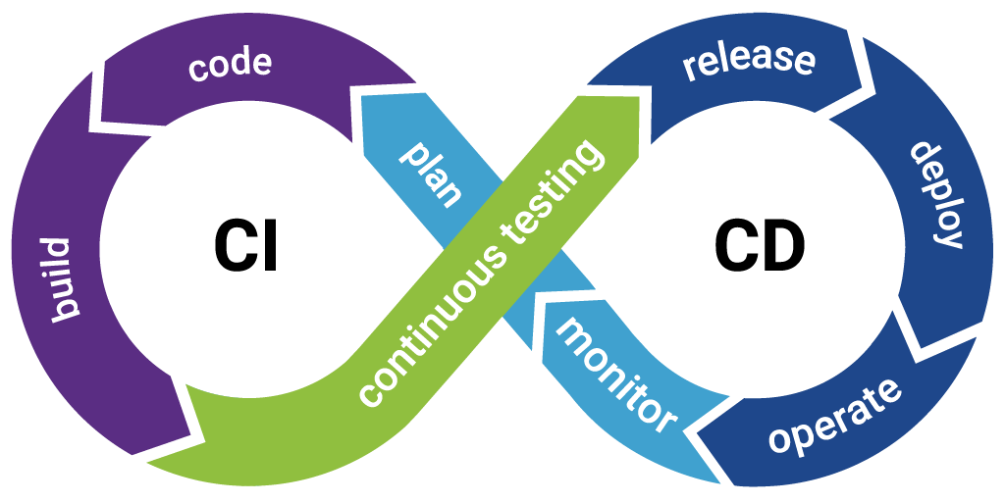
Overview
What is CI/CD
What we get from continuous integration
What we get from continuous delivery and deployment
Notes:
What is CI/CD: CI/CD is short for continuous integration and continuous delivery or is it deployment together we will see are they the same thing but different name and where is the difference exactly
Benefits and cost of continuous Integrations
Benefits and cost of continuous delivery and deployment

Slide 3


1. What is CI/CD
CI- Continuous Integration The ability to integrate code
Autonomously
CD- Continuous delivery The ability to reach QA
And staging autonomously production manually
CD- Continuous deployment (CD Again) The ability to reach from code to production Autonomously
Notes:
But what does it really mean the simplest and most proper defininations it’s a set processes and techniques that helps and enable the engineering team as whole to deliver value at faster and more stable rate (Money !)

Slide 4
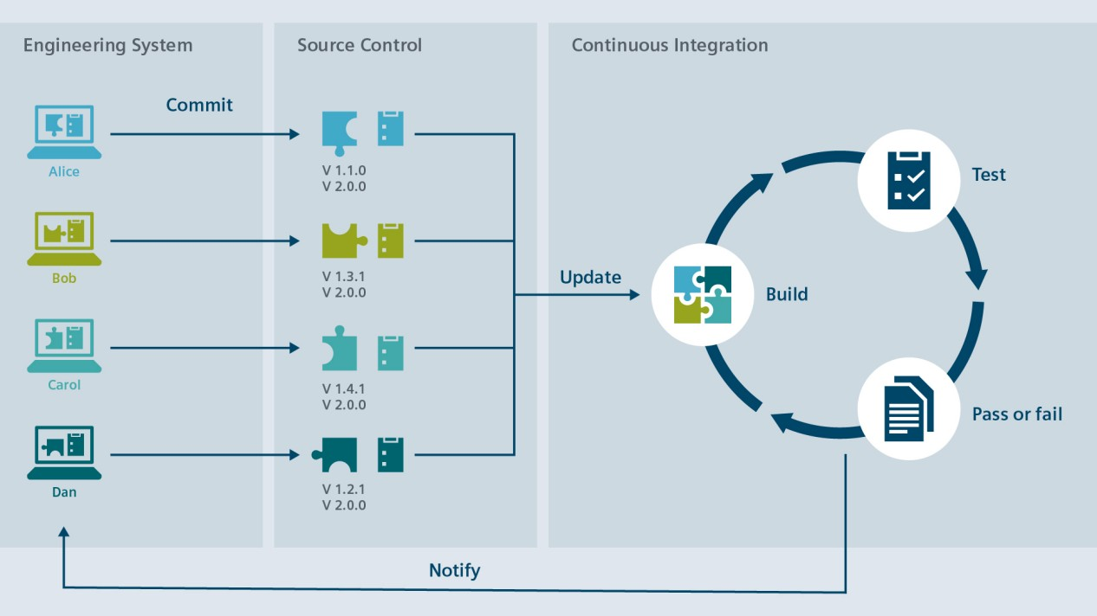
Continuous integration
Notes:
Continuous integration steps can save Money?
1 - failed build in integrations step prevent wasted times on fixing issues and time almost always means money.
2- failed tests means no times wasted on testing and avoiding the time and cost involved in the process
Other things not shown directly reducing times on code review and manually checking for security issues also translate to money saved on development process

Slide 5
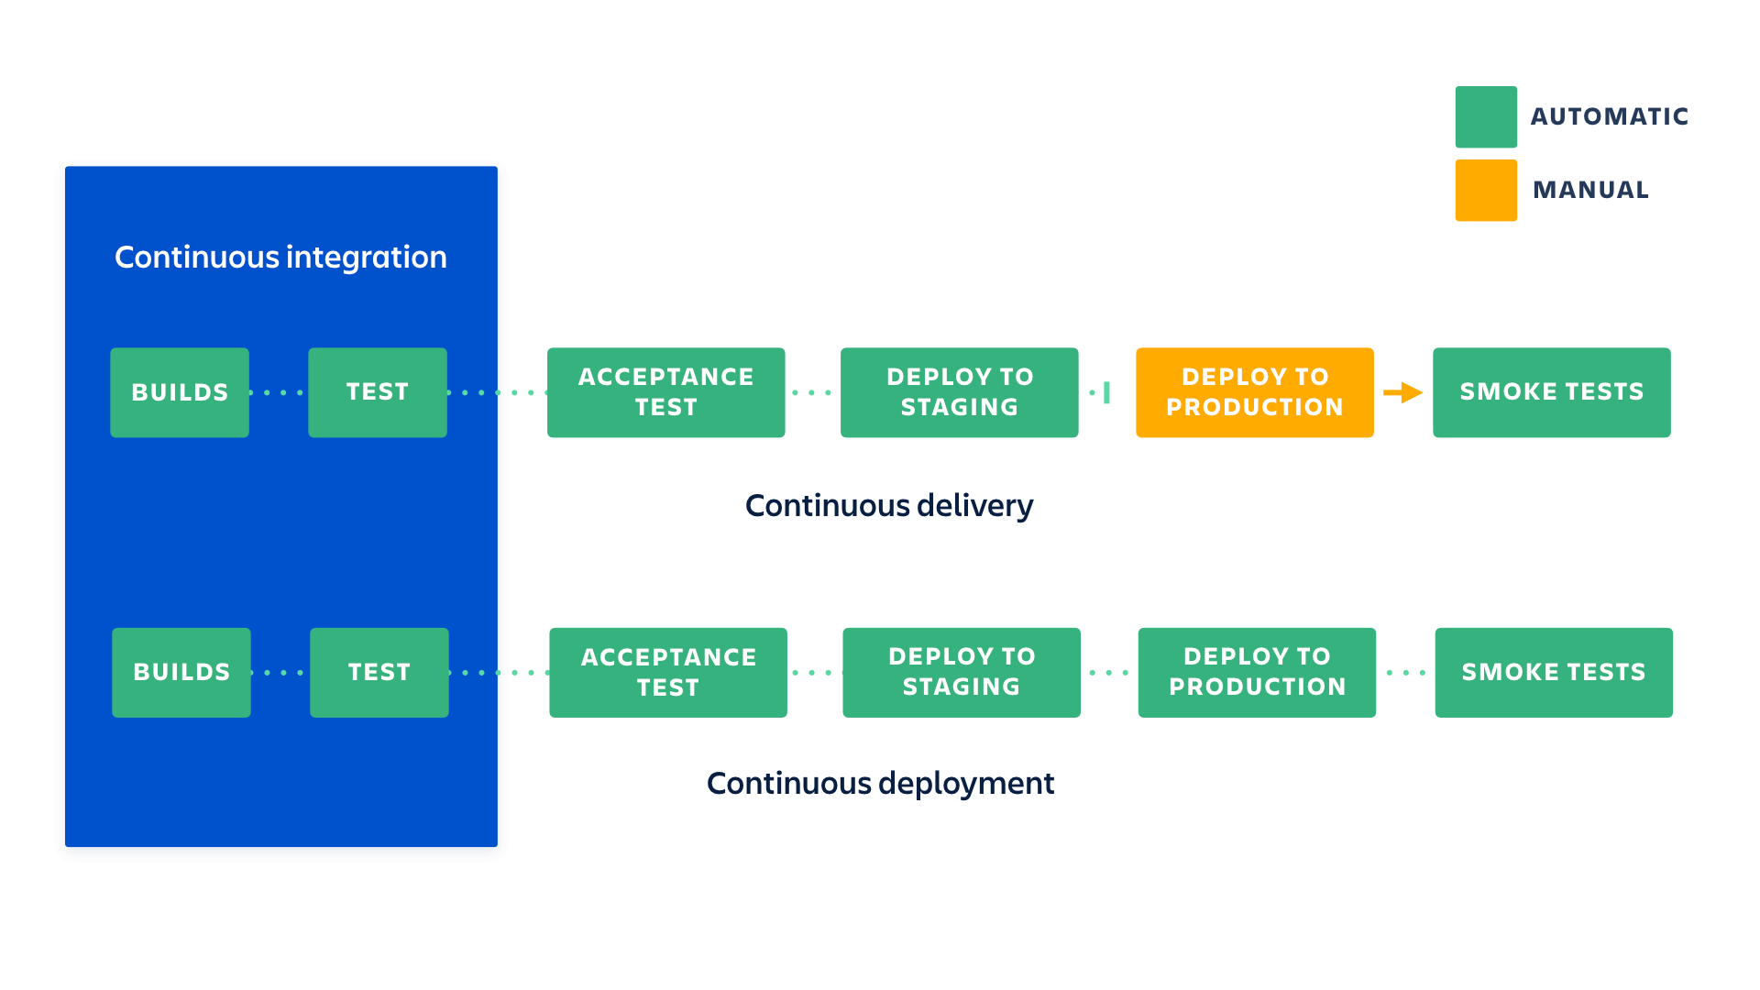
Continuous Deployment vs Continuous Delivery.
Notes:
They actually only differ on the degree of automation and how much human involvement will be required generally the less is better but not always that is true.
More tests the faster the deployment or build fails the less cost and resources are wasted starting from time, money and infrastructure (fail early and fail fast).
Automated tasks most likely is faster than any humane possible so the faster and more frequent to deploy is the faster clients gets value (money)
Reducing human interaction is similarly increase the speed of deployment no one should holds the gates for our salvation :D
The ability for automated rollback means that we botched the build we need to recover before someone catch us so we can protect our money

Slide 6
Cost Of CI/CD:
1- Money
2- Skills
3- Culture
Notes:
- like any engineering process the first difficulty that face CI/CD is money we will need to invest initially to gain later :
1- Infrastructure and license costs while we will overall save and should gain more money initial investment and cost will be made first
2- Training not every team member will have the necessary knowledge at the beginning knowledge and experience is iterative process but will be rewarding later.
3- Culture change should be made : CI/CD and devops in general bloom in agile environment sharing responsibility ,focusing business first and customer satisfaction mindset no blaming and pointing fingers (automation can be oppressive tool if misused and can celebrate with us our success we can choose where we go).

