Slide 1
Department of Applied Mathematics and Computational Sciences
III Sem M.Sc.Software Systems
Transform Techniques
Dr. V. Suresh kumar

Slide 2
Introduction to the Course
Concept of transformation
Integral transforms
Laplace Transform
Fourier Transform
Discrete Fourier Transform
Z-Transform
Wavelet Transform

Slide 3
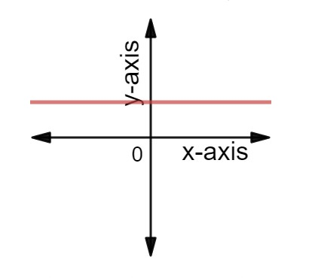
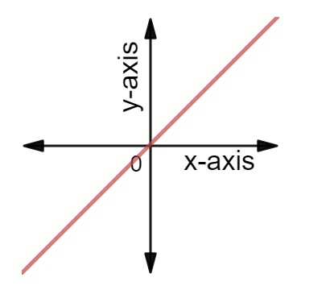
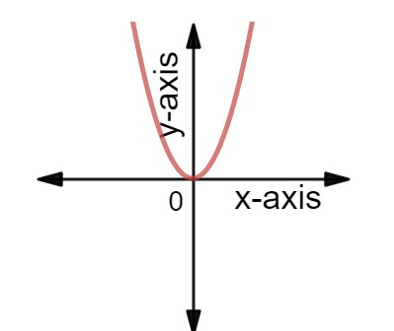
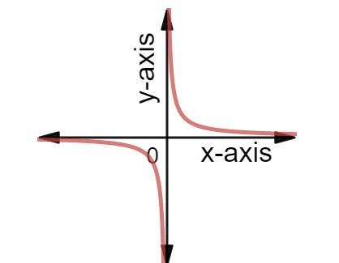
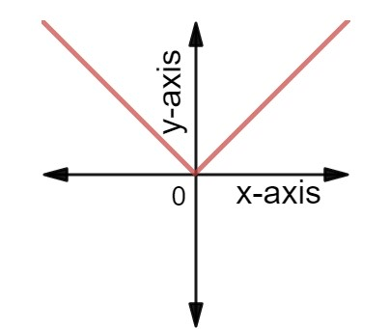





Functions and graph- Revisit
$$y=c$$
$$y=mx$$
$$y=x^{2}$$
$$y=|x|$$
$$y=\frac{1}{x}$$

Slide 4
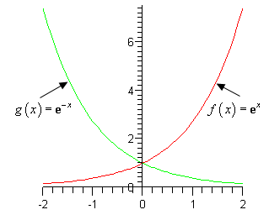
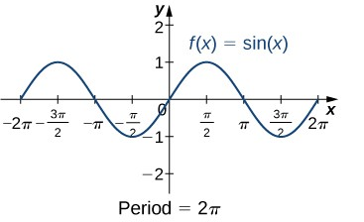
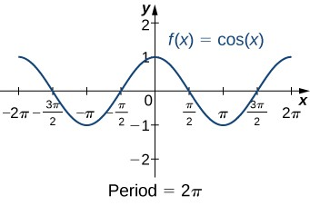
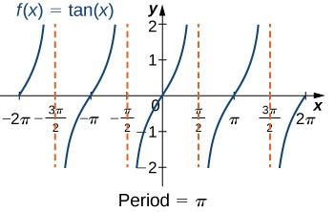
Cont…

Slide 5























Problems for practice
$$1. y=x+2$$
$$11. y=Sin 2x$$
$$12. y=Sin \left(\frac{x}{2}\right)$$
$$2. y=x−2$$
$$3. y=x^{2}+2$$
$$13. y=2 Sin x$$
$$y=Sin (x+2π)$$
$$14. y=\frac{1}{2} Sin x$$
$$4. y=x^{2}−2$$
$$5. y={(x+2)}^{2}$$
$$15. y=Cos 2x$$
$$y=Cos (x+2π)$$
$$16. y=Cos \left(\frac{x}{2}\right)$$
$$6. y={(x−2)}^{2}$$
$$7. y=|x|+2$$
$$17. y=2 Cos x$$
$$18. y=\frac{1}{2} Cos x$$
$$8. y=\left|x\right|−2$$
$$9. y=\left|x+2\right|$$
$$19. y=Sin (x+π)$$
$$10. y=\left|x−2\right|$$
$$20. y=Cos (x+π)$$

Slide 6




Concept of transformation
$$T$$
$$f(t)$$
F$(s)$
s- domain
t- domain
$${T }^{−1}$$

Slide 7
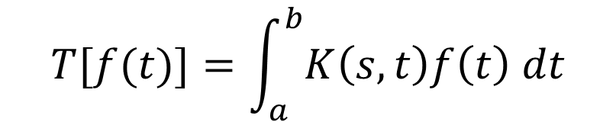
Integral transforms
The transformation that involves integration in its process is called integral transform
General form of integral transform is
$$T[f(t)]=\int_{a}^{b}{K\left(s,t\right)f\left(t\right) dt}$$
Here $K\left(s,t\right)$ is called kernel of the transformation

Slide 8
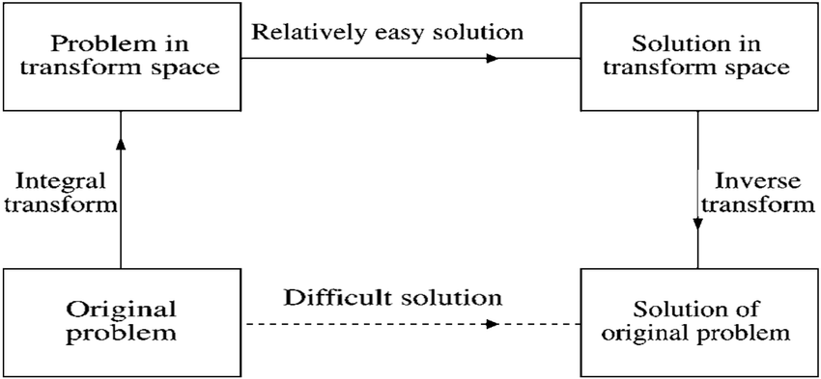
Application of integral transform

Slide 9


