Slide 1
Department of Applied Mathematics and Computational Sciences
III Sem M.Sc.Software Systems
Transform Techniques
Dr. V. Suresh kumar

Slide 2
Fast Fourier Transform

Slide 3




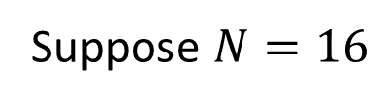

Fast Fourier Transform (FFT)
Fast Fourier Transform is an algorithm to compute the DFT.
Suppose $\{x(n)\}$ is a finite sequence of duration $N$ then $DFT\{x\left(n\right)\}$ requires $N^{2}$
number of operations.
In the same case, FFT requires $N\log_{2}{N}$ number of operations
Suppose $N=16$
$$N^{2}=256$$
$$N\log_{2}{N}=16\log_{2}{16}$$
$$=16\log_{2}{2^{4}}$$
$$=4×16\log_{2}{2}$$
$$=64$$

Slide 4
FFT Algorithms
Decimation-in-Time (DIT) Algorithm
Decimation-in-Frequency (DIF) Algorithm

Slide 5






DIT Algorithm
Two-point formula
$$n_{1}$$
$${n_{1}+W_{2}^{0}n}_{2}$$
$$W_{2}^{0}$$
$$n_{2}$$
$${n_{1}−W_{2}^{0}n}_{2}$$
$${−W}_{2}^{0}$$

Slide 6












Algorithm contd…
Four-point formula
$$n_{1}$$
$${n_{1}+W_{4}^{0}n}_{3}$$
$$W_{4}^{0}$$
$$n_{2}$$
$${n_{2}+W_{4}^{1}n}_{4}$$
$$W_{4}^{1}$$
$$n_{3}$$
$${n_{1}−W_{4}^{0}n}_{3}$$
$${−W}_{4}^{0}$$
$$n_{4}$$
$${n_{2}−W_{4}^{1}n}_{4}$$
$${−W}_{4}^{1}$$

Slide 7








Algorithm contd…
Eight-point formula
$$W_{8}^{0}$$
$$W_{8}^{1}$$
$$W_{8}^{2}$$
$$W_{8}^{3}$$
$${−W}_{8}^{0}$$
$$−W_{8}^{1}$$
$${−W}_{8}^{2}$$
$${−W}_{8}^{3}$$

Slide 8


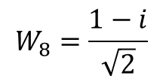
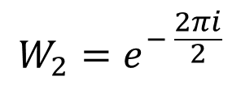

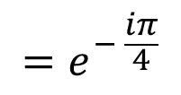

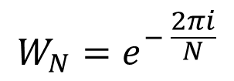



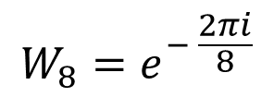
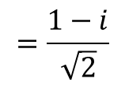

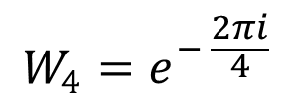
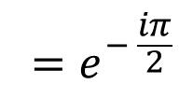
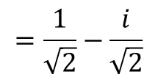
Computation of phase factors
$${W_{N}=e}^{− \frac{2πi}{N}}$$
$${W_{2}=e}^{− \frac{2πi}{2}}$$
$$=\cos{π} −i\sin{π}$$
$${=e}^{−πi}$$
$$=−1$$
$$W_{2}=−1$$
$${W_{4}=e}^{− \frac{2πi}{4}}$$
$$=\cos{\frac{π}{2}} −i\sin{\frac{π}{2}}$$
$$W_{4}=−i$$
$${ =e}^{− \frac{iπ}{2}}$$
$$=−i$$
$$W_{8}=\frac{1−i}{\sqrt{2}}$$
$${W_{8}=e}^{− \frac{2πi}{8}}$$
$$=\cos{\frac{π}{4}} −i\sin{\frac{π}{4}}$$
$${=e}^{− \frac{iπ}{4}}$$
$$=\frac{1}{\sqrt{2}}−\frac{i}{\sqrt{2}}$$
$$=\frac{1−i}{\sqrt{2}}$$

Slide 9

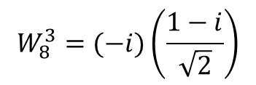

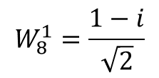


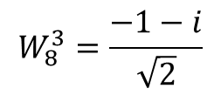



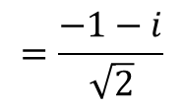
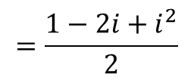
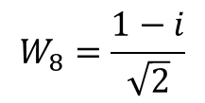
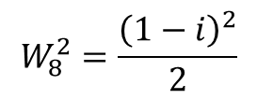
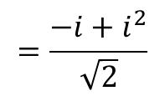
Computation contd…
$$W_{2}=−1$$
$$W_{2}^{0}=1$$
$$W_{8}^{3}=W_{8}^{2}W_{8}^{1}$$
$$W_{4}^{0}=1$$
$$W_{8}^{3}=(−i)\left(\frac{1−i}{\sqrt{2}}\right)$$
$$W_{4}=−i$$
$$W_{8}=\frac{1−i}{\sqrt{2}}$$
$$W_{4}^{1}=−i$$
$$=\frac{−i+i^{2}}{\sqrt{2}}$$
$$W_{8}^{1}=\frac{1−i}{\sqrt{2}}$$
$$=\frac{−1−i}{\sqrt{2}}$$
$$W_{8}^{2}=\frac{{\left(1−i\right)}^{2}}{2}$$
$$=\frac{1−2i+i^{2}}{2}$$
$$W_{8}^{3}=\frac{−1−i}{\sqrt{2}}$$
$$W_{8}^{2}=−i$$

Slide 10






Decimation process
Suppose given $\{x\left(n\right)\}=\{x\left(0\right), x\left(1\right), x\left(2\right), x\left(3\right), x\left(4\right), x\left(5\right), x\left(6\right), x\left(7\right)\}$
$$\{x\left(0\right), x\left(2\right), x\left(4\right), x\left(6\right)\}$$
$$\{x\left(1\right), x\left(3\right), x\left(5\right), x\left(7\right)\}$$
$$\{x\left(0\right), x\left(4\right)\}$$
$$\{ x\left(2\right), x\left(6\right)\}$$
$$\{x\left(1\right), x\left(5\right)\}$$
$$\{ x\left(3\right), x\left(7\right)\}$$

Slide 11



Example
1. Find the Discrete Fourier Transform of $x\left(n\right)=\{1, −1, 1, −1\}$ using DIT-FFT
Ans:
Decimation
$\{1, −1, 1, −1\}$
$$\{1, 1\}$$
$\{ −1, −1\}$

Slide 12












Example contd…
$$1$$
$$2$$
$$W_{2}^{0}$$
$$1$$
$$0$$
$${−W}_{2}^{0}$$
$$−1$$
$$−2$$
$$W_{2}^{0}$$
$$−1$$
$$0$$
$${−W}_{2}^{0}$$

Slide 13













Example contd…
$$2$$
$$0$$
$$W_{4}^{0}$$
$$0$$
$$0$$
$$W_{4}^{1}$$
$$−2$$
$$4$$
$${−W}_{4}^{0}$$
$$0$$
$$0$$
$${−W}_{4}^{1}$$
$X\left(k\right)=\{0, 0, 4, 0\}$

Slide 14







Example
2. Find the Discrete Fourier Transform of $x\left(n\right)=\{1, −1, −1,−1, 1, 1, 1−1\}$ using DIT-FFT.
Ans:
Decimation
$\{1, −1, −1,−1, 1, 1, 1−1\}$
$\{1, −1, 1, 1\}$
$\{−1, −1, 1, −1\}$
$$\{1, 1\}$$
$$\{−1, 1\}$$
$\{ −1, 1\}$
$\{ −1, −1\}$

Slide 15
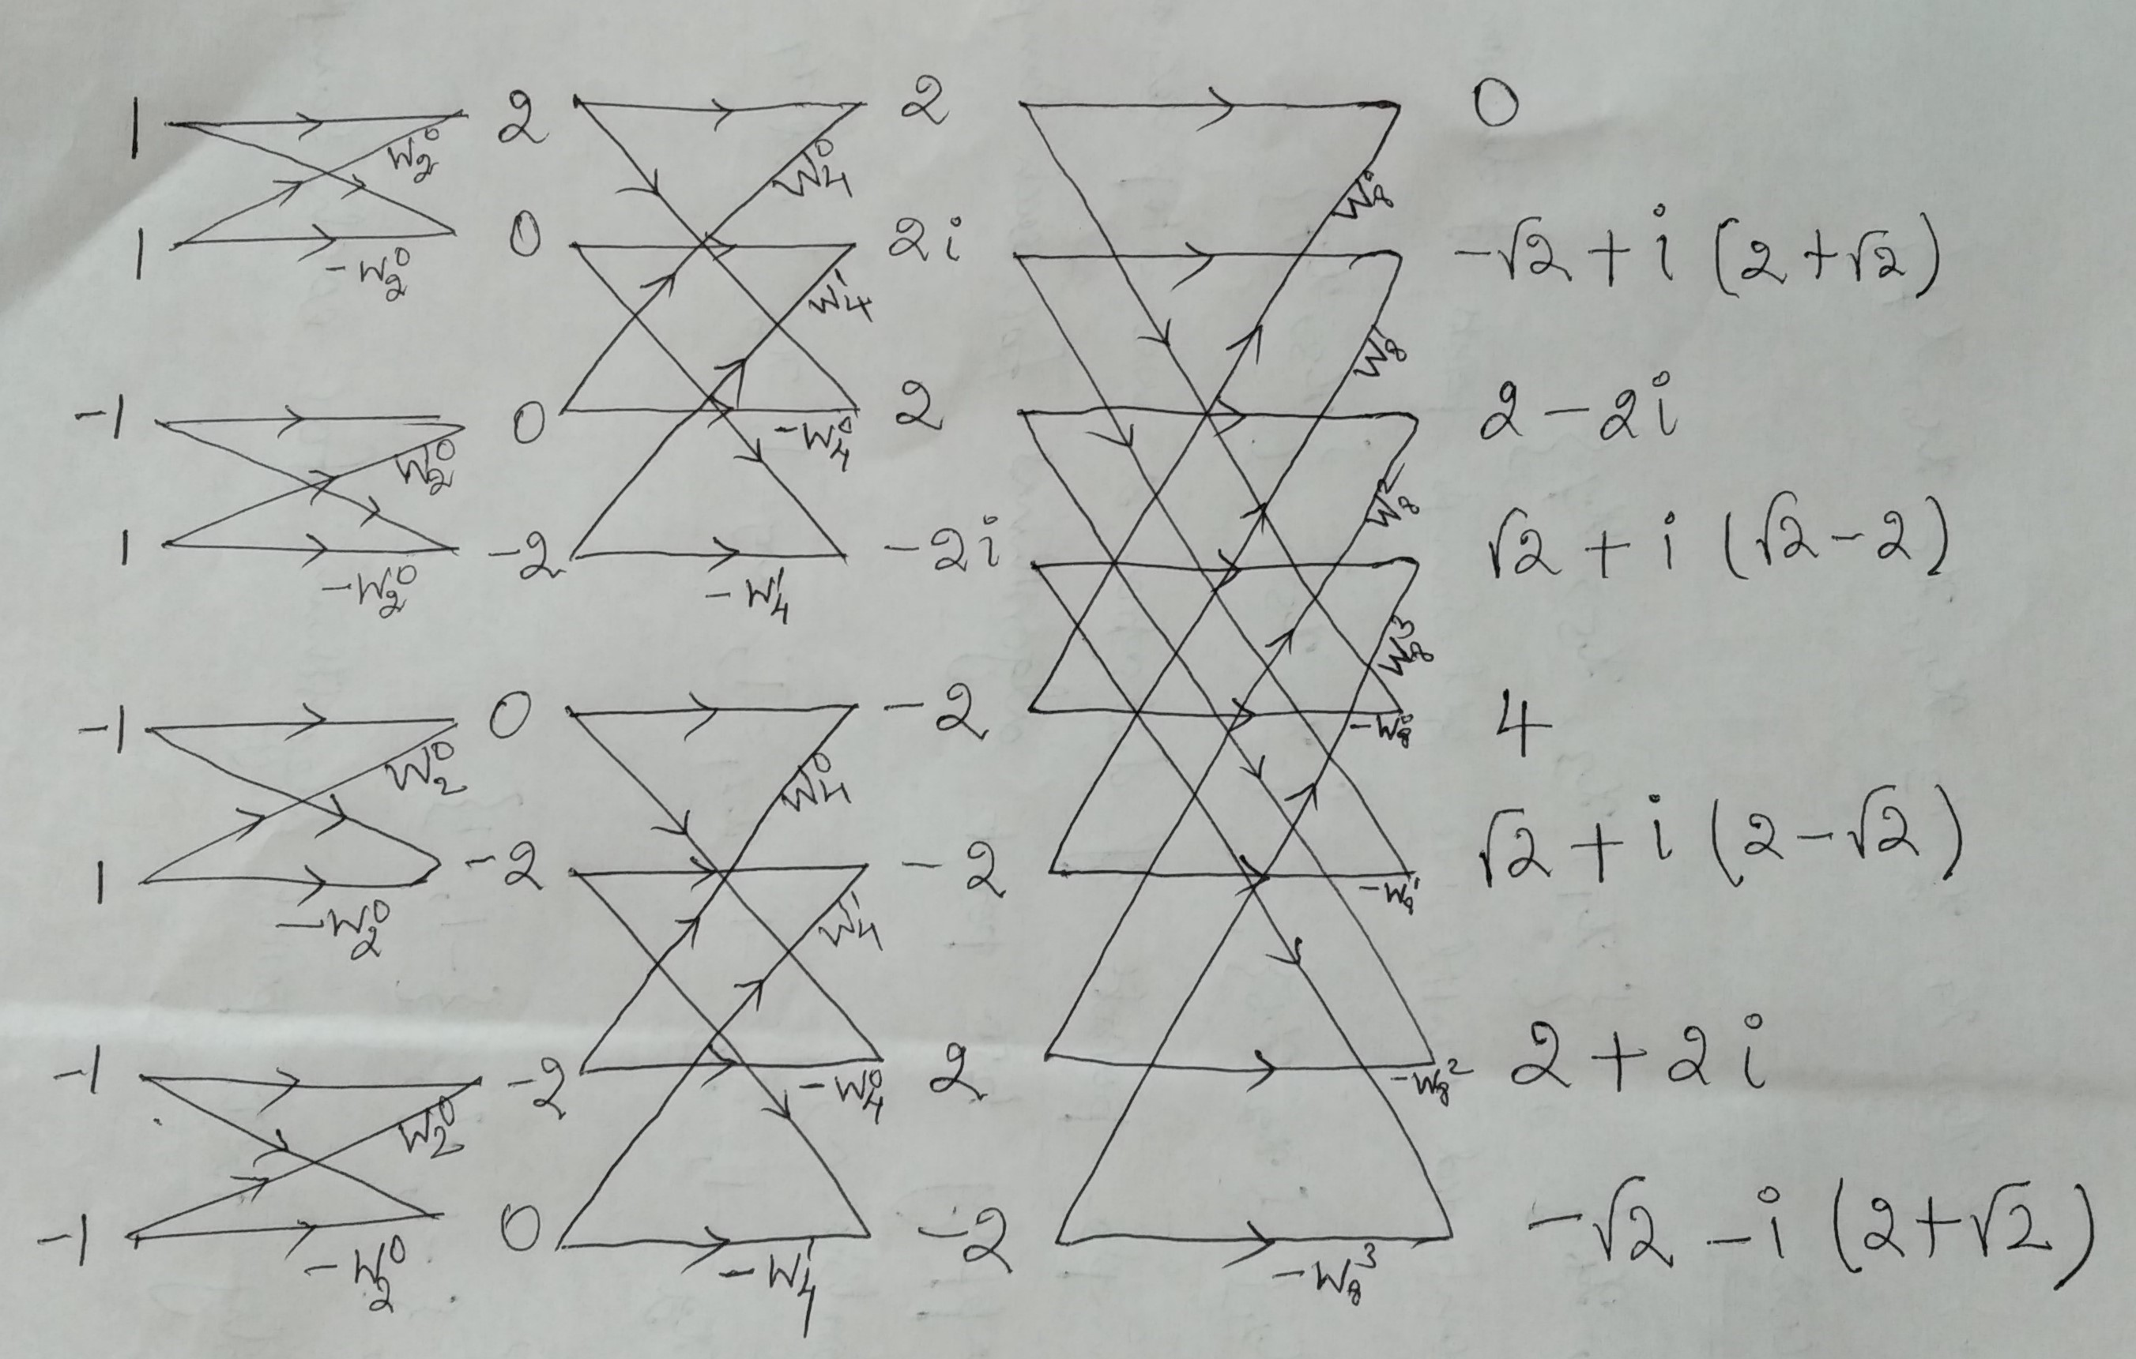
Sample

Slide 16



Example contd…
$$1$$
$$2$$
$$W_{2}^{0}$$
$$1$$
$$0$$
$${−W}_{2}^{0}$$
$$−1$$
$$0$$
$$W_{2}^{0}$$
$$1$$
$$−2$$
$${−W}_{2}^{0}$$

Slide 17




Example contd…
$$−1$$
$$0$$
$$W_{2}^{0}$$
$$1$$
$$2$$
$${−W}_{2}^{0}$$
$$−1$$
$$−2$$
$$W_{2}^{0}$$
$$−1$$
$$0$$
$${−W}_{2}^{0}$$

Slide 18










Example contd…
$$2$$
$$2$$
$$0+\left(−2\right)W_{4}^{1}=(−2)(−i)$$
$$W_{4}^{0}$$
$$=2i$$
$$0$$
$$2i$$
$$W_{4}^{1}$$
$$0$$
$$2$$
$${−W}_{4}^{0}$$
$$0+\left(−2\right){(−W}_{4}^{1})=(−2)(i)$$
$$=−2i$$
$$−2$$
$$−2i$$
$${−W}_{4}^{1}$$

Slide 19







Example contd…
$$0$$
$$−2$$
$$W_{4}^{0}$$
$$−2$$
$$−2$$
$$W_{4}^{1}$$
$$−2$$
$$2$$
$${−W}_{4}^{0}$$
$$0$$
$$−2$$
$${−W}_{4}^{1}$$

Slide 20






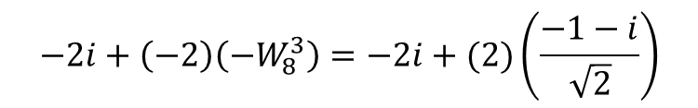



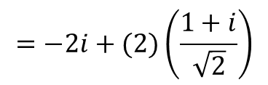




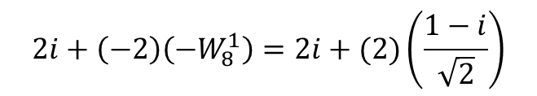


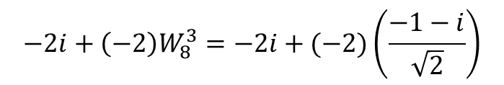







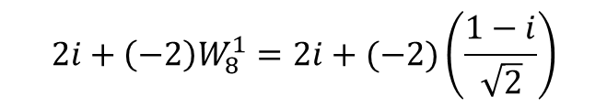








Contd…
$$2i+\left(−2\right)W_{8}^{1}=2i+(−2)\left(\frac{1−i}{\sqrt{2}}\right)$$
$$2$$
$$0$$
$$W_{8}^{0}$$
$=2i−\sqrt{2}$+i$\sqrt{2}$
$$2i$$
$$−\sqrt{2}+i\left(2+\sqrt{2}\right)$$
$$2+\left(2\right)W_{8}^{2}=2+(2)\left(−i\right)$$
$$W_{8}^{1}$$
$$2$$
$$2−2i$$
$$−2i+\left(−2\right)W_{8}^{3}=−2i+(−2)\left(\frac{−1−i}{\sqrt{2}}\right)$$
$$W_{8}^{2}$$
$$−2i$$
$$\sqrt{2}+i\left(−2+\sqrt{2}\right)$$
$$=−2i+(2)\left(\frac{1+i}{\sqrt{2}}\right)$$
$$W_{8}^{3}$$
$=−2i+\sqrt{2}$+$i\sqrt{2}$
$$−2$$
$$4$$
$${−W}_{8}^{0}$$
$$2i+\left(−2\right)\left(−W_{8}^{1}\right)=2i+(2)\left(\frac{1−i}{\sqrt{2}}\right)$$
$$−2$$
$$\sqrt{2}+i\left(2−\sqrt{2}\right)$$
$$−W_{8}^{1}$$
$$=2i+\sqrt{2}−i\sqrt{2}$$
$$2$$
$$2+\left(2\right)\left({−W}_{8}^{2}\right)=2+(−2)\left(−i\right)$$
$$2+2i$$
$${−W}_{8}^{2}$$
$$−2i+\left(−2\right)\left(−W_{8}^{3}\right)=−2i+(2)\left(\frac{−1−i}{\sqrt{2}}\right)$$
$$−2$$
$$−\sqrt{2}−i\left(2+\sqrt{2}\right)$$
$${−W}_{8}^{3}$$
$$=−2i−\sqrt{2}−i\sqrt{2}$$

Slide 21


Out put
$X\left(k\right)=\{0,−\sqrt{2}+i\left(2+\sqrt{2}\right),2−2i,\sqrt{2}+i\left(−2+\sqrt{2}\right), 4,\sqrt{2}+i\left(2−\sqrt{2}\right), 2+2i,−\sqrt{2}−i\left(2+\sqrt{2}\right)\}$
Problems for practice
Find the Discrete Fourier Transform for the following using DIT-FFT.
(i) $\{1, 2, 3,4, 4, 3, 2,1\}$
(ii) $\{1, 2, 1, 3, 1, 4, 1, 5\}$

Slide 22
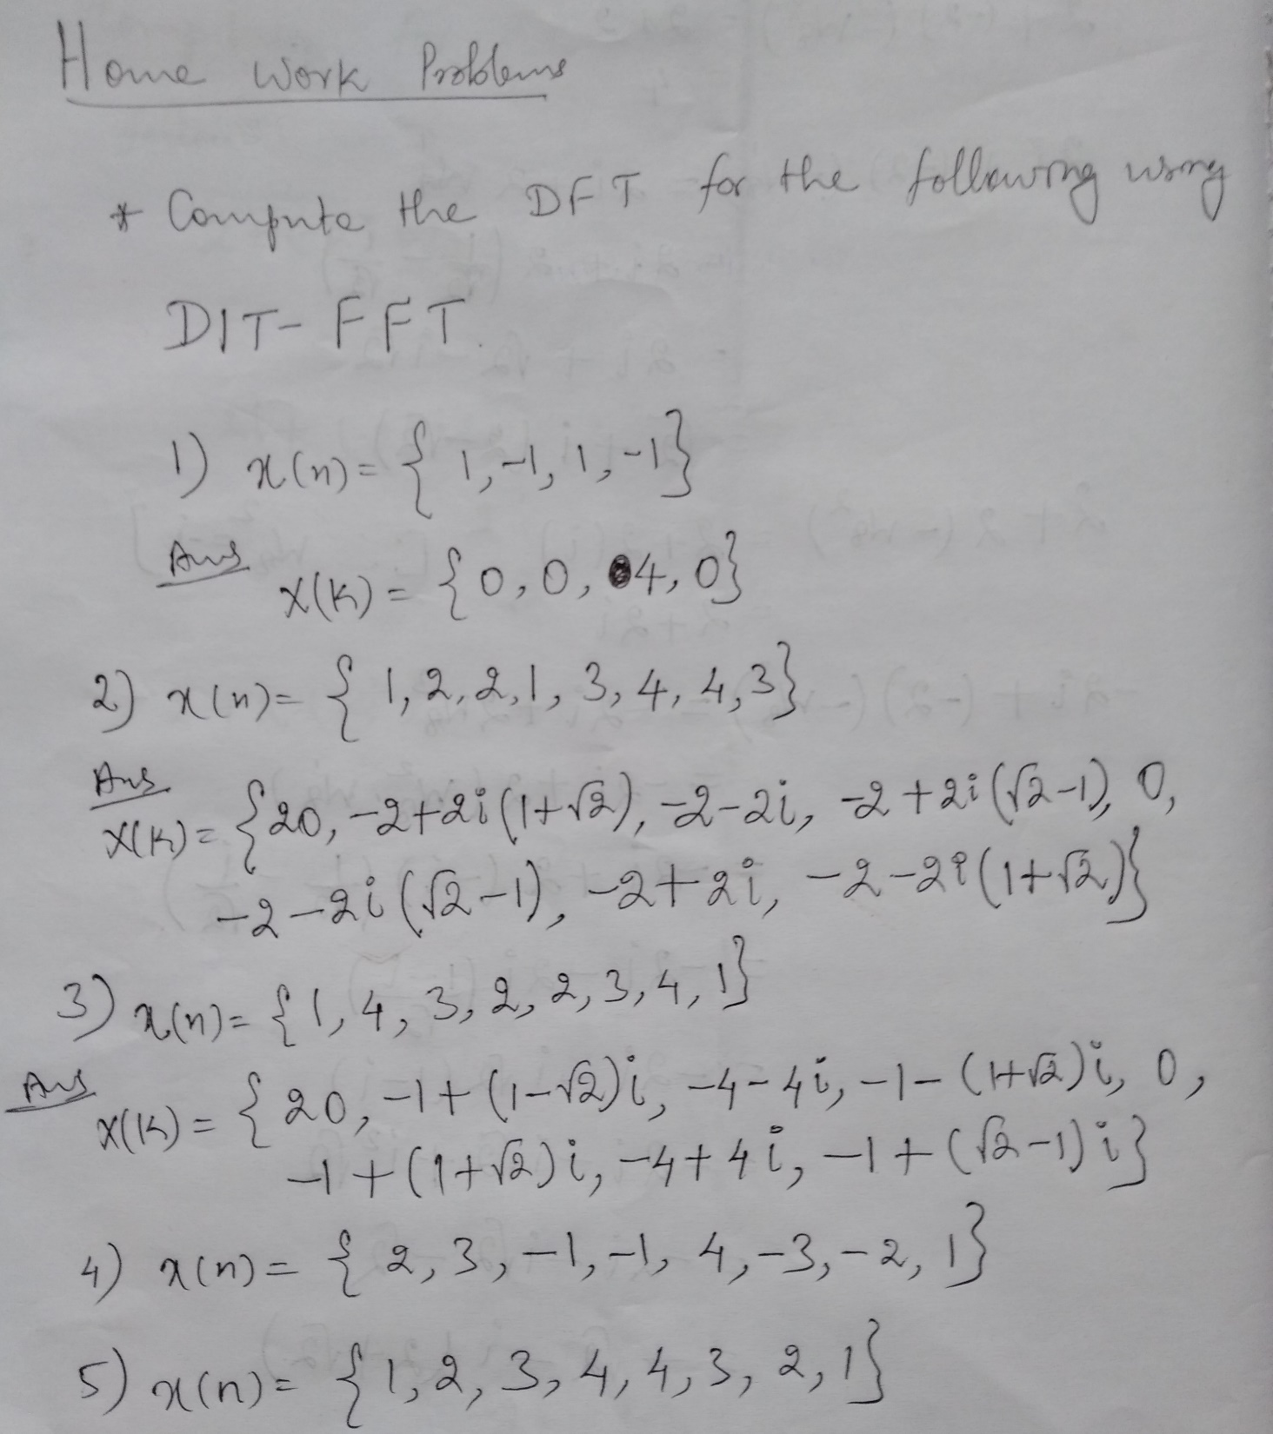

Slide 23

Algorithm for Inverse
Inverse formula differ in two aspects
Negative power phase factor
Final answer to be divided by $N$

Slide 24
DIT Algorithm for Inverse computation
Two-point formula
$$n_{1}$$
$${n_{1}+W_{2}^{0}n}_{2}$$
$$W_{2}^{0}$$
$$n_{2}$$
$${n_{1}−W_{2}^{0}n}_{2}$$
$${−W}_{2}^{0}$$

Slide 25




Algorithm contd…
Four-point formula
$$n_{1}$$
$${n_{1}+W_{4}^{0}n}_{3}$$
$$W_{4}^{0}$$
$$n_{2}$$
$${n_{2}+W_{4}^{−1}n}_{4}$$
$$W_{4}^{−1}$$
$$n_{3}$$
$${n_{1}−W_{4}^{0}n}_{3}$$
$${−W}_{4}^{0}$$
$$n_{4}$$
$${n_{2}−W_{4}^{−1}n}_{4}$$
$${−W}_{4}^{−1}$$

Slide 26






Algorithm contd…
Eight-point formula
$$W_{8}^{0}$$
$$W_{8}^{−1}$$
$$W_{8}^{−2}$$
$$W_{8}^{−3}$$
$${−W}_{8}^{0}$$
$$−W_{8}^{−1}$$
$${−W}_{8}^{−2}$$
$${−W}_{8}^{−3}$$

Slide 27
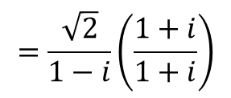

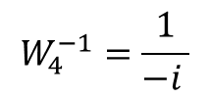
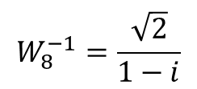
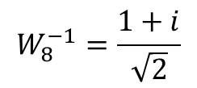
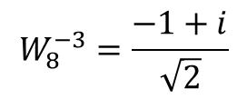

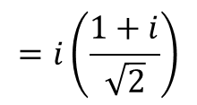
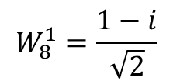
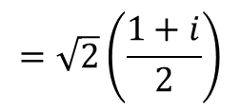


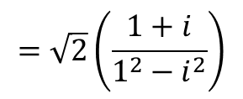
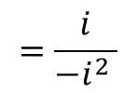
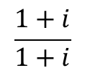

Computation of negative power phase factors
$$W_{4}^{1}=−i$$
$$\frac{1+i}{1+i}$$
$$W_{8}^{−3}=W_{8}^{−2}W_{8}^{−1}$$
$$W_{4}^{−1}=\frac{1}{−i }$$
$$=\sqrt{2}\left(\frac{1+i}{1^{2}−i^{2}}\right)$$
$$=i\left(\frac{1+i}{\sqrt{2}}\right)$$
$$=\frac{i}{−i^{2} }$$
$$=\sqrt{2}\left(\frac{1+i}{2}\right)$$
$$W_{8}^{−3}=\frac{−1+i}{\sqrt{2}}$$
$$W_{4}^{−1}=i$$
$$W_{8}^{−1}=\frac{1+i}{\sqrt{2}}$$
$$W_{8}^{1}=\frac{1−i}{\sqrt{2}}$$
$$W_{8}^{2}=−i$$
$$W_{8}^{−1}=\frac{\sqrt{2}}{1−i}$$
$$W_{8}^{−2}=i$$
$$=\frac{\sqrt{2}}{1−i}\left(\frac{1+i}{1+i}\right)$$

Slide 28



Example
1. Find the Inverse Discrete Fourier Transform of $X\left(k\right)=\left\{0, 0, 4, 0\right\}$ using decimation in Time algorithm.
$$\left\{0, 0, 4, 0\right\}$$
$$\left\{0, 4\right\}$$
$$\left\{0, 0\right\}$$

Slide 29








Example contd…
$$0$$
$$4$$
$$W_{2}^{0}$$
$$4$$
$$−4$$
$${−W}_{2}^{0}$$
$$0$$
$$0$$
$$W_{2}^{0}$$
$$0$$
$$0$$
$${−W}_{2}^{0}$$

Slide 30














Example Contd…
$$4$$
$$4$$
$$W_{4}^{0}$$
$$−4$$
$$−4$$
$$W_{4}^{−1}$$
$$0$$
$$4$$
$${−W}_{4}^{0}$$
$$0$$
$$−4$$
$${−W}_{4}^{−1}$$
$$\left\{4, −4, 4, −4\right\}$$
$$X\left(k\right)=\left\{1, −1, 1, −1\right\}$$

Slide 31






Example
2. Find the Inverse Discrete Fourier Transform of
$X\left(k\right)=\left\{18,2\sqrt{2}i, 2i,2\sqrt{2}i, −10, −2\sqrt{2}i, −2i, −2\sqrt{2}i\right\}$ using decimation in Time algorithm.
$$\left\{18,2\sqrt{2}i, 2i,2\sqrt{2}i, −10, −2\sqrt{2}i, −2i, −2\sqrt{2}i\right\}$$
$$\left\{18, 2i, −10, −2i\right\}$$
$$\left\{2\sqrt{2}i, 2\sqrt{2}i, −2\sqrt{2}i, −2\sqrt{2}i\right\}$$
$$\left\{18, −10\right\}$$
$$\left\{2i, −2i\right\}$$
$$\left\{ 2\sqrt{2}i, −2\sqrt{2}i\right\}$$
$$\left\{ 2\sqrt{2}i, −2\sqrt{2}i\right\}$$

Slide 32







Example contd…
$$18$$
$$8$$
$$W_{2}^{0}$$
$$−10$$
$$28$$
$${−W}_{2}^{0}$$
$$2i$$
$$0$$
$$W_{2}^{0}$$
$$−2i$$
$$4i$$
$${−W}_{2}^{0}$$

Slide 33






Example contd…
$$2\sqrt{2}i$$
$$0$$
$$W_{2}^{0}$$
$$−2\sqrt{2}i$$
$$4\sqrt{2}i$$
$${−W}_{2}^{0}$$
$$2\sqrt{2}i$$
$$0$$
$$W_{2}^{0}$$
$$−2\sqrt{2}i$$
$$4\sqrt{2}i$$
$${−W}_{2}^{0}$$

Slide 34













Example contd…
$$8$$
$$8$$
$$28+\left(4i\right)W_{4}^{−1}=28+(4i)(i)$$
$$W_{4}^{0}$$
$$=24$$
$$28$$
$$24$$
$$W_{4}^{−1}$$
$$0$$
$$8$$
$${−W}_{4}^{0}$$
$$28+\left(4i\right){(−W}_{4}^{−1})=28+(4i)(−i)$$
$$=32$$
$$4i$$
$$32$$
$${−W}_{4}^{−1}$$

Slide 35













Example contd…
$$0$$
$$0$$
$$4\sqrt{2}i+4\sqrt{2}iW_{4}^{−1}=4\sqrt{2}i+4\sqrt{2}i(i)$$
$$W_{4}^{0}$$
$$4\sqrt{2}i$$
$$4\sqrt{2}i−4\sqrt{2}$$
$$W_{4}^{−1}$$
$$0$$
$$0$$
$${−W}_{4}^{0}$$
$$4\sqrt{2}i$$
$$4\sqrt{2}i+4\sqrt{2}$$
$${−W}_{4}^{−1}$$

Slide 36



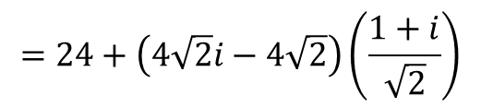











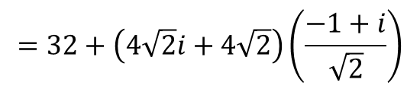



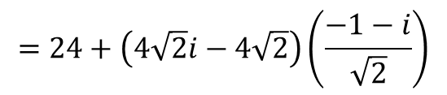














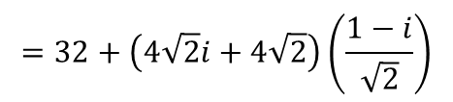
Contd…
$$8$$
$$8$$
$$24+\left(4\sqrt{2}i−4\sqrt{2}\right)\left(W_{8}^{−1}\right)$$
$$W_{8}^{0}$$
$$=24+\left(4\sqrt{2}i−4\sqrt{2}\right)\left(\frac{1+i}{\sqrt{2}}\right)$$
$$24$$
$$16$$
$$W_{8}^{−1}$$
$$=24+4(i^{2}−1^{2})$$
$$8$$
$$8$$
$$32+\left(4\sqrt{2}i+4\sqrt{2}\right)\left(W_{8}^{−3}\right)$$
$$W_{8}^{−2}$$
$$=32+\left(4\sqrt{2}i+4\sqrt{2}\right)\left(\frac{−1+i}{\sqrt{2}}\right)$$
$$32$$
$$24$$
$$W_{8}^{−3}$$
$$=32+4(i^{2}−1^{2})$$
$$0$$
$$8$$
$${−W}_{8}^{0}$$
$$24+\left(4\sqrt{2}i−4\sqrt{2}\right)\left({−W}_{8}^{−1}\right)$$
$$=24+\left(4\sqrt{2}i−4\sqrt{2}\right)\left(\frac{−1−i}{\sqrt{2}}\right)$$
$$4\sqrt{2}i−4\sqrt{2}$$
$$32$$
$$−W_{8}^{−1}$$
$$=24+4(−i^{2}+1^{2})$$
0
$$8$$
$$32+\left(4\sqrt{2}i+4\sqrt{2}\right)\left({−W}_{8}^{−3}\right)$$
$${−W}_{8}^{−2}$$
$$=32+\left(4\sqrt{2}i+4\sqrt{2}\right)\left(\frac{1−i}{\sqrt{2}}\right)$$
$$4\sqrt{2}i+4\sqrt{2}$$
$$40$$
$${−W}_{8}^{−3}$$
$$=32+4(−i^{2}+1^{2})$$

Slide 37


Final output
$$\left\{8, 16, 8, 24, 8, 32, 8, 40\right\}$$
$$X\left(k\right)=\left\{1, 2, 1, 3, 1, 4, 1, 5\right\}$$

Slide 38




DIF Algorithm
Two-point formula
$$n_{1}$$
$${n_{1}+n}_{2}$$
$$1$$
$$n_{2}$$
$${n_{1}−n}_{2}$$
$$−1$$

Slide 39






Algorithm contd…
Four-point formula
$$1$$
$$1$$
$$W_{4}^{0}$$
$$−1$$
$$W_{4}^{1}$$
$$−1$$

Slide 40












Eight-point formula
$$1$$
$$1$$
$$1$$
$$1$$
$$W_{8}^{0}$$
$$−1$$
$$W_{8}^{1}$$
$$−1$$
$$W_{8}^{2}$$
$$−1$$
$$W_{8}^{3}$$
$$−1$$

Slide 41
Example
1. Find the DFT of $x\left(n\right)=\{2, 3, −1, −1, 4,−3,−2, 1\}$ using DIF-FFT.

Slide 42









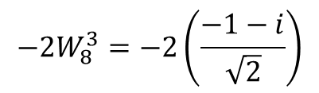








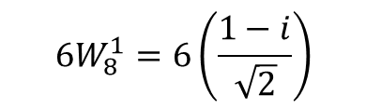
Eight-point formula
$${6W}_{8}^{1}=6\left(\frac{1−i}{\sqrt{2}}\right)$$
$$2$$
$$6$$
$$1$$
$$−1+\left(−2\right)\left(−1\right)=1W_{8}^{2}$$
$$3$$
$$0$$
$$1$$
$$−2W_{8}^{3}=−2\left(\frac{−1−i}{\sqrt{2}}\right)$$
$$−1$$
$$−3$$
$$1$$
$$−1$$
$$0$$
$$1$$
$$W_{8}^{0}$$
$$4$$
$$−2$$
$$−1$$
$$W_{8}^{1}$$
$$−3$$
$$3\sqrt{2}−i3\sqrt{2}$$
$$−1$$
$$W_{8}^{2}$$
$$−2$$
$$−i$$
$$−1$$
$$W_{8}^{3}$$
$$1$$
$$\sqrt{2}+i\sqrt{2}$$
$$−1$$

Slide 43














Four point algorithms
$$6$$
$$3$$
$$1$$
$$0$$
$$0$$
$$1$$
$$W_{4}^{0}$$
$$−3$$
$$9$$
$$−1$$
$$W_{4}^{1}$$
$$0$$
$$0$$
$$−1$$

Slide 44










Four point algorithms
$$\left(2\sqrt{2}−4i\sqrt{2}\right)W_{4}^{1}$$
$$=\left(2\sqrt{2}−4i\sqrt{2}\right)\left(−i \right)$$
$$−2$$
$$−2−i$$
$$1$$
$$3\sqrt{2}−i3\sqrt{2}$$
$$4\sqrt{2}−2i\sqrt{2}$$
$$1$$
$$W_{4}^{0}$$
$$−i$$
$$−2+i$$
$$−1$$
$$W_{4}^{1}$$
$$\sqrt{2}+i\sqrt{2}$$
$$−4\sqrt{2}−2i\sqrt{2}$$
$$−1$$

Slide 45











Example contd…
$$3$$
$$3$$
$$1$$
$$0$$
$$3$$
$$−1$$
$$9$$
$$9$$
$$1$$
$$0$$
$$9$$
$$−1$$

Slide 46












Example contd…
$$−2−i$$
$$−2+4\sqrt{2}−i(1+2\sqrt{2})$$
$$1$$
$$4\sqrt{2}−2i\sqrt{2}$$
$$−2−4\sqrt{2}+i(−1+2\sqrt{2})$$
$$−1$$
$$−2+i$$
$$−2−4\sqrt{2}−i(−1+2\sqrt{2})$$
$$1$$
$$−4\sqrt{2}−2i\sqrt{2}$$
$$−2+4\sqrt{2}+i(1+2\sqrt{2})$$
$$−1$$

Slide 47



Final output
This requires decimation process
$$\{3, 3\}$$
$$\{9, 9\}$$
$$\{−2+4\sqrt{2}−i(1+2\sqrt{2}),−2−4\sqrt{2}+i(−1+2\sqrt{2})\}$$
$$\{−2−4\sqrt{2}−i(−1+2\sqrt{2}),−2+4\sqrt{2}+i(1+2\sqrt{2})\}$$
$$\{3, 9, 3,9\}$$
$$\{−2+4\sqrt{2}−i(1+2\sqrt{2}),−2−4\sqrt{2}−i(−1+2\sqrt{2}),−2−4\sqrt{2}+i(−1+2\sqrt{2}),−2+4\sqrt{2}+i(1+2\sqrt{2})\}$$
$$\{3,−2+4\sqrt{2}−i(1+2\sqrt{2}),9,−2−4\sqrt{2}−i(−1+2\sqrt{2}),3,−2−4\sqrt{2}+i(−1+2\sqrt{2}),9,−2+4\sqrt{2}+i(1+2\sqrt{2})\}$$

Slide 48
Algorithm for Inverse
Inverse formula differ in two aspects
Negative power phase factor
Final answer to be divided by $N$

Slide 49
DIF Algorithm for finding Inverse Transform
Two-point formula
$$n_{1}$$
$${n_{1}+n}_{2}$$
$$1$$
$$n_{2}$$
$${n_{1}−n}_{2}$$
$$−1$$

Slide 50

Algorithm contd…
Four-point formula
$$1$$
$$1$$
$$W_{4}^{0}$$
$$−1$$
$$W_{4}^{−1}$$
$$−1$$

Slide 51



Eight-point formula
$$1$$
$$1$$
$$1$$
$$1$$
$$W_{8}^{0}$$
$$−1$$
$$W_{8}^{−1}$$
$$−1$$
$$W_{8}^{−2}$$
$$−1$$
$$W_{8}^{−3}$$
$$−1$$

Slide 52
F

Slide 53


