Slide 1
Algorithms
Muralidhara V N
IIIT Bangalore
murali@iiitb.ac.in
Office No 111

Slide 2
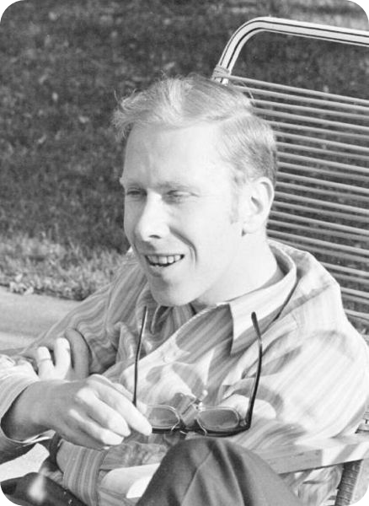
Program = Algorithms + Data Structures
In 1975, Nicklaus Wirth wrote the book,
Algorithm + Data Structures = Program
Notes:
In 1975 he wrote the book Algorithms + Data Structures = Programs, which gained wide recognition and is still useful today.
2

Slide 3
BOOK
Introduction to Algorithms by Thomas H. Cormen, Charles E. Leiserson, Ronald L. Rivest, and Clifford Stein.

Slide 4
Videos
Data Sturcures and Algorithms by Professor Naveen Garg, IIT Delhi at http://nptel.iitm.ac.in
Few courses at coursera.org

Slide 5
Evaluation
All the exams are open book and notes.
Mid Term 20%
End Term 20%
2 Quizzes 20%
2 Tests 20%
2 Programming Tests 20%

Slide 6
Plagiarism
Plagiarism is defined as “the deliberate or
reckless representation of another's words,
thoughts, or ideas as one's own without
attribution in connection with submission of
academic work”.
In the academic world, plagiarism by students
is a very serious offense that can result in
punishments !!!!.

