Slide 1


Data Governance @ SneakerPark
Prepared by: Mohit Bansal
Submitted on:2023-02-18

Slide 2
Background
SneakerPark is an online shoe reseller that allows people to buy and sell used and new shoes. Buyers can bid for shoes or buy them outright, and sellers can set a price or sell to the highest bidder.
Each buyer and seller must have an active account in order to sell, bid, or purchase sneakers using SneakerPark’s website.
SneakerPark authenticates the shoes before shipping them to the buyer, so before listing an item, the seller must ship it to SneakerPark’s warehouse. Upon receipt, SneakerPark assigns an item number to each pair of sneakers and notifies the seller that they are now free to list their item. If the item is not listed within 45 days, SneakerPark returns it to the seller and sends an invoice to the seller for the shipping cost.
If the item is found to be inauthentic or in an unacceptable condition, it is also returned back to the seller in a similar fashion.
When the item sells, the buyer’s account is credited with the purchase price minus the SneakerPark service fee and shipping fees to deliver the item to the buyer.
Currently, SneakerPark only supports sales within the United States.

Slide 3
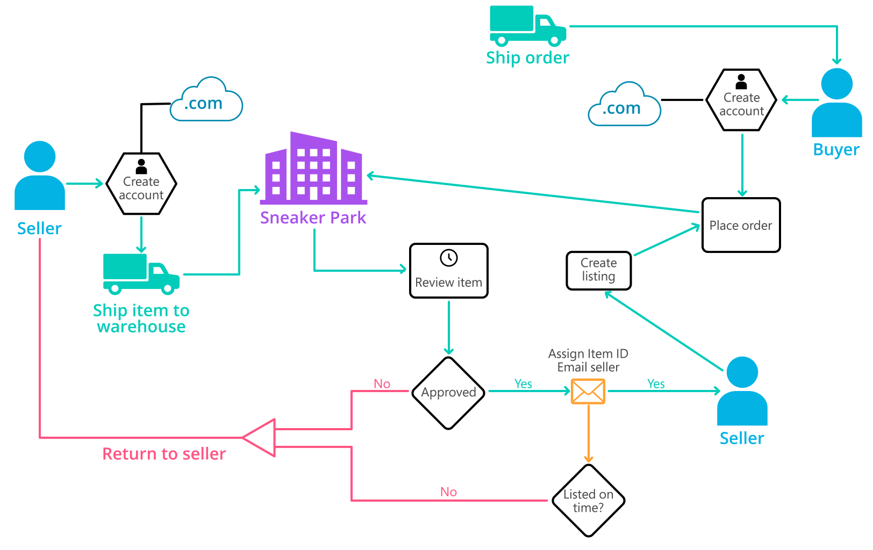
Background (cont’d)
Below you can see a diagram that will hopefully help you visualize some of SneakerPark's business processes. Keep in mind that it does not capture ALL processes and every nuance, but simply serves as another artifact to use in your project.

Slide 4
Step 1
Enterprise Data Catalog Part 1: Enterprise Data Model

Slide 5
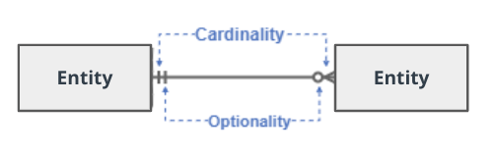
Create a conceptual data model that will provide SneakerPark with a holistic view of its data systems and help you grasp the organization's important entities and relationships, which will be instrumental as you move further in the project. You can use Lucidchart or any other diagramming tool of your choice, but please use the Crow’s Foot/IE Notation and please be sure to indicate both cardinality (the type of a relationship such as 1:N or N:N) and optionality (whether the relationship is optional or mandatory).

Slide 6
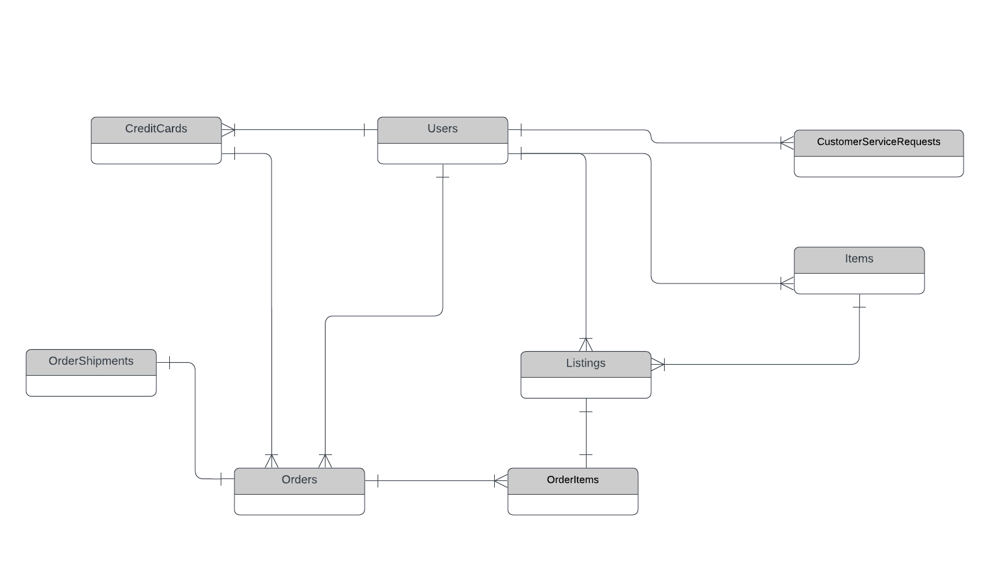
Enterprise Data Model

Slide 7
Step 2
Enterprise Data Catalog Part 2: Metadata

Slide 8
Create the first version of the Metadata Catalog by documenting the metadata from all systems in the "Data Dictionary" and the “Enterprise Data Catalog” tabs of the provided Sheets template.
Please note that you are required to fill out all fields in both tabs.

Slide 9
Step 3
Data Quality
Part 1: Profiling and Cleansing

Slide 10
Profile the data to identify at least 3 data quality issues you see in the data. Also provide at least 1 data quality issue that you haven’t yet seen in the data, but can foresee occurring in the future. Based on the issues you’ve identified, come up with the data quality rule for each data quality issue, including for the one that you foresee.
Make sure you fill out all columns in the "Data Quality Issues" tab with your answers in the provided Sheets template.

Slide 11
Step 4
Data Quality
Part 2: Monitoring

Slide 12
Using the metrics you've created in the last step, please create a mock-up of a data quality monitoring dashboard that will be used to monitor the data to ensure compliance with your data quality rules.
Please make sure to label your metrics clearly on your mock-up.

Slide 14
Step 5
Master Data Management
Part 1: MDM Architecture

Slide 15
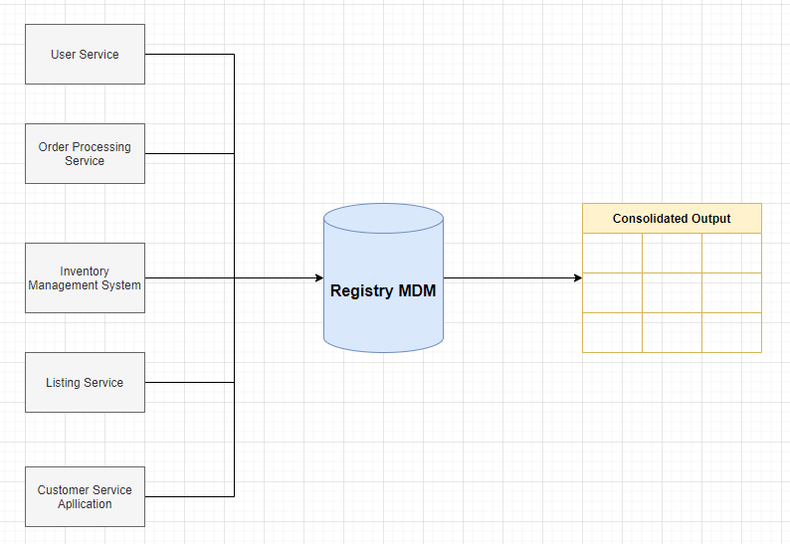
Based on what you’ve read about SneakerPark’s systems and business model, sketch out a proposed MDM implementation architecture, and write a detailed explanation of why you chose this specific approach.
Registry MDM has a central database that contains a list of primary keys for the master records along with a list of the available attributes and the source systems where these records can be found. This central database essentially serves as the “registry” for all the master records and their locations, hence the name, Registry MDM. The master data remains in the source systems and the user has to query and join this data manually using the keys provided. This architecture is simple to implement, has low cost, and causes minimal intrusion to existing systems. A more advanced version of this style uses some form of an automated mechanism to both retrieve and join data at runtime.

Slide 16
Registry MDM Table
KEY | Attributes | Source System | Identifiers
UserID | FirstName, LastName, Email, Address, ZipCode | User Service | FirstName, LastName, Email
CreditCardID | CreditCardNumber, CreditCardExpirationDate, UserID | User Service | CreditCardNumbe
ListingID | SellerID, ProductID, ShoeType, Brand, Color, Gender, Size, Condition, ListingPrice, ListingType, ListingCreateDate, ListingEndDate | Listing Service | SellerID, ProductID
OrderID | BuyerID, CreditCardID, ShippingCost, TaxRatePercent, TotalAmount, ShippingAddress, ShippingAddress, ShippingZipCode, OrderDate, Status | Order Processing Service | BuyerID, CreditCardID
ShipmentID | OrderID, Carrier, TrackingNumber, OrderShipDate | Order Processing Service | TrackingNumber
ItemID | ItemName, SellerID, Type, BrandName, Color, Size, Sex, Condition, ItemStatus, ArrivalDate | Inventory Management System | ItemName, SellerID
ID | UserID, FirstName, LastName, ContactReason, Email, Phone, OrderID, Resolution, ContactMethod | Customer Service Application | UserID, FirstName, LastName

Slide 17
Explanation:
I chose Registry MDM architecture because it is simple to implement, has low cost, and causes minimal intrusion to existing systems.
It is the first time that the company decide to invest in an Enterprise Data Management Program and Registry MDM is the most suitable architecture.
Company has simple database and less number of table so it can easily manage by Registry MDM. In Less time it can easily implemented without making lot of changes in system

Slide 18
Step 6
Master Data Management
Part 2: Master Record

Slide 19
In this step, you will define a set of matching rules that will be used by the SneakerPark's MDM Hub to match item and customer entities between the company's different systems.
Please come up with 4 rules - 2 for Items and 2 for Customers and list them below.
1 – Item: same ItemName and sellerID . Match the ItemID records on the Item Name from Item and the SellerID from Listings.
2 – Item: same BrandName, ArrivalDate and SellerID. Match the ItemID records on the Brand Name and Arrival Date from Item and Seller ID from Listings.
3 – Customer: same LastName, CreditCardNumber and CreditCardExpirationDate. Match the UserID records on the LastName of Users and the Credit Card Number and Credit Card ExpirationDate from Credit cards.
4 – Customer: Same Email and OrderID. Match the UserID records on the Email from Users and OrderID from Customer Service Requests

Slide 20
Step 7
Data Governance:
Roles and Responsibilities

Slide 21
Write 1-2 paragraphs discussing what data governance roles and responsibilities will be necessary to oversee this new Data Management initiative. Please be sure to discuss the responsibilities in the context of at least 3 different aspects of Data Governance (such as Data Quality Management, Metadata Management, MDM, etc). Based on what you know, do SneakerPark's current employees have the necessary skills for these roles or should the company make new hires?
Data Quality Management :
I think it is very important to take care about the process of Data Quality by performing data profiling, identifing the issues, computing the data quality scores and data quality thresholds. Jake spends more and more time fire-fighting and trying to fix all the data issues that have come up. He can easily handle this Management at starting.
Metadata Management:
Metadata management is critical to enabling good data governance. With proper metadata management, companies reduce the reliance on subject matter experts/IT personnel to identify the location of the information.Metadata management enables the creation of enterprise-level data definitions, proper documentation of business rules, usage, and policies.
Responsibility:
Business subject matter experts create business metadata. Jessica, a senior business analyst who is a company veteran and a subject-matter-expert can help us in this work.
Technical developers and architects create technical and operational metadata and create automated processes to ingest existing metadata into the Metadata Management System. I can help to created this architect system to enable functionality

Slide 22
3. Master Data Management:
the MDM is a good idea to focus on remediating the actual Enterprise Data Warehouse in order to improve the data quality and have a centralize business information across the company for analytics and decision making. Master data management system serves as a foundation and greatly improves the data quality of the Enterprise Data Warehouse, enabling accurate reporting and analytics.
For Warehouse Architecture and flow creation I can help in this part
For Managing data and database Jake can help this part
For Master record and Mapping of data Jessica can use her expertise.
4.Data steward
This role essentially is to support the user community. This individual is responsible for collecting, collating, and evaluating issues and problems with data. For this role Jessica, a senior business analyst who is a company veteran and a subject-matter-expert can help us in this work. Because she know about data.

