Slide 1

Data Lake Value Proposition
Medical Data Processing Company
Mohit Bansal
Udacity IPS Version 1.0

Slide 2
Agenda
What is a Data Lake
Components of a Data Lake
Data Lake vs Data Warehouse
Business Value of Data Lake Solution
Proposed Data Lake Architecture for Medical Data Processing system
Udacity IPS Ver. 1 2/2020

Slide 3
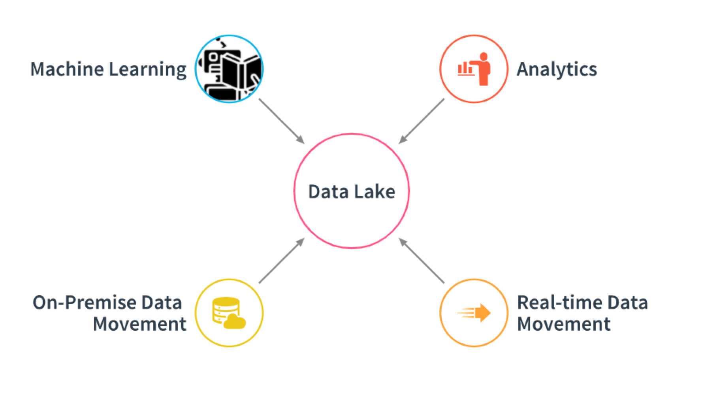
What is a Data Lake
Big Data represent large amounts of data. A Data Lake represents where and that data is stored

Slide 4

Components of Data Lake
Ingestion - tools to ingest data in Data Lake
Processing - tools to process the data in Data Lake
Storage - Store the data at scale in a data lake. Mostly leveraging Object Storage solutions
Governance - Broad term, including management of the data lake of the whole. Includes availability, monitoring, access control policies

Slide 5
Data Warehouse
Data Lake
schema designed at the end
Query results getting faster using low-cost storage
Non-relational and relational from IoT devices, web sites, mobile apps, social media, and corporate applications
Used for predictive analytics, machine learning
Connecting various types of data from a wide variety of sources
Schema designed at the beginning
Fastest query results using higher cost storage
Relational from transactional systems, operational databases, and line of business applications
Used for historical analytics, visualizations, BI
Collects similar data from multiple resources
Udacity IPS Ver. 1 2/2020

Slide 6
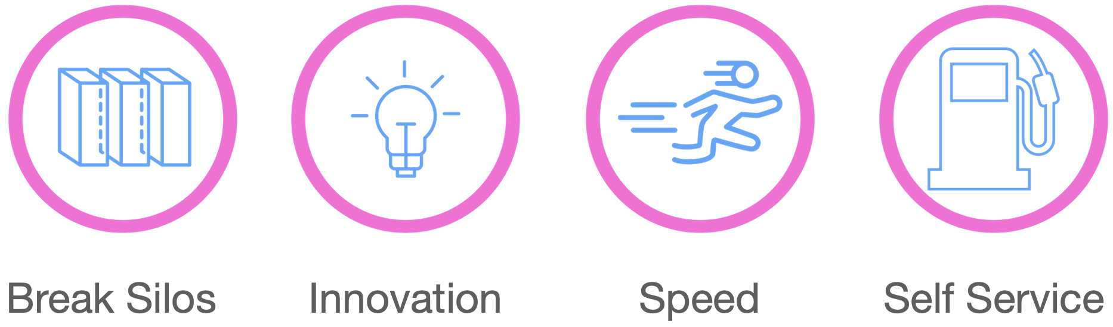
Business Value of Data Lake
Data Lake promotes organizations where
Innovation is enabled
Real-time, integrated-data Analytics is possible
Data silos are broken, which allows new collaboration and interactions
Self-service access instead of weeks months of work to get what they need
Data, even new data, can be dynamic, easy to incorporate, and quick to access

Slide 7
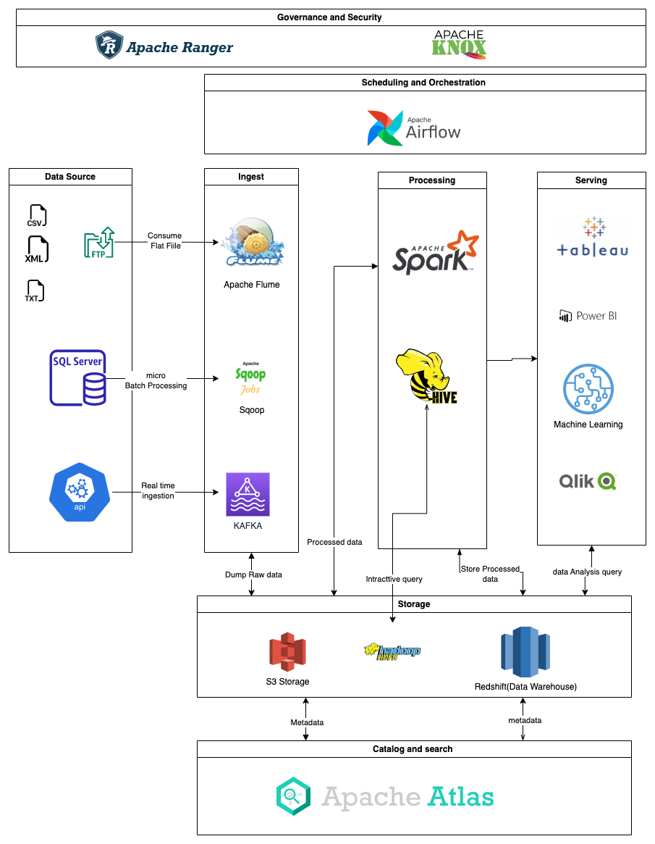
Data Lake Architecture

Slide 8
THANK YOU
Udacity IPS Version 1.0

