Slide 1

CTFs to Cyber Security Careers
Cyber SHE-ield 2025

Slide 2
# whoami
Alias @m0n1x90
Founder @TamilCTF
Security Engineer @Zoho
Red Teaming / Application Security / Malware Dev
Part time full stack development
Blog at m0n1x90.dev

Slide 3
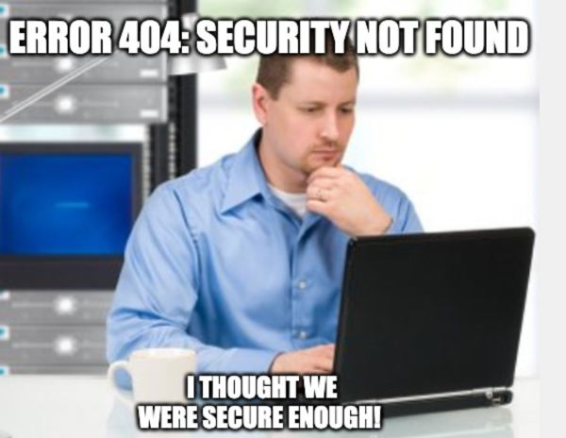
What Cybersecurity looks like...

Slide 4
Why cybersecurity matters ?
Personal, financial, and corporate data must be safeguarded from breaches
Sectors like healthcare, banking, and energy rely on cybersecurity
Cyberattacks cost billions globally, affecting economies
Cybercrime is increasing, affecting individuals, businesses, and governments
Many more unknown and upcoming attack surface ???

Slide 5
Why CTF for Cybersecurity ?
Drastic skill enhancement
Understanding multiple tech stack and frameworks
Exploring other domains
Debugging and investigation
Real world competition
Adaptability to real world exploits / CVEs
 | w/o CTF | w/ CTF
Experience | ✔️ | ✔️
Theory | ✔️ | ✔️
Practice |  | ✔️
Debugging Skill |  | ✔️
Real World Exploits |  | ✔️
Versatility |  | ✔️

Slide 6
What is CTF ?
Jeopardy-style
A cybersecurity competition where participants solve security-related challenges
CTF Time, Pico CTF
Try Hack Me, Hack The Box etc.
VulnHub, VulnLab etc.
PwnCollege
  Mixed
  Beginner Friendly
Attack Defense
  Red Team
  Blue Team
Boot2Root
  Pwn

Slide 7
Exploration in CTFs
Beginner categories like Web, Cryptography, Reverse Engineering, Forensics, Pwn, OSINT etc.
One step further – Cloud Attacks, Web3, Hardware Hacking etc.
Unlocking opportunities in each domain
Understanding attack vectors / prevention methodologies quicker
Fuzzing and exploiting real world like applications
Boosting confidence and skill level

Slide 8
Example CTF Problem ?
Are you confident in your coding skills …

Slide 9
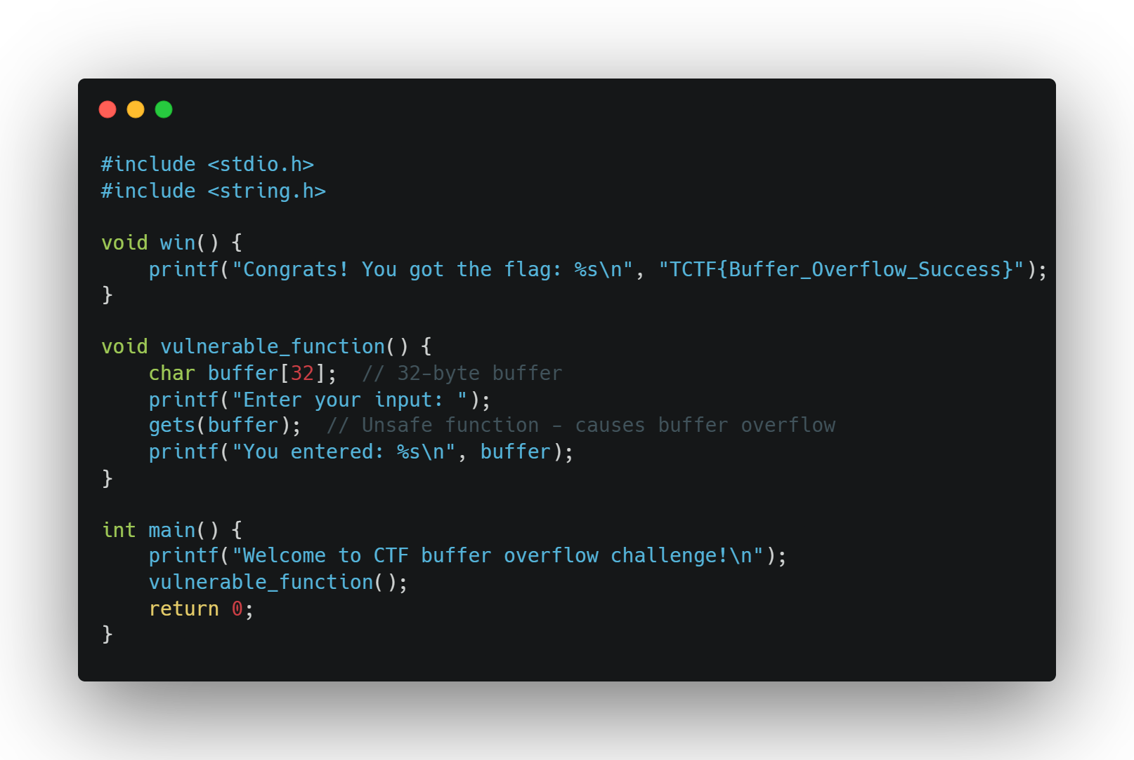
Testing You C/C++ Proficiency 😉

Slide 10
What you gain in CTFs ?
Strong problem solving skills correlating with real world expertise
Can use it in Bug Hunting, Vulnerability Research, Secure Coding etc.
Networking with like-minded people
Research & Continuous Development
Knowing reality that Cybersecurity world is just more than theory
Landing careers in your own field of expertise

Slide 11
CTFs to Career - Know your domain
Forensics = Malware Analyst , Incident Responder, SOC
Web = App Sec / Bug Hunting
Pwn = Binary Exploitation / Vulnerability Research
Reverse Engineering = Malware Analyst / Vulnerability Research
Cryptography = Mathematic / Complex Algorithms
Hardware = IoT / ICS / Other hardware

Slide 12
CTFs to Career - Hiring CTFs
Many cybersecurity companies use CTFs to identify skilled candidates
Some organizations offer direct job opportunities to top CTF players
Employers look for strong problem-solving, teamwork, and technical expertise
Performance in CTFs can replace traditional hiring processes like resumes & interviews (Depends on the company process)*

Slide 13
Start Now
Participate in CTFs regularly and identify your favorite skill
Build a portfolio (CTF write-ups, Blogs, Exploits, Vulnerable Apps)
Obtain industry reputed certifications (Adds preference to your resume)
Building network with professionals via LinkedIn & conferences
Contribute to open-source security projects

Slide 14
Start Now
Follow cybersecurity experts on social media
Start with beginner-friendly CTFs and gradually move to advanced levels
Join local cybersecurity clubs or online communities
Perseverance Never Fails 😎, Hack the planet !!!

Slide 15

Thank You
Follow Me On
@m0n1x90

