Slide 1

Linux Privilege Escalation

Slide 2
Agenda
Motivation
Types of privilege escalation
Enumeration
Automation
DEMO

Slide 3
Motivation
Full system control
Read, write, execute
Hide, persist, rootkits

Slide 4
Types of privesc
Horizontal x vertical
  Horizontal → To another non-privileged account
  Vertical → To r00t

Slide 5
Enumeration
OS/Kernel
Processes
Users and groups
Environment
History
Network
Cron
Packages
SUDO
SUID
Capabilities
LKMs
...

Slide 6
OS/Kernel
$ uname -a
$ cat /proc/version
Kernel exploits are the most common way to get root
Notes:
Ptrace is syscall for debugging, so if you can run a suid-root in a debugger, well... that's a vulnerability.
Ptrace needs to drop privileges, but you have some window of time there. That's a race condition
Result: A lot of ptrace vulnerabilities in the Linux Kernel
Search for exploits, google, exploit-db, or searchsploit. Found it! Should I use it now?
Advice:
- Kernel exploits should be the last resort! Use more stable methods first
- It might unstable and crash -> you loose
- You might get root... and then crash -> you loose
- The exploits might be noise -> you loose

Slide 7
OS/Kernel
$ cat /etc/issue
$ cat /etc/issue.net
$ cat /etc/*release
Vulnerabilities published for this distro?
Notes:
Ptrace is syscall for debugging, so if you can run a suid-root in a debugger, well... that's a vulnerability.
Ptrace needs to drop privileges, but you have some window of time there. That's a race condition
Result: A lot of ptrace vulnerabilities in the Linux Kernel
Search for exploits, google, exploit-db, or searchsploit. Found it! Should I use it now?
Advice:
- Kernel exploits should be the last resort! Use more stable methods first
- It might unstable and crash -> you loose
- You might get root... and then crash -> you loose
- The exploits might be noise -> you loose

Slide 8
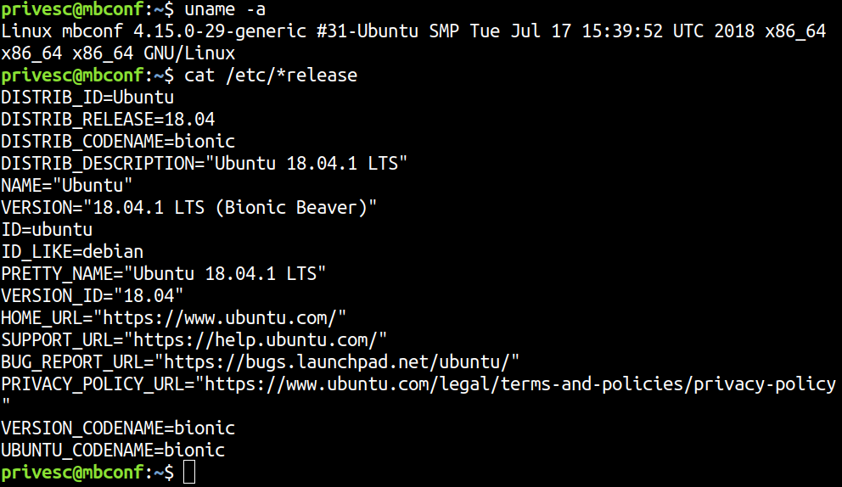
OS/Kernel

Slide 9
Users and groups
$ id
$ whoami
$ groups
$ cat /etc/passwd
$ cat /etc/group

Slide 10
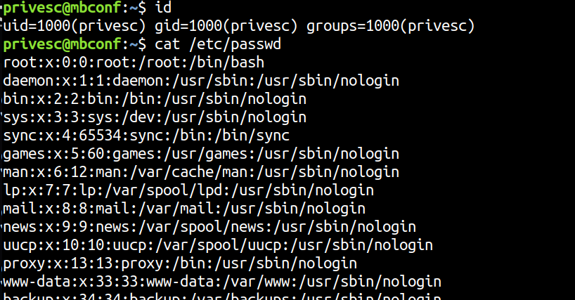
Users and groups

Slide 11
Processes
$ ps auxwf
$ ps -ef
Any vulnerable process running as root?
Notes:
Search for exploits using google, exploit-db, or searchsploit.
Exploit vulnerable programs running as root gives you root.
More stable than the kernel exploits, if the service crash the machine doesn't service probably will auto-restart

Slide 12
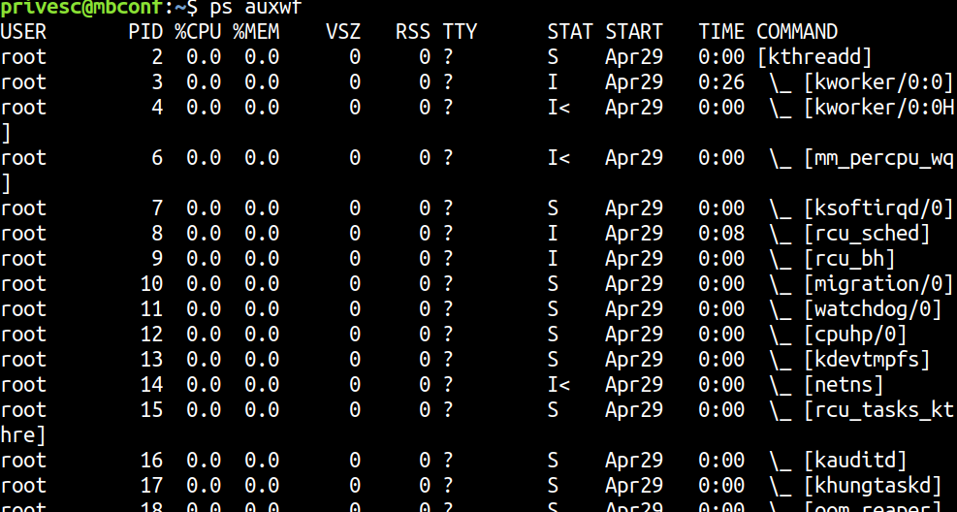
Processes

Slide 13
Environment
$ env
Passwords in the environment variables?
Notes:
Very common to have passwords, keys, etc. in the environment variables

Slide 14
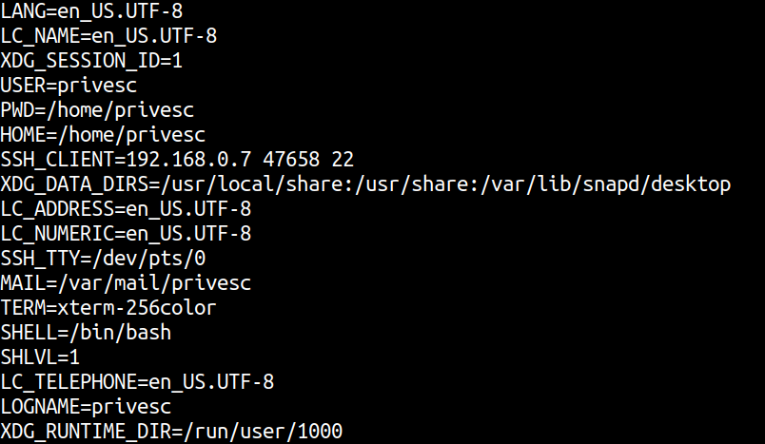
Environment

Slide 15
Network
$ hostname
$ ip a
$ ss -anltup
$ route

Slide 16
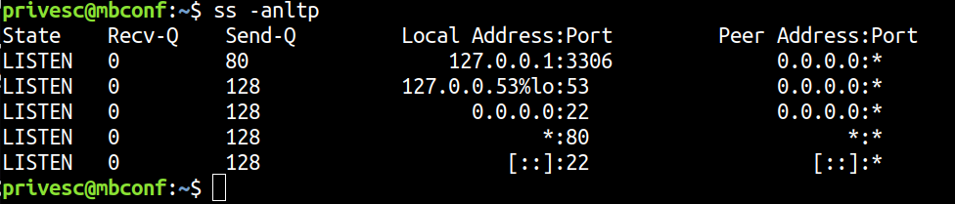
Network

Slide 17
LKMs
$ lsmod
$ cat /proc/modules
Vulnerable LKMs?

Slide 18
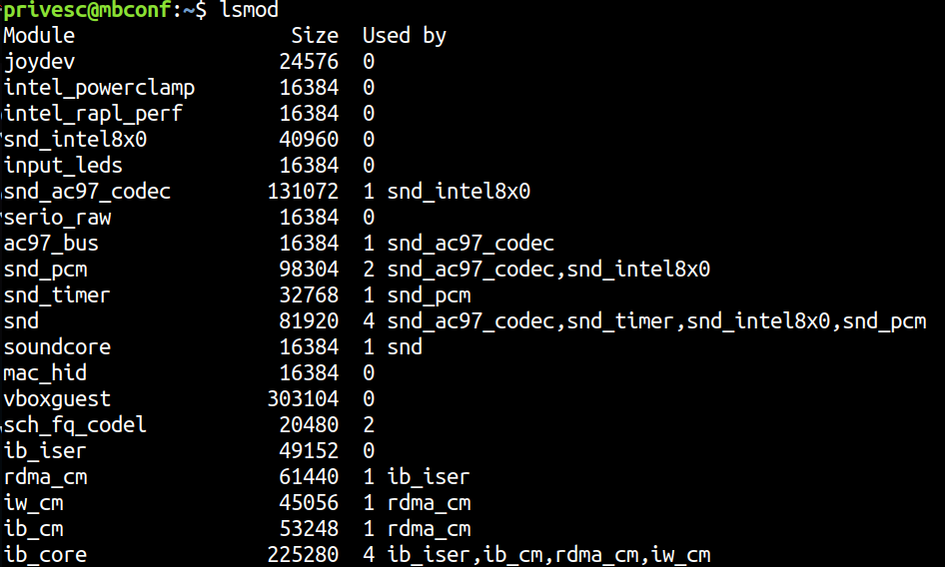
LKMs

Slide 19
Cron
$ ls -alh /etc/cron*
$ cat /etc/crontab
$ pspy
Writable cron scripts? Wildcards used?

Slide 20
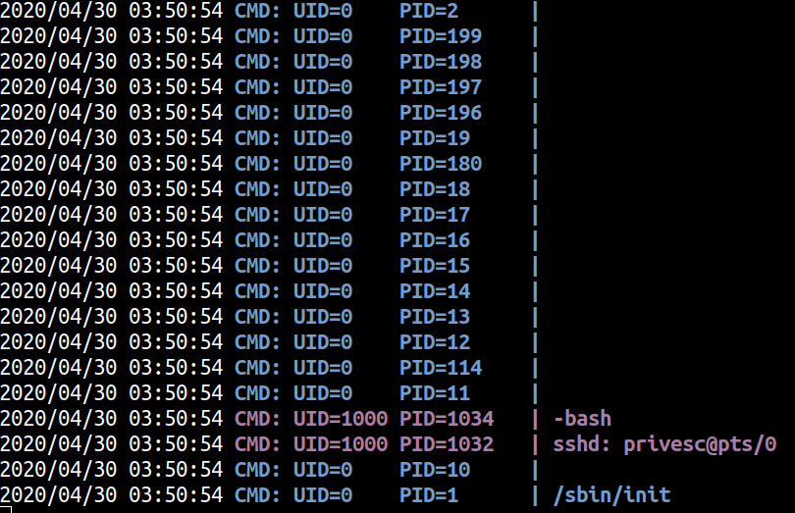
Cron

Slide 21
Files
$ find / -writable 2>/dev/null
$ find / -readable 2>/dev/null
Any writable script or cron job? /etc/passwd? Writable or readable /etc/shadow? Etc.
Notes:
- Overwhelming
write
- Find files, scripts, etc owned by root that you can write, if the root executes you win
- passwd or shadow writable?
- cron files writable?
- Find directories that you can write, so you can download your stuff (usually /tmp and /dev/shm)
read
- Readable ssh private keys?
- Config files(with passwords)?
- shadow readable?
- passwd with hashes?

Slide 22
Files – SSH keys?
$ find / -name id_rsa 2>/dev/null
Try to login with any private key that you find

Slide 23
Files - Passwords?
$ grep -iR password . 2>/dev/null
$ find . -type f 2>/dev/null | xargs grep -i "password"
Check databases, files, etc. for passwords and credentials

Slide 24
History
$ cat ~/.bash_history
$ cat ~/.mysql_history
...
Maybe you find passwords in the history files
Notes:
Can have passwords and others juice stuff

Slide 25
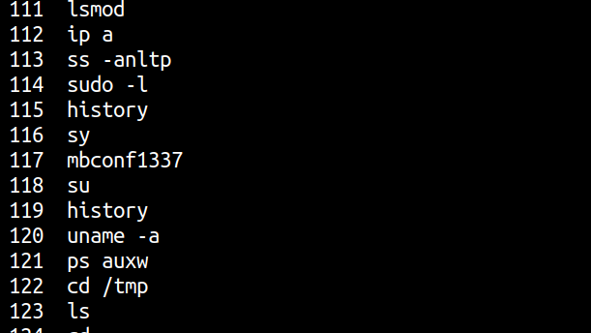
History

Slide 26
Packages
$ dpkg -l
$ rpm -qa
Vulnerable packages in the system?

Slide 27
Packages
$ mysql --version
$ exim --version
$ sudo --version
$ snap --version
...

Slide 28
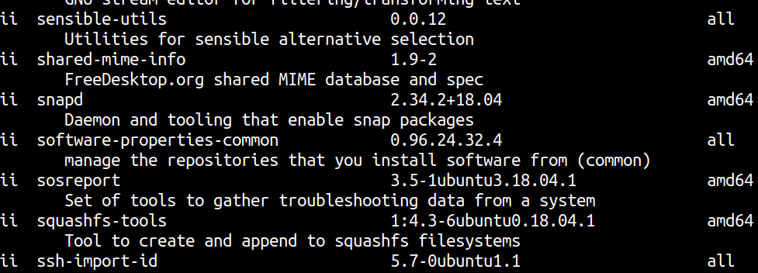
Packages

Slide 29
SUID
$ find / -perm -4000 -exec ls -l {} \;
  find
  less / more
  nmap
  Script languages (perl, python, etc.)
  Vulnerable applications: buffer overflows, format string bugs, command injection, path manipulation, etc.
  ...
Attention for any non-default suid binary. And also check GTFObins.
Notes:
An amazing number of sysadmins don't understand what should and shouldn't be setuid or sudo.
Any command in suid/sudo that can read, write, or execute code/programs can give you privileges.
Users with "restricted" sudo access can use it to obtain unrestricted root permissions.
E.g.: Read /etc/shadow, write /etc/passwd or /etc/shadow, execute /bin/bash

Slide 30
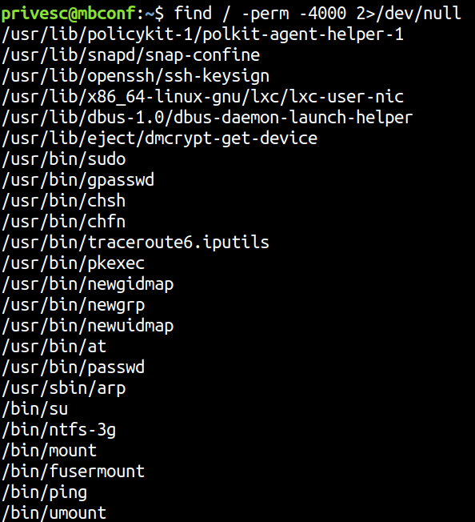
SUID

Slide 31
SUDO
$ sudo -l
  Almost same as SUID: Dangerous commands, etc.
Check GTFObins

Slide 32
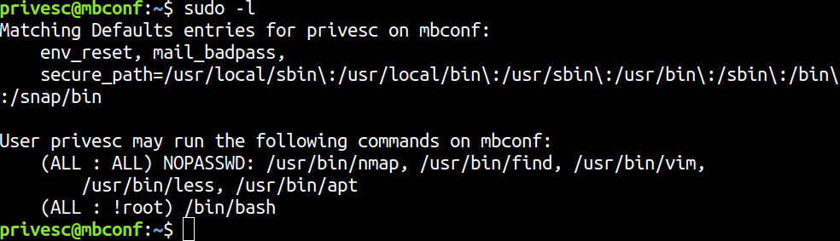
SUDO

Slide 33
Automation
LinPEAS
LinEnun
Metasploit local exploit suggester

Slide 34
DEMO
Configuration
  SUID
  SUDO
  SSH Keys
  Readable backups
  Cron

Slide 35
DEMO
Vulnerabilities
  SUDO
  Snapd
  Metasploit

Slide 36
Questions?

