Slide 1

Diamorphine for current kernel
Linux LKM rootkits in 2017

Slide 2
Index
Introduction to rootkits
  What are rootkits?
  History
  Generation of rootkits
Loadable Kernel Modules and LKM rootkits
  Loadable Kernel Modules
  LKM rootkits
LKM rootkit for current kernels
  LKM rootkit for current kernels
  Diamorphine

Slide 3
Index
  How to implement? What has changed?
  Find syscall table
  Find syscall table dynamically
  Permissions in sys_call_table page
  Hooking a syscall – Control the rootkit
  Hooking another syscall – Hide files or process
  Credentials – Get root!
  Hide/Unhide module
References
Questions? Be nice!

Slide 4
What are rootkits?
A rootkit is a stealthy type of software, typically malicious, designed to hide the existence of certain processes or programs from normal methods of detection and enable continued privileged access to a computer. [1]
The term rootkit is a concatenation of "root" (the traditional name of the privileged account on Unix operating systems) and the word "kit" (which refers to the software components that implement the tool). The term "rootkit" has negative connotations through its association with malware. [1]

Slide 5
History
The term rootkit or root kit originally referred to a maliciously modified set of administrative tools for a Unix-like operating system that granted "root" access. [1]
Ken Thompson of Bell Labs, one of the creators of Unix, theorized about subverting the C compiler in 1983 that would detect attempts to compile the Unix login command and generate altered code that would accept not only the user's correct password, but an additional "backdoor" password [1]
Lane Davis and Steven Dake wrote the earliest known rootkit in 1990 for Sun Microsystems' SunOS UNIX operating system. [1]

Slide 6
Generation of rootkits
Modify binaries
LKM rootktis
Change kmen without LKM
Bootkits

Slide 7
Loadable Kernel Modules
LKM are used to expand the functionality of the kernel;
They can be loaded dynamically, ie, it is not necessary to recompile the whole kernel;
Typically they are device drivers, filesystems or system calls;
However, this allows an attacker to write a kernel module, and subvert the whole system.

Slide 8
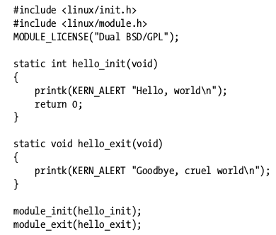
Loadable Kernel Modules – hello world [2]

Slide 9
LKM rootkits
Typically by hooking syscalls;
Technique was popularized in 1999 by the THC paper knows as LKM HACKING; [3]
By hooking syscalls, an attacker can hide files or directories, hide process, bypass file permissions, hide certain file parts, monitor file operations, etc.; [3]
Heroin was classic LKM rootkit showed in the LKM HACKING, it was written by Runar Jensen for 2.1 Linux Kernel: hide itself, hide files or directories and can hide process using a signal 31. [3]

Slide 10
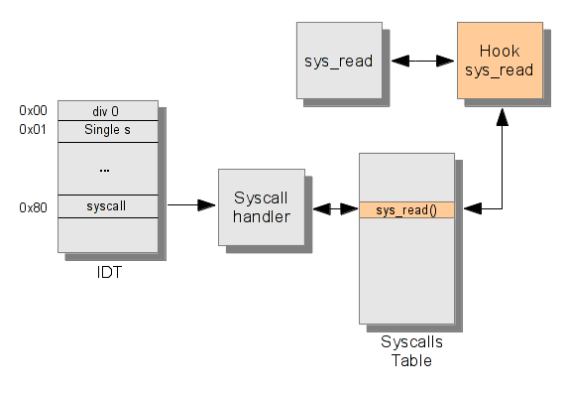
LKM rootkits – syscall hooking

Slide 11
LKM rootkit for current kernels
From the time of the LKM_HACKING paper and the heroin.c code a lot of things in the kernel has changed;
Those things affect the way of writing rootkits;
So, how can we write a rootkit for current linux kernels?
What has changed? What hasn't?

Slide 12
Diamorphine - LKM rootkit for current kernels
I choose some of the functionalities of the Heroin to write the Diamorphine, a rootkit for the 2.6.x/3.x/4.x Linux Kernels;
Most of the code that's gonna be shown in this presentation is from Diamorphine code;
Diamorphine is just another name for the heroin drug
The objective of writing the diamorphine rootkit is to provide an update for some of the functionalities used in the classic LKMs rootkit.

Slide 13
Diamorphine - features
When loaded, the module starts invisible;
Sending a signal 63(to any pid) makes the module become (in)visible;
Hide/unhide any process by sending a signal 31;
Sending a signal 64 (to any pid) makes the given user become root;
Files or directories starting with the MAGIC_PREFIX seems to disappear.
Source: https://github.com/m0nad/Diamorphine

Slide 14
How to implement? What has changed?
For >2.6 Linux kernel this seems to be true:
  System call table is not exported;
  Syscall table memory's page is not writable;
  query_module syscall(and alike) doesn't exist anymore(used to be hooked to hide the rootkit);
  To change the credentitals, now you need to use prepare_creds() and commit_creds().

Slide 15
Find syscall table
In the old times the address of the syscall table was exported;
Now its not, so we need to find it.
One way is to look at System.map:

Slide 16
Find syscall table dynamically
Look at System.map to find the syscall table, the modify the source-code of the rootkit is not pratical;
We need to find the system call table dynamically;
This can be done by searching for some syscall in the kernel land memory space. [4]
Notes:
Em 32
From the 0xc0000000 to the 0xd0000000 address (Kernel-land memory space in 32 bits)
Em 64 bits:
#ifdef __x86_64__
#define START_MEM 0xffffffff81000000
#define END_MEM 0xffffffff81fffffff

Slide 17
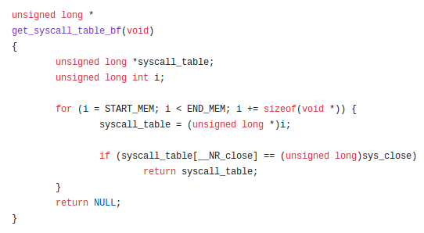
Find syscall table dynamically

Slide 18
Permissions in sys_call_table page
To hook syscalls, we have to change the address of the syscalls in the sys_call_table;
The sys_call_table memory's page doesn't come anymore with write permissions;
So, we need to change the permissions;
One way to do that is using write_cr0() function.
Notes:
set_pte_atomic() function receives a pte_t pointer to the address(can be get using lookup_address() function) of the page and a pte_t result of pte_mkwrite(), pte_wrprotect(), pte_clear_flags() like functions
Also can use write_cr0 (read_cr0 () & (~ 0x10000)); and write_cr0 (read_cr0 () | 0x10000); to change permissions.

Slide 19
Permissions in sys_call_table page – CR0
A control register is a processor register which changes or controls the general behavior of a CPU or other digital device. Common tasks performed by control registers include interrupt control, switching the addressing mode, paging control, and coprocessor control.[8]
The CR0 register is 32 bits long on the 386 and higher processors. On x86-64 processors in long mode, it (and the other control registers) is 64 bits long. CR0 has various control flags that modify the basic operation of the processor.[8]
Notes:
set_pte_atomic() function receives a pte_t pointer to the address(can be get using lookup_address() function) of the page and a pte_t result of pte_mkwrite(), pte_wrprotect(), pte_clear_flags() like functions
Also can use write_cr0 (read_cr0 () & (~ 0x10000)); and write_cr0 (read_cr0 () | 0x10000); to change permissions.

Slide 20
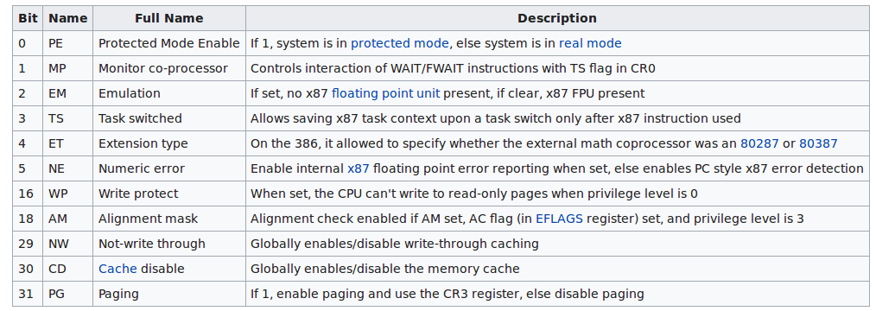
Permissions in sys_call_table page – CR0
Notes:
set_pte_atomic() function receives a pte_t pointer to the address(can be get using lookup_address() function) of the page and a pte_t result of pte_mkwrite(), pte_wrprotect(), pte_clear_flags() like functions
Also can use write_cr0 (read_cr0 () & (~ 0x10000)); and write_cr0 (read_cr0 () | 0x10000); to change permissions.

Slide 21

Permissions in sys_call_table page – unprotect
Notes:
Level its a int

Slide 22
Permissions in sys_call_table page – protect

Slide 23
Hooking a syscall – Control the rootkit
After finding the syscall table address;
And make it writeble;
Now we can hook some syscall;
To do that, just modify the address of the system call in the sys call table for the hacked syscall;
Let's see how to hook the kill() syscall and implement a hacked_kill().

Slide 24
Hooking a syscall – kill() hook

Slide 25
Hooking a syscall – kill() hook
Syscall kill() recieves pid and the signal;
When you call the command line like kill -9 <pid>, this passes the signal 9(SIGKILL) and process ID <pid> to the kill() syscall;
The classical kill() hook create news signals or some kind of a magic pid, to do the dirty job;
Let's see how.

Slide 26
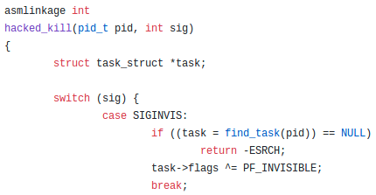
Hooking a syscall – kill() hook

Slide 27
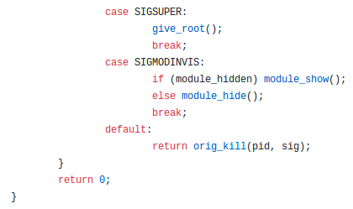
Hooking a syscall – kill() hook

Slide 28
Hooking a syscall – kill() hook
The find_task() uses the “current”, that is a macro for task_struct of the current process;
task_struct contains the pointer for the next task, its a linked list;
For interate each task, you can use the for_each_process macro;
Lets see the implementation.

Slide 29
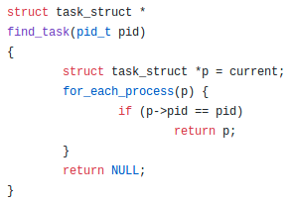
Hooking a syscall – kill() hook

Slide 30
Hooking another syscall – Hide files or process
The system call getdents() is used to get directory entries;
Commands like ls, ps, etc depends on this syscall;
Works by reading several linux_dirent structures from the directory referred by an open file descriptor into a buffer;
We can hook this syscall to make a file or process invisible.

Slide 31
Hooking another syscall – getdents()
Our getdents is gonna call the original getdents, to fill the buffer with linux_dirent structures;
To hide a file or process, we need to modify the linux_dirent structures;
Search for the MAGIC_PREFIX or if its a invisible process, then remove;
For iterating over files, just increment the linux_dirent pointer with the d_reclen size

Slide 32
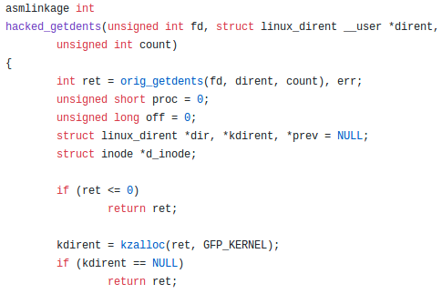
Hooking another syscall – getdents()

Slide 33
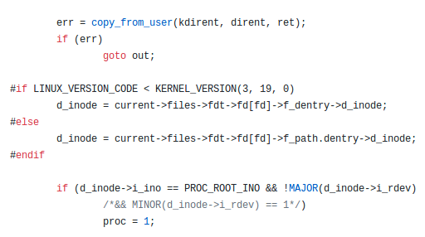
Hooking another syscall – getdents()

Slide 34
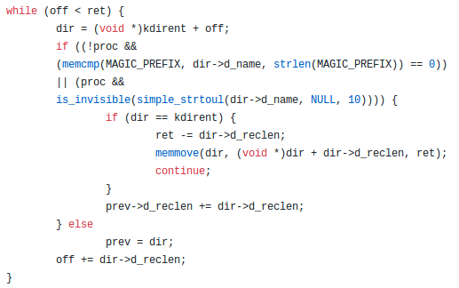
Hooking another syscall – getdents()

Slide 35
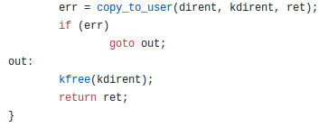
Hooking another syscall – getdents()

Slide 36
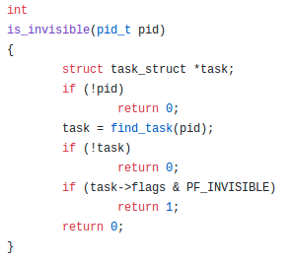
Hooking another syscall – getdents()

Slide 37
Credentials – Get root!
In the < 2.6.29 kernels we find all credentials in the “task_struct” structure. [4]
So, to give a root, just change the current uid, gid etc. to 0, as follows: current->uid = current->gid = current->euid = current->egid = current->suid = current->sgid = current->fsuid = current->fsgid = 0; [4]
Where “current” is macro for the task_struct of the current process. [4]

Slide 38
Credentials - give_root()
But the task_struct was change, and now, we have a new struct called cred; [4]
To change, first use the prepare_creds() to prepare a new set of credentials; [4]
When the new set of credentials is ready, it should be committed to the current process by calling commit_creds(); [4]

Slide 39
Credentials - give_root()
Another thing has change, the cred structure;
Prior to the kernel 3.5, the uid, gid, etc. - In the cred structure - was just an unsigned int;
Now is an structure(kuid_t, kgid_t, etc.) thats contains the unsigned int in the variable 'val';
With this information, let's see the code.

Slide 40
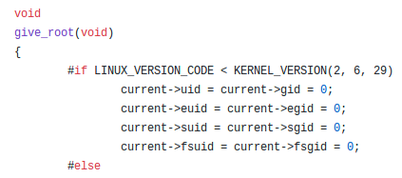
Credentials - give_root()

Slide 41
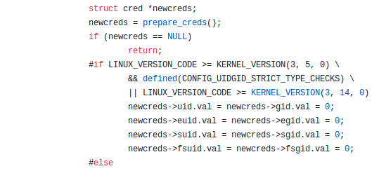
Credentials - give_root()

Slide 42
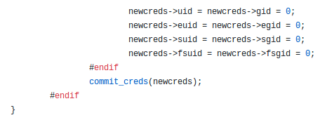
Credentials - give_root()

Slide 43
Hide/Unhide module
The Heroin LKM hides itself by hooking the query_module syscall;
But that syscall doesn't exists in > 2.6 Kernels;
The solution was to use list_del() to delete some structures from modules list; [6]
We can use list_add() to unhide the module.[6]

Slide 44

Hide/Unhide module
Notes:
module_previous its a static struct list_head *
static struct list_head *module_previous;

Slide 45
References
[1] Wikipedia Rootkit: https://en.wikipedia.org/wiki/Rootkit
[2] Linux Device Drivers: http://lwn.net/Kernel/LDD3/
[3] LKM HACKING/heroin.c: https://www.thc.org/papers/LKM_HACKING.html
[4] Memset's blog: http://memset.wordpress.com/
[5] Linux on-the-fly kernel patching without LKM: http://phrack.org/issues/58/7.html
[6] WRITING A SIMPLE ROOTKIT FOR LINUX: http://big-daddy.fr/repository/Documentation/Hacking/Security/Malware/Rootkits/writing-rootkit.txt
[7] Linux Cross Reference: http://lxr.free-electrons.com/
[8] Control Register https://en.wikipedia.org/wiki/Control_register
[*] Diamorphine: https://github.com/m0nad/Diamorphine/

Slide 46

Questions?

