Slide 1
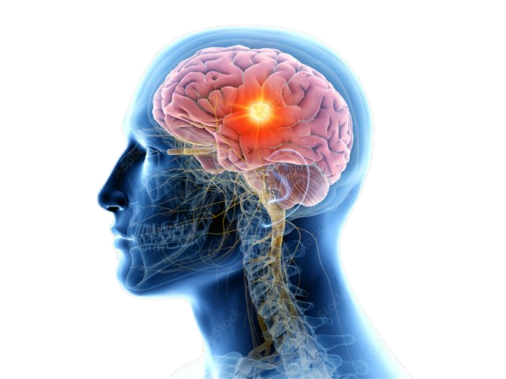
BRAIN TUMOR DETECTION USING DEEP LEARNING
Under the Esteemed Guidance of
Mr.S.Naga Chandra Sekhar
TEAM:C11
Y.Mani Sudheer(Y20ACS589)
P.karunakar(Y20ACS539)
S.S.V.S.Eswar(Y20ACS554)
R.pavan Kumar(Y20ACS544)

Slide 2
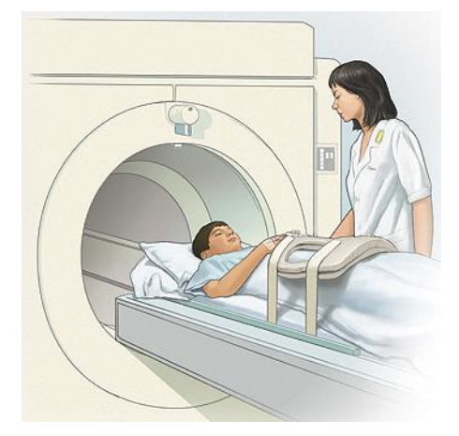
TABLE OF CONTENTS
Abstract
Existing System
Proposed System
Design
Implementation
Results
Conclusion

Slide 3
ABSTRACT
Brain tumor diagnosis is crucial in modern medicine, requiring accurate detection methods. This study employs deep learning techniques, CNN and VGG-16, to identify tumor regions in MRI images. Analyzing data from 253 patients, both with and without tumors, we compare the performance of CNN and VGG-16 models. Our results reveal insights into their strengths and weaknesses, offering implications for enhancing brain tumor detection in clinical contexts.
Keywords: Convolutional Neural Network, VGG-16 architecture, medical imaging, Tumor identification, Neural networks.

Slide 4
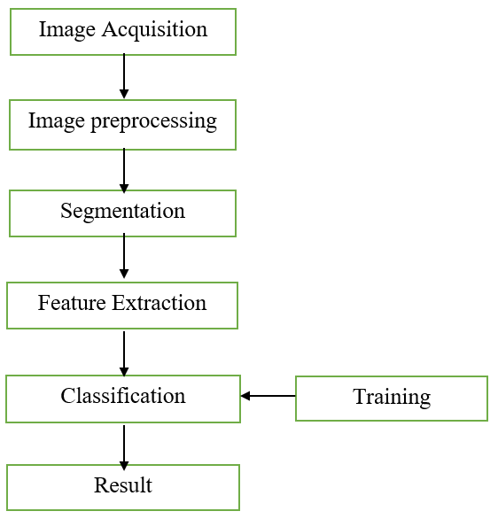
EXISTING SYSTEM
Image Acquisition:
Obtain brain MRI scans from Various Sources.
Image Preprocessing:
Preprocessing involves noise reduction and normalization.
Segmentation divides medical images into meaningful regions, often isolating structures or abnormalities, such as tumors.
Feature Extraction:
Feature Extraction involves capturing relevant information from segmented regions, utilizing methods such as CNNs.

Slide 5
EXISTING SYSTEM cont..
Classification:
Classification involves training models to assign predefined labels, like tumor or non-tumor, to extracted features.
Limitations:
Overfitting
Variability in Image Quality

Slide 6
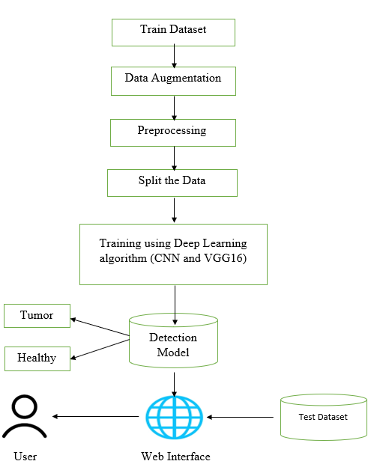
PROPOSED SYSTEM
Custom CNN Model Development
Our journey began with creating a custom Convolutional Neural Network (CNN) model for detecting brain tumors in MRI images. This approach enabled us to design and refine a model optimized specifically for identifying brain tumors.
Integrating VGG16 for Enhanced Capabilities:
Expanding on our initial progress, we introduced the VGG16 model, known for its performance in image recognition. By developing the VGG16 model, we aimed to maximize our brain tumor detection capabilities and ensure accurate predictions through its extensive training.

Slide 7
PROPOSED SYSTEM cont..
Comparative Analysis:
we conducted a thorough comparison between our custom CNN model and the VGG16 model. Through extensive evaluation and benchmarking, we aimed to highlight the strengths and weaknesses of each model in detecting brain tumors.
Web Interface with Flask:
Our user-friendly Flask-based web interface allows medical professionals to easily upload MRI images and quickly receive tumor detection results, aiding in real-time decision-making.

Slide 8
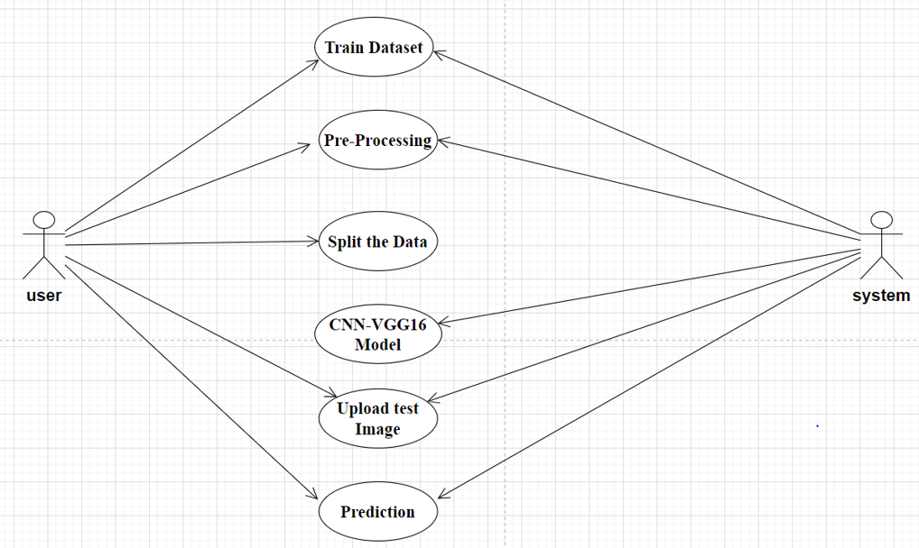
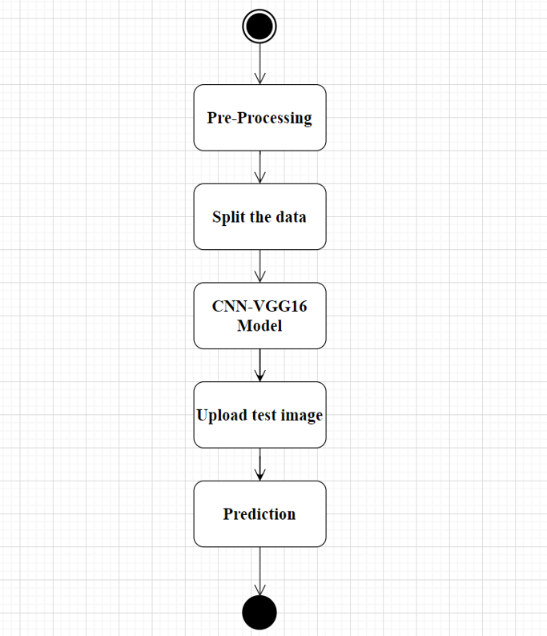
DESIGN
Use case Diagram
Activity Diagram

Slide 9
IMPLEMENTATION
1. Data Collection:
Gather a diverse dataset of labeled MRI images containing both tumor and non-tumor
2. Preprocessing:
Standardize and enhance image quality through normalization, resizing, and noise
reduction.
3. Split the Data:
Divide the dataset into training, validation, and testing sets.
4. Model Selection:
Choose model architectures such as CNN,VGG16 for tumor detection.
5. Deployment:
Deploy the trained model into a user-friendly web interface using Flask for real-time
tumor detection.

Slide 10
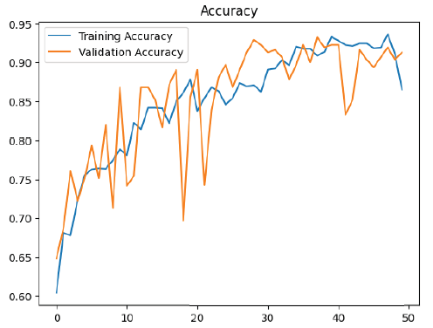
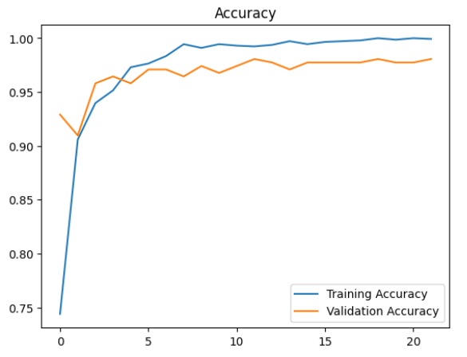
RESULT
The proposed model was trained and tested using new images, achieving an accuracy of 91.3% for the CNN and 98.3% for the VGG16, when combined with the previously mentioned results. This further strengthens the reliability and effectiveness of both the custom CNN model and the VGG16 architecture in accurately detecting and classifying brain tumors in MRI images.
CNN Results VGG16 Results

Slide 11
CONCLUSION
Brain tumors pose significant risks to human health and must be accurately detected to ensure effective treatment and positive patient outcomes.
The primary aim of our proposed approach is to recognize brain tumors accurately and efficiently, addressing the critical need for timely diagnosis and intervention.
Experimental results demonstrate the effectiveness of our approach, highlighting its value in supporting the accurate detection of brain tumors.

Slide 12
THANK YOU...!!

