Slide 1
Maximum Clique Problem
76066002 周美廷
76066001 张金源

Slide 2
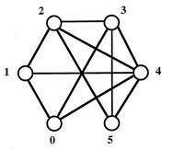
Maximum Clique Problem
A clique in a graph is a subgraph in which all vertices are connected to each other – a complete subgraph. Find the largest clique of a graph.

Slide 3
Algorithms
Brute-force search
Backtracking Algorithm
Bron–Kerbosch

Slide 4
Brute-force Search

Slide 5
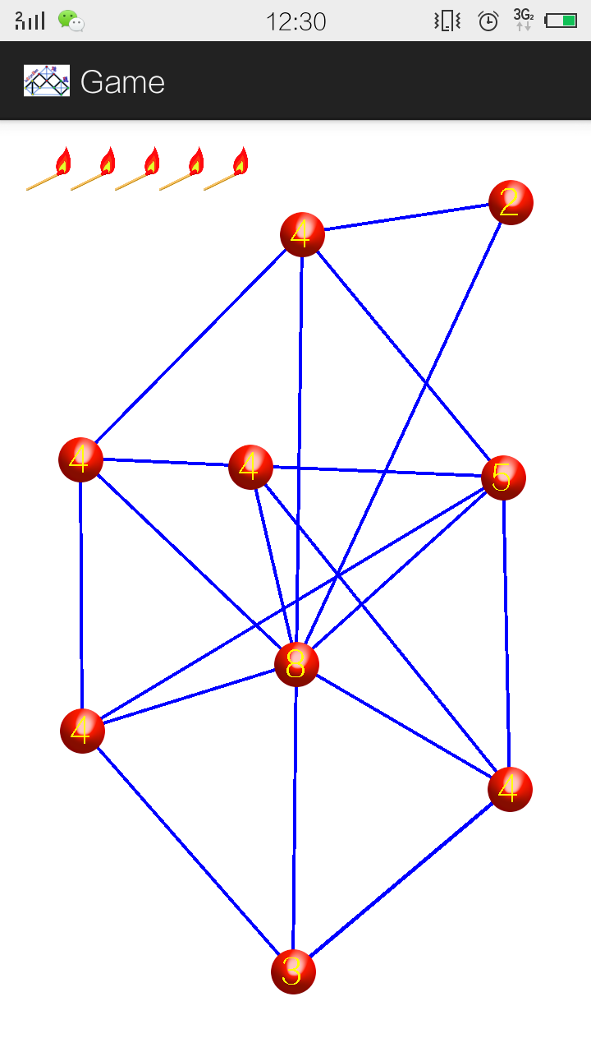
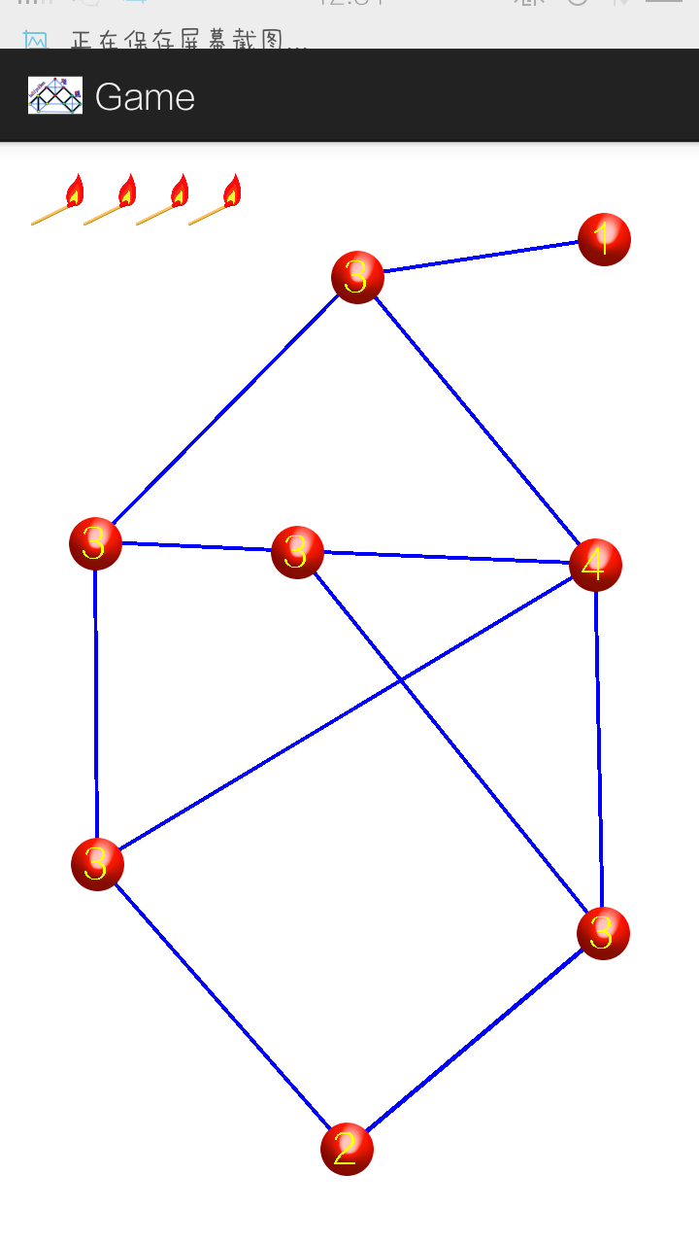
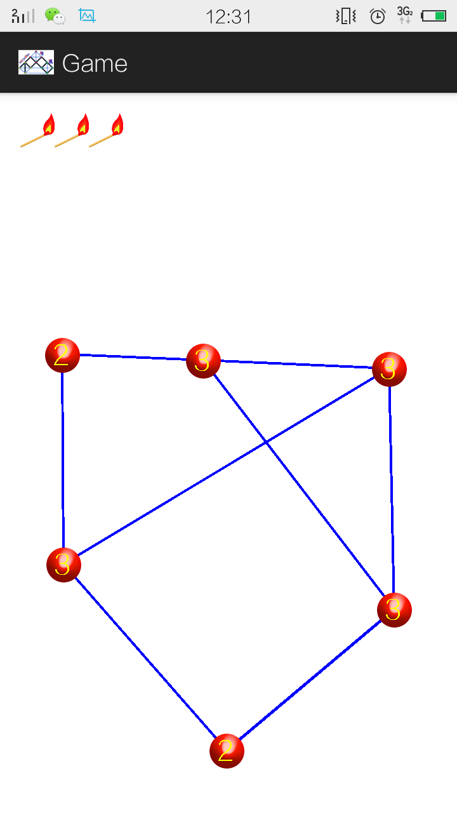

Slide 6
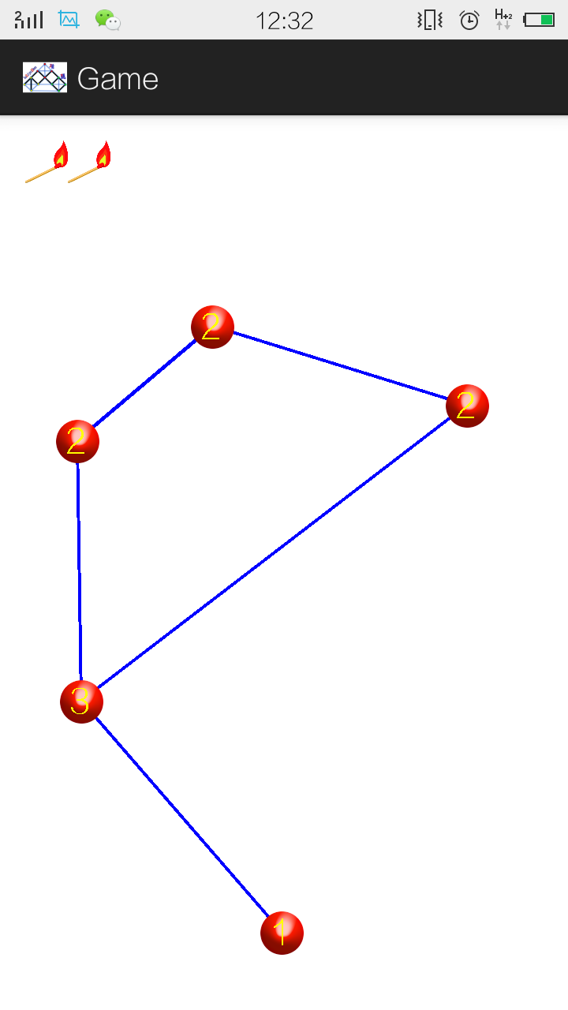
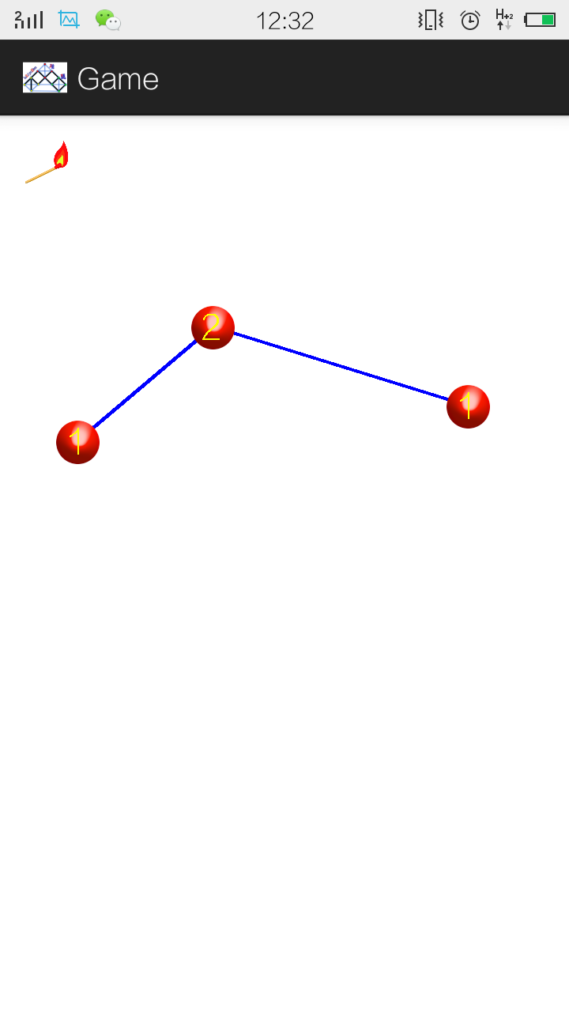

Slide 7
Backtracking Algorithm
Incrementally builds candidates to the solutions, and abandons each partial candidate ("backtracks") as soon as it determines that the candidate cannot possibly be completed to a valid solution. (Depth-first order).

Slide 8
Backtracking Algorithm
procedure bt(c)
if reject(P,c) then return
if accept(P,c) then output(P,c)
s ← first(P,c)
while s ≠ Λ do
bt(s)
s ← next(P,s)

Slide 9
Bron-Kerbosch Algorithm
Branch and Bound ALgorithm

Slide 10
Bron-Kerbosch Algorithm
Definition
Lists all subsets of vertices with the two properties that each pair of vertices in one of the listed subsets is connected by an edge, and no listed subset can have any additional vertices added to it while preserving its complete connectivity. (Breadth-First Order).
“…The Bron–Kerbosch algorithm and subsequent improvements to it are frequently reported as being more efficient in practice than the alternatives.”

Slide 11
NP-Completeness

Slide 12


