Slide 1
Image Processing on the Pi using open Frameworks

Slide 2
Setup
Before beginning:
Install openFrameworks per these instructions
Run dependency scripts and compile openFrameworks
Install g++-4.7
sudo apt-get install g++-4.7
Install and test Raspberry Pi camera
Use the raspistill command to test
Beware: The Pi camera connection is somewhat fragile. Repeated connecting and disconnecting is not advised.

Slide 3
openFrameworks
An opensource C++ toolkit that includes many libraries including openCV for computer vision
Massively cross-compatible
Windows, OSX, Linux, iOS, Android, Raspberry Pi
Four IDEs: XCode, Code::Blocks, and Visual Studio and Eclipse
All code is on GitHub
Reminiscent of Processing

Slide 4
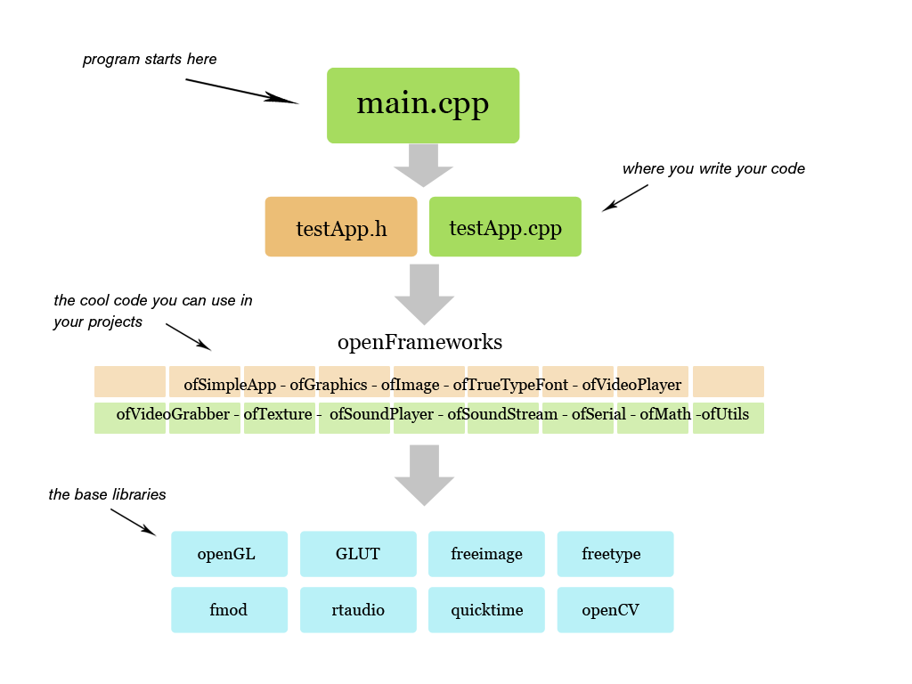
Structure

Slide 5
Resources
In Ramsey library:
Programming Interactivity by Joshua Noble
Web excerpt
On-line
OF website
A very good workshop

Slide 6
Working with the Pi Camera
Take from the Creepy Face Tracking Portrait by Tony DiCola
Uses ofxRPICameraVideoGrabber by Jason Van Cleave
Use the program structure created by DiCola to write other openFrameworks programs that work with the Pi camera

Slide 7
Demo Program: ColorTracker
Download colorTracker.tgz
Uncompress it in openFrameworks/apps/myApps
tar -xvzf colorTracker.tgz
Compile
cd colorTracker
make
Run and notice how it tracks a red colored object
bin/colorTracker pi

Slide 8
Use ColorTracker as a Template
Copy the colorTracker directory into the openFrameworks/apps/myApps directory with a new name:
cp –r colorTracker <newProjectName>
Keep the portions of main.cpp and the app .h and .cpp files in the src directory as described in the next three slides
Rename the app files, replace ColorTracker with the new app name, and add new code to create the desired functionality

Slide 9
Keep the following from ColorTracker.h
#include <vector>
#include "ofMain.h"
#include "VideoSource.h"
#include "ofxOpenCv.h"
class ColorTracker: public ofBaseApp { // ⬅ remember to change the class name throughout
public:
ColorTracker() {}
~ColorTracker() {}
void setup();
void update();
void draw();
.
. // method prototypes in all openFrameworks apps
.
void gotMessage(ofMessage msg);
ofVec2f updateAngle(const ofVec2f& point);
// Distance camera is back on the Z axis from the origin.
float cameraDistance = 650.0;
// Reference to a video source.
std::shared_ptr<IVideoSource> video;
float videoFOV;
ofVec2f videoOffset = ofVec2f(0,0);
private:
ofEasyCam camera;
float pixelFocalLength;
};

Slide 10
Keep the following from ColorTracker.cpp
void ColorTracker::setup() { // ⬅ remember to change the class name throughout
ofSetVerticalSync(true);
pixelFocalLength = sqrt(pow(video->getWidth()/2.0, 2) + pow(video->getHeight()/2.0,2))/sin(ofDegToRad(videoFOV/2.0));
// Set up camera
camera.setDistance(cameraDistance);
camera.setTarget(ofVec3f(0, 0, 0));
camera.disableMouseInput();
…
}
void ColorTracker::update() {
video->update();
}
void ColorTracker::draw(){
camera.begin();
camera.end();
if (video->isFrameNew()) {
rgb.setFromPixels(video->getPixels());
…
}
…
}

Slide 11
main.cpp
Use main.cpp as provided here replacing ColorTracker with the new app (i.e., class) name.
Allows program to use Pi camera on the Raspberry Pi or run alternative video device on another platform
Performance on alternative platform is untested

Slide 12
Try this with an openFrameworks example
Modify openFrameworks/examples/addons/opencvExample to work with the Pi camera using colorTracker as a template:
Copy the colorTracker folder to openFrameworks/apps/myApps/ giving it the new name opencvExample.
Rename opencvExample/src/ColorTracker.h to be opencvExample/src/OpencvExample.h
Rename opencvExample/src/ColorTracker.cpp to be opencvExample/src/OpencvExample.cpp
Change all occurences of ColorTracker to be OpencvExample throughout OpencvExample.h, OpencvExample.cpp, & main.cpp
Add the relevant content of openFrameworks/examples/addons/opencvExample/src/testApp.h to OpencvExample.h
Add the relevant content of openFrameworks/examples/addons/opencvExample/src/testApp.cpp to OpencvExample.cpp
Compile and run

