Slide 1
Intro to Robot Movement
Topics:
DC motors
Servos
Line following

Slide 2

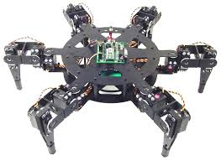
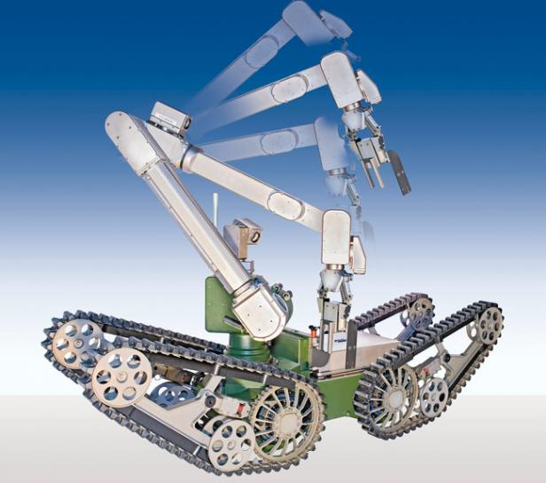

Many ways to move
Focus on wheeled movement

Slide 3
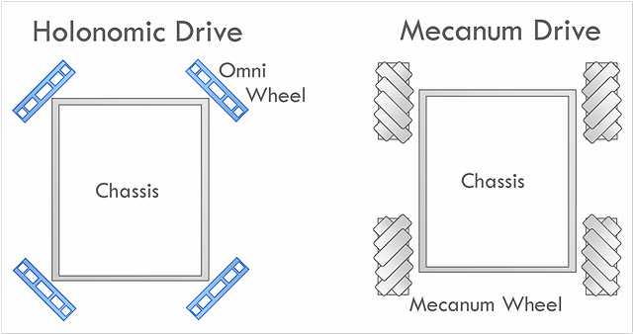
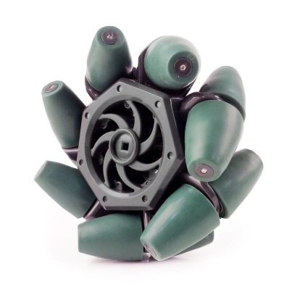
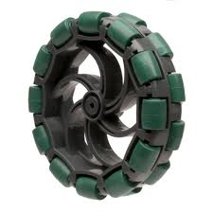
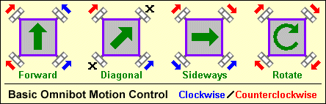
Alternative drive-trains
Mecanum
wheel
Omni
wheel
Demos
Mecanum demo
UNCA demo
Image credit: http://members.toast.net/joerger/oldarchive.html

Slide 4
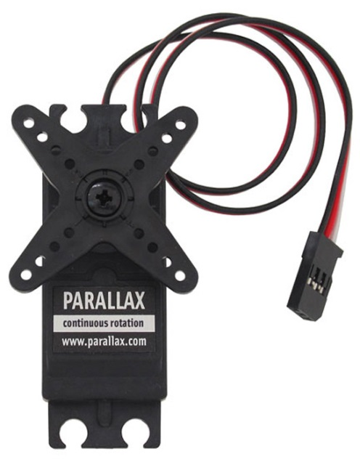
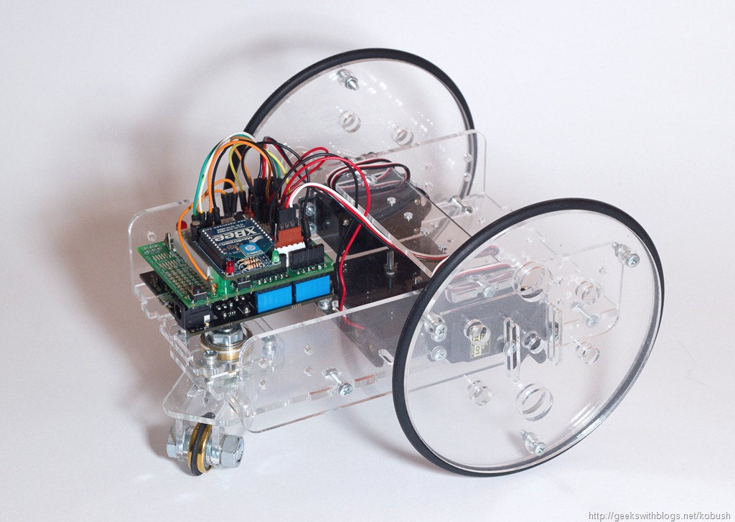
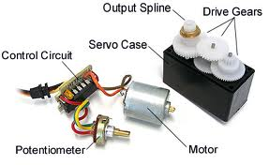
Making wheels move (using servos)
Image credit: http://induino.blogspot.com

Slide 5
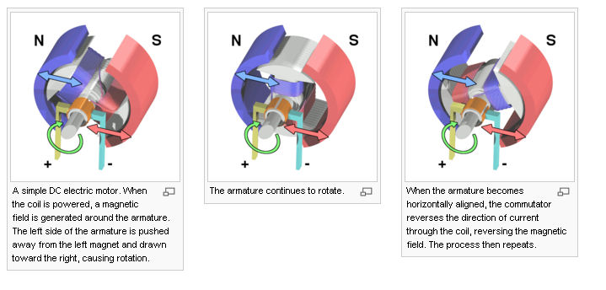
Topic 1: DC Motor
Image credit: http://en.wikipedia.org
Electromagnetism: A changing magnetic field makes an electric field. A changing electric field makes a magnetic field.
How it works

Slide 6
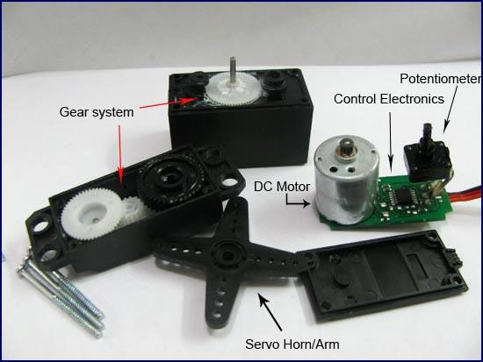
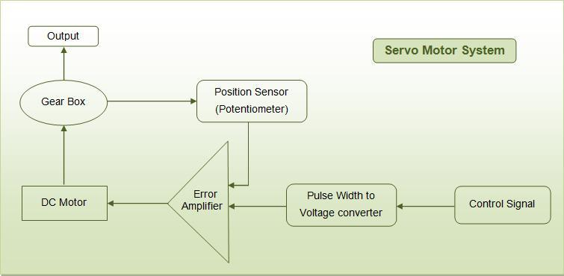
Topic 2: Servos
Image credit: http://www.engineersgarage.com
Servo motors can also be retrofitted to provide continuous rotation:
Remove mechanical limit (revert back to DC motor shaft).
Remove pot position sensor (no need to know position) and replace it with 2 equal-valued resistors with a combined resistance equivalent to that of the pot. Makes the servo “think” it is in the 90 deg position.
Not always
necessary

Slide 7
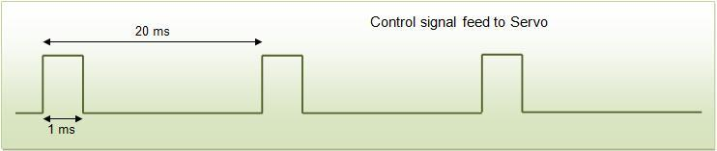
Servo control
Image credit: http://www.engineersgarage.com
An external controller (such as the Arduino) tells the servo where to go with a signal know as pulse proportional modulation (PPM) or pulse code modulation (which is often confused with pulse width modulation, PWM).
PPM uses 1 to 2ms out of a 20ms time period to encode information.

Slide 8
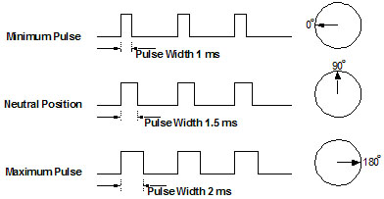
PPM
20 ms
Image credit: http://www.elprocus.com/servo-motor/
Each pulse is from 1300 to 1700 microsec (μs) in duration
The pulses repeat about 50 times each second---once every 20 millisec

Slide 9
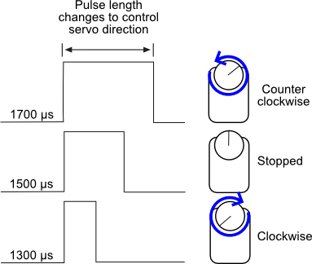
Continuous rotation servo
and speed
The amount of power applied to the motor is proportional to the distance to be traveled.
If the shaft needs to turn a large distance, the motor runs at full speed.
If it needs to turn a small amount, the motor runs at a slower speed.

Slide 10
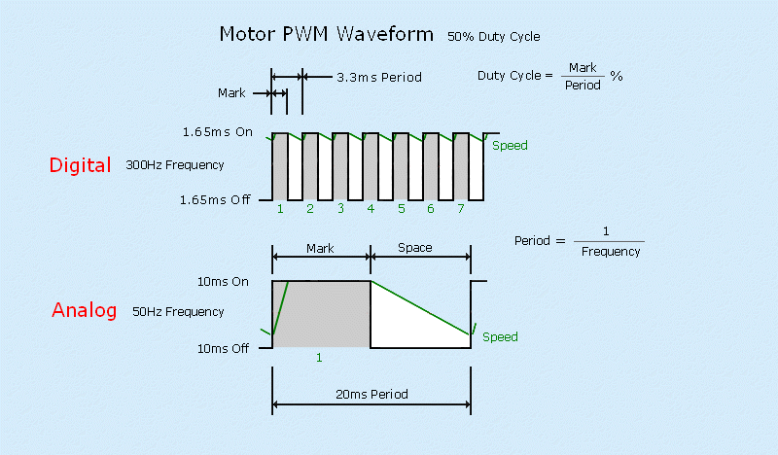
Analog vs digital servos
Image credit: http://www.sailservo.co.uk/anvdig.html
Advantages:
Higher and more consistent torque throughout the servo travel
Constant holding power when stationary and less deadband
Faster control response - increased acceleration
Disadvantages:
Higher costs
More power consumption

Slide 11
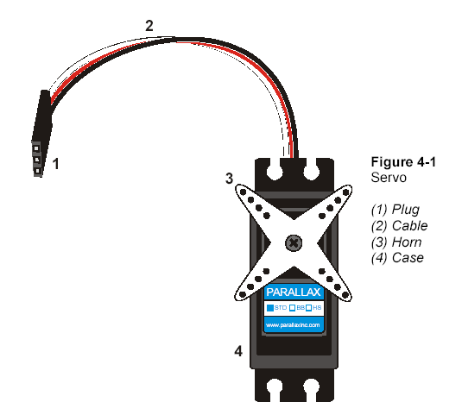
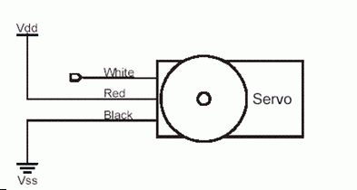
Parallax Servo Connections
Servo Connector:
Black – ground
Red – power
White – signal
Image credit: http://www.parallax.com/

Slide 12
Calibration Program
#include <Servo.h>
Servo myServo;
void setup() {
myServo.attach(9);
myServo.writeMicroseconds(1500); // Stop
}
void loop() { }
Servo library
The parallax servos are modified servos with the potentiometer intact.
The potentiometer (a.k.a., pot) should be adjusted to make the servo think that it is at the 90 degree mark. Do that now.

Slide 13
In-Class Activity 1
Read and work activity 6 in Chapter 2 of Parallax’s Robotics with the Board of Education Shield for Arduino. The activity makes reference to the “BOE Shield,” a piece of hardware designed by Parallax to interface with the Arduino. The shield contains a breadboard as well as a few switches and connectors that we don’t have, but not to worry. The Arduino programs and the information about the Parallax servos are correct for our setup.
Complete the assembly of your boe-bot chassis before beginning activity 6. The completed chassis should include both servos, the arduino, and the breadboard. For power, you can leave your robot tethered to the USB cable or use a battery pack.

Slide 14
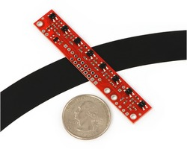
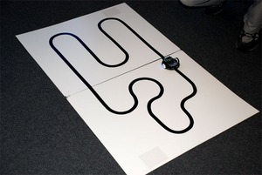
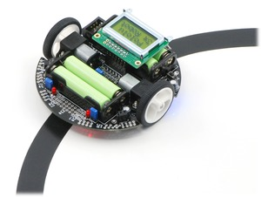
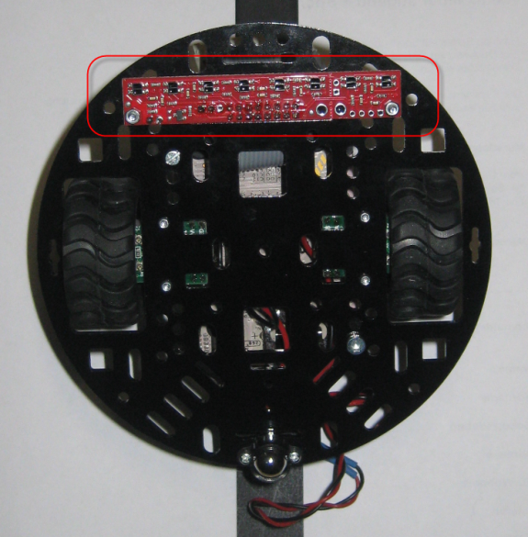
Topic 3: Line Following
Pololu QTR-8A Reflectance Sensor Array

Slide 15
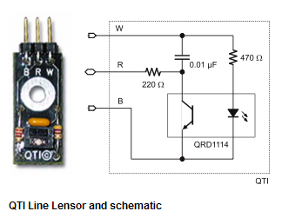
QTI sensor
Connect to digital pin
Connect to power
The QTI is a reflective object sensor. There’s an infrared LED behind its clear window and an infrared phototransistor behind its black window.
When the infrared light emitted by the LED reflects off a surface and returns to the black window, it strikes the infrared phototransistor’s base, causing it to conduct current.
The more infrared incident on the phototransistor’s base, the more current it conducts.
Connect to ground
Image credit: http://www.parallax.com/

Slide 16
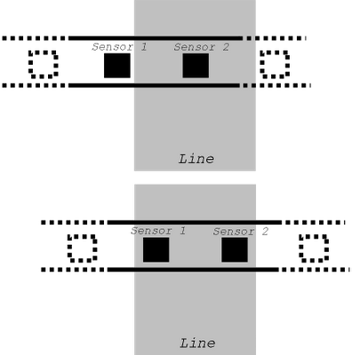
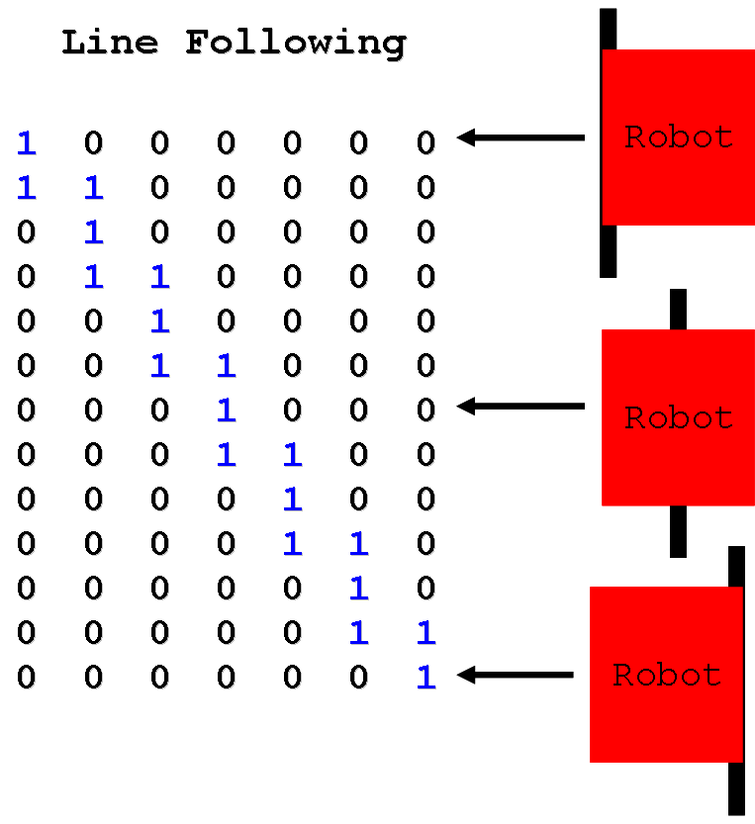
Using a sensor array
Image: http://hirobotblog.blogspot.com/2012/08/algorithms-2-bit-of-maths.html
Control the servos based on the sensor readings
The more sensors the more accurate the control

Slide 17
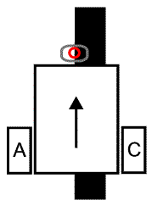
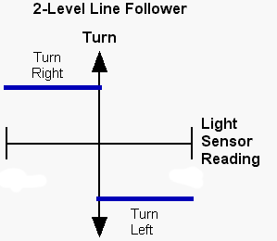
Line following with one sensor?
Image credit: http://www.inpharmix.com/jps/PID_Controller_For_Lego_Mindstorms_Robots.html
try to follow the edge of the line

Slide 18
Code (missing two functions)
#include <Servo.h> // Include servo library
Servo servoLeft; Servo servoRight; // Declare left and right servo objects
//Parameters
int target = 210; // target sensor reading
int maxSpeed = 100; // control forward speed
void setup() { // initialization method
Serial.begin(9600);
servoLeft.attach(12); // Attach left signal to pin 13
servoRight.attach(3); // Attach right signal to pin 12
}
void loop() { // main loop auto-repeats
int light = (int) rcTime(9); // Read QTI sensor
float error = light - target; // Difference between target &current reading
int speedLeft, speedRight; // Declare speed variables
if (error > 0.0) { // over only black?
speedLeft = -maxSpeed; // Slow down left wheel
speedRight = maxSpeed; // Full speed right wheel
} else { // over only white?
speedRight = -maxSpeed; // Slow down right wheel
speedLeft = maxSpeed; // Full speed left wheel
}
maneuver(speedLeft, speedRight, 20); // Set wheel speeds
}

Slide 19
rcTime() function
// rcTime function measures decay at pin
long rcTime(int pin) {
pinMode(pin, OUTPUT); // Charge capacitor
digitalWrite(pin, HIGH); // ..by setting pin ouput-high
delay(5); // ..for 5 ms
pinMode(pin, INPUT); // Set pin to input
digitalWrite(pin, LOW); // ..with no pullup
long time = micros(); // Mark the time
while(digitalRead(pin)); // Wait for voltage < threshold
time = micros() - time; // Calculate decay time
return time; // Returns decay time
}

Slide 20
maneuver() function
// maneuver function
void maneuver(int speedLeft, int speedRight, int msTime) {
servoLeft.writeMicroseconds(1500 + speedLeft); // Set left servo speed
servoRight.writeMicroseconds(1500 - speedRight); // Set right servo speed
if(msTime==-1) { // if msTime = -1
servoLeft.detach(); // Stop servo signals
servoRight.detach();
}
delay(msTime); // Delay for msTime
}

Slide 21
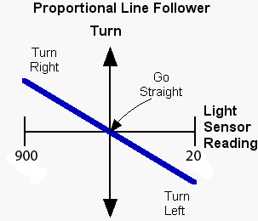
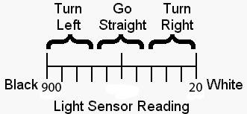
Proportional line following
Image credit: http://www.inpharmix.com/jps/PID_Controller_For_Lego_Mindstorms_Robots.html
In proportional line following the turn varies smoothly between two limits
If the light sensor reading indicates close to the line then do a small turn
If far from the line then do a big turn
Proportional means there is a linear relationship between the sensor reading and robot movement

Slide 22
Code: loop() only
float kp = 0.5;
void loop() { // main loop auto-repeats
int light = (int)rcTime(9);
float error = light - target;
int speedLeft, speedRight; // Declare speed variables
if (error > 0.0) { // on black only ?
speedLeft = int(maxSpeed - (error * kp)); // proportion adjust
speedLeft = constrain(speedLeft, -maxSpeed, maxSpeed); // scale left wheel speed
speedRight = maxSpeed; // Full speed right wheel
} else { // on white only ?
speedRight = int(maxSpeed + (error * kp)); // proportion adjust
speedRight = constrain(speedRight, -maxSpeed, maxSpeed); // scale right wheel speed
speedLeft = maxSpeed; // Full speed left wheel
}
maneuver(speedLeft, speedRight, 20); // Set wheel speeds
}

Slide 23

PID control
K_{P}, K_{I}, and K_{D} are tunable constants (i.e., weights)
(K_{P} e) proportional to the current error—the basis of the previous algorithm
(K_{I} ∫e) —the integral is the running sum of the error
integral = integral + error*(dT)
(K_{D} de/dt) —the derivative is the change in the error between two consecutive sensor readings
derivative = ((the current error) - (the previous error)) /(dT)
movement = Kp*(error) + Ki*(integral) + Kd*(derivative)

Slide 24
Code: part of loop()
void loop() { // Main loop auto-repeats
int light = (int)rcTime(9); // read sensor
float error = light - target; // proportional term
int delta = error - prevError; // derivative term
integral = integral + error; // integral term
prevError = error;
float correction = (integralMemory * integral * ki) + (error * kp) + (delta * kd);
int speedLeft, speedRight; // Declare speed variables
if (correction > 0.0) { // over black only?
speedLeft = int(maxSpeed - correction);
speedLeft = constrain(speedLeft, -maxSpeed, maxSpeed);
speedRight = maxSpeed;
} else { // over white only?
speedRight = int(maxSpeed + correction);
speedRight = constrain(speedRight, -maxSpeed, maxSpeed);
speedLeft = maxSpeed;
}
…
Link to the full program

Slide 25
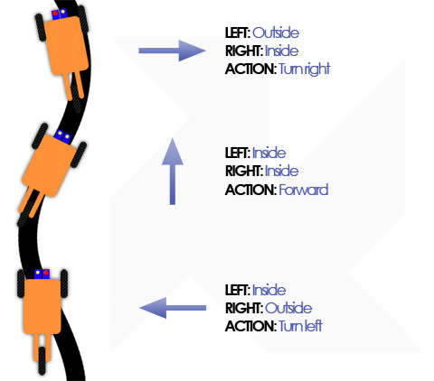

Two sensors?
OR
place them on either side of the line
Image credit: http://kile.stravaganza.org/project/lego-robot-line-follower

Slide 26
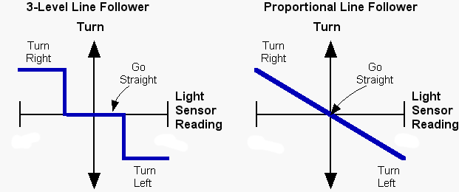
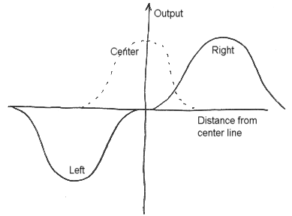
Two sensor proportional line following
Image credit: http://www.inpharmix.com/jps/PID_Controller_For_Lego_Mindstorms_Robots.html
Control based on the difference between the sensors readings:
Negate left sensor reading
Sum the right and left sensor readings
Move based on the difference
Image credit: http://www.seattlerobotics.org/encoder/200011/Line%20Following.htm

Slide 27
In-Class Activity 2
Create a two-sensor line-following robot and compete in the in-class competition.
Members of the winning team will each receive 5 extra credit pts.

