Slide 1
Map-Reduce

Slide 2
Outline
Map-Reduce in Functional Programming
Map-Reduce Examples
Map-Reduce Execution Overview
Map-Reduce and Hadoop

Slide 3
Functional Programming
MapReduce = functional programming meets distributed processing on steroids
Not a new idea… dates back to the 50’s (or even 30’s)
What is functional programming?
Computation as application of functions
Theoretical foundation provided by lambda calculus
How is it different?
Traditional notions of “data” and “instructions” are not applicable
Data flows are implicit in program
Different orders of execution are possible
Exemplified by LISP and ML

Slide 4
Overview of Lisp
Lisp ≠ Lost In Silly Parentheses
We’ll focus on particular a dialect: “Scheme”
Lists are primitive data types
Functions written in prefix notation
'(1 2 3 4 5)
'((a 1) (b 2) (c 3))
(+ 1 2) → 3
(* 3 4) → 12
(sqrt (+ (* 3 3) (* 4 4))) → 5
(define x 3) → x
(* x 5) → 15

Slide 5
Functions
Functions = lambda expressions bound to variables
Syntactic sugar for defining functions
Above expressions is equivalent to:
Once defined, function can be applied:
(define foo (lambda (x y) (sqrt (+ (* x x) (* y y)))))
(define (foo x y) (sqrt (+ (* x x) (* y y))))
(foo 3 4) → 5

Slide 6
Lisp → MapReduce?
What does this have to do with MapReduce?
After all, Lisp is about processing lists
Two important concepts in functional programming
Map: do something to everything in a list
Fold: combine results of a list in some way

Slide 7
Lisp → MapReduce?
What does this have to do with MapReduce?
After all, Lisp is about processing lists
Two important concepts in functional programming
Map: do something to everything in a list
Fold: combine results of a list in some way

Slide 8
Map
Map is a higher-order function
How map works:
Function is applied to every element in a list
Result is a new list
f
f
f
f
f

Slide 9
Fold
Fold is also a higher-order function
How fold works:
Accumulator set to initial value
Function applied to list element and the accumulator
Result stored in the accumulator
Repeated for every item in the list
Result is the final value in the accumulator
f
f
f
f
f
final value
Initial value

Slide 10
Map/Fold in Action
Simple map example:
Fold examples:
Sum of squares:
(map (lambda (x) (* x x)) '(1 2 3 4 5)) → '(1 4 9 16 25)
(fold + 0 '(1 2 3 4 5)) → 15
(fold * 1 '(1 2 3 4 5)) → 120
(define (sum-of-squares v) (fold + 0 (map (lambda (x) (* x x)) v)))
(sum-of-squares '(1 2 3 4 5)) → 55

Slide 11
Lisp → MapReduce
Let’s assume a long list of records: imagine if...
We can parallelize map operations
We have a mechanism for bringing map results back together in the fold operation
That’s MapReduce! (and Hadoop)
Observations:
No limit to map parallelization since maps are indepedent
We can reorder folding if the fold function is commutative and associative

Slide 12
Typical Problem
Map
Iterate over a large number of records
Extract something of interest from each
Shuffle and sort intermediate results
Aggregate intermediate results
Generate final output
Reduce
Key idea: provide an abstraction at the point of these two operations

Slide 13
MapReduce programming model
Process data using special map() and reduce() functions
The map() function is called on every item in the input and emits a series of intermediate key/value pairs
All values associated with a given key are grouped together
The reduce() function is called on every unique key, and its value list, and emits a value that is added to the output

Slide 14
Map:
(k, v) ↦ <(k₁,v₁), (k₂,v₂), (k₃,v₃),...,(k_{n},v_{n})>
Reduce:
(k’, <v’₁, v’_{2,}...,v’_{n’}>) ↦ <(k’, v’’₁), (k’, v’’₂),...,(k’, v’’_{n’’})>

Slide 15
Map-Reduce Examples

Slide 16
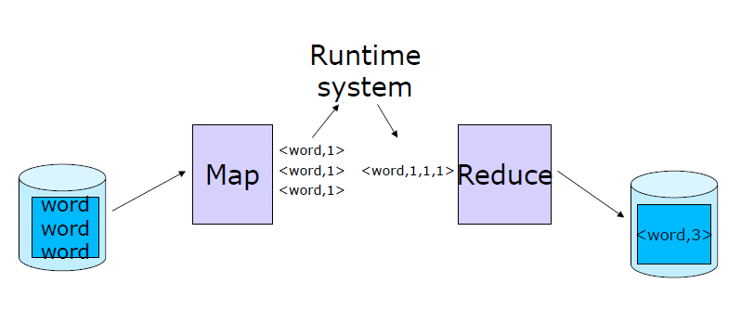
WordCount example

Slide 17
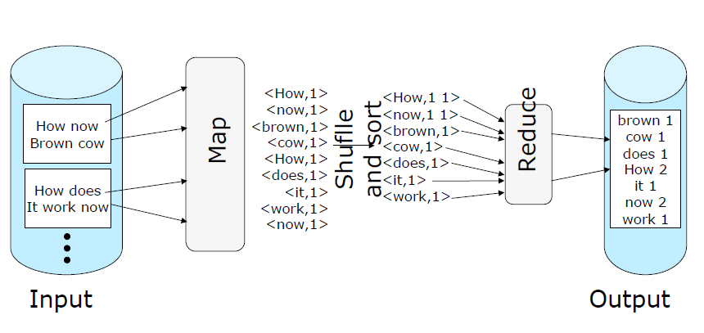
MapReduce programming model, applied to a “word count” example

Slide 18
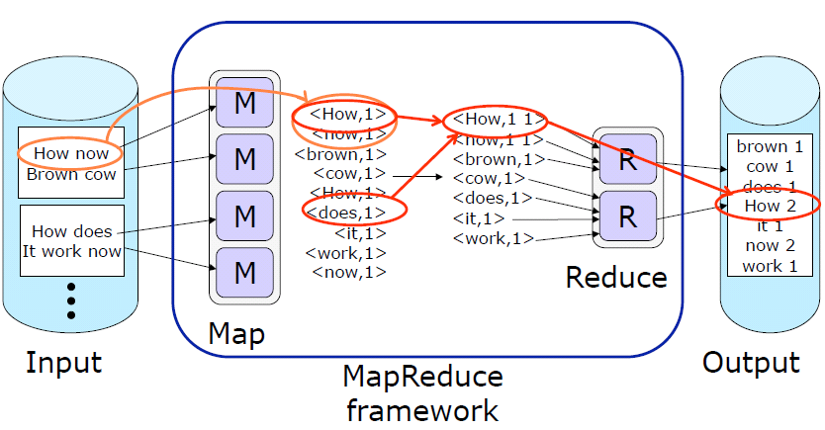
MapReduce programming model

Slide 19
More examples (1) Search
Input: (lineNumber, line) records
Output: lines matching a given pattern
Map: if(line matches pattern): output(line)
Reduce: identify function
Alternative: no reducer (map-only job)

Slide 20
More examples (2) Sort
Input: (key, value) records
Output: same records, sorted by key
Map: identity function
Reduce: identify function
Trick: Pick partitioning function h such that k₁<k₂ => h(k₁)<h(k₂)
Map
ant, bee
Reduce
[A-M]
zebra
aardvark
ant
bee
cow
elephant
cow
Map
pig
Reduce
[N-Z]
aardvark,
elephant
pig
sheep
yak
zebra
Map
sheep, yak

Slide 21
More examples (3) Inverted Index
Input: (filename, text) records
Output: list of files containing each word
Map: foreach word in text.split(): output(word, filename)
Combine: uniquify filenames for each word
Reduce: def reduce(word, filenames): output(word, sort(filenames))

Slide 22
Inverted Index Example
hamlet.txt
to, hamlet.txt
be, hamlet.txt
or, hamlet.txt
not, hamlet.txt
to be or not to be
afraid, (12th.txt)
be, (12th.txt, hamlet.txt)
greatness, (12th.txt)
not, (12th.txt, hamlet.txt)
of, (12th.txt)
or, (hamlet.txt)
to, (hamlet.txt)
12th.txt
be, 12th.txt
not, 12th.txt
afraid, 12th.txt
of, 12th.txt
greatness, 12th.txt
be not afraid of greatness

Slide 23
4. Most Popular Words
Input: (filename, text) records
Output: top 100 words occurring in the most files
Two-stage solution:
Job 1:
Create inverted index, giving (word, list(file)) records
Job 2:
Map each (word, list(file)) to (count, word)
Sort these records by count as in sort job
Optimizations:
Map to (word, 1) instead of (word, file) in Job 1
Count files in job 1’s reducer rather than job 2’s mapper
Estimate count distribution in advance and drop rare words

Slide 24
MapReduce Execution

Slide 25
MapReduce Runtime System
Partitions input data
Schedules execution across a set of machines
Handles machine failure
Manages inter-process communication

Slide 26
MapReduce benefits
Reduces parallel programming complexity
Reduces synchronization complexity
Automatically partitions data
Provides failure transparency
Handles load balancing
Practical
Approximately 1000 Google MapReduce jobs run every day

Slide 27
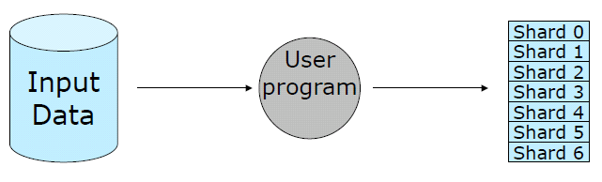
MapReduce Execution Overview
The user program, via the MapReduce library, shards the input data
* Shards are typically 16-64mb in size

Slide 28
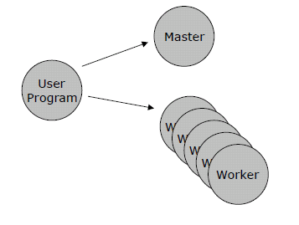
MapReduce execution overview
The user program creates process copies distributed on a machine cluster.
One copy will be the “Master” and the others
will be worker threads.

Slide 29
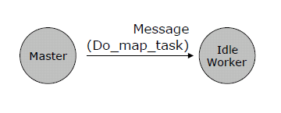
MapReduce Resources
The master distributes M map and R reduce tasks to idle workers.
M = number of shards
R = the intermediate key space is divided
into R parts

Slide 30

MapReduce Resources
Each map-task worker reads assigned input shard and outputs intermediate key/value pairs.
Output buffered in RAM.

Slide 31
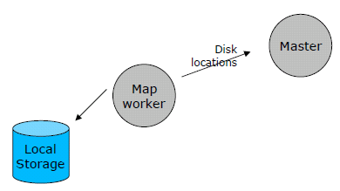
MapReduce Execution Overview
Each worker flushes intermediate values, partitioned into R regions, to disk and notifies the Master process.

Slide 32
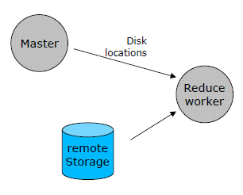
MapReduce Execution Overview
Master process gives disk locations to an available reduce-task worker who reads all associated intermediate data.

Slide 33
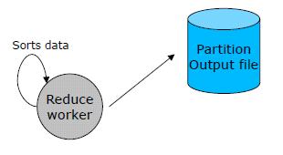
MapReduce Execution Overview
Each reduce-task worker sorts its intermediate data. Calls the reduce function, passing in unique keys and associated key values.
Reduce function output appended to reduce-task’s partition output file.

Slide 34
It’s just divide and conquer!
Data Store
Initial kv pairs
Initial kv pairs
Initial kv pairs
Initial kv pairs
map
map
map
map
k₁, values…
k₃, values…
k₁, values…
k₃, values…
k₁, values…
k₃, values…
k₁, values…
k₃, values…
k₂, values…
k₂, values…
k₂, values…
k₂, values…
Barrier: aggregate values by keys
k₁, values…
k₂, values…
k₃, values…
reduce
reduce
reduce
final k₁ values
final k₂ values
final k₃ values

Slide 35
Map-Reduce and Hadoop

Slide 36

What Is ?
The Apache Hadoop project develops open-source software for reliable, scalable, distributed computing.
Distributed computing frame work
For clusters of computers
Thousands of Compute Nodes
Petabytes of data
Open source, Java
Google’s MapReduce inspired Yahoo’s Hadoop.
Now part of Apache group

Slide 37
What Is ?
Hadoop includes:
Hadoop Common utilities
Kernel
MapReduce: distributed processing on compute clusters.
HDFS: A distributed file system.
HBase: A scalable, distributed database for large tables.
Hive: data summarization and ad hoc querying.
Pig: A high-level data-flow language for parallel computation.
ZooKeeper: coordination service for distributed applications.
Spark: fast and in-memory data process
…..
Notes:
Avro: A data serialization system with scripting languages.
Chukwa: managing large distributed systems.

Slide 38
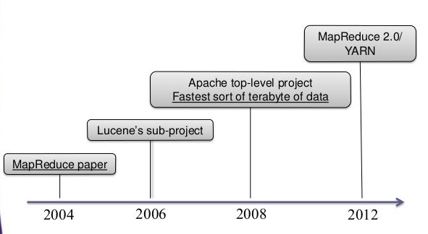
A brief History about Hadoop

Slide 39

A brief History about Hadoop
Main Developer - Doug Cutting
2002-2004: pre-history
Nutch: ( subproject of Apache Lucene )
goal: web-scale, crawler-based search
open source, handful of part-time developers
distributed, by necessity
sort/merge based processing
demonstrated on 4 nodes
100M web pages
operationally onerous
web scale still distant

Slide 40
2004-2006: gestation
GFS & MapReduce papers published
directly address Nutch's scaling issues
Added DFS & MapReduce impl to Nutch
two part-time developers, over two years
ported Nutch's crawler & indexer in 2 weeks
ran on 20 nodes at IA and UW
much easier to program & run
scaled to several 100M web pages
but still far from web-scale...

Slide 41
2006-2008: childhood
Yahoo! hired Doug Cutting & dedicated team, under e14
Hadoop project split out of Nutch
Doug Cutting : Apache/open-source liaison
e14: engineers, clusters, users, etc.
finally hit web-scale in early 2008!
April 2008—Won the 1 terabyte sort benchmark in 209 seconds on 900 nodes.

Slide 42
Sort Benchmark
2007, the sort benchmarks were primary defined by Jim Gray
GraySort Metric: Sort rate (TBs / minute) achieved while sorting a very large amount of data (currently 100 TB minimum)
MinuteSort Metric: Amount of data that can be sorted in 60.00 seconds or less.
TeraByte Sort Metric: Elapsed time to sort 1012 bytes of data.
The TeraByte benchmark is now deprecated because it became essentially the same as MinuteSort.
Notes:
2013, 1.42 TB/min
Hadoop
102.5 TB in 4,328 seconds
2100 nodes x
(2 2.3Ghz hexcore Xeon E5-2630, 64 GB memory, 12x3TB disks)
Thomas Graves
Yahoo! Inc.

Slide 43
Sort Benchmark
2013, 1.42 TB/min, Hadoop
102.5 TB in 4,328 seconds , 2100 nodes x
2009, 0.578 TB/min, Hadoop
100 TB in 173 minutes , 3452 nodes x
2009, 500 GB within 1 min, Hadoop
1406 nodes x (2 Quadcore Xeons, 8 GB memory, 4 SATA)
Notes:
2009, 0.578 TB/min
Hadoop
100 TB in 173 minutes
3452 nodes x (2 Quadcore Xeons, 8 GB memory, 4 SATA)
Owen O'Malley and Arun Murthy
Yahoo Inc.

Slide 44
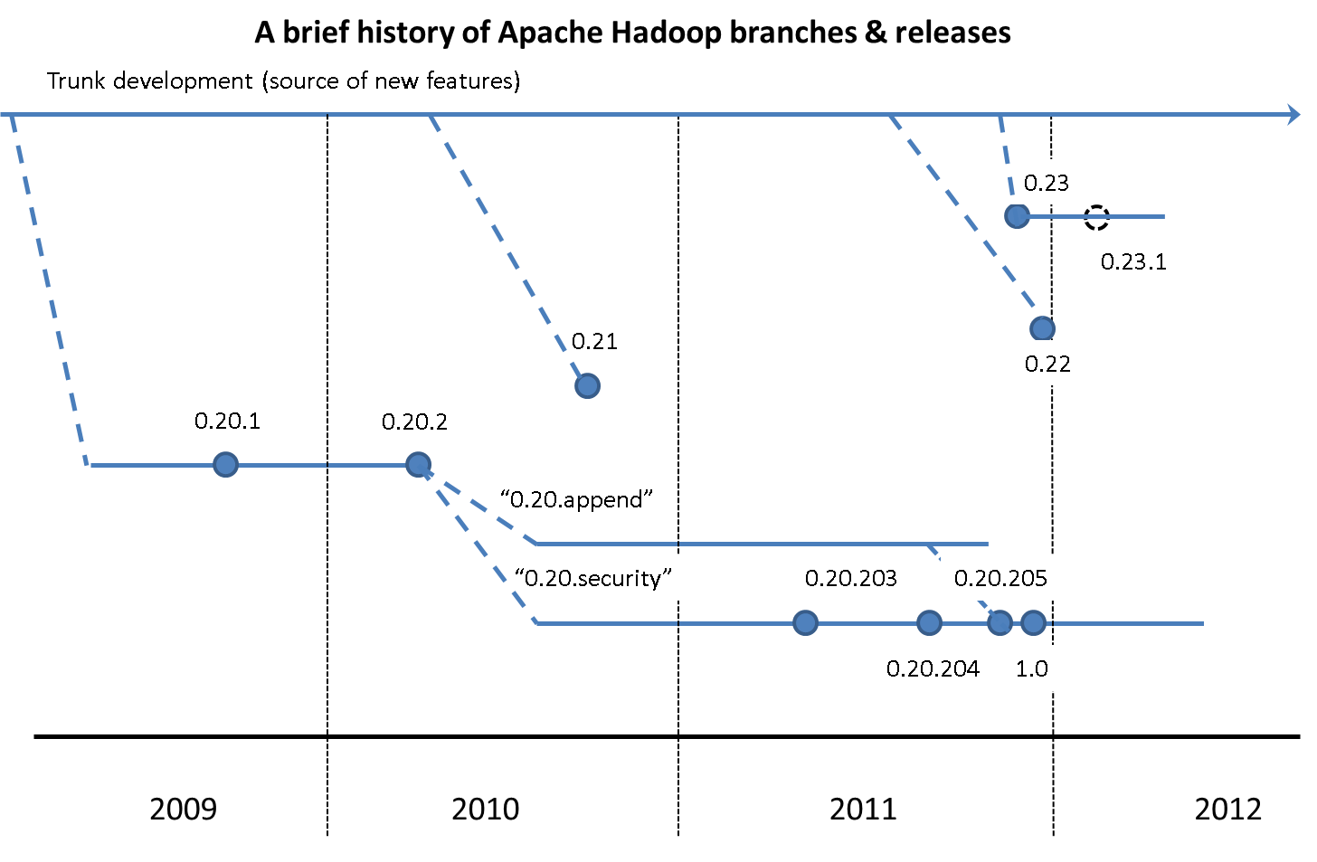
2008-2012 Hadoop 1.0
Notes:
The initial version of hadoop as mentioned on their site is 4 September 2007 Hadoop 0.14.1.

Slide 45
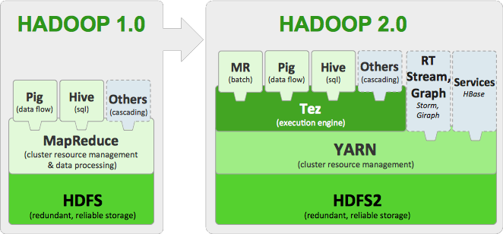
2012-Present
Notes:
October 2008—Loading 10 terabytes of data per day on to research clusters.
March 2009—17 clusters with a total of 24,000 nodes.
April 2009—Won the minute sort by sorting 500 GB in 59 seconds (on 1,400 nodes) and the 100 terabyte sort in 173 minutes (on 3,400 nodes).

Slide 46
Apache Hadoop YARN releases
15 October, 2013
The 1st GA release of Apache Hadoop 2.x
YARN
First stable and supported release of YARN
Binary Compatibility for MapReduce applications built on Hadoop-1.x
YARN level APIs solidified for the future
Performance
Scale from the get-go!
Support for running Hadoop on Microsoft Windows
Substantial amount of integration testing with rest of projects in the ecosystem
Apache Hadoop 2.2

Slide 47
Apache Hadoop 3 over Hadoop 2
Support for erasure encoding in HDFS
Erasure coding is a method for durably storing data with significant space savings compared to replication
Support for Multiple NameNodes.
NameNode Federation
YARN Timeline Service v.2
Log service for Job execution logs and profiles MapReduce task-level native optimization
MapReduce task-level native optimization
Notes:
Job execution logs and profiles are important when troubleshooting Hadoop errors, tuning job performance, and planning cluster capacity.
. Standard encodings like Reed-Solomon (10,4) have a 1.4x space overhead, compared to the 3x overhead of standard HDFS replication.
Hadoop 2 and Hadoop 1 only use a single NameNode to manage all Namespaces. Hadoop 3 has multiple Namenodes for multiple namespaces for NameNode Federation which improves scalability.
In Hadoop 2, there is only one standby NameNode. Hadoop 3 supports multiple standby NameNodes.

Slide 48
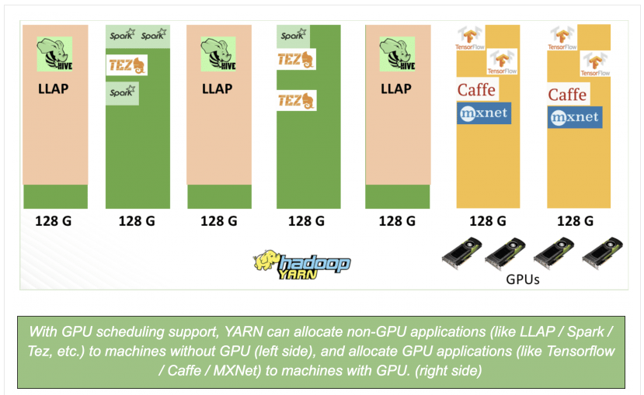
Apache Hadoop 3 over Hadoop 2
GPU pooling/ isolatio
Hadoop 2 doesn’t support GPUs.
Hadoop 3 enables scheduling of additional resources, such as disks and GPUs for better integration with containers, deep learning & machine learning.
the isolation problem: When multiple applications use GPU resources on the same machine
Use cgroups to enforce the isolation.
This works by putting a YARN container – a process tree – into a cgroup that allows access to only the prescribed GPU devices.
Notes:
Plenty of companies are taking advantage of Hadoop’s scalability to create super-sized data warehouses to execute familiar SQL statements for traditional ad-hoc and BI reporting purposes, using distributed SQL engines like Hive, Impala, Presto, and Spark SQL.

Slide 49
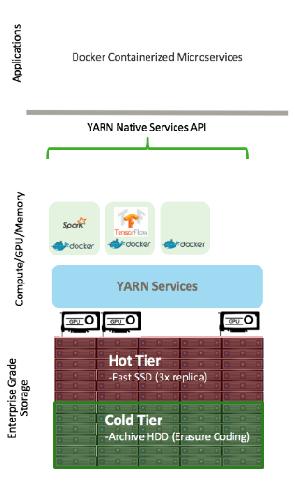
Apache Hadoop 3.1.0
Agility: Containerization support provides isolation and packaging of workloads and enables us to lift existing as well new workloads such as deep learning frameworks
Low Total Cost of Ownership: Erasure Coding helps reduce the storage overhead from 200% to 50%, as the volume of data grows.

