Slide 1
Spark
Lightning-fast cluster computing
Notes:
Spark was initially developed for applications where keeping data in memory helps performance, such as iterative algorithms, which are common in machine learning, and interactive data mining.

Slide 2
What is Spark?
Not a modified version of Hadoop
Separate, fast, MapReduce-like engine
In-memory data storage for very fast iterative queries
General execution graphs and powerful optimizations
Up to 40x faster than Hadoop
Compatible with Hadoop’s storage APIs
Can read/write to any Hadoop-supported system, including HDFS, HBase, SequenceFiles, etc

Slide 3
SchemaRDD’s
DStream’s: Streams of RDD’s
RDD-Based Matrices
Spark
SQL
Spark Streaming real-time
MLLib
machine learning
RDDs, Transformations, and Actions
Spark

Slide 4
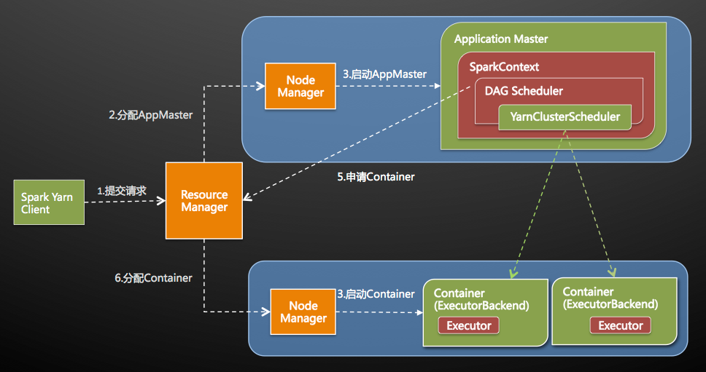
Spark on Yarn

Slide 5
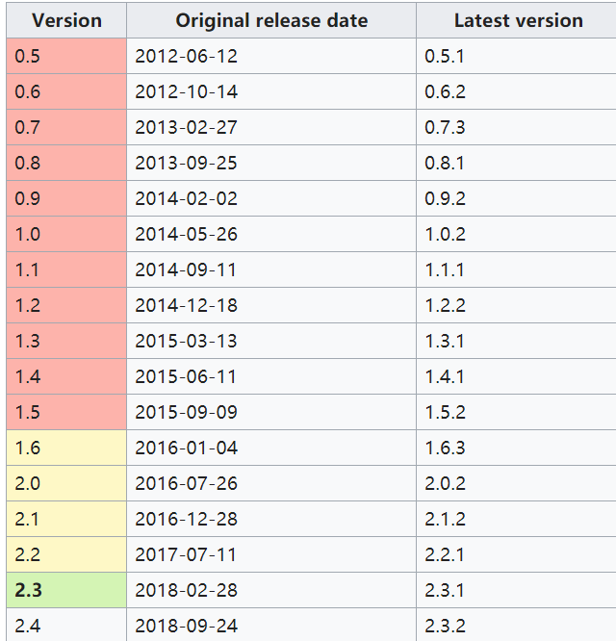
Project History
Spark project started in 2009, open sourced 2010
Shark started summer 2011, alpha April 2012
In use at Berkeley, Princeton, Klout, Foursquare, Conviva, Quantifind, Yahoo Research others
200+ member meetup, 500+ watchers on GitHub
Spark had in excess of 1000 contributors in 2015

Slide 6
Why a New Programming Model?
MapReduce greatly simplified big data analysis
But as soon as it got popular, users wanted more:
More complex, multi-stage applications (e.g. iterative graph algorithms and machine learning)
More interactive ad-hoc queries
Both multi-stage and interactive apps require faster data sharing across parallel jobs

Slide 7
Data Sharing in MapReduce
HDFS read
HDFS write
HDFS read
HDFS write
iter. 1
iter. 2
. . .
Input
HDFS read
query 1
result 1
query 2
result 2
query 3
result 3
Input
. . .
Slow due to replication, serialization, and disk IO
Notes:
Each iteration is, for example, a MapReduce job

Slide 8

Data Sharing in Spark
iter. 1
iter. 2
. . .
Input
query 1
one-time processing
query 2
query 3
Input
Distributed memory
. . .
10-100× faster than network and disk

Slide 9
Coarse Grained: Resilient Distributed Datasets (RDDs)
Restricted form of distributed shared memory
Immutable, partitioned collections of records
Can only be built through coarse-grained deterministic transformations (map, filter, join, …)
Efficient fault recovery using lineage
Log one operation to apply to many elements
Re-compute lost partitions on failure
No cost if nothing fails
Notes:
Define RDDs more precisely here

Slide 10
RDD Recovery
iter. 1
iter. 2
. . .
Input
query 1
one-time processing
query 2
query 3
Input
. . .

Slide 11
Generality of RDDs
Despite their restrictions, RDDs can express surprisingly many parallel algorithms
These naturally apply the same operation to many items
Unify many current programming models
Data flow models: MapReduce, Dryad, SQL, …
Specialized models for iterative apps:
BSP (Pregel), iterative MapReduce (Haloop), bulk incremental, …
Support new apps that these models don’t
Notes:
Similarity to GFS/HDFS: large blocks, append only.

Slide 12
Tradeoff Space
Network
bandwidth
Memory
bandwidth
Fine
K-V stores,
databases,
RAMCloud
Best for
transactional
workloads
Granularity
of Updates
Best for batch
workloads
HDFS
RDDs
Coarse
Low
High
Write Throughput

Slide 13
Spark Programming Model
Key idea: resilient distributed datasets (RDDs)
Distributed collections of objects that can be cached in memory across cluster nodes
Manipulated through various parallel operators
Automatically rebuilt on failure
Interface
Clean language-integrated API in Scala，Java, Python,
Can be used interactively from console

Slide 14
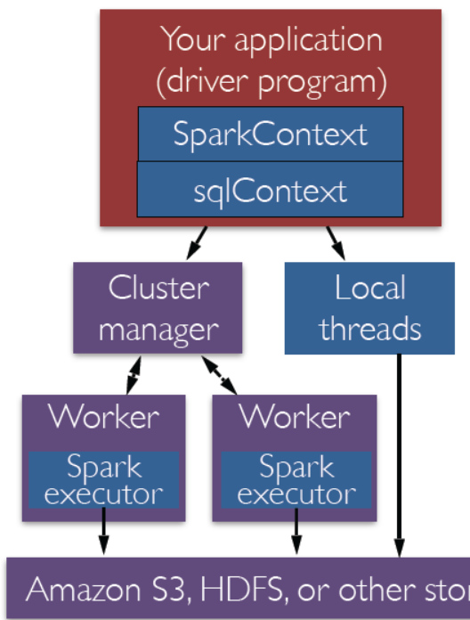
Spark Driver and Workers
A Spark program is two programs:
A driver program and a workers program
The spark driver: declares the transformations and actions on RDDs of data and submits such requests to the master.
Worker programs run on cluster nodes or in local threads

Slide 15
Spark Context
A Spark program first creates a SparkContext object
» SparkContext tells Spark how and where to access a cluster
conf = SparkConf().setAppName(appName).setMaster(master)
sc = SparkContext(conf=conf)
The appName parameter is a name for your application to show on the cluster UI.
master is a Spark, Mesos or YARN cluster URL, or a special “local” string to run in local mode.

Slide 16
RDD Operations
Two types of operations: transformations and actions
Transformations: create a new dataset from an existing one
Actions: return a value to the driver program after running a computation on the dataset.
Transformations are lazy (not computed immediately)
The transformations are only computed when an action requires a result to be returned to the driver program.
Transformed RDD is executed when action runs on it
Persist (cache) RDDs in memory or disk

Slide 17
Supported Operators
map
filter
groupBy
sort
join
leftOuterJoin
rightOuterJoin
reduce
count
reduceByKey
groupByKey
first
union
cross
sample
cogroup
take
partitionBy
pipe
save
...

Slide 18
RDD Operations
Parallel operations (return a result to driver)
reduce collect count save lookupKey …
Transformations (define a new RDD)
map, filter, sample union groupByKey reduceByKey join cache …
map is a transformation that passes each dataset element through a function and returns a new RDD representing the results.
reduce is an action that aggregates all the elements of the RDD using some function and returns the final result to the driver program
parallel reduceByKey returns a distributed dataset

Slide 19
Transformations
>>> data = [1, 2, 3, 4, 5]
>>> distData = sc.parallelize(data)
>>> rdd.map(lambda x: x*2)
RDD: [1, 2, 3, 4] →[2, 4, 6, 8]
>>> rdd.filter(lambda x: x % 2 == 0)
RDD: [1, 2, 3, 4] → [2, 4]
>>> rdd2 = sc.parallelize([1, 4, 2, 2, 3])
>>> rdd2.distinct()
RDD: [1, 4, 2, 2, 3] → [1, 4, 2, 3]

Slide 20
Creating an RDD from a File
PySpark can create distributed datasets from any storage source supported by Hadoop, including your local file system, HDFS, Cassandra, HBase, Amazon S3, etc.
Spark supports text files, SequenceFiles, and any other Hadoop InputFormat.
>>> distFile = sc.textFile("data.txt")
Once created, distFile can be acted on by dataset operations.
>>> distFile.map(lambda s: len(s)).reduce(lambda a, b: a + b).
add up the sizes of all the lines using the map and reduce operations
Notes:
Once created, distFile can be acted on by dataset operations. For example, we can add up the sizes of all the lines using the map and reduce operations as follows: distFile.map(lambda s: len(s)).reduce(lambda a, b: a + b).

Slide 21
Passing Functions to Spark
Spark’s API relies heavily on passing functions in the driver program to run on the cluster. There are three recommended ways to do this:
Lambda expressions, for simple functions that can be written as an expression.
Local defs inside the function calling into Spark, for longer code.
Top-level functions in a module.
if __name__ == "__main__":
def myFunc(s):
words = s.split(" ")
return len(words)
sc = SparkContext(...)
sc.textFile("file.txt").map(myFunc)
Notes:
(Lambdas do not support multi-statement functions or statements that do not return a value.)

Slide 22
Spark Program Lifecycle with RDDs
1. Create RDDs from external data or parallelize a
collection in your driver program
2. Lazily transform them into new RDDs
3. cache() some RDDs for reuse
4. Perform actions to execute parallel computation and produce results

Slide 23
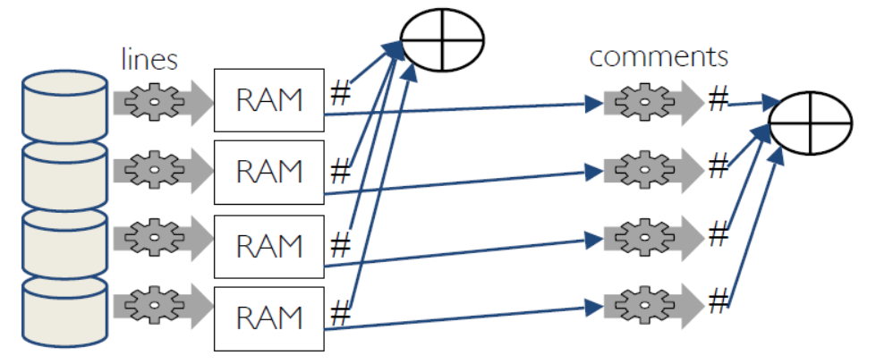
Caching RDDs
lines = sc.textFile("...", 4)
lines.cache(),#,save,,don't,recompute ,
comments = lines.filter(isComment)
print lines.count(),comments.count()

Slide 24
Shared Variables
Broadcast Variables
» Efficiently send large, read-only value to all executors
» Saved at workers for use in one or more Spark operations
» Like sending a large, read-only lookup table to all the nodes
Accumulators
» Aggregate values from executors back to driver
» Only driver can access value of accumulator
» For tasks, accumulators are write-only
» Use to count errors seen in RDD across executors

Slide 25
Broadcast Variables
Keep read-only variable cached on executors
» Ship to each worker only once instead of with each task
Example: efficiently give every executor a large dataset
Usually distributed using efficient broadcast algorithms
At the driver:
>>> broadcastVar = sc.broadcast([1, 2, 3])
At an executor (in code passed via a closure)
>>> broadcastVar.value1
[1, 2, 3]

Slide 26
Accumulators
Variables that can only be “added” to by associative op
Used to efficiently implement parallel counters and sums
Only driver can read an accumulator’s value, not tasks
>>> accum = sc.accumulator(0)
>>> rdd = sc.parallelize([1, 2, 3, 4])
>>> def f(x):
>>> global accum
>>> accum += x
>>> rdd.foreach(f) // foreach is an Action
>>> accum.value1
Value: 10
Notes:
One of the most common uses of accumulators is to count events that occur during job execution for debugging purposes. Accumulators in Spark are used specifically to provide a mechanism for safely updating a variable when execution is split up across worker nodes in a cluster.

Slide 27

Example: Log Mining
Load error messages from a log into memory, then interactively search for various patterns
Transformed RDD
Cache 1
Base RDD
Worker
lines = spark.textFile(“hdfs://...”)
errors = lines.filter(_.startsWith(“ERROR”))
messages = errors.map(_.split(‘\t’)(2))
cachedMsgs = messages.cache()
results
tasks
Block 1
Driver
Action
cachedMsgs.filter(_.contains(“foo”)).count
cachedMsgs.filter(_.contains(“bar”)).count
Cache 2
Worker
. . .
Cache 3
Result: scaled to 1 TB data in 5-7 sec (vs 170 sec for on-disk data)
Worker
Block 2
Result: full-text search of Wikipedia in <1 sec (vs 20 sec for on-disk data)
Block 3
Notes:
Add “variables” to the “functions” in functional programming

Slide 28
Fault Tolerance
RDDs track the series of transformations used to build them (their lineage) to recompute lost data
E.g:
messages = textFile(...).filter(_.contains(“error”))
.map(_.split(‘\t’)(2))
HadoopRDD
path = hdfs://…
FilteredRDD
func = _.contains(...)
MappedRDD
func = _.split(…)

Slide 29
What is MLlib?
Algorithms:
classification: logistic regression, linear support vector machine (SVM), naive Bayes
regression: generalized linear regression (GLM)
collaborative filtering: alternating least squares (ALS)
clustering: k-means
decomposition: singular value decomposition (SVD), principal component analysis (PCA)

Slide 30
MLlib
linear SVM and logistic regression
classification and regression tree
k-means clustering
recommendation via alternating least squares
singular value decomposition
linear regression with L1- and L2-regularization
multinomial naive Bayes
basic statistics
feature transformations

Slide 31
Example: Logistic Regression
Goal: find best line separating two sets of points
random initial line
+
+
+
+
+
+
–
+
+
–
–
–
+
+
–
–
–
–
–
–
target
Notes:
Note that dataset is reused on each gradient computation

Slide 32



Example: Logistic Regression
Logistic regression is widely used to predict a binary response.
It is a linear method as described above in equation (1),
with the loss function in the formulation given by the logistic loss:
Where
Notes:
We implemented two algorithms to solve logistic regression: mini-batch gradient descent and L-BFGS. We recommend L-BFGS over mini-batch gradient descent for faster convergence.

Slide 33
Example: Logistic Regression
Load data in memory once
val data = spark.textFile(...).map(readPoint).cache()
var w = Vector.random(D)
for (i <- 1 to ITERATIONS) {
val gradient = data.map(p =>
(1 / (1 + exp(-p.y*(w dot p.x))) - 1) * p.y * p.x
).reduce(_ + _)
w -= gradient
}
println("Final w: " + w)
Initial parameter vector
Repeated MapReduce steps to do gradient descent
Notes:
Key idea: add “variables” to the “functions” in functional programming

Slide 34
Logistic Regression Performance
127 s / iteration
first iteration 174 s
further iterations 6 s
Notes:
This is for a 29 GB dataset on 20 EC2 m1.xlarge machines (4 cores each)

Slide 35
Binomial logistic regression
from pyspark.ml.classification import LogisticRegression
# Load training data
training = spark.read.format("libsvm").load("data/mllib/sample_libsvm_data.txt")
lr = LogisticRegression(maxIter=10, regParam=0.3, elasticNetParam=0.8)
# Fit the model
lrModel = lr.fit(training)
# Print the coefficients and intercept for logistic regression
print("Coefficients: " + str(lrModel.coefficients))
print("Intercept: " + str(lrModel.intercept))

Slide 36
k-means (python)
# Load and Parse the Data
data = sc.textFile("kmeans_data.txt")
parsedData = data.map(lambda line:
array([float(x) for x in line.split(‘ ’)])).cache()
# Build the model (cluster the data)
clusters = KMeans.train(parsedData, 2, maxIterations = 10, runs = 1, initialization_mode = kmeans")
# Evaluate clustering by computing the sum of squared errors
def error(point):
center = clusters.centers[clusters.predict(point)]
return sqrt(sum([x**2 for x in (point - center)]))
cost = parsedData.map(lambda point: error(point)).reduce(lambda x, y : x+y)
print("Sum of squared error = "+ str(cost))
Notes:
The most important parameter in K-means is a target number of clusters to generate, K. In
practice, you rarely know the “true” number of clusters in advance, so the best practice is
to try several values of K, until the average intracluster distance stops decreasing
dramatically.

Slide 37
Dimension reduction+ k-means
// compute principal components
val points: RDD[Vector] = ...
val mat = RowRDDMatrix(points)
val pc = mat.computePrincipalComponents(20)
// project points to a low-dimensional space ( the top 20 components )
val projected = mat.multiply(pc).rows
// train a k-means model on the projected data
val model = KMeans.train(projected, 10)

Slide 38
Collaborative filtering
Collaborative filtering is a technique for recommender systems wherein users’ ratings and interactions with various products are used to recommend new ones.
Collaborative filtering is attractive because it only needs to take in a list of user/product interactions:
either “explicit” interactions (i.e., ratings on a shopping site)
or “implicit” ones (e.g., a user browsed a product page but did not rate the product).

Slide 39
Collaborative filtering: Alternating Least Squares
MLlib includes an implementation of Alternating Least Squares (ALS), a popular algorithm for collaborative filtering that scales well on clusters.
It is located in the mllib.recommendation.ALS class.
ALS works by determining a feature vector for each user and product, such that the dot product of a user’s vector and a product’s is close to their score.
“Collaborative Filtering for Implicit Feedback Datasets” ICDM 2008
Notes:
The approach used in spark.mllib to deal with such data is taken from Collaborative Filtering for Implicit Feedback Datasets.
Essentially, instead of trying to model the matrix of ratings directly, this approach treats the data as numbers representing the strength in observations of user actions (such as the number of clicks, or the cumulative duration someone spent viewing a movie).
Those numbers are then related to the level of confidence in observed user preferences, rather than explicit ratings given to items. The model then tries to find latent factors that can be used to predict the expected preference of a user for an item.

Slide 40
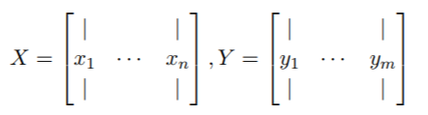


Collaborative filtering: Alternating Least Squares
matrix factorization: fix a relatively small number k (e.g. k ≈ 10), and summarize each user u with a k dimensional vector x_{u}, and each item i with a k dimensional vector y_{i}
These vectors are referred to as factors
we aim to minimize the least squares error of the observed ratings (and regularize)
ALS(Alternating Least Squares): fix Y and optimize X, then fix X and optimize Y , and repeat until convergence.

Slide 41
Collaborative filtering
// Load and parse the data
val data = sc.textFile("mllib/data/als/test.data")
Val ratings = data.map( _.split(',') match {
case Array(user, item, rate) =>
Rating(user.toInt, item.toInt, rate.toDouble)
})
// Build the recommendation model using ALS
val model = ALS.train(ratings, 1, 20, 0.01)
// Evaluate the model on rating data
val usersProducts= ratings.map { case Rating(user, product, rate) =>
(user, product)
}
val predictions = model.predict(usersProducts)

