Slide 1

Programming with Pig

Slide 2
What is Pig
Apache Pig is a platform for analyzing large data sets that consists of a high-level language (PigLatin) for expressing data analysis programs, coupled with infrastructure for evaluating these programs.
Ease of programming
Optimization opportunities
Extensibility
Built upon Hadoop

Slide 3
Map-Reduce Disadvantages
1. Extremely rigid data flow
M
R
Other flows constantly hacked in
M
M
R
M
Join, Union
Split
Chains
2. Common operations must be coded by hand
Join, filter, projection, aggregates, sorting, distinct
3. Semantics hidden inside map-reduce functions
Difficult to maintain, extend, and optimize

Slide 4
Pros And Cons
Need a high-level, general data flow language
Inflexible
Lots of hand coding
Scalable
Cheap
Control over execution
Semantics hidden

Slide 5
Enter Pig Latin
Need a high-level, general data flow language
Scalable
Cheap
Control over execution
Pig Latin

Slide 6
Java MapReduce vs. Pig Latin
1/20 the lines of code
1/16 the development time
Performance on par with raw Hadoop!
Pig Slides adapted from Olston et al.

Slide 7

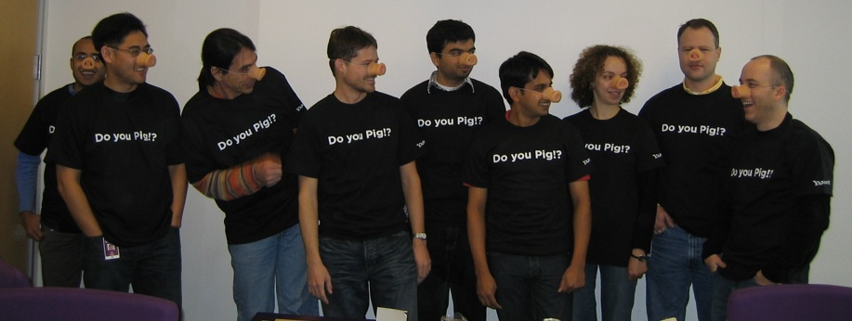
Why PIG?
Pigs Eat Anything
Pig can operate on data whether it has metadata or not. It can operate on data that is relational, nested, or unstructured. And it can easily be extended to operate on data beyond files, including key/value stores, databases, etc.
Pigs Live Anywhere
Pig is intended to be a language for parallel data processing. It is not tied to one particular parallel framework. It has been implemented first on Hadoop, but we do not intend that to be only on Hadoop.
Pigs Are Domestic Animals
Pig is designed to be easily controlled and modified by its users.
Pigs Fly
Pig processes data quickly.

Slide 8
What Pig is not?
It can’t be used as a DBMS replacement.
No single record fetching.
No SELECT keyword.
Slower than Pure Hadoop implementations
Pig and Hive are almost sisters with minor differences.

Slide 9
Pig overview
Pig has two major components:
1 A high-level data processing language called Pig Latin .
2 A compiler that compiles and runs your Pig Latin script in a choice of evaluation mechanisms .
The main evaluation mechanism is Hadoop.
Pig also supports a local mode for development purposes.

Slide 10
Architecture of Pig
Grunt (Interactive shell)
PigServer (Java API)
PigContext
Parser (PigLatin→LogicalPlan)
Optimizer (LogicalPlan → LogicalPlan)
Compiler (LogicalPlan → PhysicalPlan → MapReducePlan)
ExecutionEngine
Hadoop

Slide 11
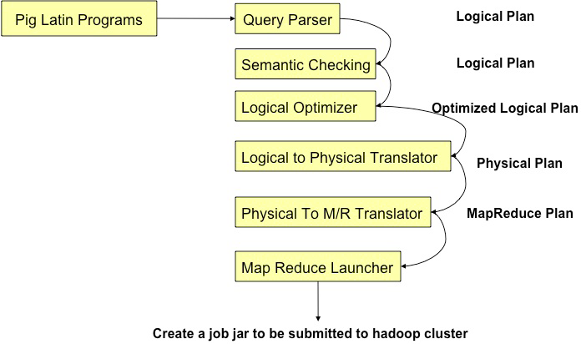
Pig Stages

Slide 12
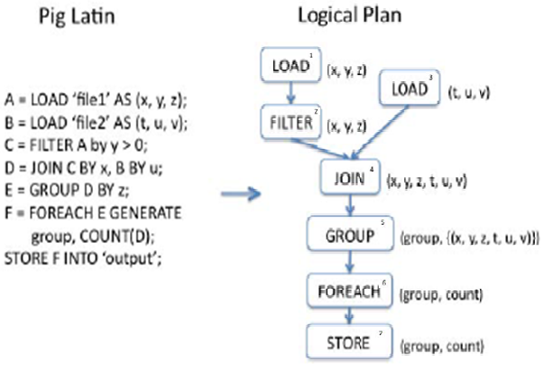
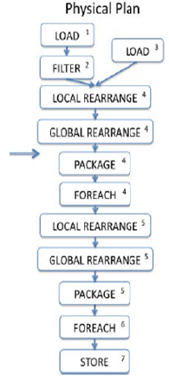
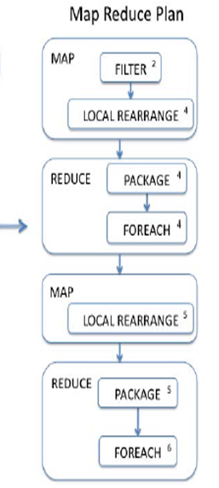
Map-Reduce Compiler:Logical to Physical compilation
Map-Reduce Compiler:LOGICAL PLAN STRUCTURE => PHYSICAL PLAN => MAP-REDUCE PLAN

Slide 13
Map-Reduce Optimizer
Performs early partial aggregation in distributive or algebraic aggregation functions
eg: for function AVERAGE, the steps are:-
Initial
e.g. generate (sum, count) pairs
Assigned to Map stage.
intermediate
e.g. combine n (sum,count) pairs into a single pair
Assigned to Combine stage.
final
e.g. combine n (sum,count) pairs and take the quotient
Assigned to Reduce step

Slide 14
Hadoop Job Manager
Map-Reduce jobs sorted and submitted to Hadoop for execution
Java jar file generated for Map and Reduce implementation classes and UDF
Map and Reduce classes contain general-purpose dataflow execution engines
Monitor and generates periodic reports
Warnings or errors logged and reported

Slide 15
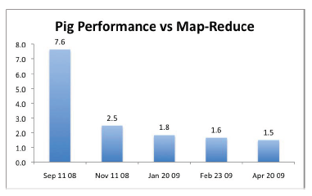
Benchmark Results
Pig Mix benchmark
September 11, 2008:
Initial Apache open-source release
November 11, 2008:
Enhanced type system
Rewrote execution pipeline
Combiner enhanced
January 20, 2009:
Buffering during data parsing
Fragment-replicate join algorithm
February 23, 2009:
Rework of partitioning function used in ORDER BY to ensure more balanced distribution of keys to reducers
April 20, 2009:
Branching execution plans
Vertical axis : Ratio of total running time for 12 Pig programs
to corresponding Map-Reduce programs
Current performance ratio is 1:5 - Reasonable trade of point between execution time and code development/maintenance effort.
Notes:
September 11, 2008:
Initial Apache open-source release
November 11, 2008:
Enhanced type system,
rewrote execution pipeline,
enhanced use of combiner
January 20, 2009:
Rework of buffering during data parsing, fragment-replicate join algorithm
February 23, 2009: Rework of partitioning function used in ORDER BY to ensure more balanced distribution of keys to reducers
April 20, 2009: Branching execution plans

Slide 16
Example

Slide 17
Example Data Analysis Task
Find the top 10 most visited pages in each category
Visits
Url Info
User | Url | Time
Amy | cnn.com | 8:00
Amy | bbc.com | 10:00
Amy | flickr.com | 10:05
Fred | cnn.com | 12:00
Url | Category | PageRank
cnn.com | News | 0.9
bbc.com | News | 0.8
flickr.com | Photos | 0.7
espn.com | Sports | 0.9

Slide 18
Data Flow
Load Visits
Group by url
Foreach url
generate count
Load Url Info
Join on url
Group by category
Foreach category
generate top10 urls

Slide 19
Three basic operations of Pig
Group by
Join
Order

Slide 20
How Pig do Group by
Data Source → Split → Mapper → Partition → Reducer
(A,1)
(B,2)
(C,3)
(A,1)
(B,2)
(C,3)
(B,4)
(B,5)
(C,6)
(A,7)
(E,8)
(D,9)
(A,{(A,1),(A,7)})
(C,{(C,3),(C,6)})
(E,{(E,8)})
(B,4)
(B,5)
(C,6)
(B,{(B,2),(B,4),(B,5)})
(D,{(D,9)})
(A,7)
(E,8)
(D,9)

Slide 21
How Pig do Join
Data Source → Split → Mapper → Partition → Reducer
(1,A1)
(4,A4)
(3,A3)
(5,A5)
(2,A2)
(1,A1)
(4,A4)
(5,B5)
(1,B1)
((1,A1),(1,B1))
((3,A3),(3,B3))
((5,A5),(5,B5))
(3,A3)
(5,A5)
(3,B3)
(2,B2)
(5,B5)
(1,B1)
(3,B3)
(2,B2)
(4,B4)
((2,A2)(2,B2))
((4,B4),(4,B4))
(2,A2)
(4,B4)

Slide 22
How Pig do Sort
Data Source → Split → Mapper → Range Partition → Reducer
(100)
(200)
(900)
(50)
(100)
(200)
(300)
(400)
(100)
(200)
(900)
(50)
(600)
(800)
(300)
(400)
(50)
(600)
(800)
(600)
(800)
(300)
(400)

Slide 23
In Pig Latin
visits = load ‘/data/visits’ as (user, url, time);
gVisits = group visits by url;
visitCounts = foreach gVisits generate url, count(visits);
urlInfo = load ‘/data/urlInfo’ as (url, category, pRank);
visitCounts = join visitCounts by url, urlInfo by url;
gCategories = group visitCounts by category;
topUrls = foreach gCategories generate top(visitCounts,10);
store topUrls into ‘/data/topUrls’;

Slide 24
Running PIG

Slide 25
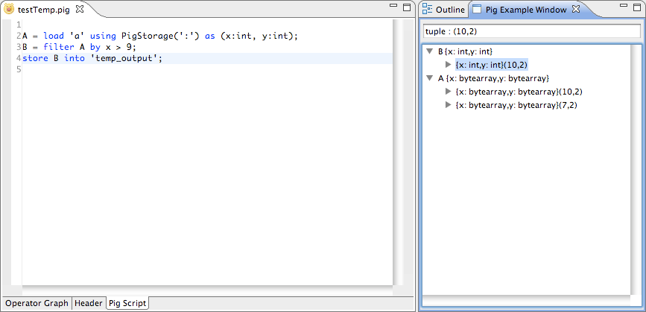
Before Starting…
If you are using Eclipse, take a look at PigPen: http://wiki.apache.org/pig/PigPen
Syntax highlighters and IDE’s always make things easy.

Slide 26
Running PIG
Three ways
Grunt interactive shell
Through a script file
As embedded queries inside Java programs
Two modes

Slide 27
Running Pig
Run Pig in 3 ways, in 2 modes (hadoop or local)
Grunt Shell: Enter Pig commands manually using Pig’s interactive shell, Grunt
Command on login nodes: “pig –x local”, “pig”
Script File: Place Pig commands in a script file and run the script.
Command on login nodes: “pig –x local your_pigscript”, “pig your_pigscript”
Embedded Program: Embed Pig commands in a Java and run the program
“javac -cp $PIG_HOME/pig.jar EmbeddedPigQuery.java”
“java -cp $PIG_HOME/pig.jar EmbeddedPigQuery mapreduce”
“java -cp $PIG_HOME/pig.jar EmbeddedPigQuery local”

Slide 28
Run PIG locally
pig -x local
pig -x mapreduce
grunt> set debug on
grunt> set job.name 'my job'

Slide 29
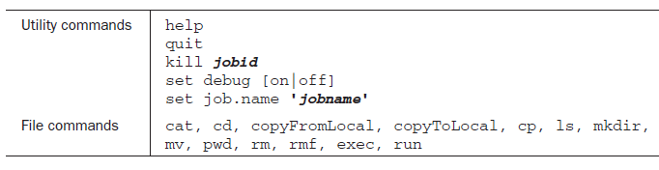
Utility and file commands in the Grunt shell

Slide 30
grunt> log = LOAD 'tutorial/data/excite-small.log' AS (user, time, query);
grunt> lmt = LIMIT log 4;
grunt> DUMP lmt;

Slide 31
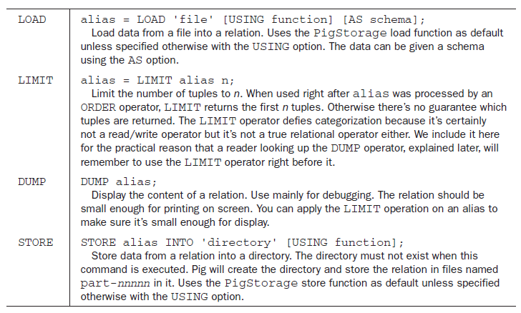
Inserting Developer Code

Slide 32
Pig Latin

Slide 33
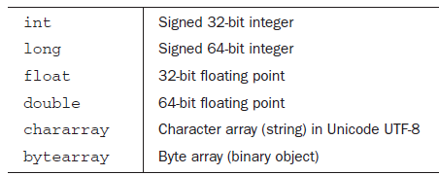
Data types and schemas
Pig has six simple atomic types and three complex types
Atomic data types in Pig Latin

Slide 34
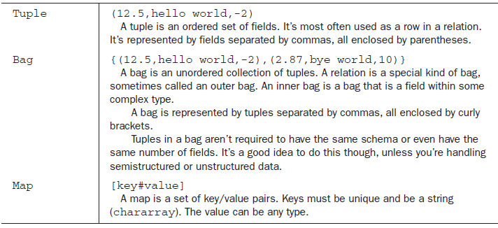
Complex data types in Pig Latin

Slide 35
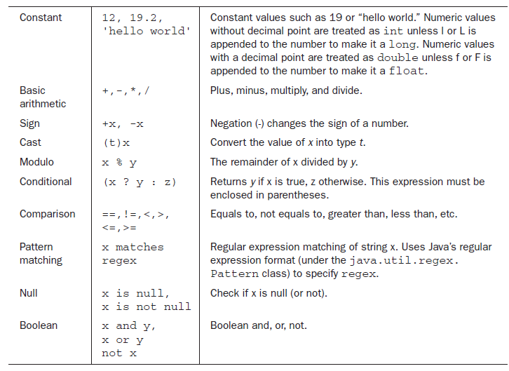
Expressions in Pig Latin

Slide 36
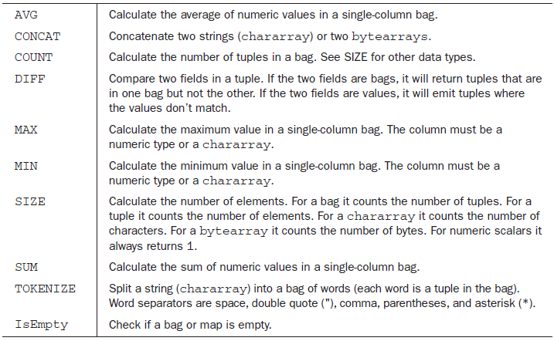
Built-in functions in Pig Latin

Slide 37
Relational operators
SPLIT | Partitions a relation into two or more relations.
SAMPLE | Selects a random sample of data based on the specified sample size.
FILTER | Selects tuples from a relation based on some condition.
FOREACH | Generates data transformations based on columns of data.
DISTINCT | Removes duplicate tuples in a relation.
Union | Computes the union of two or more relations.
GROUP/CoGroup | Groups the data in one or more relations.
Cross | Computes the cross product of two or more relations.
Join | Performs an inner/outer join of two or more relations based on common field values.
Stream | Sends data to an external script or program.
Notes:
ASSERT
COGROUP
CROSS
CUBE
DEFINE
DISTINCT
FILTER
FOREACH
GROUP
IMPORT
JOIN (inner)
JOIN (outer)
LIMIT
LOAD
MAPREDUCE
ORDER BY
RANK
SAMPLE
SPLIT
STORE
STREAM
UNION

Slide 38
Relational operators Foreach
alias = FOREACH { block | nested_block };
Block
FOREACH…GENERATE block used with a relation (outer bag). Use this syntax:
alias = FOREACH alias GENERATE expression [AS schema] [expression [AS schema]….];
nested_block
alias = FOREACH nested_alias {
alias = {nested_op | nested_exp};
[{alias = {nested_op | nested_exp}; …]
GENERATE expression [AS schema] [expression [AS schema]….] };
Notes:
Allowed operations are CROSS, DISTINCT, FILTER, FOREACH, LIMIT, and ORDER BY.
Note: FOREACH statements can be nested to two levels only. FOREACH statements that are nested to three or more levels will result in a grammar error.

Slide 39
Relational operators Foreach
X = FOREACH A GENERATE *;
DUMP X;
(1,2,3)
(4,2,1)
(8,3,4)
(4,3,3)
(7,2,5)
(8,4,3)
Notes:
Use the FOREACH…GENERATE operation to work with columns of data (if you want to work with tuples or rows of data, use the FILTER operation).

Slide 40
Relational operators Foreach
X = FOREACH A GENERATE a1, a2;
DUMP X;
(1,2)
(4,2)
(8,3)
(4,3)
(7,2)
(8,4)

Slide 41
Relational operators Foreach
A = LOAD 'data' AS (url:chararray,outlink:chararray);
DUMP A;
(www.ccc.com,www.hjk.com)
(www.ddd.com,www.xyz.org)
(www.aaa.com,www.cvn.org)
(www.www.com,www.kpt.net)
(www.www.com,www.xyz.org)
(www.ddd.com,www.xyz.org)
B = GROUP A BY url;
DUMP B;
(www.aaa.com,{(www.aaa.com,www.cvn.org)})
(www.ccc.com,{(www.ccc.com,www.hjk.com)})
(www.ddd.com,{(www.ddd.com,www.xyz.org),(www.ddd.com,www.xyz.org)})
(www.www.com,{(www.www.com,www.kpt.net),(www.www.com,www.xyz.org)})

Slide 42
Relational operators Foreach
X = FOREACH B {
FA= FILTER A BY outlink == 'www.xyz.org';
PA = FA.outlink;
DA = DISTINCT PA;
GENERATE group, COUNT(DA);
}
DUMP X;
(www.aaa.com,0)
(www.ccc.com,0)
(www.ddd.com,1)
(www.www.com,1)

Slide 43
Relational operators Join
alias = JOIN alias BY
{expression|'('expression [, expression …]')'}
(, alias BY {expression|'('expression [, expression …]')'} …)
[USING 'replicated' | 'skewed' | 'merge' | 'merge-sparse']
[PARTITION BY partitioner] [PARALLEL n];

Slide 44
Relational operators Join
A = LOAD 'data1' AS (a1:int,a2:int,a3:int);
DUMP A;
(1,2,3)
(4,2,1)
(8,3,4)
(4,3,3)
(7,2,5)
(8,4,3)
B = LOAD 'data2' AS (b1:int,b2:int);
DUMP B;
(2,4)
(8,9)
(1,3)
(2,7)
(2,9)
(4,6)
(4,9)

Slide 45
Relational operators Join
X = JOIN A BY a1, B BY b1;
DUMP X;
(1,2,3,1,3)
(4,2,1,4,6)
(4,3,3,4,6)
(4,2,1,4,9)
(4,3,3,4,9)
(8,3,4,8,9)
(8,4,3,8,9)

Slide 46
Relational operators Join
Replicated Joins
Skewed Joins
Merge Joins
Notes:
# Replicated Joins
Fragment replicate join is a special type of join that works well if one or more relations are small enough to fit into main memory. In such cases, Pig can perform a very efficient join because all of the hadoop work is done on the map side.
big = LOAD 'big_data' AS (b1,b2,b3);
tiny = LOAD 'tiny_data' AS (t1,t2,t3);
mini = LOAD 'mini_data' AS (m1,m2,m3);
C = JOIN big BY b1, tiny BY t1, mini BY m1 USING 'replicated';
# Skewed Joins
skewed join computes a histogram of the key space and uses this data to allocate reducers for a given key.
A = LOAD 'skewed_data' AS (a1,a2,a3);
B = LOAD 'data' AS (b1,b2,b3);
C = JOIN A BY a1, B BY b1 USING 'skewed';
#Merge Joins
Often user data is stored such that both inputs are already sorted on the join key. In this case, it is possible to join the data in the map phase of a MapReduce job. This provides a significant performance improvement compared to passing all of the data through unneeded sort and shuffle phases.

Slide 47
Relational operators Group and CoGroup
The GROUP and COGROUP operators are identical. Both operators work with one or more relations.
For readability GROUP is used in statements involving one relation and COGROUP is used in statements involving two or more relations.
You can COGROUP up to but no more than 127 relations at a time.

Slide 48
Relational operators Group and CoGroup
alias = GROUP alias { ALL | BY expression}
[, alias ALL | BY expression …]
[USING 'collected' | 'merge']
[PARTITION BY partitioner]
[PARALLEL n];

Slide 49
Relational operators Group and CoGroup
A = load 'student' AS (name:chararray,age:int,gpa:float);
DESCRIBE A;
A: {name: chararray,age: int,gpa: float}
DUMP A;
(John,18,4.0F)
(Mary,19,3.8F)
(Bill,20,3.9F)
(Joe,18,3.8F)

Slide 50
B = GROUP A BY age;
DESCRIBE B;
B: {group: int, A: {name: chararray,age: int,gpa: float}}
ILLUSTRATE B;
----------------------------------------------------------------------
| B | group: int | A: bag({name: chararray,age: int,gpa: float}) |
----------------------------------------------------------------------
| | 18 | {(John, 18, 4.0), (Joe, 18, 3.8)} |
| | 20 | {(Bill, 20, 3.9)} |
----------------------------------------------------------------------
DUMP B;
(18,{(John,18,4.0F),(Joe,18,3.8F)})
(19,{(Mary,19,3.8F)})
(20,{(Bill,20,3.9F)})

Slide 51
A = LOAD 'data1' AS (owner: chararray, pet: chararray);
DUMP A;
(Alice,turtle)
(Alice,goldfish)
(Alice,cat)
(Bob,dog)
(Bob,cat)
B = LOAD 'data2' AS (friend1:chararray, friend2:chararray);
DUMP B;
(Cindy,Alice)
(Mark,Alice)
(Paul,Bob)
(Paul,Jane)

Slide 52
X = COGROUP A BY owner, B BY friend2;
DESCRIBE X;
X: {group: chararray,A: {owner: chararray,pet: chararray},B: {friend1: chararray,friend2: chararray}}
DUMP X;
(Alice,{(Alice,turtle),(Alice,goldfish),(Alice,cat)},{(Cindy,Alice),(Mark,Alice)})
(Bob,{(Bob,dog),(Bob,cat)},{(Paul,Bob)})
(Jane,{},{(Paul,Jane)})

Slide 53
Nulls and GROUP/COGROUP Operators
A = load 'student' as (name:chararray, age:int, gpa:float);
dump A;
(joe,18 ,2.5)
(sam, ,3.0)
(bob, ,3.5)
X = group A by age;
dump X;
( 18,{(joe,18,2.5)})
( ,{(sam,,3.0),(bob,,3.5)})

Slide 54
Relational operators Cross
Computes the cross product of two or more relations
alias = CROSS alias, alias [, alias …] [PARTITION BY partitioner] [PARALLEL n];
>A = LOAD 'data1' AS (a1:int,a2:int,a3:int);
>DUMP A;
(1,2,3)
(4,2,1)
>B = LOAD 'data2' AS (b1:int,b2:int);
>DUMP B;
(2,4)
(8,9)
(1,3)

Slide 55
Relational operators Cross
X = CROSS A, B;
DUMP X;
(1,2,3,2,4)
(1,2,3,8,9)
(1,2,3,1,3)
(4,2,1,2,4)
(4,2,1,8,9)
(4,2,1,1,3)

Slide 56
Relational operators Order By
Sorts a relation based on one or more fields.
alias = ORDER alias BY { * [ASC|DESC] | field_alias [ASC|DESC] [, field_alias [ASC|DESC] …] } [PARALLEL n];
A = LOAD 'mydata' AS (x: int, y: map[]); B = ORDER A BY x; -- this is allowed because x is a simple type
B = ORDER A BY y; -- this is not allowed because y is a complex type
B = ORDER A BY y#'id'; -- this is not allowed because y#'id' is an expression

Slide 57
Relational operators Stream
Sends data to an external script or program.
alias = STREAM alias [, alias …]
THROUGH {`command` | cmd_alias }
[AS schema] ;
A = LOAD 'data';
B = STREAM A THROUGH `stream.pl -n 5`;

Slide 58
Examples
grunt> a = load g
grunt> b = load 'B' using PigStorage(',') as (b1:int, b2:int, b3:int);
grunt> DUMP a;
(0,1,2)
(1,3,4)
grunt> DUMP b;
(0,5,2)
(1,7,8)
grunt> c = UNION a, b;
grunt> DUMP c;
(0,1,2)
(0,5,2)
(1,3,4)
(1,7,8)

Slide 59
grunt> SPLIT c INTO d IF $0 == 0, e IF $0 == 1;
grunt> DUMP d;
(0,1,2)
(0,5,2)
grunt> DUMP e;
(1,3,4)
(1,7,8)
grunt> f = FILTER c BY $1 > 3;
grunt> DUMP f;
(0,5,2)
(1,7,8)

Slide 60
grunt> g = GROUP c BY $2;
grunt> DUMP g;
(2,{(0,1,2),(0,5,2)})
(4,{(1,3,4)})
(8,{(1,7,8)})
grunt> DESCRIBE c;
c: {a1: int,a2: int,a3: int}
grunt> DESCRIBE g;
g: {group: int,c: {a1: int,a2: int,a3: int}}

Slide 61
grunt> h = GROUP c ALL;
grunt> DUMP h;
(all,{(0,1,2),(0,5,2),(1,3,4),(1,7,8)})
grunt> i = FOREACH h GENERATE COUNT($1);
grunt> dump i;
(4L)

Slide 62
grunt> j = COGROUP a BY $2, b BY $2;
grunt> DUMP j;
(2,{(0,1,2)},{(0,5,2)})
(4,{(1,3,4)},{})
(8,{},{(1,7,8)})
grunt> DESCRIBE j;
j: {group: int,a: {a1: int,a2: int,a3: int},b: {b1: int,b2: int,b3: int}}
grunt> dump j;
(2,{(0,1,2)},{(0,5,2)})
(8,{},{(1,7,8)})
grunt> j = COGROUP a BY $2 INNER, b BY $2 INNER;
grunt> dump j;
(2,{(0,1,2)},{(0,5,2)})
Notes:
Conceptually, you can think of the default behavior of COGROUP as an outer join, and
the INNER keyword can modify it to be left outer join, right outer join, or inner join.
Another way to do inner join in Pig is to use the JOIN operator.

Slide 63
grunt> j = JOIN a BY $2, b BY $2;
grunt> dump j;
(0,1,2,0,5,2)
grunt> DESCRIBE j;
j: {a::a1: int,a::a2: int,a::a3: int,b::b1: int,b::b2: int,b::b3: int}

Slide 64
Working with user-defined functions
extensibility through user-defined functions (UDFs )
UDFs are always written in Java and packaged in jar files
Piggy Bank is a place for Pig users to share their functions
https://cwiki.apache.org/confluence/display/PIG/PiggyBank
http://hadoop.apache.org/pig/docs/r0.3.0/udf.html

Slide 65
Using UDFs
REGISTER piggybank/java/piggybank.jar;
b = FOREACH a GENERATE
➥ org.apache.pig.piggybank.evaluation.string.UPPER($0);
REGISTER piggybank/java/piggybank.jar;
DEFINE Upper org.apache.pig.piggybank.evaluation.string.UPPER();
b = FOREACH a GENERATE Upper($0);

Slide 66
Writing UDFs
abstract public T exec(Tuple input) throws IOException;
public class UPPER extends EvalFunc<String>
{
public String exec(Tuple input) throws IOException {
if (input == null || input.size() == 0)
return null;
try {
String str = (String)input.get(0);
return str.toUpperCase();
} catch(Exception e){
System.err.println("Failed to process input; error - " +
e.getMessage());
return null;
} } }

Slide 67
Working with scripts
Parameter substitution
log = LOAD '$input' AS (user, time, query);
lmt = LIMIT log $size;
DUMP lmt;
pig -param input=excite-small.log -param size=4 Myscript.pig
pig -param input=web-'date +%y-%m-%d'.log -param size=4 Myscript.pig

Slide 68
Multiquery execution
Pig script’s multiquery execution improves efficiency by avoiding redundant evaluations.
a = LOAD ...
b = some transformation of a
STORE b ...
c = some further transformation of b
STORE c ...

Slide 69
Use the Parallel Features
You Set the Number of Reducers
include the PARALLEL clause with any operator that starts a reduce phase:
COGROUP, CROSS, DISTINCT, GROUP, JOIN (inner), JOIN (outer), and ORDER BY
A = LOAD 'myfile' AS (t, u, v);
B = GROUP A BY t PARALLEL 18;
...

Slide 70

Summary
Pig is a higher-level data processing layer on top of Hadoop
Its Pig Latin language provides programmers a more intuitive way to specify data flows
It’s extensible with the use of UDFs. It vastly simplifies data joining and job chaining
Notes:
two aspects of MapReduce programming that many developers found overly complicated

