Slide 1

MonogoDB

Slide 2
Document Database
Not for .PDF & .DOC files
A document is essentially an associative
array
Document == JSON object
Document == PHP Array
Document == Python Dict
Document == Ruby Hash
….

Slide 3

Start With Collections
MongoDB uses collections for storing groups of data. A collection can be thought as a table in a relational database.
Collection
Table
Collections hold what are known as documents.
Collection with Documents

Slide 4
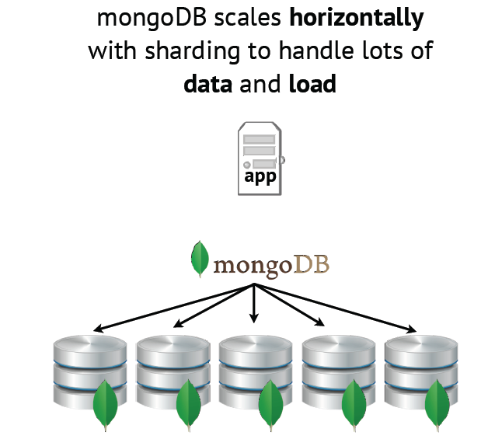

Slide 5
Data Model
N-dimensional storage
Each field can contain 0, 1,many, or embedded values
Query on any field & level
Flexible schema
Inline updates
Embedding related data has optimal data
locality, requires fewer indexes, has better
performance

Slide 6
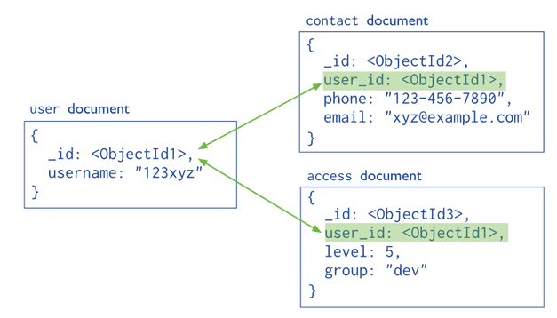
Data model using references to link documents
Both the contact document and the access document contain a reference to the user document

Slide 7
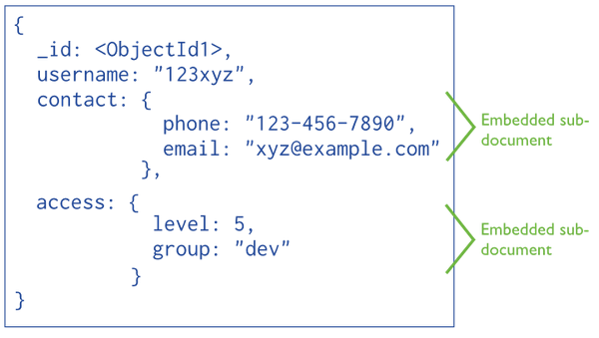
Data model with embedded fields that contain all related information

Slide 8
Requirements for a Blog System
Get blog posts for a specific blog ordered by date
possibly filtered by tag
Blogs can have an arbitrary number of blog posts
Blog posts can have an arbitrary number of comments

Slide 9
“Schema” design
Represent each Blog as a
Collection of Post
documents
Represent Comments as
nested documents in the Post documents

Slide 10
Creating a blog post
import com.mongodb.Mongo;
import com.mongodb.DB;
import com.mongodb.DBCollection;
import com.mongodb.BasicDBObject;
import com.mongodb.DBObject;
// ...
Mongo mongo = new Mongo( "localhost" ); // Connect to MongoDB
// ...
DB blogs = mongo.getDB( "blogs" ); // Access the blogs database
DBCollection myBlog = blogs.getCollection( "myBlog" );
DBObject blogPost = new BasicDBObject();
blogPost.put( "title", "JavaOne 2010" );
blogPost.put( "pub_date", new Date() );
blogPost.put( "body", "Publishing a post about JavaOne in my MongoDB blog!" );
blogPost.put( "tags", Arrays.asList( "conference", "java" ) );
blogPost.put( "comments", new ArrayList() );
myBlog.insert( blogPost );

Slide 11
Retrieving posts
// ...
import com.mongodb.DBCursor;
// ...
public Object getAllPosts( String blogName ) {
DBCollection blog = db.getCollection( blogName );
return renderPosts( blog.find() );
}
public Object getPostsByTag( String blogName, String tag ) {
DBCollection blog = db.getCollection( blogName );
return renderPosts( blog.find( new BasicDBObject( "tags", tag ) ) );
}
private Object renderPosts( DBCursor cursor ) {
// order by publication date (descending)
cursor = cursor.sort( new BasicDBObject( "pub_date", -1 ) );
// ...
}

Slide 12
Adding a comment
DBCollection myBlog = blogs.getCollection( "myBlog" );
// ...
void addComment( String blogPostId, String message ) {
DBCursor posts = myBlog.find( new BasicDBObject( "_id", blogPostId );
if ( !posts.hasNext() ) throw new NoSuchElementException();
DBObject blogPost = posts.next();
List comments = (List)blogPost.get( "comments" );
comments.add( new BasicDBObject( "message", message )
.append( "date", new Date() ) );
myBlog.save( blogPost );
}

Slide 13
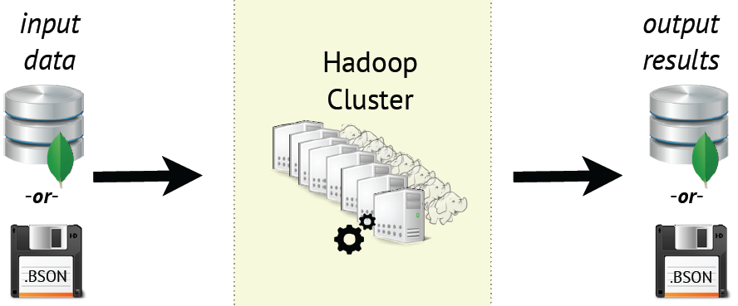
Mongo-Hadoop Connector
Turn MongoDB into a Hadoop-enabled filesystem: use as the input or output for Hadoop
New Feature: As of v1.1, also works with MongoDB backup files (.bson)

Slide 14
Data Set
ENRON emails corpus (501 records, 1.75GB)
Each document is one email
https://www.cs.cmu.edu/~enron/

Slide 15
Document Example
{
"_id" : ObjectId("4f2ad4c4d1e2d3f15a000000"),
"body" : "Here is our forecast\n\n ",
"filename" : "1.",
"headers" : {
"From" : "phillip.allen@enron.com",
"Subject" : "Forecast Info",
"X-bcc" : "",
"To" : "tim.belden@enron.com",
"X-Origin" : "Allen-P",
"X-From" : "Phillip K Allen",
"Date" : "Mon, 14 May 2001 16:39:00 -0700 (PDT)",
"X-To" : "Tim Belden ",
"Message-ID" : "<18782981.1075855378110.JavaMail.evans@thyme>",
"Content-Type" : "text/plain; charset=us-ascii",
"Mime-Version" : "1.0"
} }

Slide 16
Graph Sketch

Slide 17
Receiver Sender Pairs
{"_id": {"t":"bob@enron.com", "f":"alice@enron.com"}, "count" : 14}
{"_id": {"t":"bob@enron.com", "f":"eve@enron.com"}, "count" : 9}
{"_id": {"t":"alice@enron.com", "f":"charlie@enron.com"}, "count" : 99}
{"_id": {"t":"charlie@enron.com", "f":"bob@enron.com"}, "count" : 48}
{"_id": {"t":"eve@enron.com", "f":"charlie@enron.com"}, "count" : 20}

Slide 18
Hadoop Streaming: How it works Hadoop <-> MongoDB

Slide 19
Email Count Map Phase：BSONMapper
from pymongo_hadoop import BSONMapper
def mapper(documents):
i=0
for doc in documents: i=i+1
from_field = doc['headers']['From']
to_field = doc['headers']['To']
recips = [x.strip() for x in to_field.split(',')]
for r in recips:
yield {'_id': {'f':from_field, 't':r}, 'count': 1}
BSONMapper(mapper)
print >> sys.stderr, "Done Mapping."
Notes:
http://bsonspec.org/
BSON [bee · sahn], short for Bin­ary JSON, is a bin­ary-en­coded seri­al­iz­a­tion of JSON-like doc­u­ments. Like JSON, BSON sup­ports the em­bed­ding of doc­u­ments and ar­rays with­in oth­er doc­u­ments and ar­rays.
BSON is de­signed to be tra­versed eas­ily. This is a vi­tal prop­erty in its role as the primary data rep­res­ent­a­tion for Mon­goDB.

Slide 20
Email Reduce Phase：BSONReducer
from pymongo_hadoop import BSONReducer
def reducer(key, values):
print >> sys.stderr, "Processing from/to %s" % str(key)
_count = 0
for v in values:
_count += v['count']
return {'_id': key, 'count': _count}
BSONReducer(reducer)

Slide 21
MongoDB + Hadoop and PIG
Pig has its own special datatypes:
Bags, Maps, and Tuples
Mongo-Hadoop Connector intelligently converts between Pig datatypes and MongoDB datatypes

Slide 22
Example - Mongo-Hadoop and Pig
Pig directives for loading data:
BSONLoader and MongoLoader
data = LOAD 'mongodb://localhost:27017/db.collection'
using com.mongodb.hadoop.pig.MongoLoader;
Writing data out
BSONStorage and MongoInsertStorage
STORE records INTO 'file:///output.bson'
using com.mongodb.hadoop.pig.BSONStorage;

Slide 23
Example - Mongo-Hadoop and Pig
raw = LOAD 'hdfs:///messages.bson'
using com.mongodb.hadoop.pig.BSONLoader('','headers:[]') ;
send_recip = FOREACH raw GENERATE $0#'From' as from, $0#'To' as to;
send_recip_filtered = FILTER send_recip BY to IS NOT NULL;
send_recip_split = FOREACH send_recip_filtered GENERATE
from as from, TRIM(FLATTEN(TOKENIZE(to))) as to;

Slide 24
Example - Mongo-Hadoop and Pig
send_recip_grouped = GROUP send_recip_split BY (from, to);
send_recip_counted = FOREACH send_recip_grouped GENERATE
group, COUNT($1) as count;
STORE send_recip_counted INTO 'file:///enron_results.bson'
using com.mongodb.hadoop.pig.BSONStorage;

Slide 25
Example - MongoDB Spark Connector
Native MongoDB Connector for Apache Spark.
https://github.com/mongodb/mongo-spark
Written in Scala, Apache Spark’s native language
Enabling MongoDB data to be materialized as Dataframes and Datasets for analysis with machine learning, graph, streaming and SQL APIs
takes advantage of MongoDB’s aggregation pipeline and rich secondary indexes to extract, filter, and process only the range of data it needs

Slide 26
public final class ReadFromMongoDB {
public static void main(final String[] args) throws InterruptedException {
SparkSession spark = SparkSession.builder()
.master("local").appName("MongoSparkConnectorIntro")
.config("spark.mongodb.input.uri", "mongodb://127.0.0.1/test.myCollection")
.config("spark.mongodb.output.uri", "mongodb://127.0.0.1/test.myCollection")
.getOrCreate();
// Create a JavaSparkContext using the SparkSession's SparkContext object
JavaSparkContext jsc = new JavaSparkContext(spark.sparkContext());
/*Start Example: Read data from MongoDB************************/
JavaMongoRDD<Document> rdd = MongoSpark.load(jsc);
/*End Example**************************************************/
// Analyze data from MongoDB
System.out.println(rdd.count());
System.out.println(rdd.first().toJson());
jsc.close();
}

Slide 27
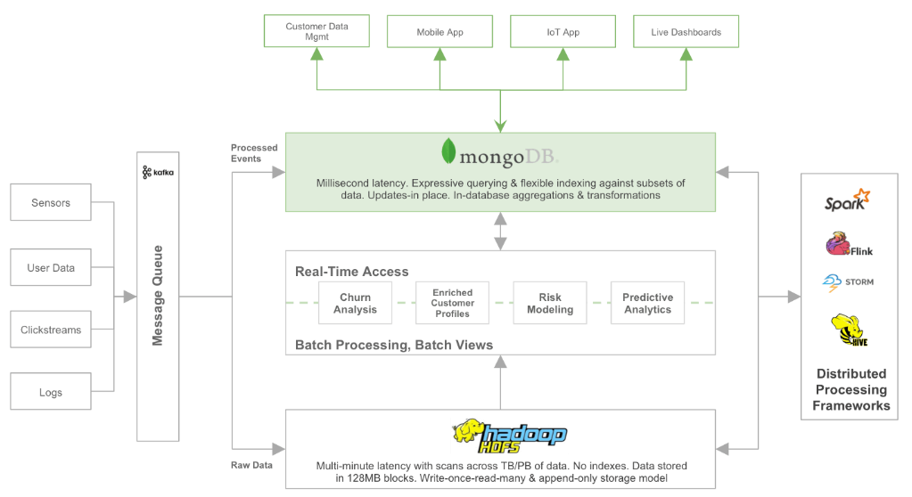
Integrating MongoDB with a data lake

Slide 28
Examples of customers using MongoDB together with Hadoop
 | MongoDB | Hadoop
Ebay | User data and metadata management for product catalog | User analysis for personalized search & recommendations
Orbitz | Management of hotel data and pricing | Hotel segmentation to support building search facets
Pearson | Student identity and access control. Content management of course materials | Student analytics to create adaptive learning programs

