Slide 1
NoSQL Database and CAP Theorem

Slide 2
Outline
What’s NoSQL
NoSQL System
CAP Theorem
MongoDB
Impala

Slide 3
NoSQL: The Name
“SQL” = Traditional relational DBMS
Recognition over past decade or so:
Not every data management/analysis problem is best
solved using a traditional relational DBMS
“NoSQL” = “No SQL” =
Not using traditional relational DBMS
“No SQL” ≠ Don’t use SQL language

Slide 4
Not every data management/analysis
problem is best solved using a traditional DBMS
Database Management System (DBMS) provides….
… efficient, reliable, convenient, and safe
multi-user storage of and access to massive
amounts of persistent data.

Slide 5
NoSQL Systems: Motivation
NoSQL Systems
Alternative to traditional relational DBMS
Flexible schema
Quicker/cheaper to set up
Massive scalability
Relaxed consistency → higher performance & availability
No declarative query language → more programming
Relaxed consistency → fewer guarantees

Slide 6
NoSQL Systems: Motivation
Example #1: Web log analysis
Each record: UserID, URL, timestamp, additional-info
Task: Load into database system

Slide 7
NoSQL Systems: Motivation
Example #1: Web log analysis
Each record: UserID, URL, timestamp, additional-info
Task: Find all records for…
Given UserID
Given URL
Given timestamp
Certain construct appearing in additional-info

Slide 8
NoSQL Systems: Motivation
Example #1: Web log analysis
Each record: UserID, URL, timestamp, additional-info
Separate records: UserID, name, age, gender, …
Task: Find average age of user accessing given URL

Slide 9
NoSQL Systems: Motivation
Example #2: Social-network graph
Each record: UserID₁, UserID₂
Separate records: UserID, name, age, gender, …
Task: Find all friends of friends of friends of … friends of given user

Slide 10
NoSQL Systems: Motivation
Example #3: Wikipedia pages
Large collection of documents
Combination of structured and unstructured data
Task: Retrieve introductory paragraph of all pages about U.S. presidents before 1900

Slide 11
NoSQL Systems: Motivation
NoSQL Systems
Alternative to traditional relational DBMS
Flexible schema
Quicker/cheaper to set up
Massive scalability
Relaxed consistency → higher performance & availability
No declarative query language → more programming
Relaxed consistency → fewer guarantees

Slide 12
What is NoSQL?
Stands for Not Only SQL
Class of non-relational data storage systems
Usually do not require a fixed table schema nor do they use the concept of joins
All NoSQL offerings relax one or more of the ACID properties (will talk about the CAP theorem)
Notes:
-> NoSQL was a term coined by Eric Evans. He states that ‘… but the whole point of seeking alternatives is that you need to solve a problem that relational databases are a bad fit for. …
-> This is why people are continually interpreting nosql to be anti-RDBMS, it's the only rational conclusion when the only thing some of these projects share in common is that they are not relational databases.’
-> Emil Elfrem stated it is not a ‘NO’ SQL but more of a ‘Not Only” SQL.

Slide 13
Dynamo and BigTable
Three major papers were the seeds of the NoSQL movement
BigTable (Google)
Dynamo (Amazon)
Gossip protocol (discovery and error detection)
Distributed key-value data store
Eventual consistency
CAP Theorem (discuss in a sec ..)
Notes:
-> BigTable: http://labs.google.com/papers/bigtable.html
-> Dynamo: http://www.allthingsdistributed.com/2007/10/amazons_dynamo.html and http://www.allthingsdistributed.com/files/amazon-dynamo-sosp2007.pdf
-> Amazon and consistency
* http://www.allthingsdistributed.com/2010/02
* http://www.allthingsdistributed.com/2008/12

Slide 14
The Perfect Storm
Large datasets, acceptance of alternatives, and dynamically-typed data has come together in a perfect storm
Not a backlash/rebellion against RDBMS
SQL is a rich query language that cannot be rivaled by the current list of NoSQL offerings
Notes:
-> So you have reached a point where a read-only cache and write-based RDBMS isn’t delivering the throughput necessary to support a particular application.
-> You need to examine alternatives and what alternatives are out there.
-> The NoSQL databases are a pragmatic response to growing scale of databases and the falling prices of commodity hardware.
-> Most likely, 10 years from now, the majority of data is still stored in RDBMS.

Slide 15
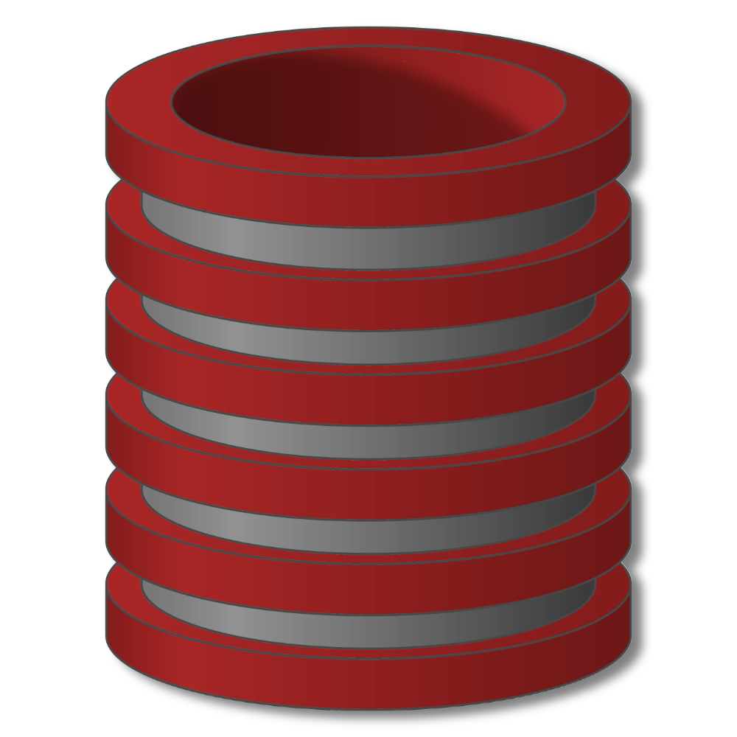
NoSQL Systems
Overview

Slide 16
NoSQL Systems
Alternative to traditional relational DBMS
Flexible schema
Quicker/cheaper to set up
Massive scalability
Relaxed consistency → higher performance & availability
No declarative query language → more programming
Relaxed consistency → fewer guarantees

Slide 17
NoSQL Systems
Several incarnations
MapReduce framework
Key-value stores
Document stores
Graph database systems

Slide 18
MapReduce Framework
Originally from Google, open source Hadoop
No data model, data stored in files
User provides specific functions
map() reduce()
System provides data processing “glue”, fault-tolerance, scalability

Slide 19
MapReduce Framework
No data model, data stored in files
User provides specific functions
System provides data processing “glue”, fault-tolerance, scalability

Slide 20
MapReduce Framework
Schemas and declarative queries are missed
Hive – schemas, SQL-like query language
Pig – more imperative but with relational operators
Both compile to “workflow” of Hadoop (MapReduce) jobs

Slide 21
Key-Value Stores
Extremely simple interface
Data model: (key, value) pairs
Operations: Insert(key,value), Fetch(key),
Update(key), Delete(key)
Implementation: efficiency, scalability, fault-tolerance
Records distributed to nodes based on key
Replication
Single-record transactions, “eventual consistency”

Slide 22
Key-Value Stores
Extremely simple interface
Data model: (key, value) pairs
Operations: Insert(key,value), Fetch(key),
Update(key), Delete(key)
Some allow (non-uniform) columns within value
Some allow Fetch on range of keys
Example systems
Google BigTable, Amazon Dynamo, Cassandra,
Voldemort, HBase, …

Slide 23
Document Stores
Like Key-Value Stores except value is document
Data model: (key, document) pairs
Document: JSON, XML, other semistructured formats
Basic operations: Insert(key,document), Fetch(key),
Update(key), Delete(key)
Also Fetch based on document contents
Example systems
CouchDB, MongoDB, SimpleDB, …

Slide 24
Graph Database Systems
Data model: nodes and edges
Nodes may have properties (including ID)
Edges may have labels or roles

Slide 25
Graph Database Systems
Interfaces and query languages vary
Single-step versus “path expressions” versus full recursion
Example systems
Neo4j, FlockDB, Pregel, …
RDF “triple stores” can map to graph databases

Slide 26
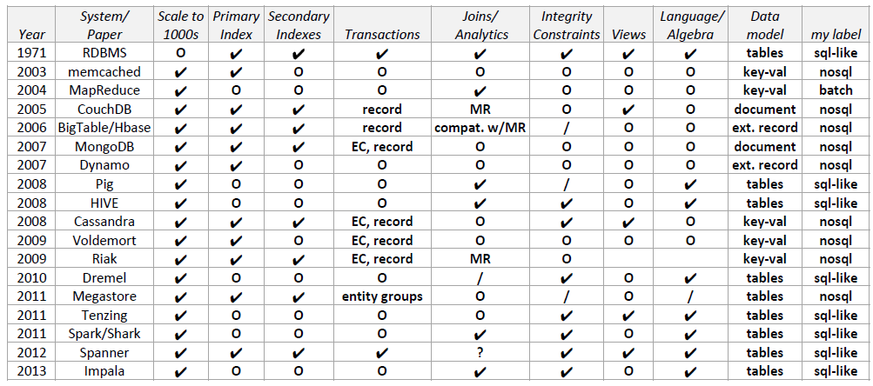
NoSQL and related systems, by feature

Slide 27
When to use Document DB (e.g. MongoDB)
When data is collections of similar entities
But semi structured (sparse) rather than tabular
•When fields in entries have multiple values

Slide 28
When to use ColumnFamily DB (e.g. Cassandra)
When scalability is the main issue
Both scaling size and scaling load
‣In particular scaling write load
Linear scalability (as you add servers) both in read and write
Low level - will require you to duplicate data to support queries

Slide 29
When to use Graph DB (e.g. Neo4j)
When deep traversals are important
For complex and domains
When how entities relate is an important aspect of the domain

Slide 30
CAP Theorem

Slide 31
The CAP Theorem
Availability
Consistency
Partition tolerance
Notes:
31
PODC:ACM Symposium on Principles of Distributed Computing(PODC)International Conference

Slide 32
CAP Theorem
Three properties of a system:
consistency, availability and partitions
You can have at most two of these three properties for any shared-data system
To scale out, you have to partition. That leaves either consistency or availability to choose from
In almost all cases, you would choose availability over consistency
Notes:
-> Proposed by Eric Brewer (talk on Principles of Distributed Computing July 2000).
-> Partitionability: divide nodes into small groups that can see other groups, but they can't see everyone. -> Consistency: write a value and then you read the value you get the same value back. In a partitioned system there are windows where that's not true. -> Availability: may not always be able to write or read. The system will say you can't write because it wants to keep the system consistent. -> To scale you have to partition, so you are left with choosing either high consistency or high availability for a particular system. You must find the right
overlap of availability and consistency.
-> Choose a specific approach based on the needs of the service. -> For the checkout process you always want to honor requests to add items to a shopping cart because it's revenue producing.
In this case you choose high availability. Errors are hidden from the customer and sorted out later. -> When a customer submits an order you favor consistency because several services--credit card processing, shipping and handling, reporting—
are simultaneously accessing the data.

Slide 33
The CAP Theorem
Once a writer has written, all readers will see that write
Availability
Consistency
Partition tolerance

Slide 34
Consistency
Two kinds of consistency:
strong consistency – ACID(Atomicity Consistency Isolation Durability)
weak consistency – BASE(Basically Available Soft-state Eventual consistency )
Notes:
Cluster里面至少有一个replica是最新的，其他的replica最终会达到一致

Slide 35
ACID Transactions
A DBMS is expected to support “ACID transactions,” processes that are:
Atomic : Either the whole process is done or none is.
Consistent : Database constraints are preserved.
Isolated : It appears to the user as if only one process executes at a time.
Durable : Effects of a process do not get lost if the system crashes.

Slide 36
Atomicity
A real-world event either happens or does not happen
Student either registers or does not register
Similarly, the system must ensure that either the corresponding transaction runs to completion or, if not, it has no effect at all
Not true of ordinary programs. A crash could leave files partially updated on recovery

Slide 37
Commit and Abort
If the transaction successfully completes it is said to commit
The system is responsible for ensuring that all changes to the database have been saved
If the transaction does not successfully complete, it is said to abort
The system is responsible for undoing, or rolling back, all changes the transaction has made

Slide 38
Database Consistency
Enterprise (Business) Rules limit the occurrence of certain real-world events
Student cannot register for a course if the current number of registrants equals the maximum allowed
Correspondingly, allowable database states are restricted
cur_reg <= max_reg
These limitations are called (static) integrity constraints: assertions that must be satisfied by all database states (state invariants).

Slide 39
Database Consistency (state invariants)
Other static consistency requirements are related to the fact that the database might store the same information in different ways
cur_reg = |list_of_registered_students|
Such limitations are also expressed as integrity constraints
Database is consistent if all static integrity constraints are satisfied

Slide 40
Transaction Consistency
A consistent database state does not necessarily model the actual state of the enterprise
A deposit transaction that increments the balance by the wrong amount maintains the integrity constraint balance ≥ 0, but does not maintain the relation between the enterprise and database states
A consistent transaction maintains database consistency and the correspondence between the database state and the enterprise state (implements its specification)
Specification of deposit transaction includes balance′ = balance + amt_deposit , (balance′ is the next value of balance)

Slide 41
Dynamic Integrity Constraints (transition invariants)
Some constraints restrict allowable state transitions
A transaction might transform the database from one consistent state to another, but the transition might not be permissible
Example: A letter grade in a course (A, B, C, D, F) cannot be changed to an incomplete (I)
Dynamic constraints cannot be checked by examining the database state

Slide 42
Transaction Consistency
Consistent transaction: if DB is in consistent state initially, when the transaction completes:
All static integrity constraints are satisfied (but constraints might be violated in intermediate states)
Can be checked by examining snapshot of database
New state satisfies specifications of transaction
Cannot be checked from database snapshot
No dynamic constraints have been violated
Cannot be checked from database snapshot

Slide 43
Isolation
Serial Execution: transactions execute in sequence
Each one starts after the previous one completes.
Execution of one transaction is not affected by the operations of another since they do not overlap in time
The execution of each transaction is isolated from all others.
If the initial database state and all transactions are consistent, then the final database state will be consistent and will accurately reflect the real-world state, but
Serial execution is inadequate from a performance perspective

Slide 44
Isolation
Concurrent execution offers performance benefits:
A computer system has multiple resources capable of executing independently (e.g., cpu’s, I/O devices), but
A transaction typically uses only one resource at a time
Hence, only concurrently executing transactions can make effective use of the system
Concurrently executing transactions yield interleaved schedules

Slide 45
Concurrent Execution
begin trans
..
op_{1,1}
..
op_{1,2}
..
commit
sequence of db
operations output by T₁
T₁
op_{1,1} op_{1.2}
local computation
DBMS
op_{1,1} op_{2,1} op_{2.2} op_{1.2}
T₂
op_{2,1} op_{2.2}
interleaved sequence of db
operations input to DBMS
local variables

Slide 46
Durability
The system must ensure that once a transaction commits, its effect on the database state is not lost in spite of subsequent failures
Not true of ordinary programs. A media failure after a program successfully terminates could cause the file system to be restored to a state that preceded the program’s execution

Slide 47
Implementing Durability
Database stored redundantly on mass storage devices to protect against media failure
Architecture of mass storage devices affects type of media failures that can be tolerated
Related to Availability: extent to which a (possibly distributed) system can provide service despite failure
Non-stop DBMS (mirrored disks)
Recovery based DBMS (log)

Slide 48
Consistency Model
A consistency model determines rules for visibility and apparent order of updates.
For example:
Row X is replicated on nodes M and N
Client A writes row X to node N
Some period of time t elapses.
Client B reads row X from node M
Does client B see the write from client A?
Consistency is a continuum with tradeoffs
For NoSQL, the answer would be: maybe
CAP Theorem states: Strict Consistency can't be achieved at the same time as availability and partition-tolerance.
Notes:
-> http://cloudera-todd.s3.amazonaws.com/nosql.pdf

Slide 49
Eventual Consistency
When no updates occur for a long period of time, eventually all updates will propagate through the system and all the nodes will be consistent
For a given accepted update and a given node, eventually either the update reaches the node or the node is removed from service
Known as BASE (Basically Available, Soft state, Eventual consistency), as opposed to ACID
Notes:
-> http://en.wikipedia.org/wiki/Eventual_consistency
-> http://www.allthingsdistributed.com/2008/12/eventually_consistent.html
The types of large systems based on CAP aren't ACID they are BASE (http://queue.acm.org/detail.cfm?id=1394128): * Basically Available - system seems to work all the time * Soft State - it doesn't have to be consistent all the time * Eventually Consistent - becomes consistent at some later time
Everyone who builds big applications builds them on CAP and BASE: Google, Yahoo, Facebook, Amazon, eBay, etc

Slide 50
The CAP Theorem
System is available during software and hardware upgrades and node failures.
Availability
Consistency
Partition tolerance

Slide 51
Availability
Traditionally, thought of as the server/process available five 9’s (99.999 %).
However, for large node system, at almost any point in time there’s a good chance that a node is either down or there is a network disruption among the nodes.
Want a system that is resilient in the face of network disruption

Slide 52
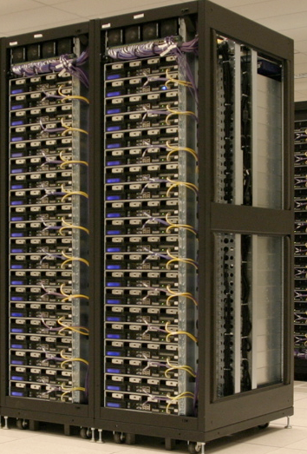
The CAP Theorem
A system can continue to operate in the presence of a network partitions.
Availability
Consistency
Partition tolerance

Slide 53
The CAP Theorem
Theorem: You can have at most two of these properties for any shared-data system
Availability
Consistency
Partition tolerance

Slide 54
What kinds of NoSQL
NoSQL solutions fall into two major areas:
Key/Value or ‘the big hash table’.
Amazon S3 (Dynamo)
Voldemort
Scalaris
Memcached (in-memory key/value store)
Redis
Schema-less which comes in multiple flavors, column-based, document-based or graph-based.
Cassandra (column-based)
CouchDB (document-based)
MongoDB(document-based)
Neo4J (graph-based)
HBase (column-based)
Notes:
-> Not an exhaustive list, just some of the more well-known.
-> HBase is the data storage solution for Hadoop.
-> Graph: is a network database that uses edges and nodes to represent and store data.
-> Document: views are stored as rows which are kept sorted by key. Can adapt to variations in document structure.

Slide 55
Key/Value
Pros:
very fast
very scalable
simple model
able to distribute horizontally
Cons:
- many data structures (objects) can't be easily modeled as key value pairs
Notes:
-> http://chariotsolutions.blogspot.com/2010/01/why-you-need-nosql-in-your-toolbox.html

Slide 56
Schema-Less
Pros:
- Schema-less data model is richer than key/value pairs
eventual consistency
many are distributed
still provide excellent performance and scalability
Cons:
- typically no ACID transactions or joins

Slide 57
Common Advantages
Cheap, easy to implement (open source)
Data are replicated to multiple nodes (therefore identical and fault-tolerant) and can be partitioned
Down nodes easily replaced
No single point of failure
Easy to distribute
Don't require a schema
Can scale up and down
Relax the data consistency requirement (CAP)
Notes:
-> As the data is written, the latest version is on at least one node. The data is then versioned/replicated to other nodes within the system.
-> Eventually, the same version is on all nodes.

