Slide 1
Hadoop Programming

Slide 2
Outline
Hadoop Programming API
Hadoop Code Examples
Hadoop Streaming and Examples
Data Join in Hadoop
Implementation of Bloom Filter in Hadoop

Slide 4
InputFormat Class
public abstract class InputFormat<K, V> {
public abstract
List<InputSplit> getSplits(JobContext context) throws ...;
public abstract
RecordReader<K,V> createRecordReader(InputSplit split,
TaskAttemptContext context) throws ...;
}

Slide 5
Most Common InputFormats
TextInputFormat
Each \n-terminated line is a value
The byte offset of that line is a key
KeyValueTextInputFormat
Key and value are separated by a separator (tab by default)
SequenceFileInputFormat
SequenceFiles are flat files consisting of binary <key,
value> pairs

Slide 6
RecordReader
Extract <key, value> pairs from corresponding InputSplit
Examples:
LineRecordReader
KeyValueRecordReader
SequenceFileRecordReader

Slide 7
Keys And Values
Keys must implement WritableComparable interface
Since they are sorted before passing to the Reducers
Values must implement “at least” Writable interface

Slide 8
Writable And WritableComparable
public interface Writable {
void write(DataOutput out) throws IOException;
void readFields(DataInput in) throws IOException;
}
public interface WritableComparable<T> extends Writable,
Comparable<T> {
}
public interface Comparable<T> {
public int compareTo(T o);
}

Slide 9
Mapper
Takes input in form of a <key, value> pair
Emits a set of intermediate <key, value> pairs
Stores them locally and later passes to the Reducers
But earlier: partition + sort + spill + merge
public class Mapper<KEYIN, VALUEIN, KEYOUT, VALUEOUT>

Slide 10
Mapper Methods
void setup(Context context) throws ... {}
protected void cleanup(Context context) throws ... {}
void map(KEYIN key, VALUEIN value, Context context) ... {
context.write((KEYOUT) key, (VALUEOUT) value);
}
public void run(Context context) throws ... {
setup(context);
while (context.nextKeyValue()) {
map(context.getCurrentKey(), context.getCurrentValue(), context);
}
cleanup(context);
}

Slide 11
MapContext Object
Allow the user map code to communicate with MapReduce system
public InputSplit getInputSplit();
public TaskAttemptID getTaskAttemptID();
public void setStatus(String msg);
public boolean nextKeyValue() throws ...;
public KEYIN getCurrentKey() throws ...;
public VALUEIN getCurrentValue() throws ...;
public void write(KEYOUT key, VALUEOUT value) throws ...;
public Counter getCounter(String groupName, String counterName);

Slide 12
Partitioner
Specifies which Reducer a given <key, value> pair is sent to
Desire even distribution of the intermediate data
Skewed data may overload a single reducer and make a whole job running longer
public abstract class Partitioner<KEY, VALUE> {
public abstract
int getPartition(KEY key, VALUE value, int numPartitions);
}

Slide 13
Reducer
Gets list(<key, list(value)>)
Keys are sorted, but values for a given key are not sorted
Emits a set of output <key, value> pairs
public class Reducer<KEYIN,VALUEIN,KEYOUT,VALUEOUT>

Slide 14
Reducer Reduce Method
protected void reduce(KEYIN key, Iterable<VALUEIN> values, Context context)
throws IOException, InterruptedException
{
for(VALUEIN value: values) { context.write((KEYOUT) key, (VALUEOUT) value);
}
}

Slide 15
Reducer Run Method
public void run(Context context) throws … {
setup(context);
while (context.nextKey()) {
reduce(context.getCurrentKey(),
context.getValues(), context);
}
cleanup(context);
}
Notes:
/** * Advanced application writers can use the * {@link #run(org.apache.hadoop.mapreduce.Reducer.Context)} method to * control how the reduce task works. */

Slide 16
OutputFormat class hierarchy

Slide 17
Hadoop Code Examples

Slide 18
Template for a typical Hadoop program
public class MyJob extends Configured implements Tool {
public static class MapClass extends MapReduceBase
implements Mapper<Text, Text, Text, Text> {
public void map(Text key, Text value,
OutputCollector<Text, Text> output,
Reporter reporter) throws IOException {
output.collect(value, key);
}
}

Slide 19
public static class Reduce extends MapReduceBase
implements Reducer<Text, Text, Text, Text> {
public void reduce(Text key, Iterator<Text> values,
OutputCollector<Text, Text> output,
Reporter reporter) throws IOException {
String csv = "";
while (values.hasNext()) {
if (csv.length() > 0) csv += ",";
csv += values.next().toString();
}
output.collect(key, new Text(csv));
}
}

Slide 20
public int run(String[] args) throws Exception {
Configuration conf = getConf();
JobConf job = new JobConf(conf, MyJob.class);
Path in = new Path(args[0]);
Path out = new Path(args[1]);
FileInputFormat.setInputPaths(job, in);
FileOutputFormat.setOutputPath(job, out);
job.setJobName("MyJob");
job.setMapperClass(MapClass.class);
job.setReducerClass(Reduce.class);
job.setInputFormat(KeyValueTextInputFormat.class);

Slide 21
job.setOutputFormat(TextOutputFormat.class);
job.setOutputKeyClass(Text.class);
job.setOutputValueClass(Text.class);
job.set("key.value.separator.in.input.line", ",");
JobClient.runJob(job);
return 0;
}
public static void main(String[] args) throws Exception {
int res = ToolRunner.run(new Configuration(), new MyJob(), args);
System.exit(res);
}

Slide 22
Word Count Example
package org.apache.hadoop.examples;
import java.io.IOException;
import java.util.StringTokenizer;
import org.apache.hadoop.conf.Configuration;
import org.apache.hadoop.fs.Path;
import org.apache.hadoop.io.IntWritable;
import org.apache.hadoop.io.Text;
import org.apache.hadoop.mapreduce.Job;
import org.apache.hadoop.mapreduce.Mapper;
import org.apache.hadoop.mapreduce.Reducer;
import org.apache.hadoop.mapreduce.lib.input.FileInputFormat;
import org.apache.hadoop.mapreduce.lib.output.FileOutputFormat;
import org.apache.hadoop.util.GenericOptionsParser;

Slide 23
MapReduce example 2/4
public class WordCount {
public static class TokenizerMapper
extends Mapper<Object, Text, Text, IntWritable>{
private final static IntWritable one = new IntWritable(1);
private Text word = new Text();
public void map(Object key, Text value, Context context)
throws IOException, InterruptedException {
StringTokenizer itr = new StringTokenizer(value.toString());
while (itr.hasMoreTokens()) {
word.set(itr.nextToken());
context.write(word, one);
}
}
}

Slide 24
MapReduce example 3/4
public static class IntSumReducer
extends Reducer<Text,IntWritable,Text,IntWritable> {
private IntWritable result = new IntWritable();
public void reduce(Text key, Iterable<IntWritable> values,
Context context)
throws IOException, InterruptedException {
int sum = 0;
for (IntWritable val : values) {
sum += val.get();
}
result.set(sum);
context.write(key, result);
}
}

Slide 25
public static void main(String[] args) throws Exception {
Configuration conf = new Configuration();
String[] otherArgs = new GenericOptionsParser(conf, args).getRemainingArgs();
if (otherArgs.length != 2) {
System.err.println("Usage: wordcount <in> <out>");
System.exit(2);
}
Job job = new Job(conf, "word count");
job.setJarByClass(WordCount.class);
job.setMapperClass(TokenizerMapper.class);
job.setCombinerClass(IntSumReducer.class);
job.setReducerClass(IntSumReducer.class);
job.setOutputKeyClass(Text.class);
job.setOutputValueClass(IntWritable.class);
FileInputFormat.addInputPath(job, new Path(otherArgs[0]));
FileOutputFormat.setOutputPath(job, new Path(otherArgs[1]));
System.exit(job.waitForCompletion(true) ? 0 : 1);
}
}

Slide 26
Summary
The whole program is often defined within
a single Java class.
Within the class, a driver sets up a MapReduce job’s configuration object
map and reduce functions in subclasses of Mapper and Reducer

Slide 27
Hadoop Streaming and Examples

Slide 28
Streaming in Hadoop
the Unix streaming paradigm
Inputs come in through STDIN
outputs go to STDOUT
Data has to be text based
each line is considered a record
enables those commands to be used as mappers and reducers.

Slide 29
WordCount in Python: mapper.py
#!/usr/bin/env python
import sys
for line in sys.stdin: #从stdin 按行读取
line = line.strip() #删除每一行的收尾空格
words = line.split() #对每一行的句子按照空格进行切分
for word in words:
print “%s\t%s” % (word, 1)
mapper.py文件从STDIN读取文件。把单词切开，并把单词和词频输出STDOUT。Map脚本不会计算单词的总数，而是输出<word> 1。在我们的例子中，我们让随后的Reduce阶段做统计工作
reducer.py文件会读取mapper.py 的结果作为reducer.py 的输入，并统计每个单词出现的总的次数，把最终的结果输出到STDOUT。

Slide 30
reducer.py
#!/usr/bin/python
from operator import itemgetter
import sys
word2count = {} #存储词频的结果字典
for line in sys.stdin:
line = line.strip()
word,count = line.split() # 获取单词名和数量
try:
count = int(count)
word2count[word] = word2count.get(word,0) + count
except ValueError as err:
print(err)
pass
sorted_word2count = sorted(word2count.items(),key=itemgetter(1)) #对单词的词频数进行从小到大排序
for word,count in sorted_word2count:
print(“%s\t%s” % (word, count)) #将结果输出到stdout

Slide 31
Hadoop Streaming Commandline
hadoop jar
/usr/local/hadoop-2.7.0/share/hadoop/tools/lib/hadoop-streaming-2.7.0.jar # 指定streaming的jar包
-D mapred.reduce.tasks=5 # 默认启动的reducer数。通过该参数可以手动修改reducer的个数。
-mapper “python mapper.py” #指定mapper所执行的命令
-reducer “python reducer.py” #指定reducer所执行的命令
-file mapper.py -file reducer.py #指定mapper，reducer文件位置
-input /user/root/input/test.txt #指定输入文件位置
-output /user/root/wordcount/out #指定输出入文件位置

Slide 32
Sample Datasets for
The data sets are approximately 250 MB each
create a smaller, sampled subset of your
large production data and call it the development data set
The patent citation data: cite75_99.txt
US patent citations for utility patents
granted in the period 1-Jan-75 to 31-Dec-99.
<"CITING","CITED“ >
Notes:
"CITING","CITED"
3858241,956203
3858241,1324234
3858241,3398406
3858241,3557384
3858241,3634889

Slide 33
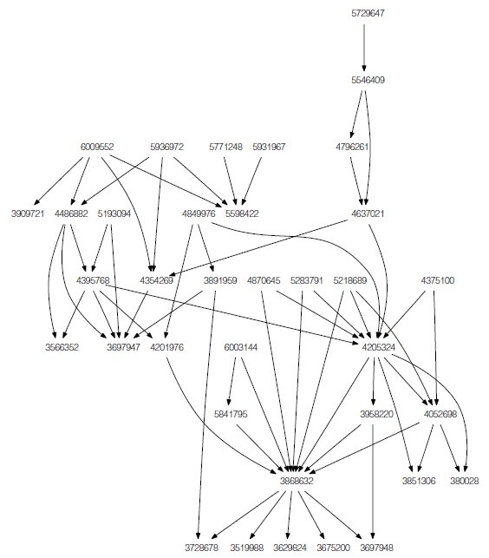

Slide 34
The patent description data apat63-99.txt
"PATENT","GYEAR","GDATE","APPYEAR",
"COUNTRY","POSTATE","ASSIGNEE","ASSCODE","CLAIMS","NCLASS",
"CAT","SUBCAT","CMADE","CRECEIVE",
"RATIOCIT","GENERAL","ORIGINAL",
"FWDAPLAG","BCKGTLAG","SELFCTUB",
"SELFCTLB","SECDUPBD","SECDLWBD
Notes:
"PATENT","GYEAR","GDATE","APPYEAR","COUNTRY","POSTATE","ASSIGNEE","ASSCODE","CLAIMS","NCLASS","CAT","SUBCAT","CMADE","CRECEIVE","RATIOCIT","GENERAL","ORIGINAL","FWDAPLAG","BCKGTLAG","SELFCTUB","SELFCTLB","SECDUPBD","SECDLWBD"3070801,1963,1096,,"BE","",,1,,269,6,69,,1,,0,,,,,,,3070802,1963,1096,,"US","TX",,1,,2,6,63,,0,,,,,,,,,3070803,1963,1096,,"US","IL",,1,,2,6,63,,9,,0.3704,,,,,,,

Slide 35
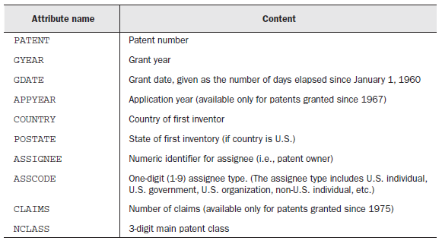
Definition of the first 10 attributes in the patent description data set

Slide 36
Streaming with commands
bin/hadoop jar share/hadoop/tools/lib/hadoop-2.7.0-streaming.jar
➥ -input input/cite75_99.txt
➥ -output output
➥ -mapper 'cut -f 2 -d ,'
➥ -reducer 'uniq'

Slide 37
Streaming with scripts
RandomSample.py
#!/usr/bin/env python
import sys, random
for line in sys.stdin:
if (random.randint(1,100) <= int(sys.argv[1])):
print line.strip()
cat input.txt | RandomSample.py 10 >sampled_output.txt

Slide 38
Streaming with scripts
bin/hadoop jar contrib/streaming/hadoop-2.7.0-streaming.jar
➥ -input input/cite75_99.txt
➥ -output output
➥ -mapper 'RandomSample.py 10'
➥ -file RandomSample.py
➥ -D mapred.reduce.tasks=1

Slide 39
AttributeMax.py
import sys
index = int(sys.argv[1])
max = 0
for line in sys.stdin:
fields = line.strip().split(",")
if fields[index].isdigit():
val = int(fields[index])
if (val > max):
max = val
else:
print max

Slide 40
Streaming with key/value pairs
bin/hadoop jar share/hadoop/tools/lib/hadoop-2.7.0-streaming.jar
➥ -input input/apat63_99.txt
➥ -output output
➥ -mapper 'AttributeMax.py 8'
➥ -reducer 'AttributeMax.py 0'
➥ -file AttributeMax.py
➥ -D mapred.reduce.tasks=1
The 8th column is Claims
Find the patent with the maximum clasms

Slide 41
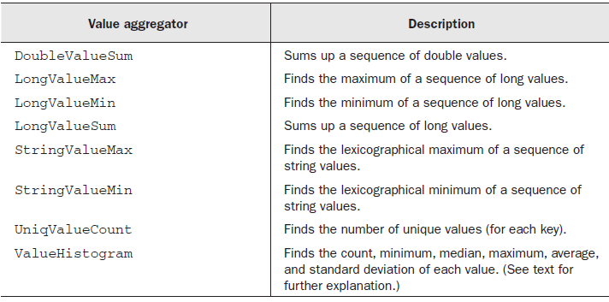
Hadoop Aggregate Package

Slide 42
AttributeCount.py
import sys
index = int(sys.argv[1])
for line in sys.stdin:
fields = line.split(",")
print "LongValueSum:" + fields[index] + "\t" + "1"
Notes:
Hadoop includes a library package called Aggregate that simplifies obtaining aggregate
statistics of a data set. This package can simplify the writing of Java statistics collectors,
especially when used with Streaming, which is the focus of this section.9
The Aggregate package under Streaming functions as a reducer that computes
aggregate statistics.

Slide 43
Streaming with the Aggregate package
bin/hadoop jar share/hadoop/tools/lib/hadoop-2.7.0-streaming.jar
➥ -input input/apat63_99.txt
➥ -output output
➥ -file AttributeCount.py
➥ -mapper 'AttributeCount.py 1'
➥ -reducer aggregate
Ouput
<LongValueSum:Gyear,
1>

Slide 44
ValueHistogram.py
import sys
index1 = int(sys.argv[1])
index2 = int(sys.argv[2])
for line in sys.stdin:
fields = line.split(",")
print "ValueHistogram:" + fields[index1] + "\t" + fields[index2]

Slide 45
Histogram
bin/hadoop jar share/hadoop/tools/lib/hadoop-2.7.0-streaming.jar
➥ -input input/apat63_99.txt
➥ -output output
➥ -file ValueHist.py
➥ -mapper 'ValueHist.py 1 4'
➥ -reducer aggregate
Ouput
<ValueHistogram::Gyear,
Country>

Slide 46
Two efficiency bottlenecks
Too many records
most of the intermediate key/value pairs will end up at a single reducer, overwhelming it.

Slide 47
Hadoop combiner
step in between the mapper and reducer
If we specify a combiner, the MapReduce
framework may apply it zero, one, or more times to the intermediate data.
Notes:
Hadoop solves these bottlenecks by extending the MapReduce framework with a combiner
.
It’s supposed to whittle down the output of the mapper to lessen the
load on the network and on the reducer. If we specify a combiner, the MapReduce
framework may apply it zero, one, or more times to the intermediate data. In order for
a combiner to work, it must be an equivalent transformation of the data with respect
to the reducer.

Slide 48
Java equivalent of AverageByAttributeMapper.py
public static class MapClass extends MapReduceBase
implements Mapper<LongWritable, Text, Text, Text> {
public void map(LongWritable key, Text value,
OutputCollector<Text, Text> output,Reporter reporter) throws IOException {
String fields[] = value.toString().split(",", -20);
String country = fields[4];
String numClaims = fields[8];
if (numClaims.length() > 0 && !numClaims.startsWith("\"")) {
output.collect(new Text(country),
new Text(numClaims + ",1"));
} } }

Slide 49
public static class Reduce extends MapReduceBase
implements Reducer<Text, Text, Text, DoubleWritable> {
public void reduce(Text key, Iterator<Text> values, OutputCollector<Text, DoubleWritable> output,
Reporter reporter) throws IOException {
double sum = 0;
int count = 0;
while (values.hasNext()) {
String fields[] = values.next().toString().split(",");
sum += Double.parseDouble(fields[0]);
count += Integer.parseInt(fields[1]);
}
output.collect(key, new DoubleWritable(sum/count));
}
}

Slide 50
Combine class
public static class Combine extends MapReduceBase
implements Reducer<Text, Text, Text, Text> {
public void reduce(Text key, Iterator<Text> values,
OutputCollector<Text, Text> output, Reporter reporter) throws IOException {
double sum = 0;
int count = 0;
while (values.hasNext()) {
String fields[] = values.next().toString().split(",");
sum += Double.parseDouble(fields[0]);
count += Integer.parseInt(fields[1]);
}
output.collect(key, new Text(sum + "," + count));
}
}

Slide 51
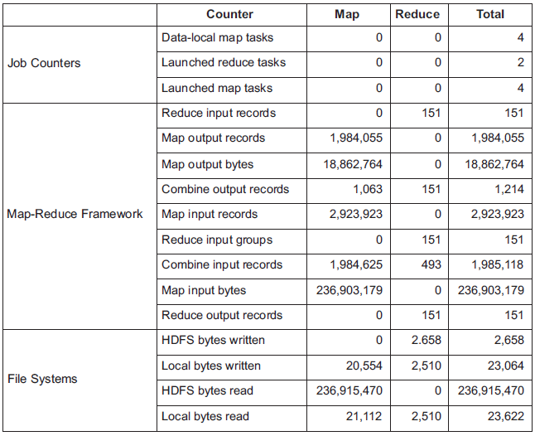
Monitoring the effectiveness of the combiner in the AveragingWithCombiner job
Notes:
in the map phase, combine has 1,984,625 input
records and only 1,063 output records. Clearly the combiner has reduced the amount
of intermediate data. Note that the reduce side executes the combiner, though the
benefit of this is negligible in this case.

Slide 52
Chaining MapReduce jobs
Chaining MapReduce jobs is analogous to Unix pipes
mapreduce-1 | mapreduce-2 | mapreduce-3 | ...
Like Unix pipe

Slide 53
Configuration conf = getConf();
JobConf job = new JobConf(conf);
job.setJobName("ChainJob");
job.setInputFormat(TextInputFormat.class);
job.setOutputFormat(TextOutputFormat.class);
FileInputFormat.setInputPaths(job, in);
FileOutputFormat.setOutputPath(job, out);
JobConf map1Conf = new JobConf(false);
ChainMapper.addMapper(job,
Map1.class,
LongWritable.class,
Text.class,
Text.class,
Text.class,
true,
map1Conf);
Add Map1 step
to job

Slide 54
JobConf map2Conf = new JobConf(false);
ChainMapper.addMapper(job,
Map2.class,
Text.class,
Text.class,
LongWritable.class,
Text.class,
true,
map2Conf);
Add Map2 step
to job

Slide 55
JobConf reduceConf = new JobConf(false);
ChainReducer.setReducer(job,
Reduce.class,
LongWritable.class,
Text.class,
Text.class,
Text.class,
true,
reduceConf);
Add Reduce step
to job

Slide 56
Data Join in Hadoop

Slide 57
Joining data from different sources
Customer
(Customer ID, Name, and Phone Number)
1,Stephanie Leung,555-555-5555
2,Edward Kim,123-456-7890
3,Jose Madriz,281-330-8004
4,David Stork,408-555-0000
Order
(Customer ID, Order ID, Price, and Purchase Date)

Slide 58
Inner join
3,A,12.95,02-Jun-2008
1,B,88.25,20-May-2008
2,C,32.00,30-Nov-2007
3,D,25.02,22-Jan-2009
Desired output of an inner join between Customers and Orders data
1,Stephanie Leung,555-555-5555,B,88.25,20-May-2008
2,Edward Kim,123-456-7890,C,32.00,30-Nov-2007
3,Jose Madriz,281-330-8004,A,12.95,02-Jun-2008
3,Jose Madriz,281-330-8004,D,25.02,22-Jan-2009

Slide 59
Outer join
1,Stephanie Leung,555-555-5555,B,88.25,20-May-2008
2,Edward Kim,123-456-7890,C,32.00,30-Nov-2007
3,Jose Madriz,281-330-8004,A,12.95,02-Jun-2008
3,Jose Madriz,281-330-8004,D,25.02,22-Jan-2009
4,David Stork,408-555-0000,NULL, NULL, NULL

Slide 60
Join on Map-Reduce
Reduce-side joining
Repartitioned join
or the repartitioned sort-merge join
Replicated joins
Map-side
Bigger datasource + smaller source
Notes:
When the smaller source can
fit in memory of a mapper, we can achieve a tremendous gain in efficiency by copying
the smaller source to all mappers and performing joining in the map phase. This is
called replicated join in the database literature as one of the data tables is replicated

Slide 61
Reduce-side joining
A data source is analogous to a table in relational databases.
The group key functions like a join key in a relational database.
the group key is the Customer ID.

Slide 62
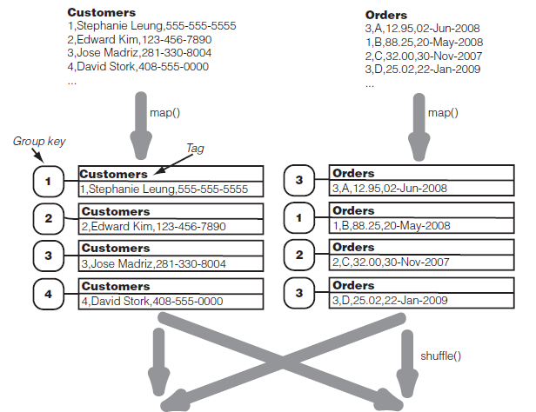
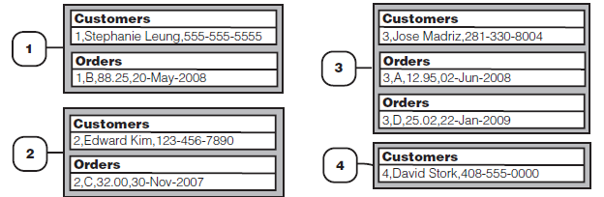
Notes:
The value in this key/value package will be the original record, tagged with
the data source (i.e., filename).
For example, for the record
3,A,12.95,02-Jun-2008
from the Orders file, map() will output a key/value pair where the key is "3",
The Customer ID that will be used to join with records from the Customers file.
The value output by map() is the entire record wrapped by a tag "Orders".

Slide 63
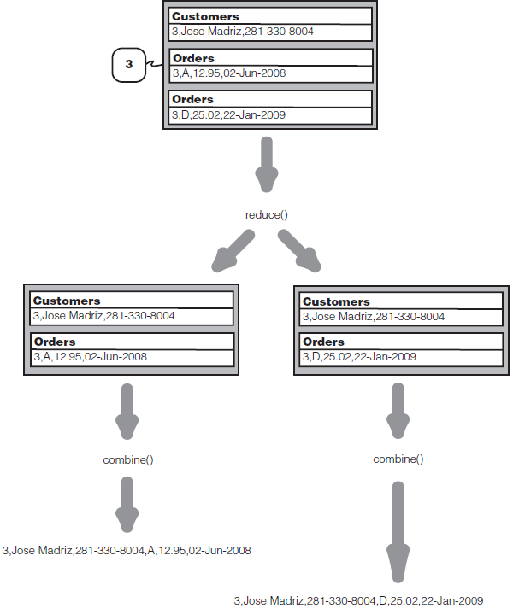
Notes:
The reduce side of a repartitioned join .
For a given join key, the reduce task performs a full cross-product of values from different sources.
It sends each combination to combine() to create an output record.
The combine() function can choose to not output any particular combination.

Slide 64
Implementation for Join
contrib package called datajoin that works as a generic framework for data joining in Hadoop
three abstract classes that we inherit and make concrete:
DataJoinMapperBase
DataJoinReducerBase
TaggedMapOutput

Slide 65
public static class TaggedWritable extends TaggedMapOutput {
private Writable data;
public TaggedWritable(Writable data) {
this.tag = new Text("");
this.data = data;}
public Writable getData() {
return data;
}
public void write(DataOutput out) throws IOException {
this.tag.write(out);
this.data.write(out);
}
public void readFields(DataInput in) throws IOException {
this.tag.readFields(in);
this.data.readFields(in);
}
}

Slide 66
Inner join of data from two files using reduce-side join: DataJoinMapperBase
public class DataJoin extends Configured implements Tool {
public static class MapClass extends DataJoinMapperBase {
protected Text generateInputTag(String inputFile) {
String datasource = inputFile.split("-")[0];
return new Text(datasource);
}
protected Text generateGroupKey(TaggedMapOutput aRecord) {
String line = ((Text) aRecord.getData()).toString();
String[] tokens = line.split(",");
String groupKey = tokens[0];
return new Text(groupKey);
Notes:
Tag: customer, order { inputfile name }
GroupKey <- customer, order ( customer id )

Slide 67
protected TaggedMapOutput generateTaggedMapOutput(Object value) {
TaggedWritable retv = new TaggedWritable((Text) value);
retv.setTag(this.inputTag);
return retv; }}

Slide 68
public static class Reduce extends DataJoinReducerBase {
protected TaggedMapOutput combine
(Object[] tags, Object[] values) {
if (tags.length < 2) return null;
String joinedStr = "";
for (int i=0; i<values.length; i++) {
if (i > 0) joinedStr += ",";
TaggedWritable tw = (TaggedWritable) values[i];
String line = ((Text) tw.getData()).toString();
String[] tokens = line.split(",", 2);
joinedStr += tokens[1];
}
TaggedWritable retv = new TaggedWritable(new Text(joinedStr));
retv.setTag((Text) tags[0]);
return retv;
} }
Notes:
tags = {"Customers", "Orders"};
values = {"3,Jose Madriz,281-330-8004", "A,12.95,02-Jun-2008"};

Slide 69
public int run(String[] args) throws Exception {
Configuration conf = getConf();
JobConf job = new JobConf(conf, DataJoin.class);
Path in = new Path(args[0]);
Path out = new Path(args[1]);
FileInputFormat.setInputPaths(job, in);
FileOutputFormat.setOutputPath(job, out);
job.setJobName("DataJoin");
job.setMapperClass(MapClass.class);
job.setReducerClass(Reduce.class);
job.setInputFormat(TextInputFormat.class);
job.setOutputFormat(TextOutputFormat.class);
job.setOutputKeyClass(Text.class);
job.setOutputValueClass(TaggedWritable.class);
job.set("mapred.textoutputformat.separator", ",");
JobClient.runJob(job);
return 0;
}

Slide 70
Replicated joins using DistributedCache
distributed cache
designed to distribute files to all nodes in a cluster
DistributedCache.addCacheFile()
to specify the files to be disseminated to all nodes
DistributedCache.getLocalCacheFiles()
to get an array of local file Paths where
the local copy is located.
Notes:
It’s normally used for distributing files containing “background” data needed by all mappers.
DistributedCache is a facility provided by the Map-Reduce framework to cache files (text, archives, jars etc.) needed by applications.
DistributedCache.addCacheFile() to specify the files to be disseminated
to all nodes. These files are specified as URI objects, and they default to HDFS unless
a different filesystem is specified. The JobTracker will take this list of URIs and
create a local copy of the files in all the TaskTrackers when it starts the job.
your mappers on each individual TaskTracker will call the static method
DistributedCache.getLocalCacheFiles() to get an array of local file Paths where
the local copy is located.

Slide 71
public int run(String[] args) throws Exception {
Configuration conf = getConf();
JobConf job = new JobConf(conf, DataJoinDC.class);
DistributedCache.addCacheFile(new Path(args[0]).toUri(), conf);
Path in = new Path(args[1]);
Path out = new Path(args[2]);
FileInputFormat.setInputPaths(job, in);
FileOutputFormat.setOutputPath(job, out);
job.setJobName("DataJoin with DistributedCache");
job.setMapperClass(MapClass.class);
job.setNumReduceTasks(0);
job.setInputFormat(KeyValueTextInputFormat.class);
job.setOutputFormat(TextOutputFormat.class);
job.set("key.value.separator.in.input.line", ",");
JobClient.runJob(job);
return 0;
}

Slide 72
MapClass
public void configure(JobConf conf) {
try {Path [] cacheFiles = DistributedCache.getLocalCacheFiles(conf);
if (cacheFiles != null && cacheFiles.length > 0) {
String line;
String[] tokens;
BufferedReader joinReader = new BufferedReader(
new FileReader(cacheFiles[0].toString() ) );
try {
while ((line = joinReader.readLine()) != null) {
tokens = line.split(",", 2);
joinData.put(tokens[0], tokens[1]);
}
} finally {joinReader.close();}}

