Slide 1
RSA
周美廷
张金源

Slide 2
Rivest–Shamir–Adleman
One of the first public-key cryptosystems and is widely used for secure data transmission
The encryption key is public and it is different from the decryption key which is kept secret (private)
RSA is a relatively slow algorithm, it is less commonly used to directly encrypt user data.
RSA passes encrypted shared keys for symmetric key cryptography which in turn can perform bulk encryption-decryption operations at much higher speed.
Cryptographic methods cannot be proven secure. The only test is to see if someone can figure out how to decipher a message without having direct knowledge of the decryption key. The RSA method's security rests on the fact that it is extremely difficult to factor very large numbers. If 100 digit numbers are used for p and q, the resulting n will be approximately 200 digits. The fastest known factoring algorithm would take far too long for an attacker to ever break the code. Other methods for determining d without factoring n are equally as difficult.

Slide 3
Patent
MIT was granted U.S. Patent 4,405,829 for a "Cryptographic communications system and method" that used the algorithm, on September 20, 1983. Though the patent was going to expire on September 21, 2000, the algorithm was released to the public domain by RSA Security on September 6, 2000, two weeks earlier. Since a paper describing the algorithm had been published in August 1977, prior to the December 1977 filing date of the patent application, regulations in much of the rest of the world precluded patents elsewhere and only the US patent was granted. Had Cocks's work been publicly known, a patent in the United States would not have been legal either.

Slide 4
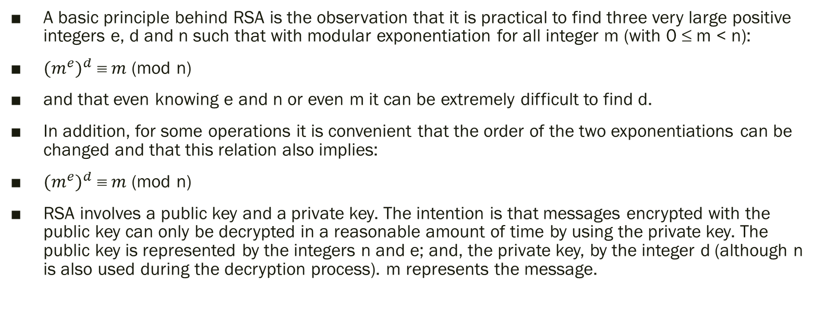
Operation
A basic principle behind RSA is the observation that it is practical to find three very large positive integers e, d and n such that with modular exponentiation for all integer m (with 0 ≤ m < n):
${{(m}^{e})}^{d}  m$ (mod n)
and that even knowing e and n or even m it can be extremely difficult to find d.
In addition, for some operations it is convenient that the order of the two exponentiations can be changed and that this relation also implies:
${{(m}^{e})}^{d}  m$ (mod n)
RSA involves a public key and a private key. The intention is that messages encrypted with the public key can only be decrypted in a reasonable amount of time by using the private key. The public key is represented by the integers n and e; and, the private key, by the integer d (although n is also used during the decryption process). m represents the message.

Slide 5
Key generation
Choose two distinct prime numbers p and q.
For security purposes, the integers p and q should be chosen at random, and should be similar in magnitude but differ in length by a few digits to make factoring harder.[2] Prime integers can be efficiently found using a primality test.
Compute n = pq.
n is used as the modulus for both the public and private keys. Its length, usually expressed in bits, is the key length.
Compute λ(n) = lcm(λ(p), λ(q)) = lcm(p − 1, q − 1), where λ is Carmichael's totient function. This value is kept private.
Choose an integer e such that 1 < e < λ(n) and gcd(e, λ(n)) = 1; i.e., e and λ(n) are coprime.
Determine d as d ≡ e−1 (mod λ(n)); i.e., d is the modular multiplicative inverse of e (modulo λ(n)).
This is more clearly stated as: solve for d given d⋅e ≡ 1 (mod λ(n)).
e having a short bit-length and small Hamming weight results in more efficient encryption – most commonly e = 216 + 1 = 65,537. However, much smaller values of e (such as 3) have been shown to be less secure in some settings.
e is released as the public key exponent.
d is kept as the private key exponent.

Slide 6
Key generation
The public key consists of the modulus n and the public (or encryption) exponent e. The private key consists of the private (or decryption) exponent d. p, q, and λ(n) must also be kept secret because they can be used to calculate d.
In the original RSA paper, the Euler totient function φ(n) = (p − 1)(q − 1) is used instead of λ(n) for calculating the private exponent d. Since φ(n) is always divisible by λ(n) the algorithm works as well. That the Euler totient function can be used can also seen as consequence of the Lagrange's theorem applied to the multiplicative group of integers modulo pq). Thus any d satisfying d⋅e ≡ 1 (mod φ(n)) also satisfies d⋅e ≡ 1 (mod λ(n)). However, computing d modulo φ(n) will sometimes yield a result that is larger than necessary (i.e. d > λ(n)). Most of the implementations of RSA will accept exponents generated using either method (if they use the private exponent d at all, rather than using the optimized decryption method based on the Chinese remainder theorem described below), but some standards like FIPS 186-4 may require that d < λ(n). Any "oversized" private exponents not meeting that criterion may always be reduced modulo λ(n) to obtain a smaller equivalent exponent.
Since any common factors of (p − 1) and (q − 1) are present in the factorisation of n − 1 = pq − 1 = (p − 1)(q − 1) + (p − 1) + (q − 1), it is recommended that (p − 1) and (q − 1) have only very small common factors, if any besides the necessary 2.
Note: The authors of the original RSA paper carry out the key generation by choosing d and then computing e as the modular multiplicative inverse of d (modulo φ(n)). Since it is beneficial to use a small value for e (e.g., 65,537) in order to speed up the encryption function, current implementations of RSA, such as PKCS#1 choose e and compute d instead.

Slide 7
Key distribution
Suppose that Bob wants to send information to Alice. If they decide to use RSA, Bob must know Alice's public key to encrypt the message and Alice must use her private key to decrypt the message. To enable Bob to send his encrypted messages, Alice transmits her public key (n, e) to Bob via a reliable, but not necessarily secret, route. Alice's private key (d) is never distributed.

Slide 8
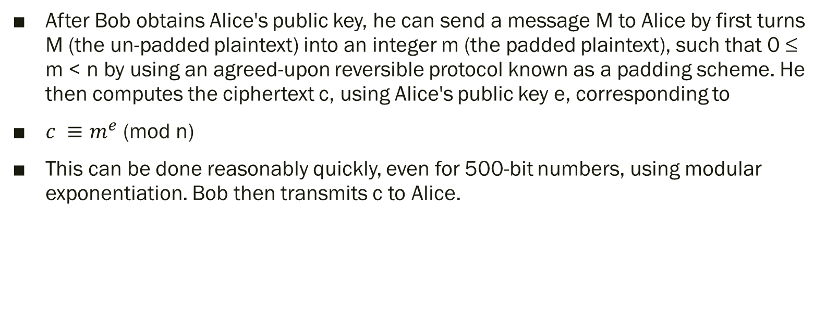
Encryption
After Bob obtains Alice's public key, he can send a message M to Alice by first turns M (the un-padded plaintext) into an integer m (the padded plaintext), such that 0 ≤ m < n by using an agreed-upon reversible protocol known as a padding scheme. He then computes the ciphertext c, using Alice's public key e, corresponding to
$c ≡m^{e}$ (mod n)
This can be done reasonably quickly, even for 500-bit numbers, using modular exponentiation. Bob then transmits c to Alice.

Slide 9

Decryption
Alice can recover m from c by using her private key exponent d by computing
$c^{d} ≡{{(m}^{e})}^{d} ≡m$ (mod n)
Given m, she can recover the original message M by reversing the padding scheme.

Slide 10
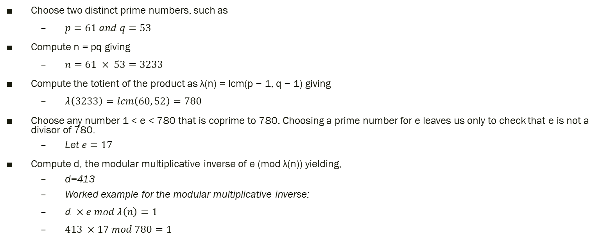
Example
Choose two distinct prime numbers, such as
$p=61 and q=53$
Compute n = pq giving
$n=61 × 53=3233$
Compute the totient of the product as λ(n) = lcm(p − 1, q − 1) giving
$λ\left(3233\right)=lcm\left(60, 52\right)=780$
Choose any number 1 < e < 780 that is coprime to 780. Choosing a prime number for e leaves us only to check that e is not a divisor of 780.
Let $e=17$
Compute d, the modular multiplicative inverse of e (mod λ(n)) yielding,
d=413
Worked example for the modular multiplicative inverse:
$d ×e mod λ\left(n\right)=1$
$413 ×17 mod 780=1$

Slide 11
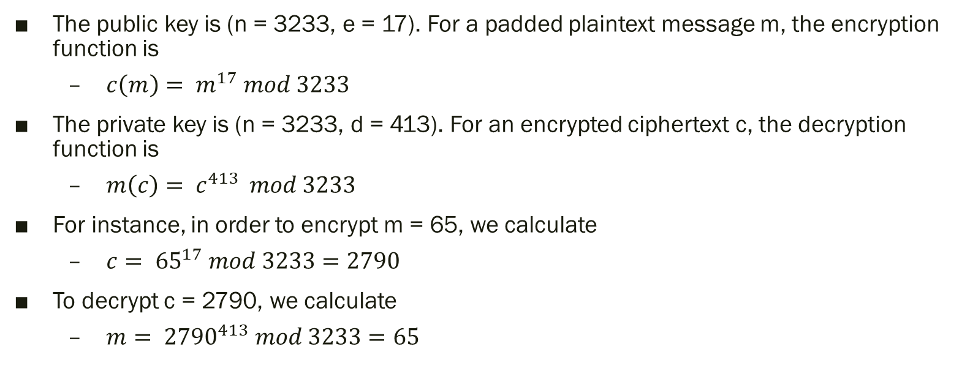
Example
The public key is (n = 3233, e = 17). For a padded plaintext message m, the encryption function is
$c\left(m\right)= m^{17} mod 3233$
The private key is (n = 3233, d = 413). For an encrypted ciphertext c, the decryption function is
$m\left(c\right)= c^{413 } mod 3233$
For instance, in order to encrypt m = 65, we calculate
$c= {65}^{17} mod 3233=2790$
To decrypt c = 2790, we calculate
$m= {2790}^{413} mod 3233=65$

Slide 12
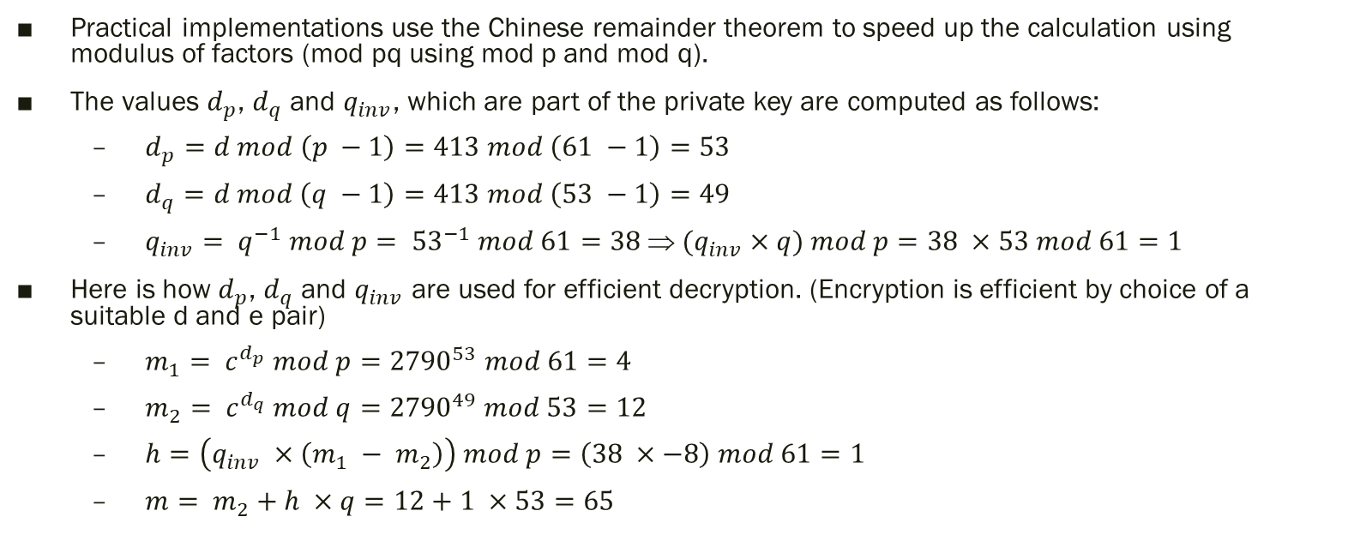
Example
Practical implementations use the Chinese remainder theorem to speed up the calculation using modulus of factors (mod pq using mod p and mod q).
The values $d_{p}$, $d_{q}$ and $q_{inv}$, which are part of the private key are computed as follows:
$d_{p}=d mod \left(p −1\right)=413 mod \left(61 −1\right)=53$
$d_{q}=d mod \left(q −1\right)=413 mod \left(53 −1\right)=49$
$q_{inv}= q^{−1} mod p= {53}^{−1} mod 61=38  {(q}_{inv} ×q) mod p=38 ×53 mod 61=1$
Here is how $d_{p}$, $d_{q}$ and $q_{inv}$ are used for efficient decryption. (Encryption is efficient by choice of a suitable d and e pair)
$m_{1}= c^{d_{p}} mod p={2790}^{53} mod 61=4$
$m_{2}= c^{d_{q}} mod q={2790}^{49} mod 53=12$
$h=\left(q_{inv} ×\left(m_{1} − m_{2}\right)\right) mod p=\left(38 ×−8\right) mod 61=1$
$m= m_{2}+h ×q=12+1 ×53=65$

