Slide 1

Data Encryption Standard
Presented By 周美廷，张金源
2018年5月
Free PowerPoint Templates
Free PowerPoint Templates

Slide 2
DES Facts
DES is insecure
Triple DES
Advanced Encryption Standard
This is mainly due to the 56-bit key size being too small.
The algorithm is believed to be practically secure in the form of Triple DES, although there are theoretical attacks.
This cipher has been superseded by the Advanced Encryption Standard (AES)
Free PowerPoint Templates

Slide 3
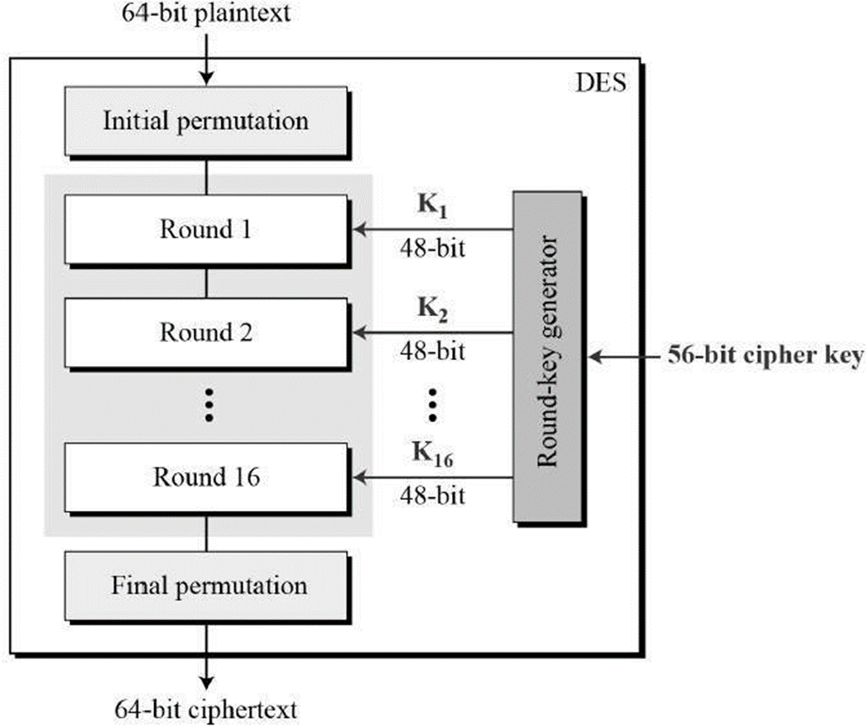
Feistel Cipher
Feistel
Cipher
TOPIC
It uses 16 round Feistel structure. The block size is 64-bit. Though, key length is 64-bit, DES has an effective key length of 56 bits, since 8 of the 64 bits of the key are not used by the encryption algorithm (function as check bits only).
Free PowerPoint Templates

Slide 4
Required to specify DES
Initial and final permutation
Round function
Key schedule
Free PowerPoint Templates
Free PowerPoint Templates

Slide 5
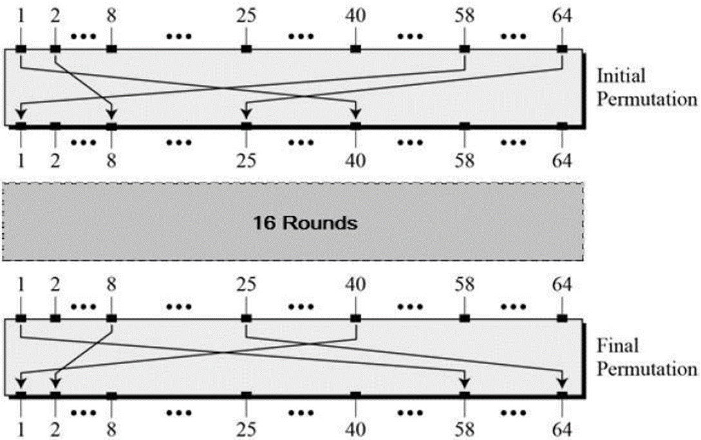
Permutation
Initial and Final Permutation
TOPIC
The initial and final permutations are straight Permutation boxes (P-boxes) that are inverses of each other. They have no cryptography significance in DES.
Free PowerPoint Templates

Slide 6
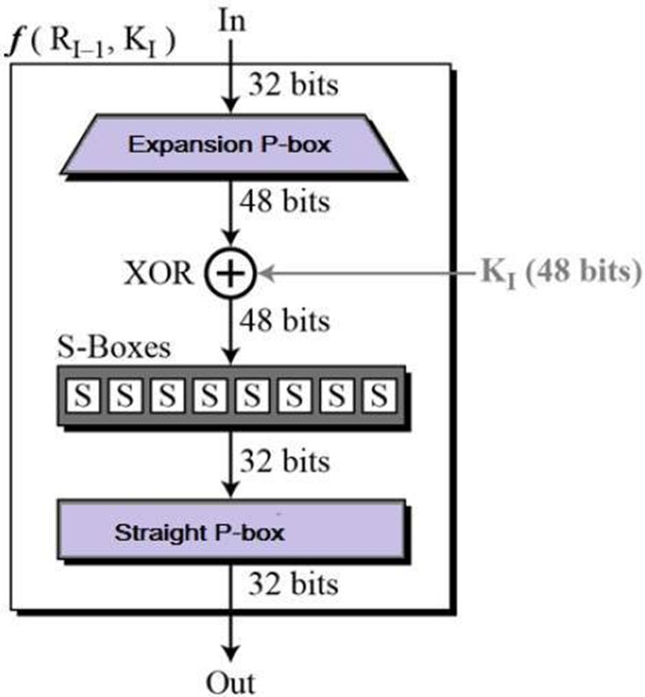
Round Function
Free PowerPoint Templates
Free PowerPoint Templates

Slide 7
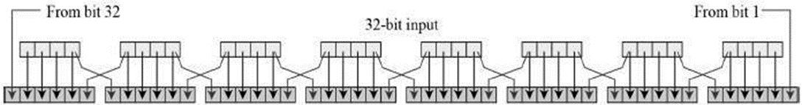
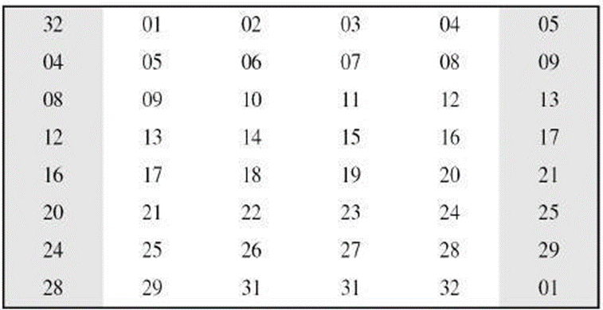


Our Team
After the expansion permutation, DES does XOR operation on the expanded right section and the round key. The round key is used only in this operation.
Expansion Permutation Box
XOR (Whitener)
Free PowerPoint Templates

Slide 8
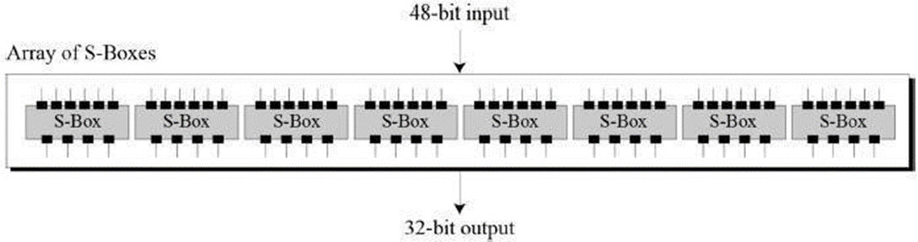
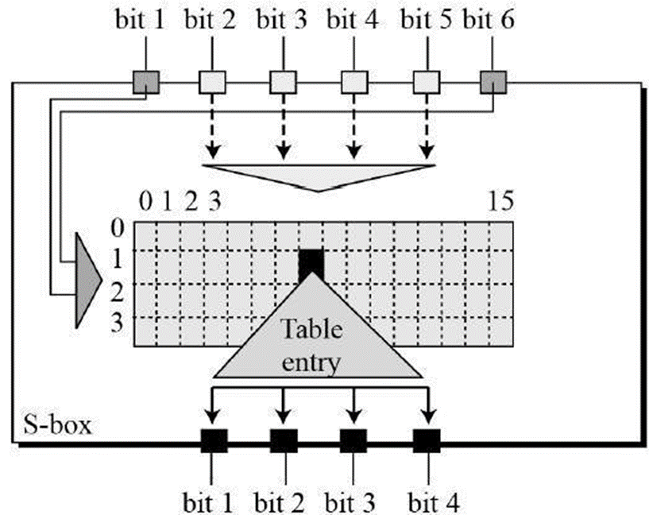
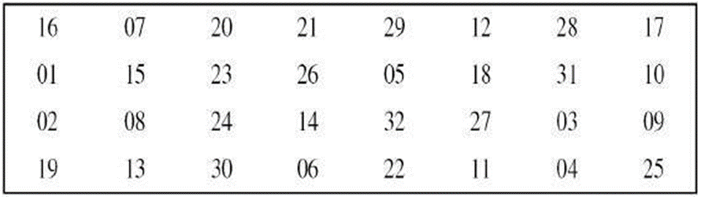
Our Team
Straight Permutation
Substitution Boxes
Free PowerPoint Templates

Slide 9
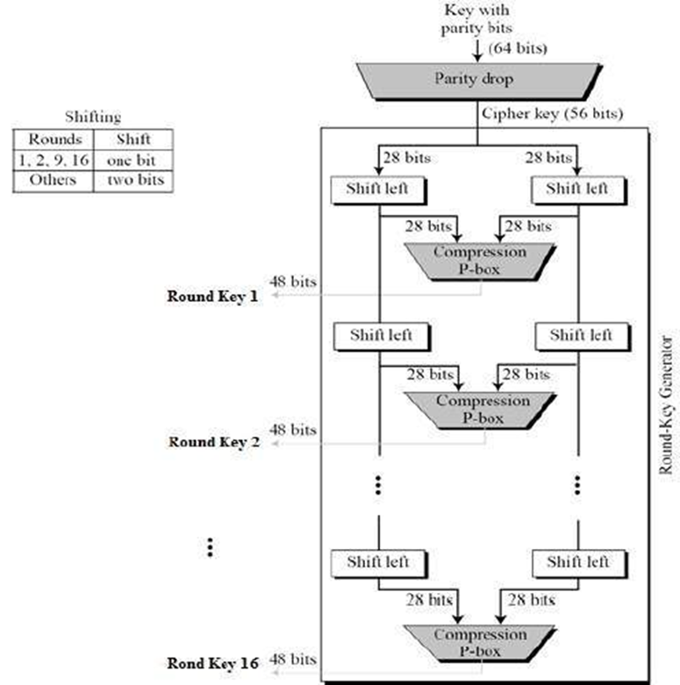
Key Generation
TOPIC
Key Generation
The round-key generator creates sixteen 48-bit keys out of a 56-bit cipher key.
Free PowerPoint Templates

Slide 10
“
EFF DES cracker
"Deep Crack"
Free PowerPoint Templates
Free PowerPoint Templates

