Slide 1
Mathematics of Cryptography Part II: Algebraic Structures
UNIT 7
应用密码学

Slide 2
Learning Outcomes
To review the concept of algebraic structures.
To define and give some examples of groups.
To define and give some examples of rings.
To define and give some examples of fields.
To emphasize the finite fields of type GF(2n) that make it possible to perform operations suc as addition, subtraction, multiplication, an division on n-bit words in modern block ciphers.

Slide 3
7.1 ALGEBRAIC STRUCTURES

Slide 4
7.1 ALGEBRAIC STRUCTURES
Cryptography requires sets of integers and specific operations that are defined for those sets. The combination of the set and the operations that are applied to the elements of the set is called an algebraic structure. In this chapter, we will define three common algebraic structures: groups, rings, and fields.

Slide 5
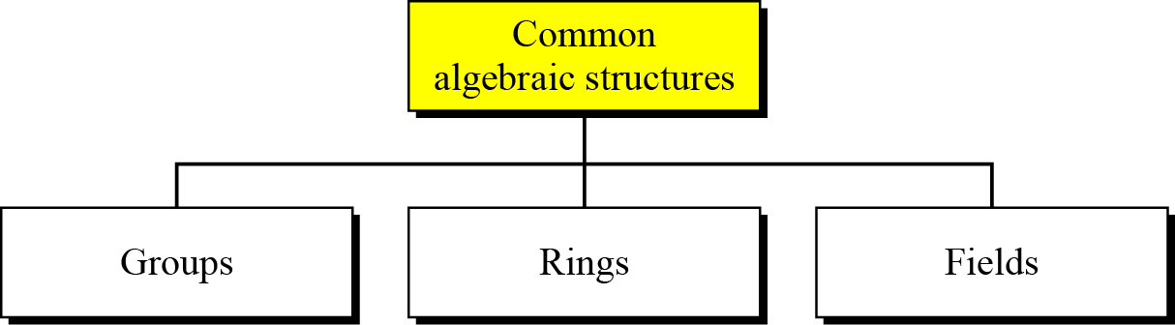
7.1 ALGEBRAIC STRUCTURES
Figure 7.1 Common algebraic structure

Slide 6
7.1.1 Groups
A group (G) is a set of elements with a binary operation (•) that satisfies four properties (or axioms). A commutative group satisfies an extra property, commutativity:
Closure.
Associativity
Commutativity
Existence of identity
Existence of inverse

Slide 7
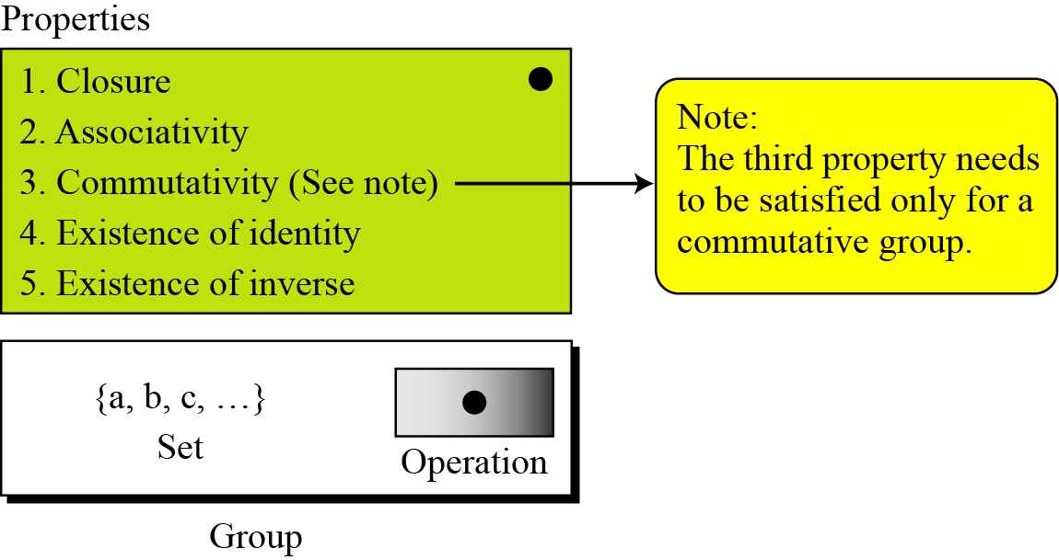
7.1.1 Groups
Figure 7.2 Group

Slide 8
6.1.1 Groups
Application
Although a group involves a single operation, the properties imposed on the operation allow the use of a pair of operations as long as they are inverses of each other.
Example 7.1
The set of residue integers with the addition operator,
G = < Z_{n} , +>,
is a commutative group. We can perform addition and subtraction on the elements of this set without moving out of the set.

Slide 9
7.1.1 Groups
Example 7.2
The set Z_{n}* with the multiplication operator, G = <Z_{n}*, ×>, is also an abelian group.
Example 7.3
Let us define a set G = < {a, b, c, d}, •> and the operation as shown in Table 7.1.
Table 7.1 operation in G = < {a, b, c, d}, •>

Slide 10
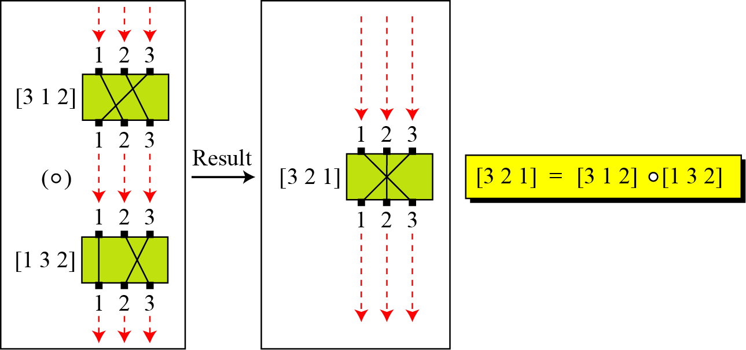
6.1.1 Groups
Example 7.4
A very interesting group is the permutation group. The set is the set of all permutations, and the operation is composition: applying one permutation after another.
Figure 7.3 Composition of permutation

Slide 11
7.1.1 Groups
Table 7.2 Operation table for permutation group

Slide 12
7.1.1 Groups
Example 7.5
In the previous example, we showed that a set of permutations with the composition operation is a group. This implies that using two permutations one after another cannot strengthen the security of a cipher, because we can always find a permutation that can do the same job because of the closure property.

Slide 13
7.1.1 Groups
Finite Group
Order of a Group
Subgroups

Slide 14
7.1.1 Groups
Example 7.6
Is the group H = <Z₁₀, +> a subgroup of the group G = <Z₁₂, +>?
Solution
The answer is no. Although H is a subset of G, the operations defined for these two groups are different. The operation in H is addition modulo 10; the operation in G is addition modulo 12.

Slide 15
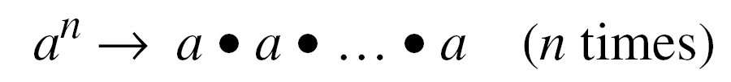
7.1.1 Groups
Cyclic Subgroups
If a subgroup of a group can be generated using the power of an element, the subgroup is called the cyclic subgroup.

Slide 16

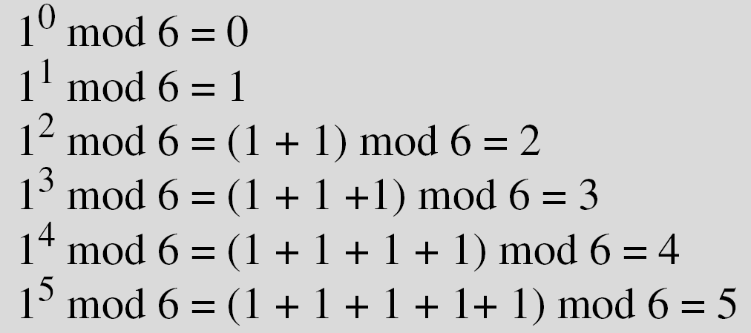
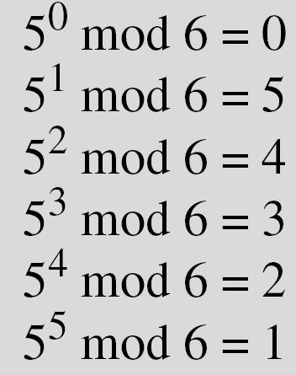
7.1.1 Groups
Example 7.7
Four cyclic subgroups can be made from the group G = <Z6, +>. They are H₁ = <{0}, +>, H₂ = <{0, 2, 4}, +>, H₃ = <{0, 3}, +>, and H₄ = G.

Slide 17
7.1.1 Groups
Example 7.8
Three cyclic subgroups can be made from the group G = <Z₁₀∗, ×>. G has only four elements: 1, 3, 7, and 9. The cyclic subgroups are H₁ = <{1}, ×>, H₂ = <{1, 9}, ×>, and H₃ = G.
and H₄ = G.

Slide 18
7.1.1 Groups
Cyclic Cyclic
A cyclic group is a group that is its own cyclic subgroup.

Slide 19
7.1.1 Groups
Example 7.9
Three cyclic subgroups can be made from the group G = <Z₁₀∗, ×>. G has only four elements: 1, 3, 7, and 9. The cyclic subgroups are H₁ = <{1}, ×>, H₂ = <{1, 9}, ×>, and H₃ = G.
a. The group G = <Z₆, +> is a cyclic group with two generators, g = 1 and g = 5.
b. The group G = <Z₁₀∗, ×> is a cyclic group with two generators, g = 3 and g = 7.

Slide 20
7.1.1 Groups
Lagrange’s Theorem
Assume that G is a group, and H is a subgroup of G. If the order of G and H are |G| and |H|, respectively, then, based on this theorem, |H| divides |G|.
Order of an Element
The order of an element is the order of the cyclic group it generates.

Slide 21
7.1.1 Groups
Example 7.10
a. In the group G = <Z₆, +>, the orders of the elements are:
ord(0) = 1, ord(1) = 6, ord(2) = 3,
ord(3) = 2, ord(4) = 3, ord(5) = 6.
b. In the group G = <Z₁₀*, ×>, the orders of the elements are: ord(1) = 1, ord(3) = 4, ord(7) = 4, ord(9) = 2.

Slide 22
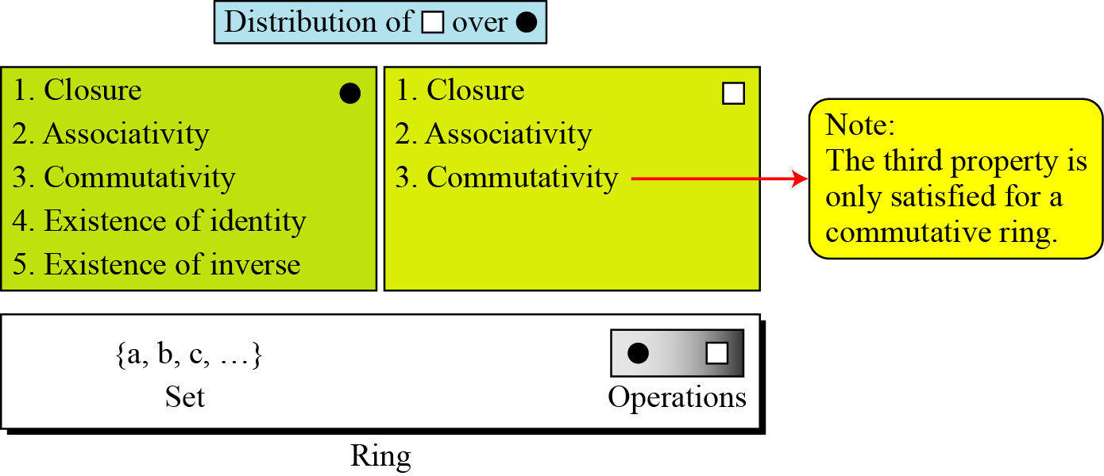
7.1.2 Ring
A ring, R = <{…}, •, >, is an algebraic structure with two operations.
Figure 7.4 Ring

Slide 23
7.1.2 Ring
Example 7.11
The set Z with two operations, addition and multiplication, is a commutative ring. We show it by R = <Z, +, ×>. Addition satisfies all of the five properties; multiplication satisfies only three properties.

Slide 24
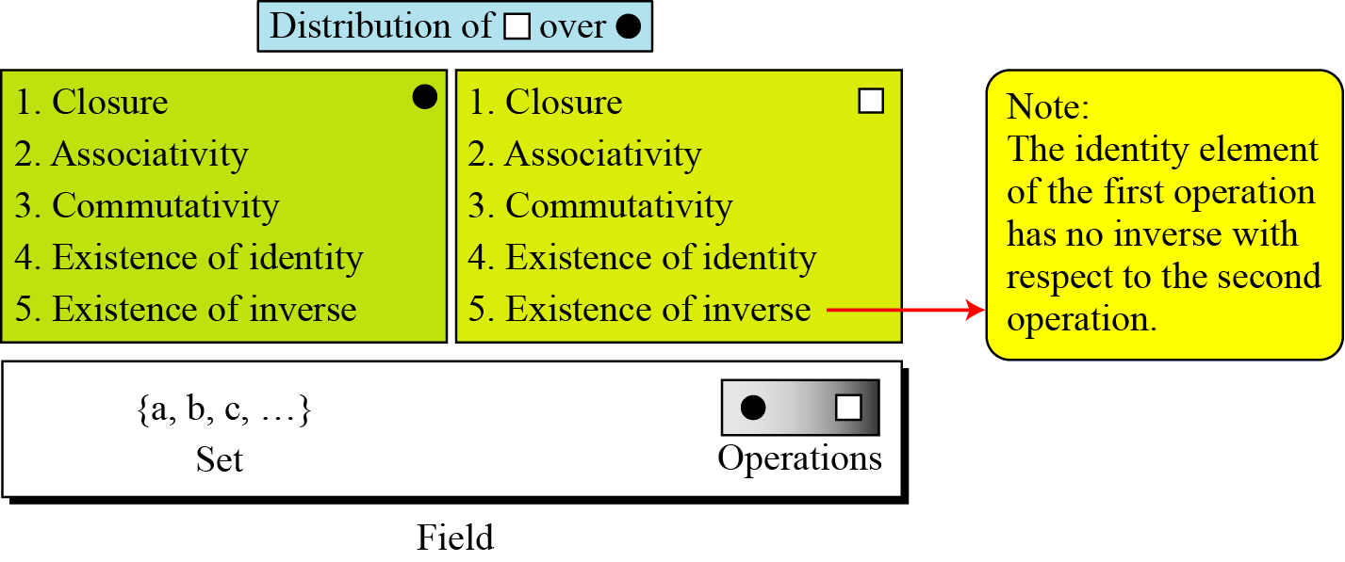
7.1.3 Field
A field, denoted by F = <{…}, •, > is a commutative ring in which the second operation satisfies all five properties defined for the first operation except that the identity of the first operation has no inverse.
Figure 7.5 Field

Slide 25
7.1.3 Field
Finite Fields
Galois showed that for a field to be finite, the number of elements should be pn, where p is a prime and n is a positive integer. .
A Galois field, GF(p^{n}), is a finite field with p^{n} elements.

Slide 26
7.1.3 Field
GF(p) Fields
When n = 1, we have GF(p) field. This field can be the set Z_{p}, {0, 1, …, p − 1}, with two arithmetic operations.

Slide 27
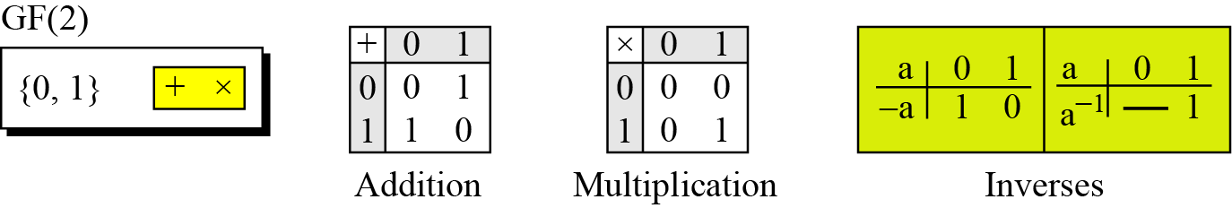
7.1.3 Field
Example 7.12
A very common field in this category is GF(2) with the set {0, 1} and two operations, addition and multiplication, as shown in Figure 7.6.
Figure 7.6 GF(2) field

Slide 28
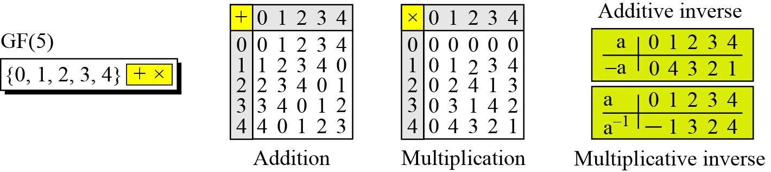
7.1.3 Field
Example 7.13
We can define GF(5) on the set Z₅ (5 is a prime) with addition and multiplication operators as shown in Figure 7.7.
Figure 7.7 GF(5) field

Slide 29
7.1.3 Field
Summary
Table 7.3 GF(5) field

Slide 30
7.1 GF(2^{n}) FIELDS

Slide 31
7.2 GF(2n) FIELDS
In cryptography, we often need to use four operations (addition, subtraction, multiplication, and division). In other words, we need to use fields. We can work in GF(2^{n}) and uses a set of 2^{n} elements. The elements in this set are n-bit words.

Slide 32
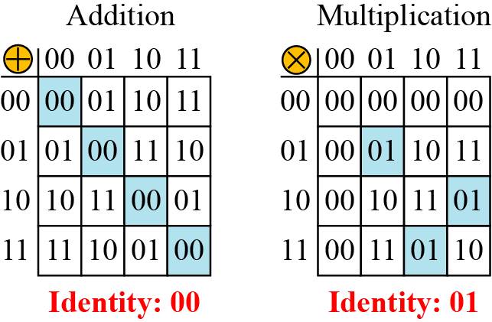
7.2 GF(2n) FIELDS
Example 7.14
Let us define a GF(2²) field in which the set has four 2-bit words: {00, 01, 10, 11}. We can redefine addition and multiplication for this field in such a way that all properties of these operations are satisfied, as shown in Figure 7.8.
Figure 7.8 An example of GF(22) field

Slide 33
7.2.1 Polynomials
A polynomial of degree n − 1 is an expression of the form
where x^{i} is called the ith term and a_{i} is called coefficient of the ith term.

Slide 34
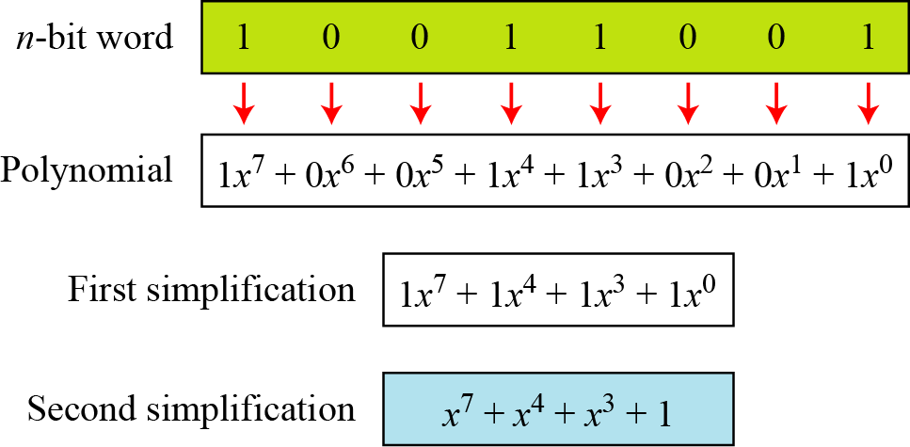
7.2.1 Polynomials
Example 7.15
Figure 7.9 show how we can represent the 8-bit word (10011001) using a polynomials.
Figure 7. 9 Representation of an 8-bit word by a polynomial

Slide 35
7.2.1 Polynomials
Example 7.16
To find the 8-bit word related to the polynomial x⁵ + x² + x, we first supply the omitted terms. Since n = 8, it means the polynomial is of degree 7. The expanded polynomial is
polynomials.
This is related to the 8-bit word 00100110.

Slide 36
7.2.1 Polynomials
GF(2^{n}) FIELDS
Polynomials representing n-bit words use two fields: GF(2) and GF(2^{n}).

Slide 37
7.2.1 Polynomials
Modulus
For the sets of polynomials in GF(2^{n}), a group of polynomials of degree n is defined as the modulus. Such polynomials are referred to as irreducible polynomials.
Table 7.4 List of irreducible polynomials

Slide 38
7.2.1 Polynomials
Addition
Addition and subtraction operations on polynomials are the same operation.

Slide 39

7.2.1 Polynomials
Example 7.17
Let us do (x⁵ + x² + x) $⨁$ (x³ + x² + 1) in GF(2⁸). We use the symbol $⨁$ to show that we mean polynomial addition. The following shows the procedure:

Slide 40
7.2.1 Polynomials
Example 7.18
There is also another short cut. Because the addition in GF(2) means the exclusive-or (XOR) operation. So we can exclusive-or the two words, bits by bits, to get the result. In the previous example, x⁵ + x² + x is 00100110 and x³ + x² + 1 is 00001101. The result is 00101011 or in polynomial notation x⁵ + x³ + x + 1.

Slide 41
7.2.1 Polynomials
Multliplication
1. The coefficient multiplication is done in GF(2).
2. The multiplying x^{i} by x^{j} results in x^{i+j}.
3. The multiplication may create terms with degree more than n − 1, which means the result needs to be reduced using a modulus polynomial.

Slide 42
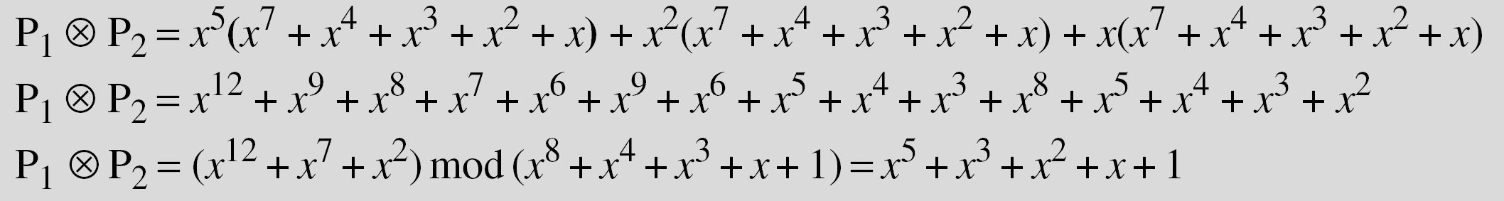
7.2.1 Polynomials
Example 7.19
Find the result of (x⁵ + x² + x) ⊗ (x⁷ + x⁴ + x³ + x² + x) in GF(2⁸) with irreducible polynomial (x⁸ + x⁴ + x³ + x + 1). Note that we use the symbol ⊗ to show the multiplication of two polynomials.
Solution
To find the final result, divide the polynomial of degree 12 by the polynomial of degree 8 (the modulus) and keep only the remainder. Figure 7.10 shows the process of division.

Slide 43
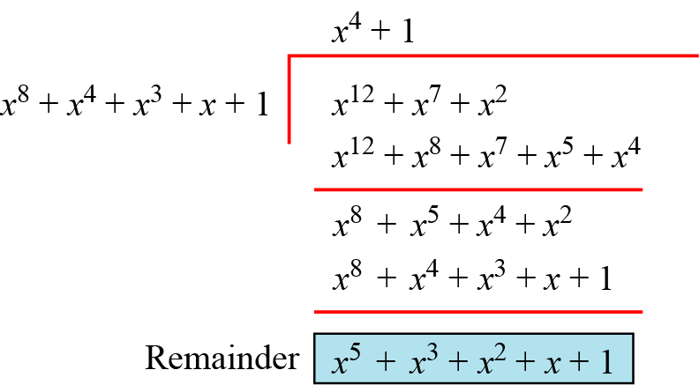
7.2.1 Polynomials
Figure 7.10 Polynomial division with coefficients in GF(2)

Slide 44
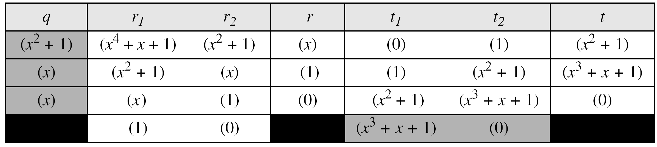
7.2.1 Polynomials
Example 7.20
In GF (2⁴), find the inverse of (x² + 1) modulo (x⁴ + x + 1)..
Solution
The answer is (x³ + x + 1) as shown in Table 7.5.
Table 7.5 Euclidean algorithm for Exercise 7.20

Slide 45
7.2.1 Polynomials
Example 7.21
In GF(2⁸), find the inverse of (x⁵) modulo (x⁸ + x4 + x³ + x + 1).
Solution
The answer is (x⁵ + x⁴ + x³ + x) as shown in Table 7.6.
Table 7.6 Euclidean algorithm for Exercise 7.21

Slide 46
7.2.1 Polynomials
Multliplication Using Computer
The computer implementation uses a better algorithm, repeatedly multiplying a reduced polynomial by x.

Slide 47
7.2.1 Polynomials
Example 7.22
Find the result of multiplying P¹ = (x⁵ + x² + x) by P² = (x⁷ + x⁴ + x³ + x² + x) in GF(2⁸) with irreducible polynomial (x⁸ + x⁴ + x³ + x + 1) using the algorithm described above.
Solution
The process is shown in Table 7.7. We first find the partial result of multiplying x⁰, x¹, x², x³, x⁴, and x⁵ by P₂. Note that although only three terms are needed, the product of x^{m} ⊗ P₂ for m from 0 to 5 because each calculation depends on the previous result.

Slide 48
7.2.1 Polynomials
Example 7.22(continued)
Table 7.7 An efficient algorithm (Example 7.22)

Slide 49
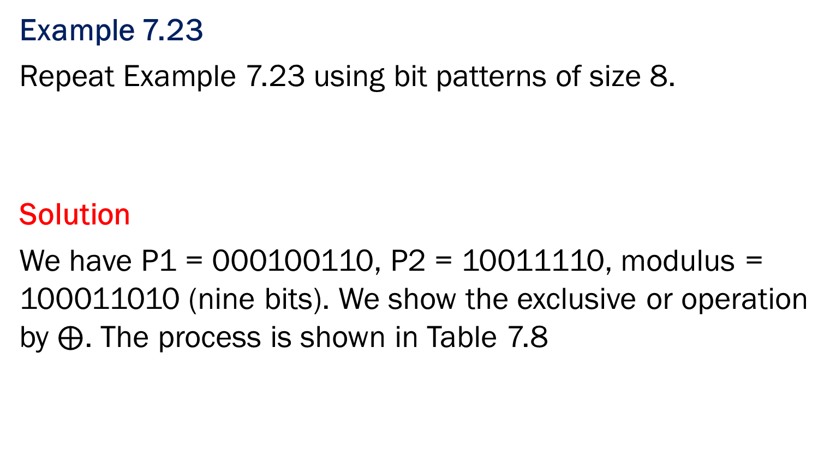
7.2.1 Polynomials
Example 7.23
Repeat Example 7.23 using bit patterns of size 8.
Solution
We have P1 = 000100110, P2 = 10011110, modulus = 100011010 (nine bits). We show the exclusive or operation by $⨁$. The process is shown in Table 7.8

Slide 50
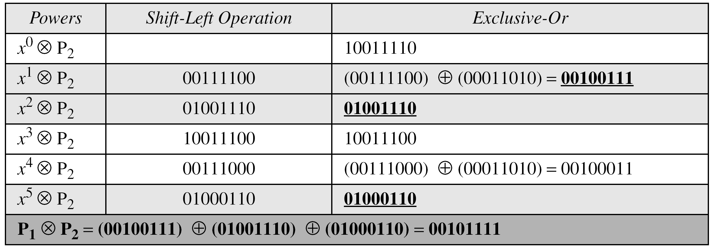
7.2.1 Polynomials
Example 7.23(continued)
Table 7.8 An efficient algorithm for multiplication using n-bit words

Slide 51
7.2.1 Polynomials
Example 7.24
The GF(2³) field has 8 elements. We use the irreducible polynomial (x³ + x² + 1) and show the addition and multiplication tables for this field. We show both 3-bit words and the polynomials. Note that there are two irreducible polynomials for degree 3. The other one, (x³ + x + 1), yields a totally different table for multiplication.

Slide 52
7.2.1 Polynomials
Example 7.25
Table 7.9 Addition table for GF(23)

Slide 53
7.2.1 Polynomials
Example 7.26
Table 7.9 Multiplication table for GF(23)

Slide 54
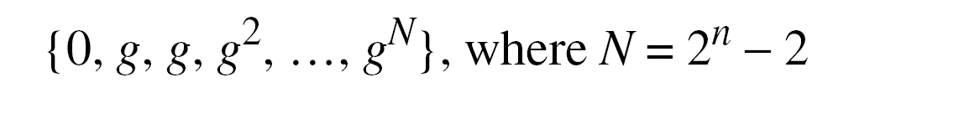
7.2.2 Using a Generator
Sometimes it is easier to define the elements of the GF(2^{n}) field using a generator.

Slide 55
7.2.1 Polynomials
Example 7.25
Generate the elements of the field GF(2⁴) using the irreducible polynomial ƒ(x) = x⁴ + x + 1.
Solution
The elements 0, g⁰, g¹, g², and g³ can be easily generated, because they are the 4-bit representations of 0, 1, x², and x³. Elements g⁴ through g¹⁴, which represent x⁴ though x¹⁴ need to be divided by the irreducible polynomial. To avoid the polynomial division, the relation ƒ(g) = g⁴ + g + 1 = 0 can be used (See next slide).

Slide 56
7.2.1 Polynomials
Example 7.25(continued)

Slide 57
7.2.1 Polynomials
Example 7.26
The following show the results of addition and subtraction operations:

Slide 58
7.2.1 Polynomials
Example 7.27
The following show the result of multiplication and division operations:

Slide 59
7.2.1 Polynomials
Summary
The finite field GF(2^{n}) can be used to define four operations of addition, subtraction, multiplication and division over n-bit words. The only restriction is that division by zero is not defined.

