Slide 1
Symmetric-Key Cryptography
Chapter 9
应用密码学

Slide 2
Learning Outcomes
To distinguish between two cryptosystems : symmetric-key and asymmetric-key.
To introduce trapdoor one-way functions and their use in asymmetric-key cryptosystems.
To introduce the knapsack cryptosystem as one of the first ideas in asymmetric-key cryptography.
To discuss the RSA cryptosystem.
To discuss the Rabin cryptosystem.
To discuss the ElGamal cryptosystem.
To discuss the elliptic curve cryptosystem.

Slide 3
9.1 INTRODUCTION

Slide 4
9.1 INTRODUCTION
Symmetric and asymmetric-key cryptography will exist in parallel and continue to serve the community. We actually believe that they are complements of each other; the advantages of one can compensate for the disadvantages of the other.

Slide 5
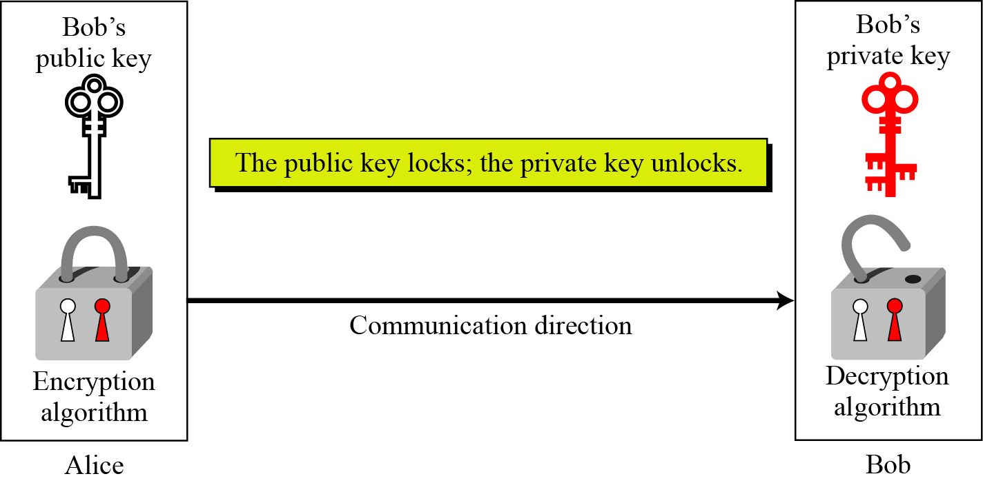
9.1.1 Keys
Asymmetric key cryptography uses two separate keys: one private and one public.
Figure 9.1 Locking and unlocking in asymmetric-key cryptosystem

Slide 6
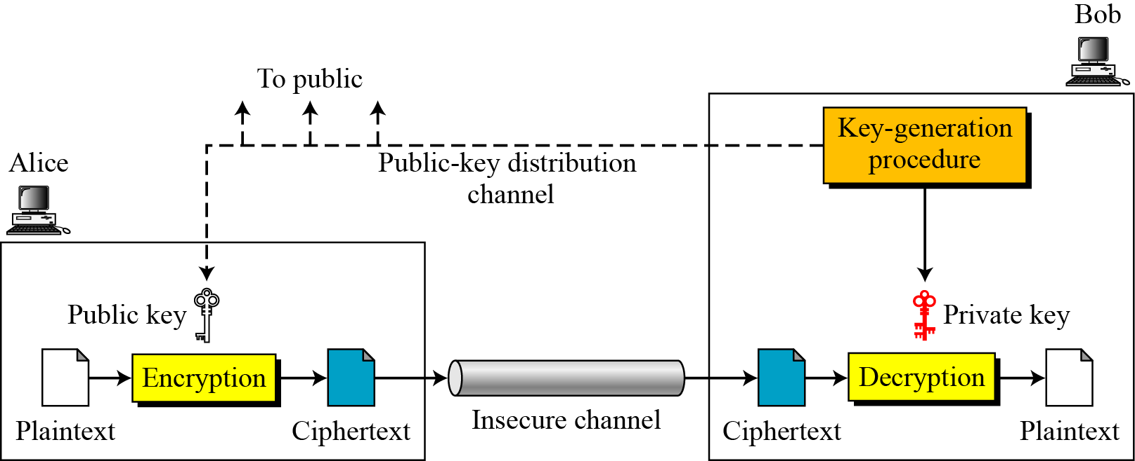
9.1.2 General Idea
Figure 9.2 General idea of asymmetric-key cryptosystem

Slide 7
9.1.2 General Idea
Plaintext/Ciphertext
Unlike in symmetric-key cryptography, plaintext and ciphertext are treated as integers in asymmetric-key cryptography.
Encryption/Decryption
C = f (K_{public} , P) P = g(K_{private} , C)

Slide 8
9.1.3 Need for Both
There is a very important fact that is sometimes misunderstood: The advent of asymmetric-key cryptography does not eliminate the need for symmetric-key cryptography.

Slide 9
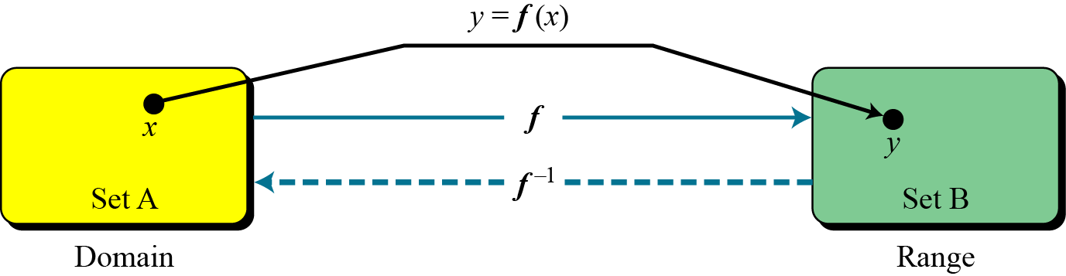
9.1.4 Trapdoor One-Way Function
The main idea behind asymmetric-key cryptography is the concept of the trapdoor one-way function.
Functions
Figure 9.3 A function as rule mapping a domain to a range

Slide 10
9.1.4 Trapdoor One-Way Function
One-Way Function (OWF)
1. f is easy to compute.
2. f ⁻¹ is difficult to compute.
Trapdoor One-Way Function (TOWF)
3. Given y and a trapdoor, x can be computed easily.

Slide 11
9.1.4 Trapdoor One-Way Function
Example 9.1
When n is large, n = p × q is a one-way function. Given
p and q , it is always easy to calculate n ; given n, it is
very difficult to compute p and q. This is the factorization
problem.
Example 9.2
When n is large, the function y = x^{k} mod n is a trapdoor one-way function. Given x, k, and n, it is easy to calculate y. Given y, k, and n, it is very difficult to calculate x. This is the discrete logarithm problem. However, if we know the trapdoor, k′ such that k × k ′ = 1 mod f(n), we can use x = y^{k}′ mod n to find x.

Slide 12
9.1.5 Knapsack Cryptosystem
Definition
a = [a₁, a₂, …, a_{k} ] and x = [x₁, x₂, …, x_{k}].
Given a and x, it is easy to calculate s. However, given s and a it is difficult to find x.
s=knapsacksum(a,x)= a₁ x₁+a₂ x₂+ …,+a_{k} x_{k}
Superincreasing Tuple
a_{i} ≥ a₁ + a₂ + … + a_{i−1}

Slide 13
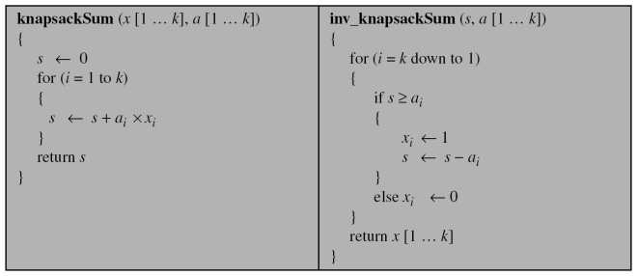
9.1.5 Knapsack Cryptosystem
Algorithm 9.1 knapsacksum and inv_knapsacksum for a superincreasing k-tuple

Slide 14
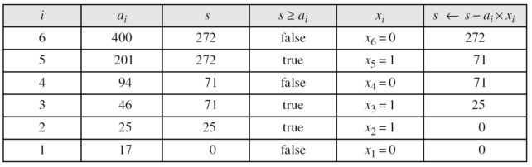
9.1.5 Knapsack Cryptosystem
Example 9.3
As a very trivial example, assume that a = [17, 25, 46, 94, 201,400] and s = 272 are given. Table 9.1 shows how the tuple x is found using inv_knapsackSum routine in Algorithm 10.1. In this case x = [0, 1, 1, 0, 1, 0], which means that 25, 46, and 201 are in the knapsack.
Table 9.1 Values of i, a_{i}, s and x_{i} in example 9.3

Slide 15
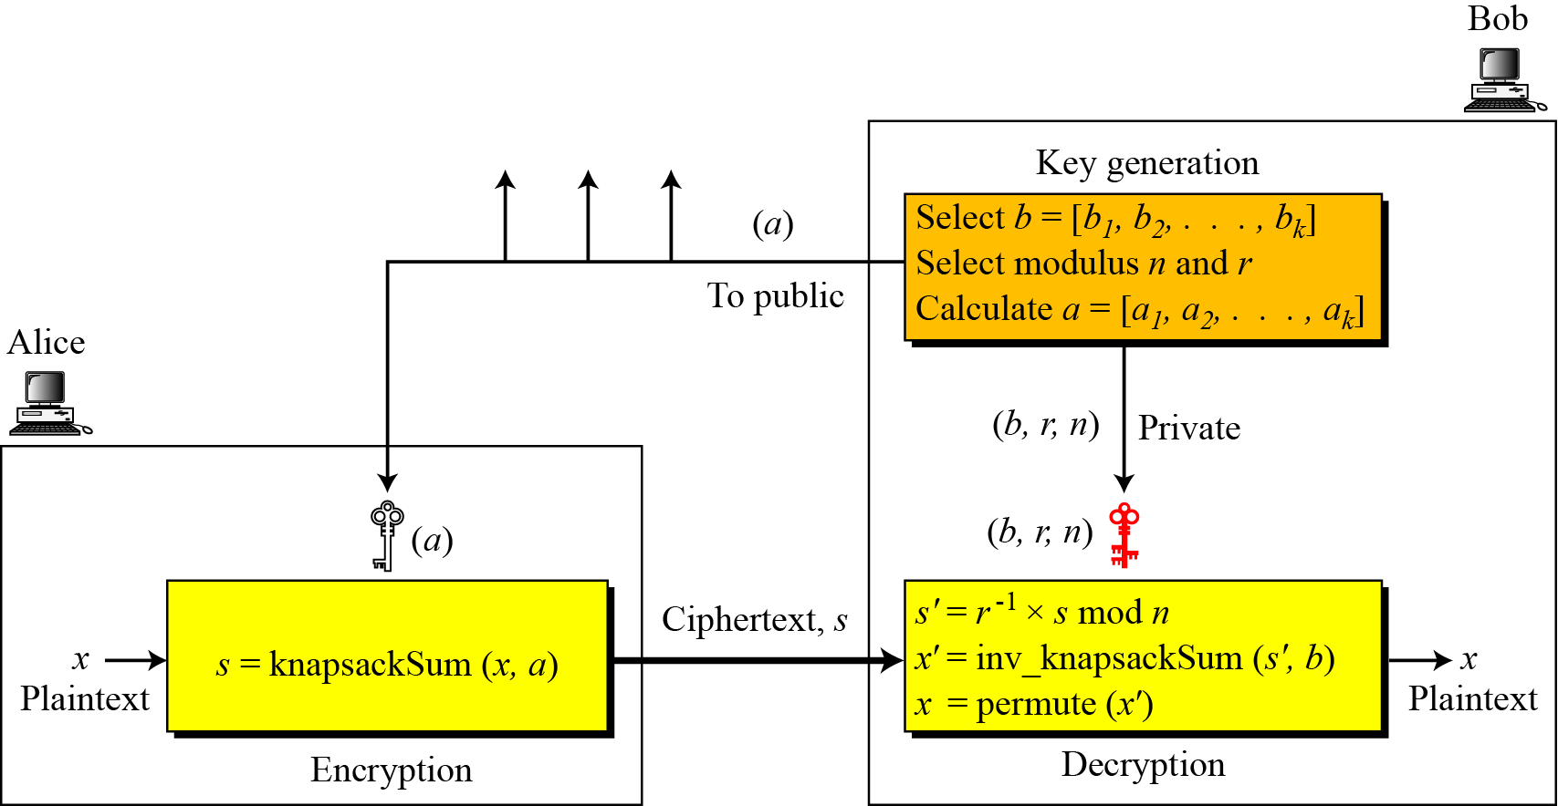
9.1.5 Knapsack Cryptosystem
Figure 9.4 Secret communication with knapsack cryptosystem

Slide 16
9.1.5 Knapsack Cryptosystem
Example 9.4
This is a trivial (very insecure) example just to show the procedure.

Slide 17
9.2 RSA CRYPTOSYSTEM

Slide 18
9.2 RSA CRYPTOSYSTEM
The most common public-key algorithm is the RSA cryptosystem, named for its inventors (Rivest, Shamir, and Adleman).

Slide 19
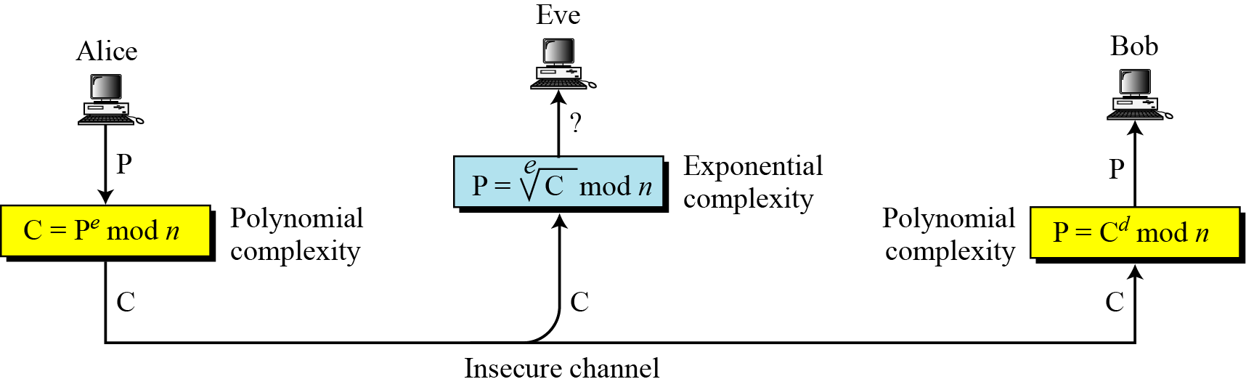
9.2.1 INTRODUCTION
Figure 9.5 Complexity of operations in RSA

Slide 20
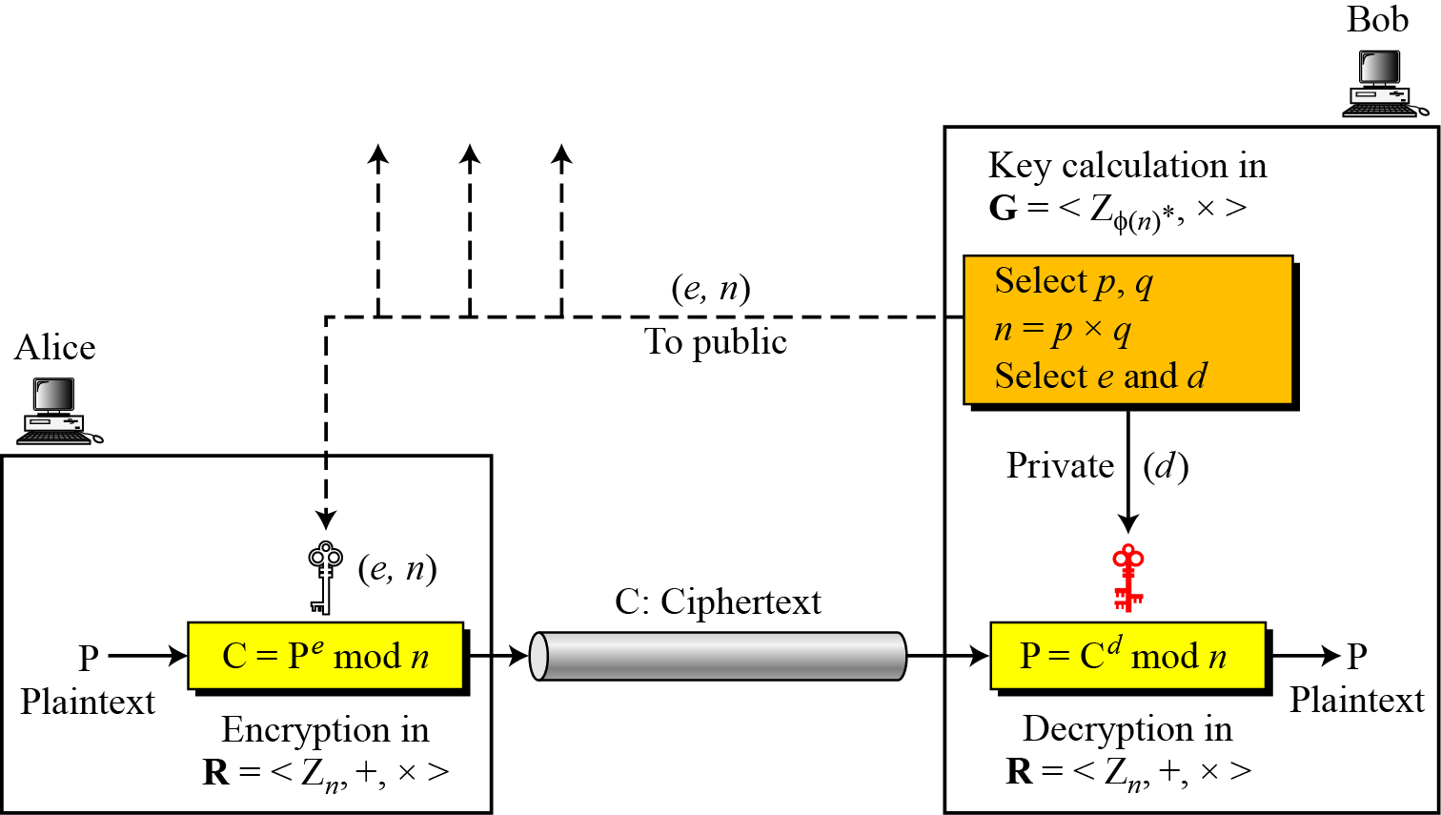
9.2.2 Procedure
Figure 9.6 Encryption, decryption, and key generation in RSA

Slide 21
9.2.2 Procedure
Two Algebraic Structures
Encryption/Decryption Ring:
Key-Generation Group:
R = <Z_{n} , +, × >
G = <Z _{φ(n)}∗, × >
RSA uses two algebraic structures:
a public ring R = <Zn , +, × >,and a private ringG = <Z _{φ(n)}∗, × >
In RSA, the tuple (e,n) is the public key;
the integer d is the private key

Slide 22
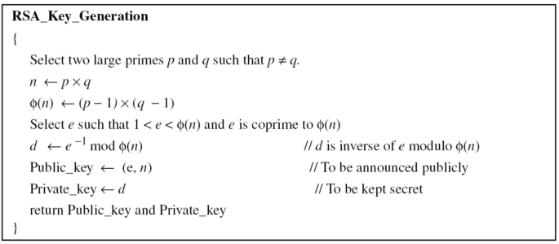
9.2.2 Procedure
Key Generation
Algorithm 9.2 RSA Key Generation

Slide 23
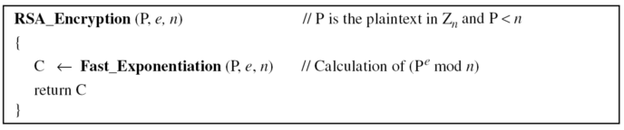
9.2.2 Procedure
Encryption
Algorithm 9.3 RSA encryption
In RSA, p and q must be at least 512 bits, n must be at least 1024bits

Slide 24
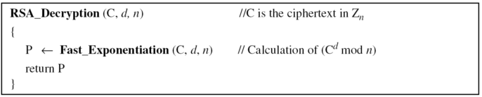
9.2.2 Procedure
Decryption
Algorithm 9.4 RSA decryption

Slide 25
9.2.2 Procedure
Proof of RSA

Slide 26

9.2.3 Some Trivial Examples
Example 9.5
Bob chooses 7 and 11 as p and q and calculates n = 77. The value of $φ$(n) = (7 − 1)(11 − 1) or 60. Now he chooses two exponents, e and d, from Z₆₀∗. If he chooses e to be 13, then d is 37. Note that e × d mod 60 = 1 (they are inverses of each) Now imagine that Alice wants to send the plaintext 5 to Bob. She uses the public exponent 13 to encrypt 5.
Bob receives the ciphertext 26 and uses the private key 37 to decipher the ciphertext:

Slide 27
9.2.3 Some Trivial Examples
Example 9.6
Now assume that another person, John, wants to send a message to Bob. John can use the same public key announced by Bob (probably on his website), 13; John’s plaintext is 63. John calculates the following:
Bob receives the ciphertext 28 and uses his private key 37 to decipher the ciphertext:

Slide 28

9.2.3 Some Trivial Examples
Example 9.7
Jennifer creates a pair of keys for herself. She chooses p = 397 and q = 401. She calculates n = 159197. She then calculates$φ$(n) = 158400. She then chooses e = 343 and d = 12007. Show how Ted can send a message to Jennifer if he knows e and n.
Suppose Ted wants to send the message “NO” to Jennifer. He changes each character to a number (from 00 to 25), with each character coded as two digits. He then concatenates the two coded characters and gets a four-digit number. The plaintext is 1314. Figure 9.7 shows the process.

Slide 29
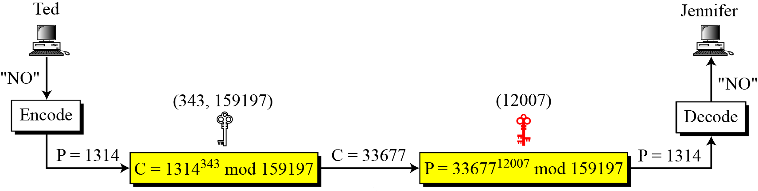
9.2.3 Some Trivial Examples
Figure 9.7 Encryption, decryption in example 9.7

Slide 30
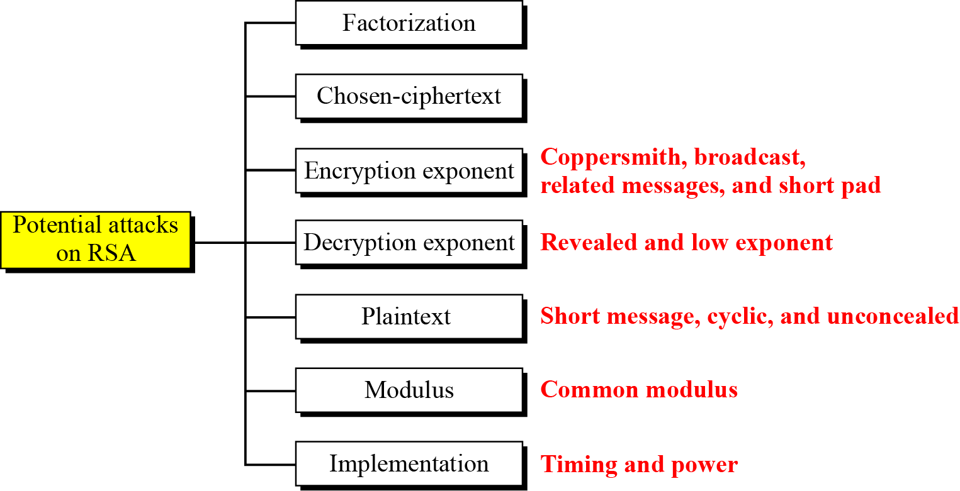
9.2.4 Attacks on RSA
Figure 9.8 Taxonomy of potential attacks on RSA

Slide 31
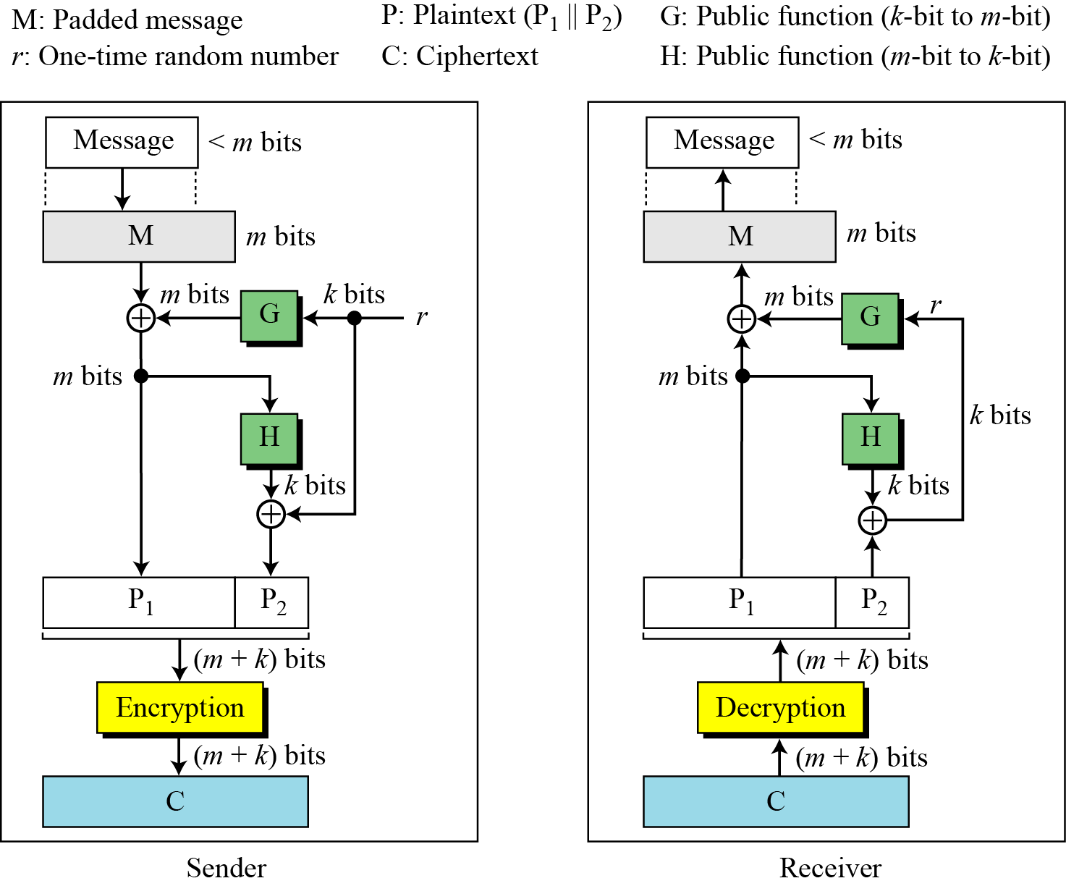
9.2.5 OAEP
Figure 9.9 Optimal asymmetric encryption padding (OAEP)

Slide 32
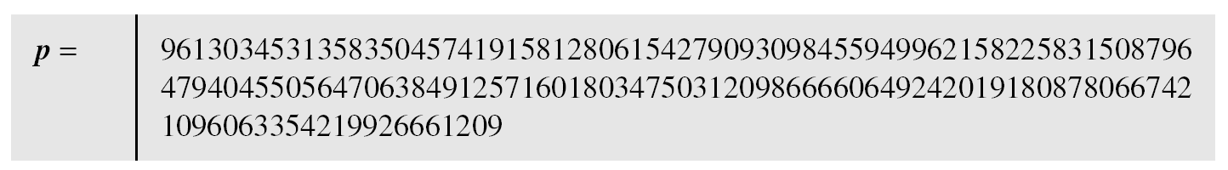
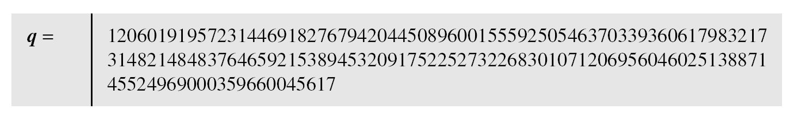
9.2.5 OAEP
Example 9.8
Here is a more realistic example. We choose a 512-bit p and q, calculate n and𝜙(n), then choose e and test for relative primeness with𝜙(n). We then calculate d. Finally, we show the results of encryption and decryption. The integer p is a 159-digit number.

Slide 33

9.2.5 OAEP
Example 9.8(continued)
The modulus n = p × q. It has 309 digits.
$φ$(n) = (p − 1)(q − 1) has 309 digits.

Slide 34

9.2.5 OAEP
Example 9.8(continued)
Bob chooses e = 35535 (the ideal is 65537) and tests it to make sure it is relatively prime with f(n). He then finds the inverse of e modulo $φ$(n) and calls it d.

Slide 35
9.2.5 OAEP
Example 9.8(continued)
Alice wants to send the message “THIS IS A TEST”, which can be changed to a numeric value using the 00−26 encoding scheme (26 is the space character).
The ciphertext calculated by Alice is C = P^{e}, which is

Slide 36
9.2.5 OAEP
Example 9.8(continued)
Bob can recover the plaintext from the ciphertext using P = C^{d}, which is
The recovered plaintext is “THIS IS A TEST” after decoding.

Slide 37
9.3 RABIN CRYPTOSYSTEM

Slide 38
9.3 RABIN CRYPTOSYSTEM
The Rabin cryptosystem can be thought of as an RSA cryptosystem in which the value of e and d are fixed. The encryption is C ≡ P² (mod n) and the decryption is P ≡ C^{1/2} (mod n).

Slide 39
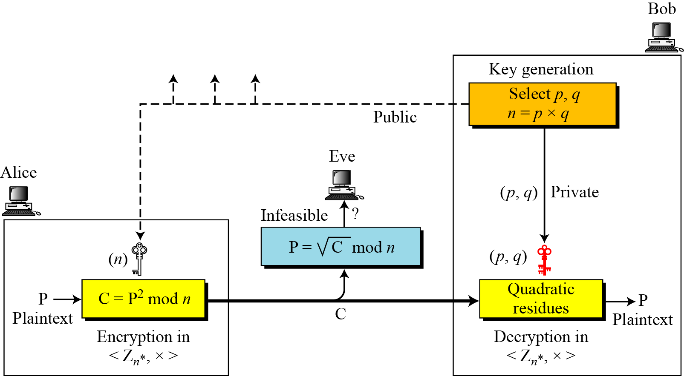
9.3 RABIN CRYPTOSYSTEM
Figure 9.10 Rabin cryptosystem

Slide 40
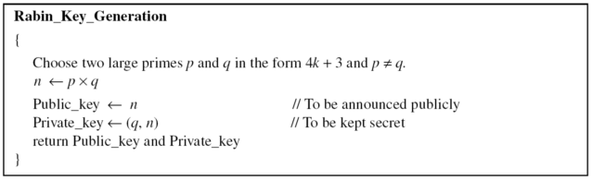
9.3.1 Procedure
Key Generation
Algorithm 9.5 Key Generation for Rabin cryptosystem

Slide 41
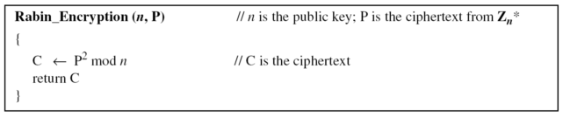
9.3.1 Procedure
Encryption
Algorithm 9.6 Encryption in Rabin cryptosystem

Slide 42
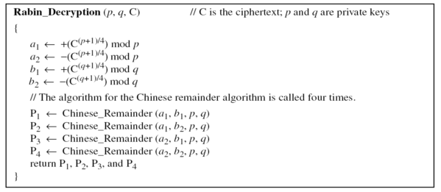
9.3.1 Procedure
Decryption
Algorithm 9.7 Decryption in Rabin cryptosystem

Slide 43
9.3.1 Procedure
Note
The Rabin cryptosystem is not deterministic: Decryption creates four plaintexts.

Slide 44
9.3.1 Procedure
Example 9.9
Here is a very trivial example to show the idea.
1.Bob selects p = 23 and q = 7. Note that both are congruent to 3 mod 4.
2.Bob calculates n = p × q = 161.
3.Bob announces n publicly; he keeps p and q private.
4.Alice wants to send the plaintext P = 24. Note that 161 and 24 are relatively prime; 24 is in Z₁₆₁*. She calculates C = 242 = 93 mod 161, and sends the ciphertext 93 to Bob.

Slide 45
9.3.1 Procedure
Example 9.9(continued)
5.Bob receives 93 and calculates four values: a1 = +(93 ^{(23+1)/4}) mod 23 = 1 mod 23 a2 = −(93 ^{(23+1)/4}) mod 23 = 22 mod 23 b1 = +(93 ^{(7+1)/4}) mod 7 = 4 mod 7 b2 = −(93 ^{(7+1)/4}) mod 7 = 3 mod 7
6.Bob takes four possible answers, (a₁, b₁), (a₁, b₂), (a₂, b₁), and (a₂, b₂), and uses the Chinese remainder theorem to find four possible plaintexts: 116, 24, 137, and 45. Note that only the second answer is Alice’s plaintext.

Slide 46
9.4 ELGAMAL CRYPTOSYSTEM

Slide 47
9.4 ELGAMAL CRYPTOSYSTEM
Besides RSA and Rabin, another public-key cryptosystem is ElGamal. ElGamal is based on the discrete logarithm problem.

Slide 48
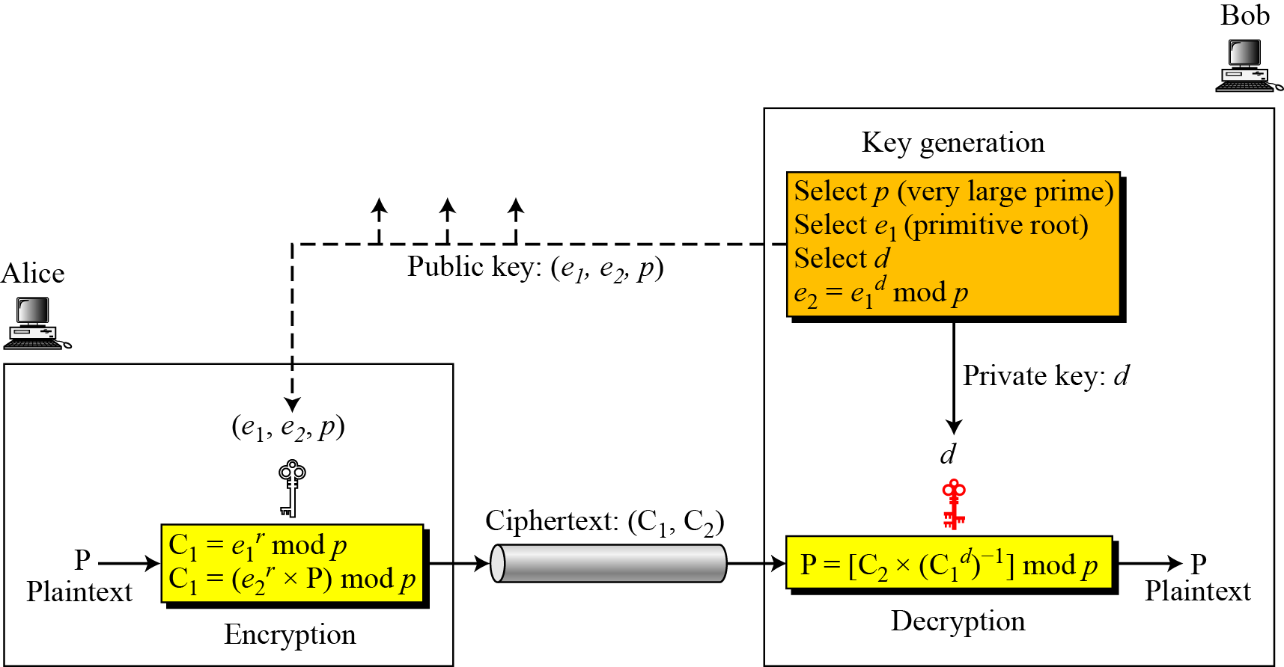
9.4.1 Procedure
Figure 9.11 Key generation, encryption, and decryption in ElGamal
cryptosystem

Slide 49
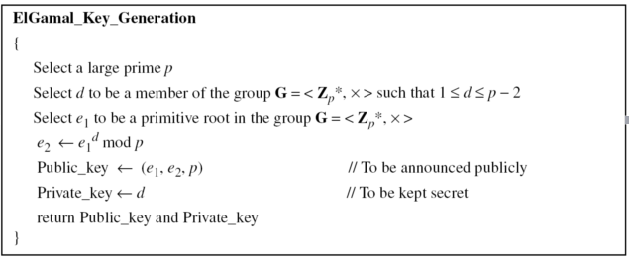
9.4.1 Procedure
Key Generation
Algorithm 9.8 Key Generation for ELGAMAL

Slide 50
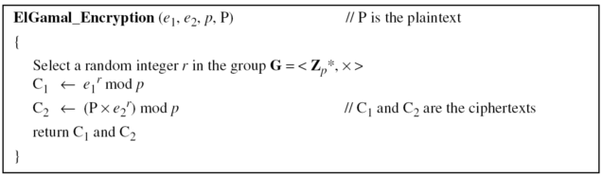
9.4.1 Procedure
Encryption
Algorithm 9.9 ELGAMAL Encryption

Slide 51
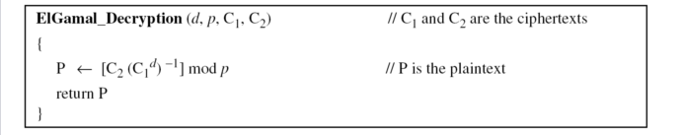
9.4.1 Procedure
Decryption
Algorithm 9.10 ELGAMAL Decryption
Note
The bit-operation complexity of encryption or decryption in ElGamal cryptosystem is polynomial.

Slide 52
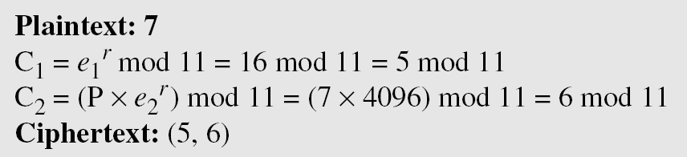
9.4.1 Procedure
Example 9.10
Here is a trivial example. Bob chooses p = 11 and e₁ = 2. and d = 3 e₂ = e₁^{d} = 8. So the public keys are (2, 8, 11) and the private key is 3. Alice chooses r = 4 and calculates C1 and C2 for the plaintext 7.
Bob receives the ciphertexts (5 and 6) and calculates the plaintext.

Slide 53
9.4.1 Procedure
Example 9.11
Instead of using P = [C₂ × (C₁^{d}) ⁻¹] mod p for decryption, we can avoid the calculation of multiplicative inverse and use P = [C₂ × C₁ ^{p−1−d}] mod p (see Fermat’s little theorem in Chapter 9). In Example 10.10, we can calculate P = [6 × 5 ¹¹⁻¹⁻³] mod 11 = 7 mod 11.
Note
For the ElGamal cryptosystem, p must be at least 300 digits and r must be new for each encipherment.

Slide 54
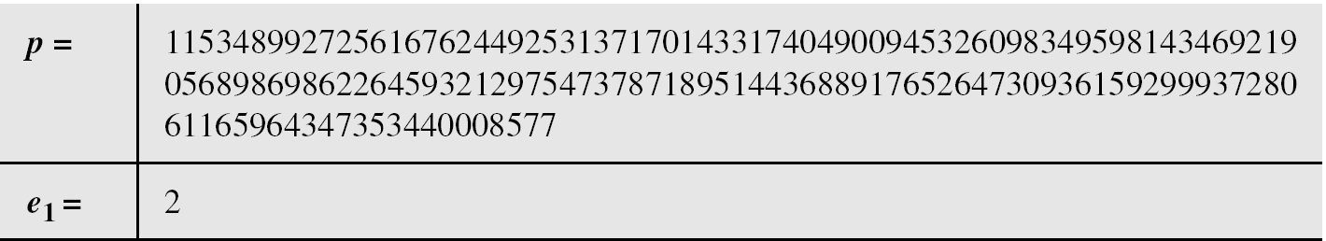
9.4.1 Procedure
Example 9.12
Bob uses a random integer of 512 bits. The integer p is a 155-digit number (the ideal is 300 digits). Bob then chooses e1, d, and calculates e2, as shown below:

Slide 55
9.4.1 Procedure
Example 9.12(continued)
Alice has the plaintext P = 3200 to send to Bob. She chooses r = 545131, calculates C₁ and C₂, and sends them to Bob.
Bob calculates the plaintext P = C₂ × ((C₁)d)−1 mod p = 3200 mod p.

Slide 56
9.5 ELLIPTIC CURVE CRYPTOSYSTEMS

Slide 57
9.5 ELLIPTIC CURVE CRYPTOSYSTEMS
Although RSA and ElGamal are secure asymmetric-key cryptosystems, their security comes with a price, their large keys. Researchers have looked for alternatives that give the same level of security with smaller key sizes. One of these promising alternatives is the elliptic curve cryptosystem (ECC).

Slide 58
9.5.1 Elliptic Curves over Real Numbers
The general equation for an elliptic curve is
Elliptic curves over real numbers use a special class of elliptic curves of the form

Slide 59
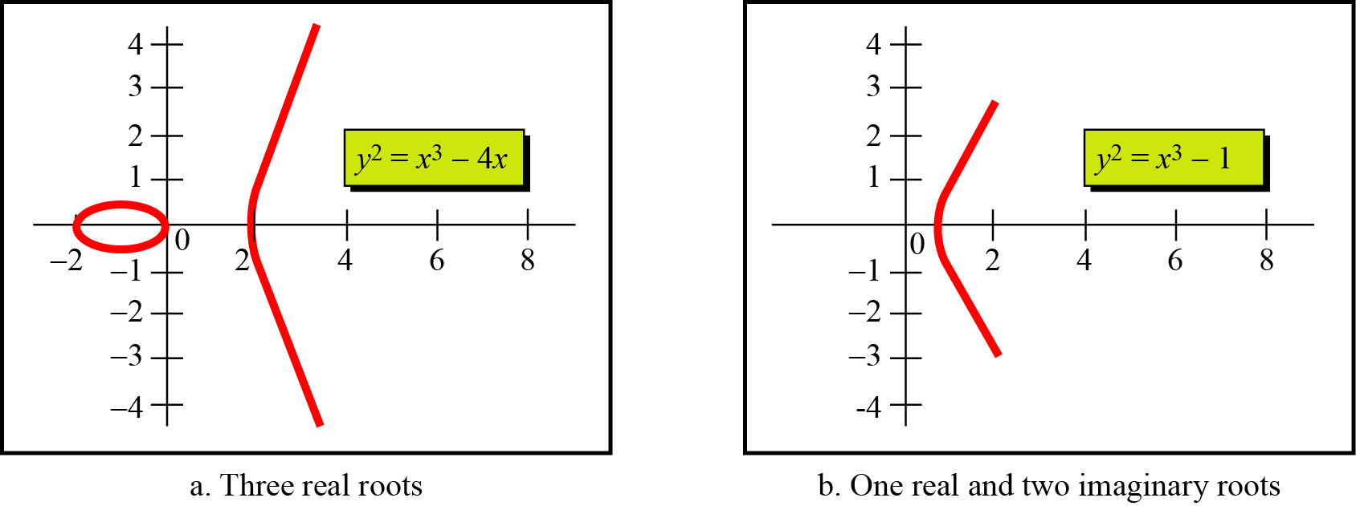
9.5.1 Elliptic Curves over Real Numbers
Example 9.13
Figure 9.12 shows two elliptic curves with equations y² = x³ − 4x and y² = x³ − 1. Both are nonsingular. However, the first has three real roots (x = −2, x = 0, and x = 2), but the second has only one real root (x = 1) and two imaginary ones.
Figure 9.12 Two elliptic curves over a real field

Slide 60
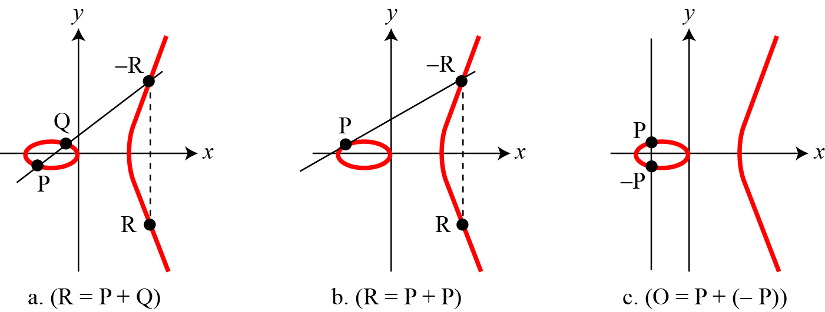
9.5.1 Elliptic Curves over Real Numbers
Figure 9.13 Three adding cases in an elliptic curve

Slide 61
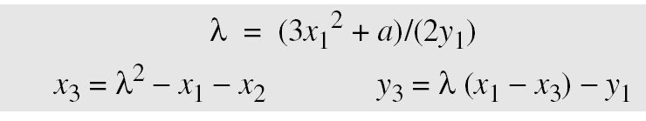
9.5.1 Elliptic Curves over Real Numbers
1.
2.
3.The intercepting point is at infinity; a point O as the point at infinity or zero point, which is the additive identity of the group.

Slide 62
9.5.2 Elliptic Curves over GF( p)
Finding an Inverse
The inverse of a point (x, y) is (x, −y), where −y is the additive inverse of y. For example, if p = 13, the inverse of (4, 2) is (4, 11).
Finding Points on the Curve
Algorithm 9.11 shows the pseudocode for finding the points on the curve Ep(a, b).

Slide 63
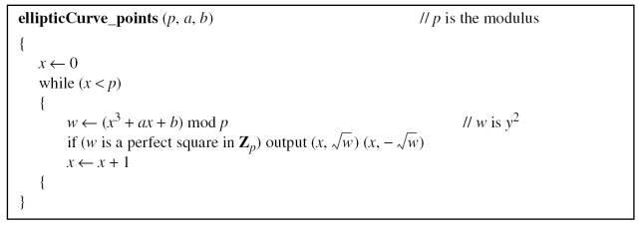
9.5.2 Elliptic Curves over GF( p)
Algorithm 9.11 Pseudocode for finding points on an elliptic curve

Slide 64
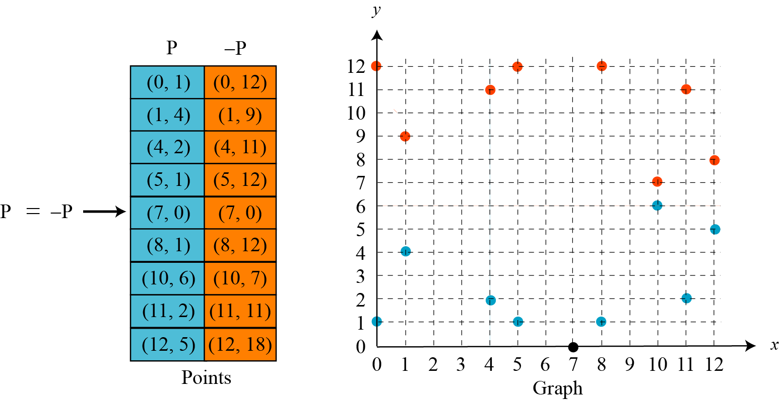
9.5.2 Elliptic Curves over GF( p)
Example 9.14
The equation is y² = x³ + x + 1 and the calculation is done modulo 13.
Figure 9.14 Points on an elliptic curve over GF(p)

Slide 65
9.5.2 Elliptic Curves over GF( p)
Example 9.15
Let us add two points in Example 9.14, R = P + Q, where P = (4, 2) and Q = (10, 6).
a. λ = (6 − 2) × (10 − 4)−1 mod 13 = 4 × 6−1 mod 13 = 5 mod 13.
b. x = (52 − 4 −10) mod 13 = 11 mod 13.
c. y = [5 (4 −11) − 2] mod 13 = 2 mod 13.
d. R = (11, 2), which is a point on the curve in Example 9.14.
13.
How about E23(1,1), let P=(3, 10) and Q=(9,7), P + Q? 2P?

Slide 66
9.5.3 Elliptic Curves over GF( 2^{n})
To define an elliptic curve over GF(2^{n}), one needs to change the cubic equation. The common equation is
Finding inverse
If P = (x, y), then −P = (x, x + y).
Finding Points on the Curve
We can write an algorithm to find the points on the curve using generators for polynomials. This algorithm is left as an exercise. Following is a very trivial example.

Slide 67
9.5.3 Elliptic Curves over GF( 2^{n})
Example 9.16
We choose GF(2³) with elements {0, 1, g, g², g³, g⁴, g⁵, g⁶} using the irreducible polynomial of f(x) = x³ + x + 1, which means that g³ + g + 1 = 0 or g³ = g + 1. Other powers of g can be calculated
accordingly. The following shows the values of the g’s.

Slide 68
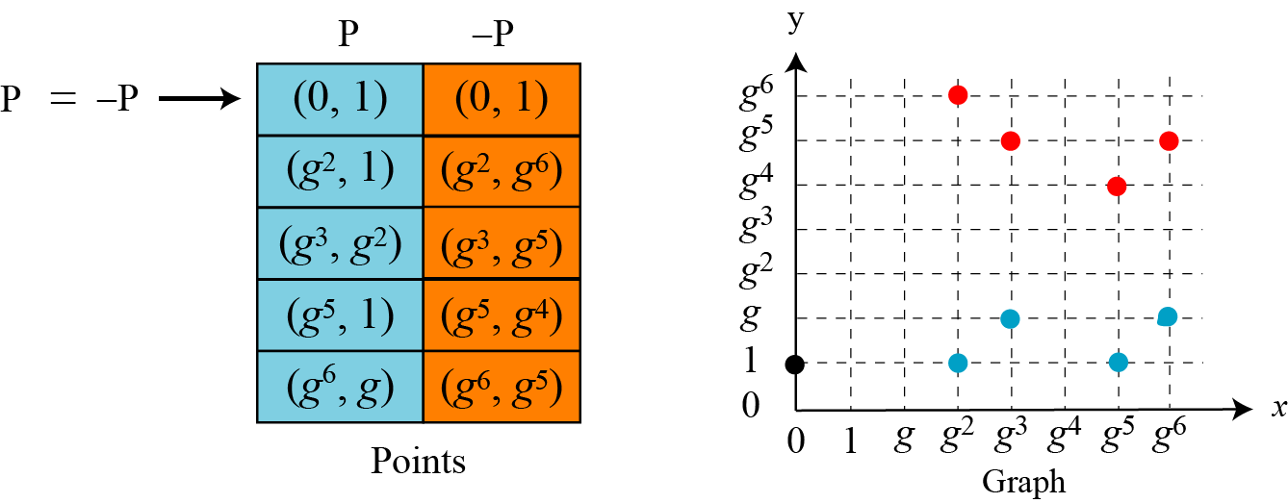
9.5.3 Elliptic Curves over GF( 2^{n})
Example 9.16(continued)
Using the elliptic curve y² + xy = x³ + g³x² + 1, with a = g³ and b = 1, we can find the points on this curve, as shown in Figure 9.15.
Figure 9.15 Points on an elliptic curve over GF(2n)

Slide 69
9.5.3 Elliptic Curves over GF( 2^{n})
Add two ponits
1. If P = (x₁, y₁), Q = (x₂, y₂), Q ≠ −P, and Q ≠ P, then R = (x₃, y₃)= P + Q can be found as
If Q = P, then R = P + P (or R = 2P) can be found as

Slide 70
9.5.3 Elliptic Curves over GF( 2^{n})
Example 9.17
Let us find R = P + Q, where P = (0, 1) and Q = (g², 1).
We have λ = 0 and R = (g⁵, g⁴).
Example 9.18
Let us find R = 2P, where P = (g², 1). We have λ = g² + 1/g² = g² + g⁵ = g + 1 and R = (g⁶, g⁵).

Slide 71
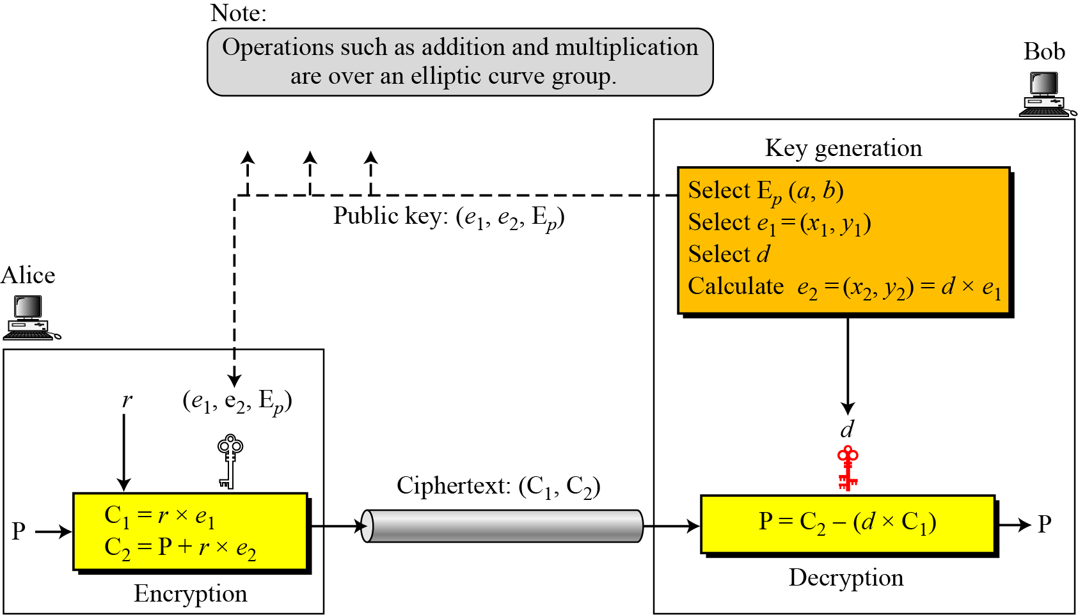
9.5.4 ECC Simulating ElGamal
Figure 9.16 ElGamal cryptosystem using the elliptic curve

Slide 72
9.5.4 ECC Simulating ElGamal
Generating Public and Private Keys
E(a, b) e₁(x₁, y₁) d e₂(x₂, y₂) = d × e₁(x₁, y₁)
Encryption
Decryption
Note
The security of ECC depends on the difficulty of solving the elliptic curve logarithm problem.

Slide 73
9.5.4 ECC Simulating ElGamal
Example 9.19
1.Bob selects E₆₇(2, 3) as the elliptic curve over GF(p).
2.Bob selects e₁ = (2, 22) and d = 4.
3.Bob calculates e₂ = (13, 45), where e₂ = d × e₁.
4.Bob publicly announces the tuple (E, e₁, e₂).
5.Alice sends the plaintext P = (24, 26) to Bob. She selects r = 2.
6.Alice finds the point C₁=(35, 1), C₂=(21, 44).
7.Bob receives C₁, C₂. He uses 4xC₁(35,1) to get (23, 25), inverts the points (23, 25) to get the points (23, 42).
8.Bob adds (23, 42) with C₂=(21, 44) to get the original one P=(24, 26).

Slide 74
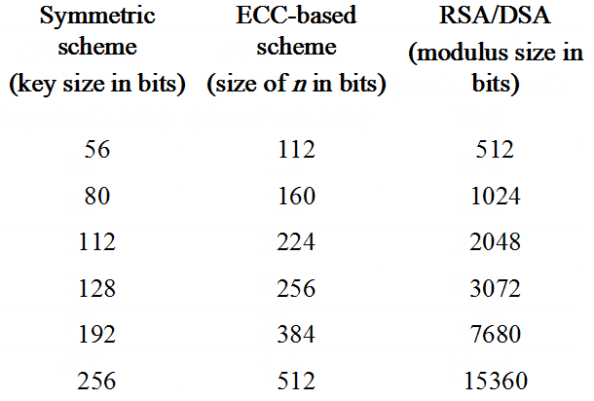
9.5.5 Comparable Key Sizes for Equivalent Security

