Slide 1
第二讲 场景设置： 基本准则
应用密码学

Slide 2
Learning Outcomes
Justify the need for information security.
Identify some of the essential security requirements of the modern world.
Appreciate the most significant risks to which information is exposed.
Identify a number of different security services that cryptography can provide.
Describe the basic model of a cryptosystem.
Recognise the differences between symmetric and public-key cryptosystems.
Appreciate the importance of identifying the assumptions about what an attacker knows about a cryptosystem.
Discuss what it means to break a cryptosystem.

Slide 3
Sections
Why information security?
The security risks
Security services
The basic model of a cryptosystem
Security assumptions
Breaking cryptosystems

Slide 4
1. Why information security?

Slide 5
Importance of information security
Information is not a new concept
Cryptography is not a new subject
?
Why have we seen a steady increase in the perceived importance of information (cyber) security, and hence of cryptography?

Slide 6
Essence of information security
Let’s (try to!) imagine a “computer-free” office of the distant past, where there are no computers and no digital networks.
?
What are the basic security processes in this mainly physical world that help us to make security decisions about information that we receive?

Slide 7
Essence of information security
Now imagine a modern fully networked office environment. Let’s suppose that nobody has implemented any information security controls.
How do you identify the sender of a file?
Can anyone else read an email that you send to a colleague?
How do you sign a contract?
Is this a more secure environment than the old office?
?

Slide 8
Basic security requirement
The basic security requirement is the need for the translation of the fundamental security mechanisms used in the physical world into mechanisms suitable for application in a digital environment.
A central aim of this course is to demonstrate precisely what role cryptography plays in this translation process.

Slide 9
Business perspective
For businesses, operating in cyberspace presents opportunities and cost savings.
It also introduces a number of significant risks (not all of which some businesses are aware).
The benefits of operating in cyberspace need to outweigh the risks.

Slide 10
Individual perspective
Individuals have a right to use cryptography as they see fit.
Cryptography enables perceived rights such as privacy and freedom of expression.

Slide 11
Government perspective
Governments have conflicting requirements with respect to information security…
On the one hand they may wish to promote competitive business by reducing costs and obstacles to business operation, such as reducing trade barriers and harmonising laws and regulations.
On the other hand, governments may wish to control crime and manage issues of national security by imposing certain barriers and introducing other laws and regulations.

Slide 12
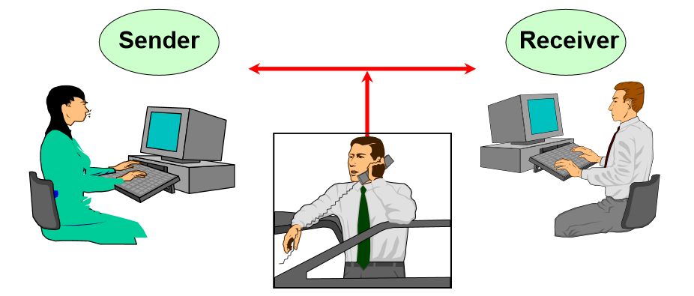
Who are the good guys?

Slide 13
The importance of security infrastructure
All security (cryptographic) technologies require a supporting security infrastructure:
This includes the policies, procedures and ongoing management to make sure that the technology does its intended job.

Slide 14
2. The security risks

Slide 15
Risks to information
Passive attacks
Unauthorised access to information
Active attacks
Unauthorised alteration
Unauthorised deletion
Unauthorised transmission
Falsification of origin of information
Unauthorised prevention of access to information

Slide 16
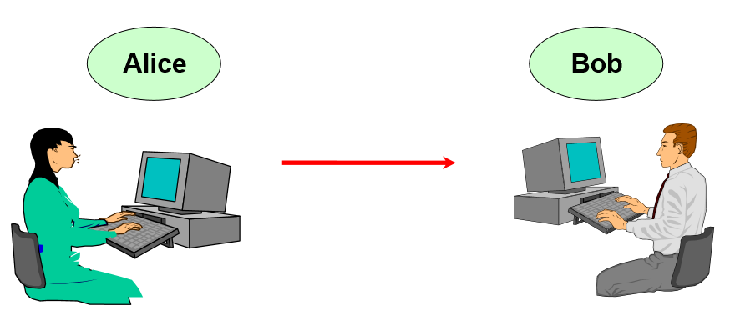
A simple scenario

Slide 17
Security issues
If Alice and Bob are to have any assurances about the security of the communication that they have just exchanged then they must ask themselves some serious questions.
What questions should Alice be thinking about before she sends her information to Bob?
After he has received the information, what questions should Bob be contemplating with regard to his newly received information?
?

Slide 18
Choosing a security mechanism
Appropriateness
One aim of this module is to explain what types of job the tools of cryptography can be used for.
Strength
Why put in an expensive burglar alarm in situations where a warning sign would suffice?
Cost
Cost can be measured in terms of ease of use, efficiency to operate, as well as directly in terms of financial worth.

Slide 19
3. Security services

Slide 20
More than confidentiality
Many people assume that cryptography is used to provide confidentiality of data, which is the assurance that data can not be accessed by an unauthorised entity.
For many applications, confidentiality is not the most important security service. Can you provide some examples?
?

Slide 21
Security services
Confidentiality
the assurance that data cannot be viewed by an unauthorised entity (sometimes referred to as secrecy).
Data integrity
the assurance that data has not been altered in an unauthorised (which includes accidental) manner since the time that the data was last created, transmitted or stored by an authorised entity.
Data origin authentication
the assurance that a given entity was the original source of some data (sometimes referred to as message authentication).
Entity authentication
the assurance that a given entity is involved and currently active in a communication session (sometimes referred to as identification).
Non-repudiation
the assurance that an entity cannot deny any previous commitments or actions (normally with respect to origin of data).

Slide 22
Terminology minefield!
Can you think of potential problems with the words:
entity?
integrity?
authentication??
?

Slide 23
Some relationships between services
Data origin authentication is a stronger version of data integrity
Non-repudiation of a source is a stronger notion than data origin authentication
Data origin authentication and entity authentication are different!
Data origin authentication plus a freshness check can provide entity authentication
Confidentiality does not imply data origin authentication

Slide 24
Some relationships between services
Data origin authentication is a stronger version of data integrity
Non-repudiation of a source is a stronger notion than data origin authentication
Data origin authentication and entity authentication are different!
Data origin authentication plus a freshness check can provide entity authentication
Confidentiality does not imply data origin authentication

Slide 25
4. The basic model of a cryptosystem

Slide 26
Concepts
Cryptography
Cryptology
Cryptographic primitive
Cryptographic algorithm
Cryptographic protocol
Cryptosystem

Slide 27
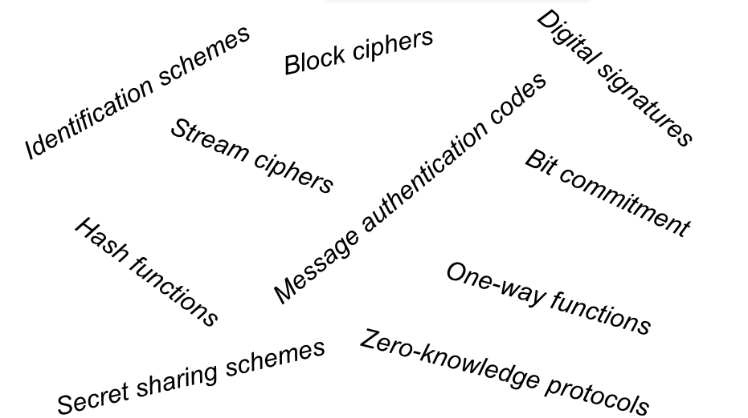
Cryptographic primitives

Slide 28
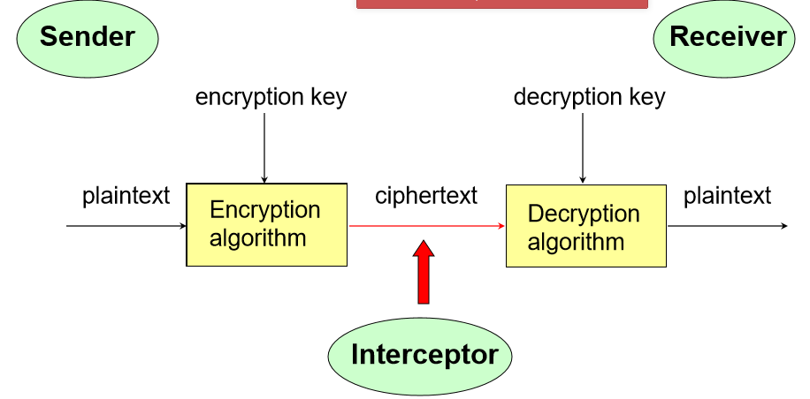
A cryptosystem (for encryption)

Slide 29
Three important questions
Can cryptography prevent a communication from being intercepted?
?

Slide 30
Three important questions
2. Which of the following need to be kept secret?
Encryption algorithm
Decryption algorithm
Encryption key
Decryption key?
?

Slide 31
Three important questions
3. Does choosing a good encryption algorithm guarantee the confidentiality of a message?
?

Slide 32
Is this a cryptosystem?
Which of the following is a cryptosystem?
Morse Code
Replacing each word you speak with another secret word that you agree with a friend (rather like talking in riddles)
Embedding a secret image into a jpeg file
?

Slide 33
Symmetric cryptosystems
In symmetric cryptosystems the decryption key is easily obtained from (the same as) the encryption key.
All practical cryptosystems prior to the 1980’s were symmetric cryptosystems. Indeed symmetric cryptosystems are still heavily use today and there is no sign that their importance is fading.
The study of symmetric cryptosystems is often referred to as symmetric cryptography.

Slide 34
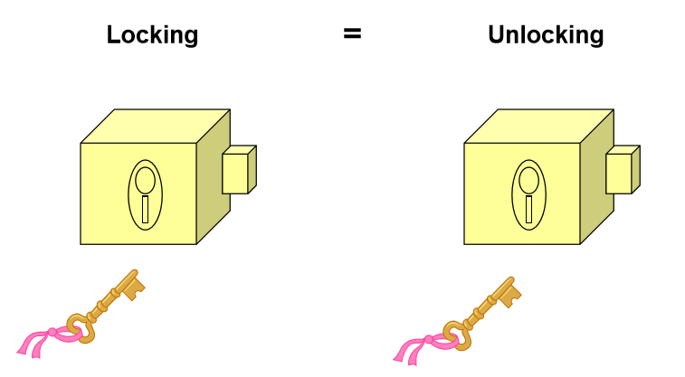
Symmetric cryptosystems

Slide 35
Public key cryptosystems
In public key cryptosystems it is computationally infeasible (practically impossible) to determine the decryption key from the encryption key. The encryption key and the decryption key are thus different.
For this reason, public key cryptosystems are sometimes referred to as asymmetric cryptosystems.
The study of public key cryptosystems is often referred to as public key cryptography.

Slide 36
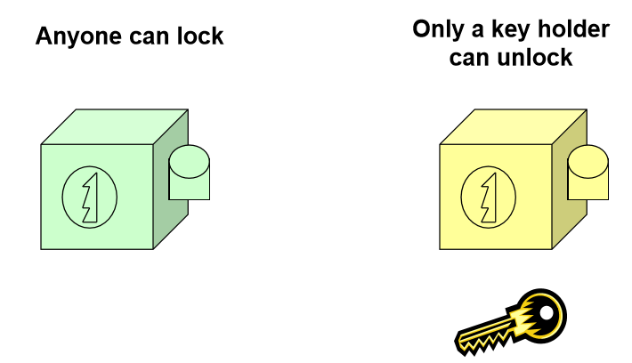
Public key cryptosystems

Slide 37
Which is better?
The concept of public key cryptography seems extremely attractive for a number of different applications. However, public key cryptography comes with its own set of problems…
One of the main aims of this module is to explain the advantages and disadvantages of using symmetric and public key cryptosystems.
Symmetric and public key cryptosystems are often both implemented and used together in real systems.

Slide 38
5. Security assumptions

Slide 39
Standard assumptions
We normally assume that the attacker knows:
All ciphertexts sent using the cryptosystem
Some corresponding pairs of plaintexts and ciphertexts
The encryption algorithm
In a public key cryptosystem the attacker will also know:
All encryption keys used to encrypt the ciphertexts

Slide 40
Rationale for standard assumptions
Are these standard assumptions reasonable? •All ciphertexts sent using the cryptosystem
• Some corresponding pairs of plaintexts and ciphertexts
• The encryption algorithm
For each of the standard assumptions, under what circumstances do you think it is reasonable to assume that an attacker has the specified information?
?

Slide 41
Example attack models
Ciphertext-only attack
– The attacker only possesses some ciphertext
Known plaintext attack
– The attackers possesses some corresponding pairs of plaintext and ciphertext
Chosen plaintext attack
– The attacker has temporary access to the encryption process and hence can choose plaintexts and generate the corresponding ciphertexts

Slide 42
Public v proprietary algorithms
Publicly known encryption algorithm Everyone knows the details of the algorithm ➢
Proprietary encryption algorithm Only the system designers knows the details of the algorithm (an attacker may well know the name of the algorithm, and certain basic properties, but they will not know any of the details of how it performs the encryption process.)
Which is better?
?

Slide 43
6. Breaking cryptosystems

Slide 44
“Breaking” a cryptosystem
A cryptosystem is often referred to as being broken if a method of determining the plaintext from the cipher text is found that does not involve being legitimately given the decryption key.
A cryptosystem is usually broken either by:
Finding a way of determining the decryption key
Finding a way of determining the plaintext directly

Slide 45
What does “broken” really mean?
The term “break” is of course subjective
What is “broken” for one application may not be for another
Most cryptosystems are “broken” without “breaking” the encryption algorithm
Weaknesses in key management are more commonly exploited

Slide 46
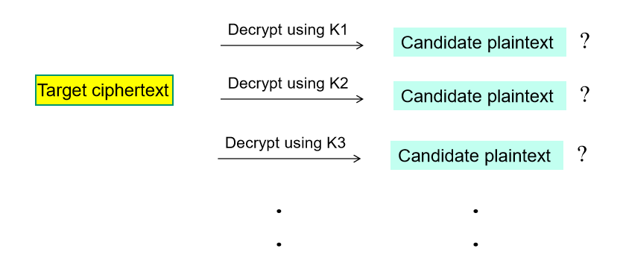
Every algorithm can be broken!
There is one attack that can be applied to any known encryption algorithm. An exhaustive key search involves decrypting the cipher text sequentially with every possible decryption key until the correct decryption key is found.

Slide 47
Exhaustive key search
How will an attacker conducting an exhaustive key search know when they have found the correct decryption key?
What must you do to protect against an exhaustive key search?
?

Slide 48
Key length
The number of (decryption) keys in a cryptosystem is often referred to as the size of the keyspace.
We often represent this by the key length (size):
for symmetric cryptosystems, the key length determines the size of the key space:
key length = 4 size of keyspace = 2x2x2x2 = 16
for public key cryptosystems, the key length only provides an indication of the size of the key space.

Slide 49
Exhaustive key search
By estimating the resources available to an attacker we can try to calculate the time that an attacker would take to conduct an exhaustive key search.
One approach that we could take is
Estimate the amount of time that it takes an attacker to try out one decryption key.
Use that estimate to assess how long an exhaustive key search might take.

Slide 50
Exhaustive key search
If the size of the key space of an encryption algorithm is 2^{k} then the laws of probability tell us that we can expect to find the correct decryption key after 2^{k-1} attempts.

Slide 51
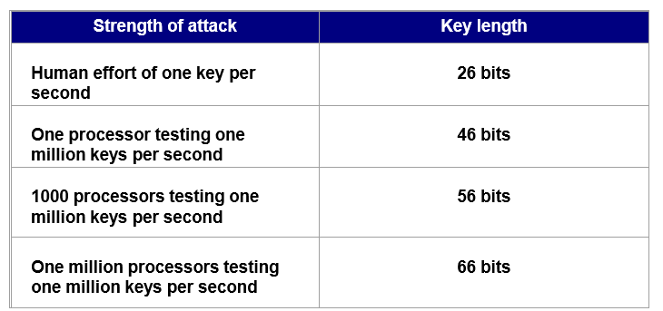
Exhaustive key search
To protect against a year long exhaustive key search: There are approximately 3 x 10⁷ seconds (this is approximately 2²⁵ seconds) in a year.

Slide 52
Classes of attacks
Generic attacks
Exhaustive key search
Dictionary attacks
Time-memory trade-off attacks
Attacks specific to certain classes of cryptosystem
Meet-in-the-middle attacks
Birthday attacks
Differential/linear cryptanalysis

Slide 53
Side channel attacks
Timing attacks
Measuring computation time
Differential power analysis
Measuring power consumption
Differential fault analysis
Introducing errors
Padding attacks
Utilising error messages

Slide 54
“Academic” breaks
Be careful of when hearing stories about encryption algorithms being broken.
Many attacks that are significant from a design perspective may be completely infeasible in practice.
If generic attacks (such as exhaustive key search) are sufficiently infeasible, then so are many attacks that are significantly faster than them!

Slide 55
Word of warning!!!
Almost all cryptosystems as described on this module can be broken!!!

Slide 56
Summary
Cryptography provides the technical means to replicate some of the key security requirements of the physical world in an electronic environment.
Cryptography can offer strong protection, but only against certain specific threats. It is important to be aware of the security threats that cryptography does not protect against.
There are two different types of cryptosystem, symmetric and public key, each with their own properties.
In order to assess the security offered by a cryptosystem, it is extremely important to make certain assumptions about what an attacker can do, and what resources they might make available to attack the cryptosystem.

