Slide 1
第三讲 场景设置： 古典密码
应用密码学

Slide 2
Learning Outcomes
Describe a number of simple historical cryptosystems
Relate a number of historical cryptosystems to the basic model of a cryptosystem
Illustrate properties of these historical cryptosystems that make them unsuitable for modern use
Formulate some fundamental design principles for a modern cryptosystem

Slide 3
Sections
Monoalphabetic ciphers
Historical advances

Slide 4
1. Monoalphabetic ciphers

Slide 5
Cryptosystems in this unit
Please note that all the cryptosystems in this unit are:
Symmetric
Operate on alphabetic characters
Are not suitable for general modern use
However, they allow us to:
Illustrate the basic model of a cryptosystem
Learn some basic design principles

Slide 6
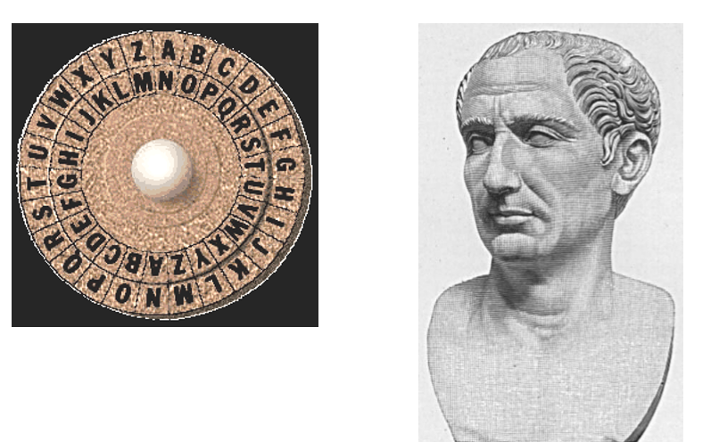
The Caesar Cipher

Slide 7
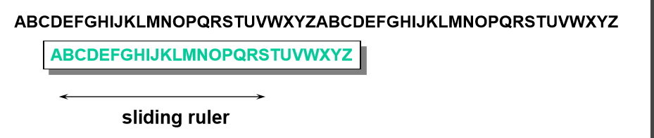
The Caesar Cipher

Slide 8
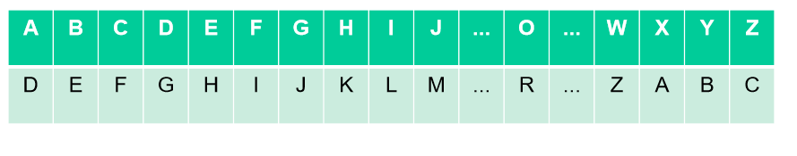
Caesar Cipher with a shift of 3

Slide 9
The Caesar Cipher
The Caesar Cipher is clearly unsuitable for modern use!
Identify at least two cryptographic weaknesses that result in the Caesar Cipher being regarded as insecure.
?

Slide 10
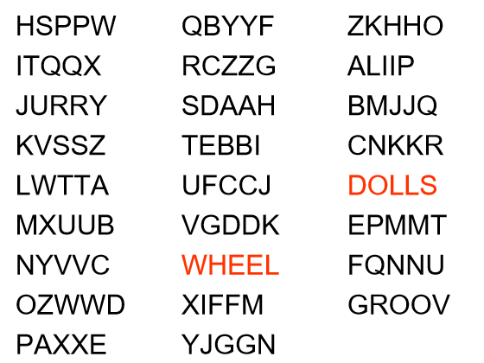
Ciphertext HSPPW

Slide 11
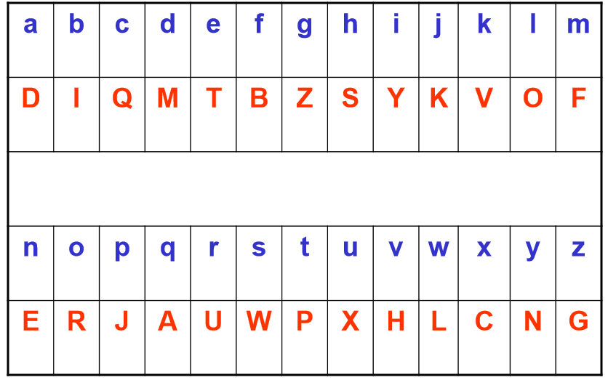
Simple Substitution Cipher

Slide 12
Substitution Cipher Examples
Decrypt the following ciphertexts
1 B TO T OTA
2 XAV
3 VBDDQD
4 VBDDQD (given it’s the name of a country)
5 ABXAZ OAZT CYE FCEOE UCZX HDR
?

Slide 13
Keyspace of the Substitution Cipher
The key space of the Simple Substitution Cipher is approximately 4 x 10²⁶, that is:
400 000 000 000 000 000 000 000 000
Just how big is that?
?

Slide 14
Keyspace of the Substitution Cipher
The key space of the Simple Substitution Cipher is approximately 4 x 10²⁶, that is:
400 000 000 000 000 000 000 000 000
There are an estimated 10²² stars in our universe.
The key space of DES is somewhere between 10¹⁶ and 10¹⁷.
?

Slide 15
Wise words
Having a large key space is necessary to prevent an exhaustive key search, but it is not sufficient to guarantee the security of a cryptosystem.
A large key is not a guarantee of security but a small key is a guarantee of insecurity.

Slide 16
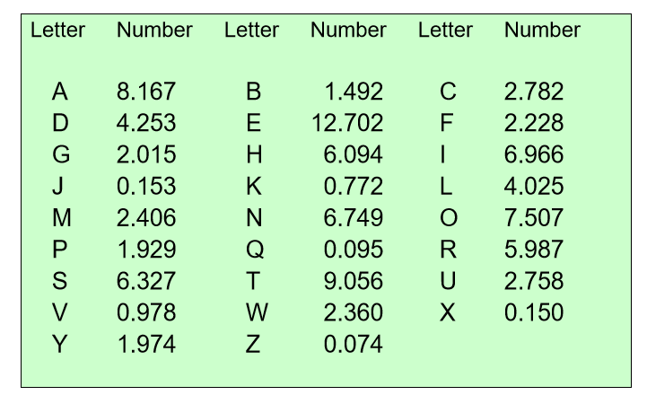
English letter frequencies

Slide 17
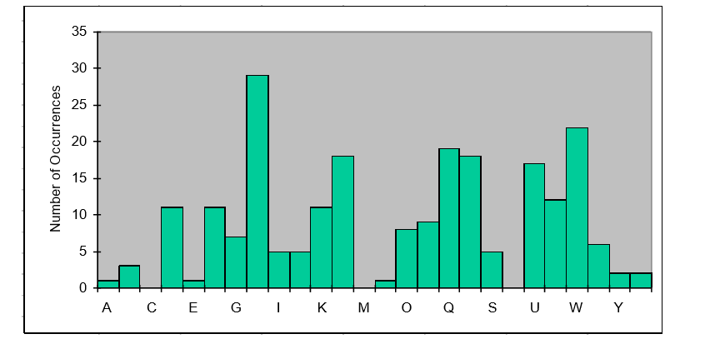
Substitution Cipher Histogram
A histogram showing the relative frequencies of the letters in a ciphertext that was obtained by using a simple substitution cipher.

Slide 18
Observations
The Simple Substitution Cipher leaks information about the plaintext even before detailed letter frequency analysis has been conducted.
Knowing the context of the plaintext can be helpful when conducting letter frequency analysis.
It is not necessary to determine the entire key before being able to decrypt the cipher text.

Slide 19
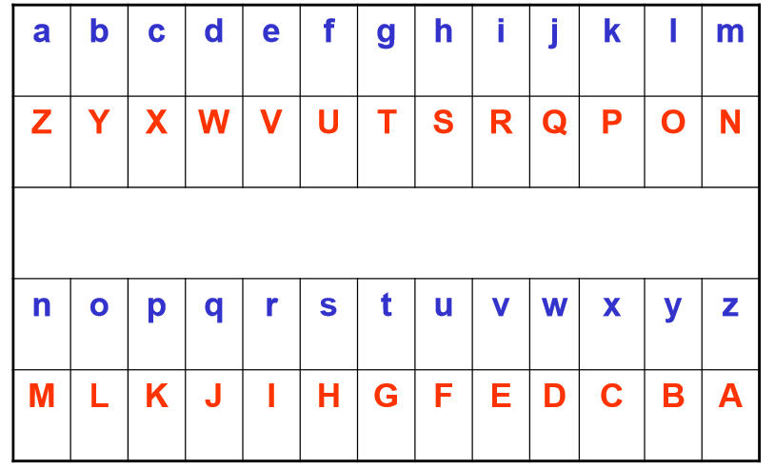
Atbash Cipher

Slide 20
2. Historical advances

Slide 21
Playfair Cipher
The Playfair Cipher operates on pairs of letters (bigrams).
The key is a 5x5 square consisting of every letter except J.
Before encrypting, the plaintext must be transformed::
Replace all J’s with I’s
Write the plaintext in pairs of letters…
…separating any identical pairs by a Z
If the number of letters is odd, add a Z to the end

Slide 22
Playfair Cipher: Encryption
If two plaintext letters lie in the same row then replace each letter by the one on its “right” in the key square
If two plaintext letters lie in the same column then replace each letter by the one “below” it in the key square
Else, replace:
First letter by letter in row of first letter and column of second letter in the key square
Second letter by letter in column of first letter and row of second letter in the key square

Slide 23
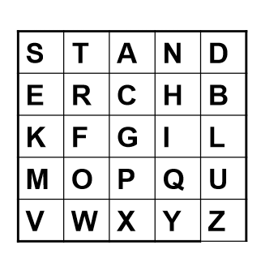
Playfair Cipher: Example
NATTERJACK TOAD
NA TZ TE RI AC KT OA DZ
DN DW SR HF CG FS PT BD

Slide 24
Playfair Cipher
In what way has the Playfair Cipher defeated single letter frequency analysis?
How might you try to decrypt a ciphertext that was encrypted using a Playfair Cipher, without knowing the key?
?

Slide 25
Homophonic Coding
A modification of the Simple Substitution Cipher
The idea is to replace some plaintext letters with different ciphertext characters in order to confuse the ciphertext character frequency statistics.

Slide 26
Homophonic Coding
A possible homophonic code is as follows:
Use a character alphabet of 1000.
use 82 different characters to encode A
use 15 different characters to encode B
use 1 character to encode J, Q, X and Z
etc.
How well do you think such a code will hold out against single letter frequency analysis?
Do you think that such a code is suitable for adoption in a practical environment?
?

Slide 27
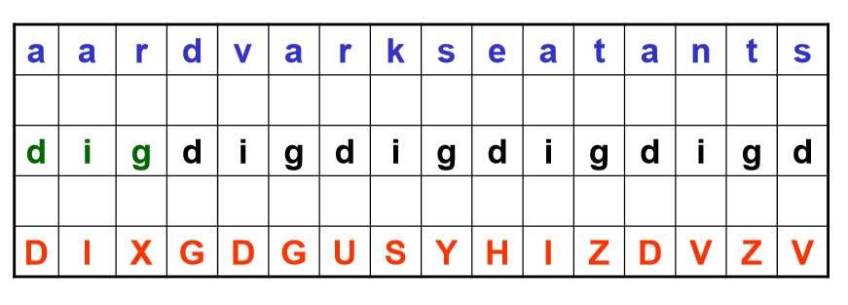
Vigenère Cipher

Slide 28
Vigenère Cipher
What is the size of the keyspace of the Vigenère Cipher?
How would you break the Vigenère Cipher?
?

Slide 29
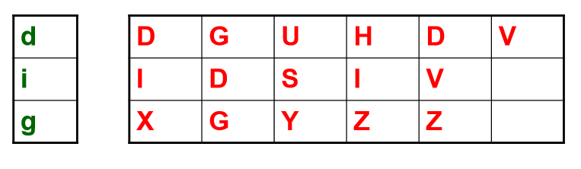
Cryptanalysis of Vigenère Cipher

Slide 30
Summary
A large key space alone does not guarantee security.
It is possible to break a cryptosystem without first determining the key.
The ciphertext produced by a cryptosystem should disguise the statistics of the plaintext alphabet.
Effective techniques for disguising plaintext statistics include:
Increasing the size of the plaintext alphabet
Replacing plaintext characters with more than one different ciphertext character
Introducing positional dependence
but these properties alone do not guarantee security.

