Slide 1
第五讲 密码学工具： 对称密码
应用密码学

Slide 2
Learning Outcomes
Identify some of the factors involved in selecting an encryption algorithm
Describe the model of a block cipher
Recall the basic design features and history of DES
Comment on the security issues surrounding modern use of DES
Explain the reasoning behind the basic specifications for AES
Describe and compare four different modes of operation of a block cipher
Describe the model of a stream cipher
Appreciate the types of application where a stream cipher is most appropriate

Slide 3
Sections
Encryption algorithms
A symmetric classification
Types of error
Components of a Modern Block Cipher
P-boxes.
S-Boxes.
Exclusive-or operation, Circular Shift, Swap, Split and Combine.
DES Structure
Initial and Final Permutations.
Round Function.
Cipher and Reverse Cipher.
Key generation

Slide 4
1. Encryption algorithms

Slide 5
Modern Block Ciphers
All the afternoon Mungo had been working on Stern's code, principally with the aid of the latest messages which he had copied down at the Nevin Square drop. Stern was very confident. He must be well aware London Central knew about that drop. It was obvious that they didn't care how often Mungo read their messages, so confident were they in the impenetrability of the code.
—Talking to Strange Men, Ruth Rendell

Slide 6
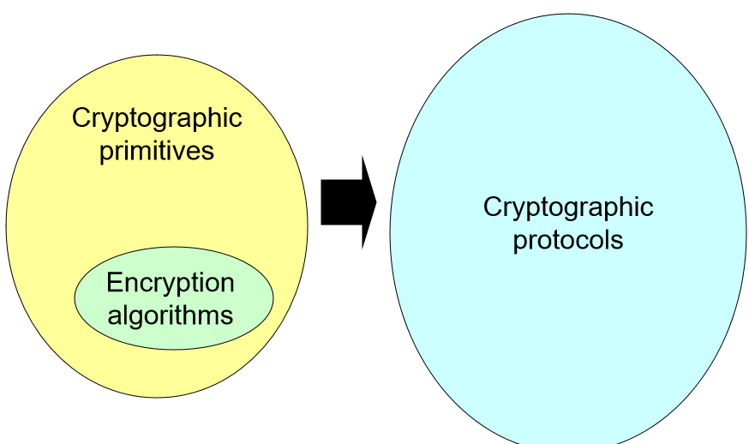
Encryption algorithms

Slide 7
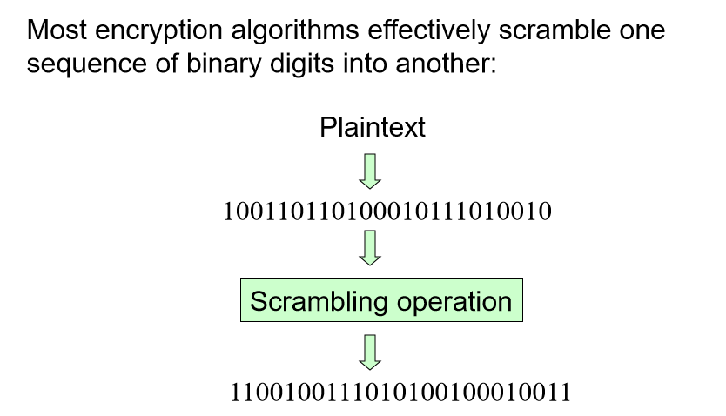
A symmetric classification

Slide 8
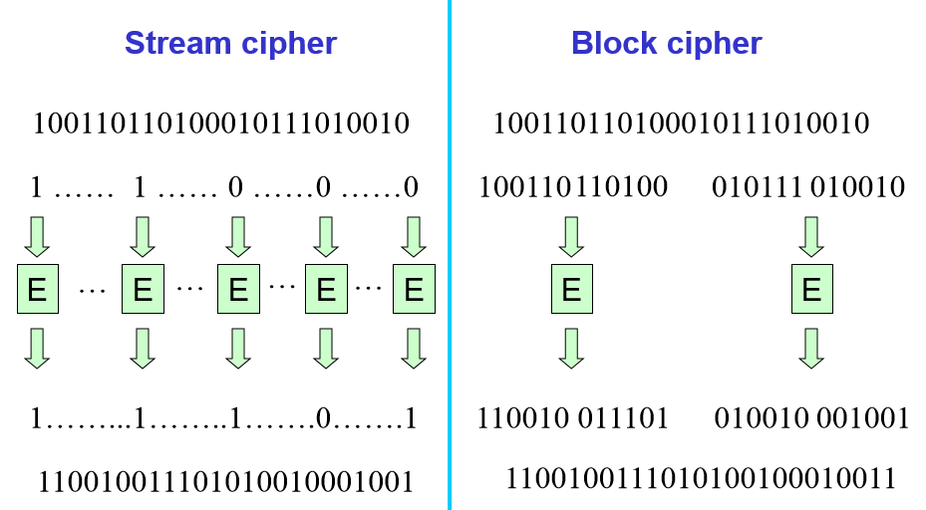
A symmetric classification

Slide 9
A word of warning
Our separation of stream and block ciphers is simplistic
Some stream ciphers (such as RC4) actually process plaintext in streams of bytes (and hence could be regarded as block ciphers with 8-bit blocks)
Block ciphers are often used in modes of operation that essentially convert them into stream ciphers

Slide 10
Types of error
The following errors can occur in any cryptosystem:
Transmission errors are errors (a 1 becomes a 0 or a 0 becomes a 1) that occur in the communication channel.
Transmission losses are bits that get lost (are dropped) in the communication channel.
Computational errors are errors that occur during a (cryptographic) computation.

Slide 11
Error propagation
A decryption process involves error propagation if a ciphertext input that has one incorrect bit produces a plaintext output that has more than one incorrect bit.

Slide 12
2. Components of a Modern Block Cipher

Slide 13
P-Boxes
Modern block ciphers normally are keyed substitution ciphers in which the key allows only partial mappings from the possible inputs to the possible outputs.
P-Boxes
A P-box (permutation box) parallels the traditional transposition cipher for characters. It transposes bits.

Slide 14
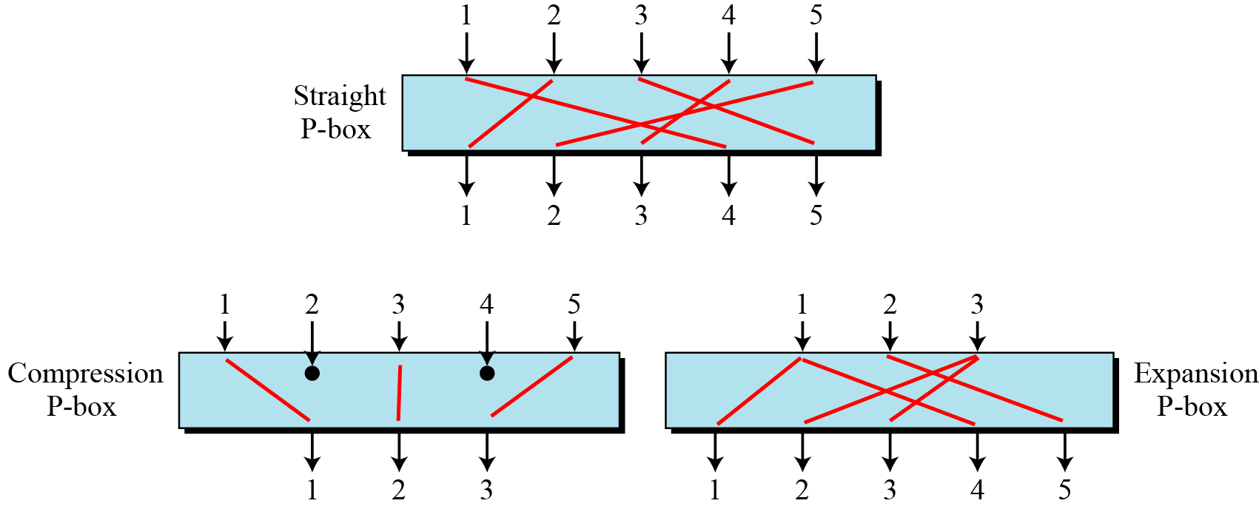
P-Boxes
Figure 4.1 Three types of P-boxes

Slide 15
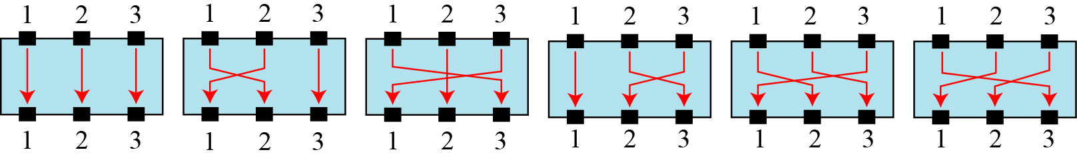
P-Boxes
Example 4.1
Figure 4.2 shows all 6 possible mappings of a 3 × 3 P-box.
Figure 4.2 The possible mappings of a 3 × 3 P-box

Slide 16
P-Boxes
Example 4.2
Table 4.1 shows a permutation table for a straight P-box.
Table 4.1 permutation table for a straight P-Box

Slide 17
P-Boxes
Exercise 4.1
Design an 8 × 8 permutation table for a straight P-box that moves the two middle bits (bits 4 and 5) in the input word to the two ends (bits 1 and 8) in the output words. Relative positions of other bits should not be changed.
Solution
We need a straight P-box with the table [4 1 2 3 6 7 8 5]. The relative positions of input bits 1, 2, 3, 6, 7, and 8 have not been changed, but the first output takes the fourth input and the eighth output takes the fifth input.

Slide 18
P-Boxes
Compression P-Boxes
A compression P-box is a P-box with n inputs and m outputs where m < n.
Example 4.3
Table 4.2 shows a permutation table for a compression P-box .
Table 4.2 A 32 × 24 permutation table

Slide 19
P-Boxes
Expansion P-Boxes
An expansion P-box is a P-box with n inputs and m outputs where m > n.
Example 4.4
Table 4.3 shows a permutation table for a compression P-box .
Table 4.3 A 12 × 16 permutation table

Slide 20
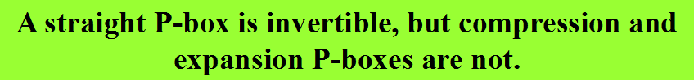
P-Boxes
P-Boxes: Invertibility

Slide 21
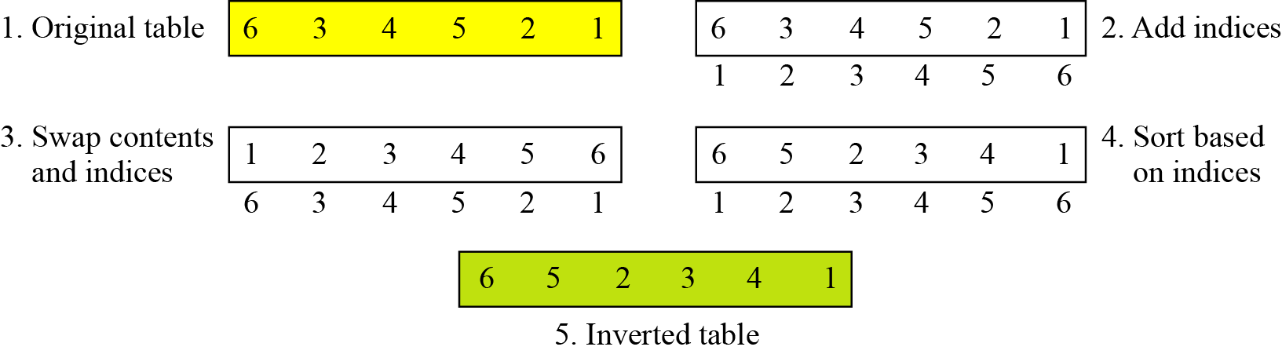
P-Boxes
Example 4.5
Figure 4.3 shows how to invert a permutation table represented as a one-dimensional table.
Figure 4.3 Inverting a permutation table

Slide 22
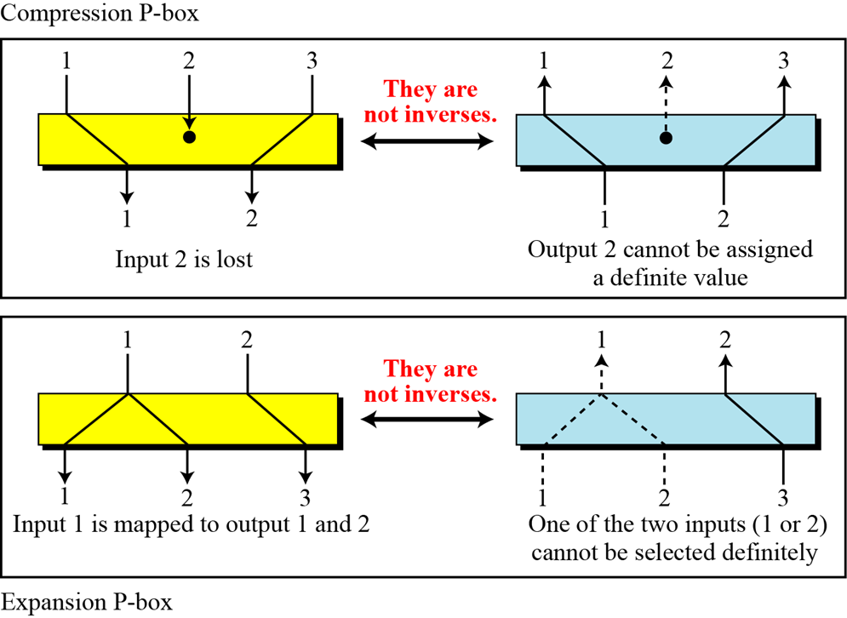
P-Boxes
Compression and expansion P-boxes are non-invertible

Slide 23
S-Boxes
S-Boxes
An S-box (substitution box) can be thought of as a miniature substitution cipher.

Slide 24
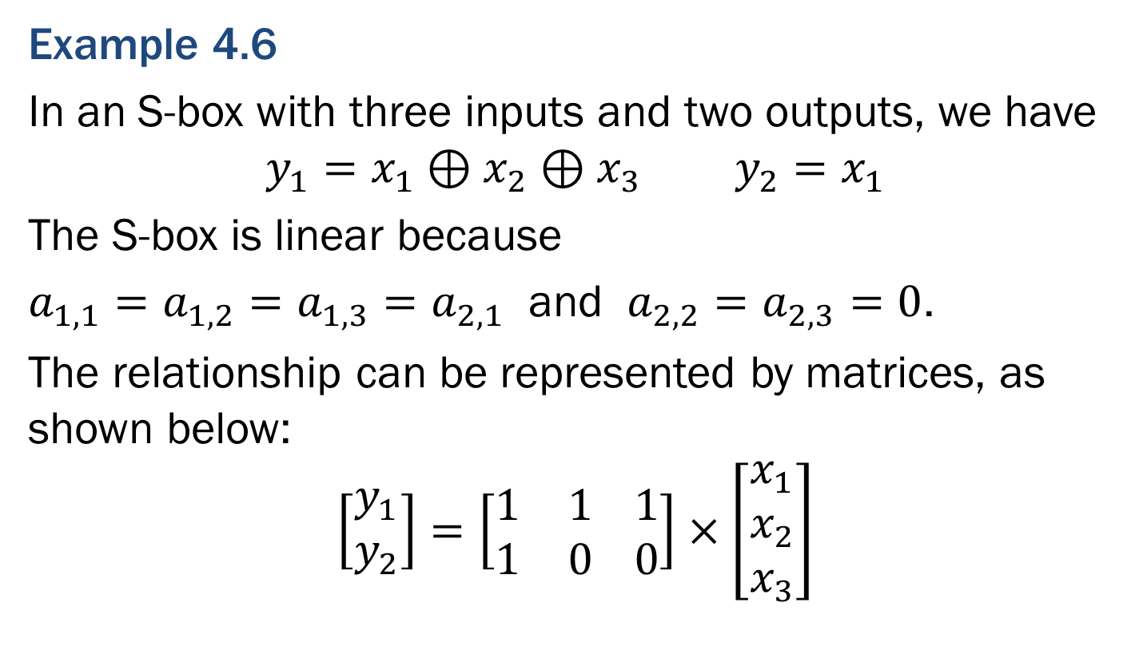
S-Boxes
Example 4.6
In an S-box with three inputs and two outputs, we have
$$y_{1}=x_{1}⊕x_{2}⊕x_{3} y_{2}=x_{1}$$
The S-box is linear because
$a_{1,1}=a_{1,2}=a_{1,3}=a_{2,1}$ and $a_{2,2}=a_{2,3}=0$.
The relationship can be represented by matrices, as shown below:
$$\left[\begin{aligned}y_{1} \\ y_{2}\end{aligned}\right]=\left[\begin{matrix}1 & 1 \\ 1 & 0\end{matrix} \begin{matrix}1 \\ 0\end{matrix}\right]×\left[\begin{aligned}x_{1} \\ x_{2} \\ x_{3}\end{aligned}\right]$$

Slide 25
S-Boxes
Example 4.7
The following table defines the input/output relationship for an S-box of size 3 × 2. The leftmost bit of the input defines the row; the two rightmost bits of the input define the column. The two output bits are values on the cross section of the selected row and column.
Based on the table, an input of 010 yields the output 01. An input of 101 yields the output of 00.

Slide 26
S-Boxes
S-Boxes: Invertibility
An S-box may or may not be invertible. In an invertible S-box, the number of input bits should be the same as the number of output bits.

Slide 27
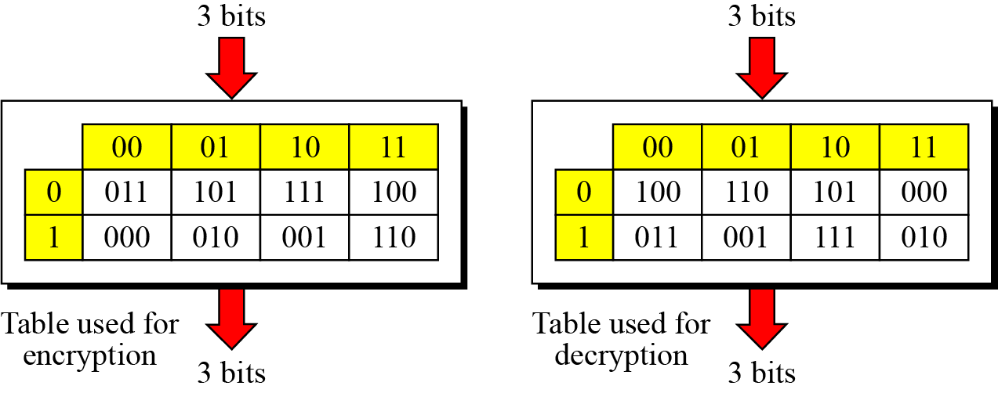
S-Boxes
Example 4.8
Figure 4.4 shows an example of an invertible S-box. For example, if the input to the left box is 001, the output is 101. The input 101 in the right table creates the output 001, which shows that the two tables are inverses of each other.
Figure 4.4 An invertible S-box

Slide 28
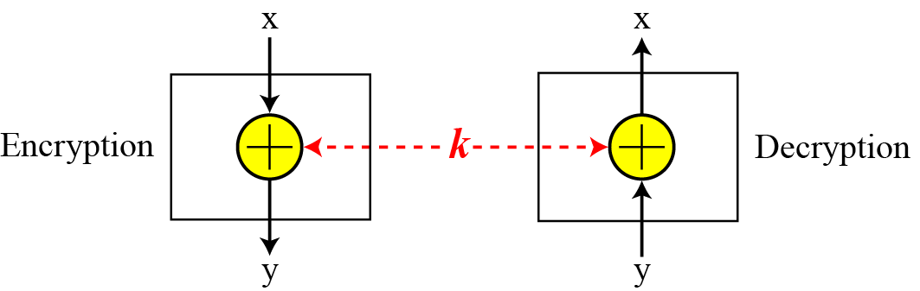
Exclusive-Or
Exclusive-Or
An important component in most block ciphers is the exclusive-or operation.
Example 4.9
Figure 4.5 shows an example of a exclusive-or operation.
Figure 4.5 an invertible S-box

Slide 29
Exclusive-Or
Exclusive-Or(Continued)
An important component in most block ciphers is the exclusive-or operation. Addition and subtraction operations in the GF(2^{n}) field are performed by a single operation called the exclusive-or (XOR).
The five properties of the exclusive-or operation in the GF(2^{n}) field makes this operation a very interesting component for use in a block cipher: closure, associativity, commutativity, existence of identity, and existence of inverse.

Slide 30
Exclusive-Or
Exclusive-Or(Continued)
The inverse of a component in a cipher makes sense if the component represents a unary operation (one input and one output). For example, a keyless P-box or a keyless S-box can be made invertible because they have one input and one output. An exclusive operation is a binary operation.
The inverse of an exclusive-or operation can make sense only if one of the inputs is fixed (is the same in encryption and decryption). For example, if one of the inputs is the key, which normally is the same in encryption and decryption, then an exclusive-or operation is self-invertible, as shown in Figure 4.4.

Slide 31
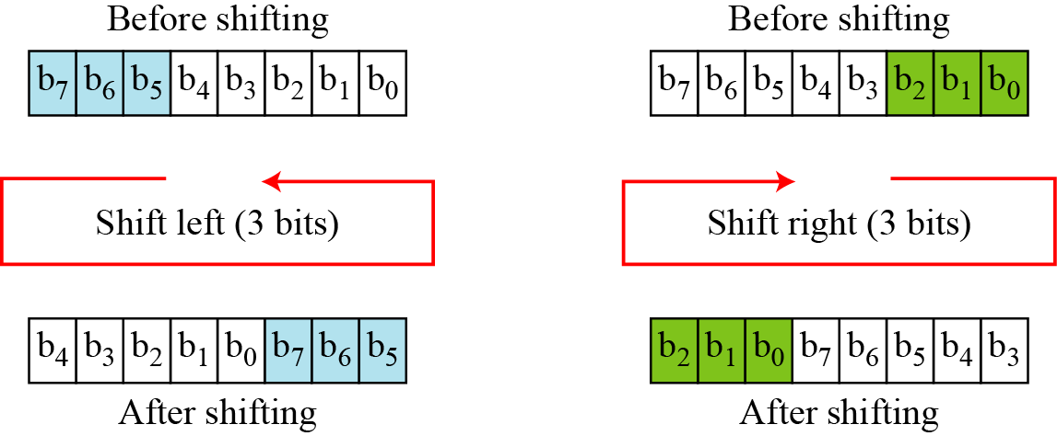
Circular Shift
Circular Shift
Another component found in some modern block ciphers is the circular shift operation.
Example 4.10
Figure 4.6 shows a circular shifting an 8-bit word to the left or right.
Figure 4.6 Circular shifting

Slide 32
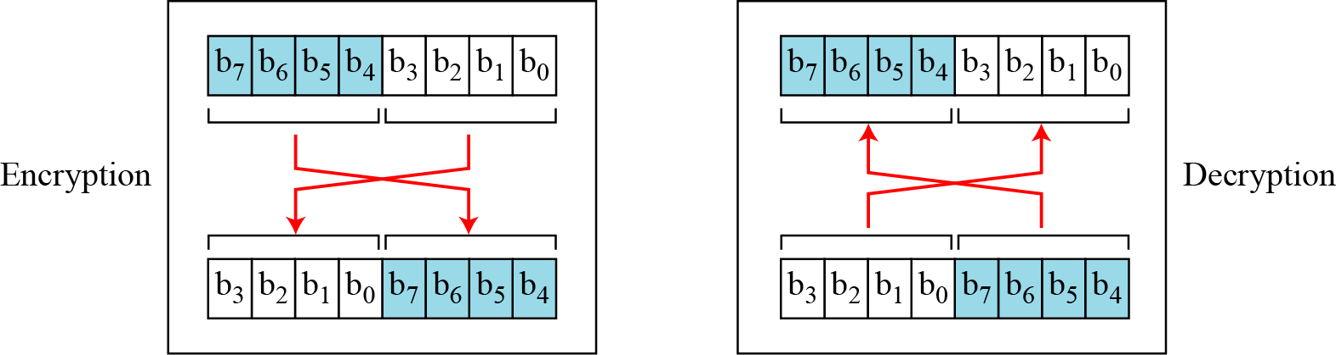
Swap
Swap
The swap operation is a special case of the circular shift operation where k = n/2.
Example 4.11
Figure 4.7 shows a swap operation.
Figure 4.7 Swap operation

Slide 33
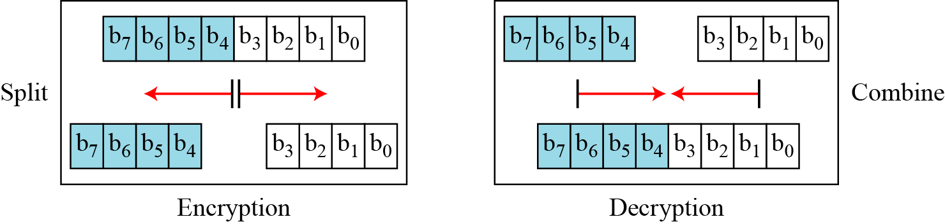
Split and Combine
Split and Combine
Two other operations found in some block ciphers are split and combine.
Example 4.12
Figure 4.8 Show a split and combine operations on an 8-bit word.
Figure 4.8 Split and combine

Slide 34
Block size
Normally the block size is fixed, and the block of ciphertext produced by the block cipher is usually also the same length as the plaintext block size.
Typical block sizes are 64 (DES) and 128 (AES).
?
What happens if the block size is “too short”?
2. What happens if the block size is “too long”?

Slide 35
2. DES

Slide 36
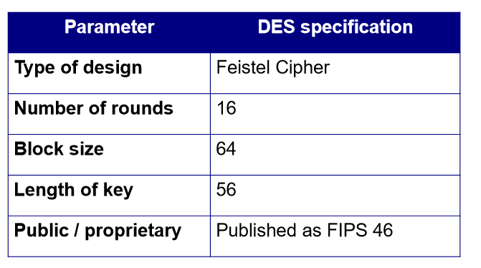
Data Encryption Standard

Slide 37
Brief history of DES
1973: NBS publish a call for proposals for an encryption algorithm standard.
1974: IBM encouraged to submit an encryption algorithm.
1976: After consultation this algorithm adopted as a federal standard and then published as DES the following year.
1977: DES mandatory for Federal Agencies and adopted as ANSI X3.92 and used throughout international financial industry.
1988: NSA removed its endorsement of DES (despite predicted 15-year lifespan).
1988: NBS reaffirmed use of DES to appease the financial industry.
1998: NIST issue a new call for an algorithm in 1998.

Slide 38
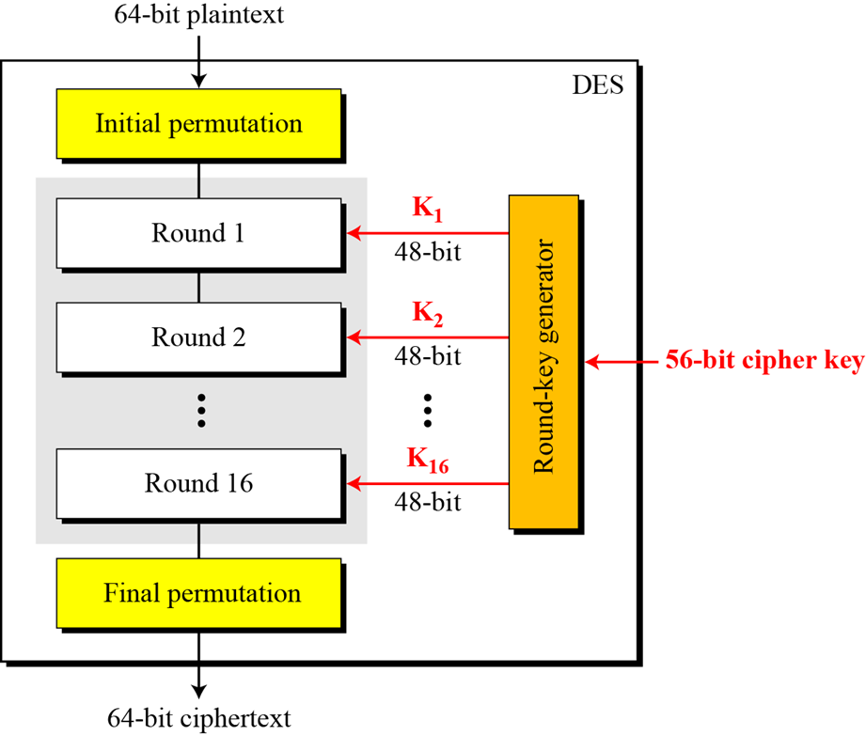
Structure
The encryption process is made of two permutations (P-boxes), which we call initial and final permutations, and 16 Feistel rounds.
Figure 4.9
General structure of DES

Slide 39
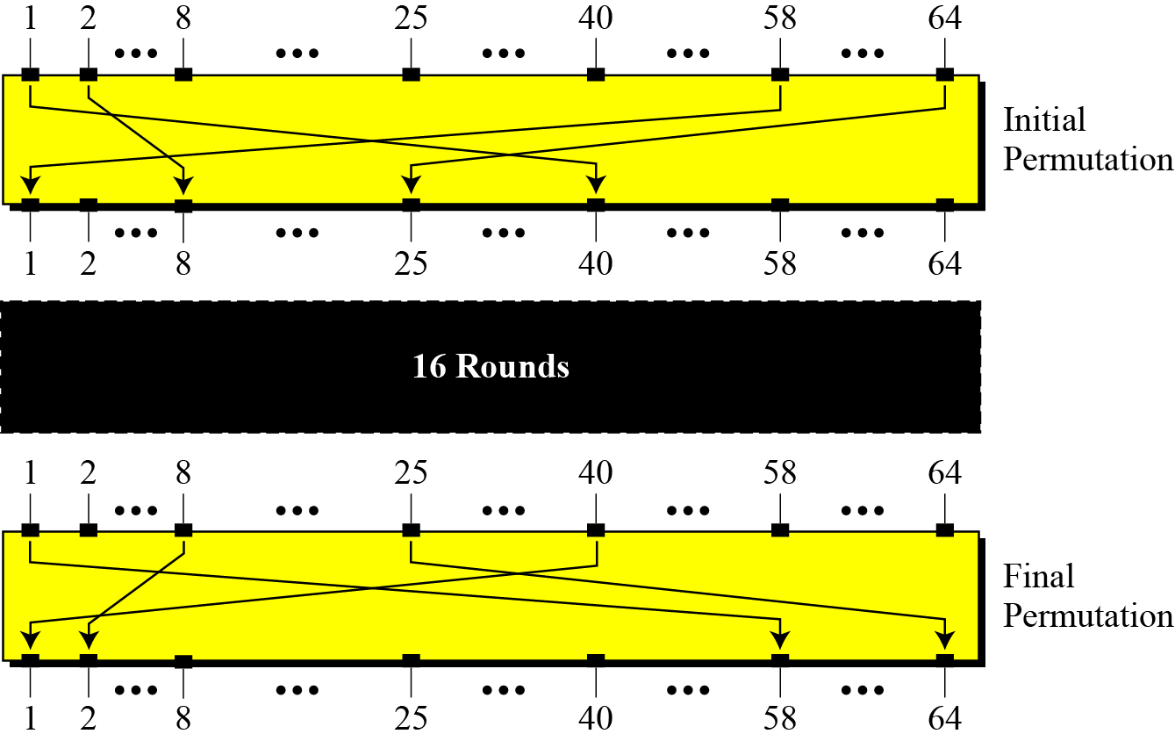
Initial and final permutation steps in DES
Figure 4.10 Initial and final permutation steps in DES

Slide 40
Initial and final permutation steps in DES
Table 4.4 shows an initial and final permutation tables
Table 4.4 Initial and final permutation steps in DES

Slide 41
Initial and final permutation steps in DES
Exercise 4.2
Find the output of the final permutation box when the input is given in hexadecimal as:
Solution
Only bit 25 and bit 64 are 1s; the other bits are 0s. In the final permutation, bit 25 becomes bit 64 and bit 63 becomes bit 15. The result is
0x 0000 0080 0000 0002

Slide 42
Initial and final permutation steps in DES
Exercise 4.2
Prove that the initial and final permutations are the inverse of each other by finding the output of the initial permutation if the input is:
Solution
The input has only two 1s; the output must also have only two 1s. Using Table 6.1, we can find the output related to these two bits. Bit 15 in the input becomes bit 63 in the output. Bit 64 in the input becomes bit 25 in the output. So the output has only two 1s, bit 25 and bit 63. The result in hexadecimal is
Ox0002 0000 0000 0001

Slide 43
Initial and final permutation steps in DES
The initial and final permutations are straight P-boxes that are inverses of each other.
They have no cryptography significance in DES.

Slide 44
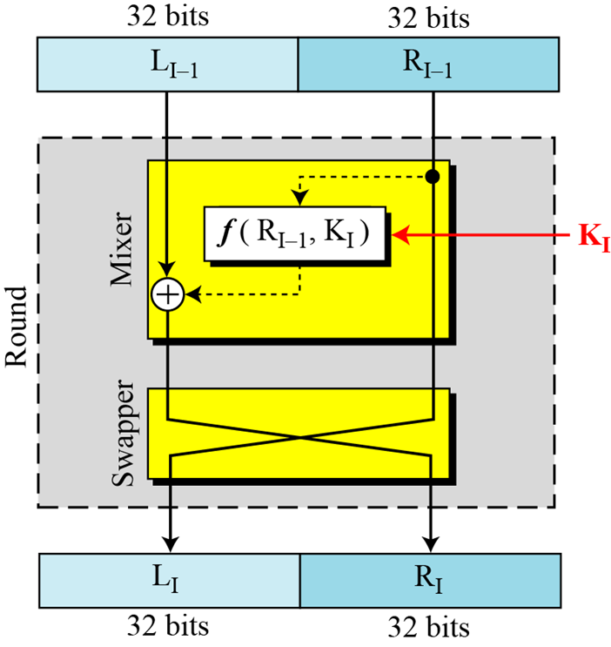
Round Function
DES uses 16 rounds. Each round of DES is a Feistel cipher.
Figure 4.11 A round in DES (encryption site)

Slide 45
Round Function
How do you choose the round function f ?
How do you decrypt using a Feistel cipher?
How many rounds should a Feistel cipher have?
?

Slide 46
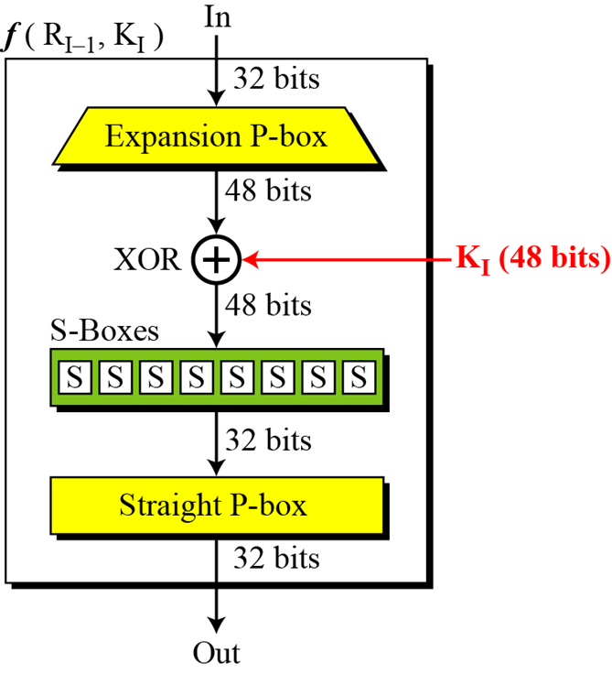
Round Function
DES Function
The heart of DES is the DES function. The DES function applies a 48-bit key to the rightmost 32 bits to produce a 32-bit output.
Figure 4.12
DES function

Slide 47
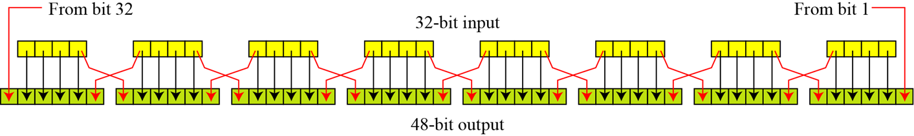
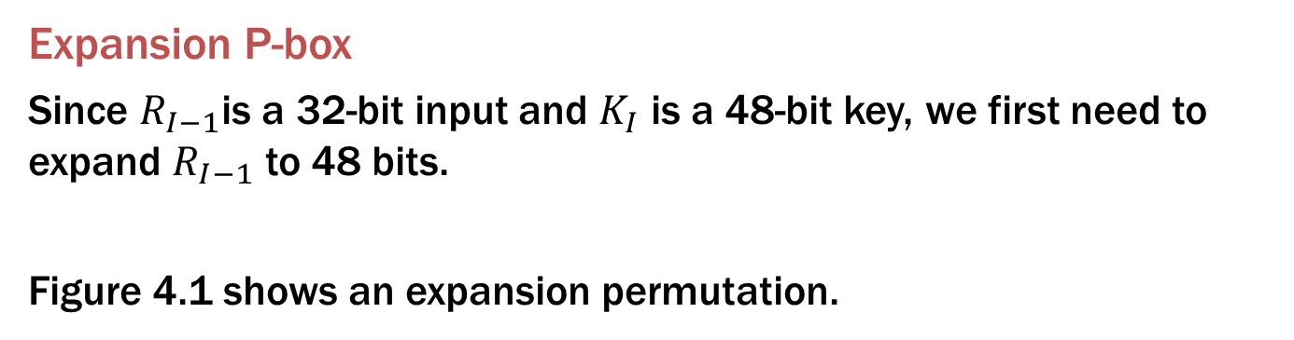
Round Function
Expansion P-box
Since $R_{I−1}$is a 32-bit input and $K_{I}$ is a 48-bit key, we first need to expand $R_{I−1}$ to 48 bits.
Figure 4.1 shows an expansion permutation.
Figure 4.11 Expansion permutation

Slide 48
Round Function
Although the relationship between the input and output can be defined mathematically, DES uses Table 4.5 to define this P-box.
Table 4.5 Expansion P-box table

Slide 49
Round Function
Whitener(XOR)
After the expansion permutation, DES uses the XOR operation on the expanded right section and the round key. Note that both the right section and the key are 48-bits in length. Also note that the round key is used only in this operation.

Slide 50
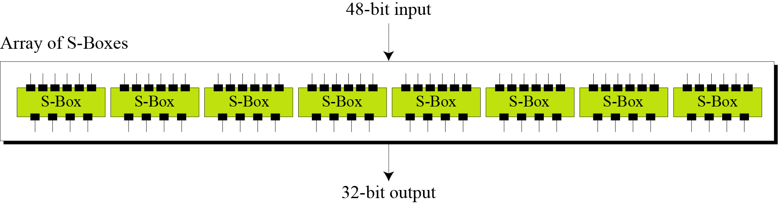
Round Function
S-Boxes
The S-boxes do the real mixing (confusion). DES uses 8 S-boxes, each with a 6-bit input and a 4-bit output. See Figure 4.13.
Figure4.13 Initial and final permutation steps in DES

Slide 51
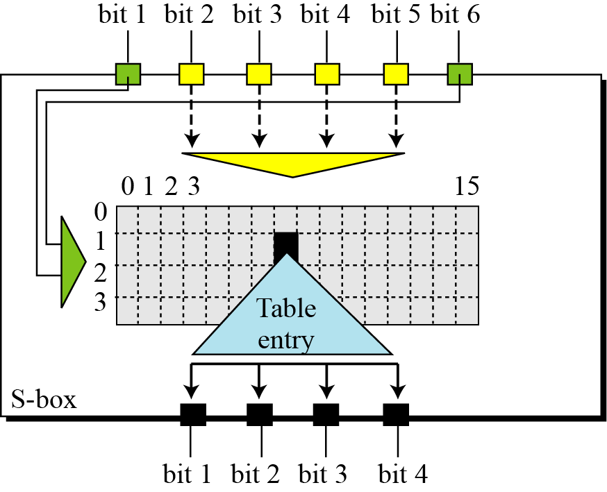
Round Function
S-Box Rule
Figure 4.14 S-box rule

Slide 52
Round Function
Table 4.5 shows the permutation for S-box 1. For the rest of the boxes see the textbook.
Table 4.5 S-box 1

Slide 53
Round Function
Exercise 4.4
The input to S-box 1 is:
What is the out-put?
Solution
If we write the first and the sixth bits together, we get 11 in binary, which is 3 in decimal. The remaining bits are 0001 in binary, which is 1 in decimal. We look for the value in row 3, column 1, in Table 6.3 (S-box 1). The result is 12 in decimal, which in binary is 1100. So the input 100011 yields the output 1100.
100011

Slide 54
Round Function
Exercise 4.5
The input to S-box 1 is:
What is the out-put?
Solution
If we write the first and the sixth bits together, we get 00 in binary, which is 0 in decimal. The remaining bits are 0000 in binary, which is 0 in decimal. We look for the value in row 0, column 0, in Table 6.10 (S-box 8). The result is 13 in decimal, which is 1101 in binary. So the input 000000 yields the output 1101.
000000

Slide 55
Round Function
Straight Permutation
Table 4.6 Straight permutation table

Slide 56
Key Generation
Key Generation
The round-key generator creates sixteen 48-bit keys out of a 56-bit cipher key. See Figure 4.16.

Slide 57
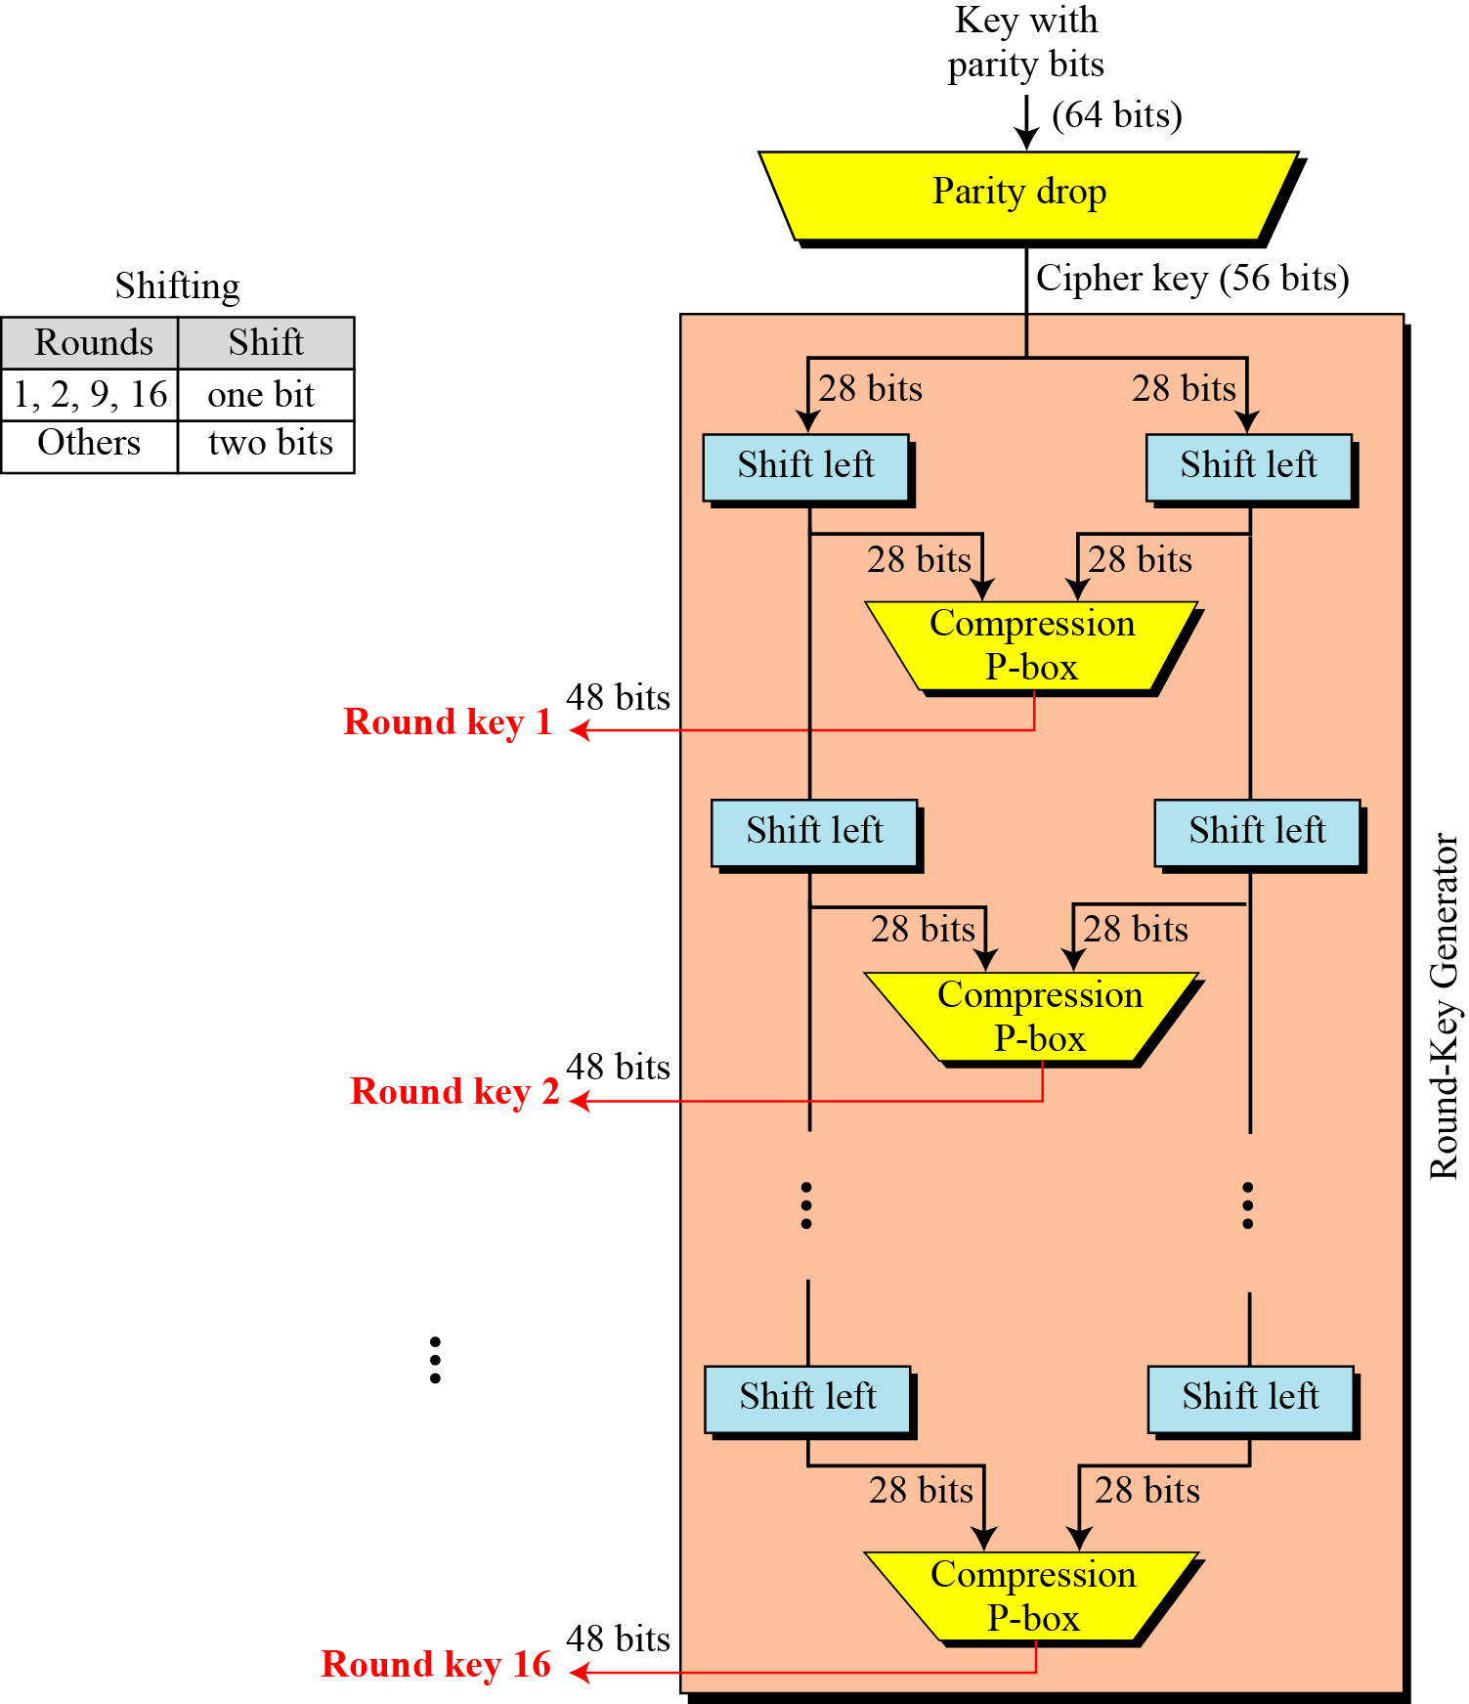
Key Generation
Figure 4.15
Key Generation

Slide 58
Key Generation
Table 4.7 Parity-bit drop table
Table 4.8 Number of bits shifts

Slide 59
Key Generation
Table 4.9 Key-compression table

Slide 60
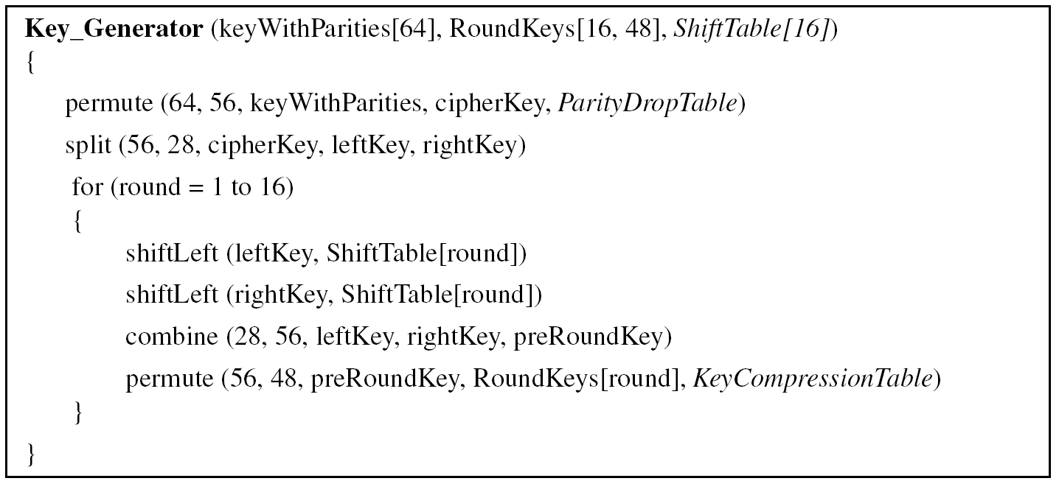
Key Generation
Algorithm 6.2 Round-key generation

Slide 61
Key Generation
Algorithm 6.2 Round-key generation (Continued)

Slide 62
Cipher and Reverse Cipher
Using mixers and swappers, we can create the cipher and reverse cipher, each having 16 rounds.
First Approach
To achieve this goal, one approach is to make the last round (round 16) different from the others; it has only a mixer and no swapper.
In the first approach, there is no swapper in the last round.

Slide 63
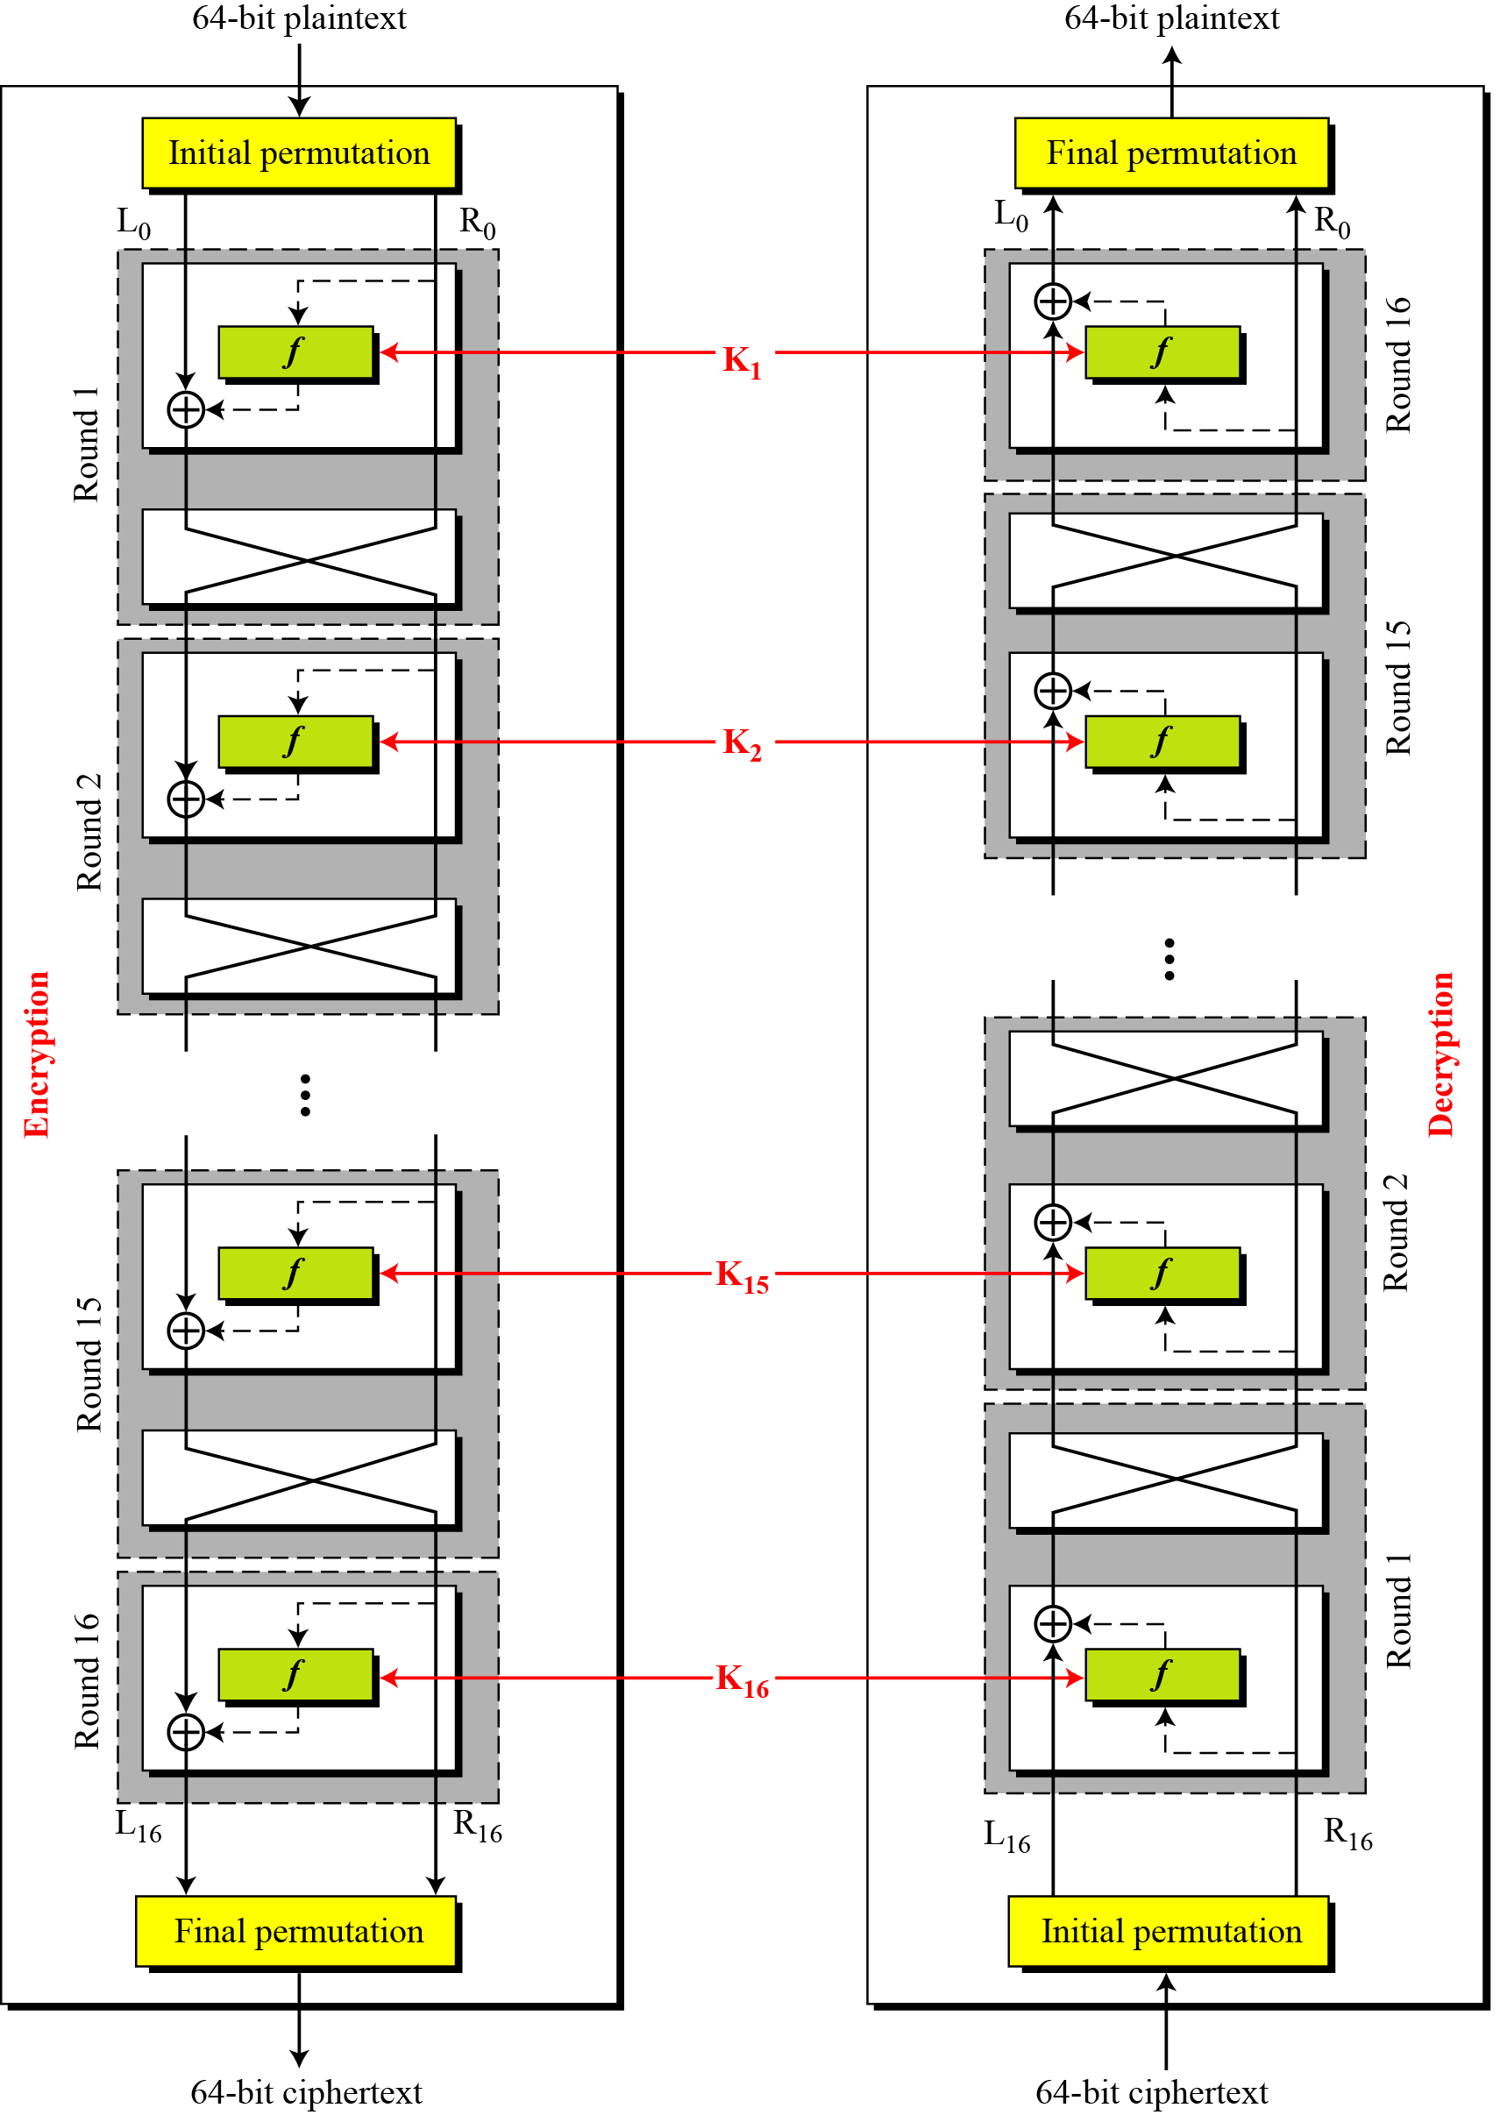
Cipher and Reverse Cipher
Figure 4.15 DES cipher and reverse cipher for the first approach

Slide 64
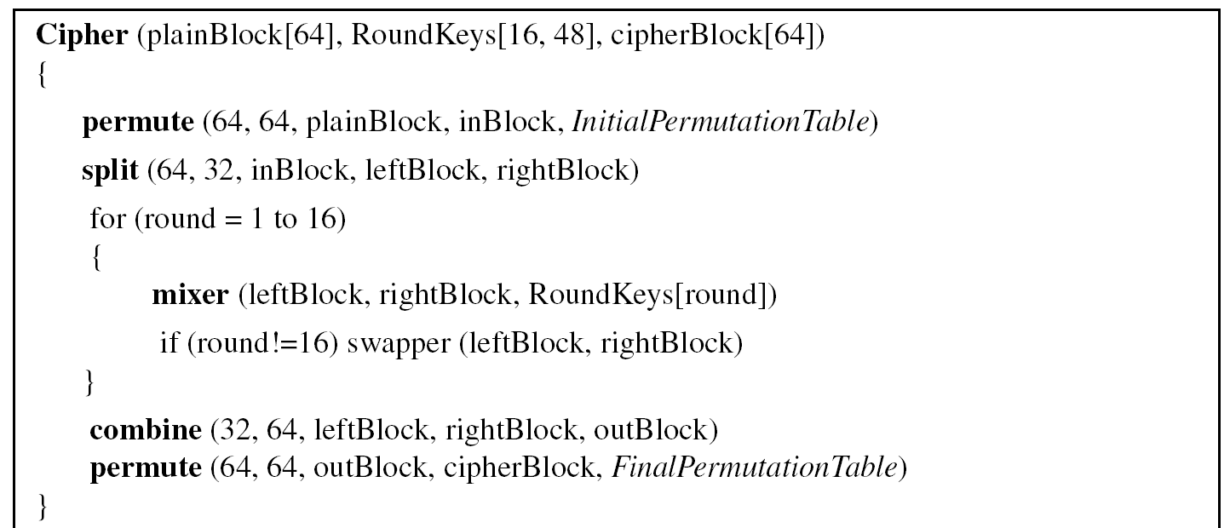
Cipher and Reverse Cipher
Algorithm 6.1 DES cipher

Slide 65
Cipher and Reverse Cipher
Algorithm 6.1 DES cipher (Continued)

Slide 66
Cipher and Reverse Cipher
Algorithm 6.1 DES cipher (Continued)

Slide 67
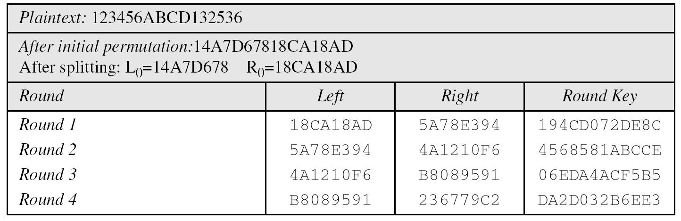
Cipher and Reverse Cipher
Example 4.12
We choose a random plaintext block and a random key, and determine what the ciphertext block would be (all in hexadecimal):
Trace of data for example 4.12:

Slide 68
Cipher and Reverse Cipher
Trace of data for example 4.12 (Continued)

Slide 69
Cipher and Reverse Cipher
Let us see how Bob, at the destination, can decipher the ciphertext received from Alice using the same key. Table 6.16 shows some interesting points.

