Slide 1
Data Encryption Standard (DES)
----Analysis
UNIT 5
应用密码学

Slide 2
Learning Outcomes
Properties of DES.
Design Criteria .
DES Weaknesses.
Brute-Force Attack.
Differential Cryptanalysis.
Linear Cryptanalysis.
Double DES.
Triple DES.

Slide 3
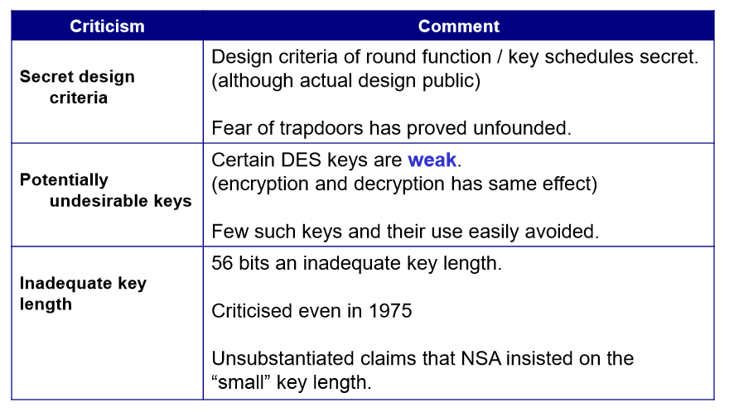
Design criticisms

Slide 4
5.1 DES ANALYSIS

Slide 5
5.1 DES ANALYSIS
Critics have used a strong magnifier to analyze DES. Tests have been done to measure the strength of some desired properties in a block cipher.

Slide 6
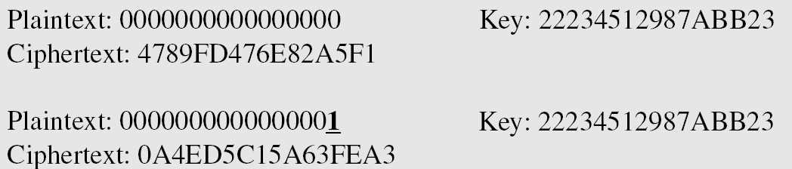
5.1.1 Properties
Two desired properties of a block cipher are the avalanche effect and the completeness.
Example 5.1
To check the avalanche effect in DES, let us encrypt two plaintext blocks (with the same key) that differ only in one bit and observe the differences in the number of bits in each round.

Slide 7
5.1.1 Properties
Example 5.1(continued)
Although the two plaintext blocks differ only in the rightmost bit, the ciphertext blocks differ in 29 bits. This means that changing approximately 1.5 percent of the plaintext creates a change of
approximately 45 percent in the ciphertext.
Table 5.1 Number of bit differences for Example 5.1

Slide 8
5.1.1 Properties
Completeness effect
Completeness effect means that each bit of the ciphertext needs to depend on many bits on the plaintext.

Slide 9
5.1.2 Design Criteria
S-Boxes
The design provides confusion and diffusion of bits from each round to the next.
P-Boxes
They provide diffusion of bits.
Number of Rounds
DES uses sixteen rounds of Feistel ciphers. the ciphertext is thoroughly a random function of plaintext and ciphertext.

Slide 10
5.1.3 DES Weaknesses
During the last few years critics have found some weaknesses in DES.
Weaknesses in Cipher Design
Weaknesses in S-boxes
Weaknesses in P-boxes
Weaknesses in Key

Slide 11
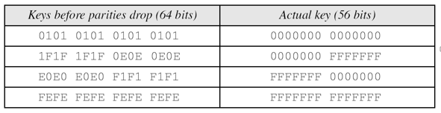
5.1.3 DES Weaknesses
Table 5.2 Weak keys

Slide 12
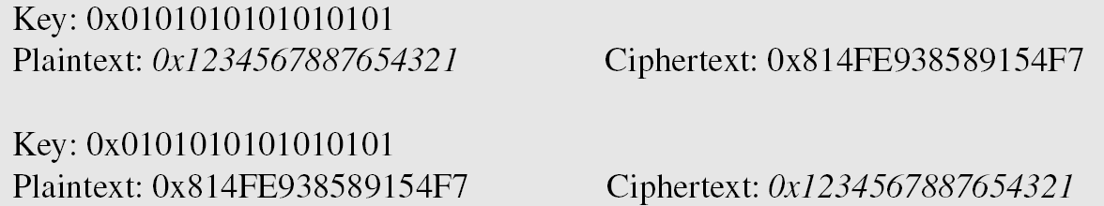
5.1.3 DES Weaknesses
Example 5.2
Let us try the first weak key in Table 5.2 to encrypt a block two times. After two encryptions with the same key the original plaintext block is created. Note that we have used the encryption algorithm two times, not one encryption followed by another decryption.

Slide 13
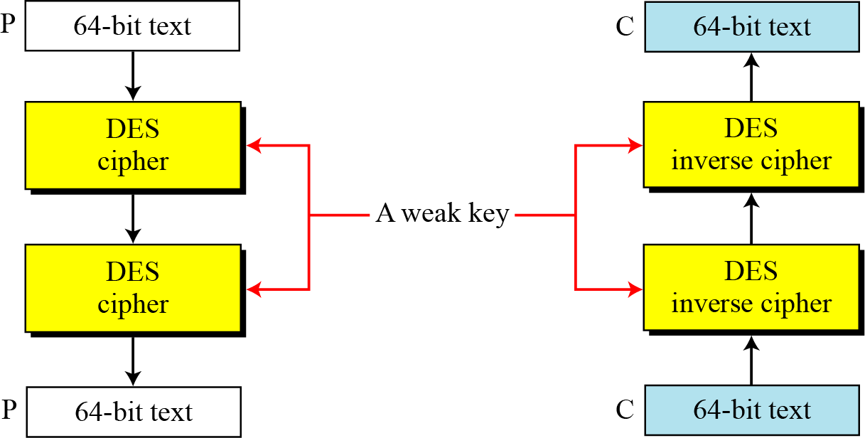
5.1.3 DES Weaknesses
Figure 5.1 Double encryption and decryption with a weak key

Slide 14
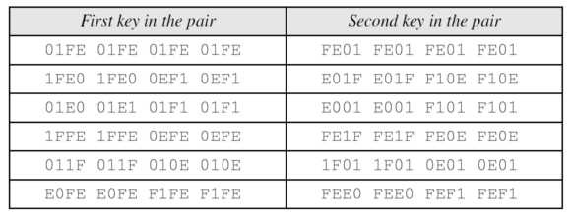
5.1.3 DES Weaknesses
Table 5.3 Double encryption and decryption with a weak key

Slide 15
5.1.3 DES Weaknesses

Slide 16
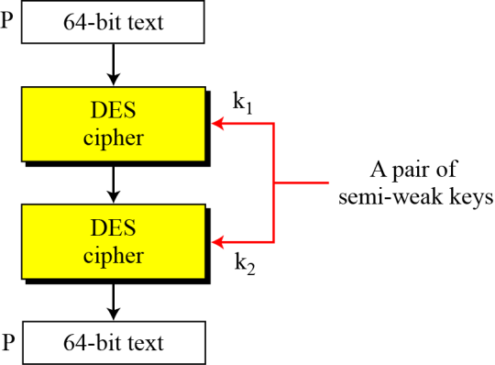
5.1.3 DES Weaknesses
Figure 5.2 A pair of semi-weak keys in encryption and decryption

Slide 17
5.1.3 DES Weaknesses
Example 5.3
What is the probability of randomly selecting a weak, a semi-weak, or a possible weak key?
Solution
DES has a key domain of 256. The total number of the above keys are 64 (4 + 12 + 48). The probability of choosing one of these keys is 8.8 × 10−16, almost impossible.

Slide 18
5.1.3 DES Weaknesses

Slide 19
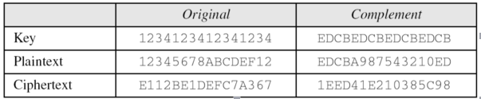
5.1.3 DES Weaknesses
Example 5.4
Let us test the claim about the complement keys. We have used an arbitrary key and plaintext to find the corresponding ciphertext. If we have the key complement and the plaintext, we can obtain the complement of the previous ciphertext (Table 5.4).
Table 5.4 Result for example 5.4

Slide 20
5.2 Security of DES

Slide 21
5.2 Security of DES
DES, as the first important block cipher, has gone through much scrutiny. Among the attempted attacks, three are of interest: brute-force, differential cryptanalysis, linear cryptanalysis.

Slide 22
5.2.1 Brute-Force Attack
We have discussed the weakness of short cipher key in DES. Combining this weakness with the key complement weakness, it is clear that DES can be broken using 2⁵⁵ encryptions.

Slide 23
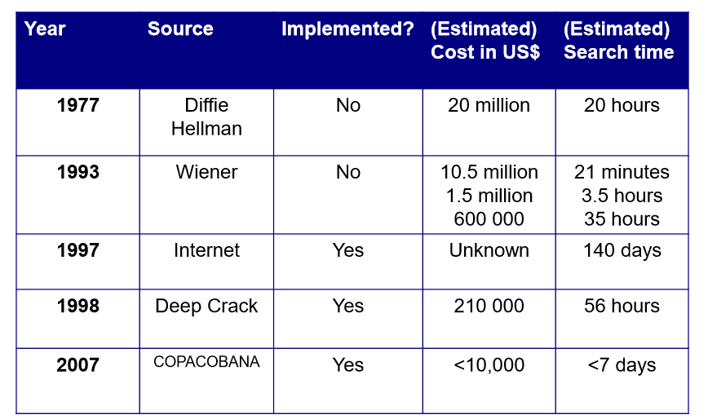
Searching for a DES key

Slide 24
5.2.2 Differential Cryptanalysis
It has been revealed that the designers of DES already knew about this type of attack and designed S-boxes and chose 16 as the number of rounds to make DES specifically resistant to this type of attack.
We show an example of DES differential cryptanalysis in Appendix N.

Slide 25
5.2.2 Differential Cryptanalysis
Differential Cryptanalysis
Eli Biham and Adi Shamir introduced the idea of differential cryptanalysis. This is a chosen-plaintext attack.

Slide 26
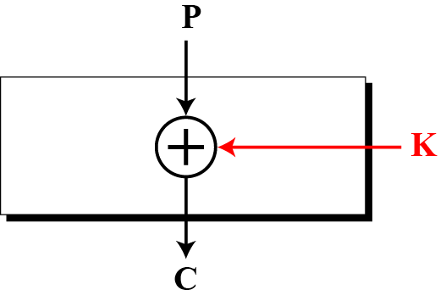
5.2.2 Differential Cryptanalysis
Example 5.4
Assume that the cipher is made only of one exclusive-or operation, as shown in Figure 5.3.
Figure 5.3 Diagram for Example 5.4

Slide 27
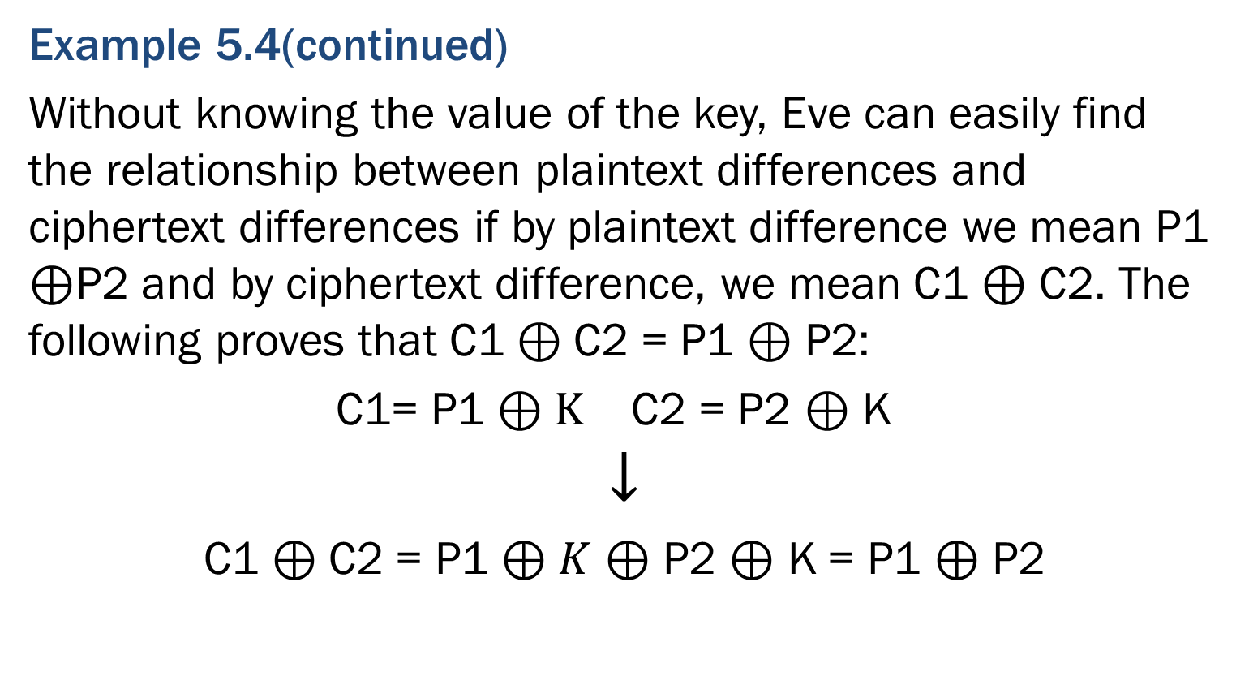
5.2.2 Differential Cryptanalysis
Example 5.4(continued)
Without knowing the value of the key, Eve can easily find the relationship between plaintext differences and ciphertext differences if by plaintext difference we mean P1 $⊕$P2 and by ciphertext difference, we mean C1 $⊕$ C2. The following proves that C1 $⊕$C2 = P1 $⊕$ P2:
C1= P1 $⊕K$ C2 = P2 $⊕$ K
$$↓$$
C1 $⊕$C2 = P1 $⊕K$ $⊕$ P2 $⊕$ K = P1 $⊕$ P2

Slide 28
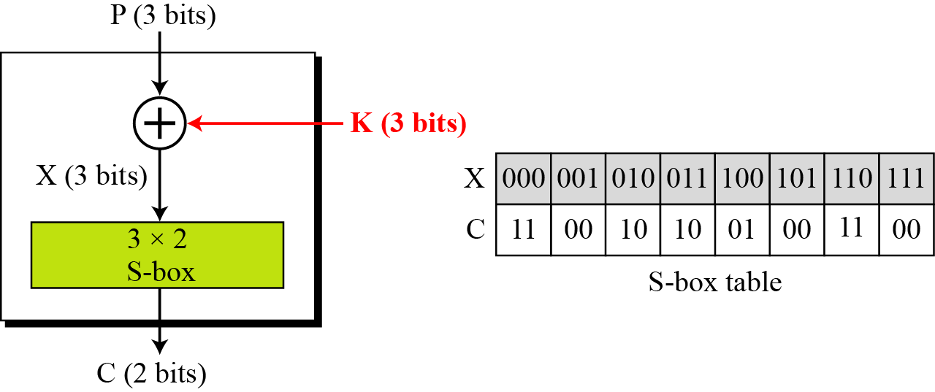
5.2.2 Differential Cryptanalysis
Example 5.5
We add one S-box to Example 5.4, as shown in Figure 5.4:
Figure 5.4 Diagram for Example 5.5

Slide 29
5.2.2 Differential Cryptanalysis
Example 5.5(continued)
Eve now can create a probabilistic relationship as shown in Table 5.5:
Table 5.5 Differential input/output

Slide 30
5.2.2 Differential Cryptanalysis
Example 5.6
The heuristic result of Example 5.5 can create probabilistic information for Eve as shown in Table 5.6.
Table 5.6 Differential distribution table

Slide 31
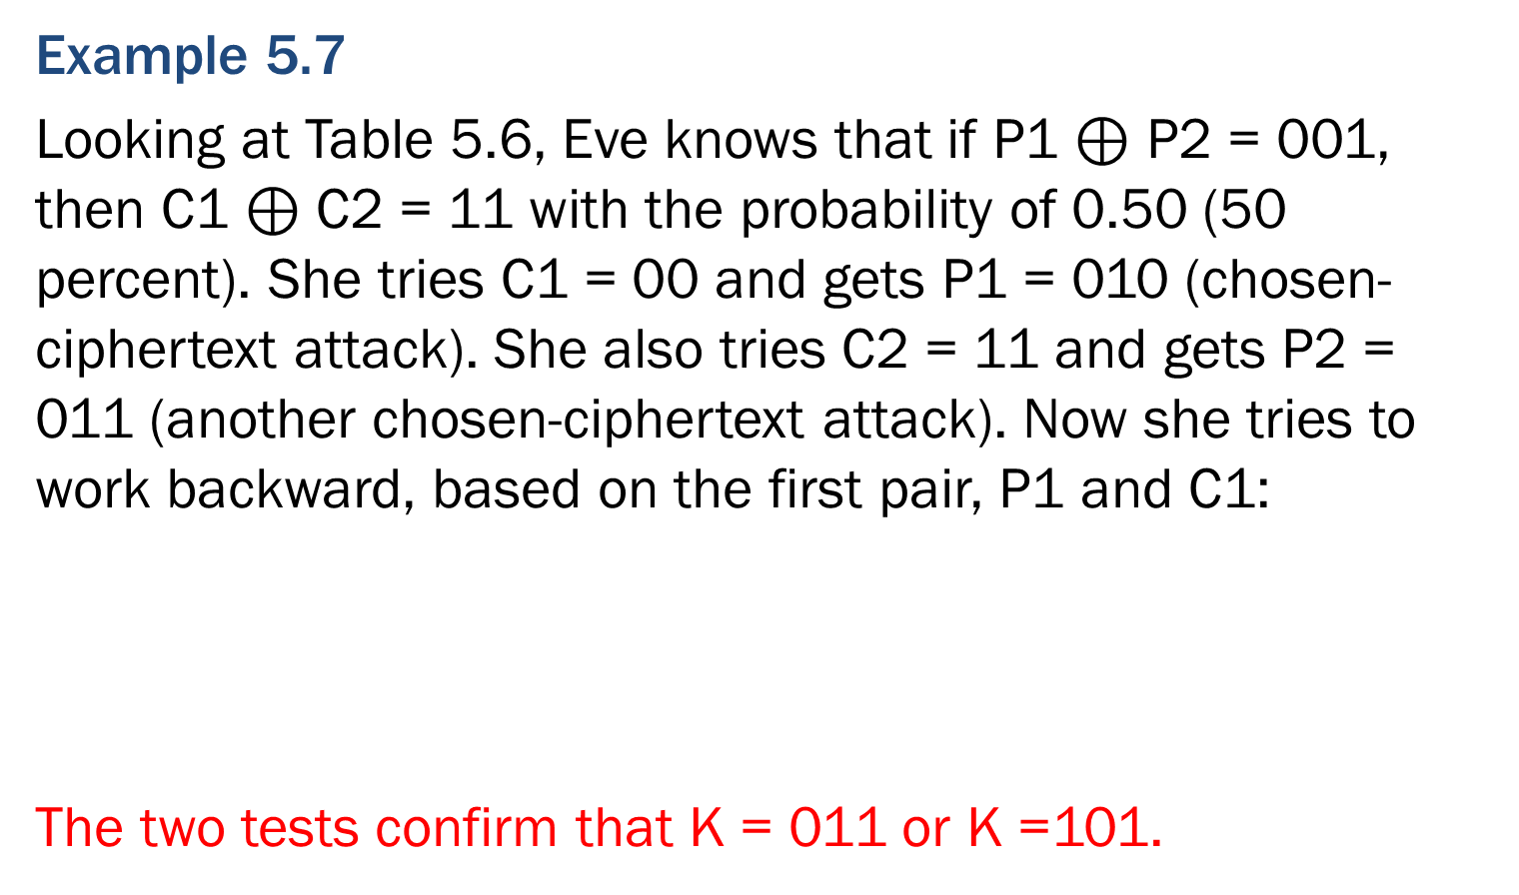
5.2.2 Differential Cryptanalysis
Example 5.7
Looking at Table 5.6, Eve knows that if P1 $⊕$ P2 = 001, then C1 $⊕$ C2 = 11 with the probability of 0.50 (50 percent). She tries C1 = 00 and gets P1 = 010 (chosen-ciphertext attack). She also tries C2 = 11 and gets P2 = 011 (another chosen-ciphertext attack). Now she tries to work backward, based on the first pair, P1 and C1:
The two tests confirm that K = 011 or K =101.

Slide 32
5.2.2 Differential Cryptanalysis
Differential cryptanalysis is based on a nonuniform differential distribution table of the S-boxes in a block cipher.
A more detailed differential cryptanalysis is given in Appendix N.

Slide 33
5.2.3 Linear Cryptanalysis
Linear cryptanalysis is newer than differential cryptanalysis. DES is more vulnerable to linear cryptanalysis than to differential cryptanalysis. S-boxes are not very resistant to linear cryptanalysis. It has been shown that DES can be broken using 2⁴³ pairs of known plaintexts. However, from the practical point of view, finding so many pairs is very unlikely.
We show an example of DES linear cryptanalysis in Appendix N.

Slide 34
5.2.3 Linear Cryptanalysis
Linear Cryptanalysis
Linear cryptanalysis was presented by Mitsuru Matsui in 1993. The analysis uses known plaintext attacks.

Slide 35
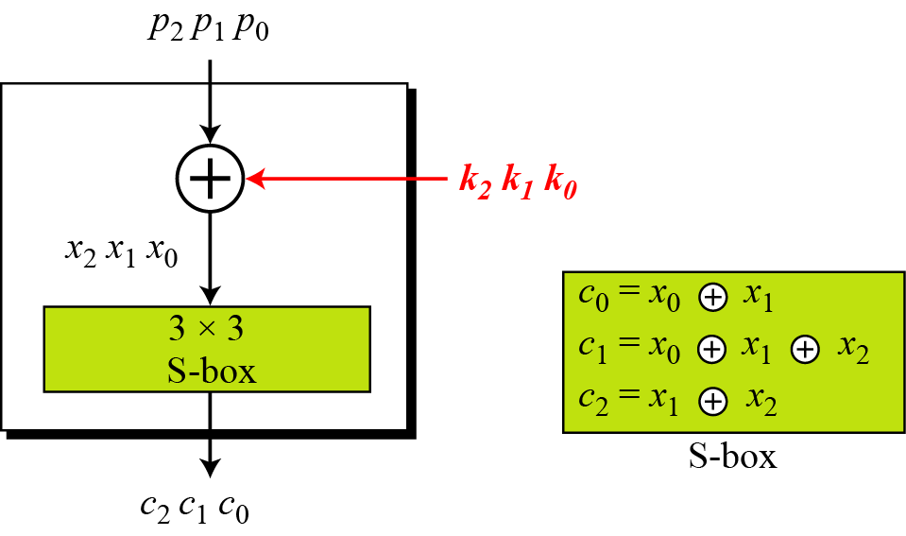
5.2.3 Linear Cryptanalysis
Figure 5.5 A simple cipher with a linear S-box

Slide 36
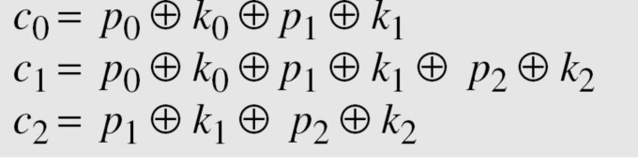
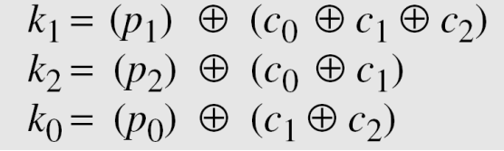
5.2.3 Linear Cryptanalysis
Solving for three unknowns, we get
This means that three known-plaintext attacks can find the values of k₀, k₁, and k₂ .

Slide 37
5.2.3 Linear Cryptanalysis
In some modern block ciphers, it may happen that some
S-boxes are not totally nonlinear; they can be approximated, probabilistically, by some linear functions.
where 1 ≤ x ≤ m, 1 ≤ y ≤ n, and 1 ≤ z ≤ n.
A more detailed linear cryptanalysis is given in Appendix N.

Slide 38
DES today
Well accepted that a DES key can be found by anyone determined enough.
Differential and linear cryptanalysis provide academic attacks on DES.
DES is still in use in many applications.
Triple DES or AES are commonly recommended instead of DES .

Slide 39
5.3 Multiple DES

Slide 40
5.3 Multiple DES
The major criticism of DES regards its key length. Fortunately DES is not a group. This means that we can use double or triple DES to increase the key size.

Slide 41
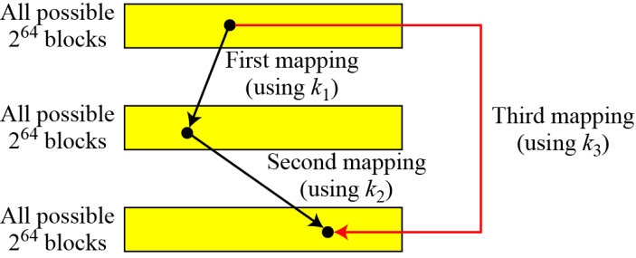
5.3 Multiple DES
A substitution that maps every possible input to every possible output is a group.
Figure 5.6 Composition of mapping

Slide 42
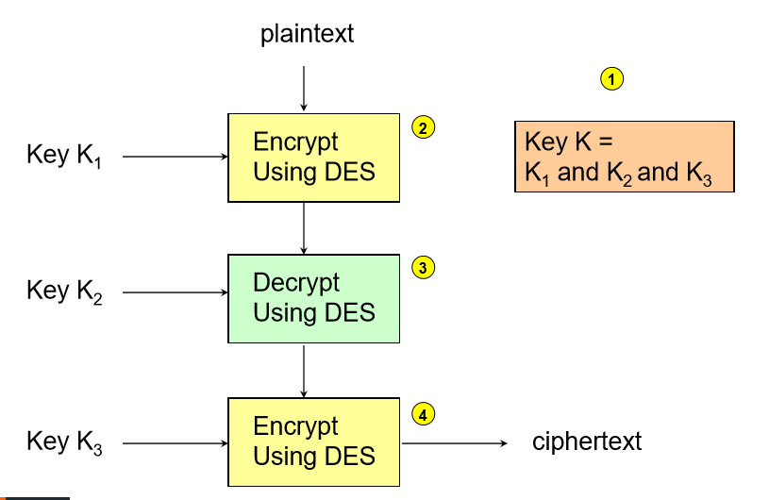
Triple DES

Slide 43
Triple DES
?
Could you encrypt at step 3 of Triple DES instead of decrypting?

Slide 44
Triple DES
?
2. Could you use K1 at step 4 of Triple DES, rather than K3 (2TDES)?

Slide 45
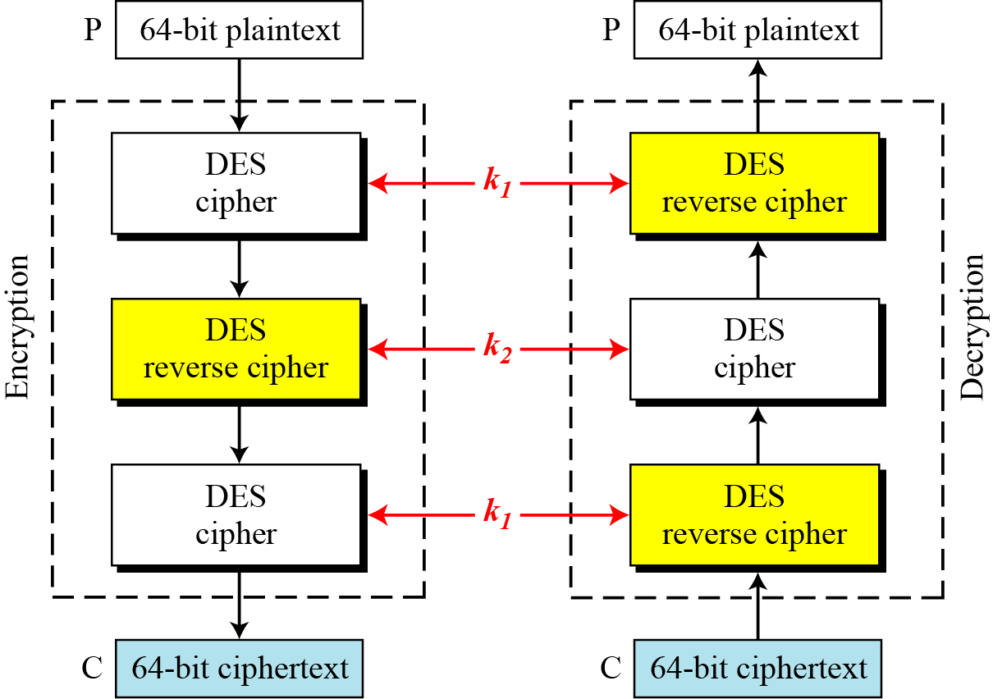
5.3.2 Triple DES
Figure 5.9 Triple DES with two keys

Slide 46
5.3.2 Triple DES
Triple DES with Three Keys
The possibility of known-plaintext attacks on triple DES with two keys has enticed some applications to use triple DES with three keys. Triple DES with three keys is used by many applications such as PGP.

Slide 47
Triple DES
Triple DES is highly regarded but is slowly disappearing from use
AES is “six times faster” in software than Triple DES
3TDES is currently used in the EMV standard (for card payments) but there are plans to replace it

Slide 48
Triple DES
?
3. Why don’t we use “Double DES”?

Slide 49
5.3.1 Double DES
The first approach is to use double DES (2DES).
Meet-in-the-Middle Attack
However, using a known-plaintext attack called meet-in-the-middle attack proves that double DES improves this vulnerability slightly (to 2⁵⁷ tests), but not tremendously (to 2¹¹²).

Slide 50
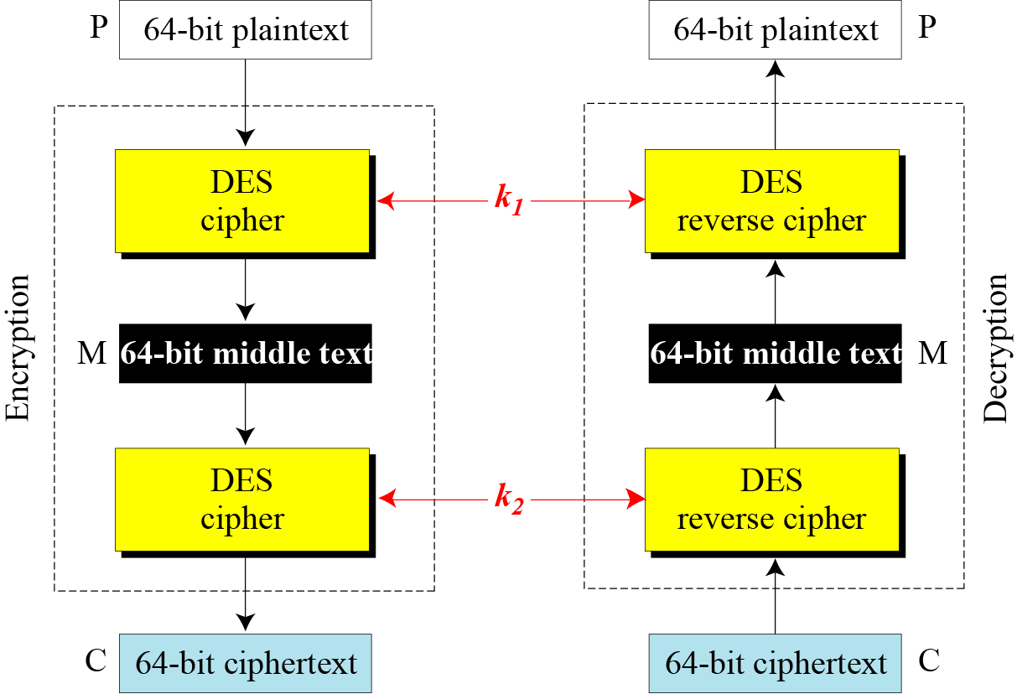
5.3.1 Double DES
Figure 5.7 Meet-in-the-middle attack for double DES

Slide 51
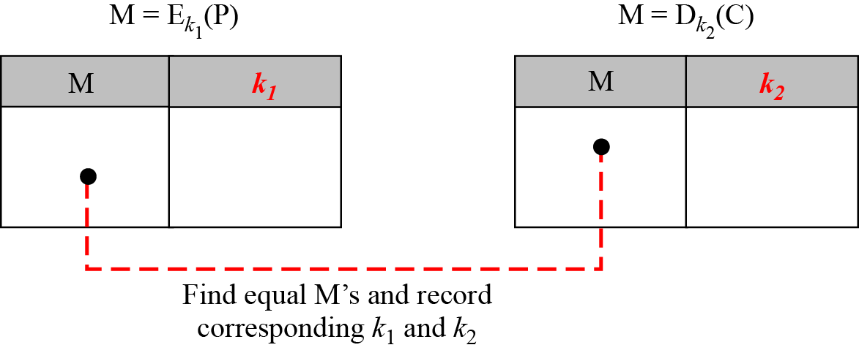
5.3.1 Double DES
Figure 5.8 Tables for meet-in-the-middle attack

