Slide 1
Advanced Encryption Standard
(AES)
UNIT 7
应用密码学

Slide 2
Learning Outcomes
To review a short history of AES.
To define the basic structure of AES.
To define the transformations used by AES.
To define the key expansion process.
To discuss different implementations.

Slide 3
6.1 INTRODUCTION

Slide 4
6.1 INTRODUCTION
The Advanced Encryption Standard (AES) is a symmetric-key block cipher published by the National Institute of Standards and Technology (NIST) in December 2001.

Slide 5
6.1.1 History
In February 2001, NIST announced that a draft of the Federal Information Processing Standard (FIPS) was available for public review and comment. Finally, AES was published as FIPS 197 in the Federal Register in December 2001.

Slide 6
6.1.2 Criteria
The criteria defined by NIST for selecting AES fall into three areas:
Security
Cost
Implementation

Slide 7
6.1.3 Rounds
AES is a non-Feistel cipher that encrypts and decrypts a data block of 128 bits. It uses 10, 12, or 14 rounds. The key size, which can be 128, 192, or 256 bits, depends on the number of rounds.
AES has defined three versions, with 10, 12, and 14 rounds.
Each version uses a different cipher key size (128, 192, or 256), but the round keys are always 128 bits.

Slide 8
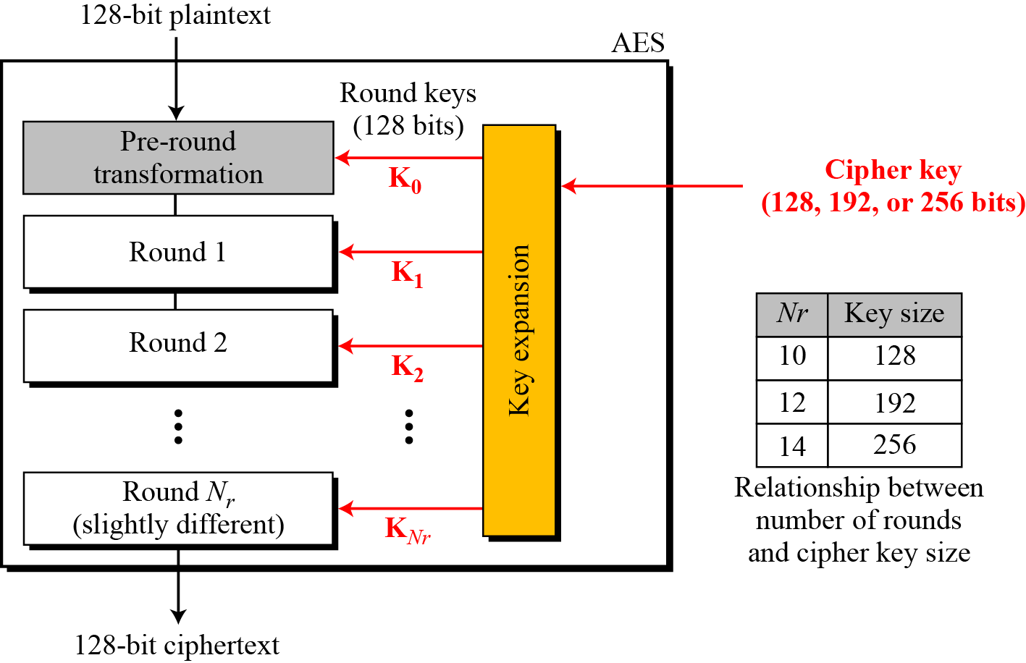
6.1.3 Rounds
Figure 6.1 General design of AES encryption cipher

Slide 9
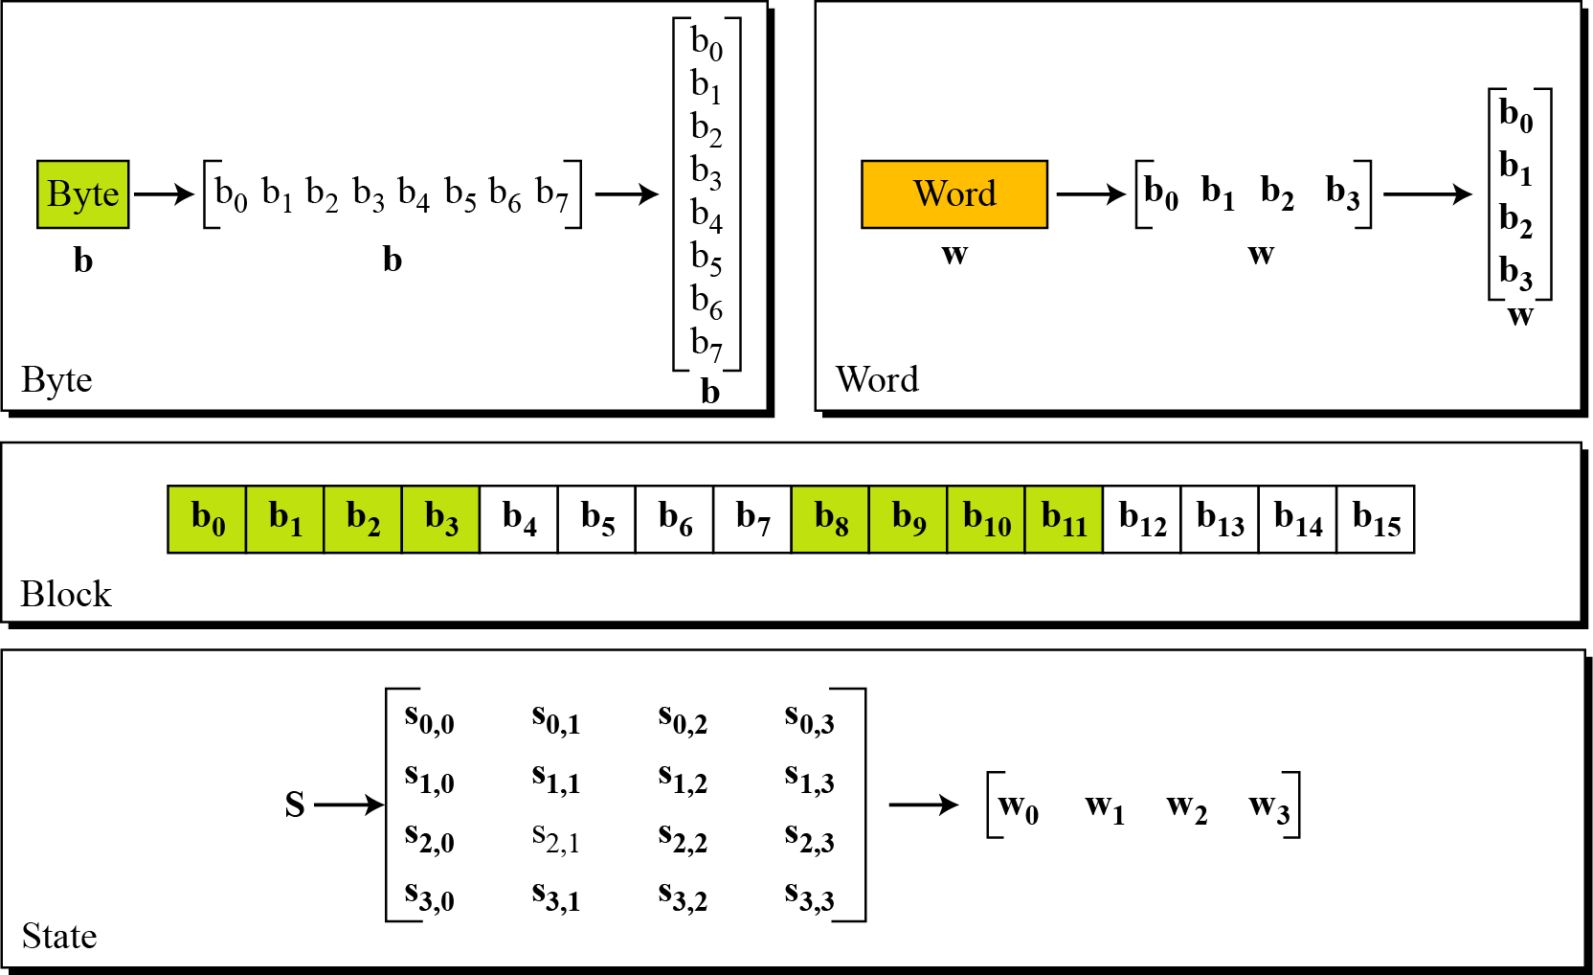
6.1.4 Data Unit
Figure 6.2 Data units used in AES

Slide 10
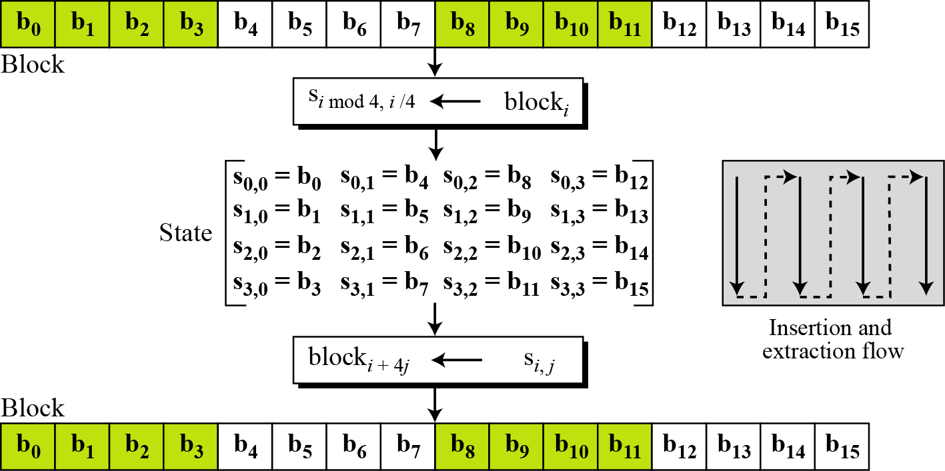
6.1.4 Data Unit
Figure 6.3 Block-to-state and state-to-block transformation

Slide 11
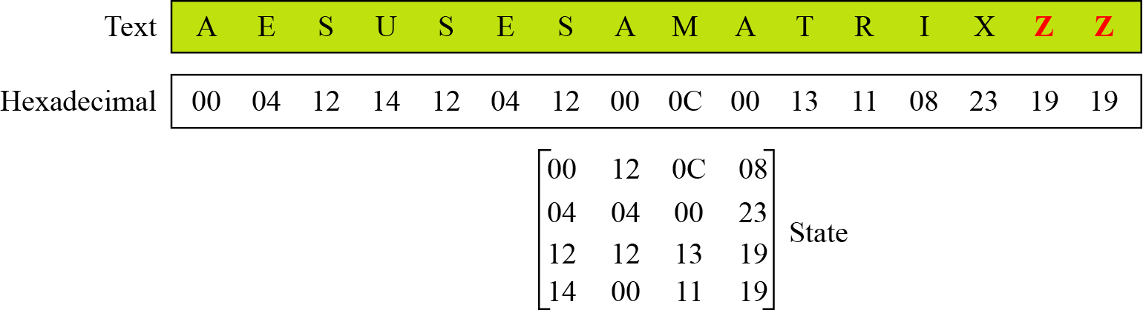
6.1.4 Data Unit
Example 6.1
Figure 6.4 Block-to-state and state-to-block transformation

Slide 12
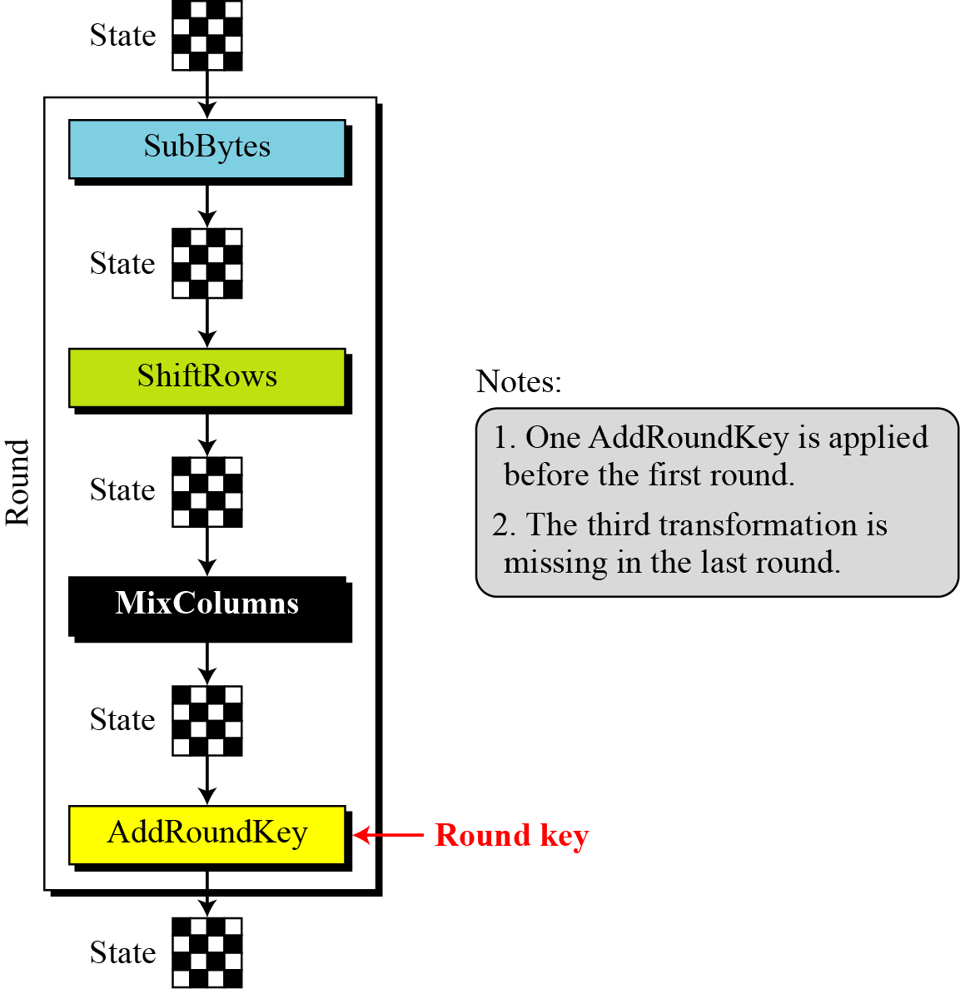
6.1.5 Structure of Each Round
Figure 6.5 Structure of each round at the encryption sitetrans

Slide 13
6.2 TRANSFORMATIONS

Slide 14
6.2 TRANSFORMATIONS
To provide security, AES uses four types of transformations:
Substitution
Permutation
Mixing
Key-adding

Slide 15
6.2.1 Substitution
AES, like DES, uses substitution. AES uses two invertible transformations.
SubBytes
The first transformation, SubBytes, is used at the encryption site. To substitute a byte, we interpret the byte as two hexadecimal digits.
The SubBytes operation involves 16 independent byte-to-byte transformations.

Slide 16
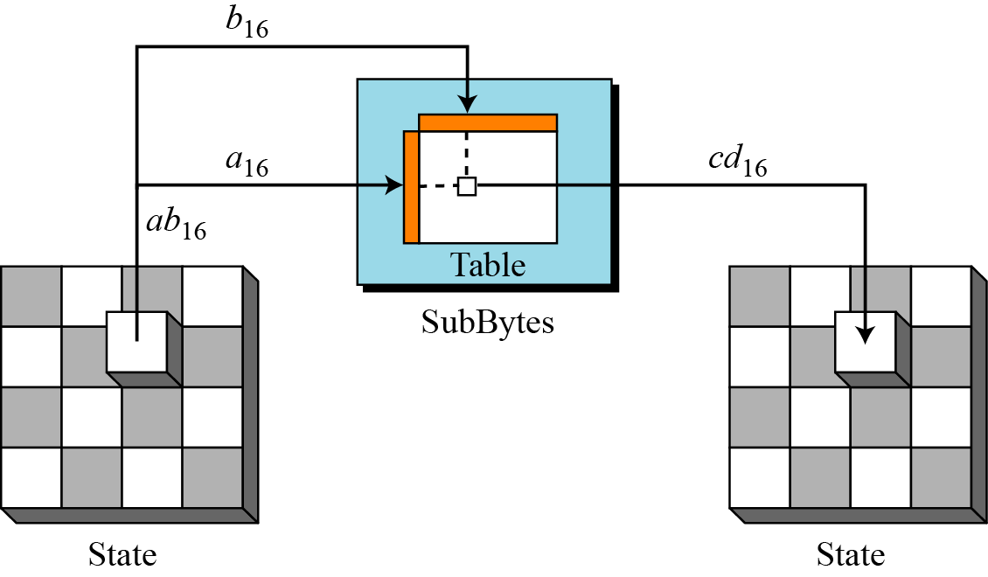
6.2.1 Substitution
Figure 6.6 SubBytes transformation

Slide 17
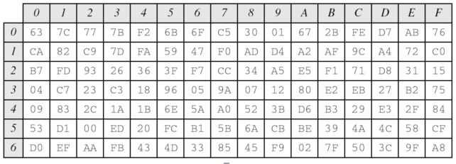
6.2.1 Substitution
Table 6.1 SubBytes transformation table

Slide 18
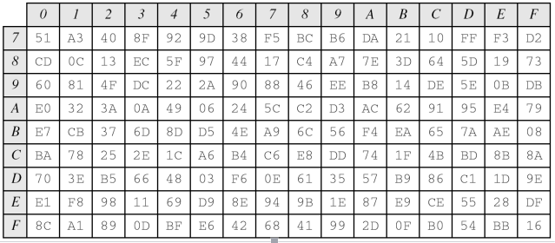
6.2.1 Substitution
Table 6.1 SubBytes transformation table(continued)

Slide 19
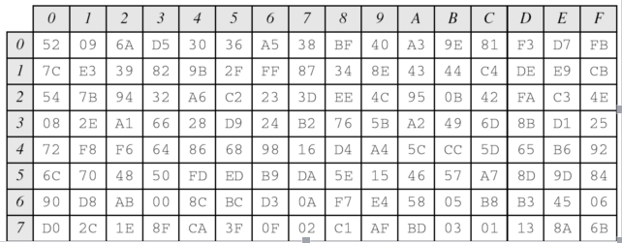
6.2.1 Substitution
Table 6.2 InvSubBytes transformation table

Slide 20
6.2.1 Substitution
Table 6.2 InvSubBytes transformation table(continued)

Slide 21
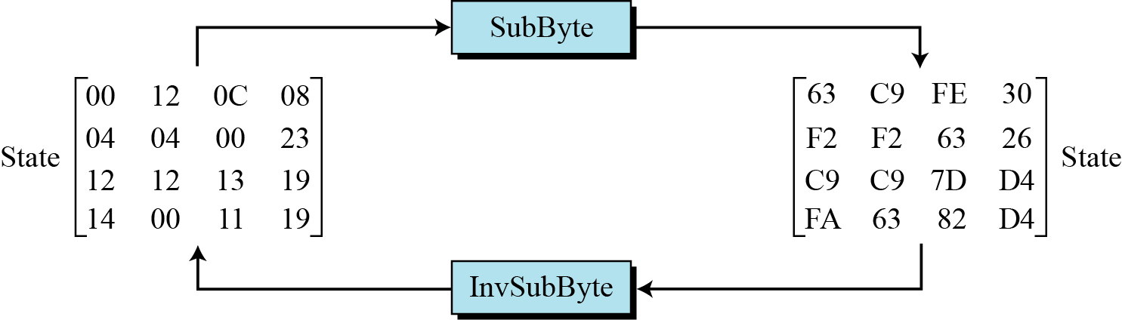
6.2.1 Substitution
Example 6.2
Figure 6.7 shows how a state is transformed using the SubBytes transformation. The figure also shows that the InvSubBytes transformation creates the original one. Note that if the two bytes have the same values, their transformation is also the same.
Figure 6.7 SubBytes transformation for Example 6.2

Slide 22
6.2.1 Substitution
Transformation Using the GF(28) Field
AES also defines the transformation algebraically using the GF(2⁸) field with the irreducible polynomials (x⁸ + x⁴ + x³+ x + 1), as shown in Figure 6.8.
The SubBytes and InvSubBytes transformations are inverses of each other.

Slide 23
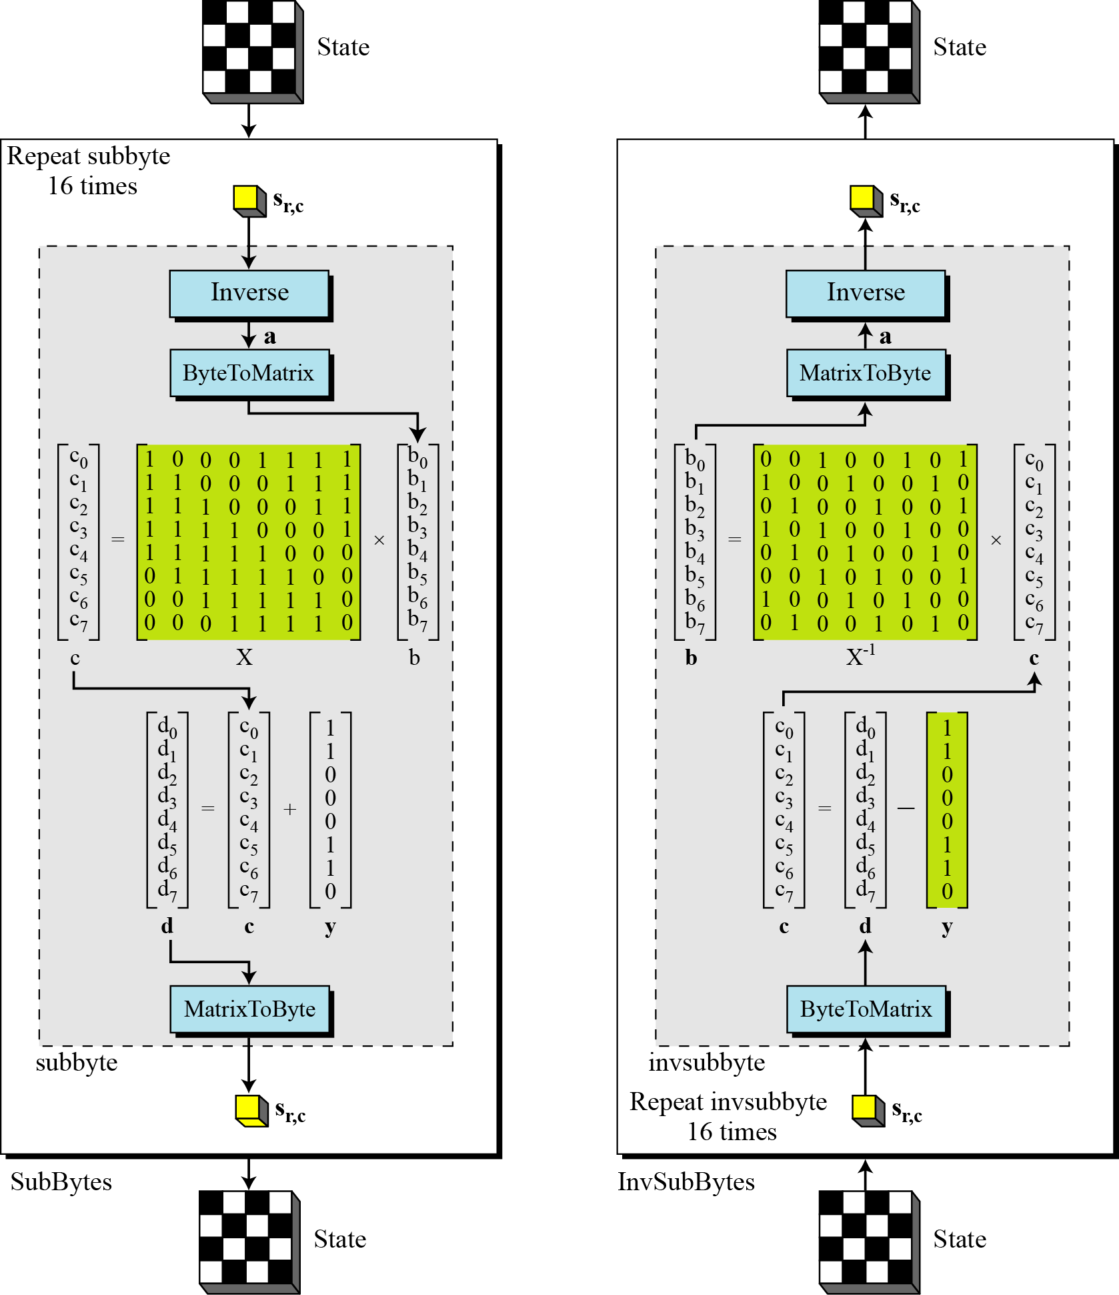
6.2.1 Substitution
Figure 6.8 SubBytes and InvSubBytes processes

Slide 24
6.2.1 Substitution
Example 6.3
Let us show how the byte 0C is transformed to FE by subbyte
routine and transformed back to 0C by the invsubbyte routine.

Slide 25
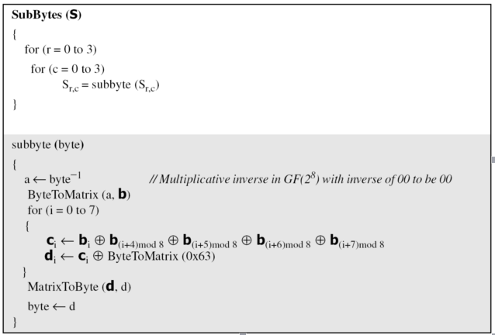
6.2.1 Substitution
Algorithm 6.1 Pseudocode for SubBytes processes

Slide 26
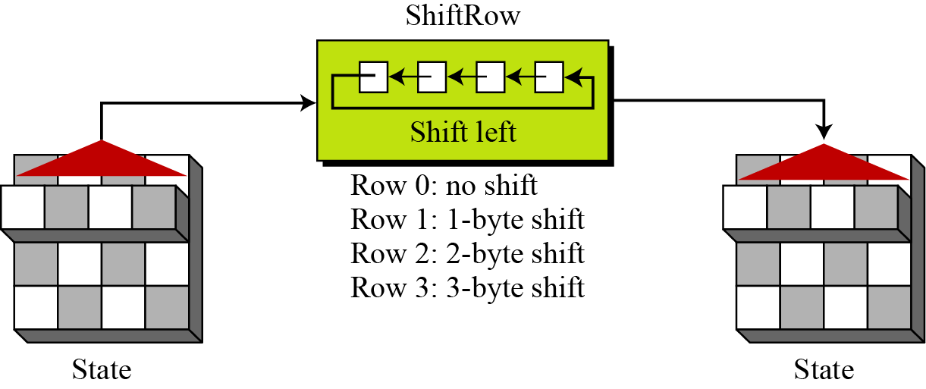
6.2.2 Permutation
Another transformation found in a round is shifting, which permutes the bytes.
ShiftRows
In the encryption, the transformation is called ShiftRows
Figure 6.9 ShiftRows transformation

Slide 27
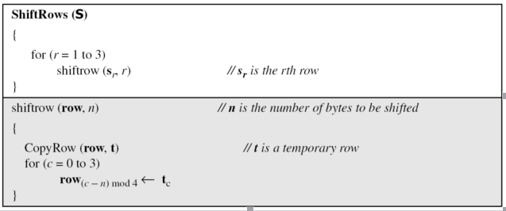
6.2.2 Permutation
InvShiftRows
In the decryption, the transformation is called InvShiftRows and the shifting is to the right.
Algorithm 6.2 Pseudocode for ShiftRows transformation

Slide 28
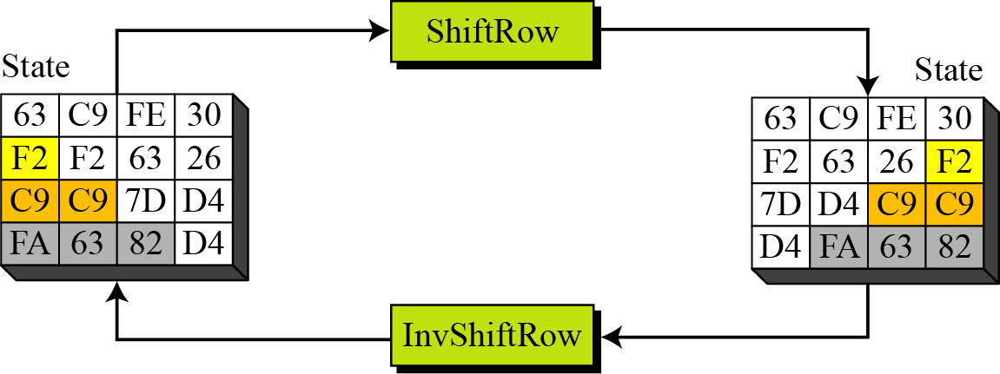
6.2.2 Permutation
Example 6.4
Figure 6.10 shows how a state is transformed using ShiftRows transformation. The figure also shows that InvShiftRows transformation creates the original state.
Figure 6.10 ShiftRows transformation in Example 6.4

Slide 29
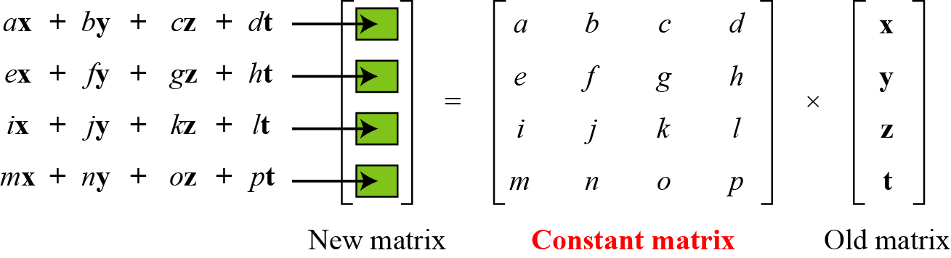
6.2.3 Mixing
We need an interbyte transformation that changes the bits inside a byte, based on the bits inside the neighboring bytes. We need to mix bytes to provide diffusion at the bit level.
Figure 6.11 Mixing bytes using matrix multiplication

Slide 30
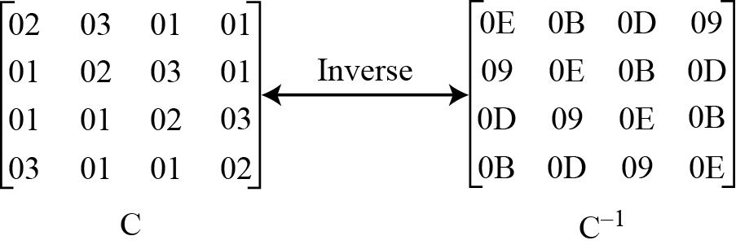
6.2.3 Mixing
Figure 6.12 Constant matrices used by MixColumns and InvMixColumns

Slide 31
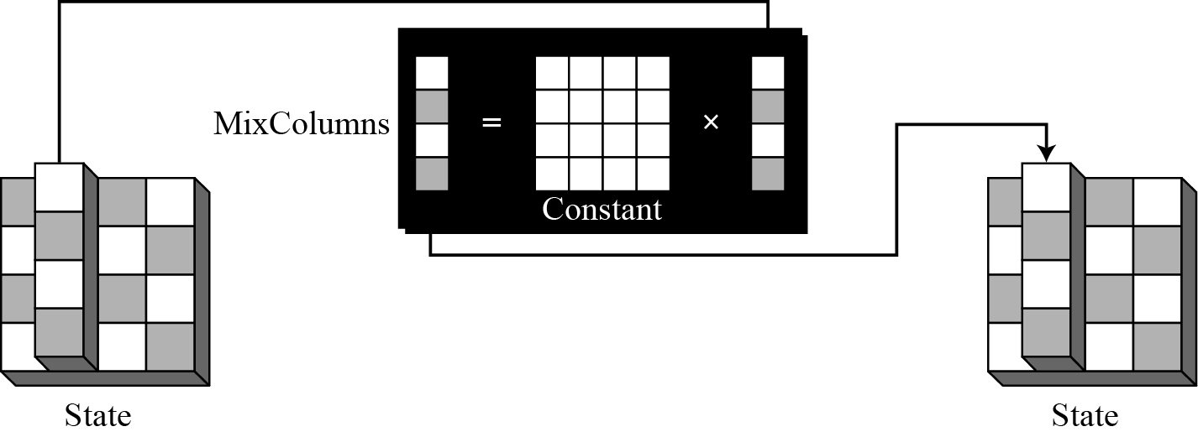
6.2.3 Mixing
MixColumns
The MixColumns transformation operates at the column level; it transforms each column of the state to a new column.
Figure 6.13 MixColumns transformation

Slide 32
6.2.3 Mixing
InvMixColumns
The InvMixColumns transformation is basically the same as the MixColumns transformation.
The MixColumns and InvMixColumns transformations are inverses of each other.

Slide 33
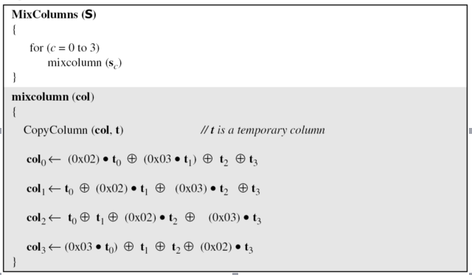
6.2.3 Mixing
Algorithm 6.3 Pseudocode for ShiftRows transformation

Slide 34
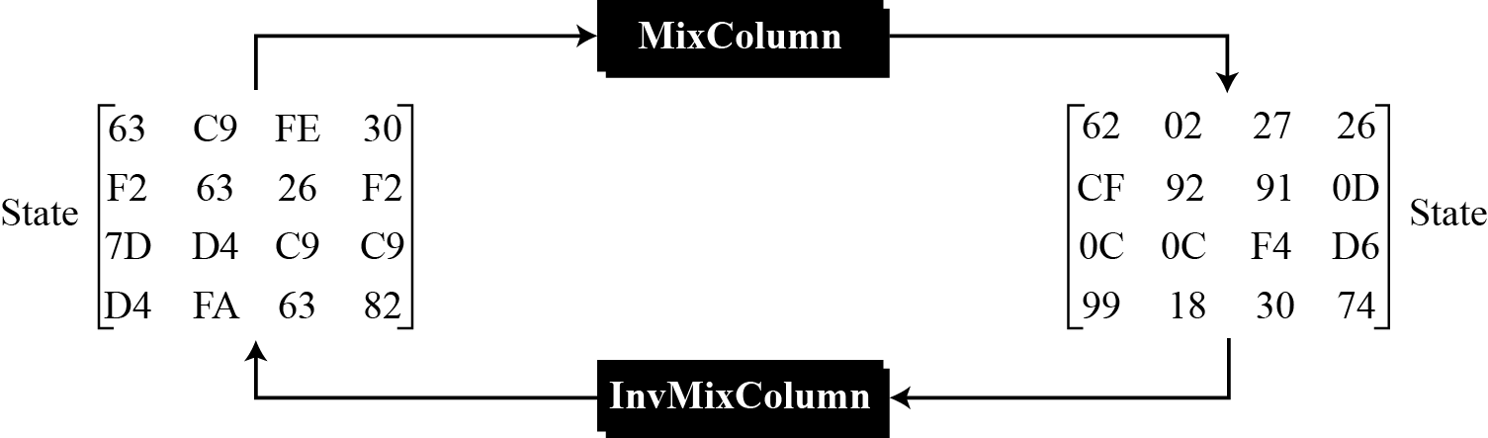
6.2.3 Mixing
Example 6.5
Figure 6.14 shows how a state is transformed using the MixColumns transformation. The figure also shows that the InvMixColumns transformation creates the original one.
Figure 6.14 The MixColumns transformation in Example 6.5

Slide 35
6.2.4 Key Adding
AddRoundKey
AddRoundKey proceeds one column at a time. AddRoundKey adds a round key word with each state column matrix; the operation in AddRoundKey is matrix addition.
The AddRoundKey transformation is the inverse of itself.

Slide 36
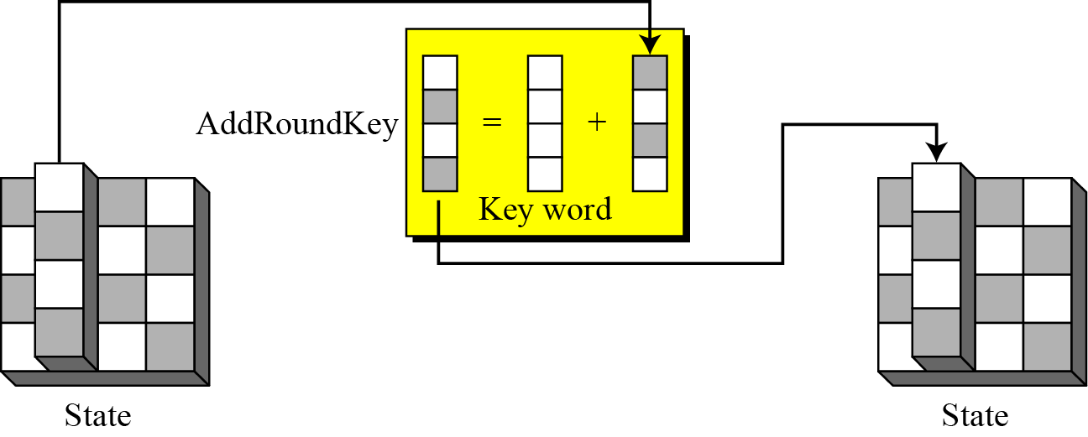
6.2.4 Key Adding
Figure 6.15 AddRoundKey transformation

Slide 37
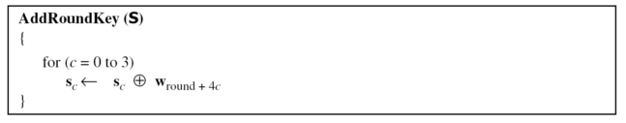
6.2.4 Key Adding
Algorithm 6.4 Pseudocode for AddRoundKey transformation

Slide 38
6.2 KEY EXPANSION

Slide 39
6.3 KEY EXPANSION
To create round keys for each round, AES uses a key-expansion process. If the number of rounds is Nr , the key-expansion routine creates N_{r} + 1 128-bit round keys from one single 128-bit cipher key.

Slide 40
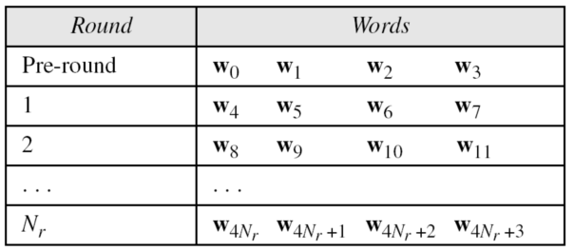
6.3 KEY EXPANSION
Table 6.3 Words for each round

Slide 41
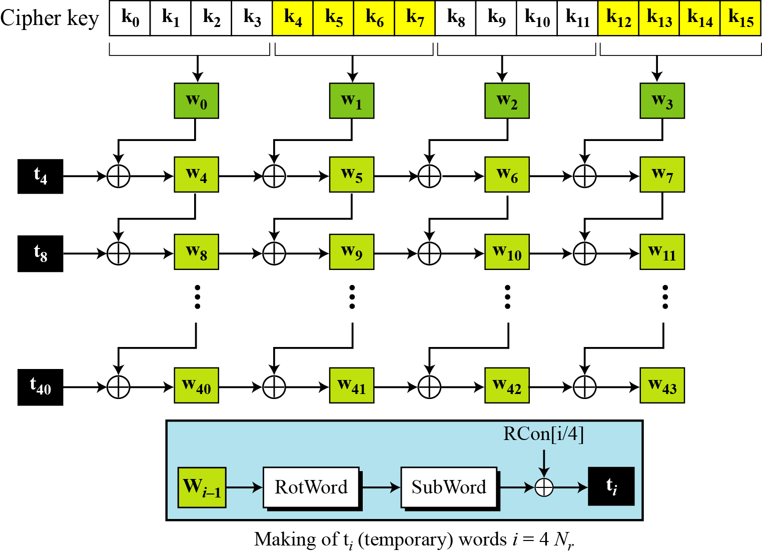
6.3.1 KEY EXPANSION in AES-128
Figure 6.16 Key expansion in AES

Slide 42
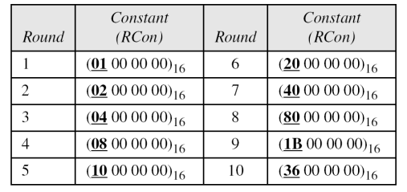
6.3.1 KEY EXPANSION in AES-128
Table 6.4 RCon constant

Slide 43
6.3.1 KEY EXPANSION in AES-128
The key-expansion routine can either use the above table when calculating the words or use the GF(2⁸) field to calculate the leftmost byte dynamically, as shown below (prime is the irreducible polynomial):

Slide 44
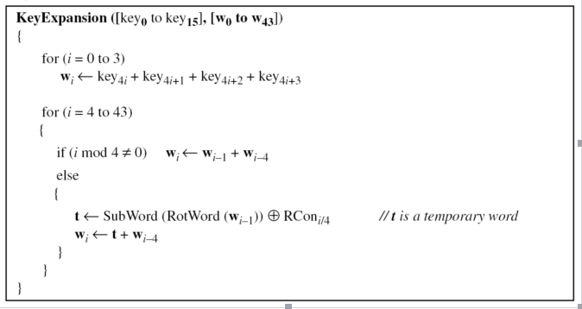
6.3.1 KEY EXPANSION in AES-128
Algorithm 6.5 Pseudocode for Key expansion transformation

Slide 45
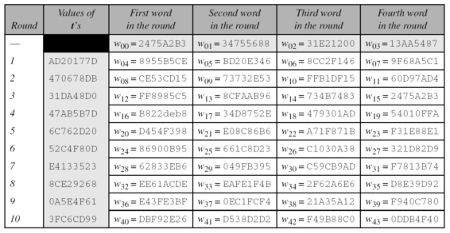
6.3.1 KEY EXPANSION in AES-128
Example 6.6
Table 6.5 shows how the keys for each round are calculated assuming that the 128-bit cipher key agreed upon by Alice and Bob is (24 75 A2 B3 34 75 56 88 31 E2 12 00 13 AA 54 87)₁₆.
Table 6.5 KEY EXPANSION example

Slide 46
6.3.1 KEY EXPANSION in AES-128
Example 6.7
Each round key in AES depends on the previous round key. The dependency, however, is nonlinear because of SubWord transformation. The addition of the round constants also guarantees that each round key will be different from the previous one.

Slide 47
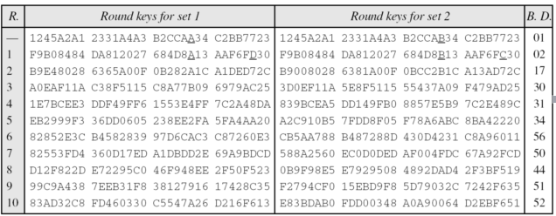
6.3.1 KEY EXPANSION in AES-128
Example 6.8
The two sets of round keys can be created from two cipher keys that are different only in one bit.
Table 6.6 Comparing two sets of round keys

Slide 48
6.3.1 KEY EXPANSION in AES-128
Example 6.9
The concept of weak keys, as we discussed for DES in Chapter 6, does not apply to AES. Assume that all bits in the cipher key are 0s. The following shows the words for some rounds:
The words in the pre-round and the first round are all the same. In the second round, the first word matches with the third; the second word matches with the fourth. However, after the second round the pattern disappears; every word is different.

Slide 49
6.3.3 Key-Expansion Analysis
The key-expansion mechanism in AES has been designed to provide several features that thwart the cryptanalyst.

Slide 50
6.4 CIPHERS

Slide 51
6.4 CIPHERS
AES uses four types of transformations for encryption and decryption. In the standard, the encryption algorithm is referred to as the cipher and the decryption algorithm as the inverse cipher.

Slide 52
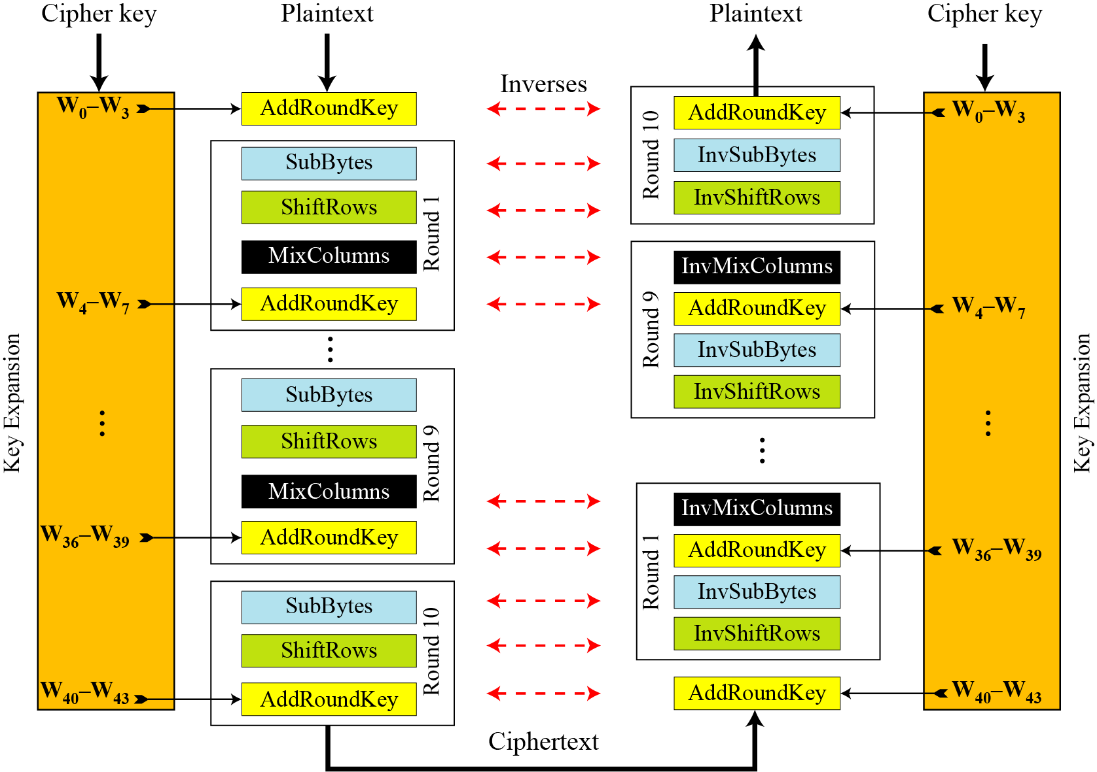
6.4.1 Original Design
Figure 6.17 Ciphers and inverse ciphers of the original design

Slide 53
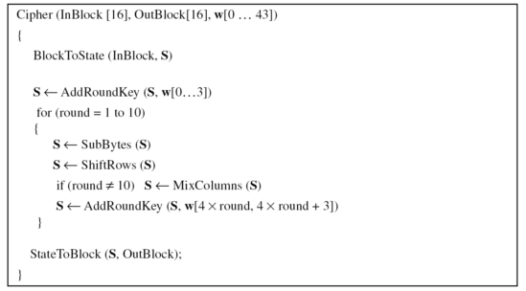
6.4.1 Original Design
Algorithm
The code for the AES-128 version of this design is shown in Algorithm 6.6.
Algorithm 6.6 Pseudocode ciper in original design

Slide 54
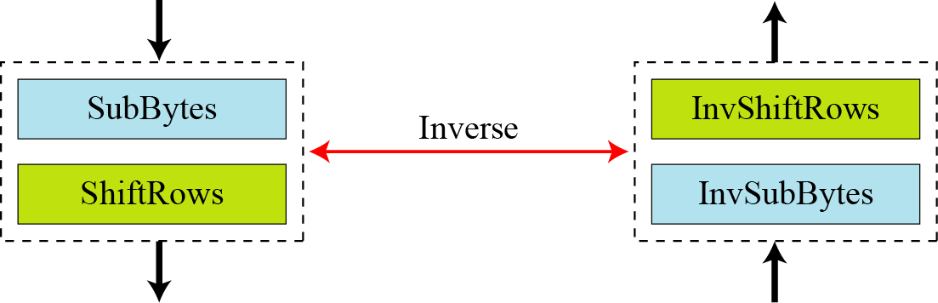
6.4.2 Alternative Design
Figure 6.18 Invertibility of SubBytes and ShiftRows combinations

Slide 55
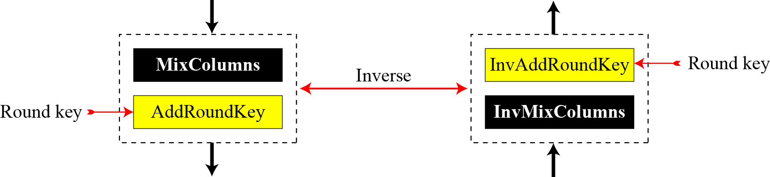
6.4.2 Alternative Design
Figure 6.19 Invertibility of MixColumns and AddRoundKey combination

Slide 56
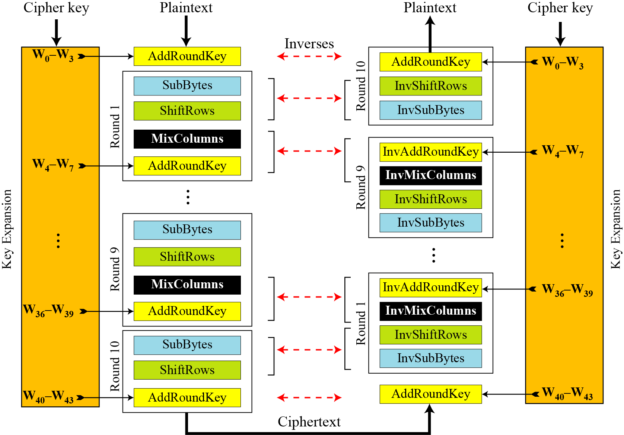
6.4.2 Alternative Design
Figure 6.20 Cipher and reverse cipher in alternate design

Slide 57
6.4.2 Alternative Design
Changing Key-Expansion Algorithm
Instead of using InvRoundKey transformation in the reverse cipher, the key-expansion algorithm can be changed to create a different set of round keys for the inverse cipher.

Slide 58
6.5 Examples

Slide 59
6.5 Examples
Changing Key-Expansion Algorithm
In this section, some examples of encryption/ decryption and key generation are given to emphasize some points discussed in the two previous sections.
Example 6.10
The following shows the ciphertext block created from a plaintext block using a randomly selected cipher key.

Slide 60
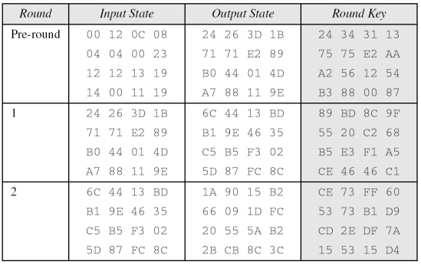
6.5 Examples
Example 6.10(continued)
Table 6.7 Example of encryption

Slide 61
6.5 Examples
Example 6.10(continued)

Slide 62
6.5 Examples
Example 6.10(continued)

Slide 63
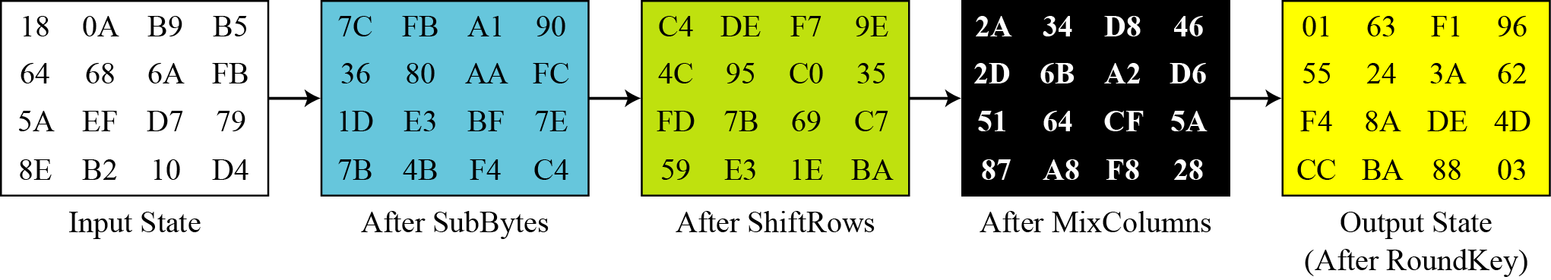
6.5 Examples
Example 6.11
Figure 6.21 shows the state entries in one round, round 7, in Example 6.10.
Figure 6.21 States in a single round

Slide 64
6.5 Examples
Example 6.12
One may be curious to see the result of encryption when the plaintext is made of all 0s. Using the cipher key in Example 6.10 yields the ciphertext.

Slide 65
6.5 Examples
Example 6.13
Let us check the avalanche effect that we discussed in Chapter 6. Let us change only one bit in the plaintext and compare the results. We changed only one bit in the last byte. The result clearly shows the effect of diffusion and confusion. Changing a single bit in the plaintext has affected many bits in the ciphertext.

Slide 66
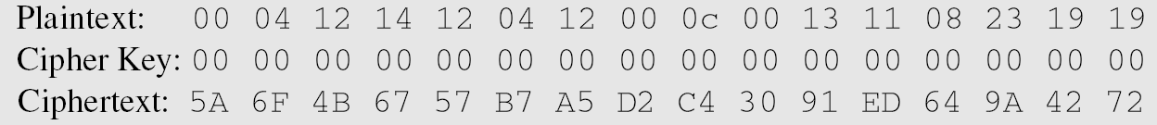
6.5 Examples
Example 6.14
The following shows the effect of using a cipher key in which all bits are 0s.

Slide 67
6.5 ANALYSIS OF AES

Slide 68
6.5 ANALYSIS OF AES
This section is a brief review of the three characteristics of AES.

Slide 69
6.5.1 Security
AES was designed after DES. Most of the known attacks on DES were already tested on AES.
Brute-Force Attack
AES is definitely more secure than DES due to the larger-size key.
Statistical Attack
Numerous tests have failed to do statistical analysis of the ciphertext.
Differential and Linear Attacks
There are no differential and linear attacks on AES as yet.

Slide 70
6.5.2 Implementation
AES can be implemented in software, hardware, and firmware. The implementation can use table lookup process or routines that use a well-defined algebraic structure.

Slide 71
6.5.3 Simplicity and Cost
The algorithms used in AES are so simple that they can be easily implemented using cheap processors and a minimum amount of memory.

