Slide 1
伪随机数和流密码
应用密码学

Slide 2
Learning Outcomes
随机数的基本特点及用途.
密码学伪随机数的产生、特性与应用.
PRNG算法的设计与分析.
线性同余发生器工作机制及评价标准.
伪随机数BBS算法.
使用分组密码的伪随机数产生.
流密码的结构与RC4算法.
RC4与WEP.

Slide 3
8.1 伪随机数（ Pseudo-random number）

Slide 4
8.1 随机数
随机数用途，重要的角色，例如
认证过程中，避免重放攻击
会话密钥
RSA公钥算法
随机数的基本特点
随机性
均匀分布，有大量的测试方案
独立性，难以测试，只能测试足够独立
不可预测性

Slide 5
8.1.1 随机数的产生
随机性
分布一致性：0 1出现概率大约相等
独立性：任何子序列不能由其他子序列推导出
不可预测性
随机数的源
物理噪声
已公布的好的随机数
算法生成的伪随机数

Slide 6
8.1.2 伪随机数(Pseudo-random number)
密码应用大多使用算法来生成随机数。这些算法是确定的，所以产生的序列并非统计随机的。但是，算法足够好的话，产生的序列可以经受住随机性检测，这样的树一般称为伪随机数。
although are not truly random
can pass many tests of “randomness”
created by “Pseudorandom Number Generators (PRNGs)”

Slide 7
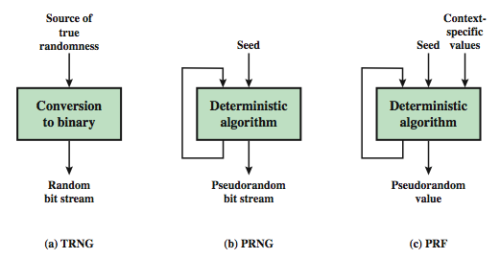
8.1.3 PRNG
Figure 8.1 Random & Pseudorandom Number Generators(PRNG)

Slide 8
8.1.4 PRNG Requirements
randomness
uniformity, scalability, consistency
unpredictability
forward & backward unpredictability
use same tests to check
characteristics of the seed
secure
if known adversary can determine output
so must be random or pseudorandom number

Slide 9
8.1.5 PRNG算法设计
特意构造算法
基于现存密码算法的算法
对称
非对称
Hash函数和消息认证码

Slide 10
8.1.5 PRNG算法设计
线性拟合法
X_{n+1} = (aX_{n} + c) mod m
评价随机数发生器的三个标准：
全周期
“显得”随机，使用多种方法评估其随机程度
方便实现
注意，敌手如果知道一些东西就可重构后续所有序列。

Slide 11
8.1.6 伪随机数的产生---线性同余发生器
真正的随机数难以产生
伪随机数
线性同余法 linear congruence
m 模数 m>0 2³¹
a 乘数 0≤a<m a=7⁵=16807
c 增量 0 ≤c<m
X₀ 种子 0 ≤ X₀<m
“s₀” is the seed
X_{n+1} = (aX_{n}+c) mod m
线性同余伪随机数缺乏不可预测性

Slide 12
8.1.6 伪随机数的产生---线性同余发生器
X_{n+1} = (aX_{n}+c) mod m
Choice of a, c and m are critical
a = c = X₀ = 1 and m = 8 produces random numbers {2, 3, 4, 5, 6, 7, 0, 1}. This set is not random at all.
n = 7, c = 0, m = 32 and s₀ = 1 produces the set {7, 17, 23, 1, 7, 17, 23, 1, …}. This set has a period 4, meaning that after the 4th number there is repetition in the sequence

Slide 13
8.1.6 伪随机数的产生---线性同余发生器
评价随机数发生器的三个标准:
生成函数应是全周期的，即函数再重复之前应该产生0 and m-1之间所有数
产生的序列应是随机的
生成函数可以用32位运算器方便地实现
m 2³¹-1；a=7⁵=16807；c=0

Slide 14
8.1.7 BBS method
Take large primes p and q that have a reminder of 3 upon division by 4： p=q=3 mod 4
Let n = p * q
Choose a seed “s” relatively prime with n
Algorithm:
X₀ = s² mod n
For i = 1 to ∞
{ X_{i} = (X_{i-1})² mod n
B_{i} = X_{i} mod 2 }

Slide 15
8.1.7 BBS method
B_{i} denotes the least significant bit in each iteration
The algorithm generates the bits continuously
User decides how many of the bits to choose to form the number, e.g., 64-bits chosen to form a key
不存在多项式时间的算法使得在已知前k位的情况下预测出第k+1位的概率大于0.5
BBS的安全性基于分解n的难度

Slide 16
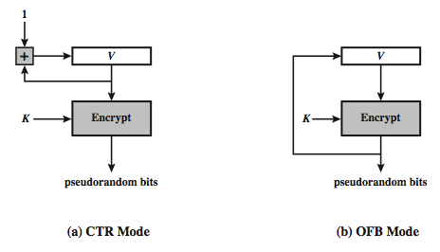
8.1.8 使用分组密码的伪随机数产生
Figure 8.2 使用分组密码的伪随机数产生

Slide 17
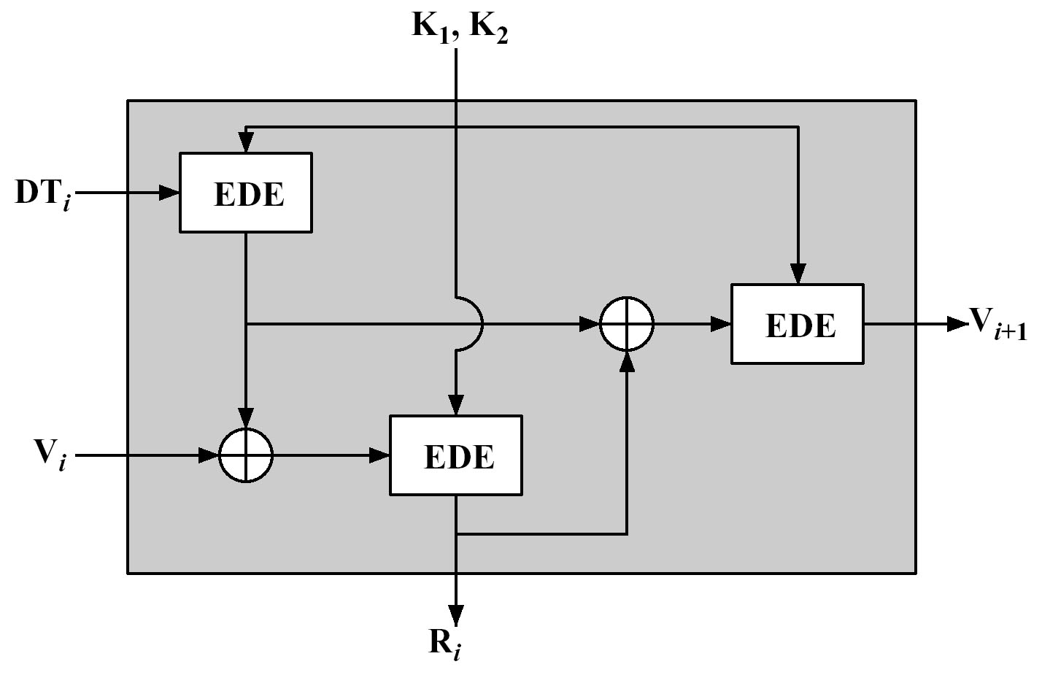
8.1.9 ANSI X9.17
R_{i}=EDE_{K1,K2}(V_{i}⊕EDE_{K1,K2}(DT_{i}))
V_{i+1}= EDE_{K1,K2}(R_{i}⊕EDE_{K1,K2}(DT_{i}))
Figure 8.2 ANSI X9.17

Slide 18
8.2 流密码（Stream Ciphers）

Slide 19

8.2 流密码(stream ciphers)
Key=k₁k₂k₃k₄…(random, used one-time only)
Plaintext=m₁m₂m₃m₄...
Ciphertext = c₁c₂c₃c₄…,Where c_{i}=m_{i} $⨁$ k_{i}
Can be proved to be unconditionally secure

Slide 20
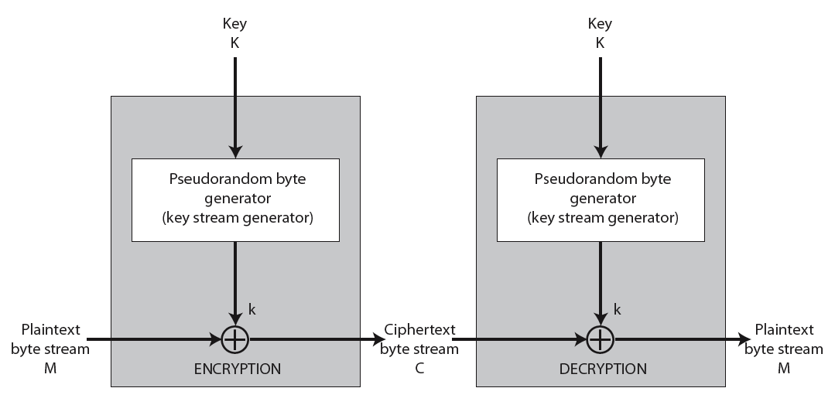
8.2 Stream Cipher
Figure 8.3 Stream Cipher Structure

Slide 21
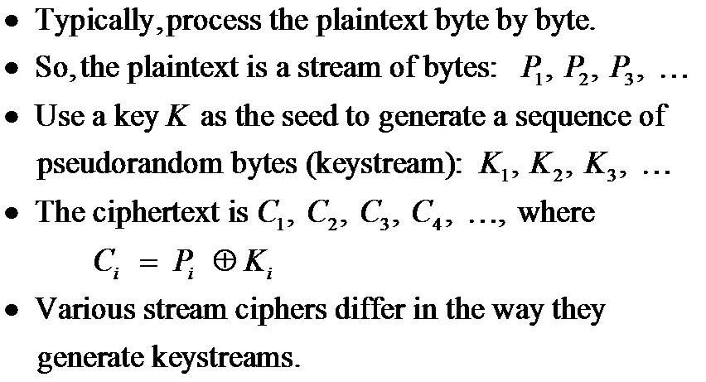
8.2 Stream Cipher

Slide 22
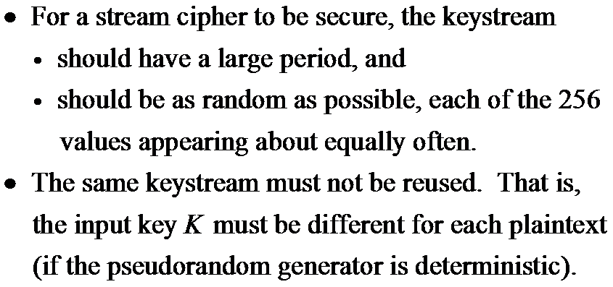
8.2 Stream Cipher

Slide 23
8.2.1 RC4
Designed by Ron Rivest in 1987 for RSA Security.
Kept as a trade secret until leaked out in 1994.
The most popular stream cipher.
Simple and fast.
With a 128 bits key, the period is > 10¹⁰⁰ .
Used in the SSL/TLS standards (for secure Web communication), IEEE 802.11 wireless LAN standard, Microsoft Point-to-Point Encryption, and many others.

Slide 24
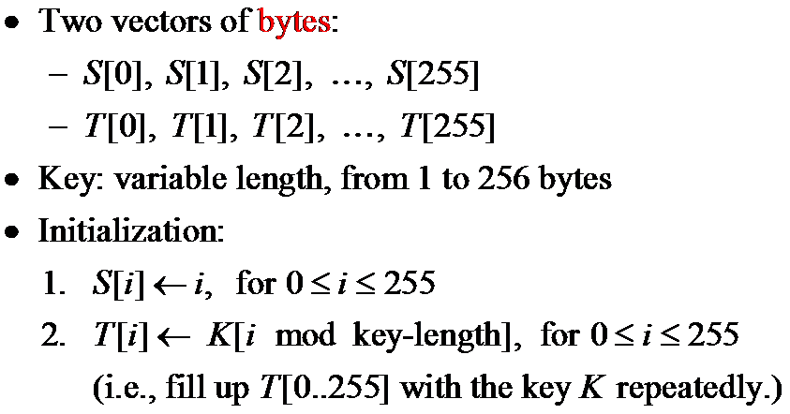
8.2.1 RC4

Slide 25
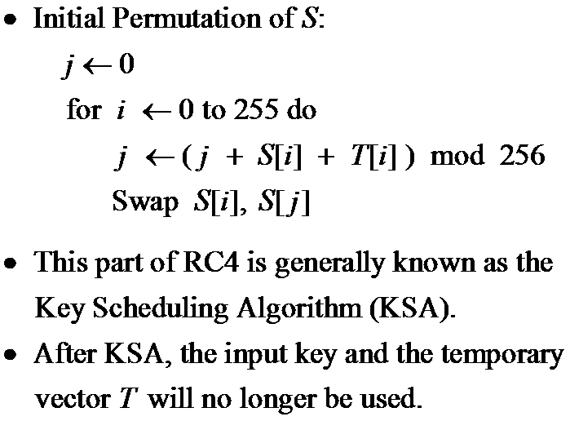
8.2.2 RC4-Initial Permutation

Slide 26
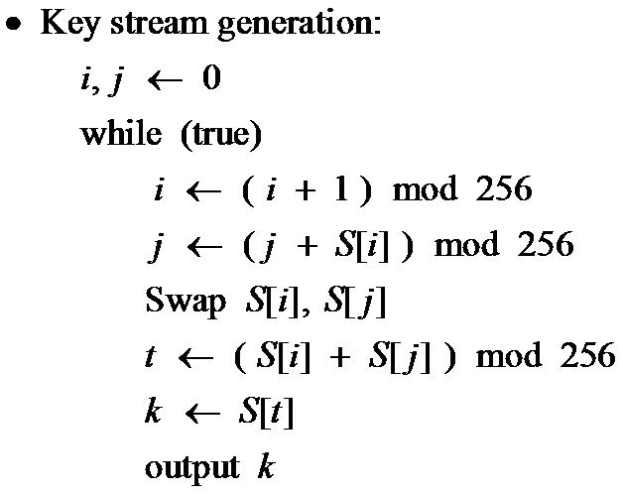
8.2.3 RC4-Key Stream Generation

Slide 27
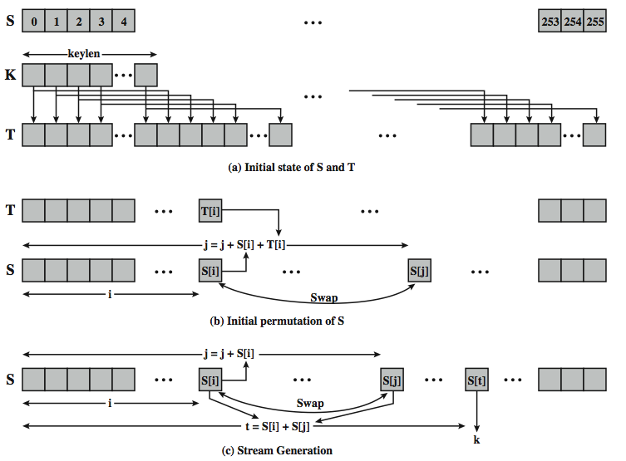
8.2.4 RC4 Overview
Figure 8.4 RC4 Overview

Slide 28
8.2.5 Security of RC4
The keystream generated by RC4 is biased.
The second byte is biased toward zero with high probability.
The first few bytes are strongly non-random and leak information about the input key.
Defense: discard the initial n bytes of the keystream.
Called “RC4-drop[n-bytes]”.
Recommended values for n = 256, 768, or 3072 bytes.
Efforts are underway (e.g. the eSTREAM project) to develop more secure stream ciphers.

Slide 29

8.2.6 RC4 and WEP
WEP is a protocol using RC4 to encrypt packets for transmission over IEEE 802.11 wireless LAN.
WEP requires each packet to be encrypted with a separate RC4 key.
The RC4 key for each packet is a concatenation of a 24-bit IV (initialization vector) and a 40 or 104-bit long-term key.

Slide 30
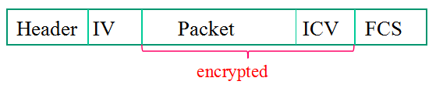
8.2.7 802.11 frames using WEP
ICV: integrity check value (for data integrity)
FCS: frame check sequence (for error detection)
Both use CRC32

Slide 31
8.2.7 Security of WEP
WEP has been shown to be insecure.
There is an article, “Breaking 104 bit WEP in less than 60 seconds,” discussing how to discover the RC4 key by analyzing encrypted ARP packets.

