Slide 1
MRZ
Pharmacy Database system
Mohammad
Zaid
reem

Slide 2
Problem & Objective
Need system to manage pharmacy data
Manage patients, doctors, medicines, prescriptions
Ensure data integrity

Slide 3
Users & Functions
Users
Pharmacist
Doctor
Manager
Functions
Patient, Doctor, Medicine, Prescription Management

Slide 4
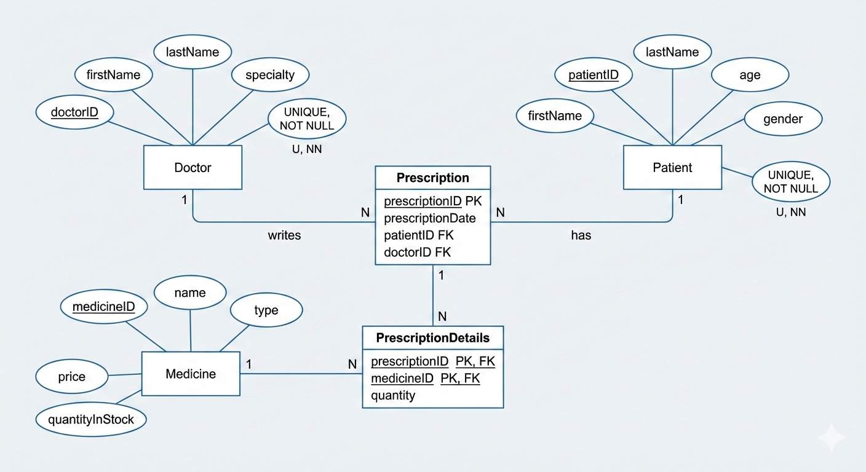

Overcoming
Nervousness

Slide 5
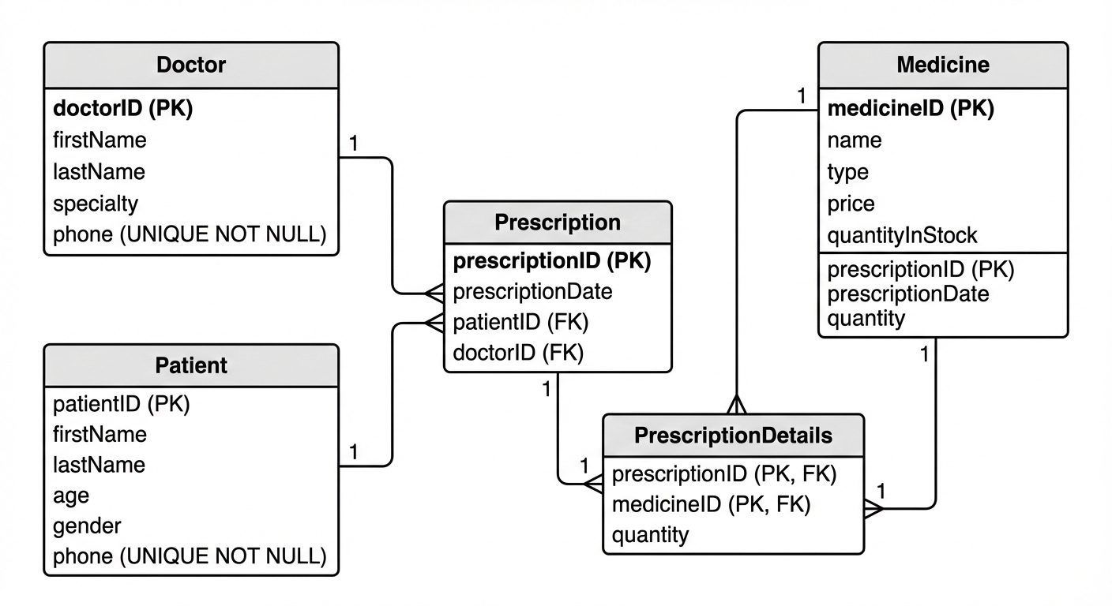
ENGAGING THE AUDIENCE
Make eye contact with your audience to create a sense of intimacy and involvement
Weave relatable stories into your presentation using narratives that make your message memorable and impactful
Encourage questions and provide thoughtful responses to enhance audience participation
Use live polls or surveys to gather audience opinions, promoting engagement and making sure the audience feel involved

Slide 6
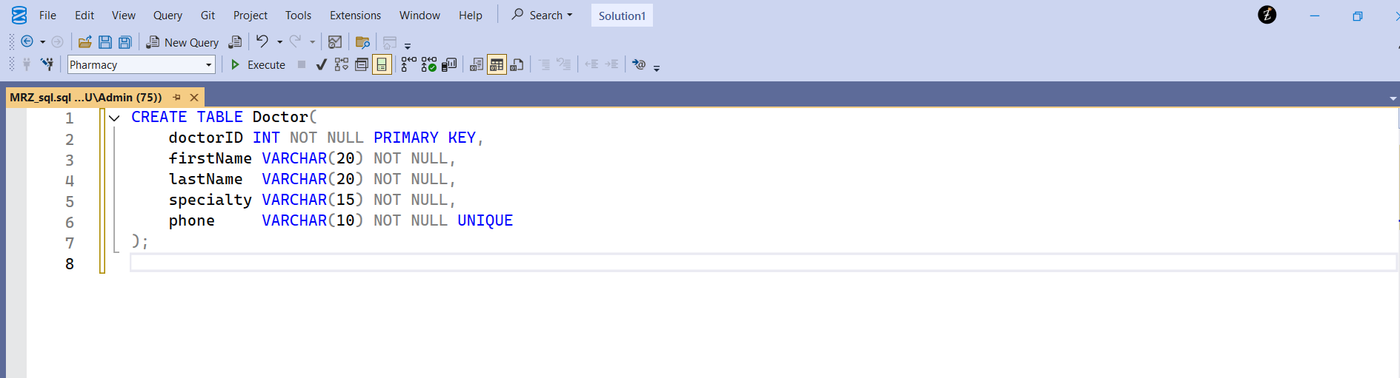
SELECTING
VISUAL AIDS
ENHANCING YOUR PRESENTATION

Slide 7
Keys & Constraints
Medicine
medicineID INT PK NOT NULL
name VARCHAR(20) NN, type VARCHAR(20) NN
price MONEY NN CHECK (>0)
quantityInStock INT NN CHECK (≥0)
Prescription
prescriptionID INT PK NOT NULL
prescriptionDate DATETIME NN
patientID INT NN FK → Patient(patientID) (ON UPDATE CASCADE, ON DELETE CASCADE)
doctorID INT NN FK → Doctor(doctorID) (ON UPDATE CASCADE, ON DELETE NO ACTION)
PrescriptionDetails
(prescriptionID INT, medicineID INT) Composite PK
prescriptionID FK → Prescription(prescriptionID)
medicineID FK → Medicine(medicineID) , quantity INT NN CHECK (>0)
Doctor
doctorID INT PK NOT NULL
firstName VARCHAR(20) NN, lastName VARCHAR(20) NN, specialty VARCHAR(15) NN
phone VARCHAR(10) NN UNIQUE
Patient
patientID INT PK NOT NULL
firstName VARCHAR(20) NN, lastName VARCHAR(20) NN
age INT NN CHECK (0–120)
gender VARCHAR(6) NN CHECK ('Male','Female')
phone VARCHAR(10) NN UNIQUE

